Slide 1
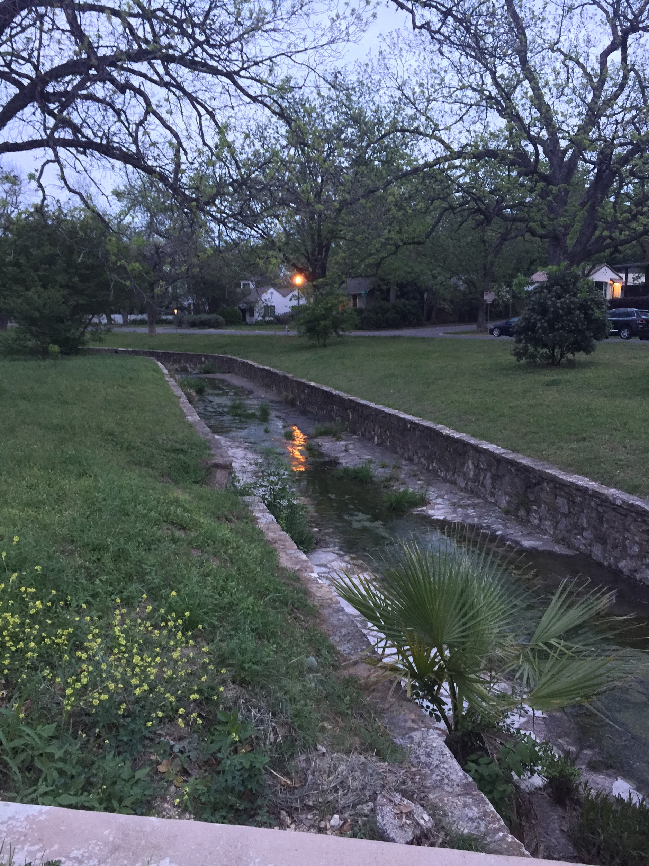
Hemphill Park Channel
Ethan Earl
Kiersten Holms
Mallory Stallings
Shelby Wiedrich
Notes:
Ethan

Slide 2
Overview
Study Area
Water Source
Problem Overview
Possible Solutions
Proposed Plan
Notes:
Ethan

Slide 3
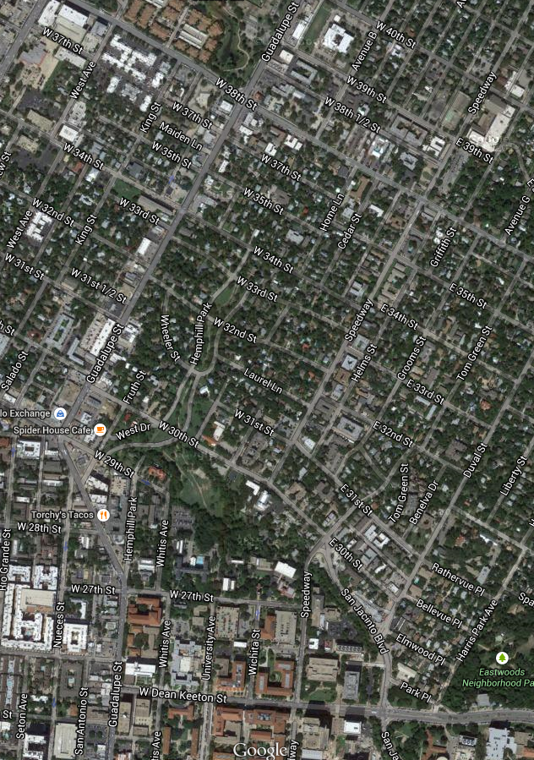
Study Area
How should the study area be described?
Part of the Waller Creek Watershed
Located north of campus in Hemphill Park
Begins at 33rd street and runs until it spills into Waller Creek
Masonry channel
Focusing Specifically at 32nd St Bridge
Subject Site
Notes:
Ethan

Slide 4
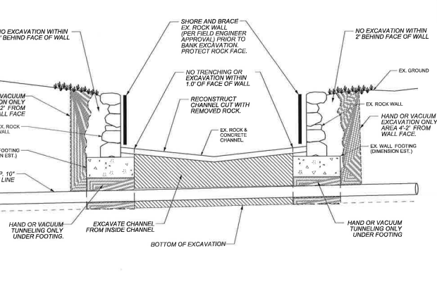
Study Area (Cont’d)
Channel designed and Built in the 1930s
Notes:
Ethan

Slide 5
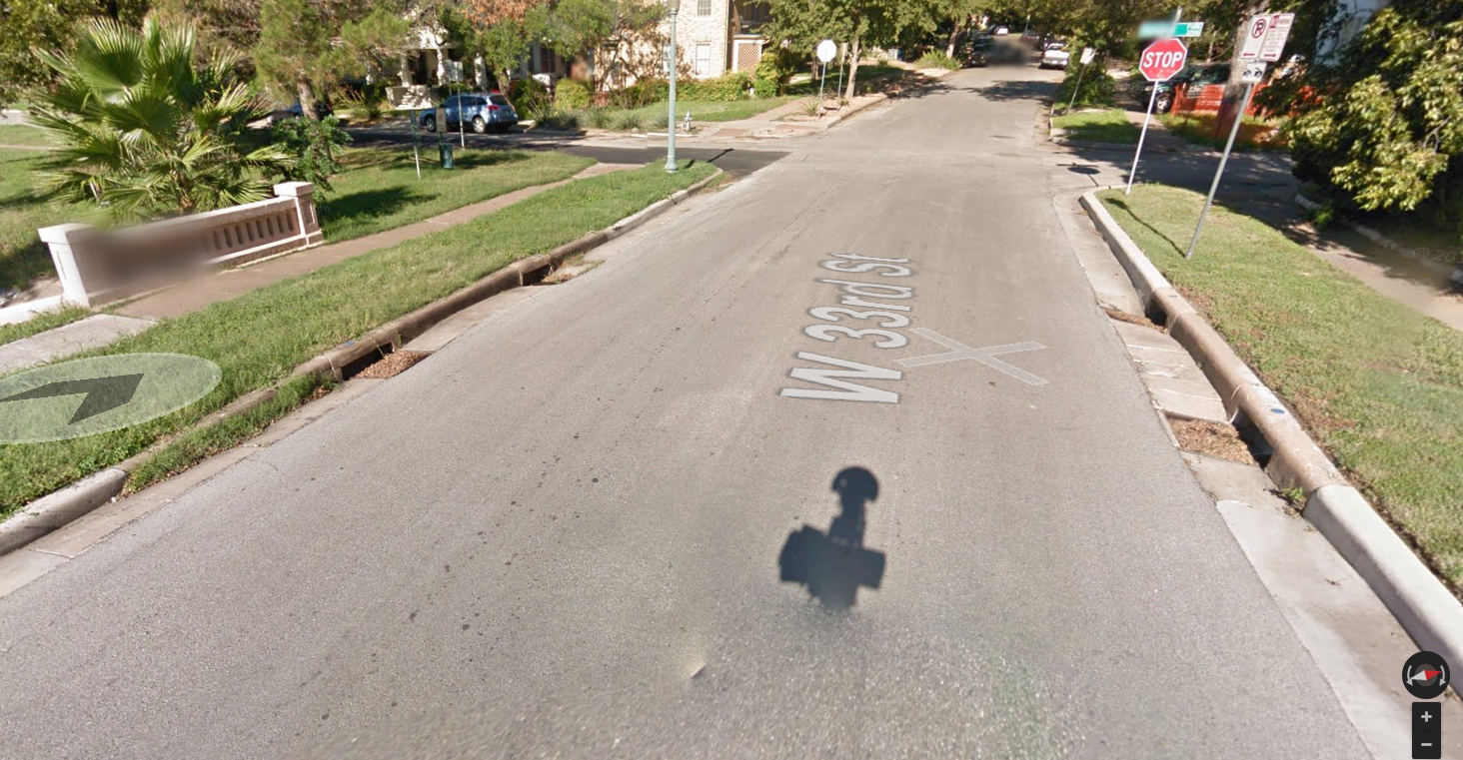
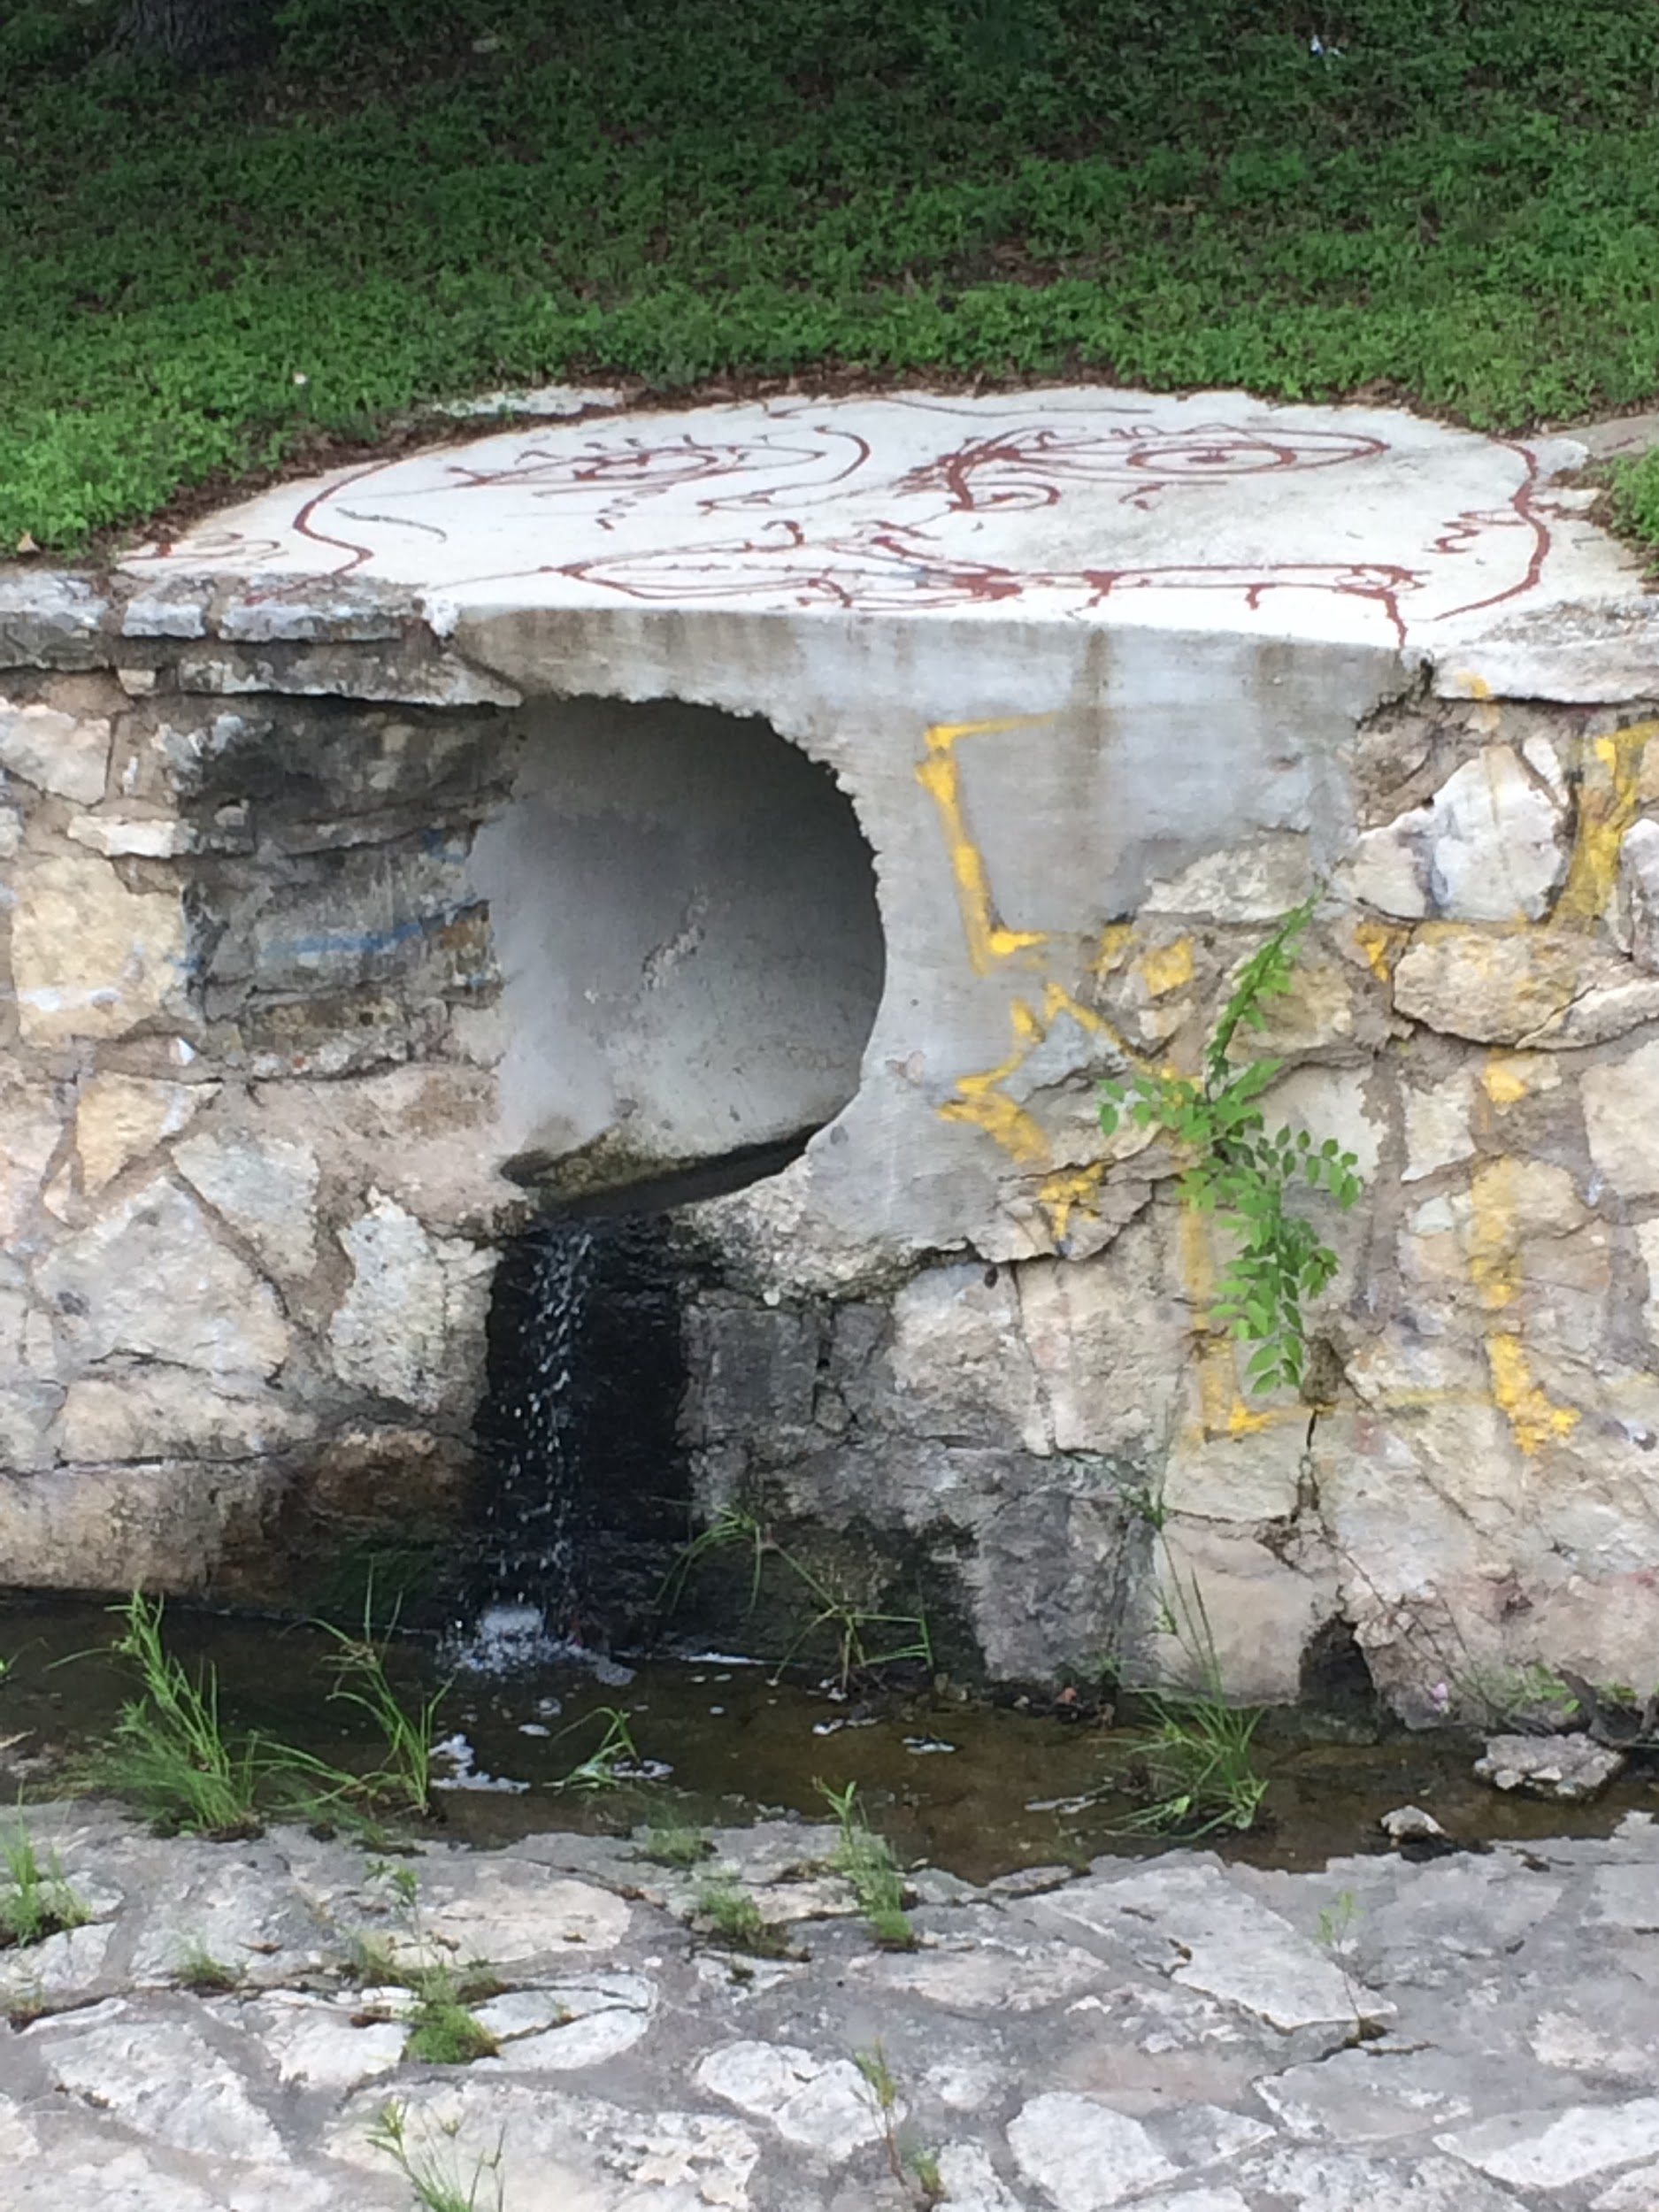
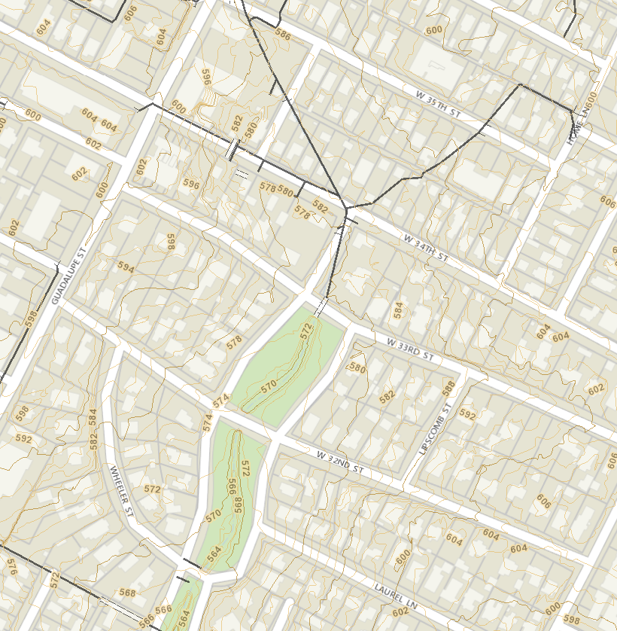
Water Sources
How does the study area operate?
Underground stormwater tunnels (main source)
Inlets from street drains
Sheet flow directly into the channel
Notes:
Ethan

Slide 6
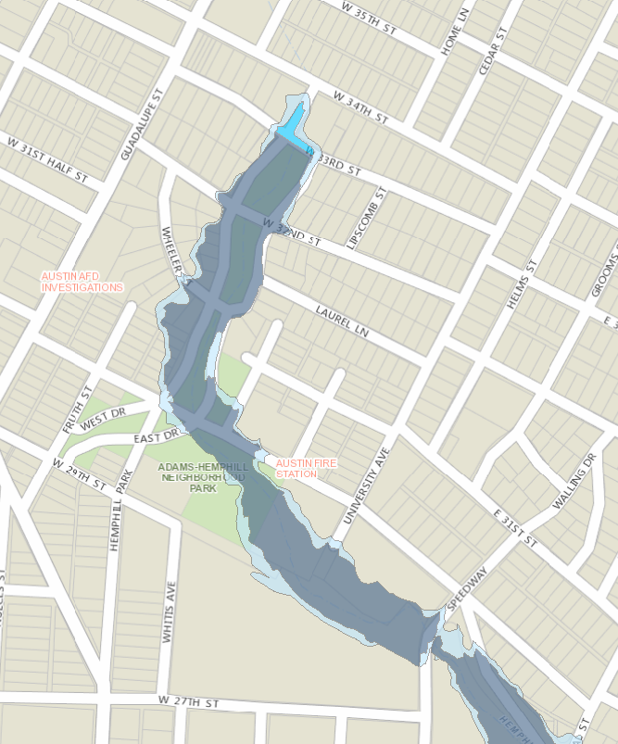
Problem Overview
Floodplain for Hemphill Park Channel
courtesy of FEMA
Is the current study area working well?
Prone to flooding at 32nd St Bridge
Channel narrowing after initial inlet
Impervious channel bottom
Notes:
Kiersten

Slide 7
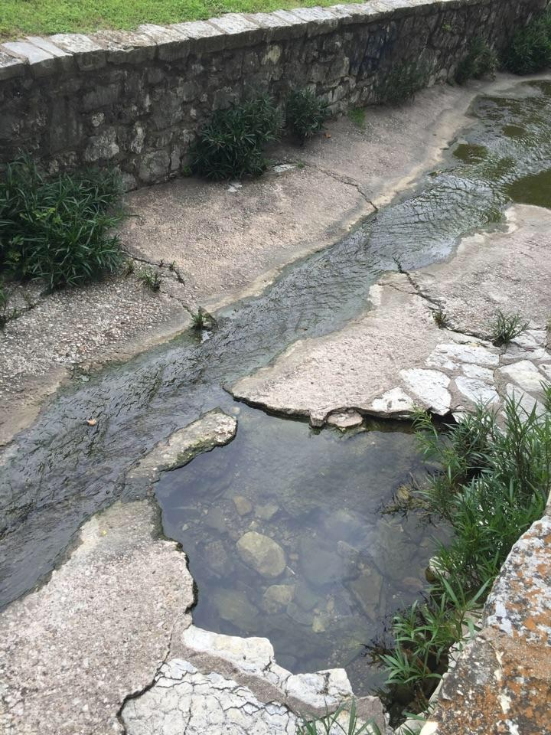
Problem Overview (Cont’d)
Erosion
Very old channel
parts of channel bottom missing
Aesthetics
In a local neighborhood
Channel looks dirty and eroded
Notes:
Kiersten

Slide 8
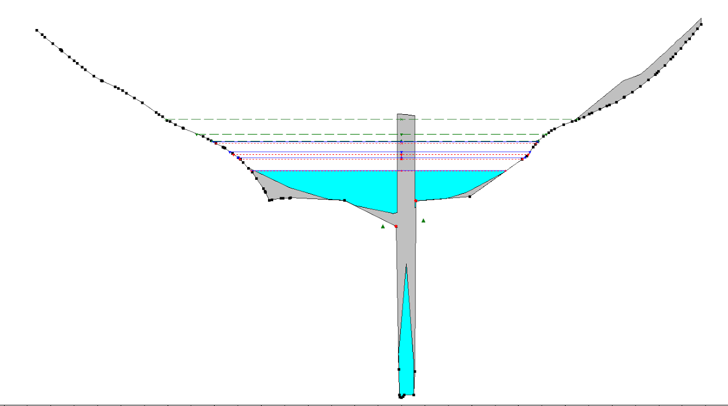
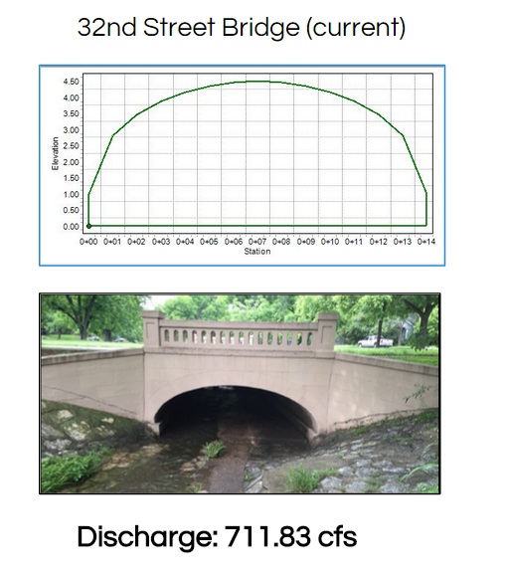
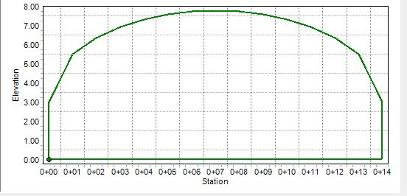
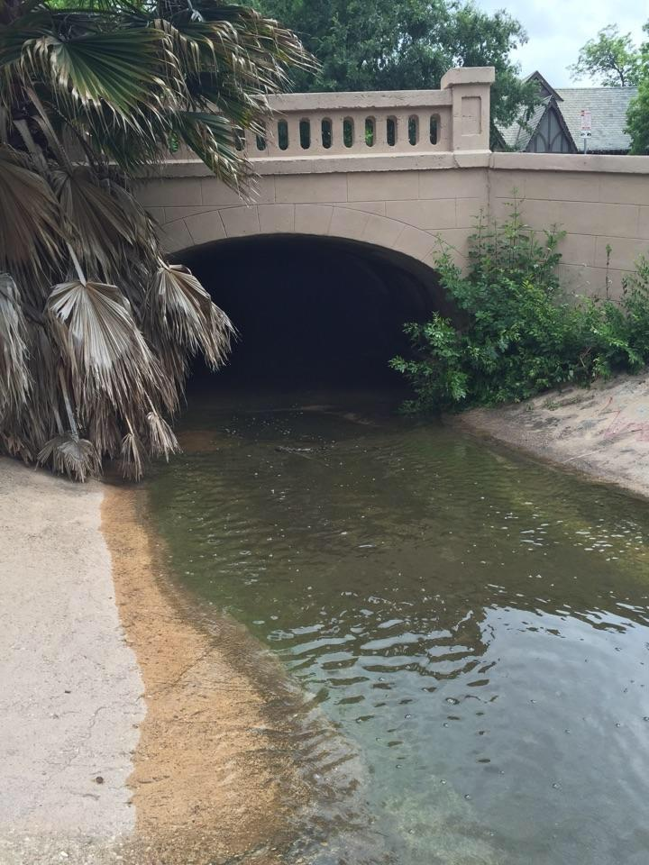
Current Flow Conditions
33rd Street Bridge
HEC- RAS Model
Discharge: 1709.6 cfs
Notes:
Shelby
Put in modflow calculations and schematics of new channel and bridge at 33rd

Slide 9
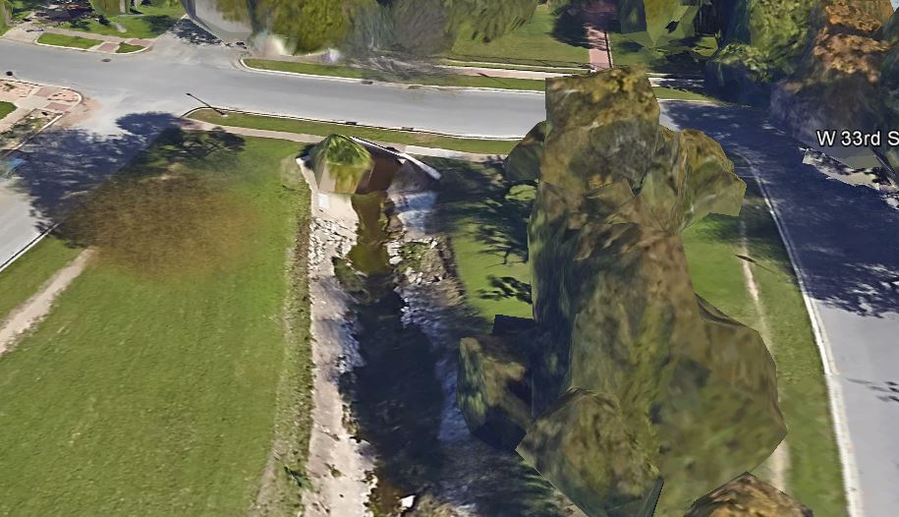
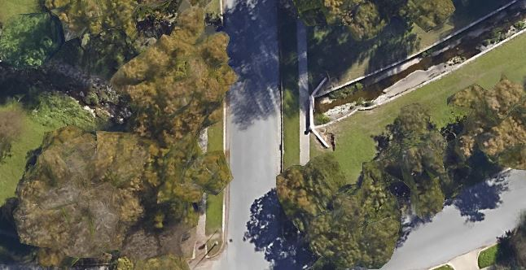
33rd Street Bridge
32nd Street Bridge
Notes:
Kiersten

Slide 10
Possible Solutions
How might the study area be altered?
What differences would the changes cause?
Notes:
Mallory

Slide 11
Alternative 1: Install Pervious Bottom
Change the Bottom of the Channel to Pervious Pavement
Pros:
Increased flow through infiltration
Helps recharge the water table
Cons:
Soil underneath cannot infiltrate, Classified by class C and D hydrological groups:
D: Houston Black soils and Urban land (HsD)
C: Urban land, Austin, and Whitewright soils (UtD)
C: Urban land (Ur)
Notes:
Mallory

Slide 12
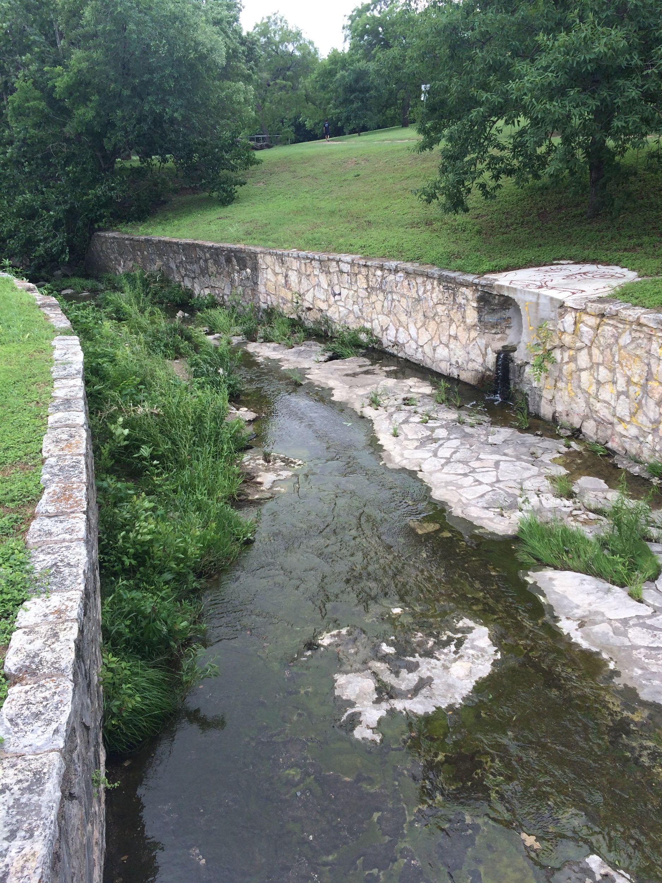
Alternative 2: Modify Channel Geometry
Modify the Channel Geometry
Pros:
Decreased velocity
Helps reduce water overflow (flooding)
Cons:
Widening of the channel would cut into the surrounding park area
Notes:
Mallory

Slide 13
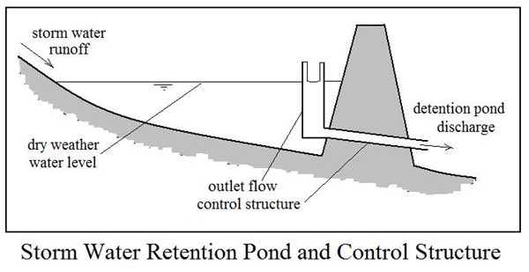
Alternative 3: Install Detention Pond
Implement a detention pond upstream of 32nd Street bridge
Pros:
Detains flow
Increases Quality
Cons:
Requires a large amount of space
No way to completely verify where the runoff is coming from (because of complex pipe system shown before)
Notes:
Mallory

Slide 14
Proposed Solution
How should the study area be changed?
Notes:
Shelby

Slide 15
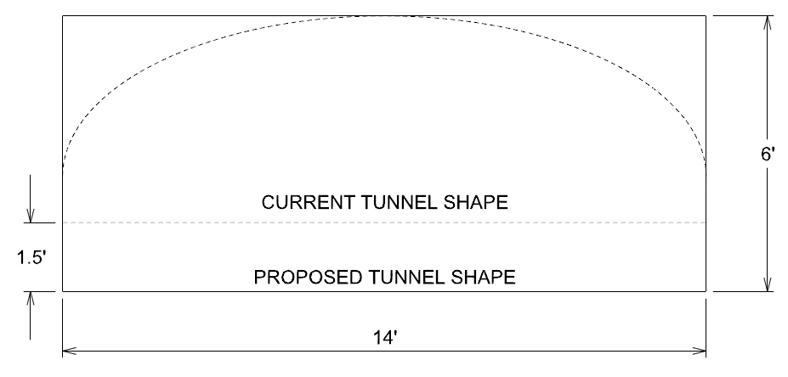
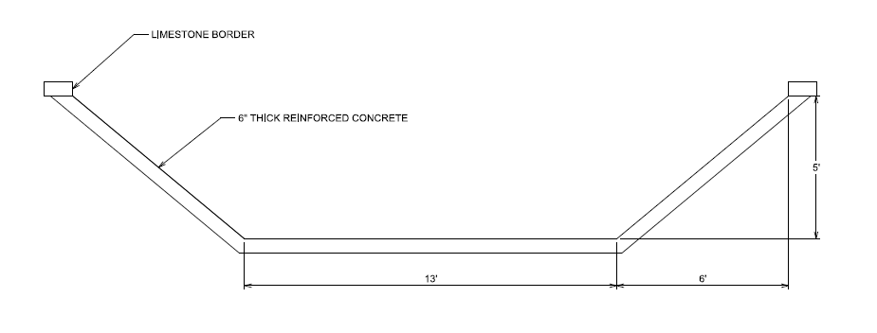
Design of Modified Channel
Modify bridge at 32nd street
Change to a rectangular cross-section
Notes:
Shelby
Enter a Schematic of the channel here, talk about how it reduces flooding

Slide 16
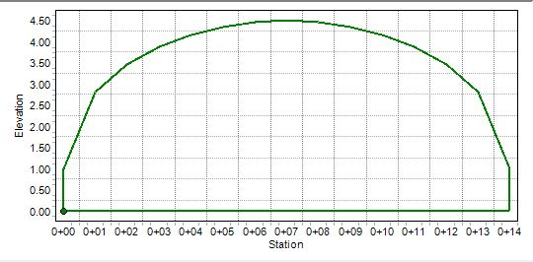
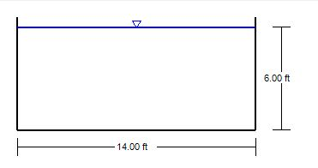
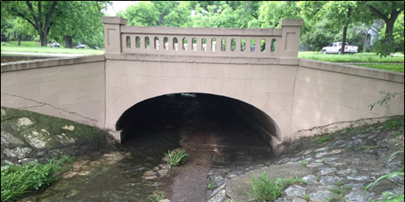
Revised Flow Calculations
32nd Street Bridge (current)
32nd Street Bridge (after)
This is acceptable as the new 32nd street bridge only needs to handle 1709.6 cfs, the discharge from 33rd street bridge
Discharge: 2654.17 cfs
Discharge: 711.83 cfs
Notes:
Shelby
Put in modflow calculations and schematics of new channel and bridge at 33rd

Slide 17
New Bridge Schematic
New 32nd St Bridge Design
Notes:
Shelby
Put in modflow calculations and schematics of new channel and bridge at 33rd

Slide 18
Channel Modifications
Current channel holds correct amount of water but is highly eroded
Reline entire channel with smooth concrete
increases Flow through channel
Helps prevent future erosion
Schematic of Channel Relining between 33rd and 32nd St
Notes:
INSERT PICTURE OF OUR SCHEMATIC OF CHANNEL RELIGNING

Slide 19
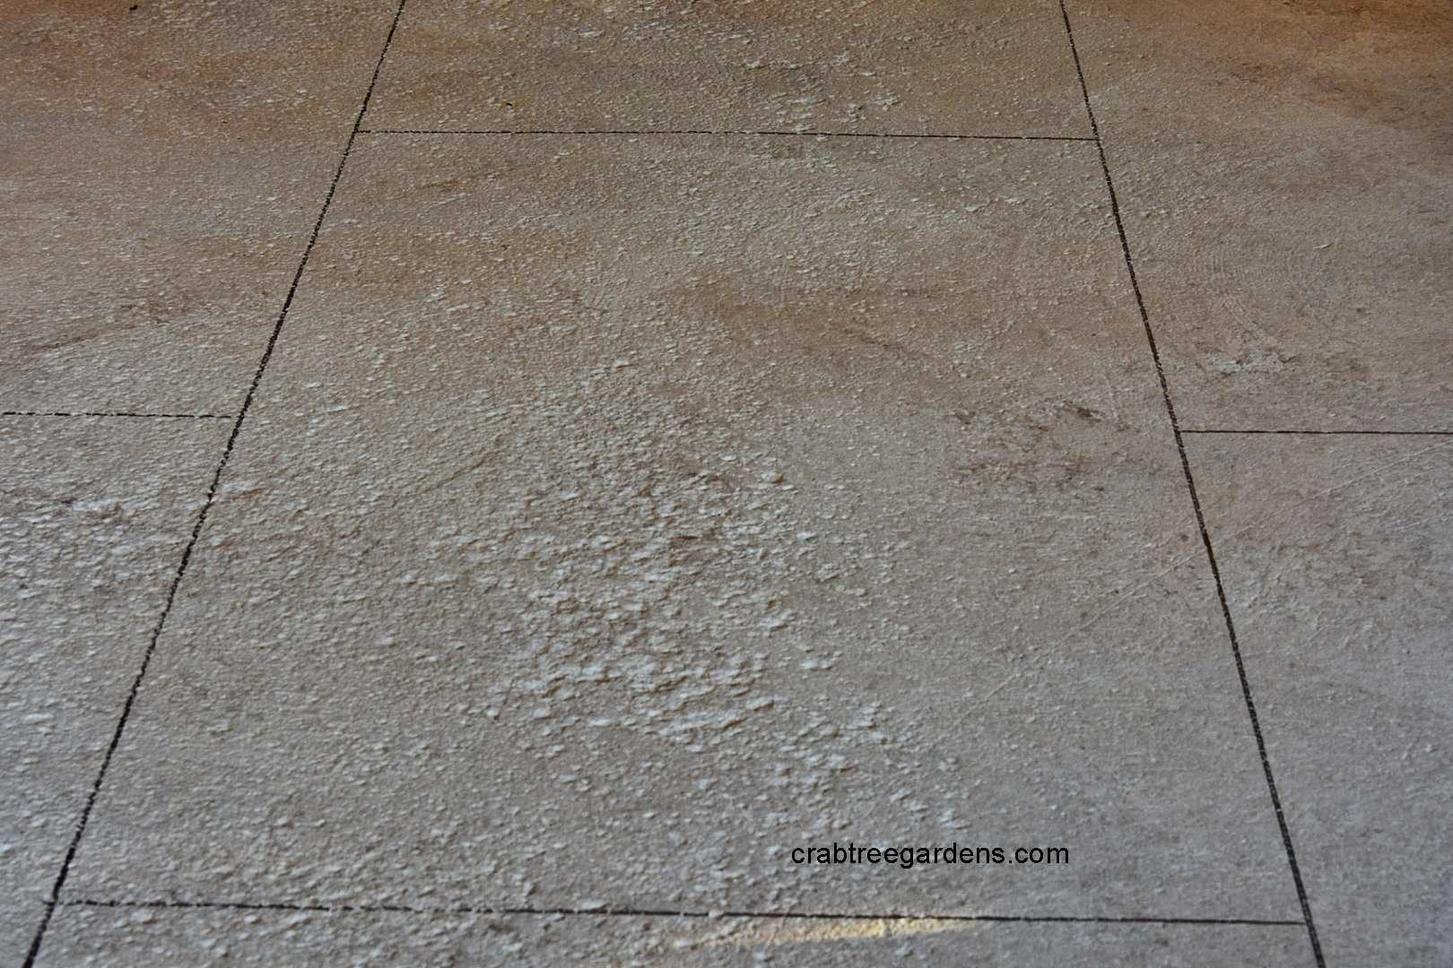
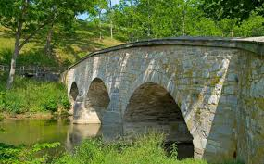
Aesthetics of Design
Limestone Rocks along the edge of the channel
Keep with Limestone theme in channel
Helps keep water in channel
Space 2” Apart to also allow water to flow in
Imitation Concrete
Helps the channel look more natural, less like concrete
Glaze with help with preservation
Limestone Bridge
Will withstand erosion
Aesthetically pleasing
Notes:
Shelby

Slide 20
Slope Amendments along Channel
Current slope: 0.012
New slope: 0.016
El: 576 ft
El: 572 ft
1.5 ft
El: 570.5 ft
Notes:
Shelby
talk about hwat ever you did wit hthe slope!

Slide 21
Questions?
Notes:
Shelby

