Slide 1
Waller Creek Rehabilitation
Presented by: Rachel Bowie, Aurora Castaneda, and Joanne Neira
Thursday, May 7th, 2015
The University of Texas at Austin

Slide 2
Overview
Representation
Process
Evaluation
Change
Impact
Decision

Slide 3
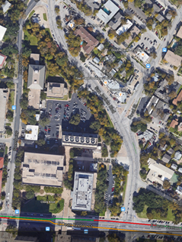
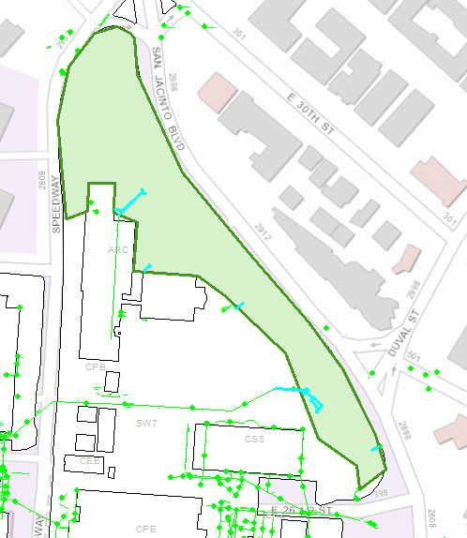
REPRESENTATION
Project Study Area:
0.2 Mile Section of Waller Creek
Borders north campus along San Jacinto Blvd.

Slide 4
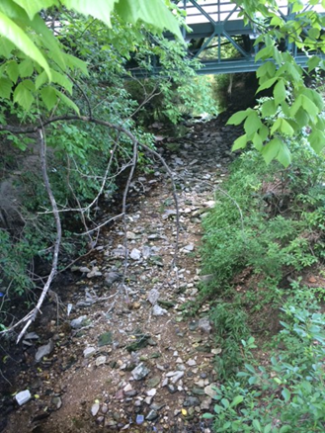
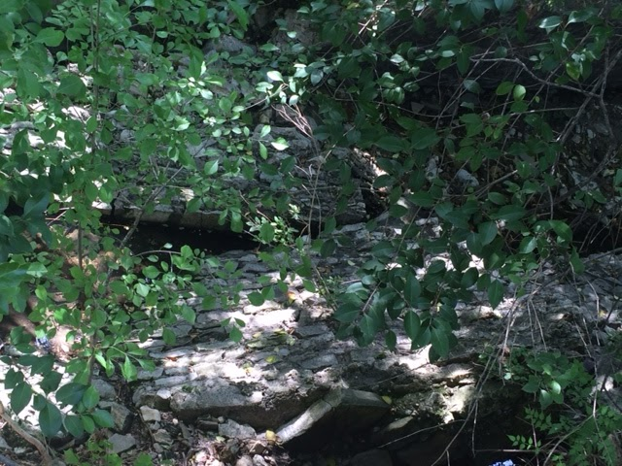
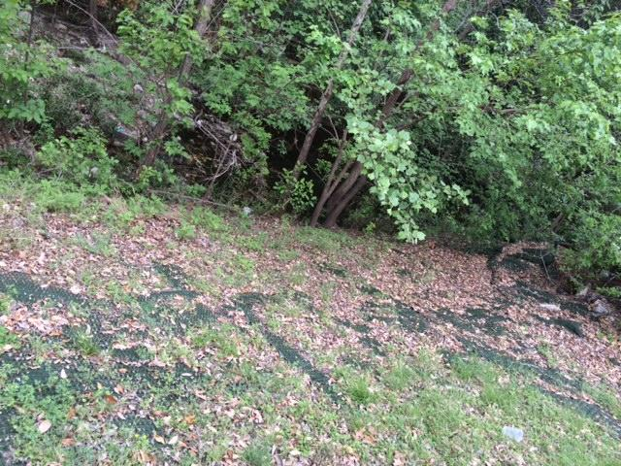
PROCESS

Slide 5
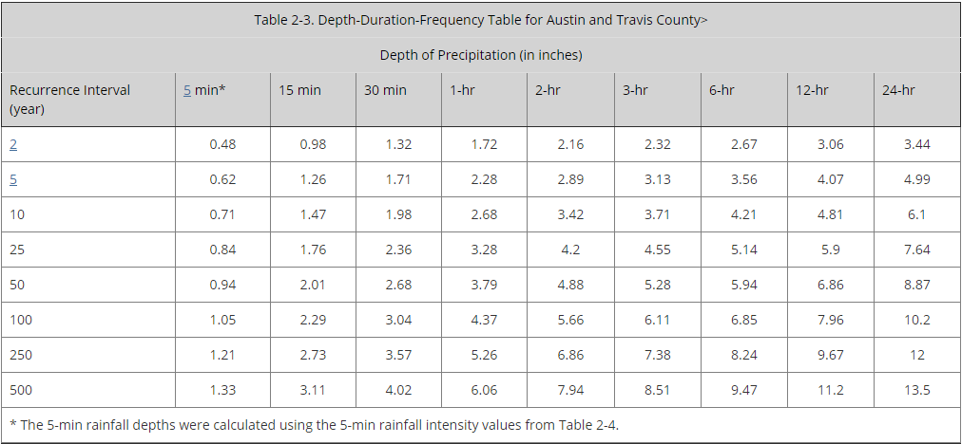
EVALUATION
HEC-HMS
3 day Simulation

Slide 6
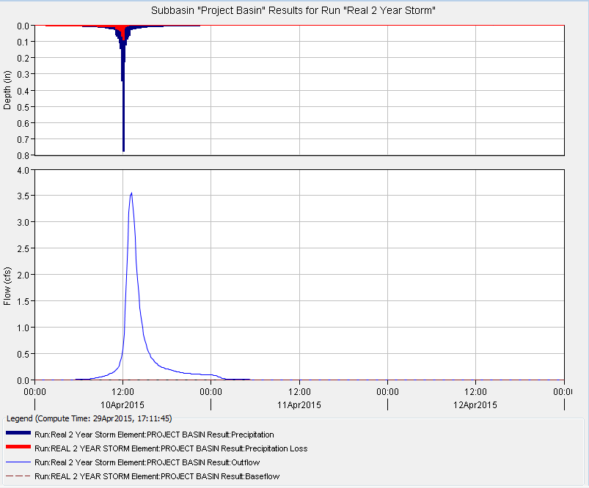
2 Year Storm
Peak Discharge: 3.5 CFS
Total Precipitation: 3.44 IN

Slide 7
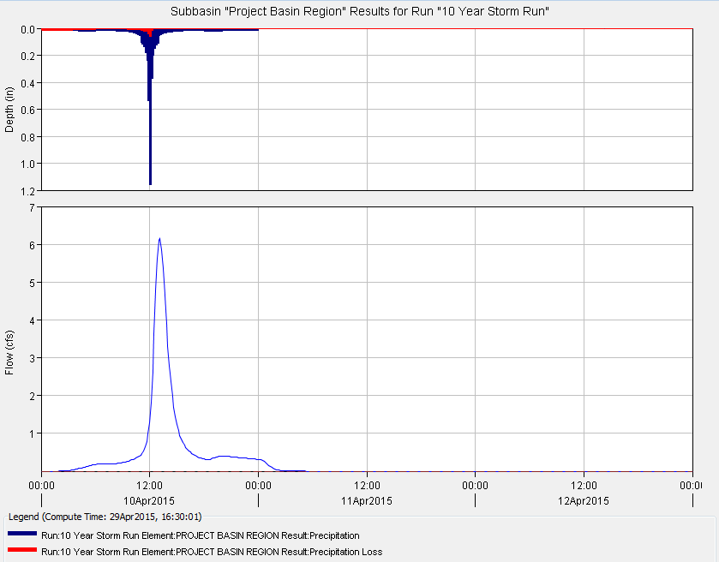
10 Year Storm
Peak Discharge: 6.2 CFS
Total Precipitation: 6.1 IN

Slide 8
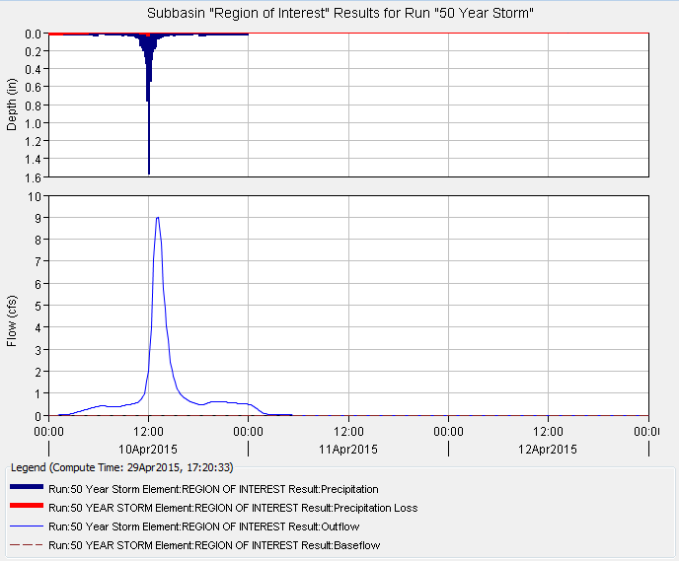
50 Year Storm
Peak Discharge: 9 CFS
Total Precipitation: 8.87 IN

Slide 9
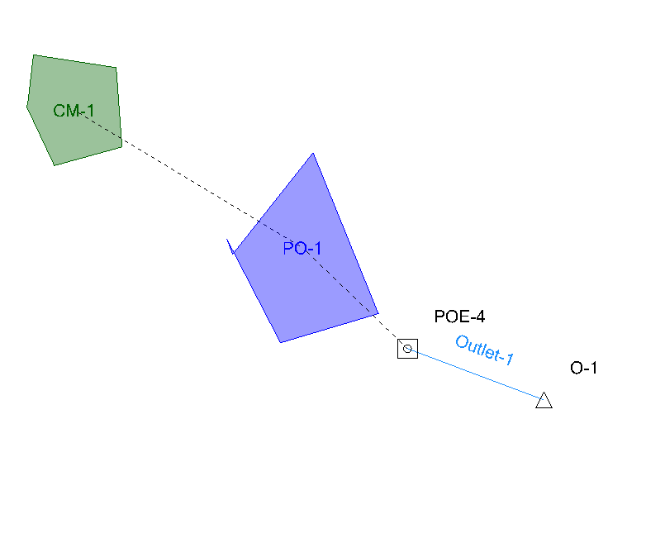
CHANGE
PondPack
Detention Pond Addition
Pond Area: 25ft²
Pond Depth: 5ft

Slide 10
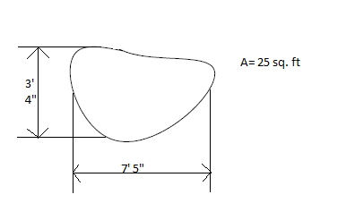
Detention Pond Dimensions

Slide 11
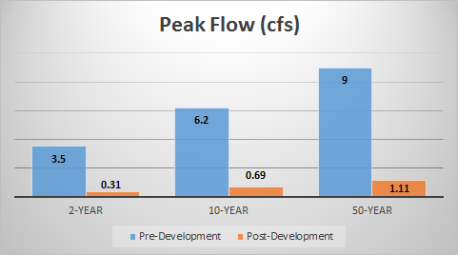
IMPACT

Slide 12
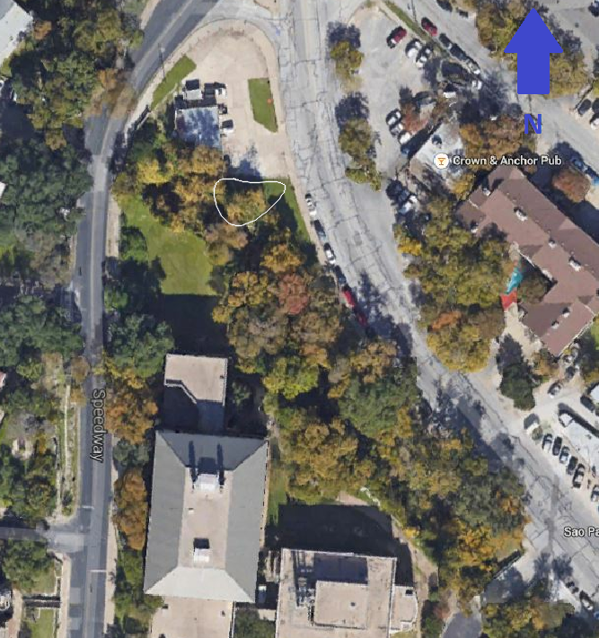
DECISION
Create detention pond in area demonstrated
Add retaining walls
Erosion control netting

Slide 13
QUESTIONS?

