Slide 1

Lake Ralph Hall
Upper Trinity Basin, Texas
Team 9
MOSAED ALRASHIDI, SCOTT GRZYB, SARA MCNEIL, CARLOS MENDEZ
05/07/2015
Hydraulic Engineering Design Spring/2015
Notes:
Introduction: Just names and name of our project.

Slide 2
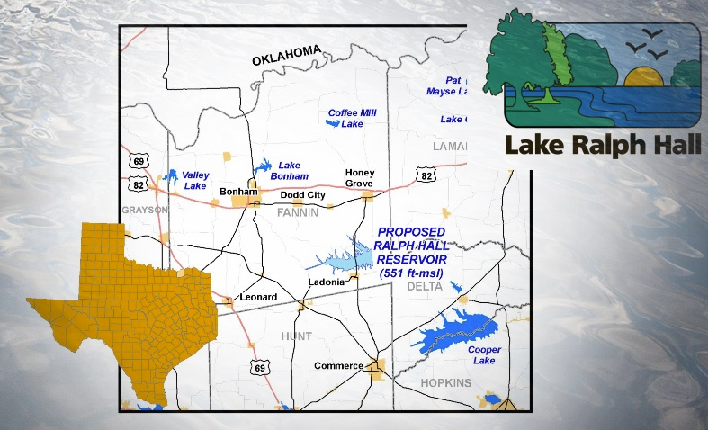
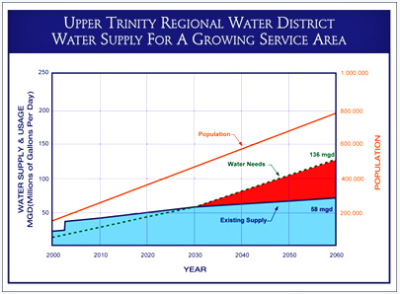
Background Information and Problem
Location: Fannin County (Upper Trinity Regional Water District)
Problem: Water shortage due to population growth
Inaction = Water deficit by 2025
Source: City of Ladonia Website
Notes:
Introduce our problem, where it is occurring, what will happen if nothing happens, lack of water drought etc.

Slide 3
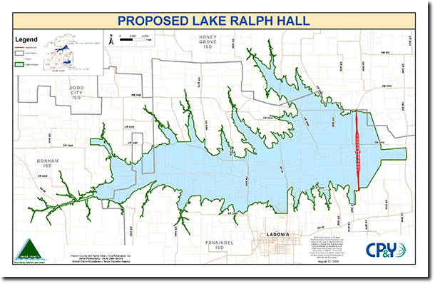
Design Criteria
Reservoir Specifications:
Active Storage Capacity = 180,000 acre-ft
Flood attenuation of a 100 year storm with freeboard of at least 5 ft.
Estimated time to fill the reservoir = 3 years
Source: City of Ladonia Website
Notes:
Proposed to create a manmade lake damming up the Sulpher river. TCEQ storage permitting has been acquired, houses are yet to be bought up.

Slide 4
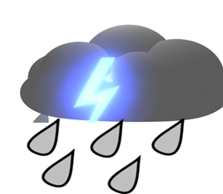
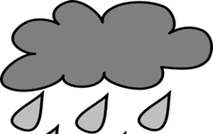
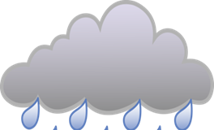
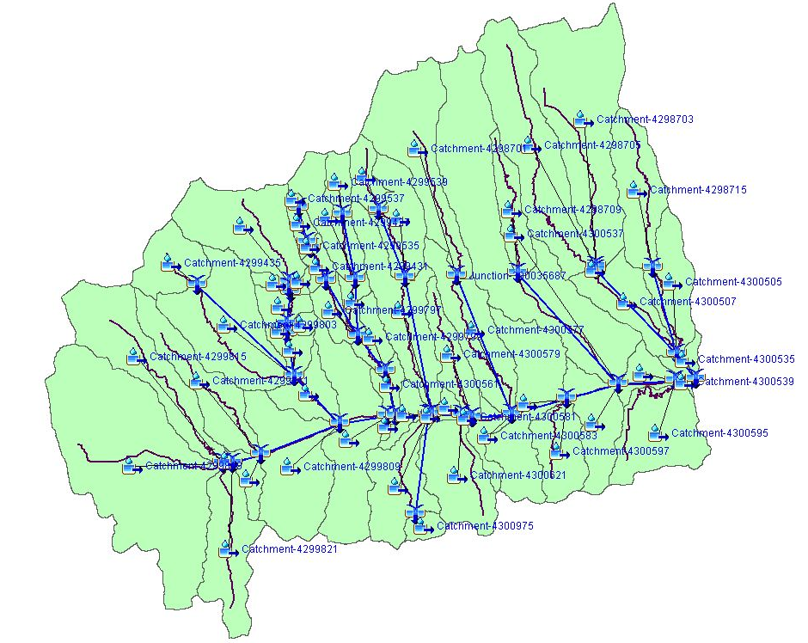
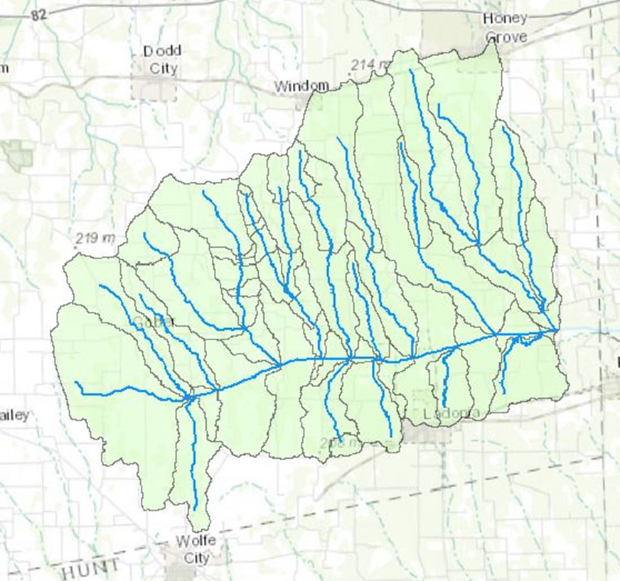

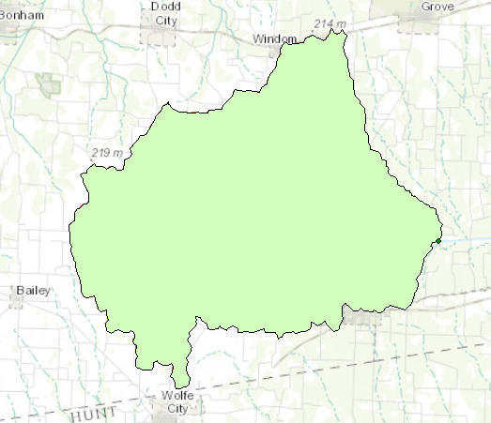
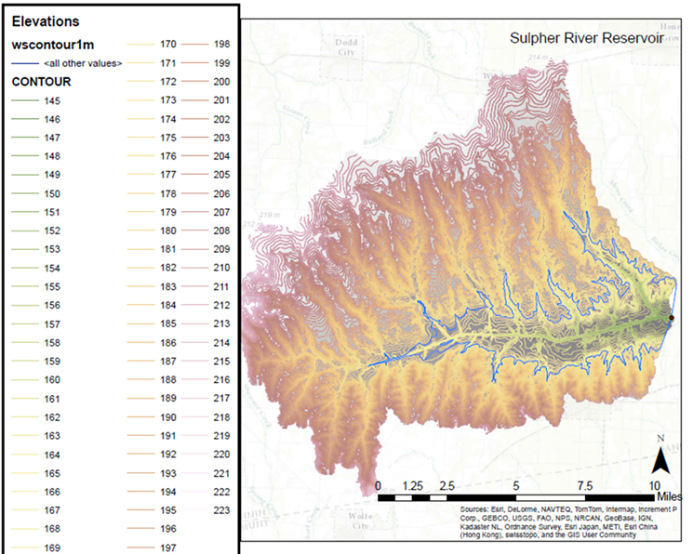
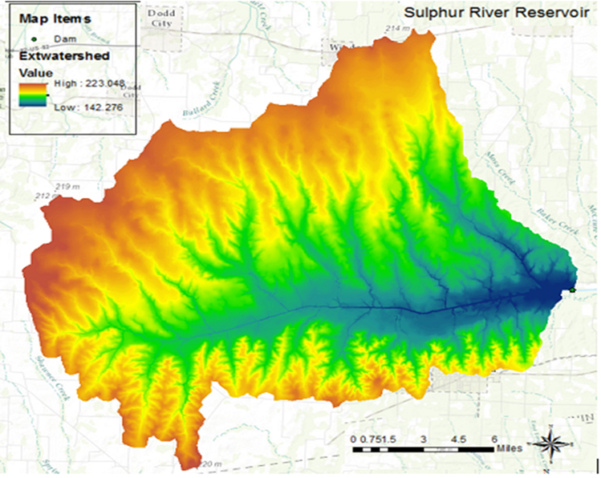
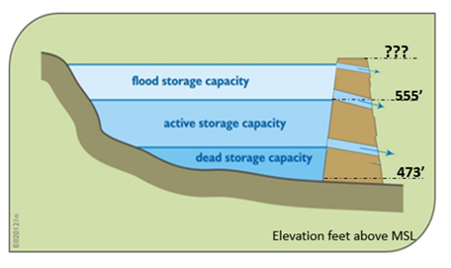
100 Year Storm
50 Year Storm
10 Year Storm
Design Processes
555'

Slide 5
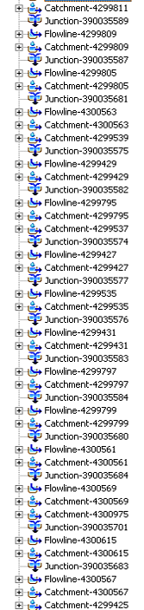
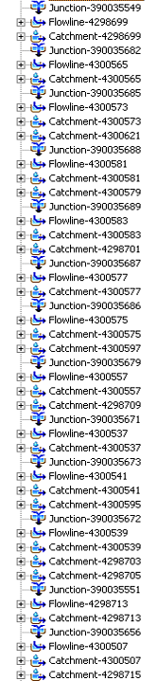
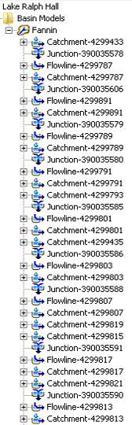
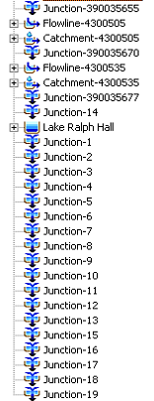
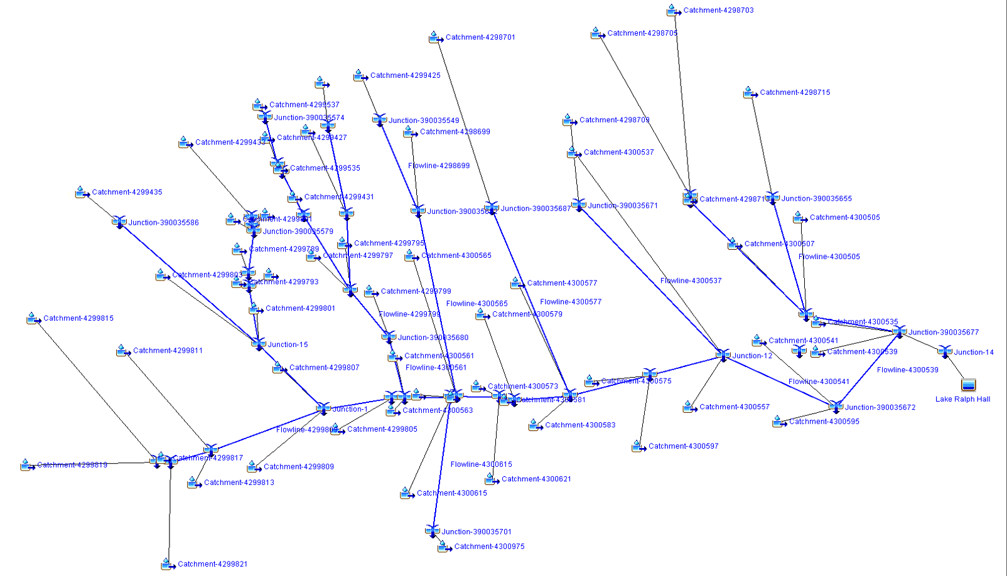
Creation of Lake Ralph Hall
58 catchments
Notes:
Added a junction and added a Resevoir. Received help from Dr. Maidments student who helped us developed individual basins for the study area.
Some basins were not connected to the model. flow lines needed to be added.

Slide 6
4 Scenarios
*Storm data acquired from Dallas County drainage Criteria
*Models were run in HEC-HMS for 30 days at 15 min increments

Slide 7
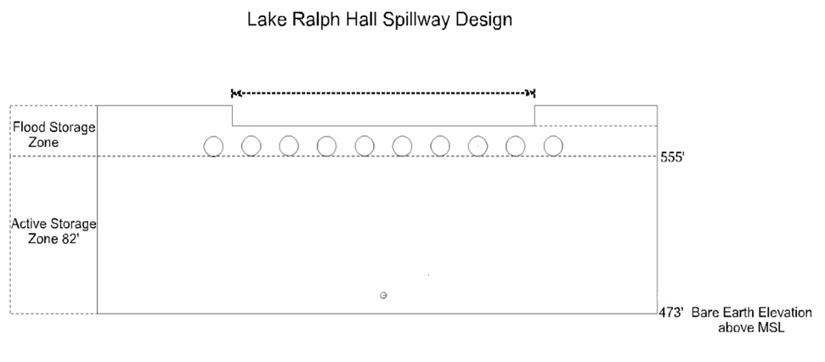
Design Evaluation
?
Emergency Spillway
?
Primary Spillway
Environmental Orifices
?
Notes:
Gated Enviromental orifice at 481’ ( designed to discharge approximately 150 cfs when orifice is open )
10 auxiliary orifices located at starting at 555
Spillway located at 565 ft.

Slide 8
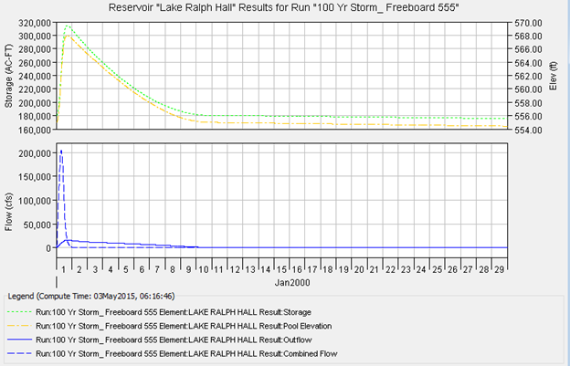
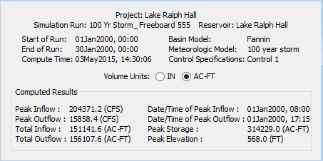
Scenario A: 100 year storm with freeboard 20 ft

Slide 9
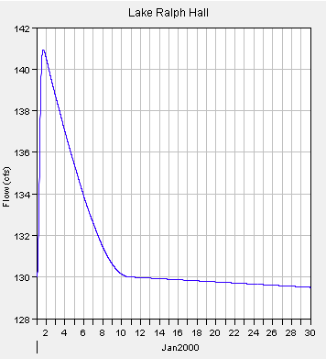
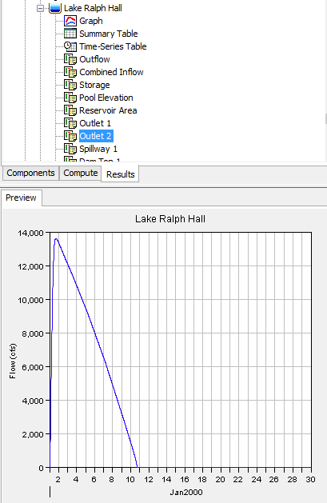
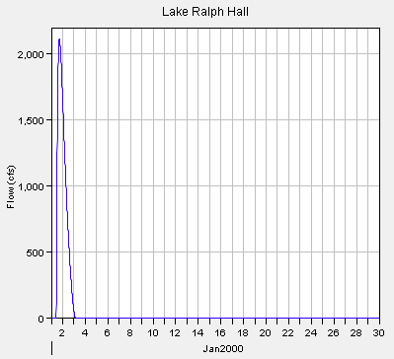
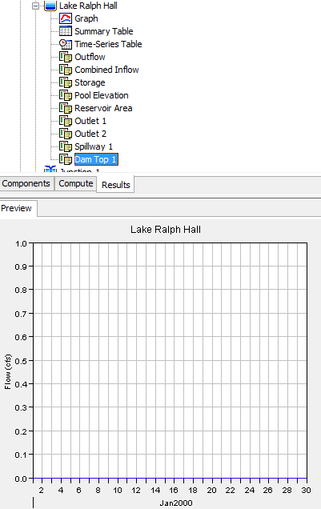
Scenario A: Water elevation does not reach dam top.
Environmental Orifice
Auxiliary Orifice
Weir Safety Spillway
Dam Top

Slide 10
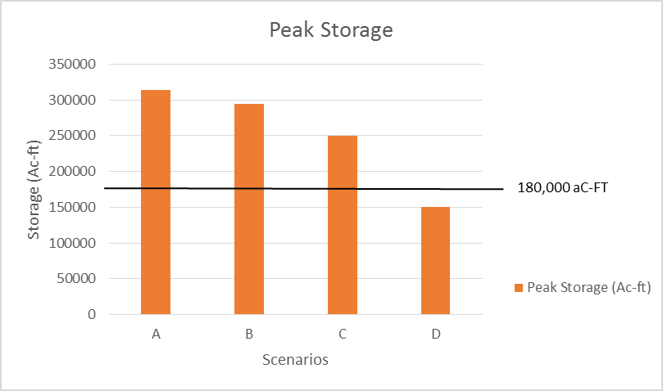
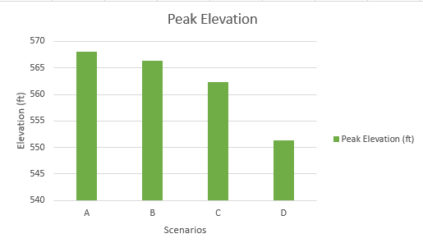
Comparison of Scenarios
spillway
Active Zone

Slide 11
Design Impact

Slide 12
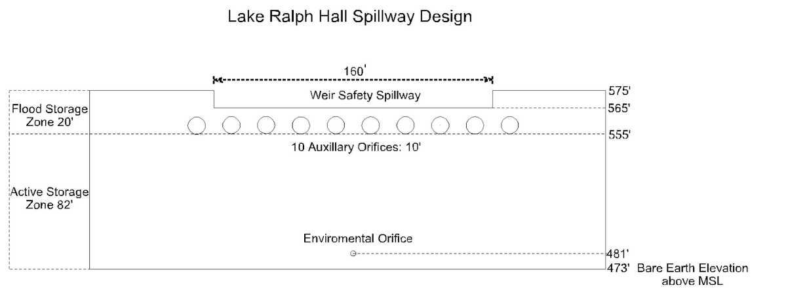
Final Design Decision
Notes:
Gated Enviromental orifice at 481’ ( designed to discharge approximately 150 cfs when orifice is open )
10 auxiliary orifices located at starting at 555
Spillway located at 565 ft.
Dam Height 103 ft
Withstands 100 year design storm while maintaining 7 ft freeboard
1 environmental orifice, gate controlled
10 auxiliary orifices, gate controlled
160 ft Weir spillway

Slide 13
Acknowledgements
Thank you Dr. David Maidment for your supervising
and suggesting we do this project.
Thank you Cynthia for providing the Basin model.

Slide 14
Questions?

