Slide 1
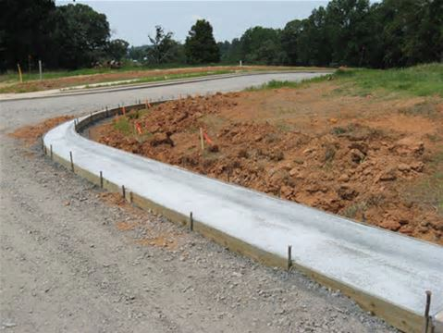
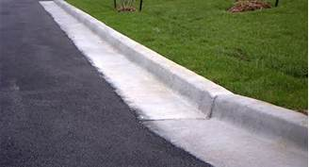
Curb and Gutter
Under Construction
Completed
Curb
Gutter
http://www.ellsworthinc.com/concretework.html
http://www.sscsitework.com/Photo-Gallery.html

Slide 2
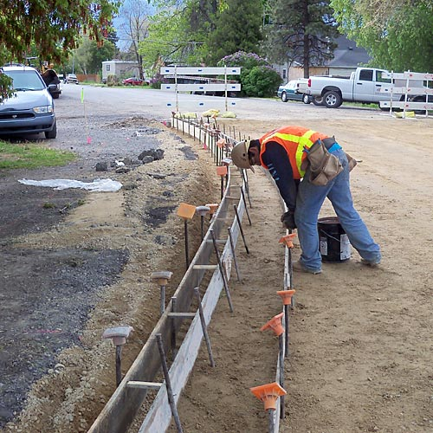
Curb and Gutter Formwork
http://overmanconcrete.com/concrete-services.html

Slide 3
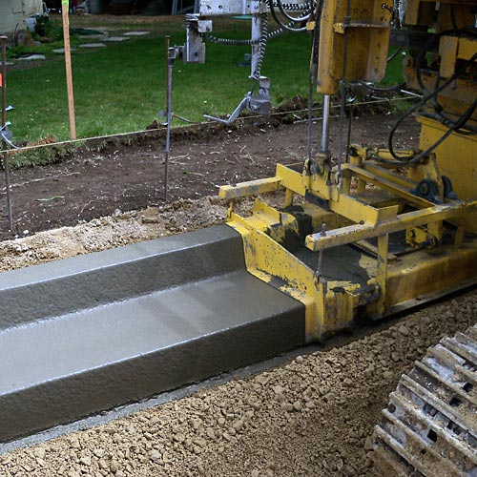
Curb and Gutter Machine
http://overmanconcrete.com/concrete-services.html

Slide 4
Gutter Flow
$$Q=\frac{K_{c}}{n}{{{S_{x}^{}}^{\frac{5}{3}}{S_{L}^{}}^{\frac{1}{2}}T^{\frac{8}{3}}}_{}^{}}^{}$$
T
d
S_{x}
1
Q = flow in gutter (cfs)
K_{c} = coefficient (0.56 for US units, 0.376 for SI units
S_{L} = longitudinal slope
T = spread (ft)
S_{x} = transverse slope
Ref: Haested p. 99

Slide 5
City of Austin Drainage Criteria for Minimum Clear Width
City of Austin, Drainage Criteria Manual, Section 3

Slide 6
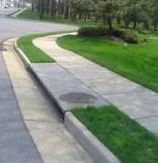
Flow into a Curb Inlet
L_{T}
$$L_{T}={{{K_{c}Q^{0.42}S}_{L}^{}}^{0.3}{\left(\frac{1}{nS_{x}}\right)}^{0.6}}_{}$$
L_{T} = required length to intercept all flow (ft)
Q = flow in gutter (cfs)
K_{c} = coefficient (0.60 for US units, 0.817 for SI units)
S_{L} = longitudinal slope
S_{x} = transverse slope
$$E=1−{\left(1−\frac{L}{L_{T}}\right)}^{1.8}$$
E = efficiency (proportion of flow captured
L = actual length (ft) (for L < L_{T})
Ref: Haested p. 103

