Slide 1
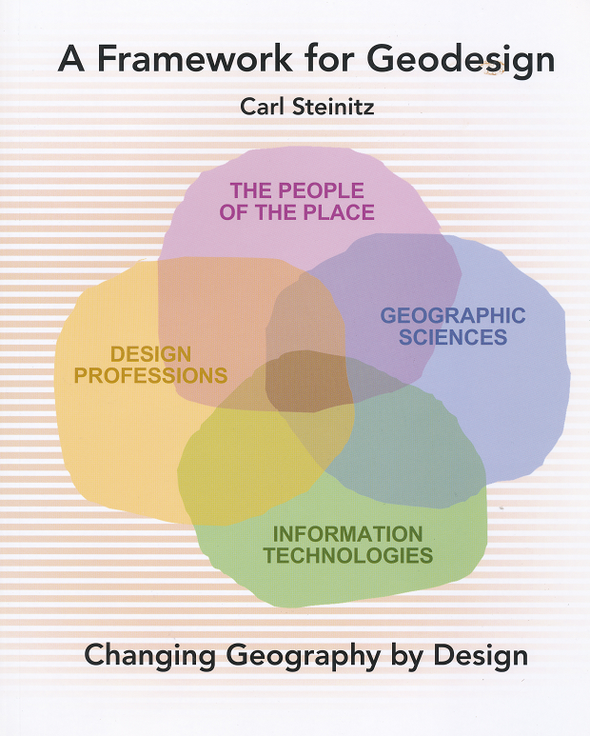
Geodesign
Design – Everyone designs who devises courses of action aimed at changing existing situations into better ones (Herbert Simon)
Geodesign – understanding the impact of our decisions on the planet and using this information to make the world a better place (Jack Dangermond)
http://esripress.esri.com/display/index.cfm?fuseaction=display&moduleID=0&websiteID=218

Slide 2
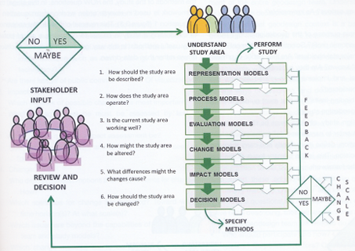
Geodesign Process

Slide 3
Hydrodesign
Hydrodesign is an analogous process to Geodesign for design with water in the constructed and in the natural environment
  Flooding
  Water use
  Water quality
  Environmental integrity
People of the Place
Design Professionals:
Civil Engineers Architects
Earth and Natural Sciences: Geology, Biology
Information Technology

Slide 4
Questions
How should the study area be described?
How does the study area operate?
Is the current study area working well?
How might the study area be altered?
What differences would the changes cause?
How should the study area be changed?
Representation
Process
Evaluation
Change
Impact
Decision

