Slide 1
Design Storms
CE 365K Hydraulic Engineering Design
Spring 2015

Slide 2
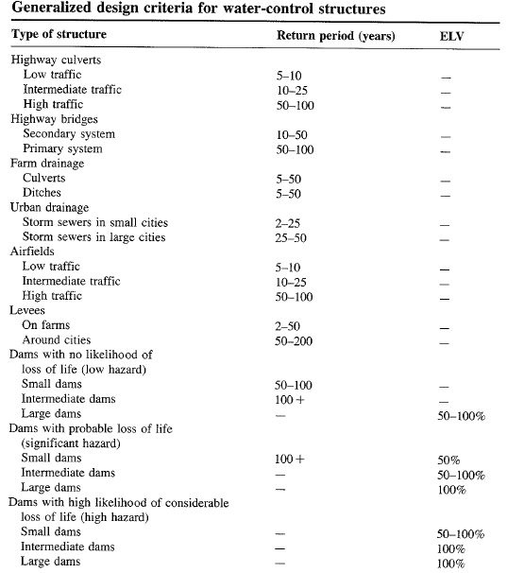

Slide 3
Return Period
Random variable:
Threshold level:
Extreme event occurs if:
Recurrence interval:
Return Period:
  Average recurrence interval between events equalling or exceeding a threshold
If p is the probability of occurrence of an extreme event, then
or

Slide 4
More on return period
If p is probability of success, then (1-p) is the probability of failure
Find probability that (X ≥ x_{T}) at least once in N years.

Slide 5
Example
Expected life of culvert = 10 yrs
Acceptable risk of 10 % for the culvert capacity
Find the design return period
What is the chance that the culvert designed for an event of 95 yr return period will have its capacity exceeded at least once in 50 yrs?
The chance that the capacity will not be exceeded during the next 50 yrs is 1-0.41 = 0.59

Slide 6
Design Storms
Get Depth, Duration, Frequency Data for the required location
Select a return period
Convert Depth-Duration data to a design hyetograph.

Slide 7
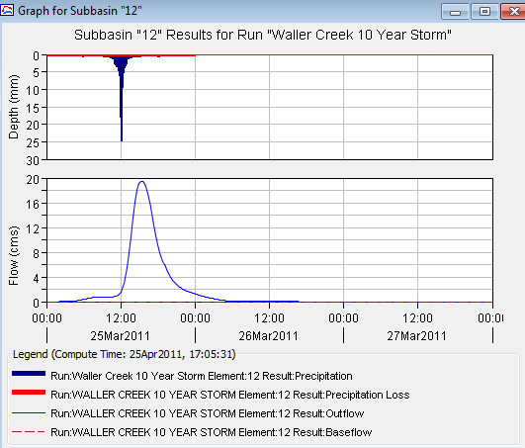
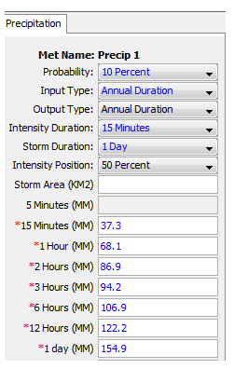
Depth Duration Data to Rainfall Hyetograph

Slide 8
TP 40
Hershfield (1961) developed isohyetal maps of design rainfall and published in TP 40.
TP 40 – U. S. Weather Bureau technical paper no. 40. Also called precipitation frequency atlas maps or precipitation atlas of the United States.
  30mins to 24hr maps for T = 1 to 100
Web resources for TP 40 and rainfall frequency maps
  http://www.tucson.ars.ag.gov/agwa/rainfall_frequency.html
  http://www.erh.noaa.gov/er/hq/Tp40s.htm
  http://hdsc.nws.noaa.gov/hdsc/pfds/

Slide 9
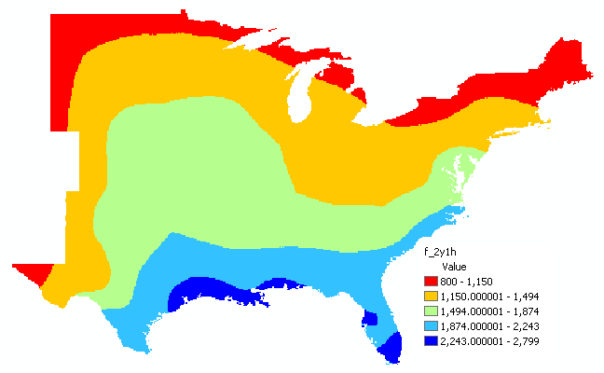
2yr-60min precipitation GIS map

Slide 10
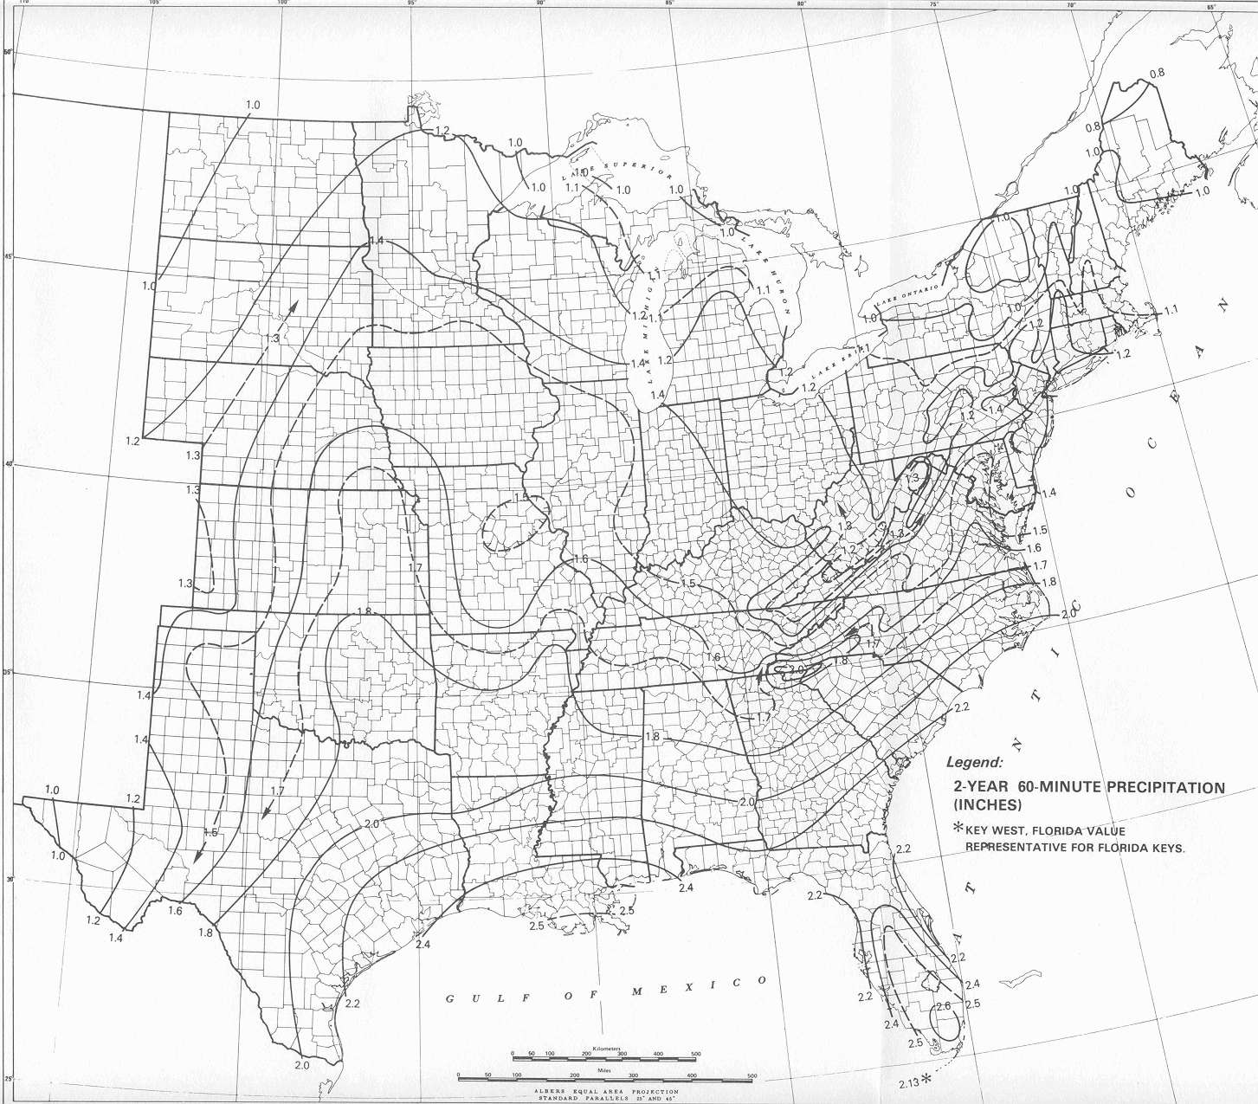
2yr-60min precipitation map
This map is from HYDRO 35 (another publication from NWS) which supersedes TP 40

Slide 11

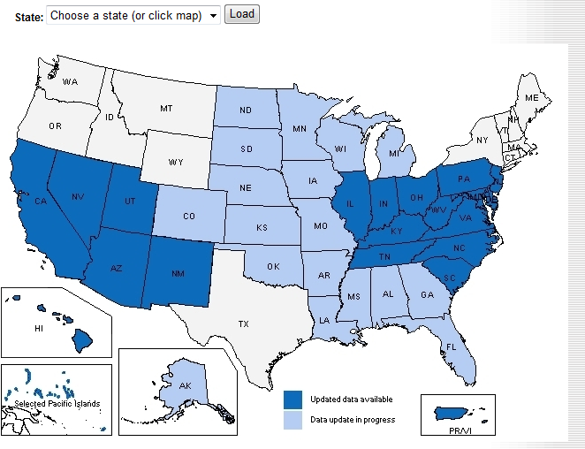
http://hdsc.nws.noaa.gov/hdsc/pfds/index.html

Slide 12
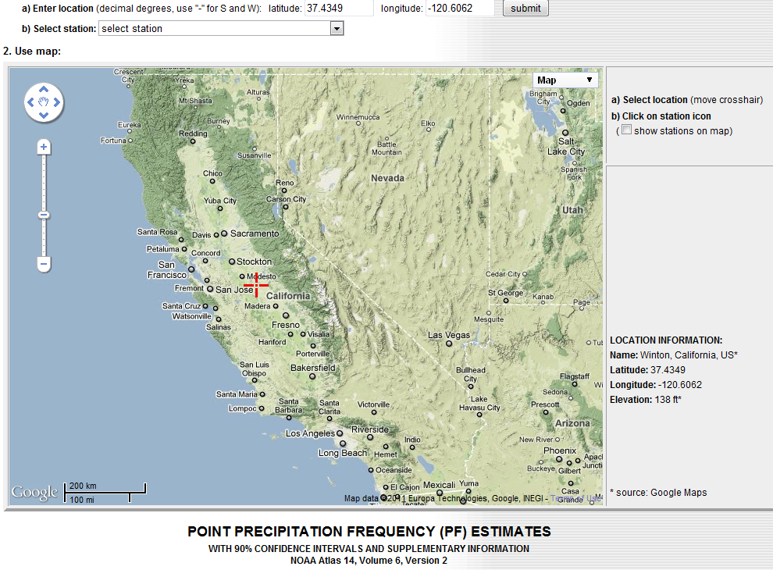
An example of precipitation frequency estimates for a location in California
37.4349 N
120.6062 W

Slide 13
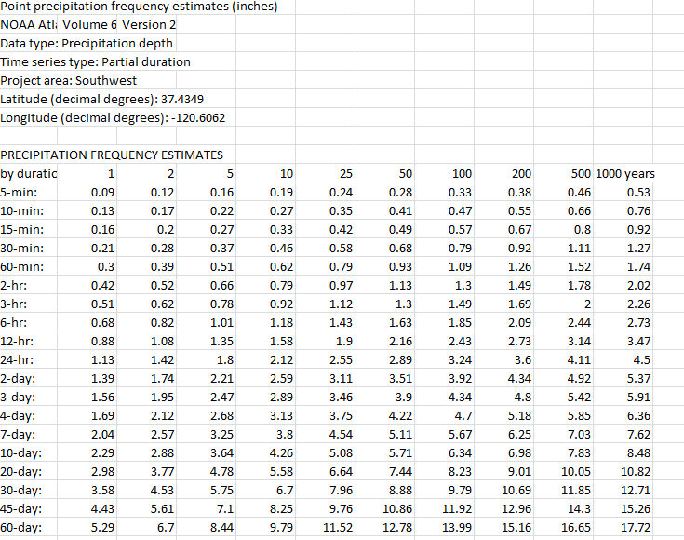
Results of Precip Frequency Query

Slide 14
Design areal precipitation
Point precipitation estimates are extended to develop an average precipitation depth over an area
Depth-area-duration analysis
  Prepare isohyetal maps from point precipitation for different durations
  Determine area contained within each isohyet
  Plot average precipitation depth vs. area for each duration

Slide 15
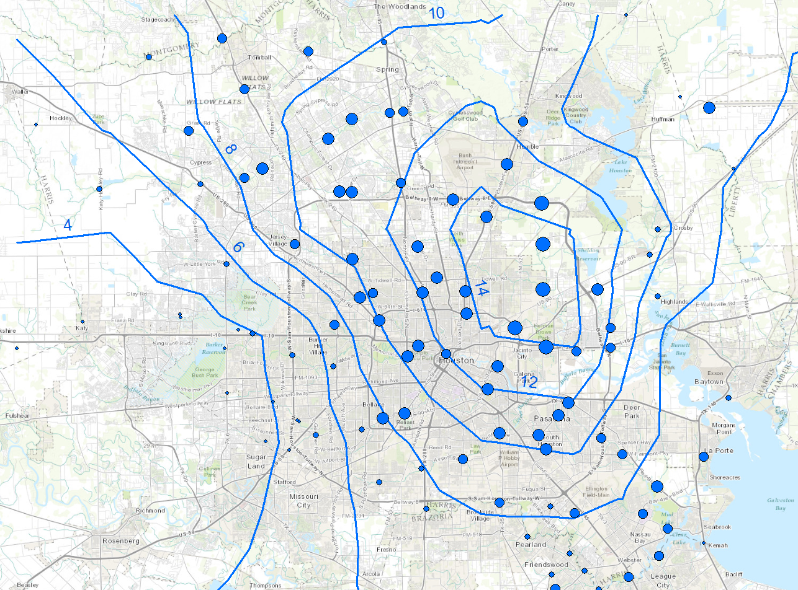
Tropical Storm Allison

Slide 16
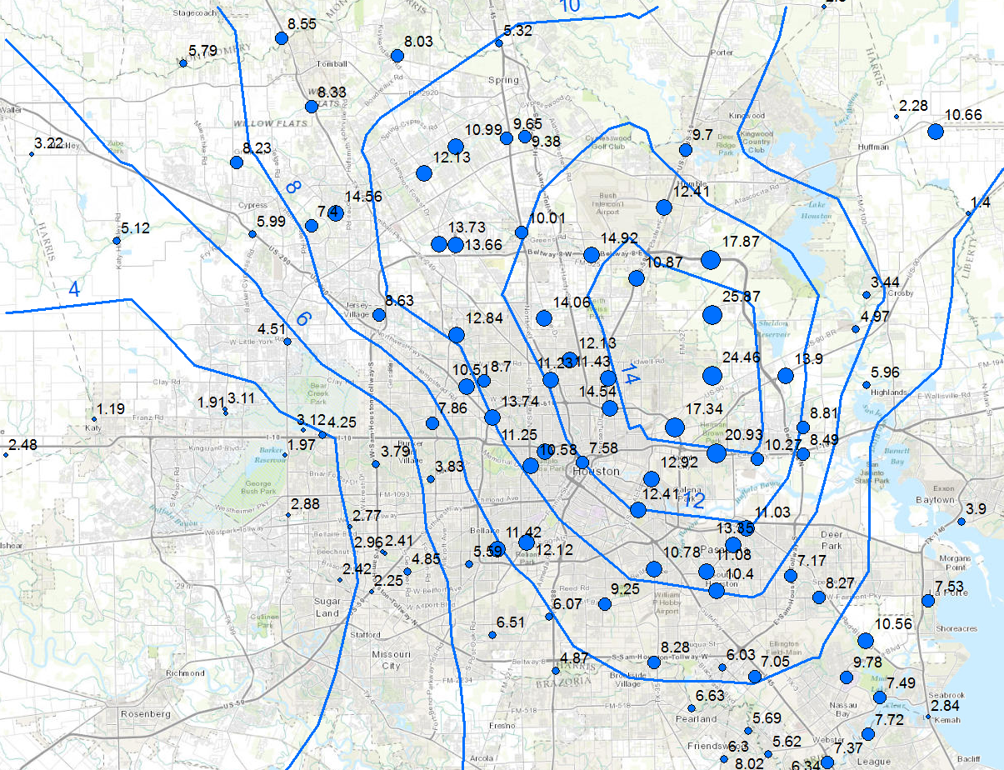
TS Allison

Slide 17
Depth-area curve
(World Meteorological Organization, 1983)

Slide 18
TS Allison

Slide 19
Depth (intensity)-duration-frequency
DDF/IDF – graph of depth (intensity) versus duration for different frequencies
  TP 40 or HYDRO 35 gives spatial distribution of rainfall depths for a given duration and frequency
  DDF/IDF curve gives depths for different durations and frequencies at a particular location
  TP 40 or HYDRO 35 can be used to develop DDF/IDF curves
Depth (P) = intensity (i) x duration (T_{d})

Slide 20
IDF curves for Austin
Source: City of Austin, Watershed Management Division

Slide 21
Design Precipitation Hyetographs
Most often hydrologists are interested in precipitation hyetographs and not just the peak estimates.
Techniques for developing design precipitation hyetographs
  SCS method
  Triangular hyetograph method
  Using IDF relationships (Alternating block method)

Slide 22
TS Allison

Slide 23
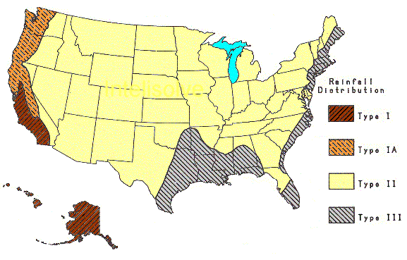
SCS Method
SCS (1973) adopted method similar to DDF to develop dimensionless rainfall temporal patterns called type curves for four different regions in the US.
SCS type curves are in the form of percentage mass (cumulative) curves based on 24-hr rainfall of the desired frequency.
If a single precipitation depth of desired frequency is known, the SCS type curve is rescaled (multiplied by the known number) to get the time distribution.
For durations less than 24 hr, the steepest part of the type curve for required duraction is used

Slide 24
SCS type curves for Texas (II&III)
SCS 24-Hour Rainfall Distributions |  |  |  | SCS 24-Hour Rainfall Distributions
T (hrs) | Fraction of 24-hr rainfall |  |  | T (hrs) | Fraction of 24-hr rainfall
 | Type II | Type III |  |  | Type II | Type III
0.0 | 0.000 | 0.000 |  | 11.5 | 0.283 | 0.298
1.0 | 0.011 | 0.010 |  | 11.8 | 0.357 | 0.339
2.0 | 0.022 | 0.020 |  | 12.0 | 0.663 | 0.500
3.0 | 0.034 | 0.031 |  | 12.5 | 0.735 | 0.702
4.0 | 0.048 | 0.043 |  | 13.0 | 0.772 | 0.751
5.0 | 0.063 | 0.057 |  | 13.5 | 0.799 | 0.785
6.0 | 0.080 | 0.072 |  | 14.0 | 0.820 | 0.811
7.0 | 0.098 | 0.089 |  | 15.0 | 0.854 | 0.854
8.0 | 0.120 | 0.115 |  | 16.0 | 0.880 | 0.886
8.5 | 0.133 | 0.130 |  | 17.0 | 0.903 | 0.910
9.0 | 0.147 | 0.148 |  | 18.0 | 0.922 | 0.928
9.5 | 0.163 | 0.167 |  | 19.0 | 0.938 | 0.943
9.8 | 0.172 | 0.178 |  | 20.0 | 0.952 | 0.957
10.0 | 0.181 | 0.189 |  | 21.0 | 0.964 | 0.969
10.5 | 0.204 | 0.216 |  | 22.0 | 0.976 | 0.981
11.0 | 0.235 | 0.250 |  | 23.0 | 0.988 | 0.991
 |  |  |  | 24.0 | 1.000 | 1.000

Slide 25
Alternating block method
Given T_{d} and T/frequency, develop a hyetograph in Δt increments
  Using T, find i for Δt, 2Δt, 3Δt,…nΔt using the IDF curve for the specified location
  Using i compute P for Δt, 2Δt, 3Δt,…nΔt. This gives cumulative P.
  Compute incremental precipitation from cumulative P.
  Pick the highest incremental precipitation (maximum block) and place it in the middle of the hyetograph. Pick the second highest block and place it to the right of the maximum block, pick the third highest block and place it to the left of the maximum block, pick the fourth highest block and place it to the right of the maximum block (after second block), and so on until the last block.

Slide 26
Example: Alternating Block Method
Find: Design precipitation hyetograph for a 2-hour storm (in 10 minute increments) in Denver with a 10-year return period 10-minute

