Slide 1
Detention Pond Design
Reading: Haested, Section 5.1 to 5.7

Slide 2
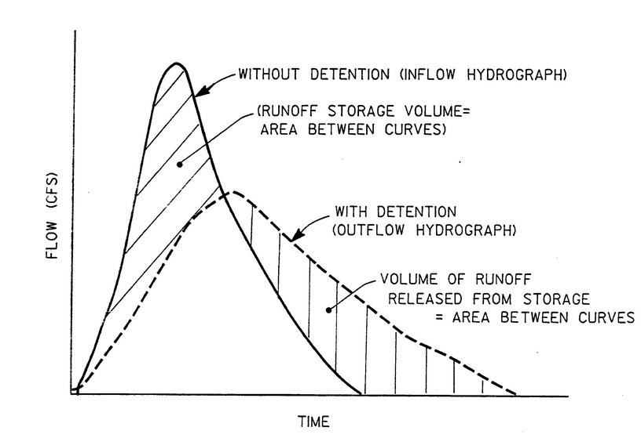
Detention Pond Flows
Figure 8-1 Austin Drainage Criteria Manual

Slide 3
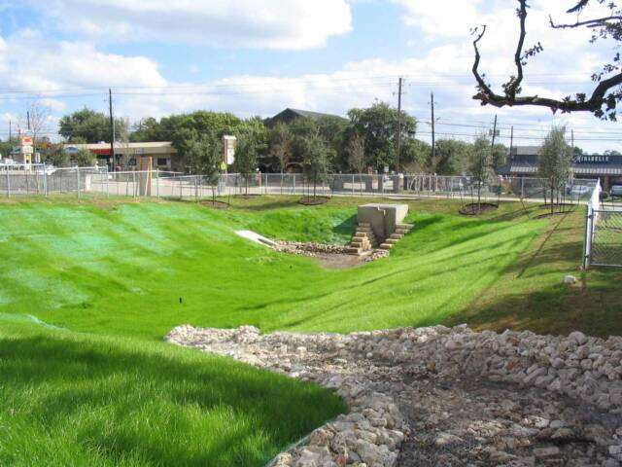
Detention Pond
http://www.tleng.net/Dentention_Pond.html#anchor_70

Slide 4
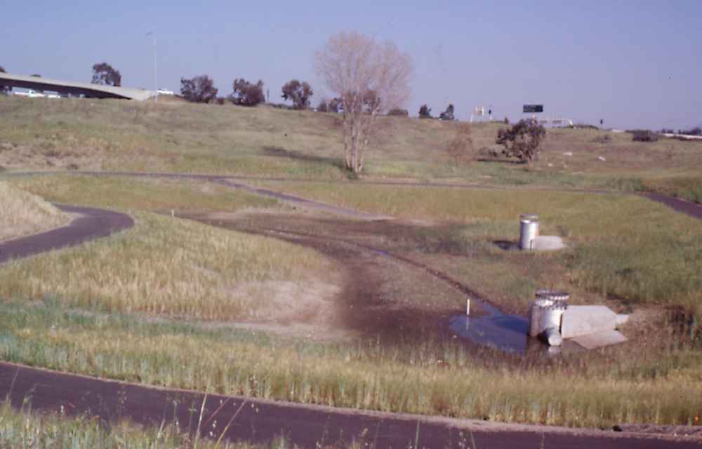
Extended Detention Pond
Notes:
After the basin had been in operation for several months. Two outlet risers to get the capacity for flood control, since this is a flow through EDB, couldn't put any more of a backwater on the existing upstream SD.
There was a buried bridge at this locaiton, not shown on the as-builts, large amounts of broken concrete with rebar. We took two boring logs, niether hit the material. The CCO for this site exceeded the bid price for the basin.
The contractor constructed the outlet too high, ended up leaving that, with reduced slope between inlet and outlet, a retrofit issue.

Slide 5
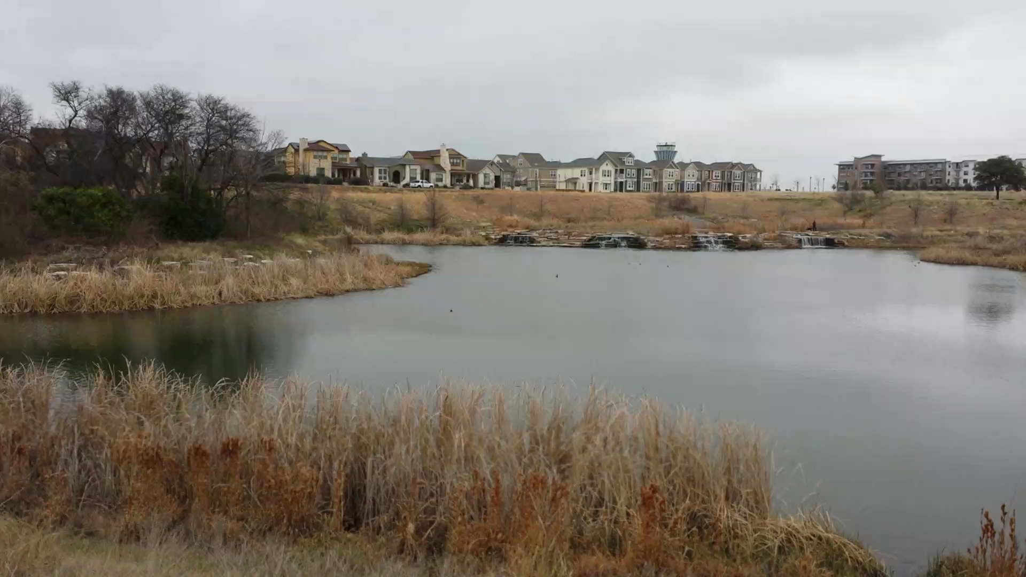
Retention Pond Plus Stormwater Detention
Stormater Detention (Flooding)
Retention Pond (Water Quality)

Slide 6
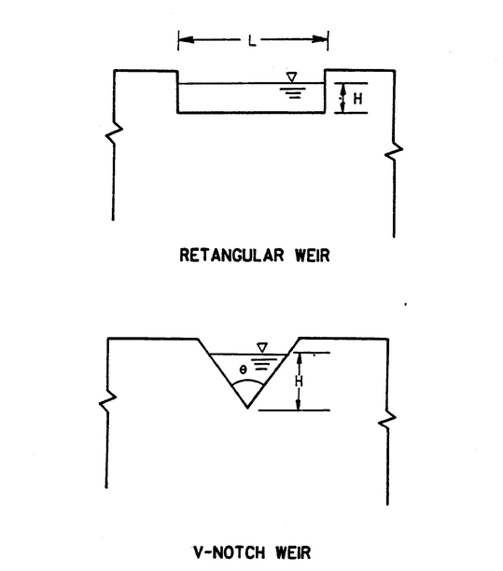
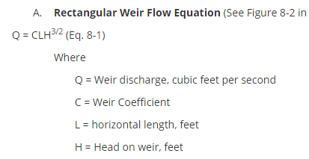
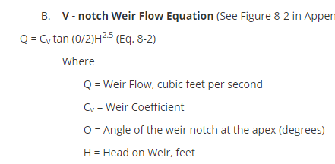
Weir Outflows
Figure 8-2 Austin Drainage Criteria Manual

Slide 7
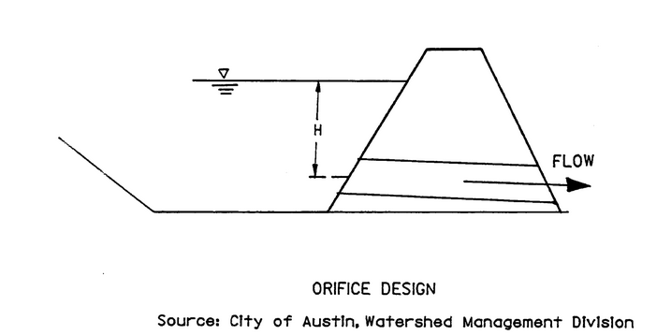
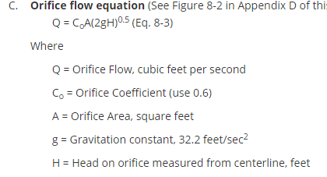
Orifice Outflow

Slide 8
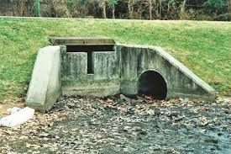
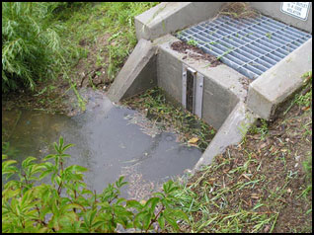
Outlet Structures
http://cenews.com/article/6095/interesting-infrastructure
http://stormwater-filters.com/products/images/DetentionPondOutletStructure.jpg

