Slide 1
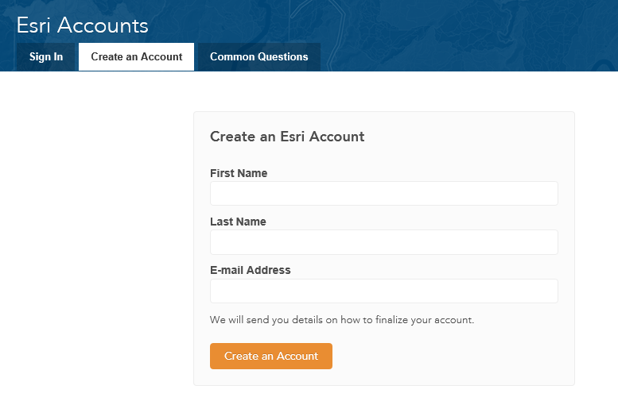
Creating an ESRI Account
Use your CE 365K email address here

