Slide 1
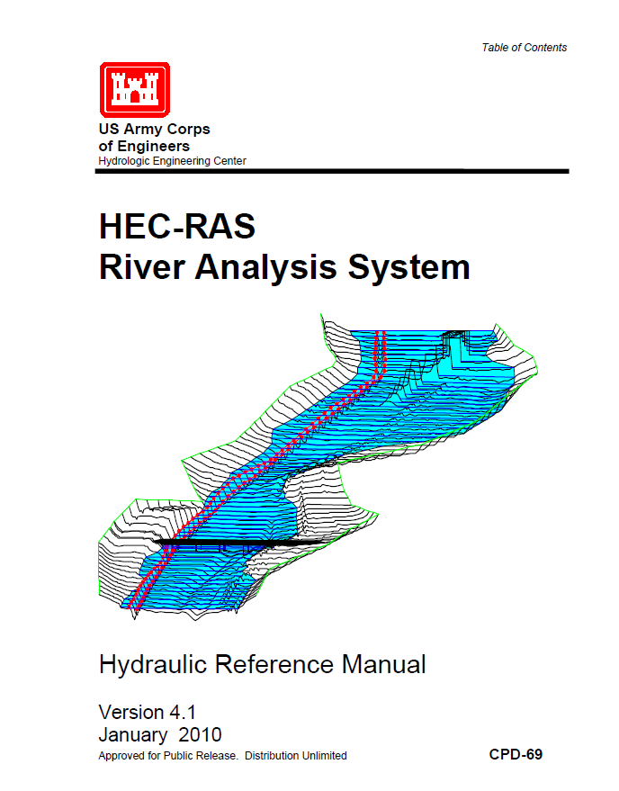
Hydraulic Routing in Rivers
  Reading: HEC-RAS Manual pp. 2-1 to 2-15
http://www.hec.usace.army.mil/software/hec-ras/documentation/HEC-RAS_4.1_Reference_Manual.pdf

Slide 2
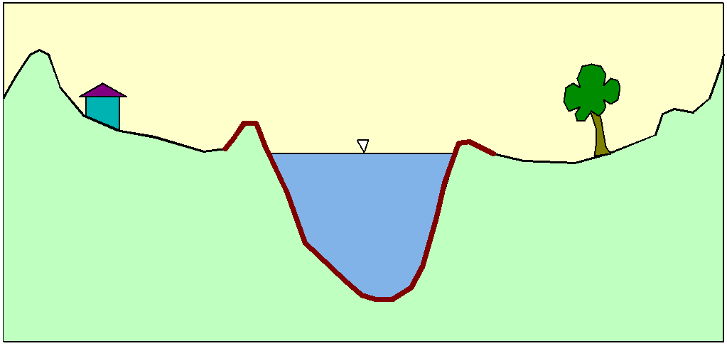
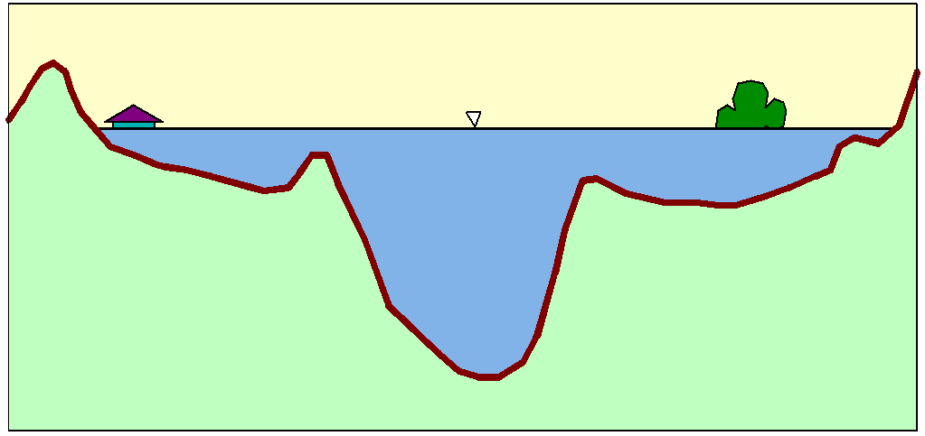
Flood Inundation

Slide 3
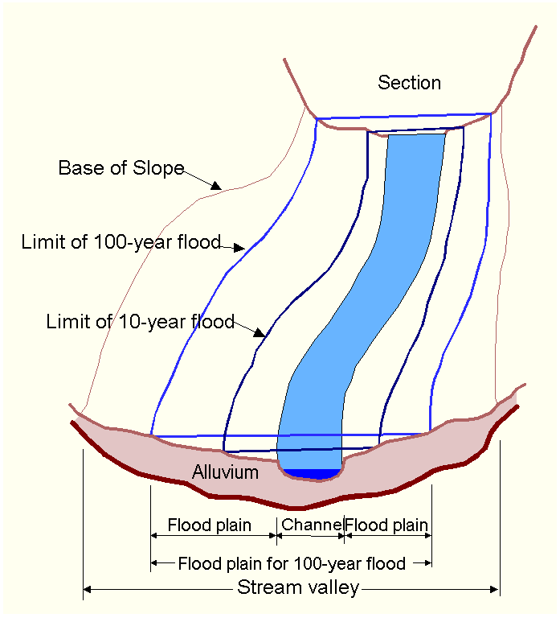
Floodplain Delineation
Notes:
The channel and floodplain are both integral parts of the natural conveyance of a stream. The floodplain carries flow in excess of the channel capacity. The greater the discharge, the greater the extent of inundation. …. Because of its devastating nature, flooding poses serious hazards to human populations in many parts of the world. “The Flood Disaster Protection Act of 1973” required the identification of all floodplain areas in the United States and the establishments of flood-risk zones within those areas.

Slide 4
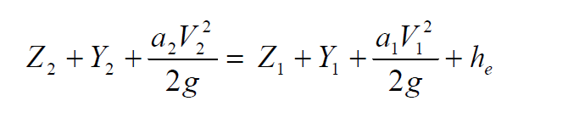
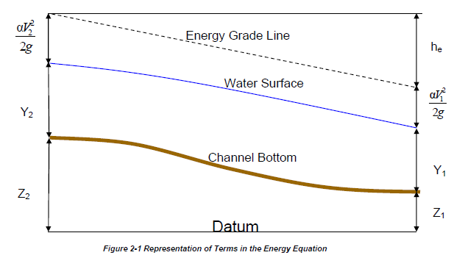
Steady Flow Solution

Slide 5
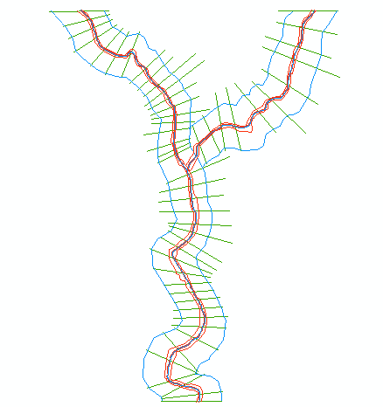
One-Dimensional Flow Computations
Cross-section
Channel centerline
and banklines
Right Overbank
Left Overbank

Slide 6
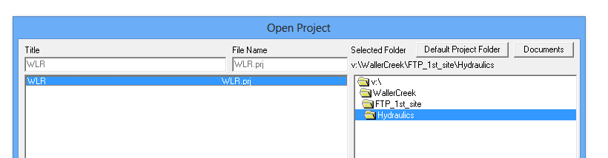
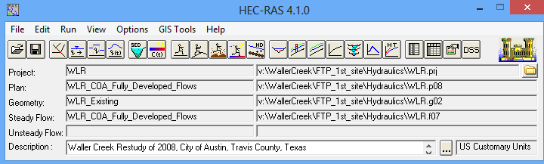
Waller Creek HEC-RAS model

Slide 7
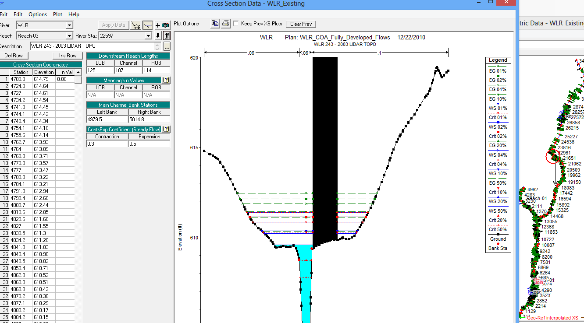
HEC-RAS Model – Waller Creek at 45th St (Station 22597)

Slide 8

Return Periods of Floods
Exceedance % | Exceedance Prob | Return Period (Yr)
1 | 0.01 | 100
2 | 0.02 | 50
4 | 0.04 | 25
10 | 0.10 | 10
20 | 0.20 | 5
50 | 0.50 | 2

Slide 9
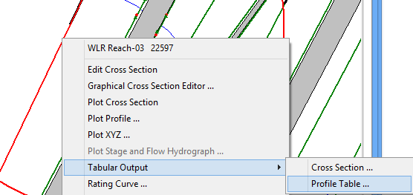
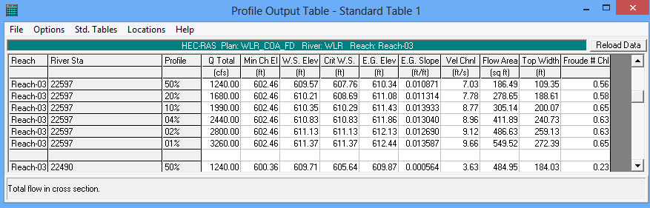
Water Surface Elevations

Slide 10
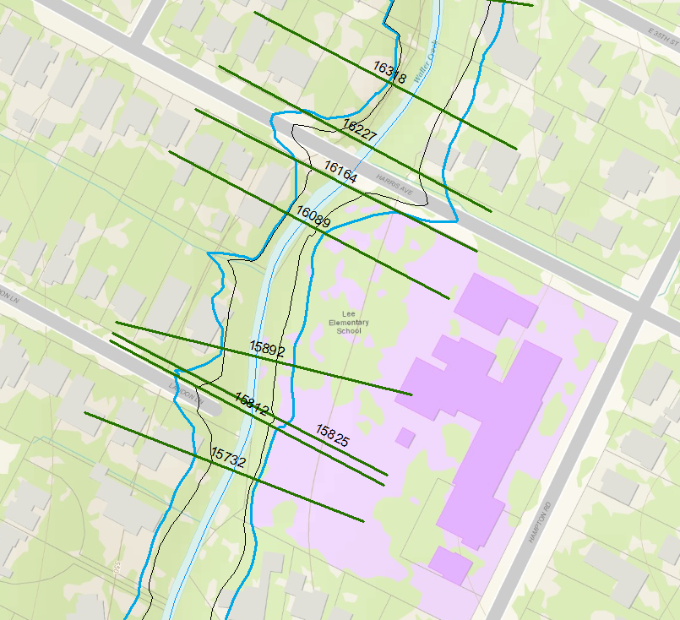
Cross-Sections at Lee Elementary School

Slide 11
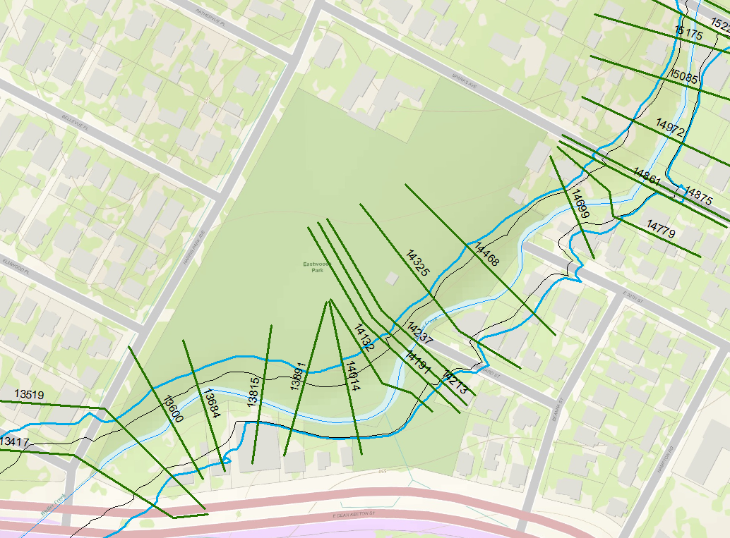
Cross-Sections at Eastwoods Park

Slide 12
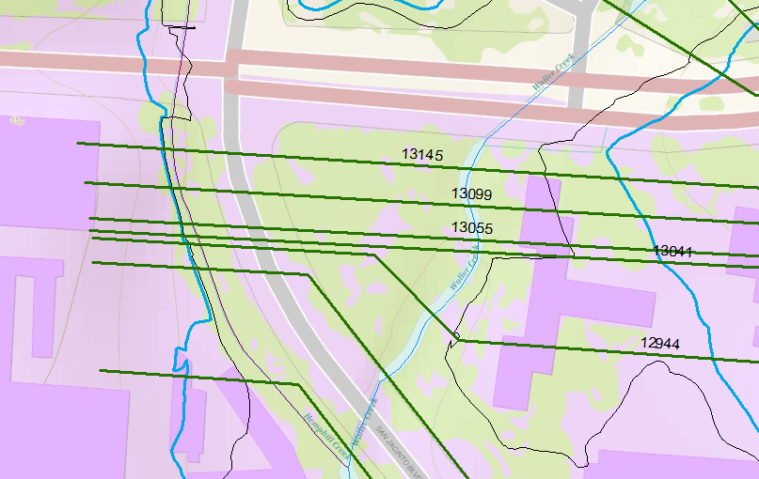
Cross-Sections at ECJ

Slide 13
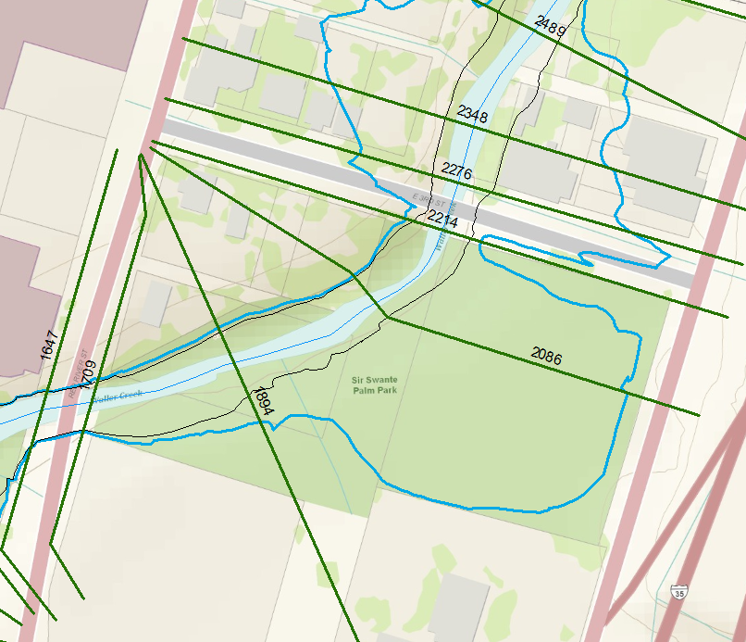
Cross-Sections at Palm Park

