Slide 1
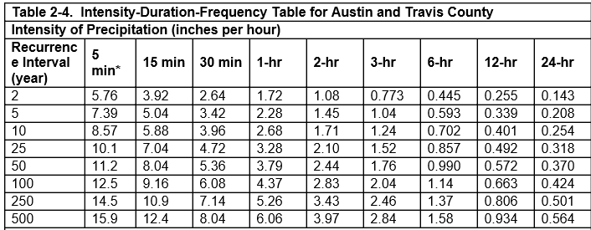
Intensity-Duration-Frequency Curves

