Slide 1
CE 365K Hydraulic Engineering Design
David R. Maidment
Spring Semester 2015
University of Texas at Austin

Slide 2

Course Reference Book
First five chapters
  Basic hydraulics
  Basic hydrology
  Storm sewer design
  Culvert hydraulics
  Detention pond design
8th Edition, 2013,
ISBN 1-934493-16-3
Regular cost is $295
Student edition is $80
http://www.bentley.com/en-US/Training/Products/Resources/Books/CAiHE+8th+edition.htm

Slide 3
Course Reference Book
We will cover these chapters up to Spring Break
Reading for Thursday is Chapter 1
Has a disk at the back with computer programs
These are licensed through the LRC

Slide 4
Bentley Computer Programs
Flow Master
  Design of pipes, gutters, inlets, ditches, open channels, weirs and orifices
Culvert Master
  Design and analyze culvert hydraulics
StormCAD
  Design and analyze storm sewer systems
PondPack
  Pre- and Post-developed watershed conditions
  Sizing ponds
  Outlet structure rating curves
Steady Flow
Unsteady Flow

Slide 5
Evolution of Hydraulic Design
Stormwater runoff disposal
  Get the water off the site as quickly and efficiently possible
Stormwater detention
  Slow down the stormwater so that peak flow after development is not more than before
Water Quality Enhancement
  Retain and filter water on site so that bacteria are reduced and water quality improves
Low Impact Development
  Dispersed onsite infiltration, filtration and retention schemes

Slide 6

Geodesign
Design – Everyone designs who devises courses of action aimed at changing existing situations into better ones (Herbert Simon)
Geodesign – understanding the impact of our decisions on the planet and using this information to make the world a better place (Jack Dangermond)
http://esripress.esri.com/display/index.cfm?fuseaction=display&moduleID=0&websiteID=218

Slide 7
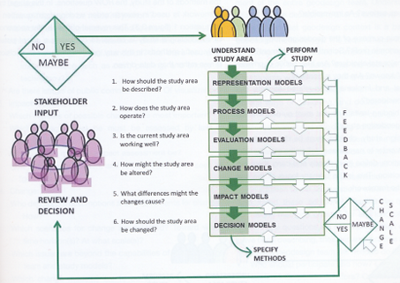
Geodesign Process

Slide 8
Hydrodesign
Hydrodesign is an analogous process to Geodesign for design with water in the constructed and in the natural environment
  Flooding
  Water use
  Water quality
  Environmental integrity
People of the Place
Design Professionals:
Civil Engineers Architects
Earth and Natural Sciences: Geology, Biology
Information Technology

Slide 9
Questions
How should the study area be described?
How does the study area operate?
Is the current study area working well?
How might the study area be altered?
What differences would the changes cause?
How should the study area be changed?
Representation
Process
Evaluation
Change
Impact
Decision

Slide 10
Design Project
Needs a team of three people
You are free to form your own team and to give it a name
Think about a design project that you would like to do
I need your group membership by Thursday 12 February
I will make up groups for students unassigned to groups by 27 February
Your design project proposal is due on Thursday Mar 12.
Oral presentation in last 2 weeks of semester
Written Report on last day of semester, May 8

Slide 11
Key Players
Owner
Architect
Permits
City
Regulatory
Process
Engineers

Slide 12

UT Austin Landscape Master Plan:
Evaluating Opportunities for Progressive Storm Water Management
Slide: Kaethe Selkirk

Slide 13
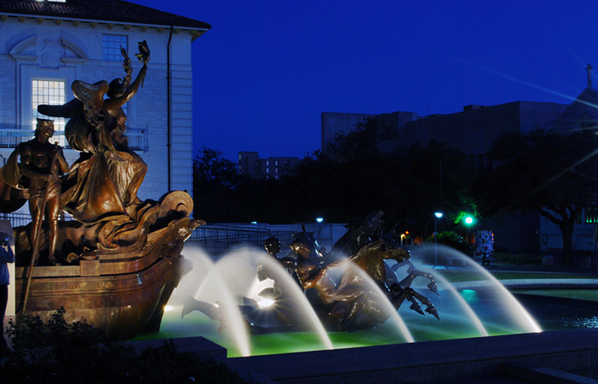
CIVIC SPACE
Foundation of campus identity; classical compositions
Iconic, institutional, and ceremonial references
Vegetation type is limited
Spaces experienced as single, non-segmented units
View sheds structured by high quality masonry
Slide: Kaethe Selkirk

Slide 14
“…Opportunities to reduce water use and improve storm water management in existing Civic landscapes should be explored; however, human use should be prioritized in these important public spaces.”
Slide: Kaethe Selkirk

Slide 15
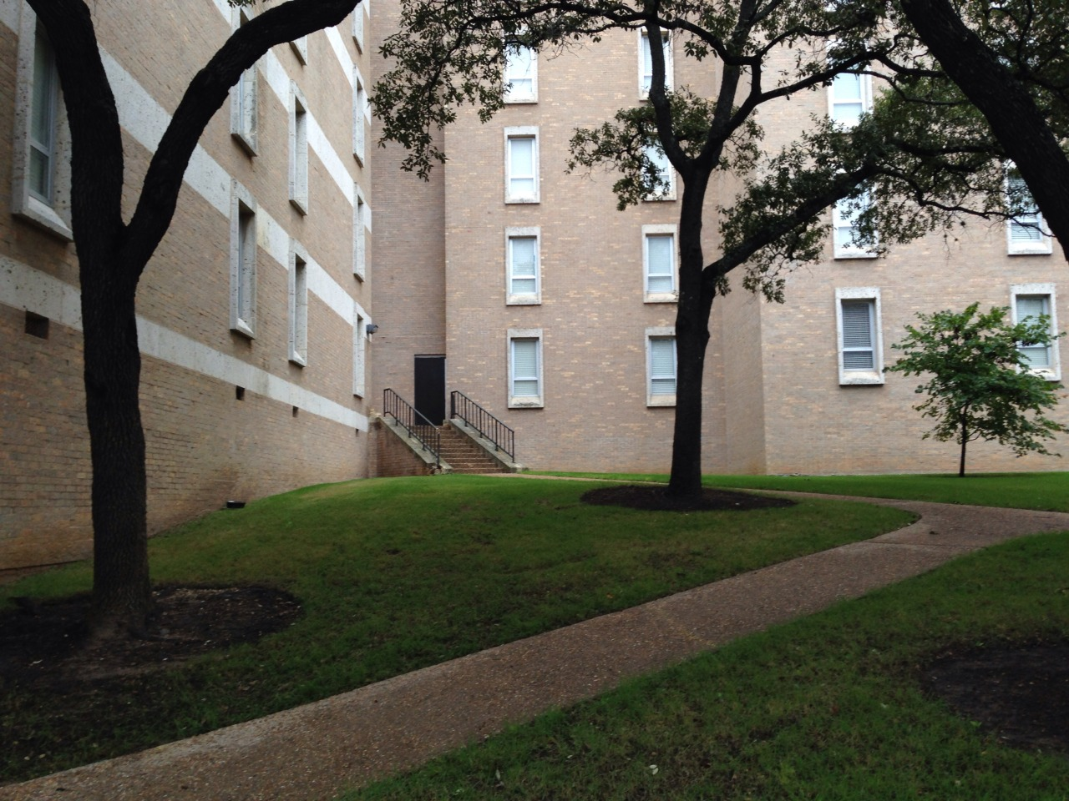
QUADS, COURTYARDS,
PLAZAS
Self-contained and noncontiguous
Structured by formal buildings and walls
Aesthetics are defined by adjacent architecture
Landscape as laboratory: specific materials and planting types are not explicit
Slide: Kaethe Selkirk

Slide 16
Storm water “collection, detention and infiltration can be integrated as a design feature. Consideration should be given to storing the SITES Prerequisite Water Quality Storm Volume for each space’s immediate catchment area in a small wet-dry infiltration feature. If employed across the campus, this strategy would significantly reduce storm water runoff volume entering Waller Creek during storm events.”
Slide: Kaethe Selkirk

Slide 17
Slide: Kaethe Selkirk

Slide 18
Slide: Kaethe Selkirk

Slide 19
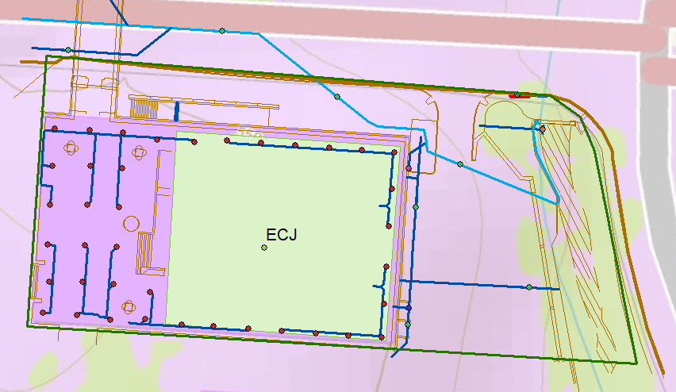
GIS Base Mapping:
Study Area: Cockrell Hall(ECJ)

Slide 20
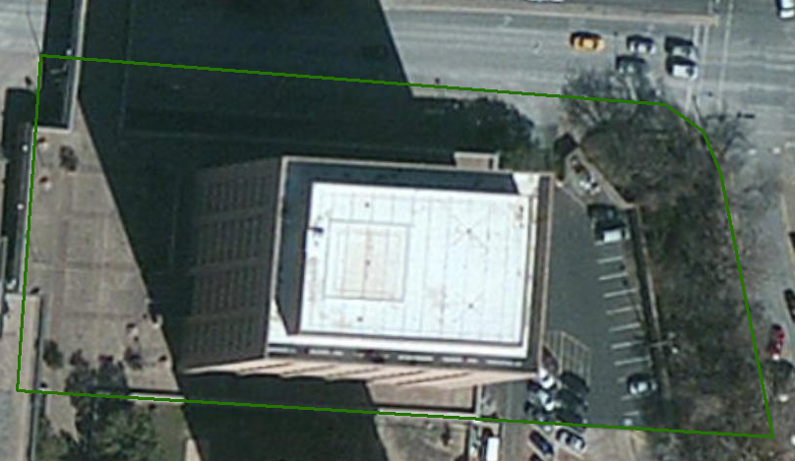
Study Area in Imagery

Slide 21
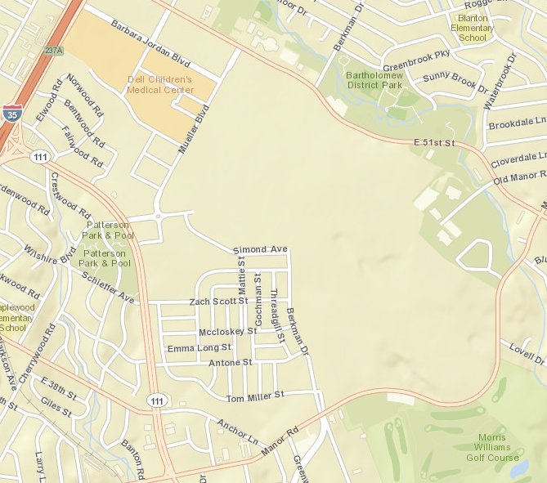
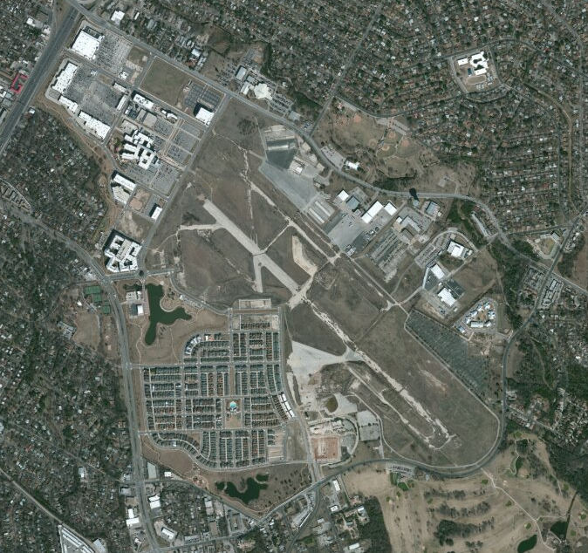
Water Quality Enhancement and Low Impact Development:
Redevelopment of Mueller Airport

Slide 22
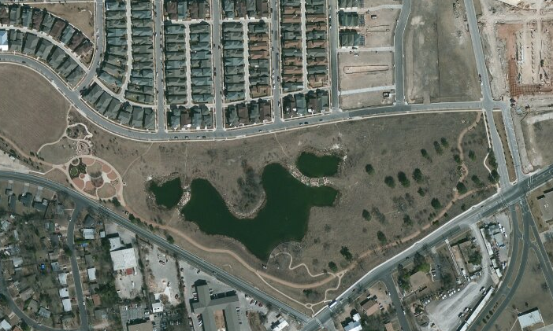
Flood Detention and Water Quality Pond

Slide 23
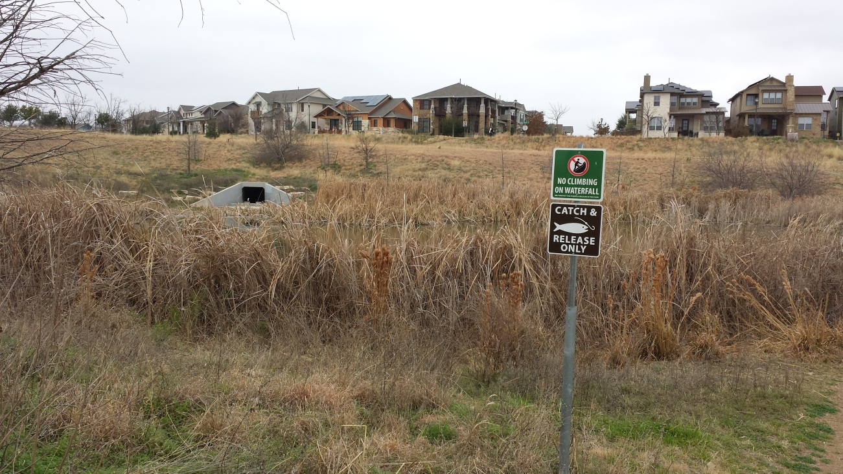
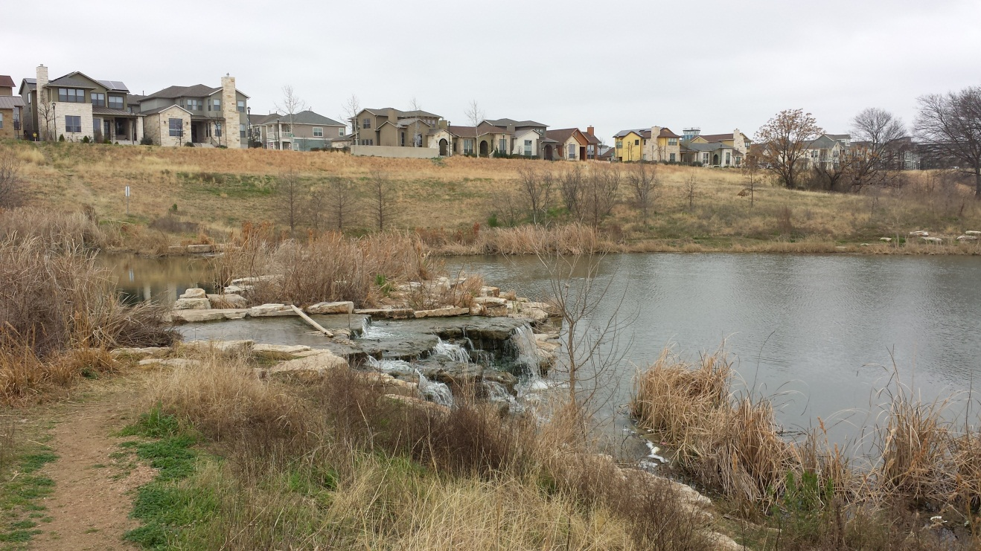
Mueller Wet Pond
Stormwater Outlet and
Upper Pond
Back pumping
Aeration System and
Lower Pond

Slide 24
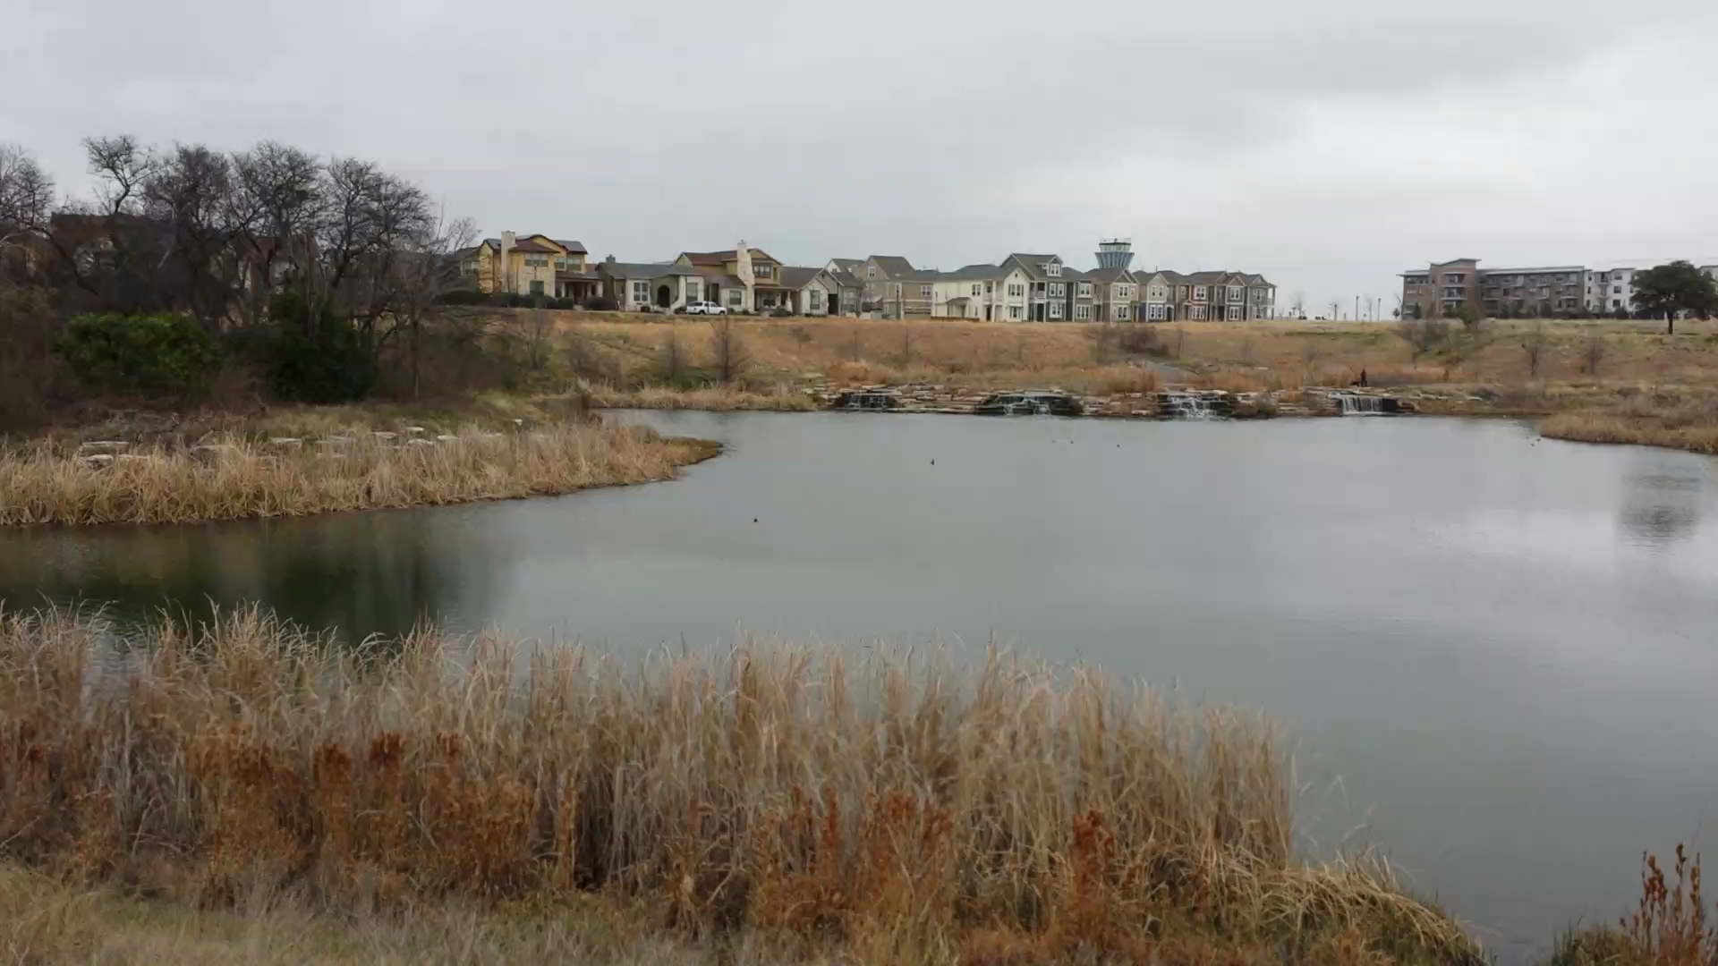
Pond, Outfall and Overflow
Stormater Detention (Flooding)
Wet Pond (Water Quality)

Slide 25
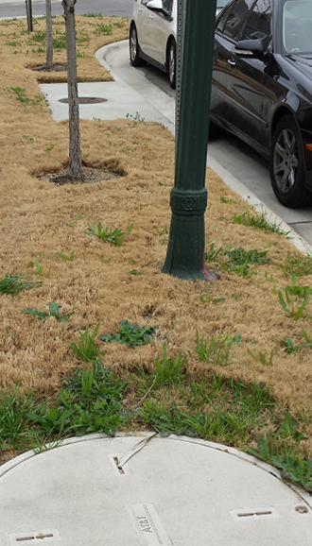
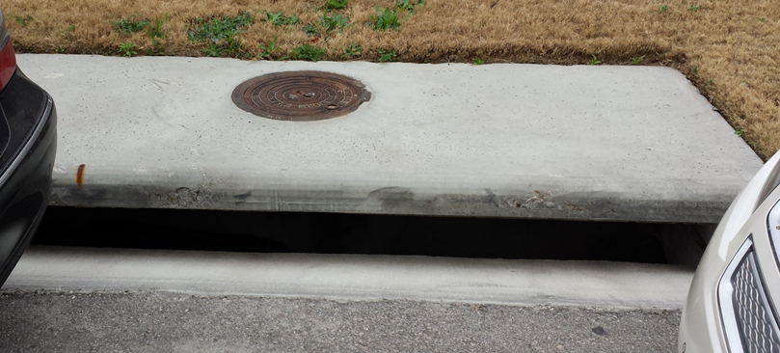
Normal Sidewalk and Stormwater Inlet

Slide 26
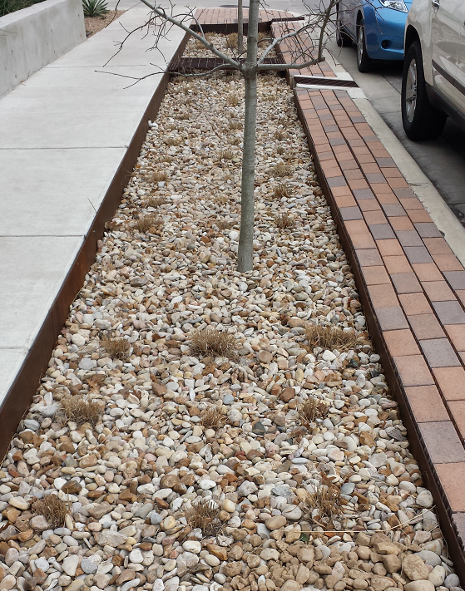
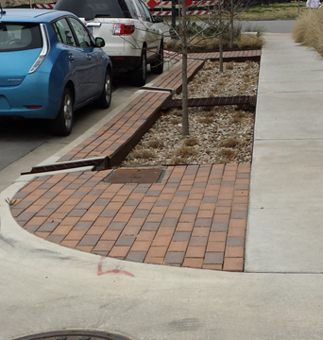
An Alternative: Infiltration Trench
Water flows in from gutter, and along the gravel bed, infiltrating as it goes,
and the remainder goes back out into the gutter again
Pike Powers Laboratory, 3924 Berkman Drive, Austin Texas

Slide 27
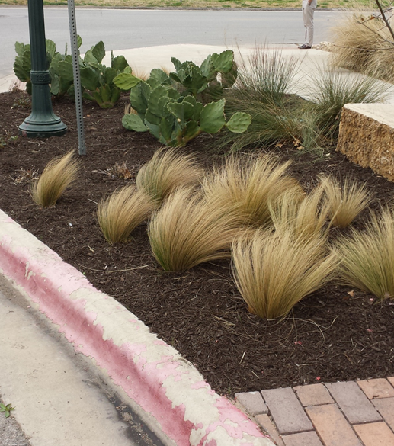
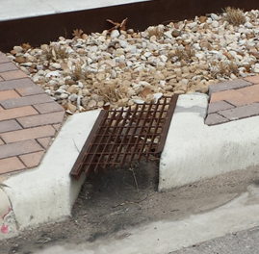
Low Impact Development Elements
Infiltration trench outfall
Alternative Plant Materials

Slide 28

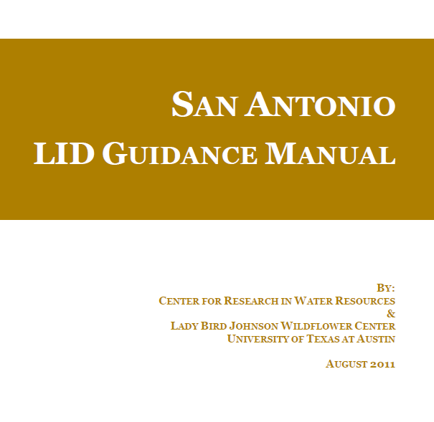
Water Quality Enhancement and Low Impact Development
Dr Michael Barrett
Design for sediment control
http://www.tceq.texas.gov/publications/rg/rg-348/rg-348.html

Slide 29
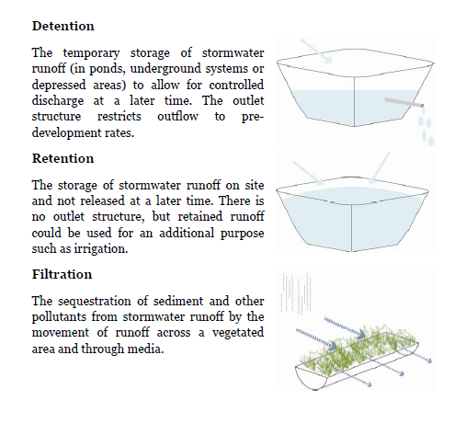
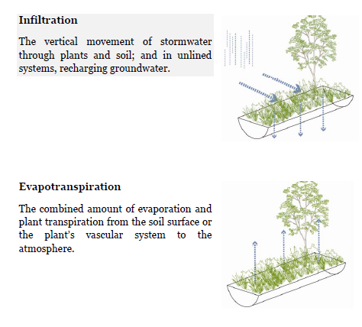
Definitions

Slide 30
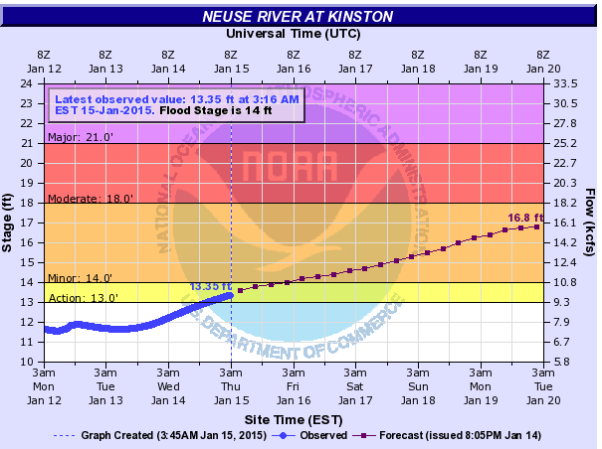
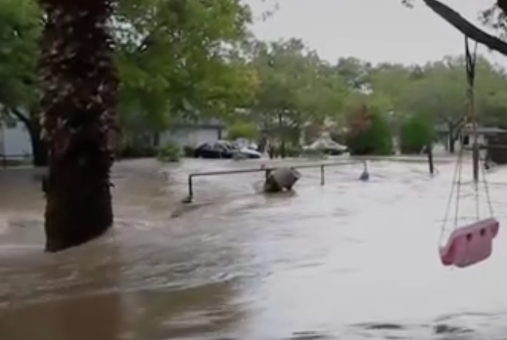
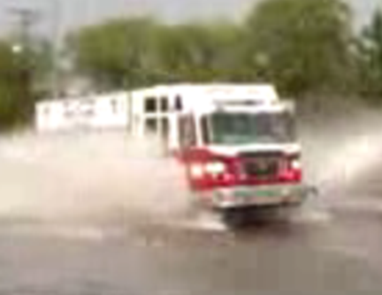
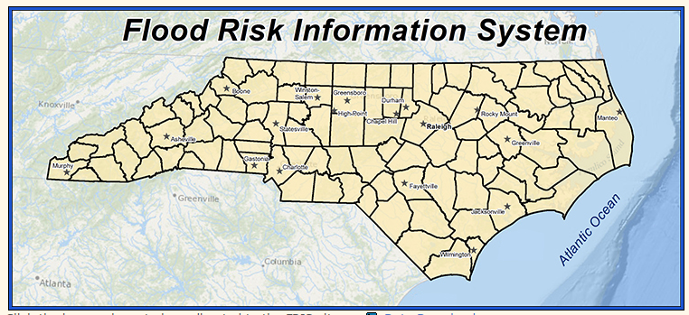
National Flood Interoperability Experiment:
Building a stronger flood forecasting system for citizens
National Weather Service
Citizens
Local and State Flood Managers
First Response Community

Slide 31

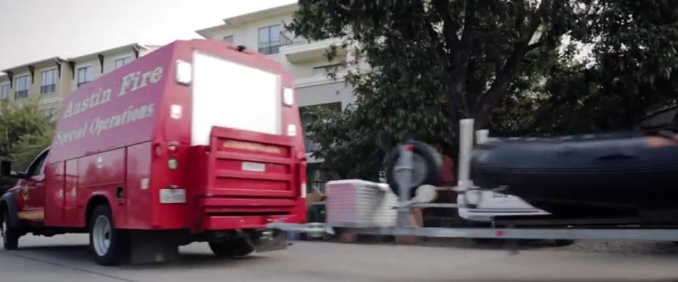
Link with the First Response Community
Harry Evans, Chief of Staff Austin Fire Department
Responsible for flood emergency response in Austin
https://www.youtube.com/watch?v=ympaR6YUxiA&feature=youtube

Slide 32
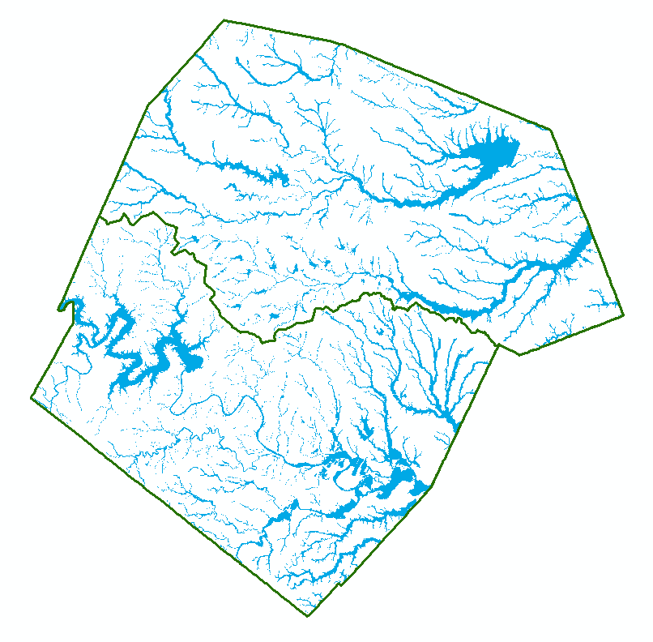
100-year floodplain for Travis and Williamson Counties
13% ( > 1/8) of the land is in the 100-year floodplain

Slide 33
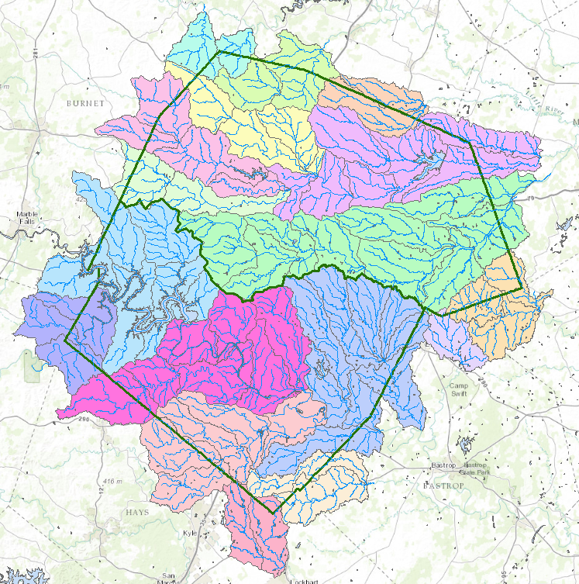
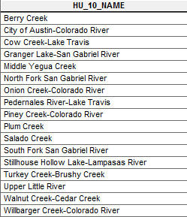
HUC-10 Watersheds for City of Austin-Colorado River
19 Watersheds: Prioritize and Rank in Order of Importance

Slide 34
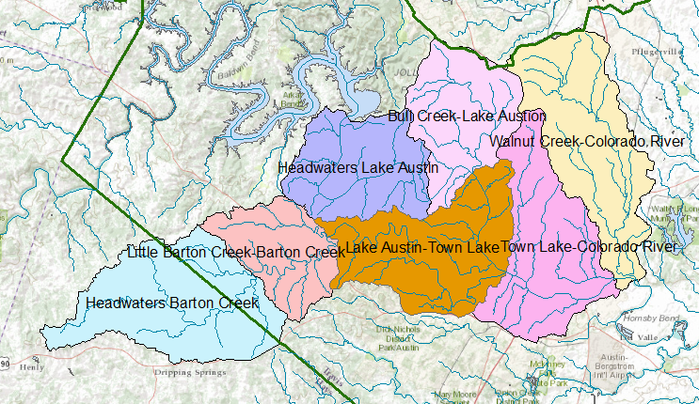
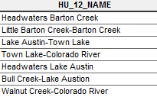
HUC-12 Subwatersheds in City of Austin-Colorado River HUC-10
Use these Units for Wide Area Flood Planning

Slide 35
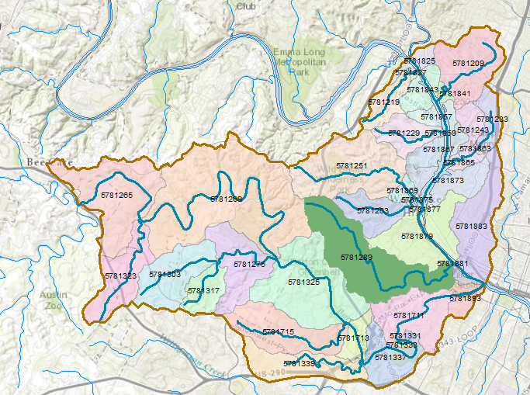
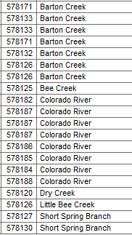
NHDPlus Catchments in Lake Austin-Town Lake HUC12 Subwatershed
Flood forecasting operates at this level. Each catchment has one stream reach.
A flow forecast is made for that stream reach

Slide 36
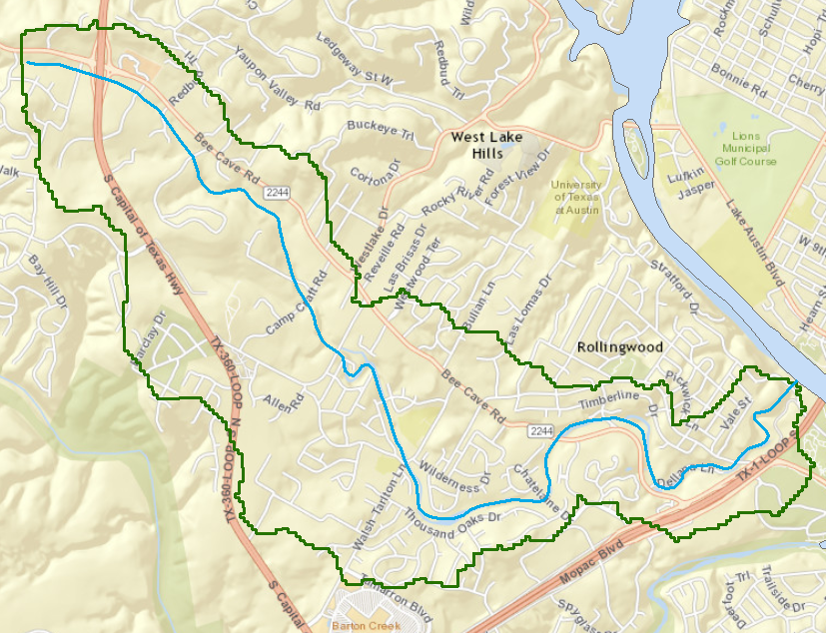
Dry Creek – Flood Response Mapping and Planning
Catchment 5781289

Slide 37
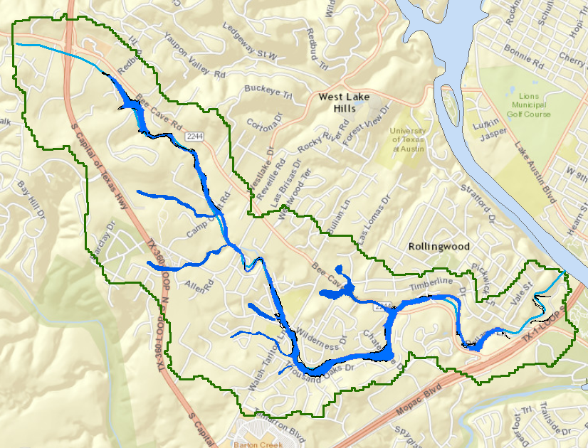
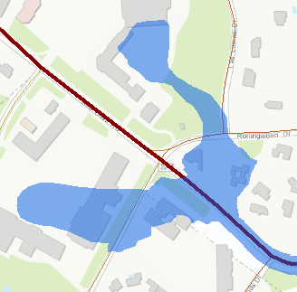
Dry Creek Floodplain
Identify buildings at flood risk

Slide 38
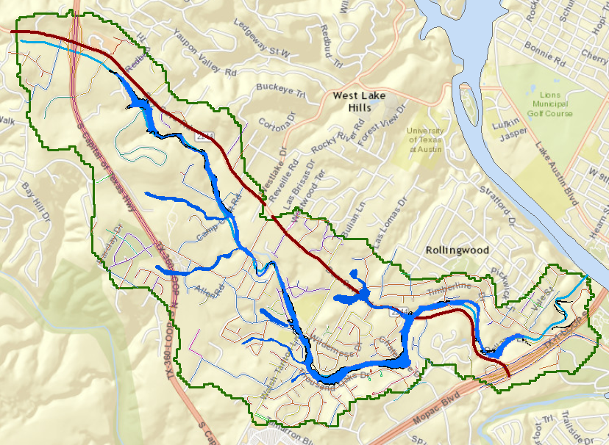
Dry Creek Transportation
Bee Cave Rd (FM 2244)
Identify streets with flood risk

Slide 39
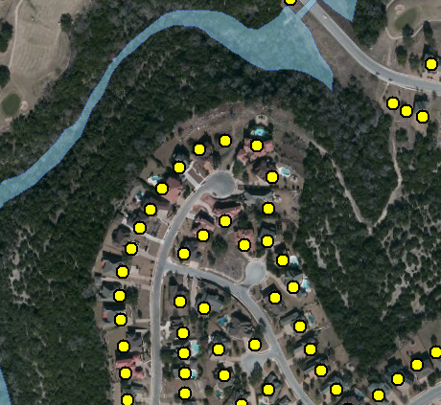
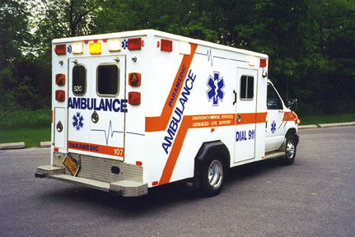

Address Points -- used for directing emergency response vehicles
All legal residences have an address point
Established when the lot is legally platted and registered with the county

Slide 40
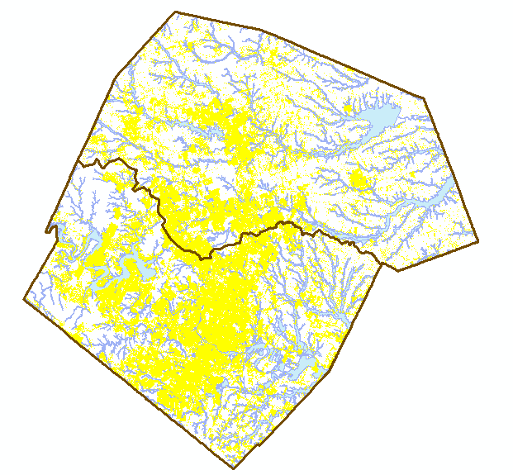
Address Points and the Flood Hazard Zone
Williamson County
495,000 Address points in the two counties
How many points are in the flood hazard zone?
Where are the high flood risk areas in these counties?
Travis County

Slide 41
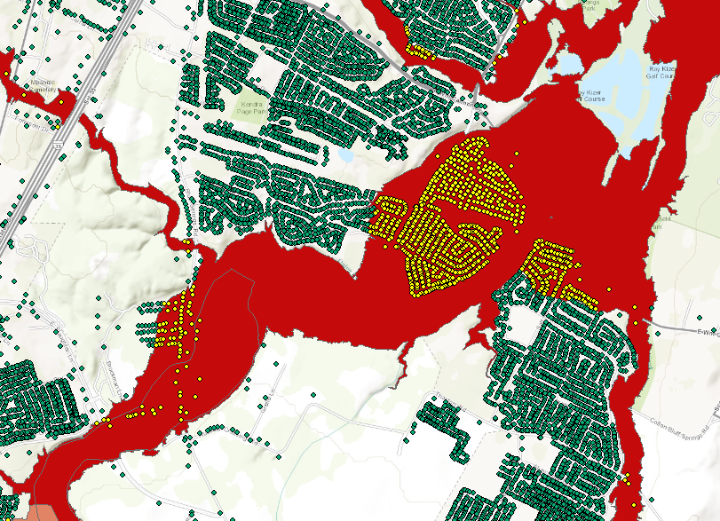

Address Points and the Floodplain

Slide 42
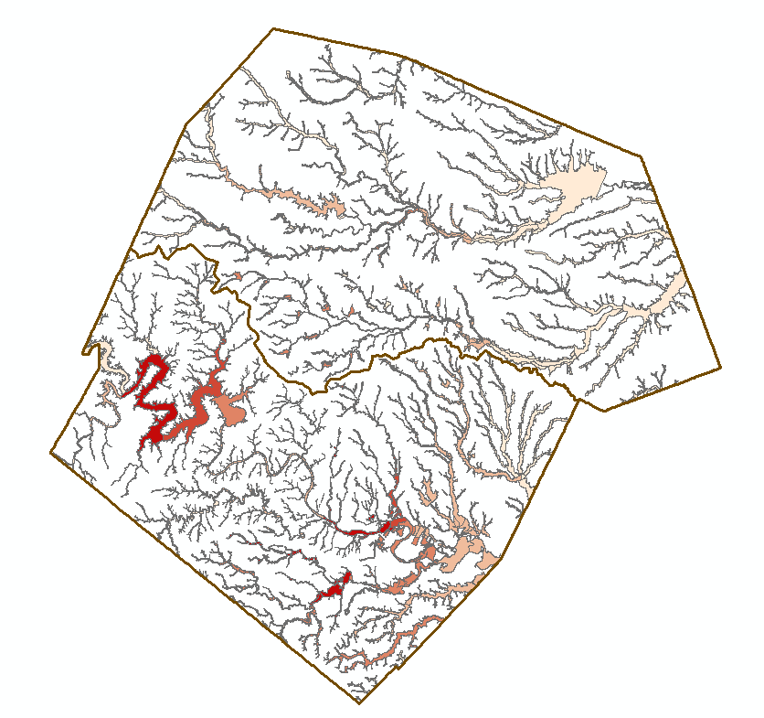
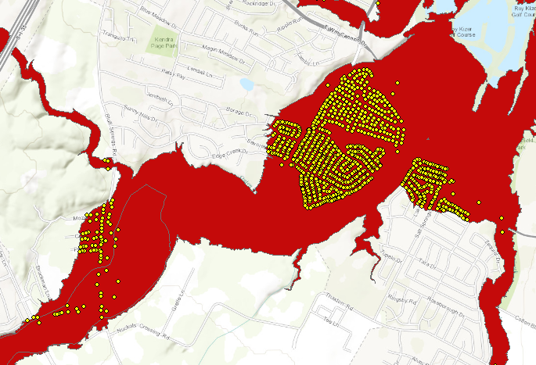

Address Points in the Floodplain
Address Points in Floodplain of Onion Creek
Floodpoints

Slide 43
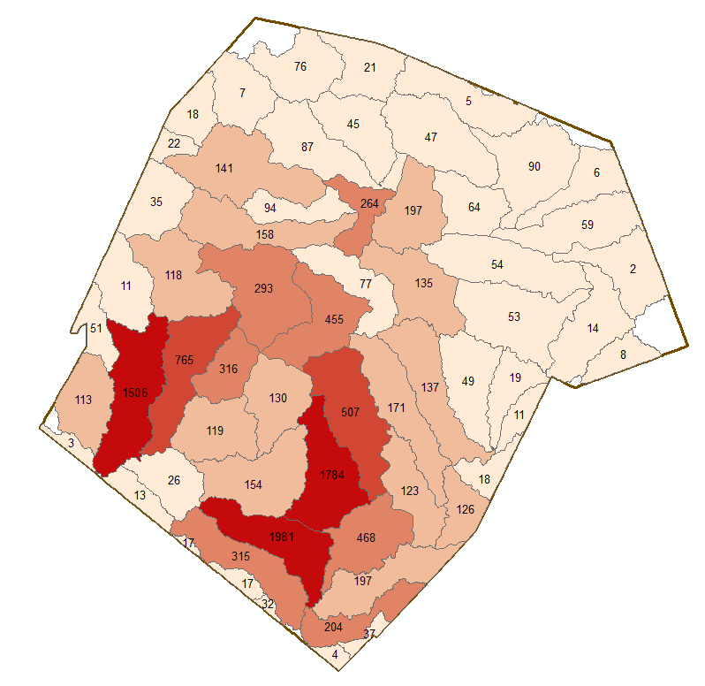

Address Points in Floodplain of a Subwatershed
Number of Address Points in the Floodplain
A total of 12,052 address points are in the floodplain out of 495,468 in the study region (2.5%)

Slide 44
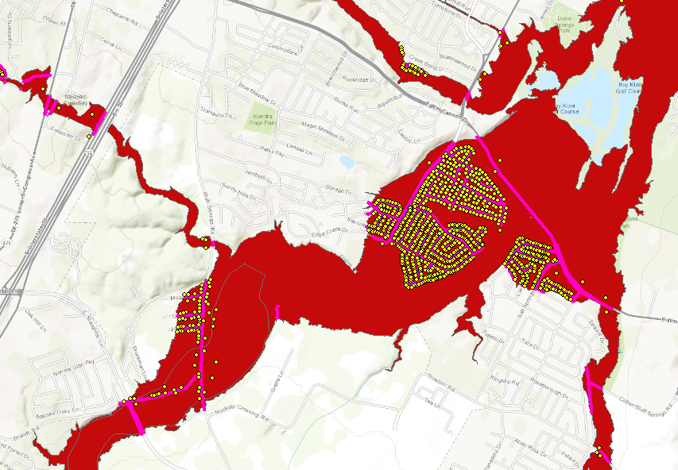

Address Points and Roads in Floodplain of Onion Creek

Slide 45
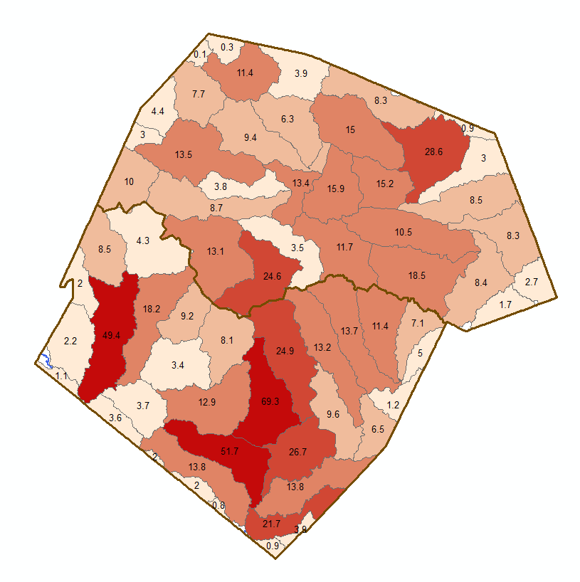

Length of Roads in Floodplain of a Subwatershed
Length of Roads in Floodplain (Km)
A total of 711 km of roads are in the floodplain out of 14,732 km in the study region (4.8%)

Slide 46
Summary
We will focus on three design subjects
  Stormwater conveyance
  Stormwater hydrology and storage
  Water Quality Enhancement and Low Impact Development (Dr Michael Barrett)
We will work in the context of the UT Campus and Waller Creek for “local” projects
We will leverage the GIS, hydrology and hydraulic database being developed for the National Flood Interoperability Experiment in Travis and Williamson Counties for projects elsewhere in this area

