Slide 1
Geodesy, Map Projections and Coordinate Systems
Geodesy - the shape of the earth and definition of earth datums
Map Projection - the transformation of a curved earth to a flat map
Coordinate systems - (x,y,z) coordinate systems for map data

Slide 2
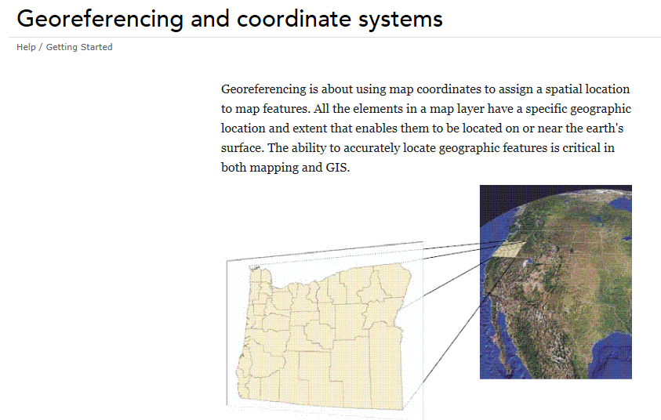
Readings: Introduction
http://resources.arcgis.com/en/help/main/10.1/index.html#//00v20000000q000000

Slide 3
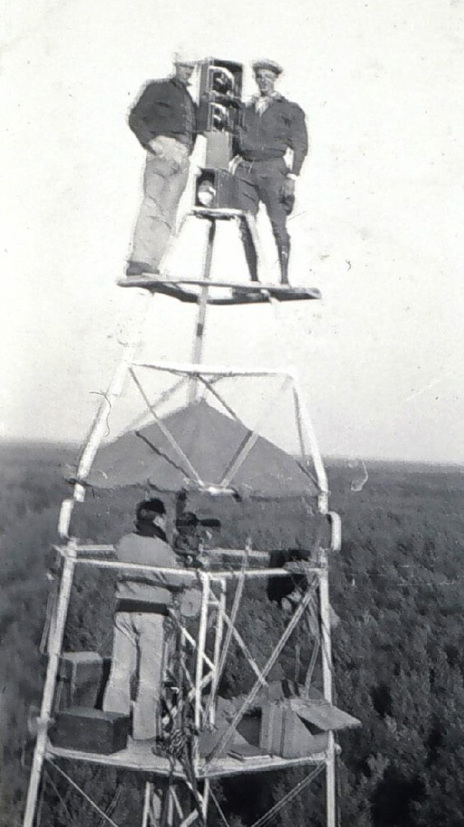
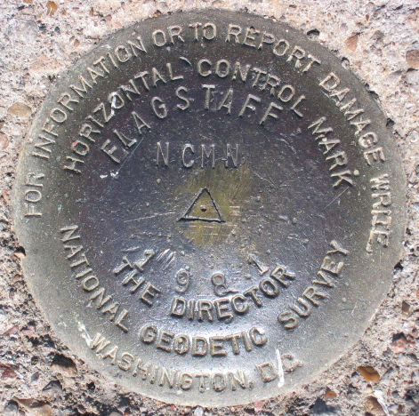
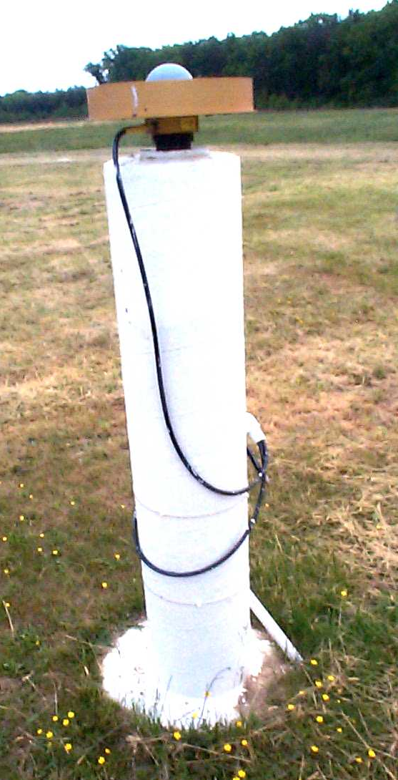
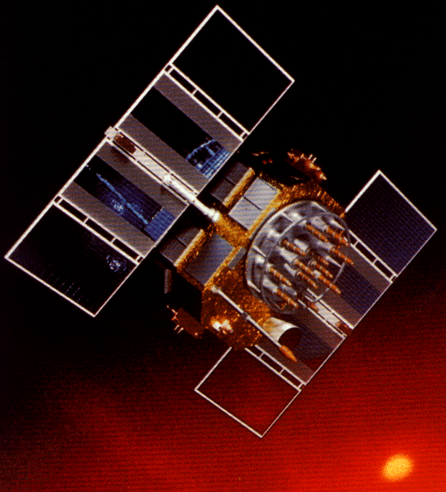
Revolution in Earth Measurement
Some images and slides from Michael Dennis, National Geodetic Survey and Lewis Lapine, South Carolina Geodetic Survey
Traditional Surveying uses benchmarks as reference points
Global Positioning uses fixed GPS receivers as reference points (Continuously Operating Reference System, CORS)

Slide 4
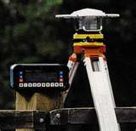
Differential GPS
Differential GPS uses the time sequence of observed errors at fixed locations to adjust simultaneous measurements at mobile receivers
A location measurement accurate to 1 cm horizontally and 2cm vertically is now possible in 3 minutes with a mobile receiver
More accurate measurements if the instrument is left in place longer

Slide 5
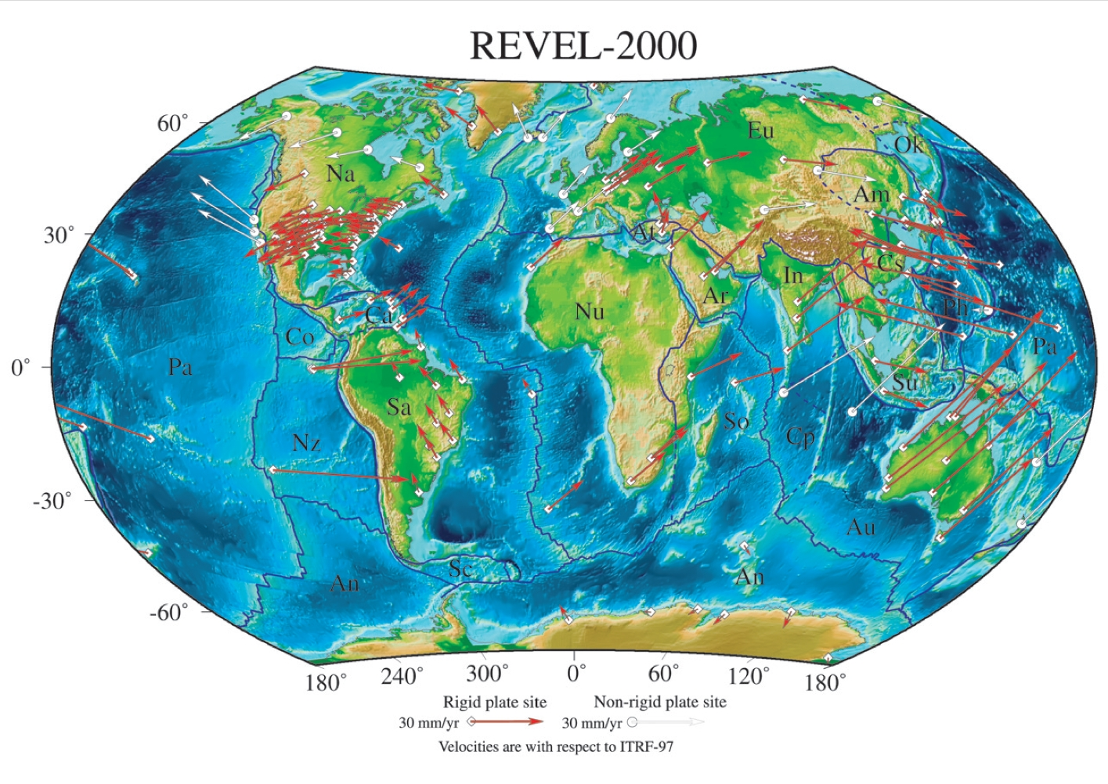
Tectonic Motions
This has to take Tectonic Motions into account
From Sella et al., 2002

Slide 6
Types of Coordinate Systems
(1) Global Cartesian coordinates (x,y,z) for the whole earth
(2) Geographic coordinates (φ, λ, z)
(3) Projected coordinates (x, y, z) on a local area of the earth’s surface
The z-coordinate in (1) and (3) is defined geometrically; in (2) the z-coordinate is defined gravitationally

Slide 7
Geographic Coordinates (φ, λ, z)
Latitude (φ) and Longitude (λ) defined using an ellipsoid, an ellipse rotated about an axis
Elevation (z) defined using geoid, a surface of constant gravitational potential
Earth datums define standard values of the ellipsoid and geoid

Slide 8
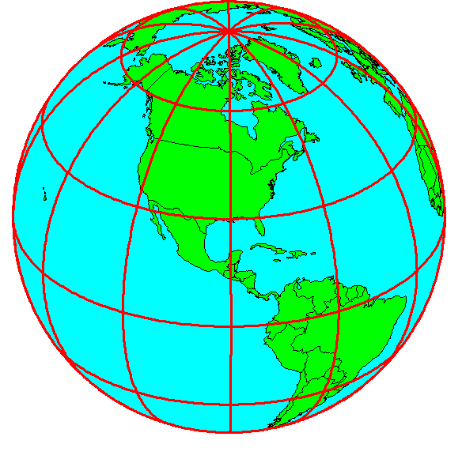
Shape of the Earth
It is actually a spheroid, slightly larger in radius at the equator than at the poles
We think of the
earth as a sphere

Slide 9
Ellipse
An ellipse is defined by:
Focal length = ε
Distance (F1, P, F2) is
constant for all points
on ellipse
When ε = 0, ellipse = circle
Z
b
O
a
X
F₁
ε
ε
F₂
For the earth:
Major axis, a = 6378 km
Minor axis, b = 6357 km
Flattening ratio, f = (a-b)/a
~ 1/300
P

Slide 10
Ellipsoid or Spheroid
Rotate an ellipse around an axis
Z
b
O
a
Y
a
X
Rotational axis

Slide 11
Standard Ellipsoids
Ref: Snyder, Map Projections, A working manual, USGS
Professional Paper 1395, p.12

Slide 12
Geodetic Datums
World Geodetic System (WGS) – is a global system for defining latitude and longitude on earth independently of tectonic movement (military)
North American Datum (NAD) – is a system defined for locating fixed objects on the earth’s surface and includes tectonic movement (civilian)

Slide 13
Horizontal Earth Datums
An earth datum is defined by an ellipse and an axis of rotation
NAD27 (North American Datum of 1927) uses the Clarke (1866) ellipsoid on a non geocentric axis of rotation
NAD83 (NAD,1983) uses the GRS80 ellipsoid on a geocentric axis of rotation
WGS84 (World Geodetic System of 1984) uses GRS80, almost the same as NAD83

Slide 14
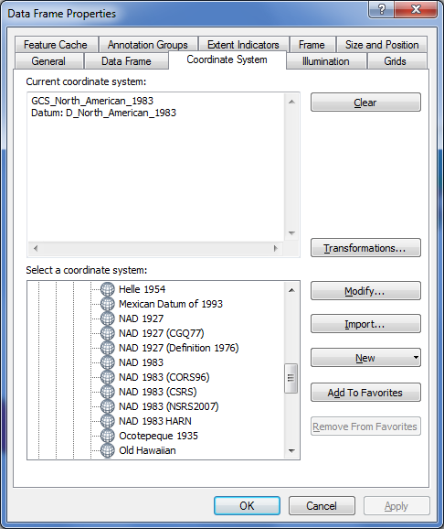

Adjustments of the NAD83 Datum
Slightly different (φ, λ) for benchmarks
Continuously Operating Reference System
Canadian Spatial Reference System
National Spatial Reference System
High Accuracy Reference Network

Slide 15
Representations of the Earth
Mean Sea Level is a surface of constant
gravitational potential called the Geoid
Sea surface
Ellipsoid
Earth surface
Geoid

Slide 16
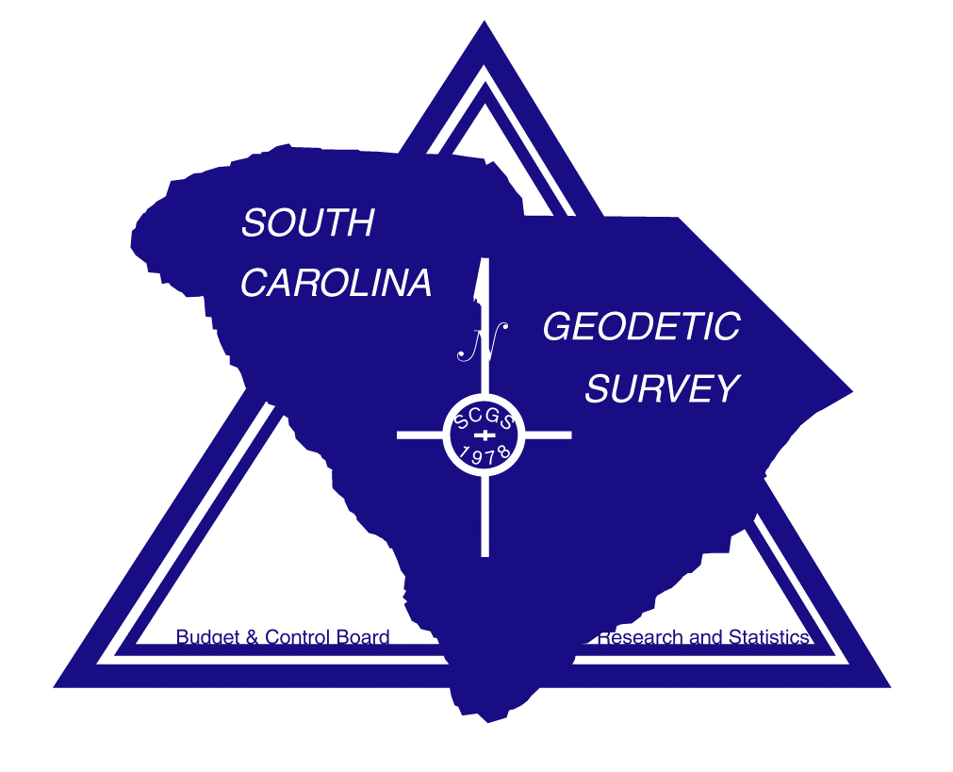
THE GEOID AND TWO ELLIPSOIDS
CLARKE 1866 (NAD27)
GRS80-WGS84
(NAD83)
Earth Mass
Center
Approximately
236 meters
GEOID

Slide 17

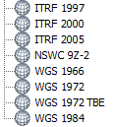
WGS 84 and NAD 83
North American Datum of 1983 (NAD 83) (Civilian Datum of US)
International Terrestrial Reference Frame (ITRF) includes updates to WGS-84 (~ 2 cm)
Earth Mass
Center
2.2 m (3-D)
dX,dY,dZ
World Geodetic System of 1984 (WGS 84) is reference frame for Global Positioning Systems
GEOID

Slide 18
Definition of Latitude, φ
m
S
p
O
n
φ
q
r
(1) Take a point S on the surface of the ellipsoid and define there the tangent plane, mn
(2) Define the line pq through S and normal to the
tangent plane
(3) Angle pqr which this line makes with the equatorial
plane is the latitude φ, of point S

Slide 19
Cutting Plane of a Meridian
P
Prime Meridian
Equator
Meridian
plane

Slide 20
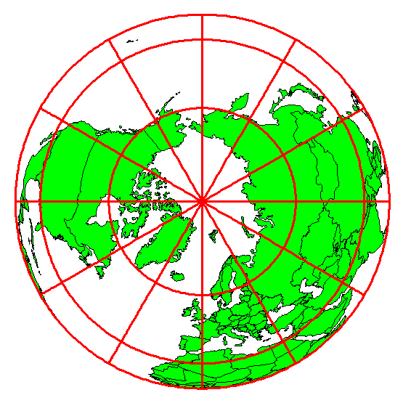
Definition of Longitude, λ
λ = the angle between a cutting plane on the prime meridian
and the cutting plane on the meridian through the point, P
180°E, W
-150°
150°
-120°
120°
90°W
(-90 °)
90°E
(+90 °)
-60°
P
λ
-60°
-30°
30°
0°E, W

Slide 21
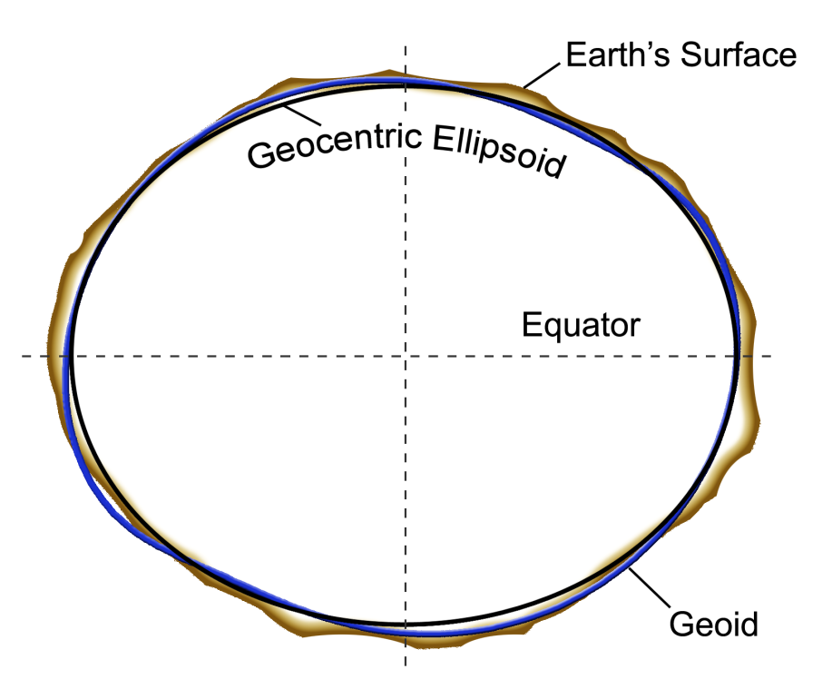
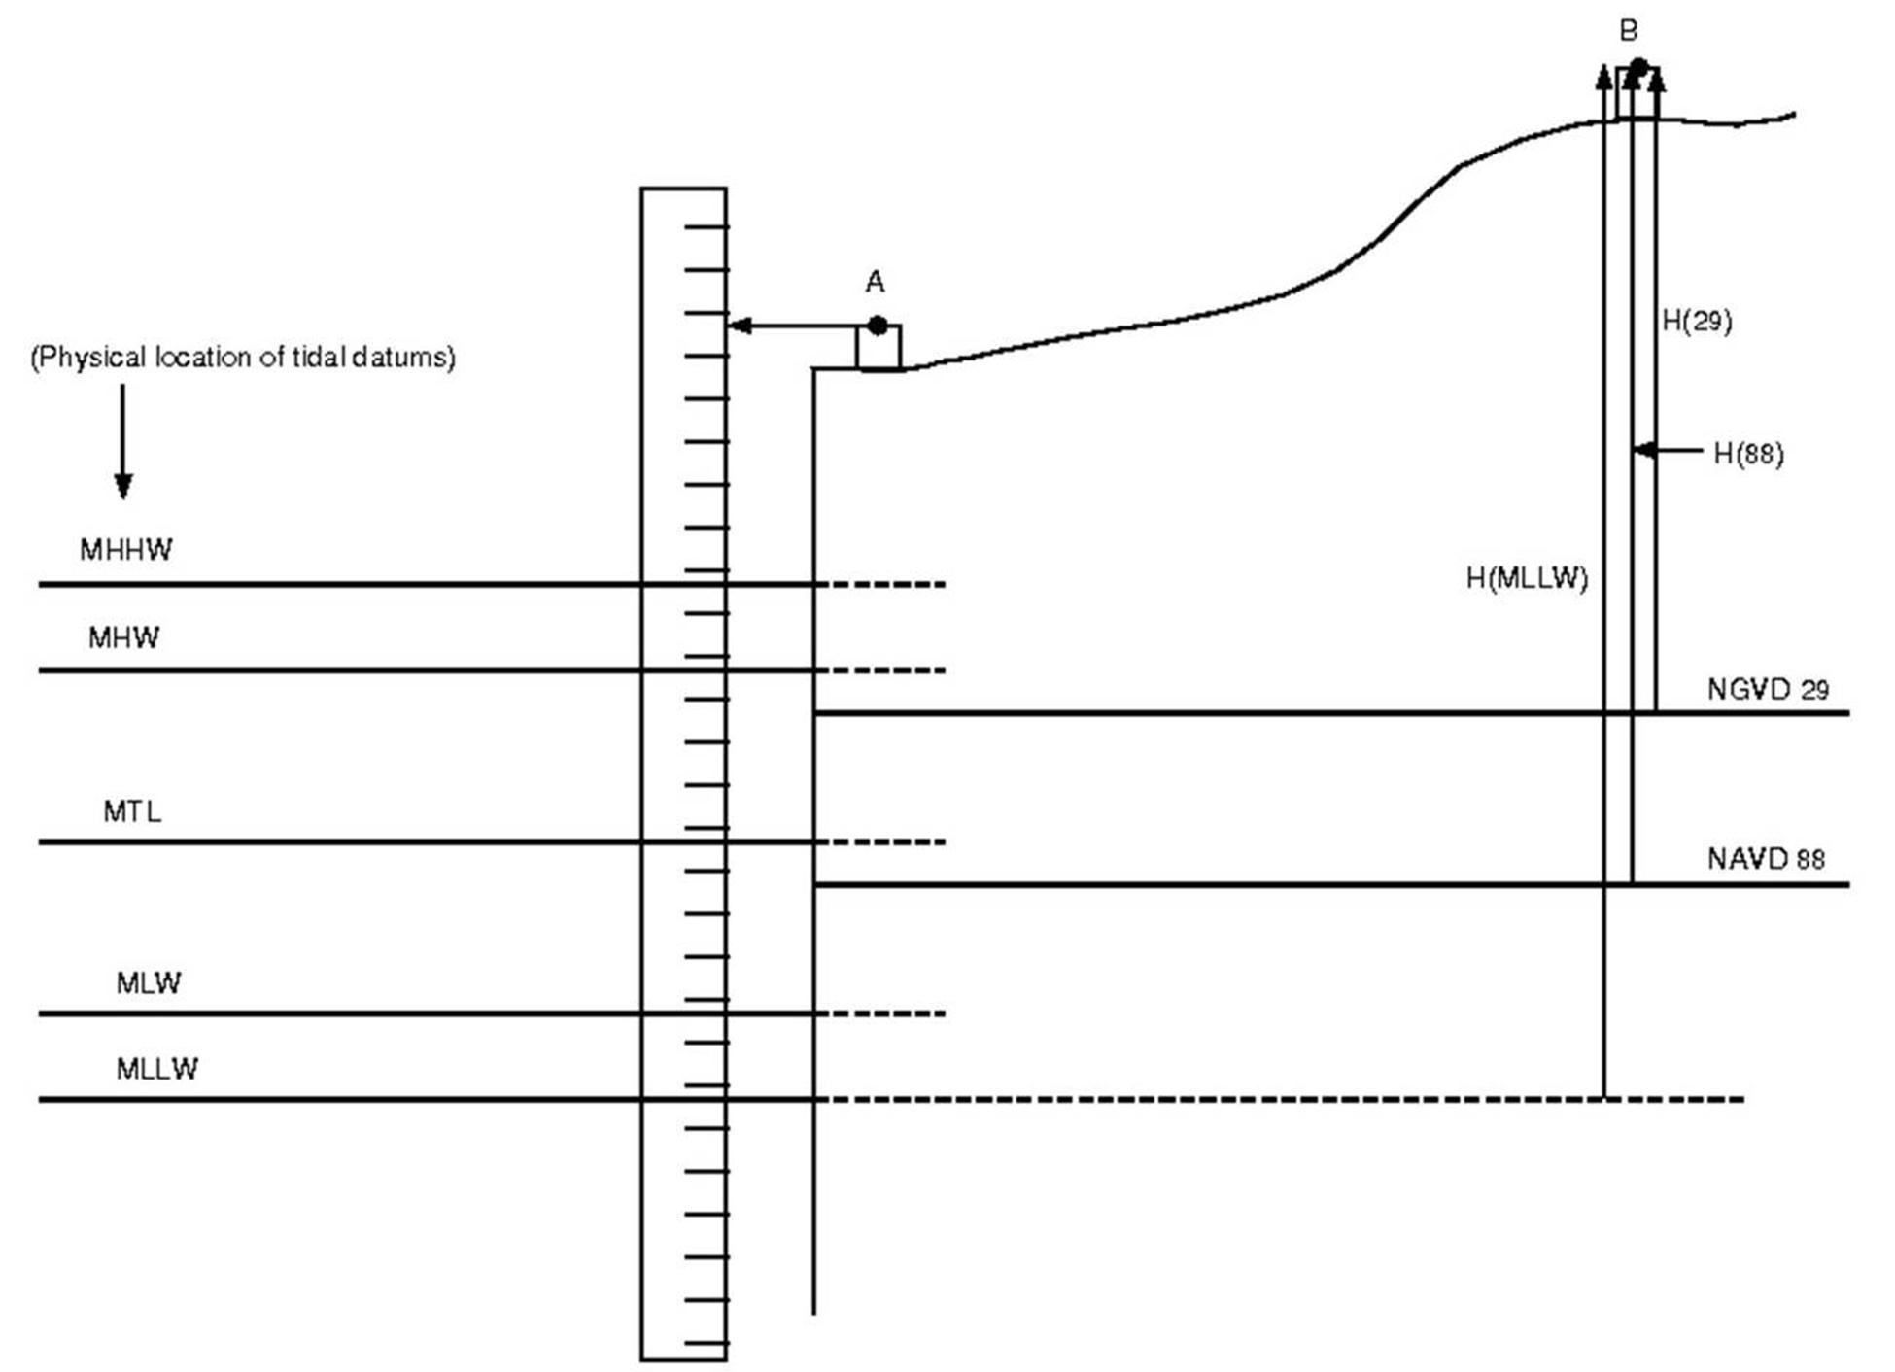
Three systems for measuring elevation
Orthometric heights
(land surveys, geoid)
Ellipsoidal heights
(lidar, GPS)
Tidal heights
(Sea water level)
Conversion among these height systems has some uncertainty

Slide 22
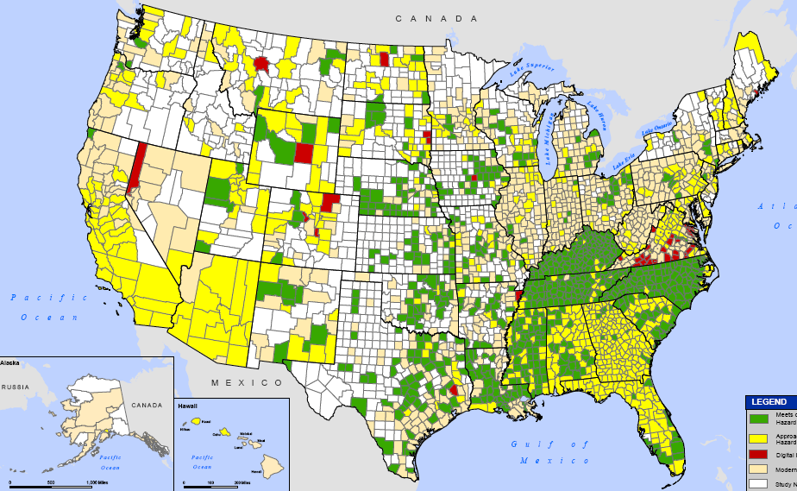
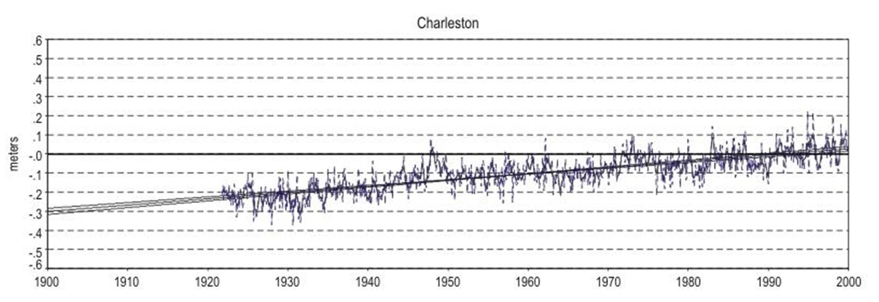
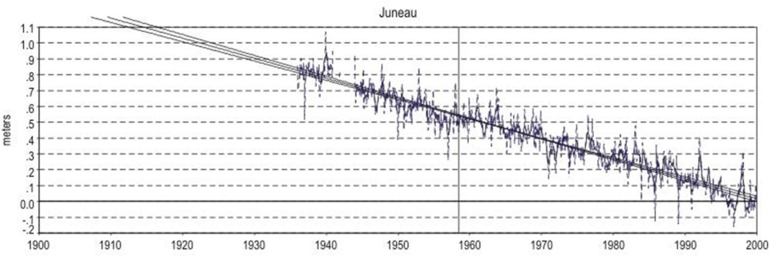
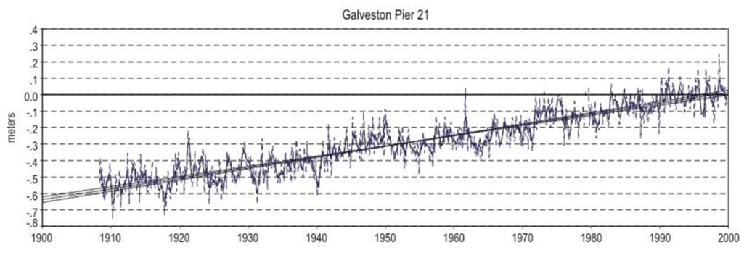
Trends in Tide Levels
(coastal flood risk is changing)
Charleston, SC
+ 1.08 ft/century
1900
2000
Galveston, TX
+ 2.13 ft/century
- 4.16 ft/century
1900
2000
Juneau, AK
1900
2000

Slide 23
Geoid and Ellipsoid
Earth surface
Ellipsoid
Ocean
Geoid
Gravity Anomaly
Gravity anomaly is the elevation difference between
a standard shape of the earth (ellipsoid) and a surface
of constant gravitational potential (geoid)

Slide 24
Definition of Elevation
Elevation Z
P
z = z_{p}
•
z = 0
Land Surface
Mean Sea level = Geoid
Elevation is measured from the Geoid

Slide 25
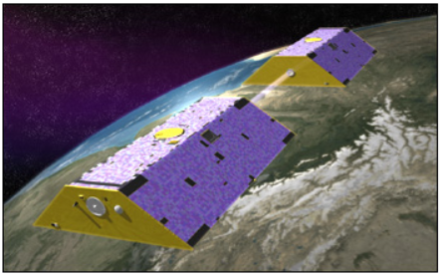
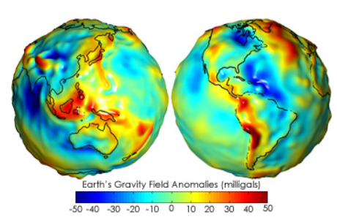
Gravity Recovery and Climate Experiment (GRACE)
http://earthobservatory.nasa.gov/Features/GRACE/
NASA Mission launched in 2002
Designed to measure gravity anomaly of the earth
Two satellites, 220 km apart, one leading, one trailing
Distance between them measured by microwave to 2µm
High gravity force pulls satellites together
Lower gravity force, lets them fly apart more
Gravity anomaly = difference from average

Slide 26
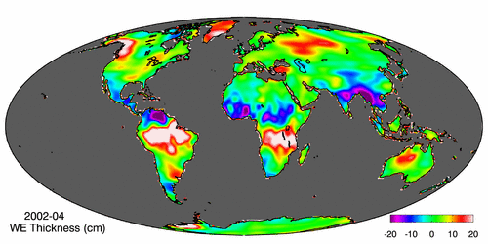
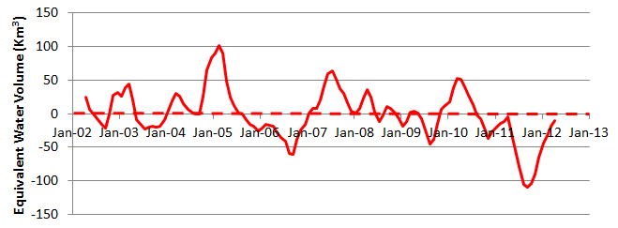
Gravity Recovery and Climate Experiment (GRACE)
Force of gravity responds to changes in water volume
Water is really heavy! Gravity is varying in time and space.
Gravity Anomaly of Texas, 2002 – 2012
Normal
In 2011, we lost 100 Km³ of water or 3 Lake Mead’s

Slide 27
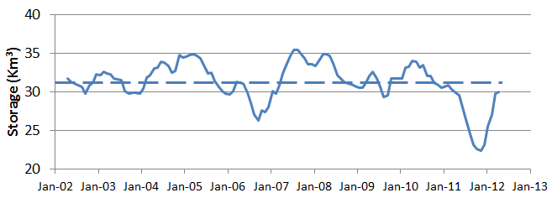

GRACE and Texas Reservoir Water Storage
Surface water reservoir storage is closely correlated with the GRACE data
Grace Satellites
Normal
In 2011 we lost 100 Km³ of water overall
Surface Water Reservoirs
Normal
In 2011 we lost 9 Km³ of water from reservoirs

Slide 28
Vertical Earth Datums
A vertical datum defines elevation, z
NGVD29 (National Geodetic Vertical Datum of 1929)
NAVD88 (North American Vertical Datum of 1988)
takes into account a map of gravity anomalies between the ellipsoid and the geoid

Slide 29
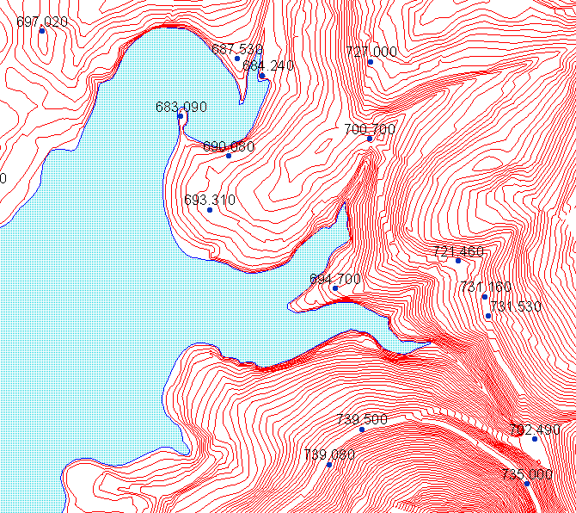
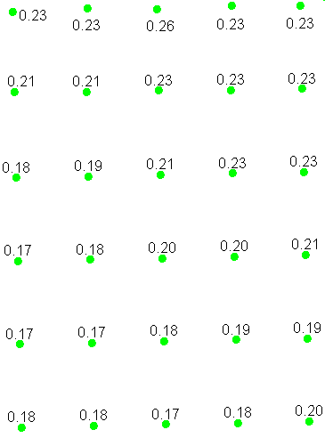
Converting Vertical Datums
Corps program Corpscon (not in ArcInfo)
  http://crunch.tec.army.mil/software/corpscon/corpscon.html
Point file attributed with the elevation difference between NGVD 29 and NAVD 88
NGVD 29 terrain + adjustment
= NAVD 88 terrain elevation

Slide 30
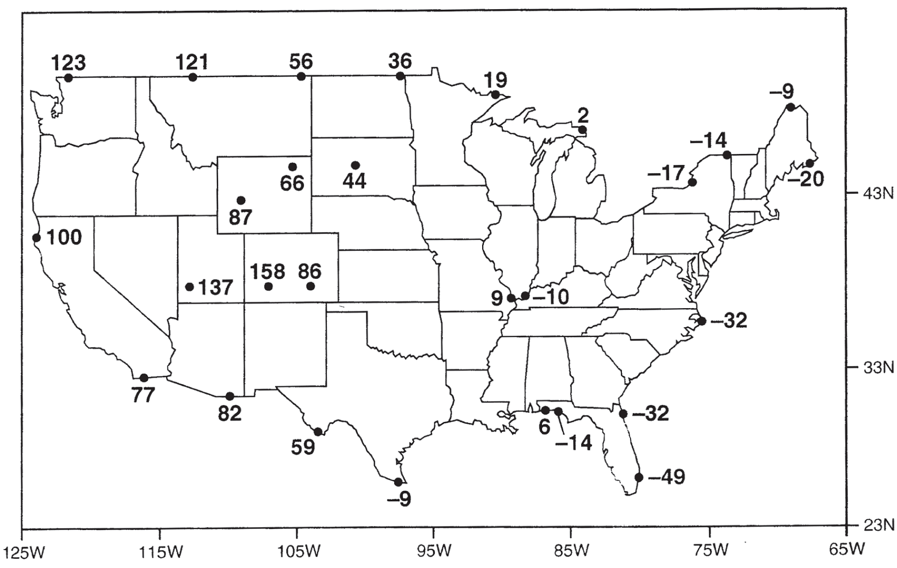
Importance of geodetic datums
NAVD88 – NGVD29 (cm)
NGVD29 higher in East
More than 1 meter difference
NAVD88 higher in West
Orthometric datum height shifts are significant relative to BFE accuracy, so standardization on NAVD88 is justified

Slide 31
Geodesy and Map Projections
Geodesy - the shape of the earth and definition of earth datums
Map Projection - the transformation of a curved earth to a flat map
Coordinate systems - (x,y) coordinate systems for map data

Slide 32
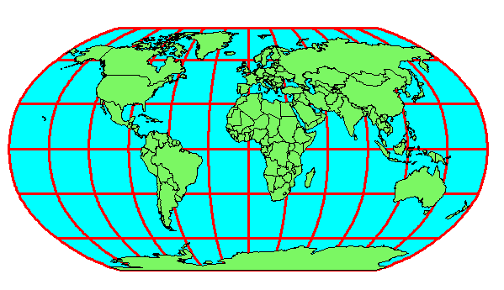
Earth to Globe to Map
Map Scale:
Map Projection:
Representative Fraction
Globe distance
Earth distance
Scale Factor
Map distance
Globe distance
=
=
(e.g. 1:24,000)
(e.g. 0.9996)

Slide 33
Types of Projections
Conic (Albers Equal Area, Lambert Conformal Conic) - good for East-West land areas
Cylindrical (Transverse Mercator) - good for North-South land areas
Azimuthal (Lambert Azimuthal Equal Area) - good for global views

Slide 34
Conic Projections
(Albers, Lambert)

Slide 35
Cylindrical Projections
(Mercator)
Transverse
Oblique

Slide 36
Azimuthal
(Lambert)

Slide 37
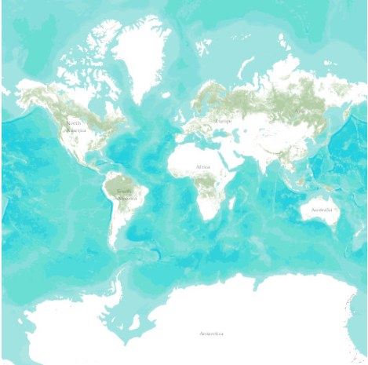
Web Mercator Projection
(used for ESRI Basemaps)
Web Mercator is one of the most popular coordinate systems used in web applications because it fits the entire globe into a square area that can be covered by 256 by 256 pixel tiles.
The spatial reference for the ArcGIS Online / Google Maps / Bing Maps tiling scheme is WGS 1984 Web Mercator (Auxiliary Sphere).

Slide 38
Coordinate Systems
Universal Transverse Mercator (UTM) - a global system developed by the US Military Services
State Plane Coordinate System - civilian system for defining legal boundaries
Texas Centric Mapping System - a statewide coordinate system for Texas

Slide 39
Coordinate System
A planar coordinate system is defined by a pair
of orthogonal (x,y) axes drawn through an origin
Y
Origin
X
(x_{o},y_{o})
(φ_{o},λ_{o})

Slide 40
Universal Transverse
Mercator
Uses the Transverse Mercator projection
Each zone has a Central Meridian (λ_{o}), zones are 6° wide, and go from pole to pole
60 zones cover the earth from East to West
Reference Latitude (φ_{o}), is the equator
(Xshift, Yshift) = (x_{o},y_{o}) = (500000, 0) in the Northern Hemisphere, units are meters

Slide 41
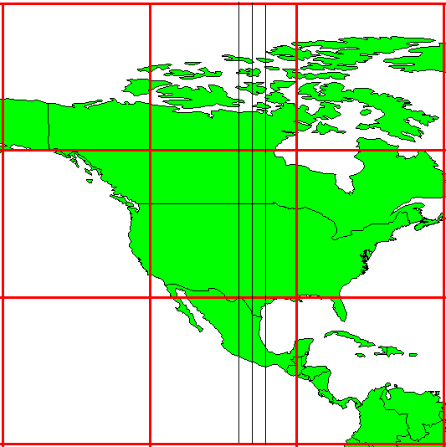
UTM Zone 14
-99°
-102°
-96°
6°
Origin
Equator
-120°
-90 °
-60 °

Slide 42
State Plane Coordinate System
Defined for each State in the United States
East-West States (e.g. Texas) use Lambert Conformal Conic, North-South States (e.g. California) use Transverse Mercator
Texas has five zones (North, North Central, Central, South Central, South) to give accurate representation
Greatest accuracy for local measurements

Slide 43
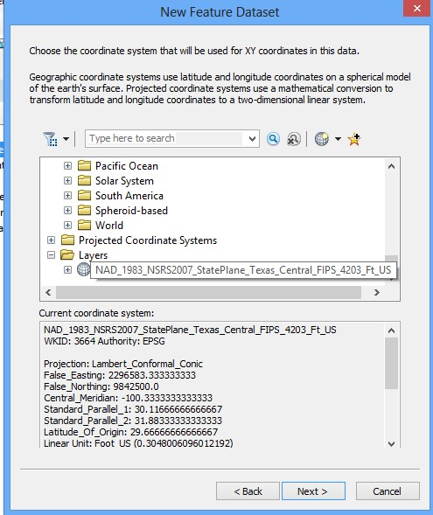
ArcGIS Spatial Reference Frames
Defined for a feature dataset in ArcCatalog
XY Coordinate System
  Projected
  Geographic
Z Coordinate system
Domain, resolution and tolerance

