Slide 1
Rainfall and Runoff
Reading: Haested Section 2.4 Computing Hydrographs

Slide 2
Excess Rainfall and Direct Runoff
Rainfall that is neither retained on the land surface nor infiltrated into the soil
Graph of excess rainfall versus time is called excess rainfall hyetograph
Direct runoff = observed streamflow - baseflow
Excess rainfall = observed rainfall - abstractions
Abstractions/losses – difference between total rainfall hyetograph and excess rainfall hyetograph

Slide 3
SCS method
Soil conservation service (SCS) method is an experimentally derived method to determine rainfall excess using information about soils, vegetative cover, hydrologic condition and antecedent moisture conditions
The method is based on the simple relationship that P_{e} = P - F_{a} – I_{a}
P_{e} is runoff depth, P is precipitation depth, F_{a} is continuing abstraction, and I_{a} is the sum of initial losses (depression storage, interception, ET)
Precipitation
Time

Slide 4
Abstractions – SCS Method
In general
After runoff begins
Potential runoff
SCS Assumption
Combining SCS assumption with P=P_{e}+I_{a}+F_{a}
Precipitation
Time

Slide 5
SCS Method (Cont.)
Experiments showed
So
Surface
  Impervious: CN = 100
  Natural: CN < 100

Slide 6
SCS Method (Cont.)
SCS Curve Numbers depend on soil conditions
Group | Minimum Infiltration Rate (in/hr) | Hydrologic Soil Group
A | 0.3 – 0.45 | High infiltration rates. Deep, well drained sands and gravels
B | 0.15 – 0.30 | Moderate infiltration rates. Moderately deep, moderately well drained soils with moderately coarse textures (silt, silt loam)
C | 0.05 – 0.15 | Slow infiltration rates. Soils with layers, or soils with moderately fine textures (clay loams)
D | 0.00 – 0.05 | Very slow infiltration rates. Clayey soils, high water table, or shallow impervious layer

Slide 7
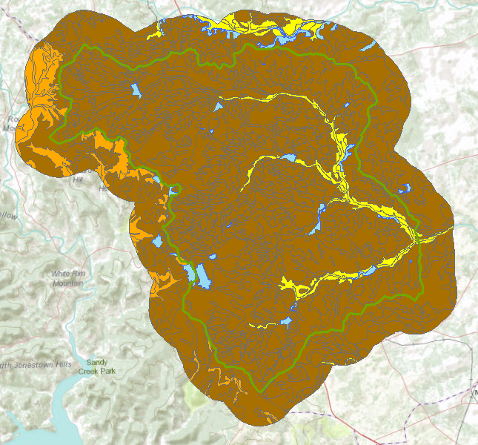

Hydrologic Soil Group in Brushy Creek
Water

Slide 8
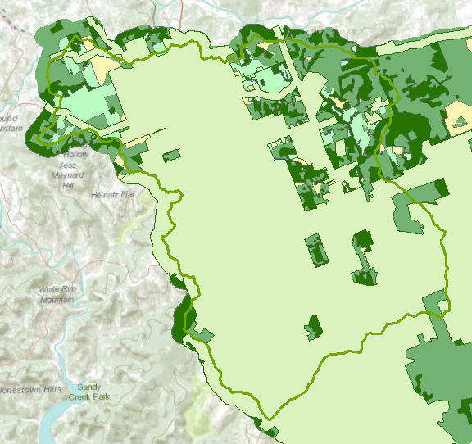

Land Cover
Interpreted from remote sensing

Slide 9
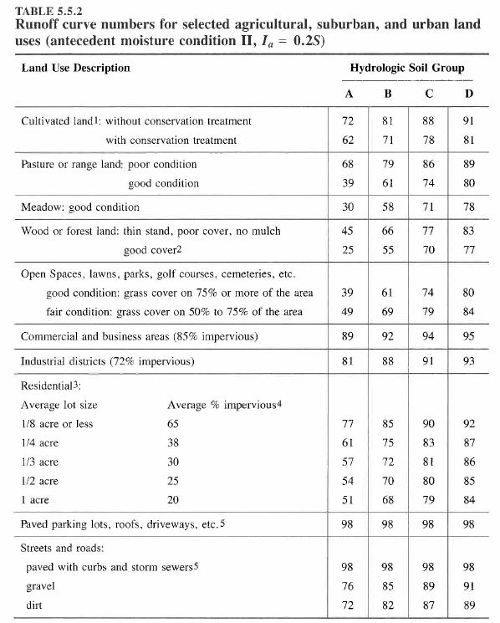
CN Table

Slide 10
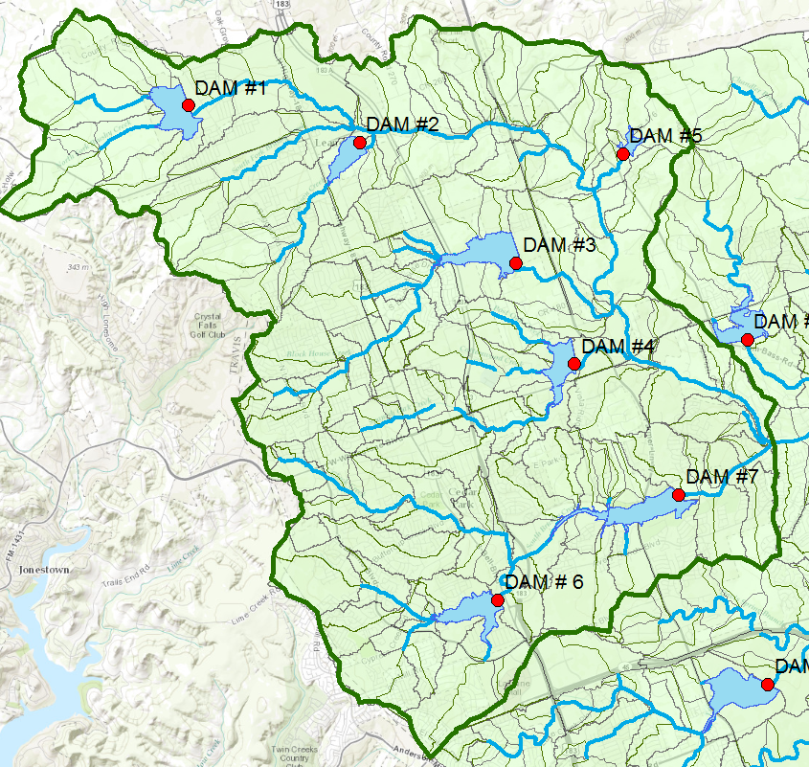
Upper Brushy Creek Watershed

Slide 11
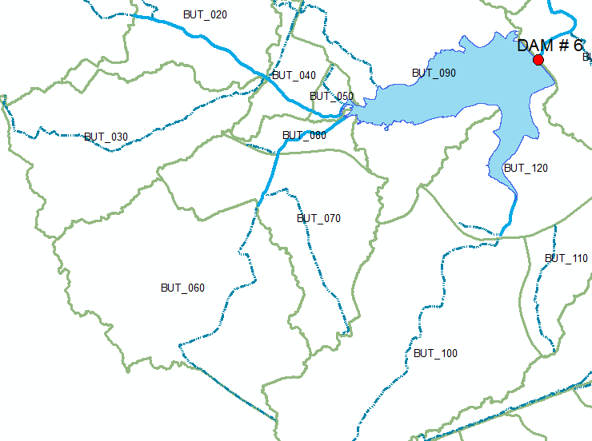
Watersheds upstream of Dam 6

Slide 12
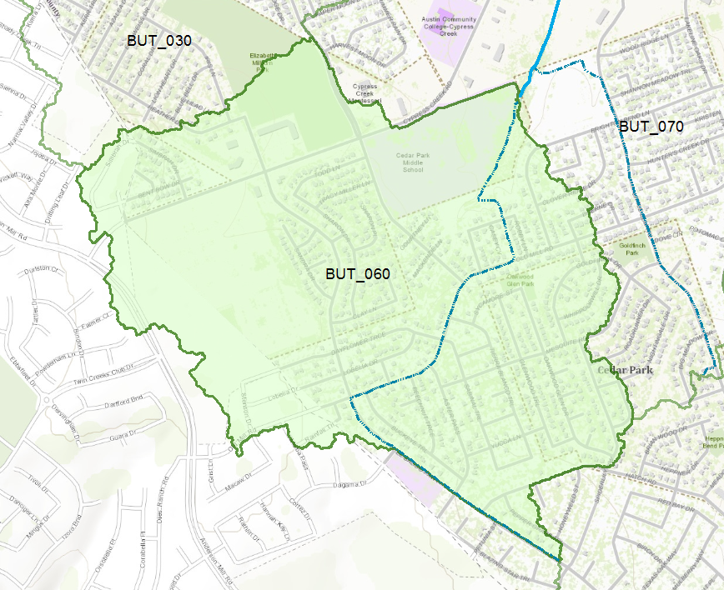
Subbasin BUT_060

Slide 13
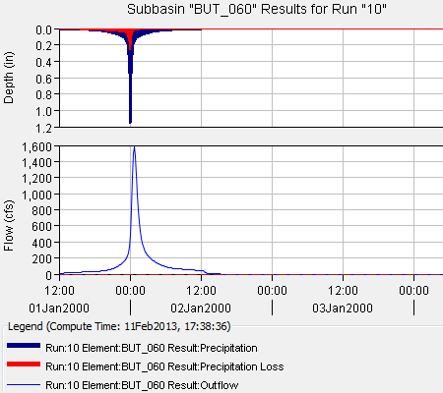
HEC-HMS simulation of Subbasin
Two questions:
How much of the precipitation becomes “losses” and how much becomes runoff
What is the time lag between the time that the rainfall occurs over the subbasin and the time the runoff appears at the outlet?

Slide 14
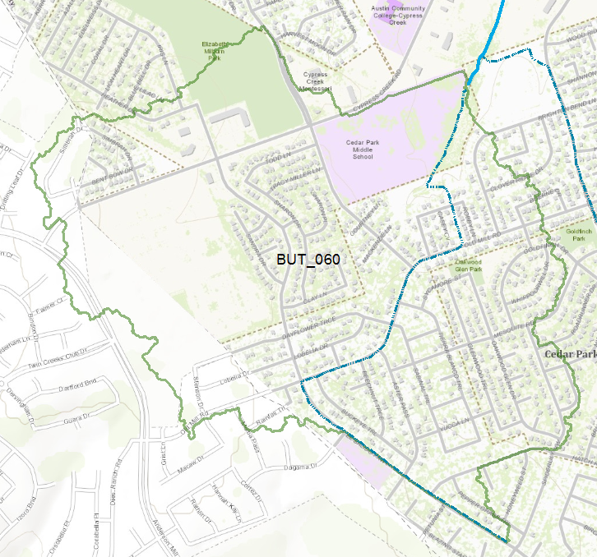
Land Use in BUT_060
Park
School

Slide 15
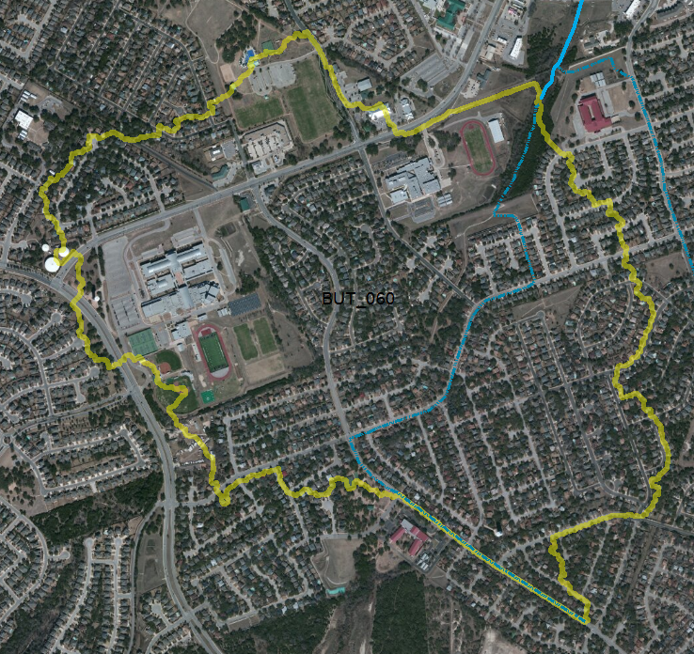
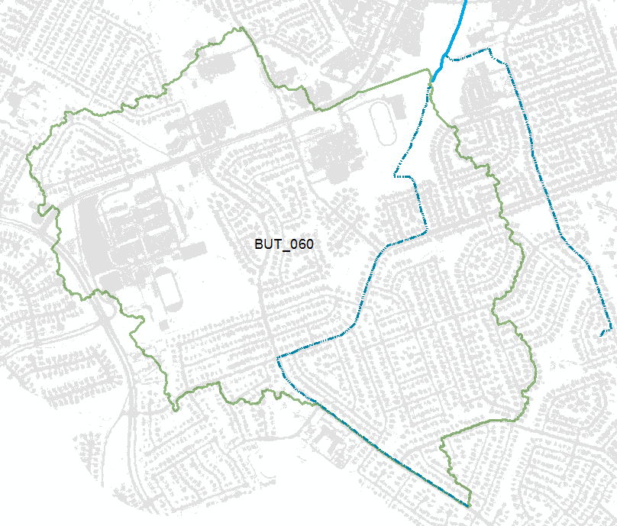
Imagery and Impervious Cover
42% of land cover is impervious

Slide 16
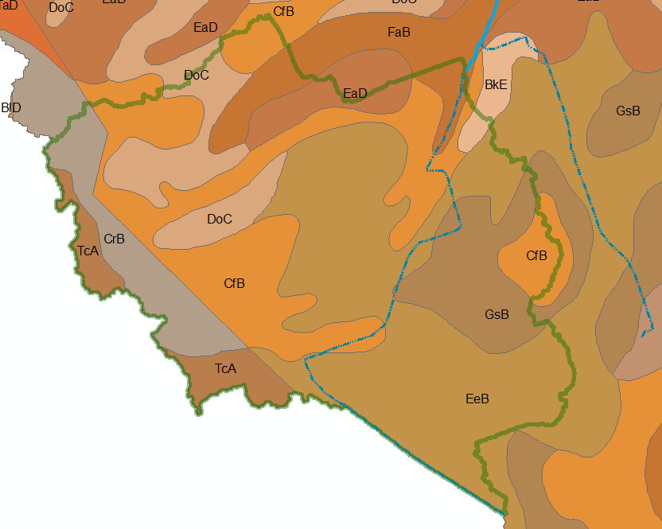
Soil Map Units
All soils in this Subbasin are classified as SCS Class D (very limited drainage)

Slide 17
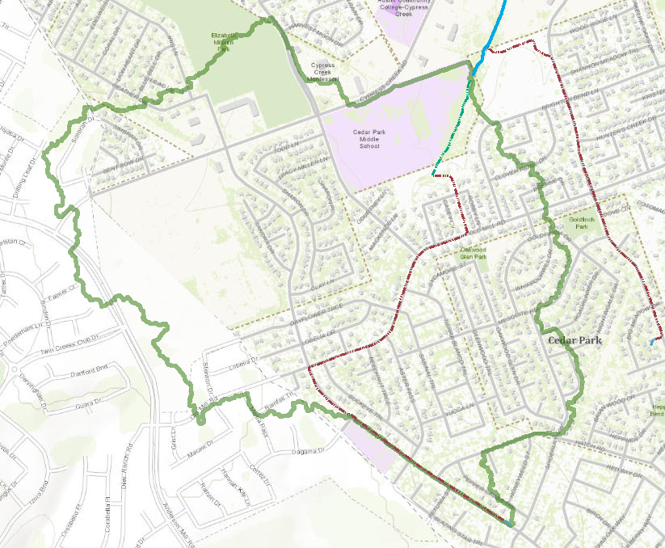

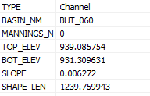
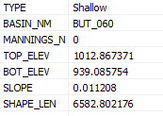
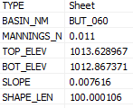
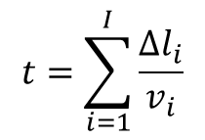
Flow along the longest path
Channel Flow
$$t=\sum_{i=1}^{I}{\frac{∆l_{i}}{v_{i}}}$$
Shallow Flow
Sheet Flow
Sum travel times over each segment

Slide 18
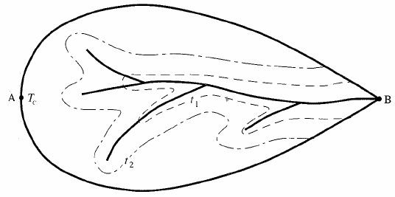
Time of Concentration
Different areas of a watershed contribute to runoff at different times after precipitation begins
Time of concentration
  Time at which all parts of the watershed begin contributing to the runoff from the basin
  Time of flow from the farthest point in the watershed
Isochrones: boundaries of contributing areas with equal time of flow to the watershed outlet

Slide 19
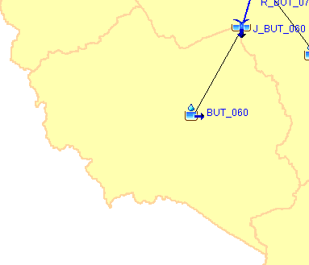
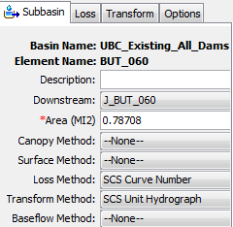
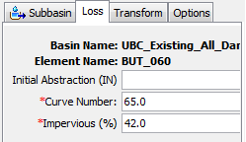
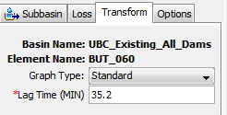
Modeling Runoff from BUT_060
How to characterize this subbasin?
How quickly does it move?
How much runoff?

