Slide 1
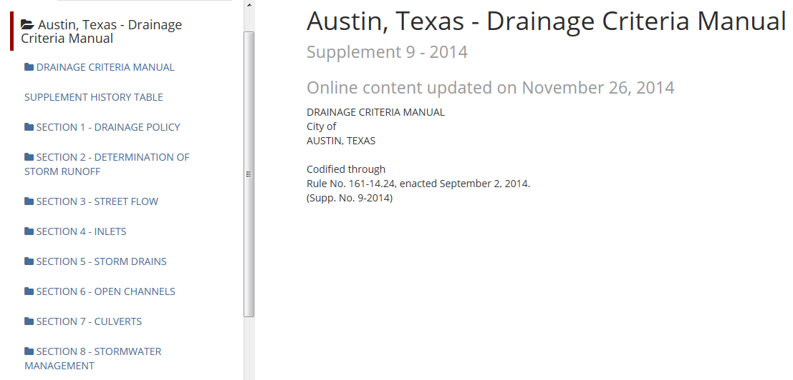
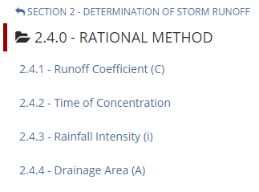
City of Austin Drainage Criteria Manual
https://www.municode.com/library/#!/tx/austin/codes/drainage_criteria_manual

Slide 2
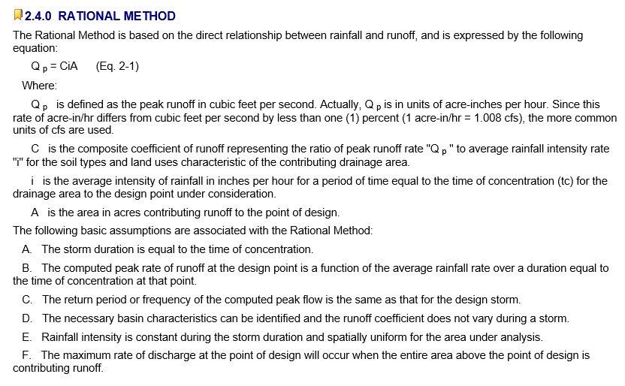
Rational Method
Source: Austin Drainage Criteria Manual, Chapter 2

Slide 3
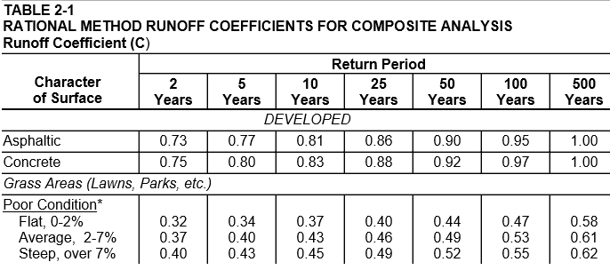
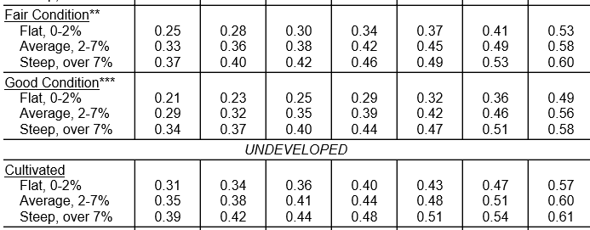
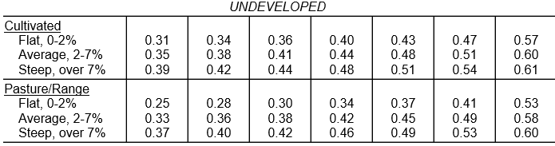

Source: Austin Drainage Criteria Manual, Chapter 2

Slide 4
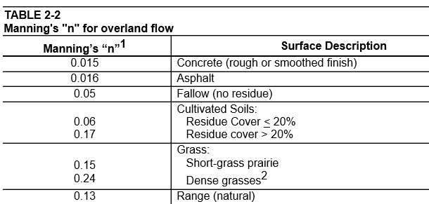
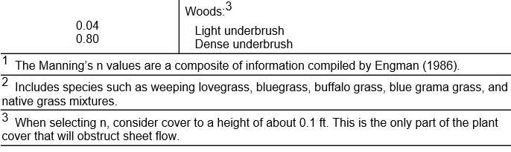
Manning’s N values

Slide 5
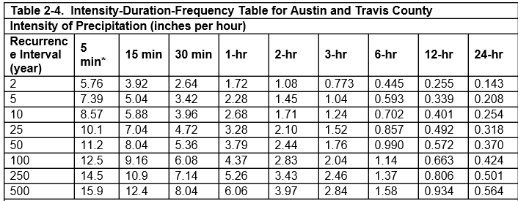
Intensity-Duration-Frequency Curves

