Slide 1
Stormwater Best Management Practices Continued
Michael Barrett, Ph.D., P.E.
University of Texas at Austin

Slide 2
Typical Stormwater BMPs
Sand filters
Retention irrigation
Retention (wet) ponds
Extended detention
Infiltration basins and trenches
Proprietary devices

Slide 3
Sand Filter Design Guidance
Design as Offline device
“Full Sedimentation” discharge runoff from sedimentation basin to filter basin over 24 hours
“Partial Sedimentation” water quality volume includes area over the filter – no separate sedimentation basin
Notes:
50 acrea area would be a BIG filter, not out of concrete, but earth
Size orifice for release of sed basin water.

Slide 4
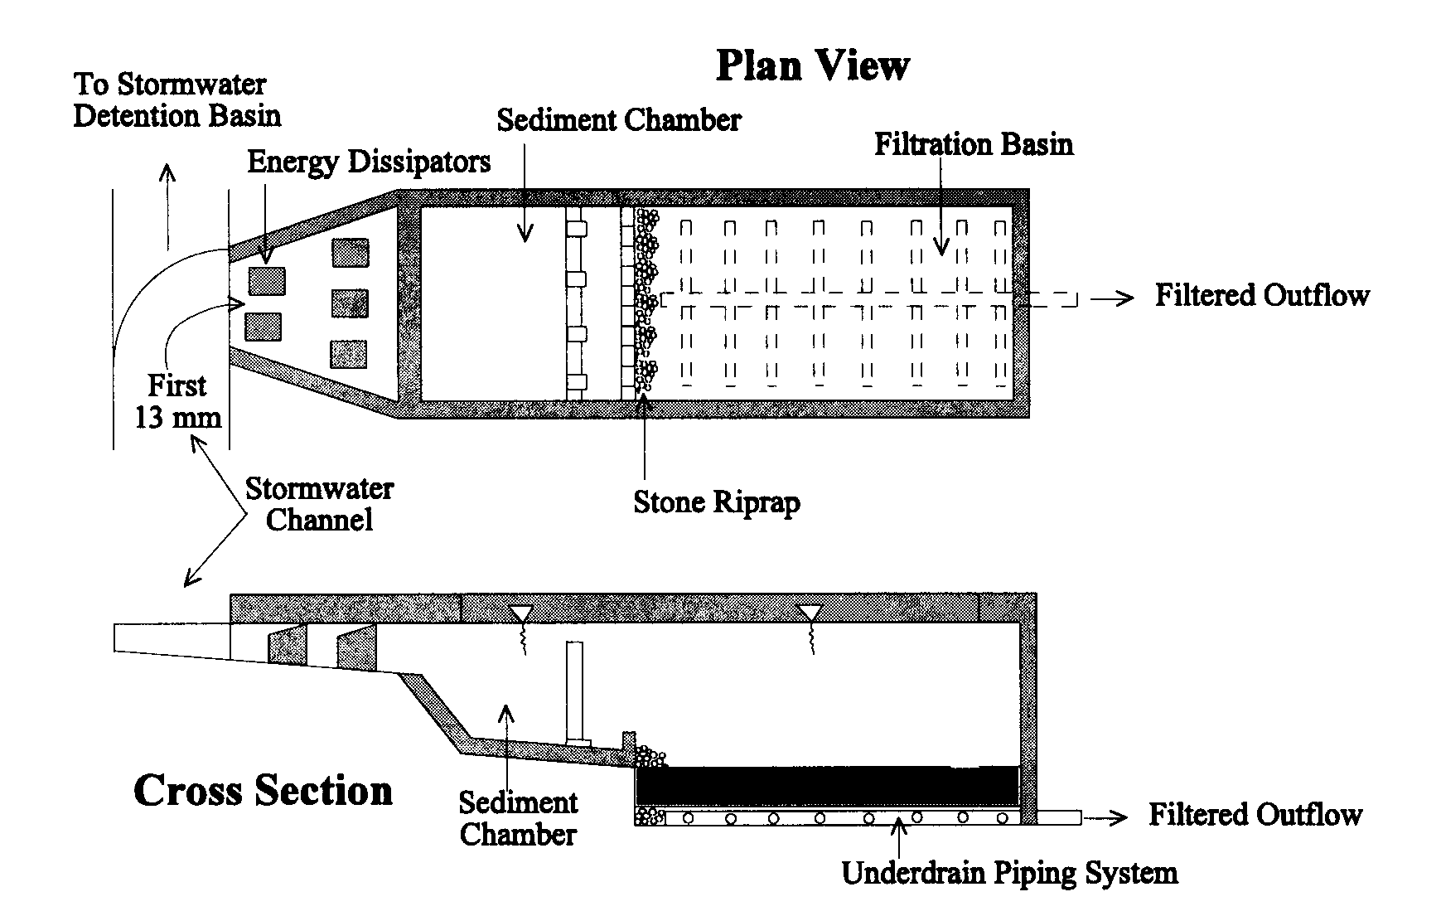
Austin Sand Filter Schematic

Slide 5
Offline Filter Design

Slide 6
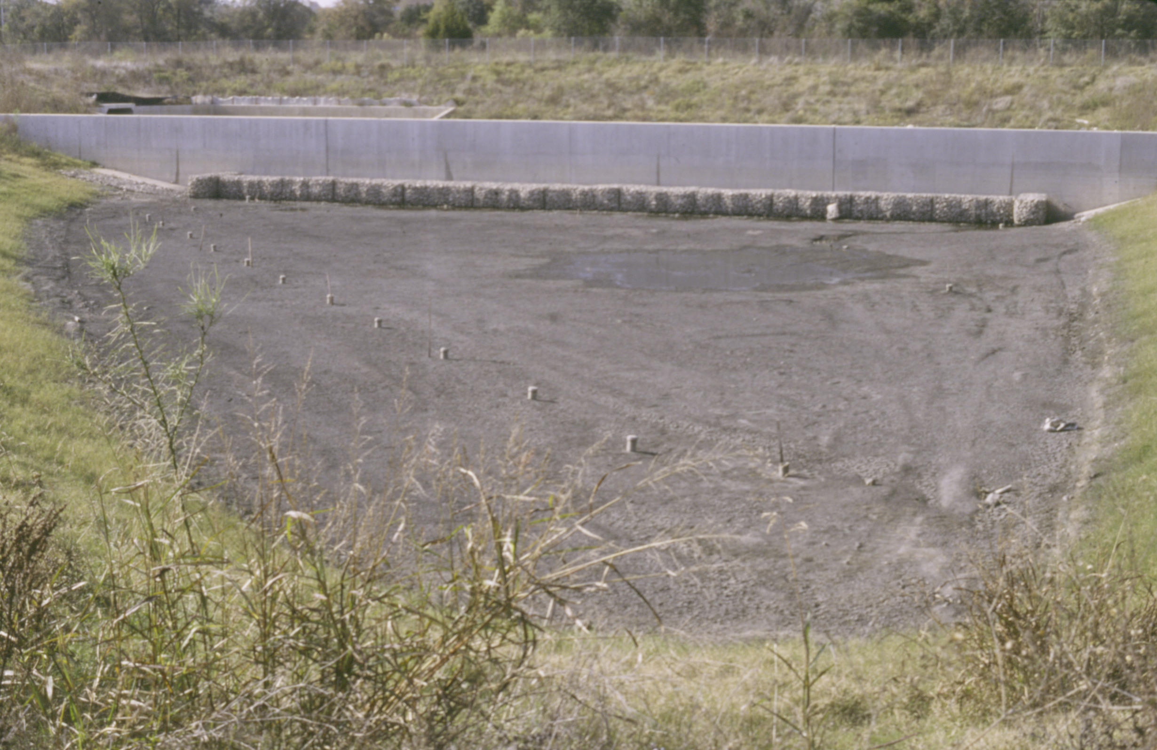
Austin Filter Bed

Slide 7
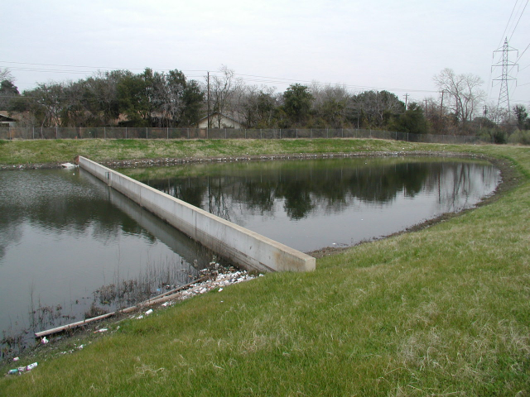
Failed Sand Filter

Slide 8
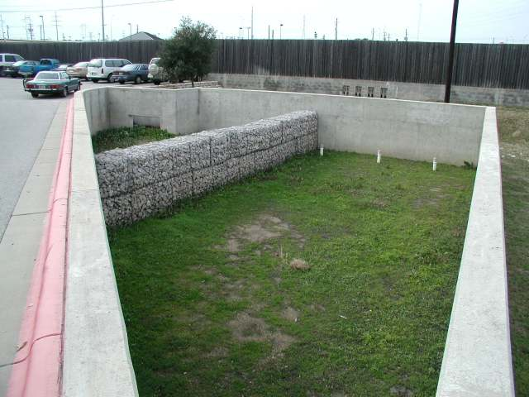
Partial Sedimentation

Slide 9
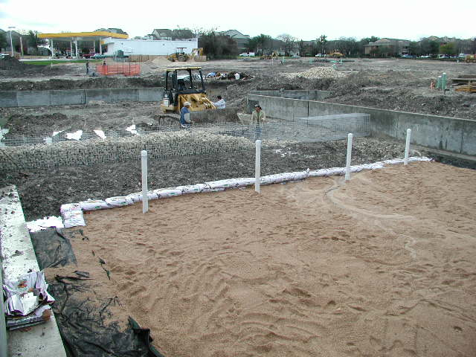
Gabion Construction

Slide 10
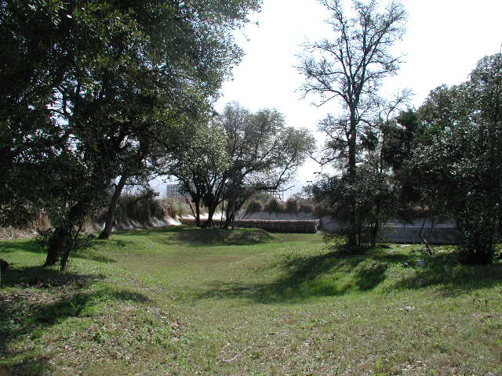
Integrated SF Design

Slide 11
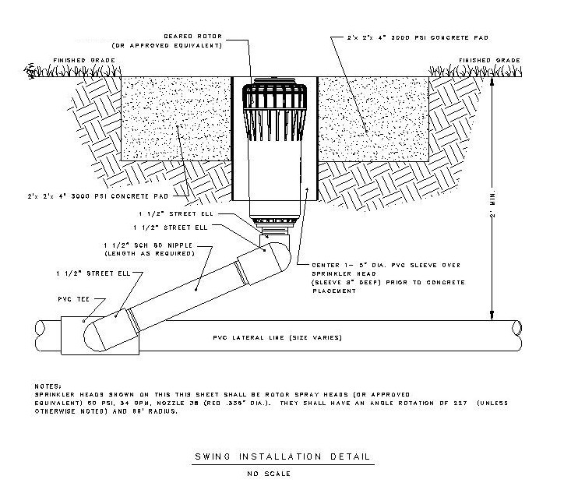
Retention Irrigation

Slide 12
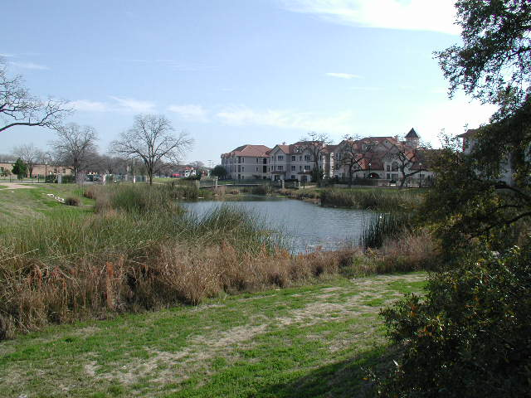
Central Park Wet Pond (TX)

Slide 13
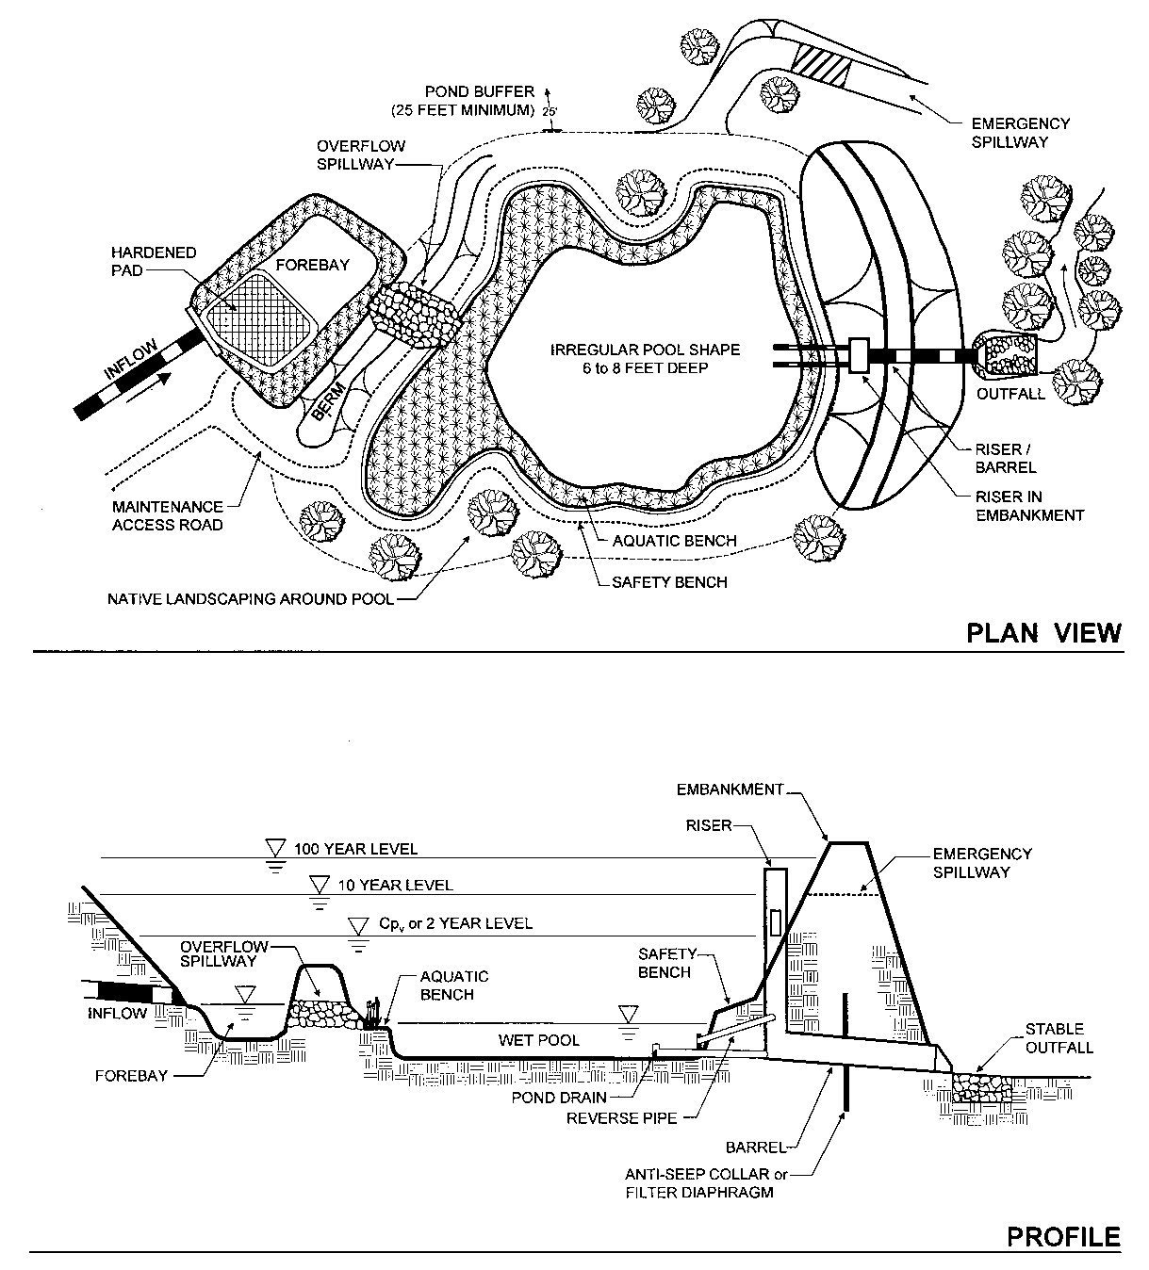

Slide 14
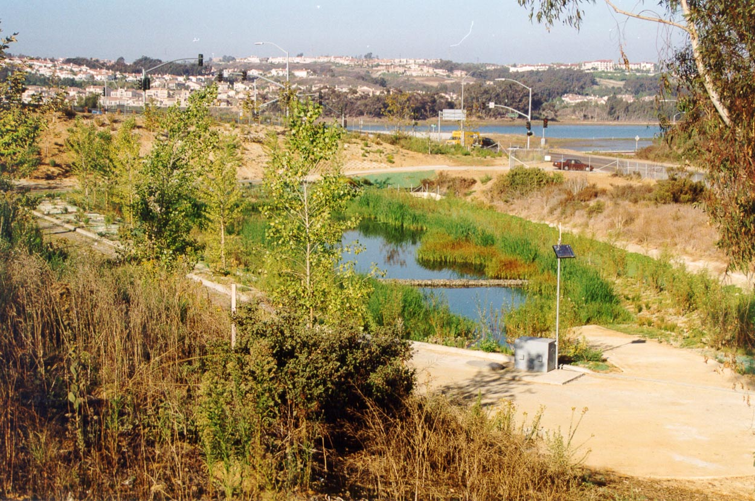
Wet Pond
Notes:
The vegetation at this site has filled in rapidly, vector monitoring concerns are becoming a challenge to ensure access for inspection.

Slide 15
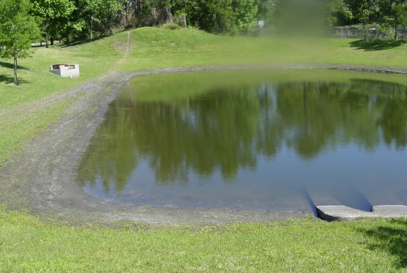
Orlando Pond

Slide 16
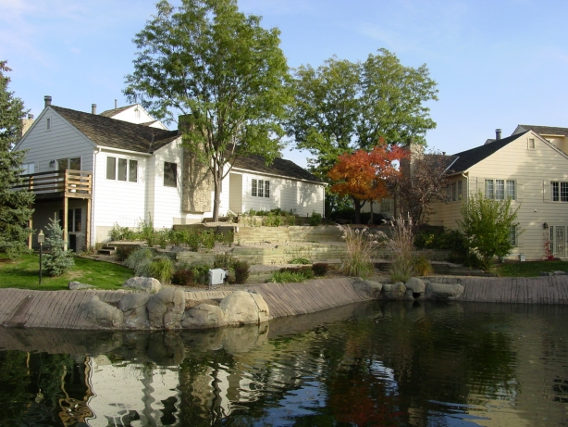
Retention Pond, Denver

Slide 17
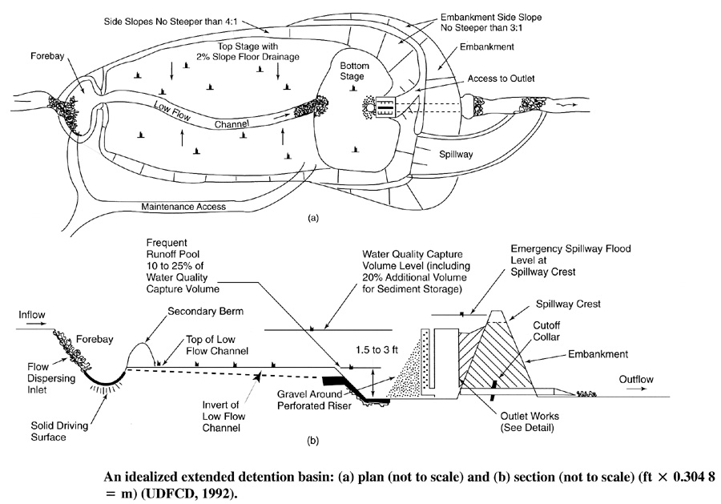
Typical Detention Basin

Slide 18
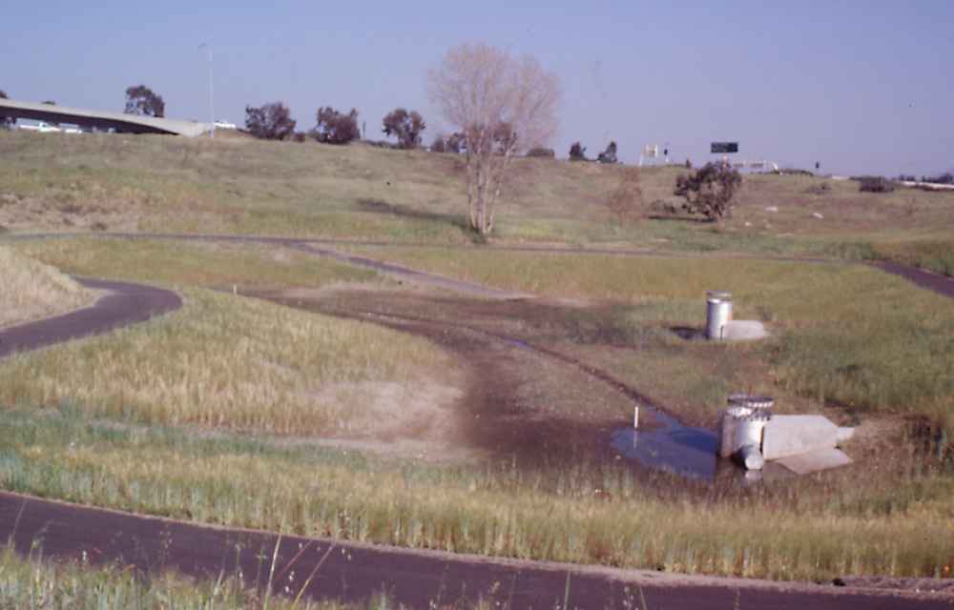
Extended Detention Basin
Notes:
After the basin had been in operation for several months. Two outlet risers to get the capacity for flood control, since this is a flow through EDB, couldn't put any more of a backwater on the existing upstream SD.
There was a buried bridge at this locaiton, not shown on the as-builts, large amounts of broken concrete with rebar. We took two boring logs, niether hit the material. The CCO for this site exceeded the bid price for the basin.
The contractor constructed the outlet too high, ended up leaving that, with reduced slope between inlet and outlet, a retrofit issue.

Slide 19
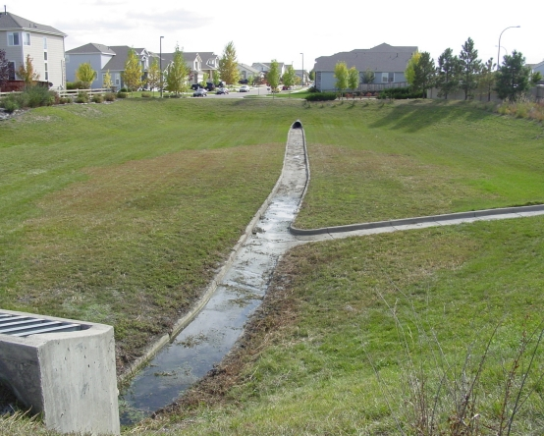

Slide 20
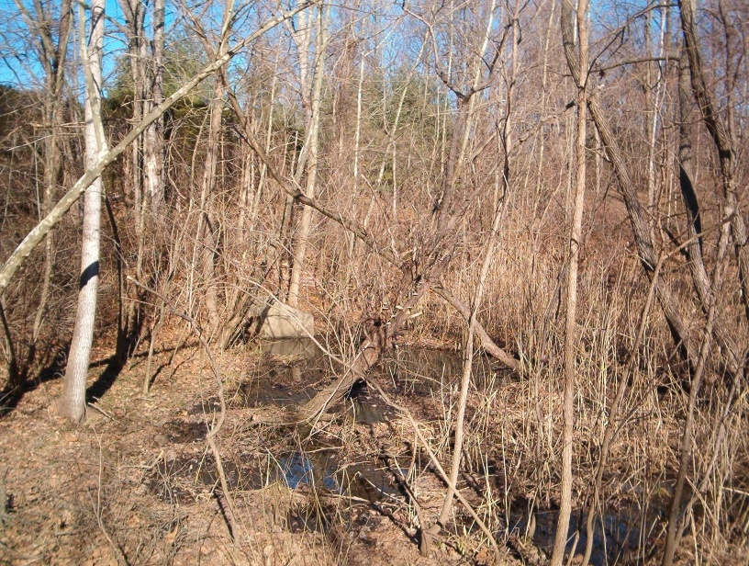

Slide 21
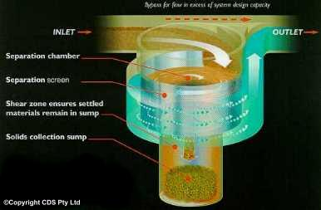
CDS Technology

Slide 22
BMP Performance
BMP | TSS Removal | TSS Effluent Concentration (mg/L)
Retention/Irr. | 100% | NA
Wet Pond | 93% | 10 - 20
Austin Sand Filter | 89% | 5 - 15
Buffer Strip | 85% | 20 - 30
Detention Basin | 75% | 30 - 45
Grassy Swale | 70% | 40
Proprietary Controls | Varies | Varies

Slide 23
Process for BMP Sizing
Determine increase in pollutant load associated with the project
Select a BMP or combination of BMPs that are appropriate for the site
Calculate the TSS load removed by each BMP
Calculate the percentage of runoff that must be treated to achieve the 80% removal of the increase in TSS

Slide 24
Load Equation
L = annual pollutant load (pounds)
A = Contributing drainage area (acres)
P = Average annual precipitation (inch)
Rv = Appropriate runoff coefficient
C = Average TSS concentration (mg/L)
0.226 = units conversion factor

Slide 25
Assumptions
Concentration is constant for each event
Undeveloped TSS = 80 mg/L
Developed TSS = 170 mg/L

Slide 26
Required Load Reduction
L_{M} = Required TSS removal (pounds)
A_{N} = Net increase in impervious area (acres)
P = Average annual precipitation (inches)

Slide 27
Maximum Removal
L_{R} = (BMP efficiency) x 0.226 x P x (A_{I} x 0.9 x 170 mg/L + A_{P} x 0.03 x 80 mg/L)
L_{R} = (BMP efficiency) x P x (A_{I} x 34.6 + A_{P} x 0.54)

Slide 28
BMP TSS Removal
Ext. Detention Basin | 75
Grassy Swales | 70
Vegetated Filter Strips | 85
Sand Filters | 89
AquaLogic Cartridge Filter System | 95
Wet Basins | 93
Constructed Wetlands | 93
Bioretention | 89
Permeable Pavement | 89

Slide 29
Calculate Fraction of Rainfall to Treat
F = Fraction of the annual rainfall treated by the BMP
L_{R} = Load removed for each BMP from Step 3 calculation (pounds)
L_{M} = Required load reduction from Step 1 (pounds)

Slide 30
Rainfall Distribution

Slide 31
Water Quality Volume
WQV = Rainfall depth x Runoff Coefficient x Area
Runoff Coefficient = 1.72(IC)³ – 1.97(IC)² + 1.23(IC) + 0.02
Where: IC = fraction of impervious cover

Slide 32
More Info in:
Complying with the Edwards Aquifer Rules: Technical Guidance on Best Management Practices
Google: RG-348

Slide 33
National Stormwater Conferences in Austin
ASCE Environmental & Water Resources Institute: May 17-21, 2015
StormCon: August 2-6, 2015

