Slide 1
Stream Gaging Information
Prepared by Scott Gzyb,
US Geological Survey
Austin Texas
CE 365K, Hydraulic Engineering Design
Spring 2015

Slide 2
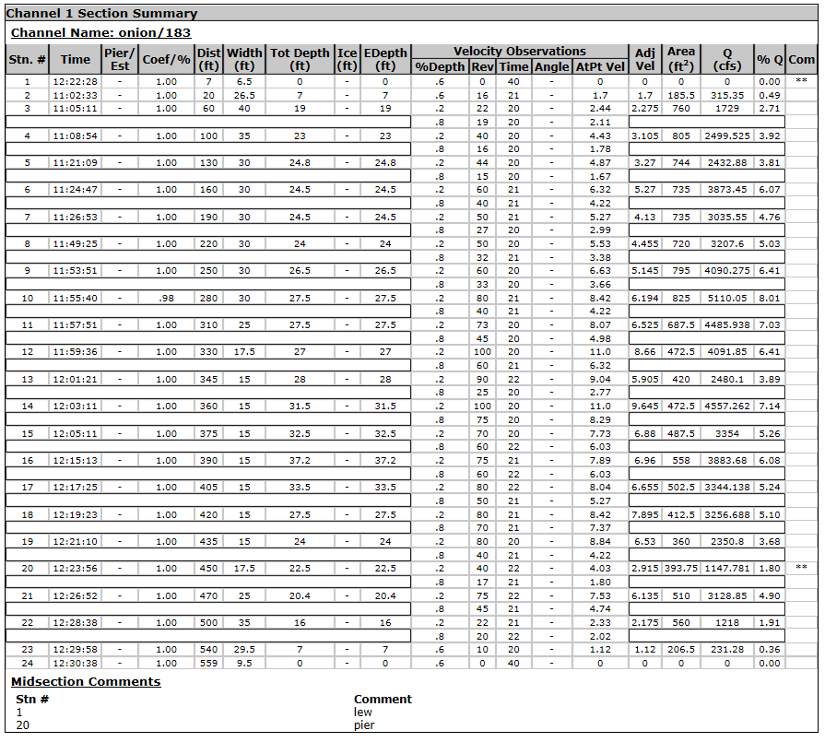
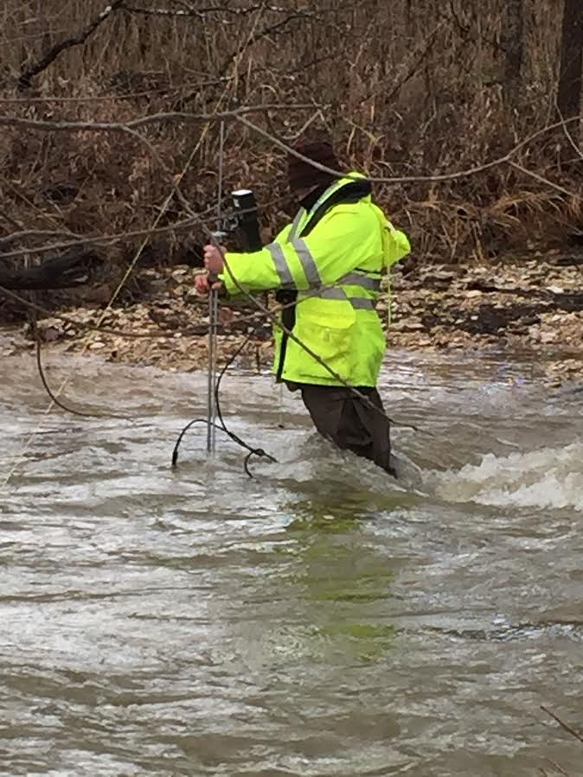
Stream Gaging, Onion Creek at Highway 183
For method see: http://water.usgs.gov/edu/measureflow.html

Slide 3
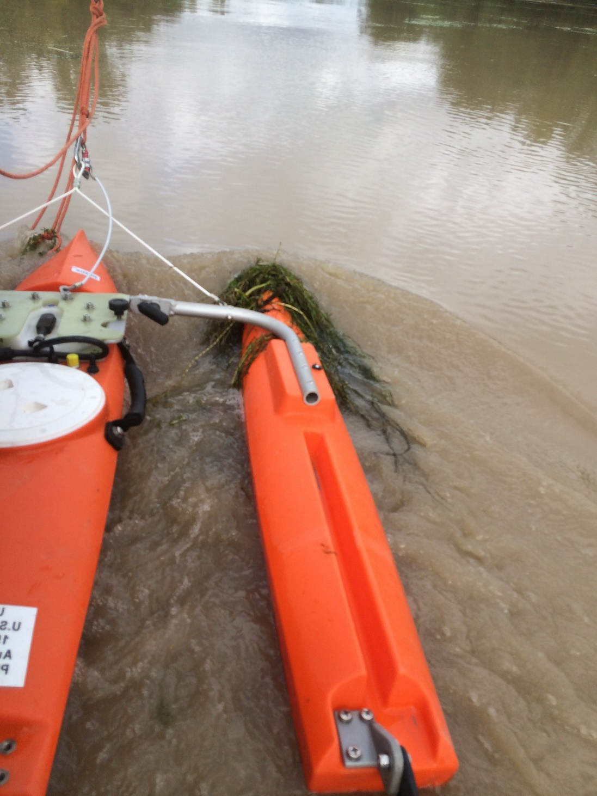
ADCP
Acoustic Doppler Current Profiler

Slide 4
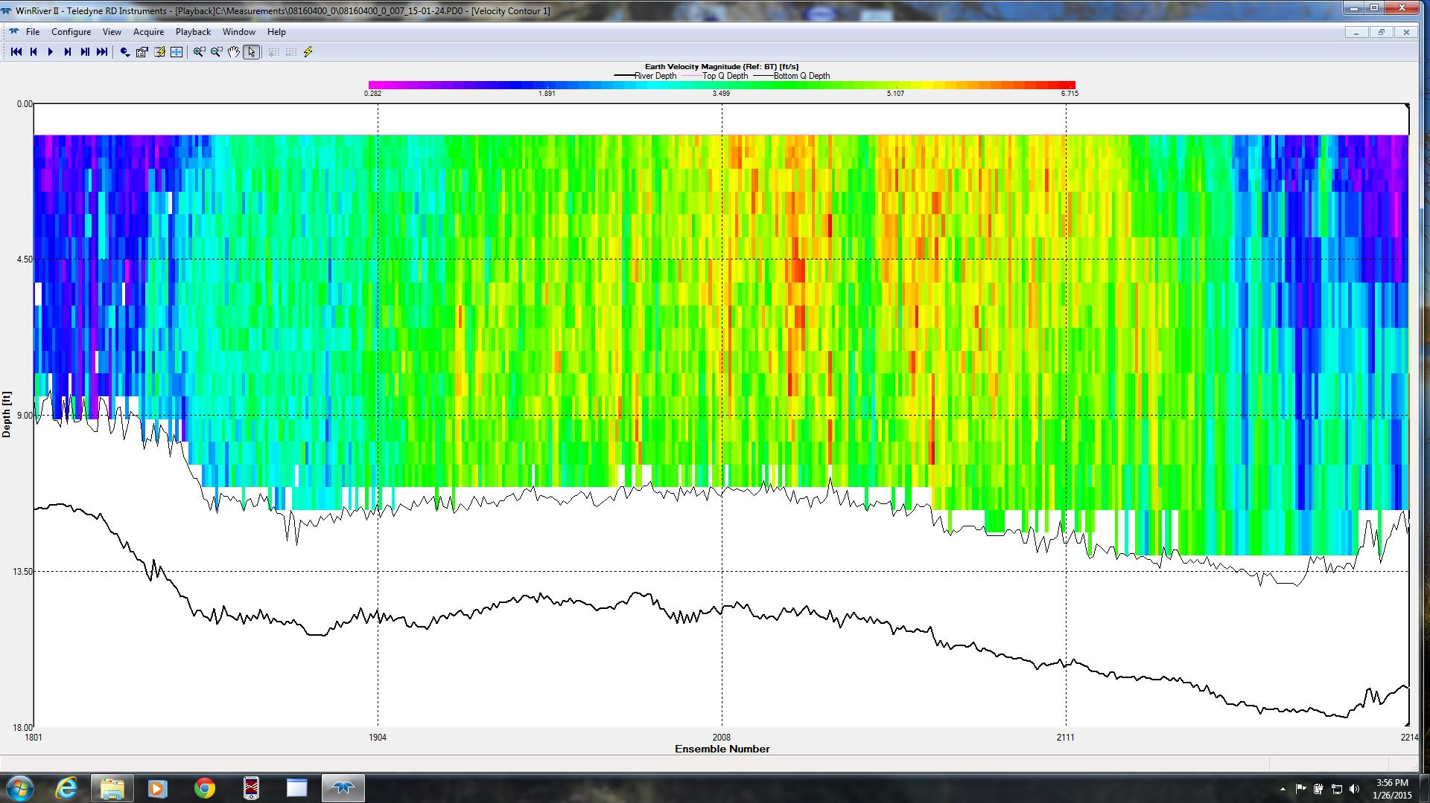
ADCP Velocity Profile – Colorado River at La Grange

Slide 5
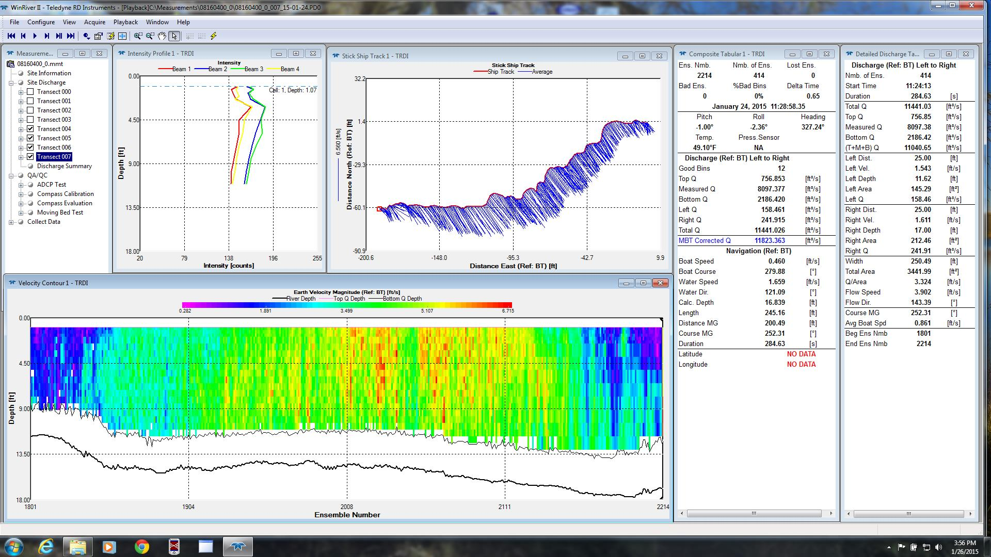
ADCP data collection information

Slide 6
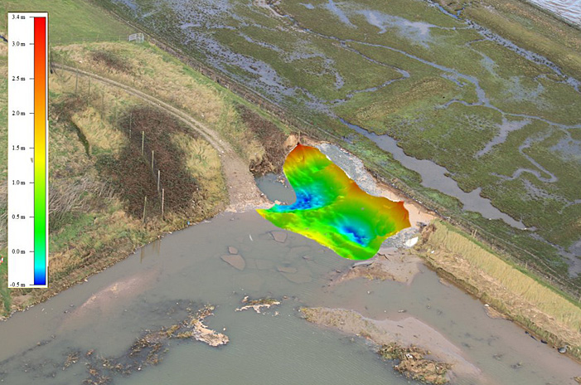
Dam Wall Repair – Importance of Bathymetric information

