Slide 1
Hydrograph Computation
CE 365K Hydraulic Engineering Design
Spring 2015

Slide 2
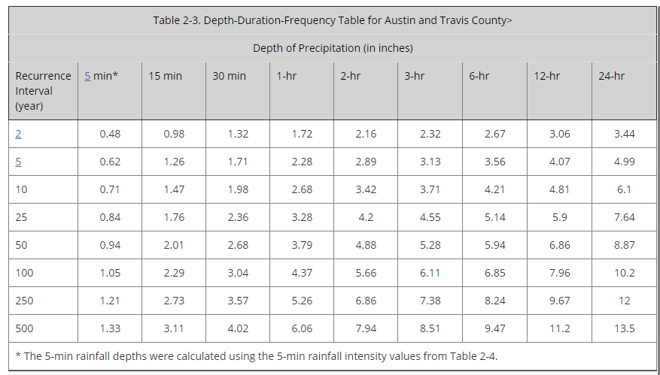
Depth-Duration-Frequency Table

Slide 3
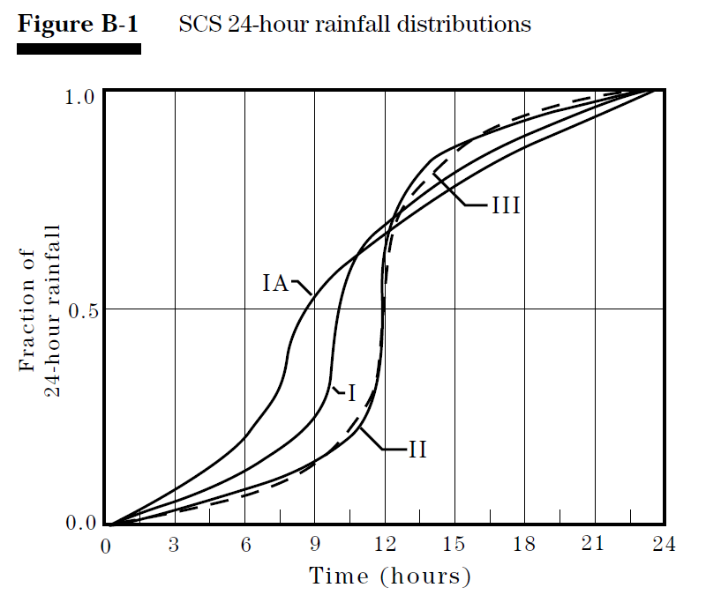
Source: SCS TR-55 Manual, 1986

Slide 4
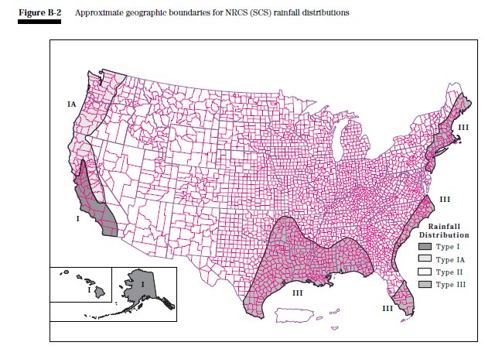
Source: SCS TR-55 Manual, 1986

Slide 5
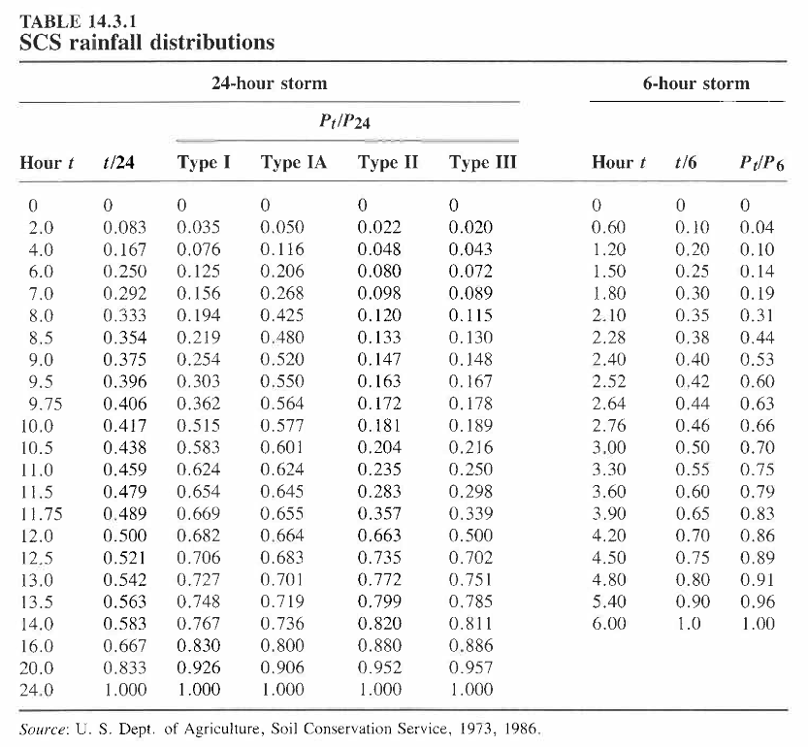

Slide 6
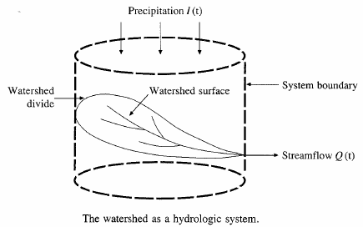






Hydrologic Analysis
Change in storage w.r.t. time = inflow - outflow
In the case of a linear reservoir, S = kQ
Transfer function for a linear system (S = kQ).

Slide 7
Proportionality and superposition
Linear system (k is constant in S = kQ)
  Proportionality
    If I₁ → Q₁ then C*I₂ → C*Q₂
  Superposition
    If I₁ → Q₁ and I₂ → Q₂, then I₁ +I₂→ Q₁ + Q₂

Slide 8
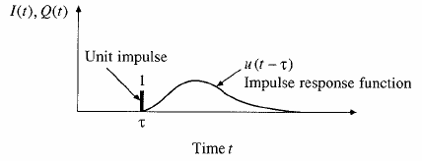
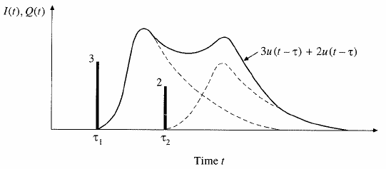
Impulse response function
Impulse input: an input applied instantaneously (spike) at time τ and zero everywhere else
An unit impulse at τ produces as unit impulse response function u(t-τ)
Principle of proportionality and superposition

Slide 9
Unit Hydrograph Theory
Direct runoff hydrograph resulting from a unit depth of excess rainfall occurring uniformly on a watershed at a constant rate for a specified duration.
Unit pulse response function of a linear hydrologic system
Can be used to derive runoff from any excess rainfall on the watershed.

Slide 10
Unit hydrograph assumptions
Assumptions
  Excess rainfall has constant intensity during duration
  Excess rainfall is uniformly distributed on watershed
  Base time of runoff is constant
  Ordinates of unit hydrograph are proportional to total runoff (linearity)
  Unit hydrograph represents all characteristics of watershed (lumped parameter) and is time invariant (stationarity)

Slide 11
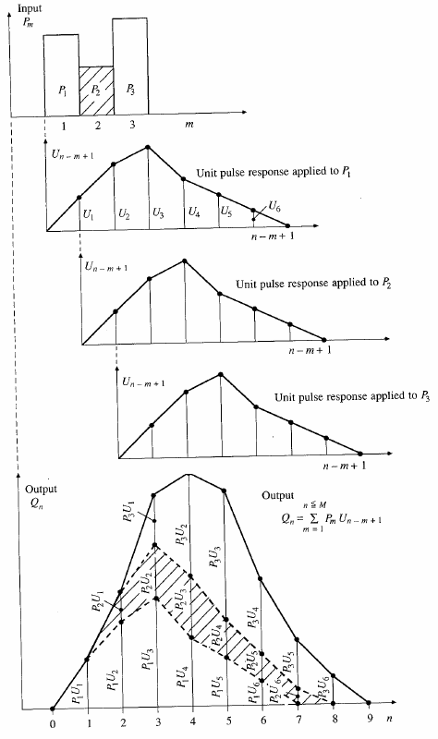
Application of convolution to the output from a linear system

Slide 12
Need for synthetic UH
UH is applicable only for gauged watershed and for the point on the stream where data are measured
For other locations on the stream in the same watershed or for nearby (ungauged) watersheds, synthetic procedures are used.

Slide 13
SCS dimensionless hydrograph
Synthetic UH in which the discharge is expressed by the ratio of q to q_{p} and time by the ratio of t to T_{p}
If peak discharge and lag time are known, UH can be estimated.
t_{p} = lag time in HEC-HMS
T_{c}: time of concentration
C = 2.08 (483.4 in English system)
A: drainage area in km² (mi²)

Slide 14
Example
Construct a 10-min SCS UH. A = 3.0 km² and T_{c} = 1.25 h
0.833 h
q
7.49 m3/s.cm
Multiply y-axis of SCS hydrograph by q_{p} and x-axis by T_{p} to get the required UH, or construct a triangular UH
t
2.22 h

Slide 15
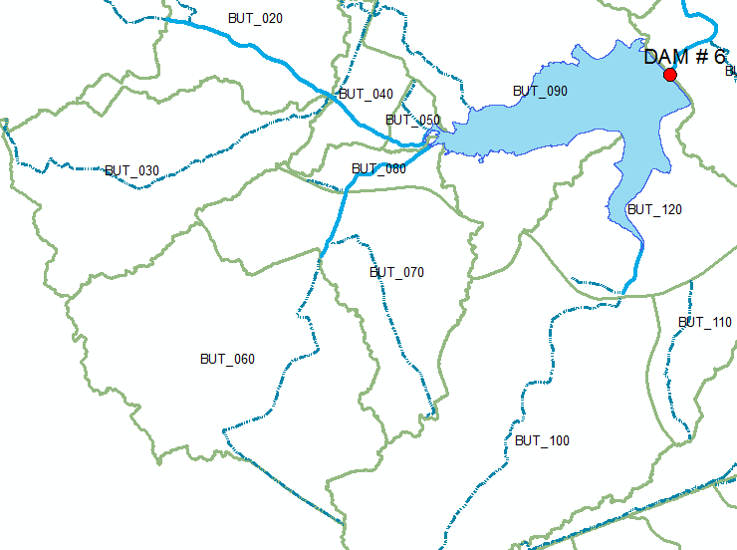
Watersheds upstream of Dam 6

Slide 16
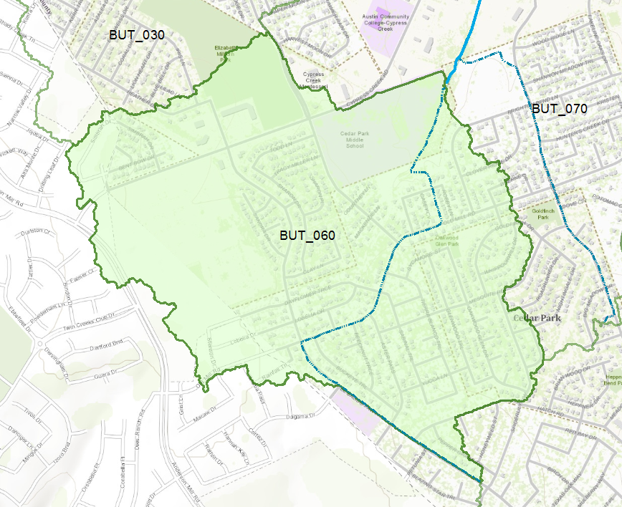
Subbasin BUT_060

Slide 17
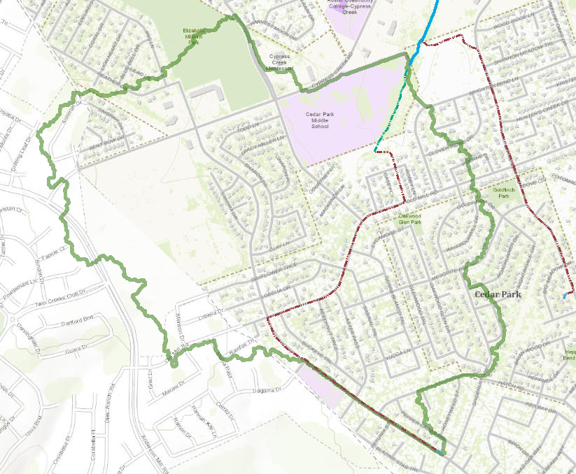

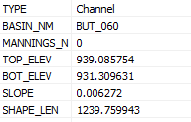
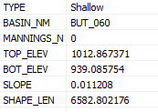
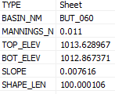
Flow along the longest path
Channel Flow
$$t=\sum_{i=1}^{I}{\frac{∆l_{i}}{v_{i}}}$$
Shallow Flow
Sheet Flow
Sum travel times over each segment

Slide 18
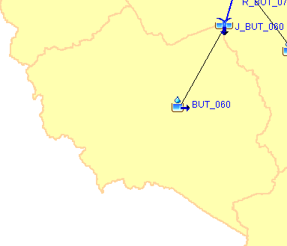
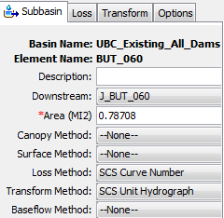
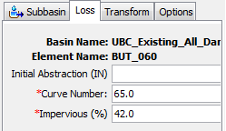
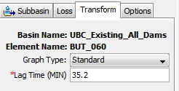
Modeling Runoff from BUT_060
How to characterize this subbasin?
How quickly does it move?
How much runoff?

Slide 19
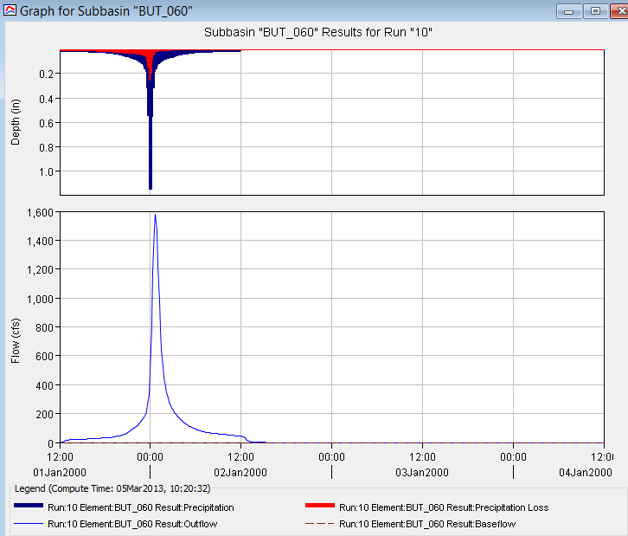
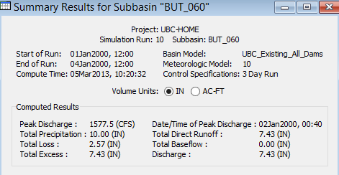
Results for Run “10”
24 hour design storm of 10” total precipitation in 10 min increments

