Slide 1



Flow through a Circular Pipe
$$A= \frac{1}{8}(α−\sin{α)D^{2}}$$
D
α
y
$$P= \frac{1}{2}αD$$
$$R= \frac{1}{4}(1−\frac{Sinα}{α})D{ }$$

Slide 2
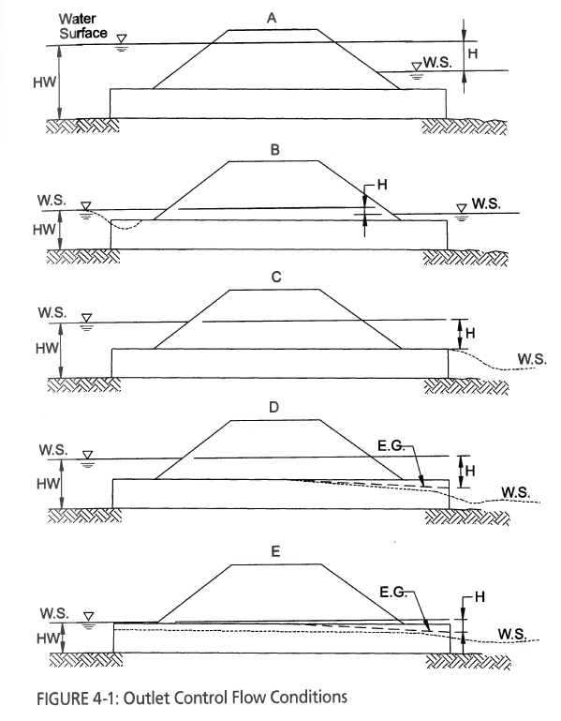
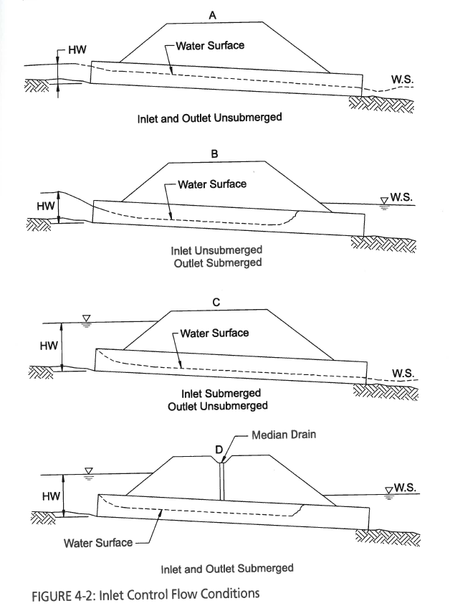
Culvert Flow Control
Haested Methods Water Solutions “Computer Applications in Hydraulic Engineering, 8th Edition

Slide 3
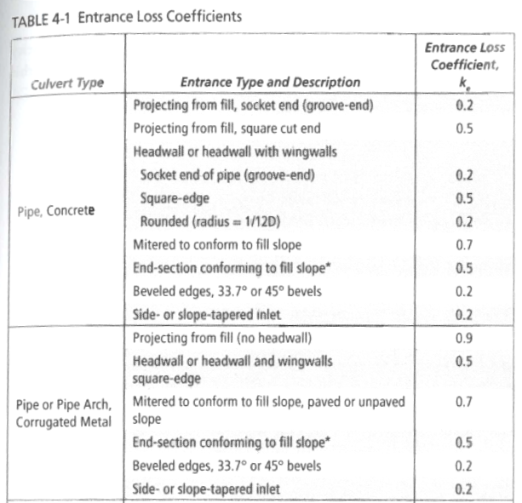
Entrance Loss Coefficients
Haested Methods Water Solutions “Computer Applications in Hydraulic Engineering, 8th Edition

Slide 4
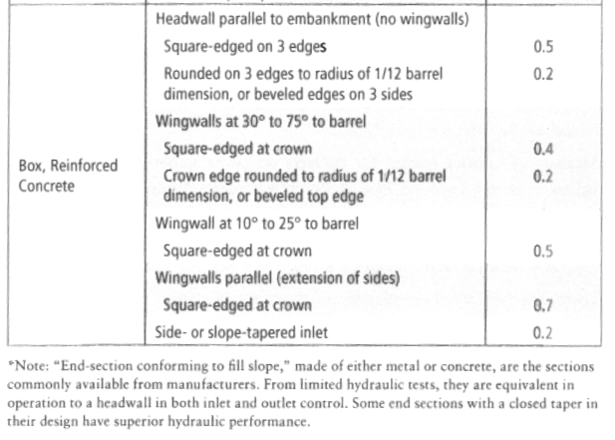
Entrance Loss Coefficients
Haested Methods Water Solutions “Computer Applications in Hydraulic Engineering, 8th Edition

