Slide 1
Evolution of Hydraulic Design
Stormwater runoff disposal
  Get the water off the site as quickly and efficiently possible
Stormwater detention
  Slow down the stormwater so that peak flow after development is not more than before
Water Quality Enhancement
  Retain and filter water on site so that bacteria are reduced and water quality improves
Low Impact Development
  Dispersed onsite infiltration, filtration and retention schemes

Slide 2

Geodesign
Design – Everyone designs who devises courses of action aimed at changing existing situations into better ones (Herbert Simon)
Geodesign – understanding the impact of our decisions on the planet and using this information to make the world a better place (Jack Dangermond)
http://esripress.esri.com/display/index.cfm?fuseaction=display&moduleID=0&websiteID=218

Slide 3
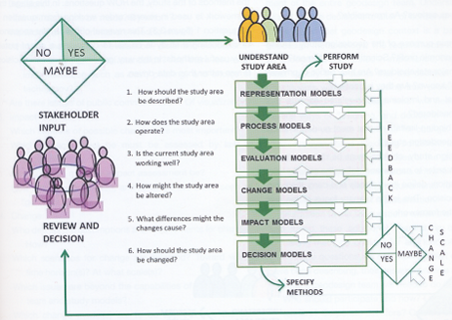
Geodesign Process

Slide 4
Hydrodesign
Hydrodesign is an analogous process to Geodesign for design with water in the constructed and in the natural environment
  Flooding
  Water use
  Water quality
  Environmental integrity
People of the Place
Design Professionals:
Civil Engineers Architects
Earth and Natural Sciences: Geology, Biology
Information Technology

Slide 5
Questions
How should the study area be described?
How does the study area operate?
Is the current study area working well?
How might the study area be altered?
What differences would the changes cause?
How should the study area be changed?
Representation
Process
Evaluation
Change
Impact
Decision

Slide 6
Design Project
Needs a team of three people
You are free to form your own team and to give it a name
Think about a design project that you would like to do
I need your group membership by Thursday 12 February
I will make up groups for students unassigned to groups by 27 February
Your design project proposal is due on Thursday Mar 12.
Oral presentation in last 2 weeks of semester
Written Report on last day of semester, May 8

Slide 7
Key Players
Owner
Architect
Permits
City
Regulatory
Process
Engineers

Slide 8
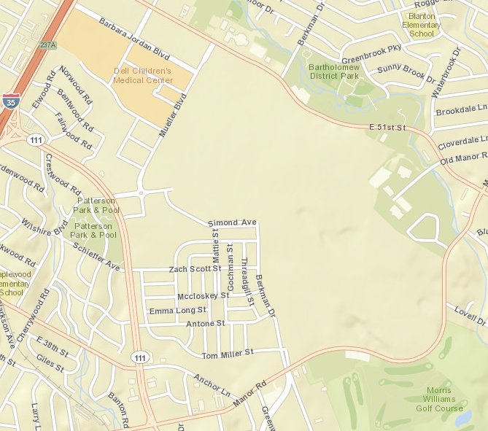
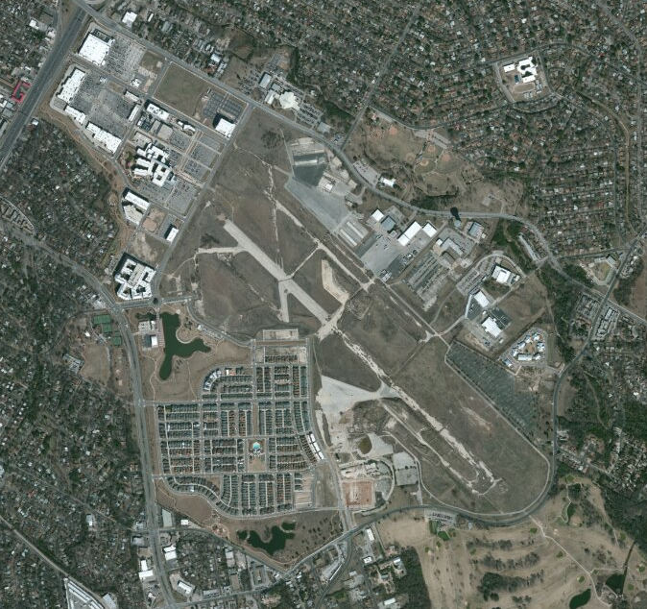
Water Quality Enhancement and Low Impact Development:
Redevelopment of Mueller Airport

Slide 9
Water Quality Enhancement and Low Impact Development:
Redevelopment of Mueller Airport

Slide 10
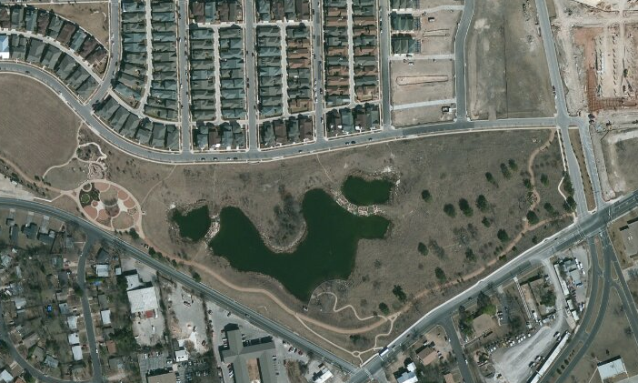
Flood Detention and Water Quality Pond

Slide 11
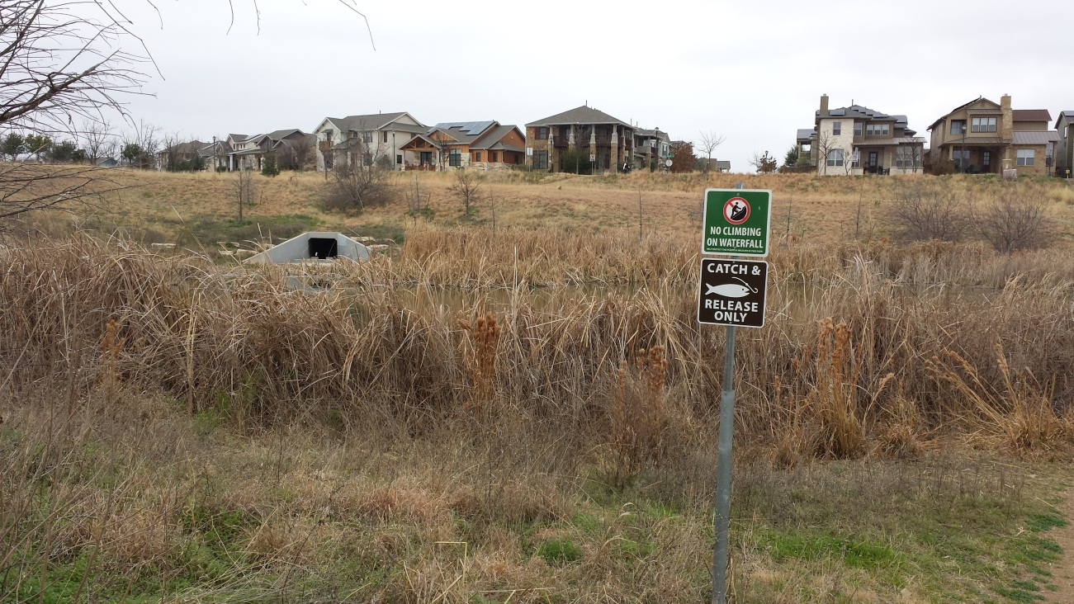
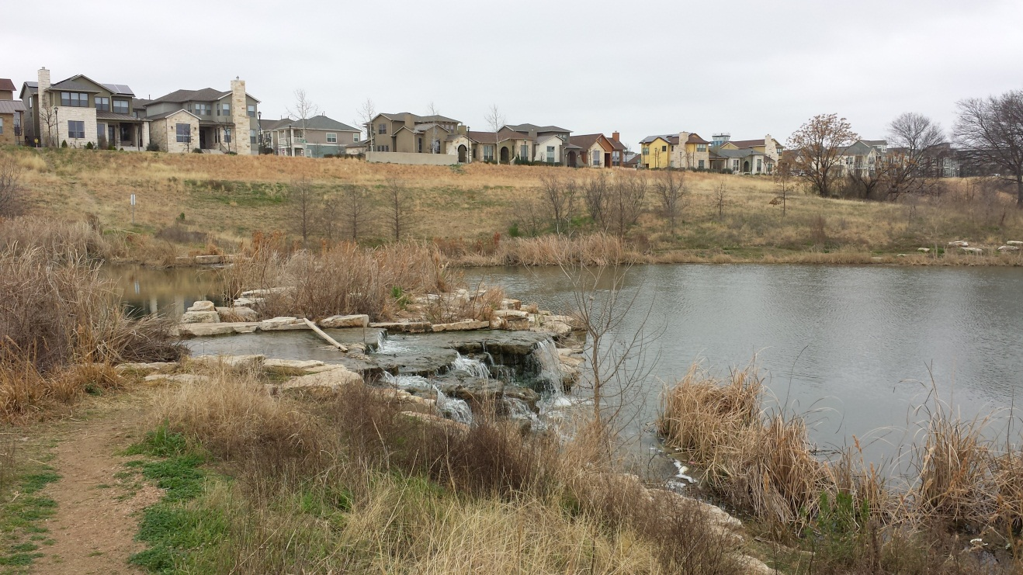
Mueller Wet Pond
Stormwater Outlet and
Upper Pond
Back pumping
Aeration System and
Lower Pond

Slide 12
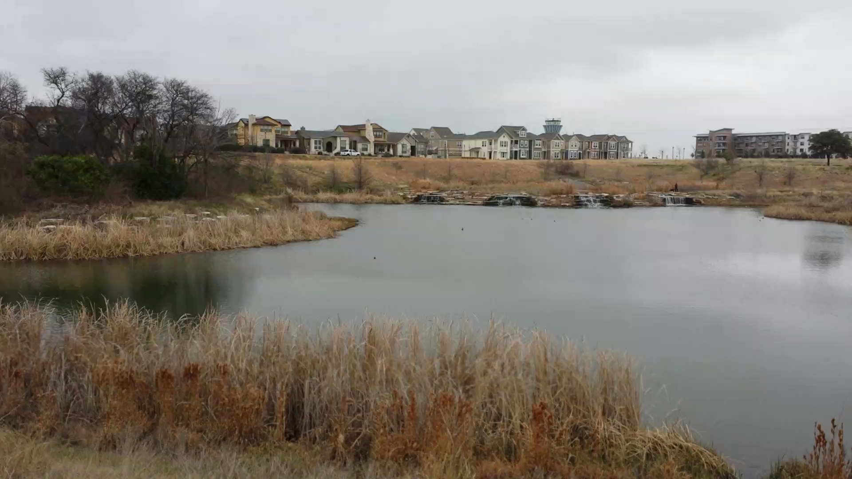
Pond, Outfall and Overflow
Stormater Detention (Flooding)
Wet Pond (Water Quality)

Slide 13
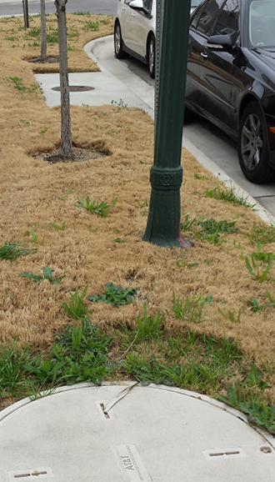
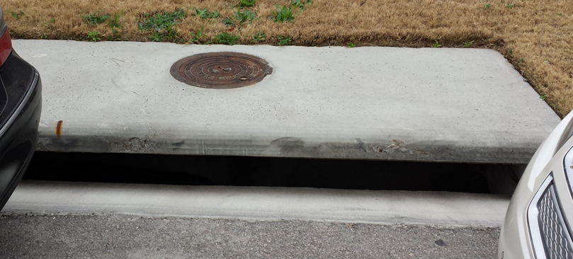
Normal Sidewalk and Stormwater Inlet

Slide 14
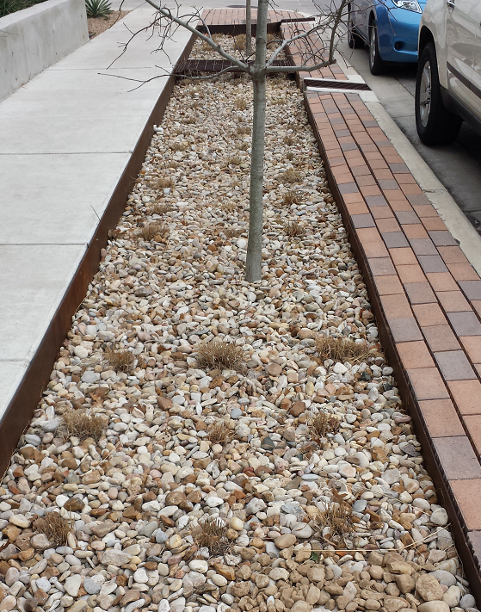
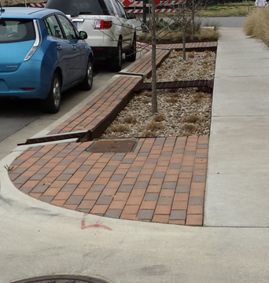
An Alternative: Infiltration Trench
Water flows in from gutter, and along the gravel bed, infiltrating as it goes,
and the remainder goes back out into the gutter again
Pike Powers Laboratory, 3924 Berkman Drive, Austin Texas

Slide 15
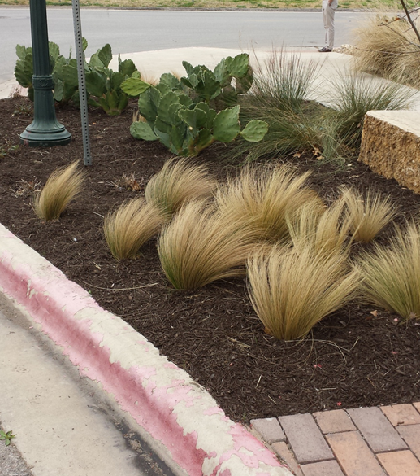
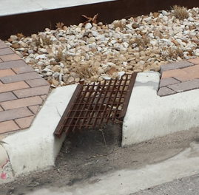
Low Impact Development Elements
Infiltration trench outfall
Alternative Plant Materials

Slide 16
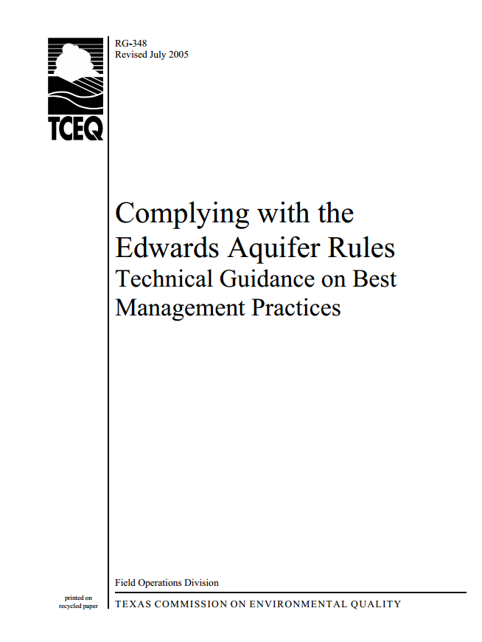
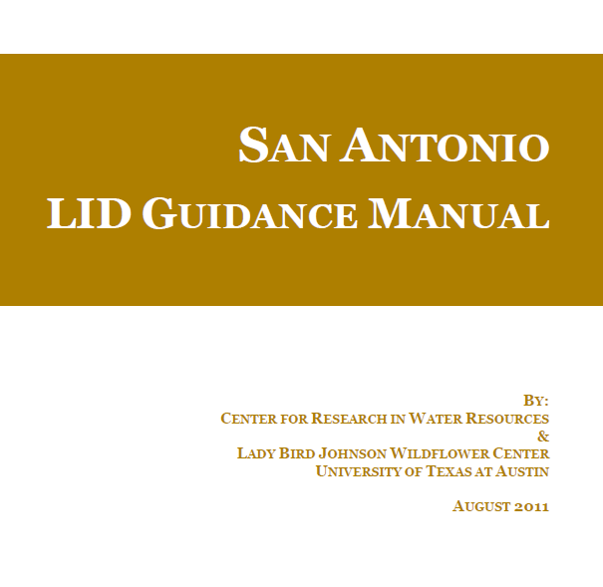
Water Quality Enhancement and Low Impact Development
Dr Michael Barrett
Design for sediment control
http://www.tceq.texas.gov/publications/rg/rg-348/rg-348.html

Slide 17
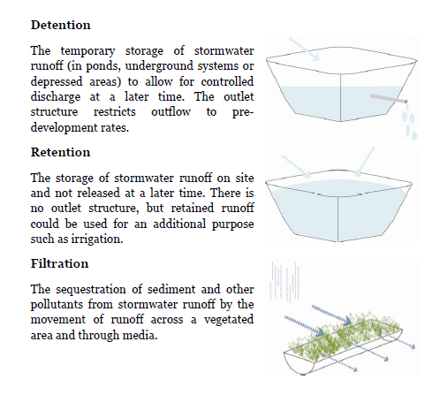
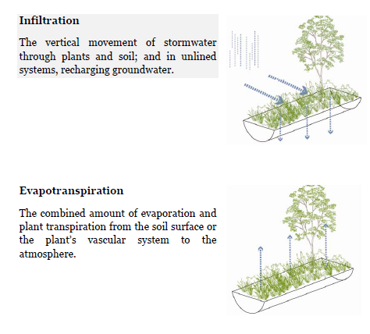
Definitions

