Slide 1
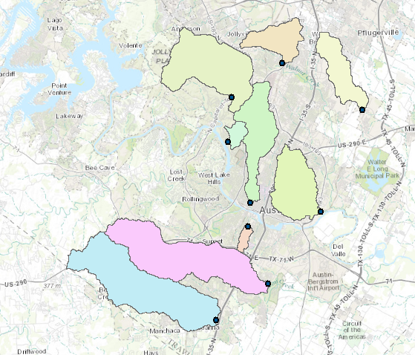
Watersheds in Austin Area

Slide 2
SCS method
Soil conservation service (SCS) method is an experimentally derived method to determine rainfall excess using information about soils, vegetative cover, hydrologic condition and antecedent moisture conditions
The method is based on the simple relationship that P_{e} = P - F_{a} – I_{a}
P_{e} is runoff depth, P is precipitation depth, F_{a} is continuing abstraction, and I_{a} is the sum of initial losses (depression storage, interception, ET)
Precipitation
Time

Slide 3
Abstractions – SCS Method
In general
After runoff begins
Potential runoff
SCS Assumption
Combining SCS assumption with P=P_{e}+I_{a}+F_{a}
Precipitation
Time

Slide 4
SCS Method (Cont.)
Experiments showed
So
Surface
  Impervious: CN = 100
  Natural: CN < 100

Slide 5
SCS Method (Cont.)
SCS Curve Numbers depend on soil conditions
Group | Minimum Infiltration Rate (in/hr) | Hydrologic Soil Group
A | 0.3 – 0.45 | High infiltration rates. Deep, well drained sands and gravels
B | 0.15 – 0.30 | Moderate infiltration rates. Moderately deep, moderately well drained soils with moderately coarse textures (silt, silt loam)
C | 0.05 – 0.15 | Slow infiltration rates. Soils with layers, or soils with moderately fine textures (clay loams)
D | 0.00 – 0.05 | Very slow infiltration rates. Clayey soils, high water table, or shallow impervious layer

Slide 6
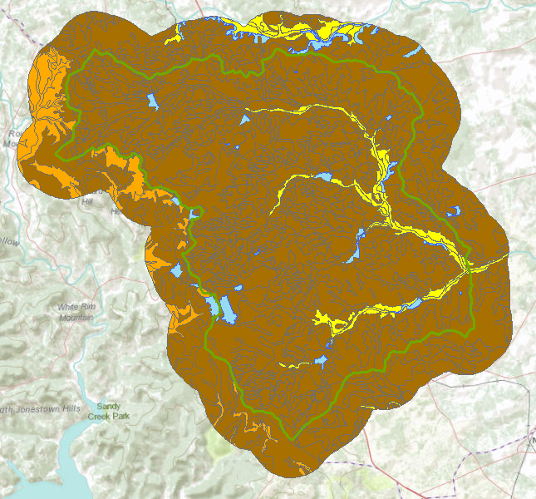

Hydrologic Soil Group in Brushy Creek
Water

Slide 7
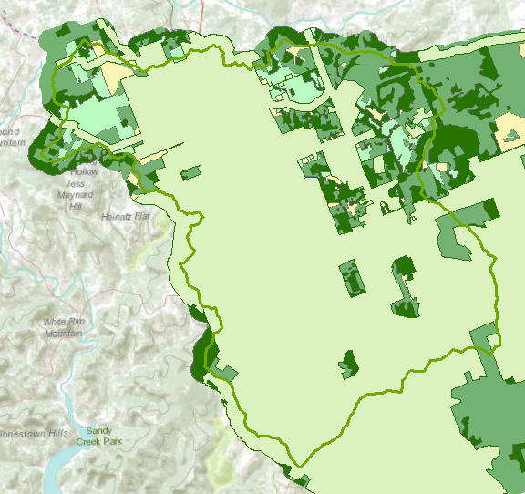

Land Cover
Interpreted from remote sensing

Slide 8
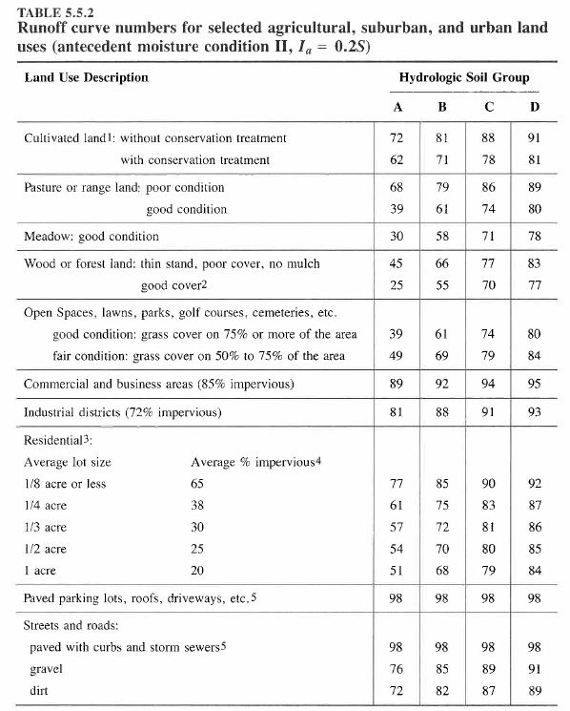
CN Table

Slide 9

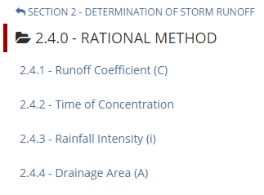
City of Austin Drainage Criteria Manual
https://www.municode.com/library/#!/tx/austin/codes/drainage_criteria_manual

Slide 10
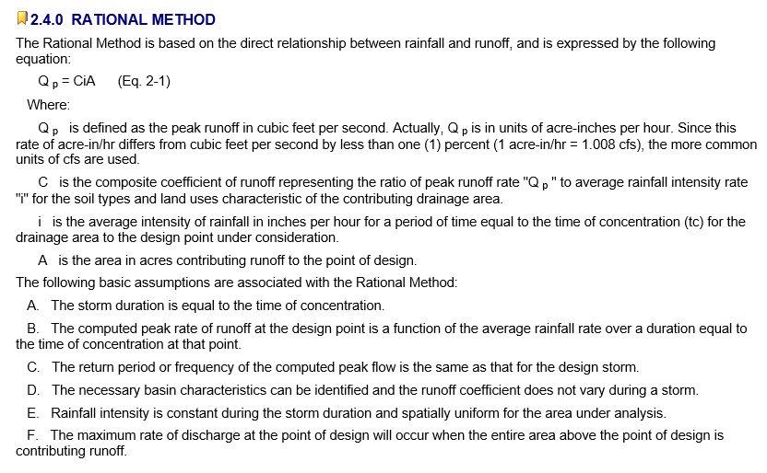
Rational Method
Source: Austin Drainage Criteria Manual, Chapter 2

Slide 11
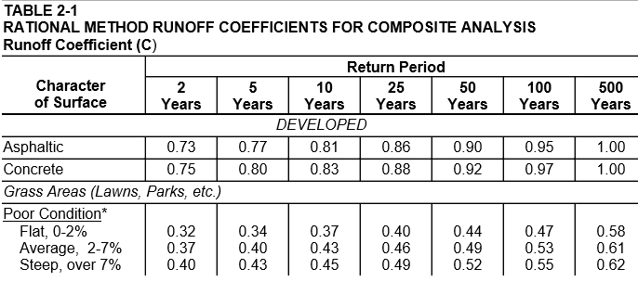
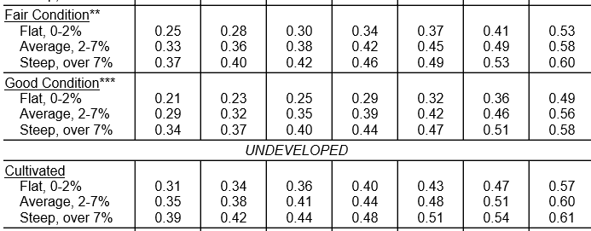
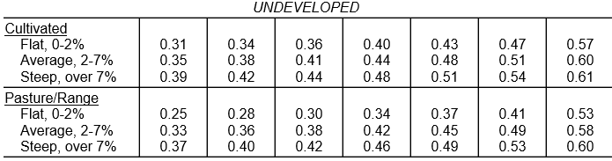

Source: Austin Drainage Criteria Manual, Chapter 2

Slide 12
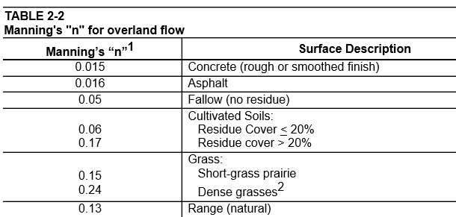
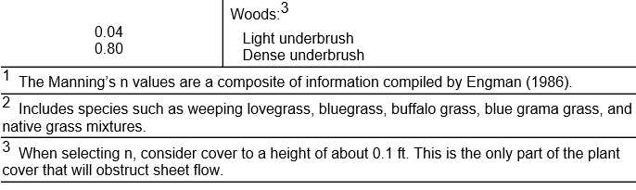
Manning’s N values

Slide 13
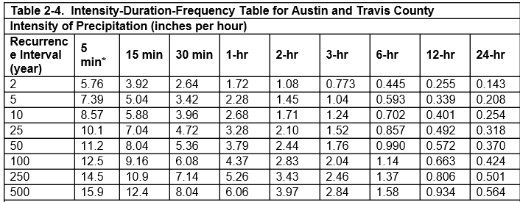
Intensity-Duration-Frequency Curves

