Slide 1
CE 365K Hydraulic Engineering Design
Inlet Design
By David R. Maidment
Spring 2016

Slide 2
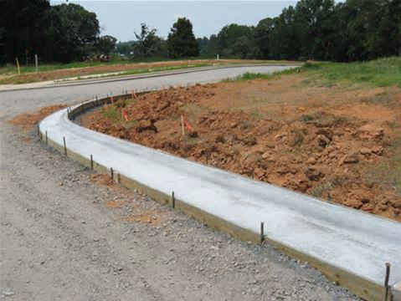
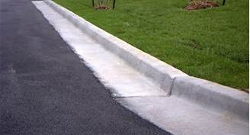
Curb and Gutter
Under Construction
Completed
Curb
Gutter
http://www.ellsworthinc.com/concretework.html
http://www.sscsitework.com/Photo-Gallery.html

Slide 3
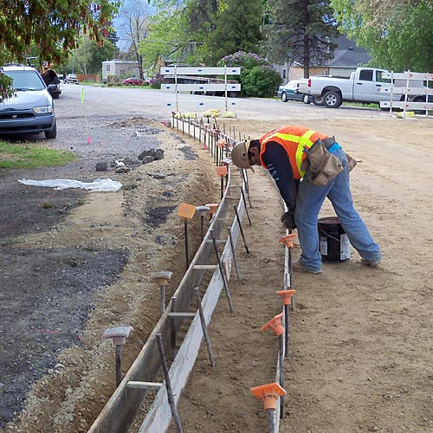
Curb and Gutter Formwork
http://overmanconcrete.com/concrete-services.html

Slide 4
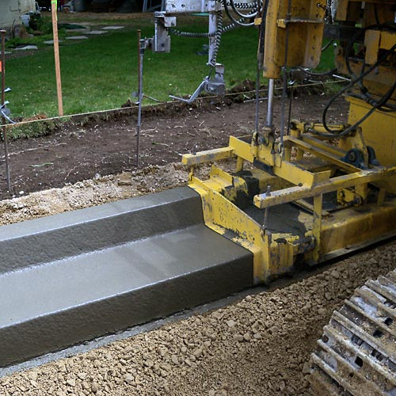
Curb and Gutter Machine
http://overmanconcrete.com/concrete-services.html

Slide 5
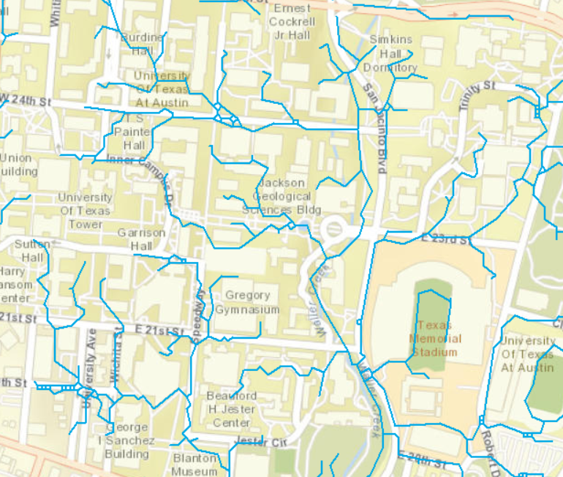
Drainage Patterns at UT-Austin

Slide 6
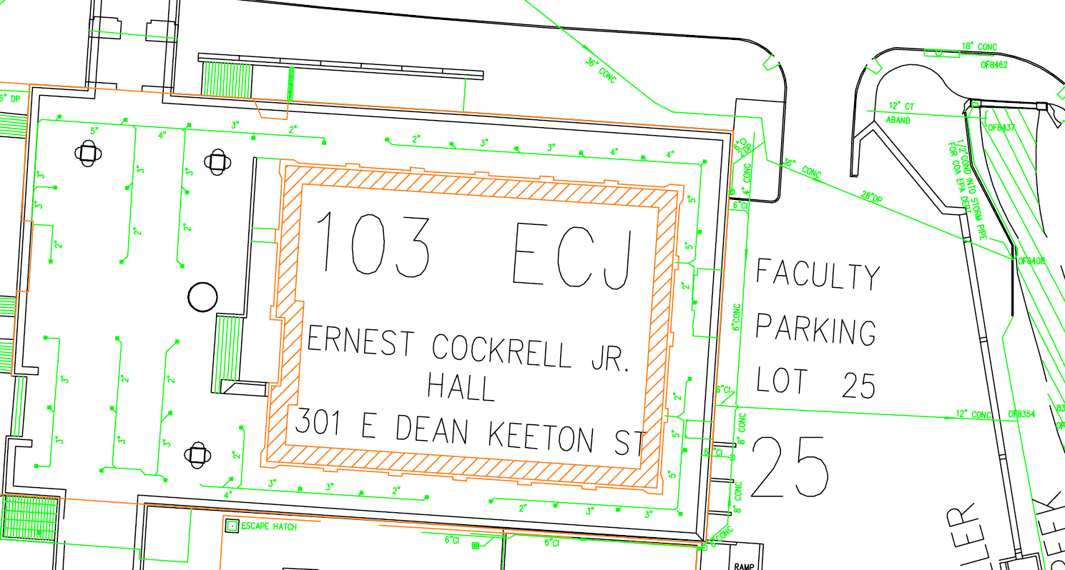
ECJ and Waller Creek

Slide 7
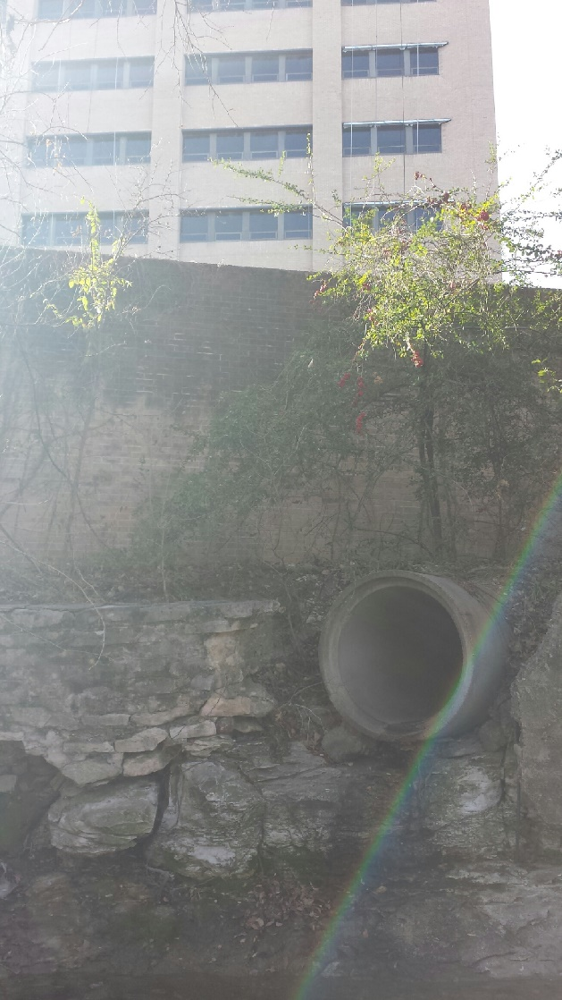
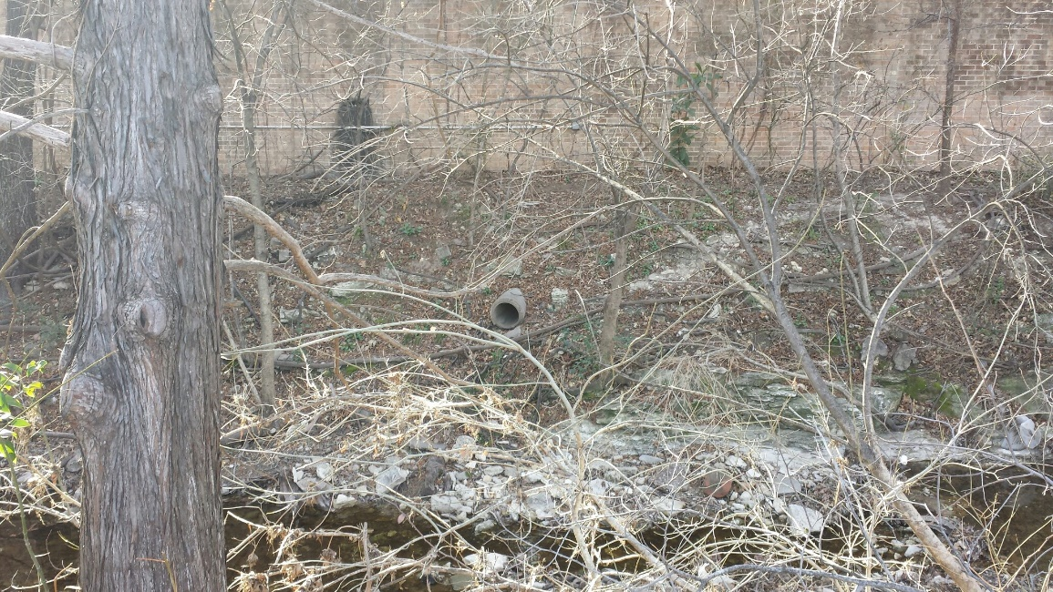
Pipe Outlets to Waller Creek

Slide 8
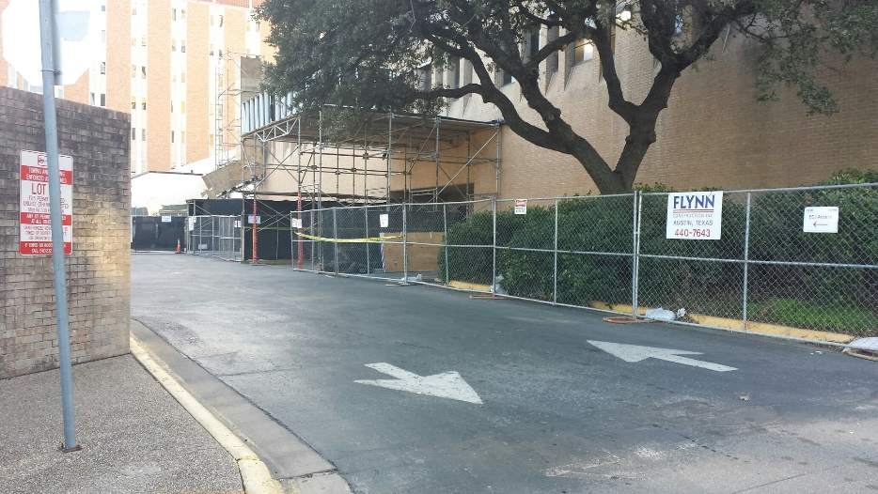
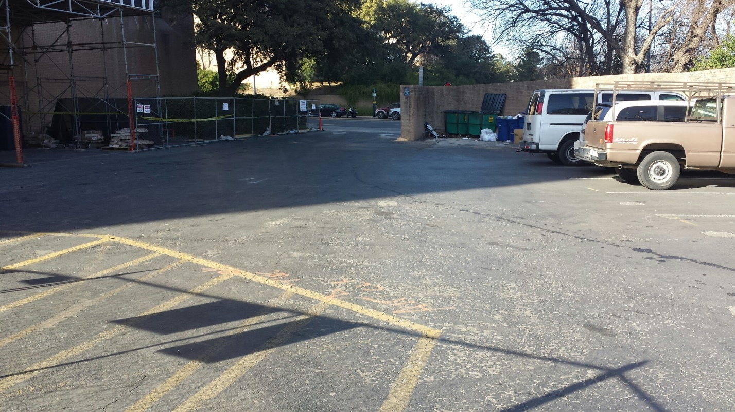
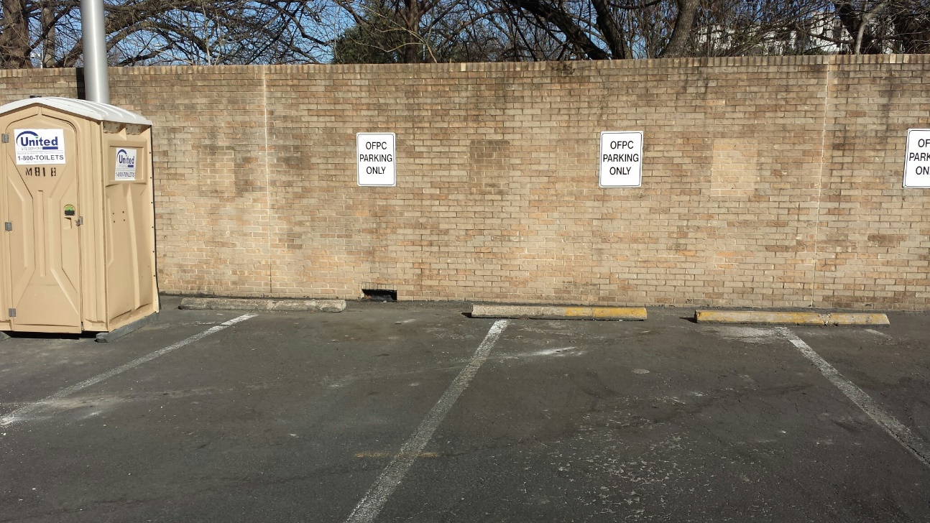
ECJ Parking Lot

Slide 9
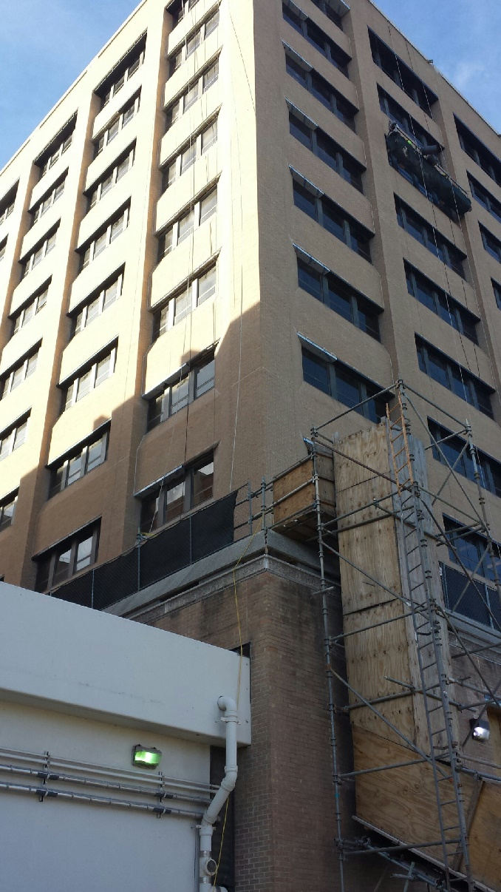
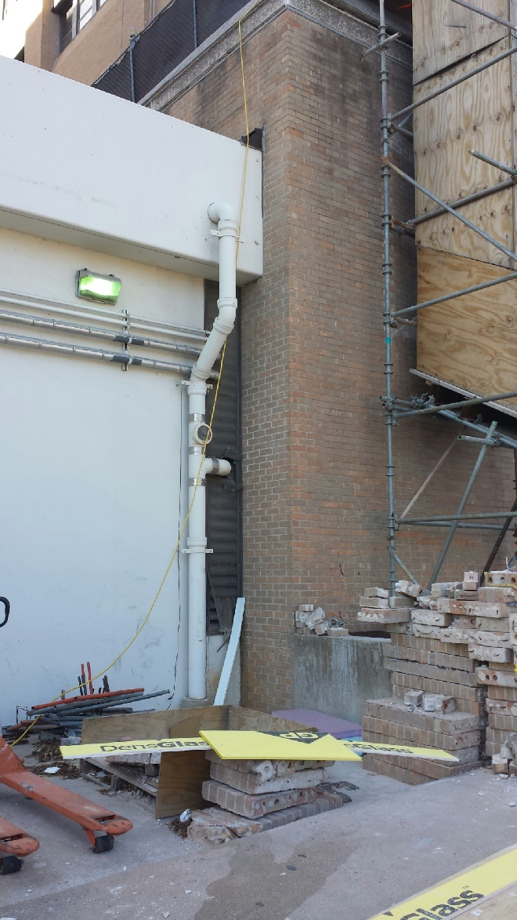
Roof Drains

Slide 10
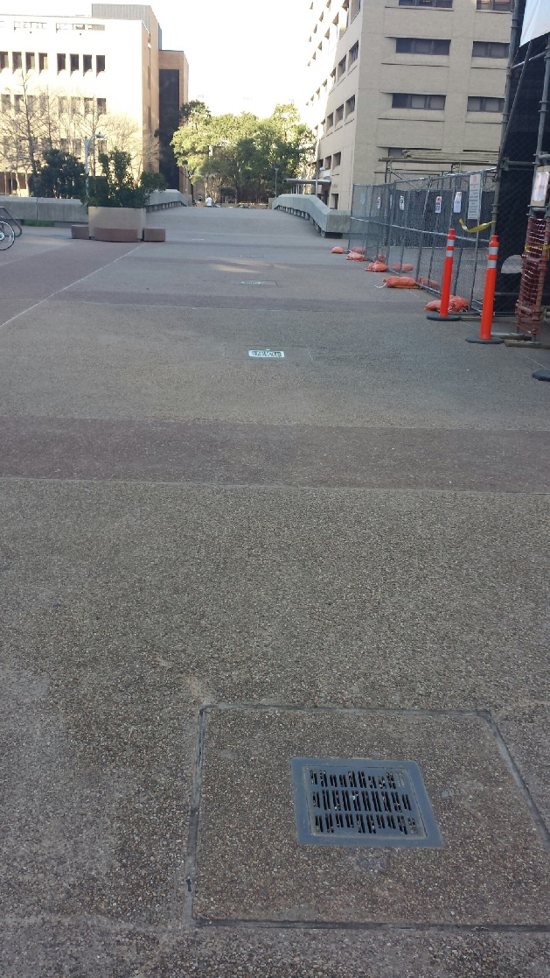
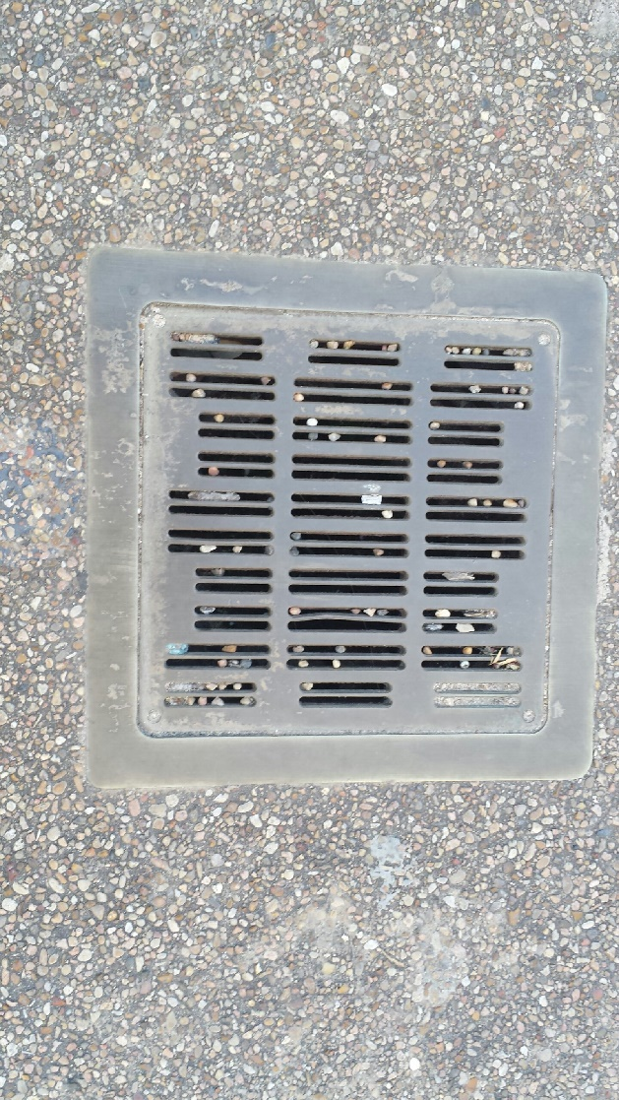
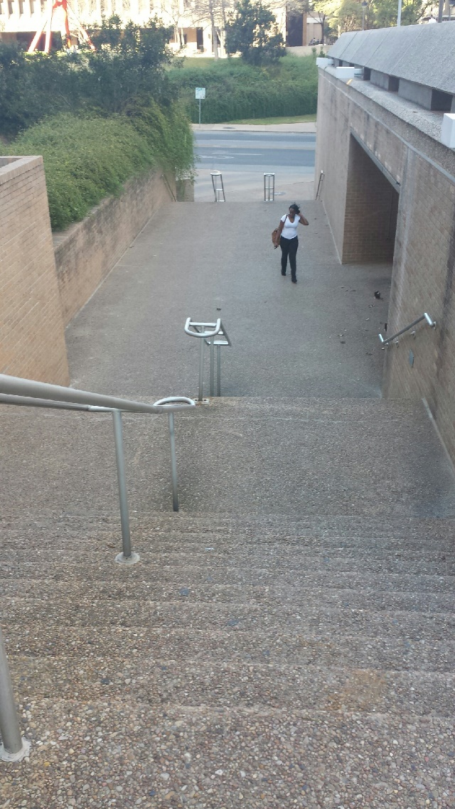
Drainage System on Plaza

Slide 11
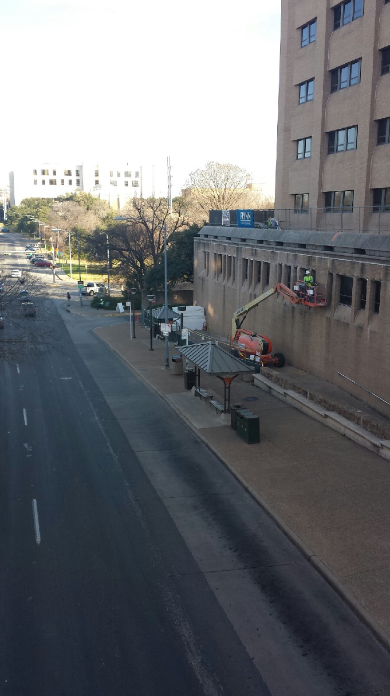
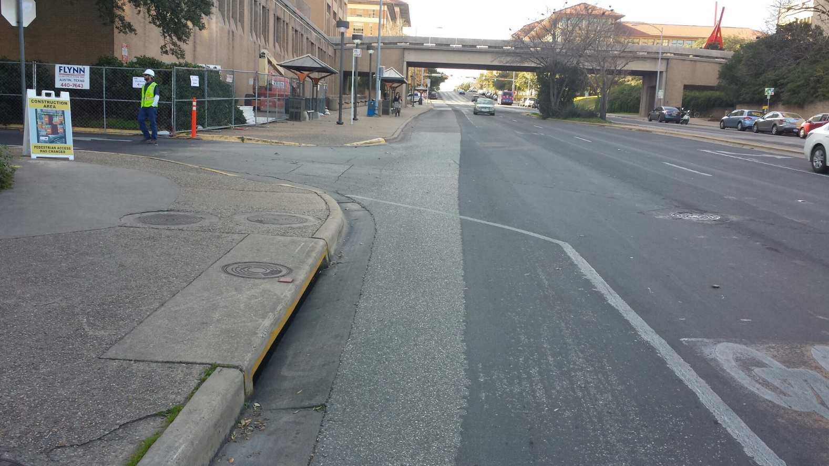
Stormwater Inlet on Dean Keaton

Slide 12
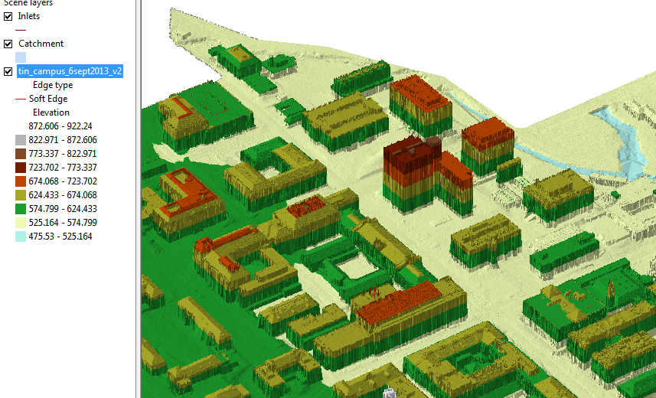
TIN of the North East part of campus
ECJ

Slide 13
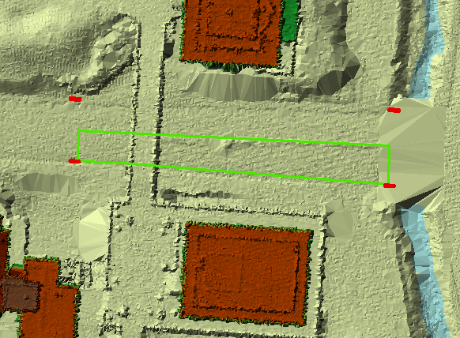
Airborne LIDAR coverage of Dean Keaton St and surroundings
CrossSection 56
Location

Slide 14
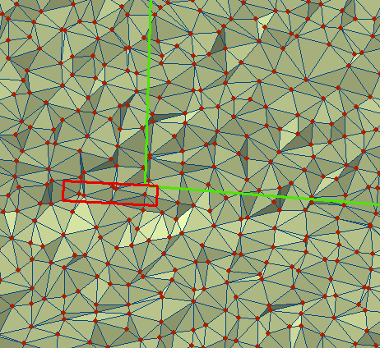
TIN of a portion of Dean Keaton St

Slide 15
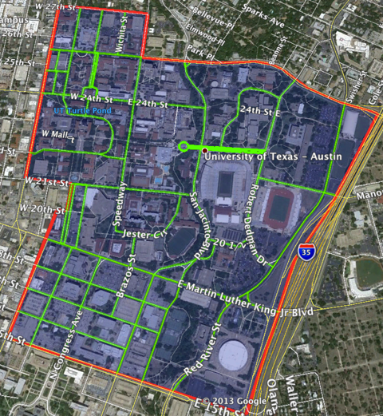
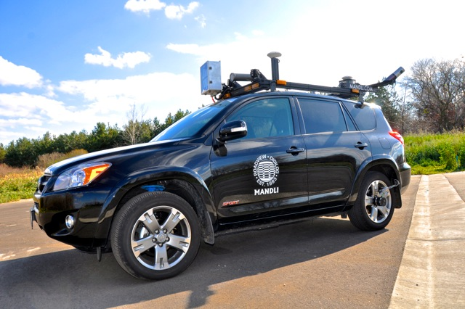
Vehicle-based LIDAR collection at UT-Austin
Mandli Communications

Slide 16
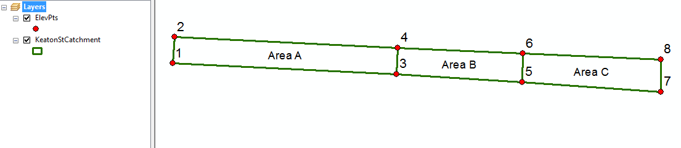
Dean Keaton St
CrossSection 56
Location

Slide 17
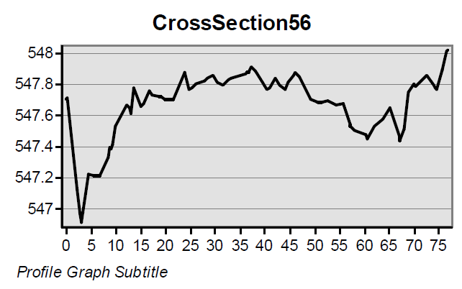
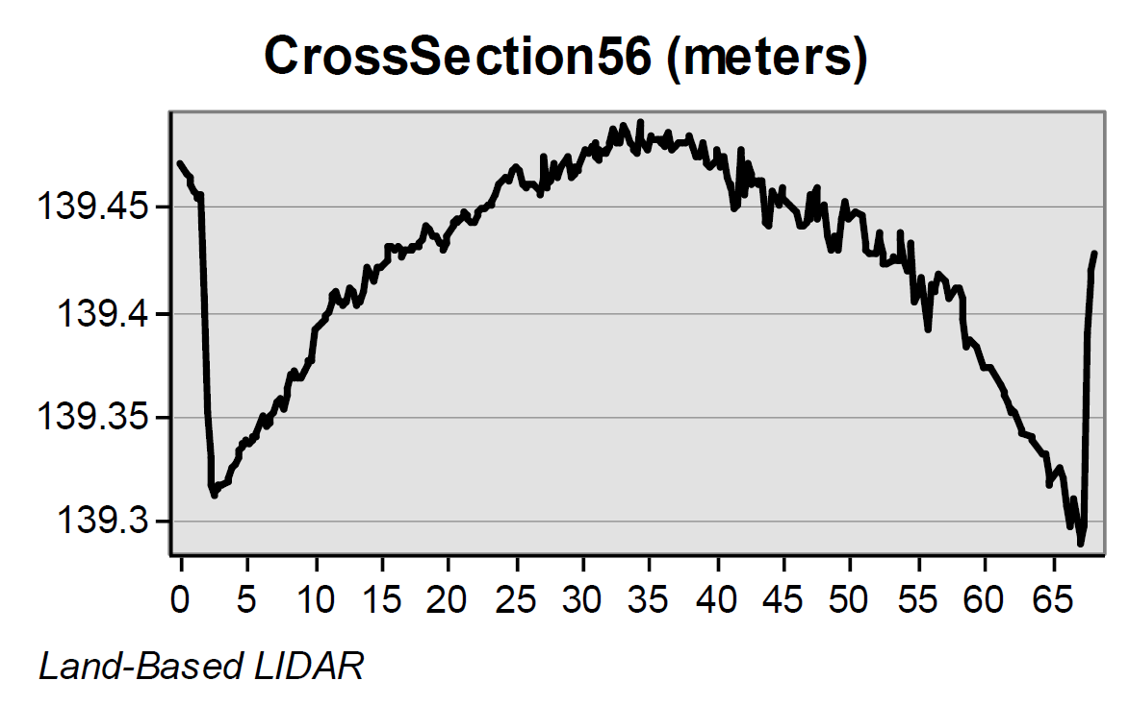
Road CrossSections from LIDAR
Location 5-6 is shown
in previous slides
Airborne LIDAR (ft)
(City of Austin data)
Its clear that the vehicle-based
LIDAR gives a better definition
of the road Cross-Section
Vehicle LIDAR (m) (Mandli Communications)

Slide 18
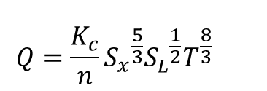
Gutter Flow
$$Q=\frac{K_{c}}{n}{{{S_{x}^{}}^{\frac{5}{3}}{S_{L}^{}}^{\frac{1}{2}}T^{\frac{8}{3}}}_{}^{}}^{}$$
T
d
S_{x}
1
Q = flow in gutter (cfs)
K_{c} = coefficient (0.56 for US units, 0.376 for SI units
S_{L} = longitudinal slope
T = spread (ft)
S_{x} = transverse slope
Ref: Haested p. 99

Slide 19
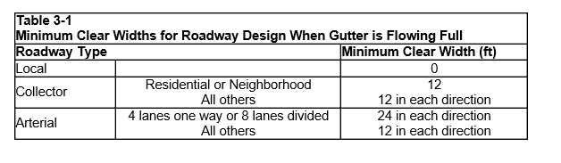
City of Austin Drainage Criteria for Minimum Clear Width
City of Austin, Drainage Criteria Manual, Section 3

Slide 20
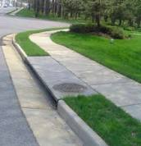
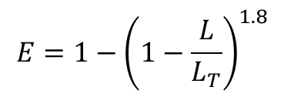
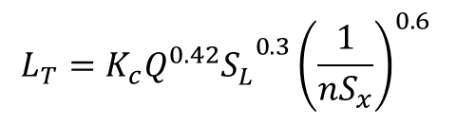
Flow into a Curb Inlet
L_{T}
$$L_{T}={{{K_{c}Q^{0.42}S}_{L}^{}}^{0.3}{\left(\frac{1}{nS_{x}}\right)}^{0.6}}_{}$$
L_{T} = required length to intercept all flow (ft)
Q = flow in gutter (cfs)
K_{c} = coefficient (0.60 for US units, 0.817 for SI units)
S_{L} = longitudinal slope
S_{x} = transverse slope
$$E=1−{\left(1−\frac{L}{L_{T}}\right)}^{1.8}$$
E = efficiency (proportion of flow captured
L = actual length (ft) (for L < L_{T})
Ref: Haested p. 103

