Slide 1

National Flood Interoperability
Experiment
David R. Maidment

Slide 2

National Flood Interoperability Experiment
David R. Maidment
Center for Research in Water Resources
University of Texas at Austin
UT Austin Flood Symposium, Austin, Texas, 11 February 2016
Acknowledgements: UT Austin Colleagues and Students, National Weather Service,
City of Austin, ESRI, Kisters, Microsoft Research
This research is supported in part by NSF EarthCube grant 1343785

Slide 3
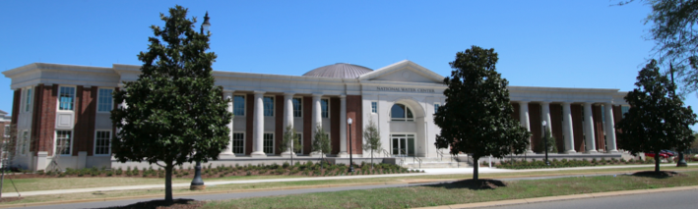
The Opportunity
New National Water Center established on the Tuscaloosa campus of University of Alabama by the National Weather Service and federal agency partners
Has a mission to assess hydrology in a new way at the continental scale for the United States

Slide 4

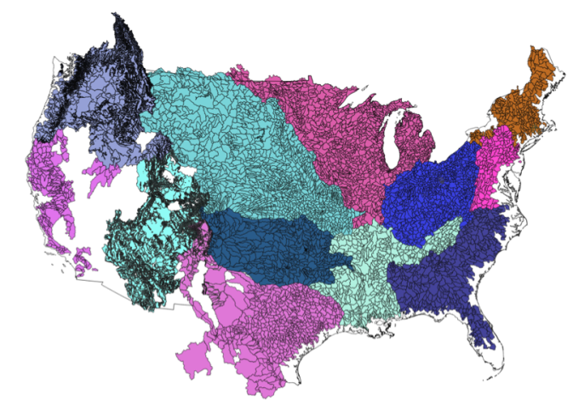
NWS River Forecast Centers (RFCs)
  Prepare river and flood forecasts using models based on average basin characteristics
  Provide forecast guidance to Weather Forecast Offices (WFOs)
  Issue daily stage and streamflow forecasts, rainfall and drought data and information, and flash flood guidance
  Work with water managers and other Federal Agencies
6600 sub-basins in continental US
4
Notes:
RFC Summary

Slide 5
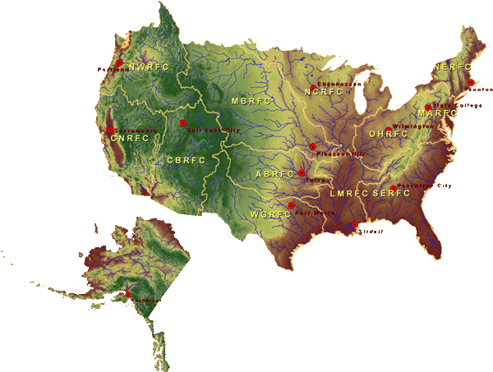

National Water Center
FY15 Centralized Water Forecasting
Centralized Data Archive – all RFC data
Modeling Evaluation Service
  RFC and NWC modeling and forecasts
Modeling Testbed – new NWC capabilities
Centralized Water Forecasting Demonstration
Notes:
TRANSITION INTO METHODS
FY15 PROJECT HAS FOUR CORE COMPONENTS
RFC archive
Model evaluation service
Modeling testbed
Centralized modeling demonstration

Slide 6
Transformative Research (NSF)
Transformative research involves ideas, discoveries, or tools that radically change our understanding of an important existing scientific or engineering concept or educational practice or leads to the creation of a new paradigm or field of science, engineering, or education. Such research challenges current understanding or provides pathways to new frontiers.
http://www.nsf.gov/about/transformative_research/definition.jsp
How to move from evolutionary change
to transformative change?

Slide 7


National Flood Interoperability Experiment (NFIE) (Sept 2014 to August 2015)
Partnership between NWS and the academic community (Interagency Agreement between NSF and NOAA)
Included a Summer Institute for 44 graduate students from 19 Universities at the National Water Center, June 1 to July 17, 2015

Slide 8
Goal of the Experiment
Close the gap between National Flood Forecasting and Local Emergency Response
Demonstrate forecasting of flood impacts at “stream and street level”
National
Weather and Hydrology
National Weather Service and federal agencies
National Water Center
River Flooding and Emergency Response
Local, State and Regional Agencies
Citizens
Local

Slide 9
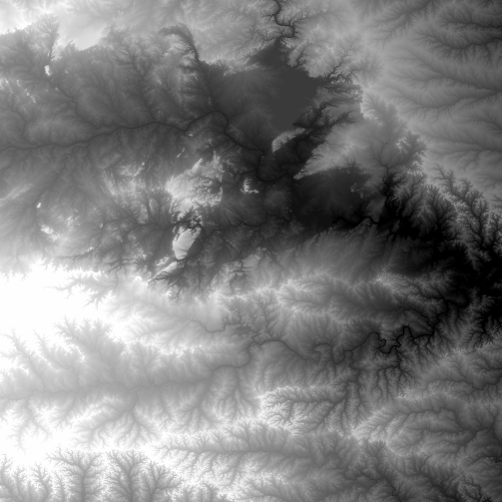
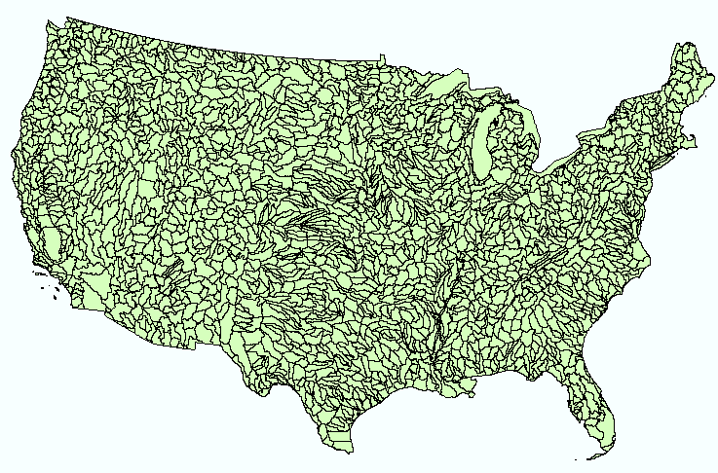
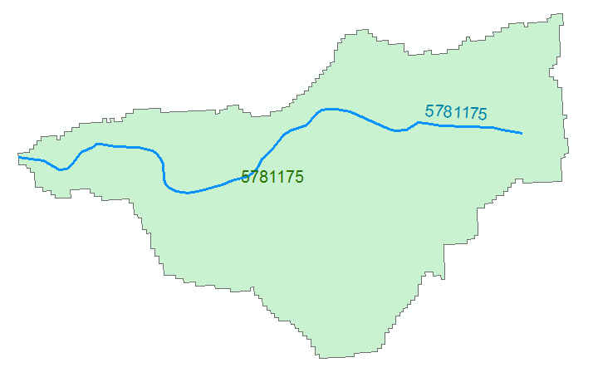
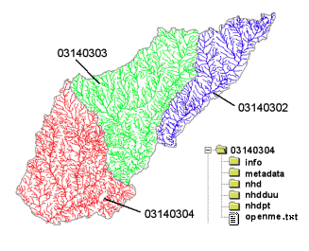
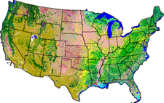
NHDPlus Version 2.1
Foundation for a Geospatial Hydrologic Framework for the United States
NHDPlus
2.7 million reach catchments in US
average area 3 km²
reach length 2 km
Uniquely labelled
National Elevation Dataset
Watershed Boundary Dataset
National Hydrography Dataset
National Land Cover Dataset

Slide 10
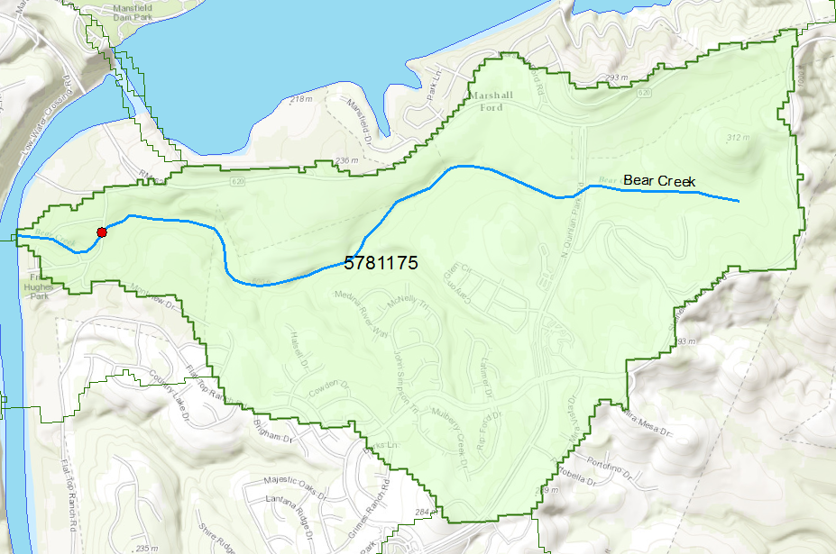
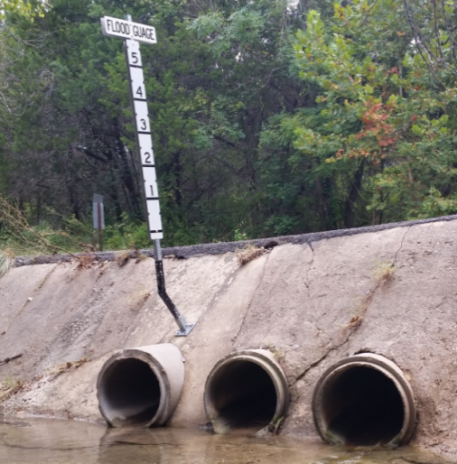
Flood Information for Fritz Hughes Park Rd
National Hydrography Dataset Plus
catchment for Bear Creek
(area = 5.71 km²)
Low water crossing at
3400 Fritz Hughes Park Rd

Slide 11

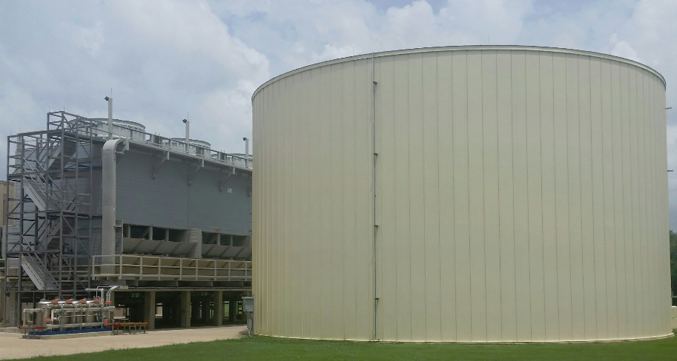
Stampede
1.2 million gallon cooling tank
500,000 processors operating in parallel

Slide 12
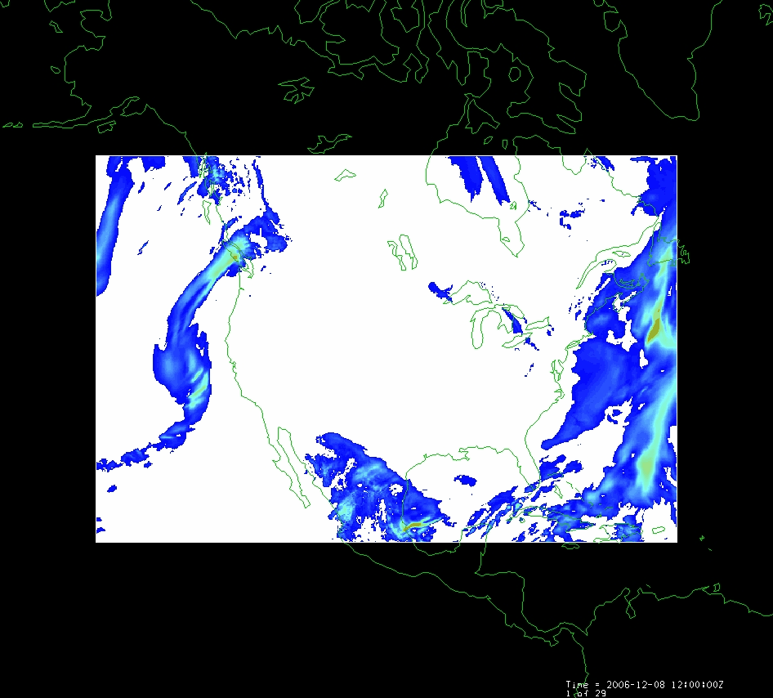
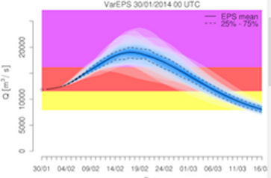
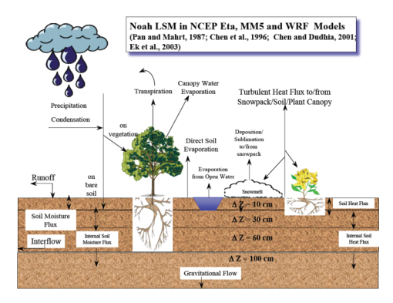
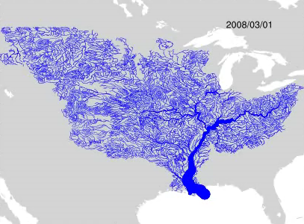
WRF-Hydro Forecasting Model
Computed for 2.7 million stream reaches of the continental US in 10 minutes
at Texas Advanced Computing Center
Weather model and forecasts (HRRR)
Probabilistic flood forecasts
Catchment-level forecasts
Weather
Precipitation
Streamflow
Runoff
Land-Atmosphere Model (NOAH-MP)
RAPID flow routing (for continental US)

Slide 13
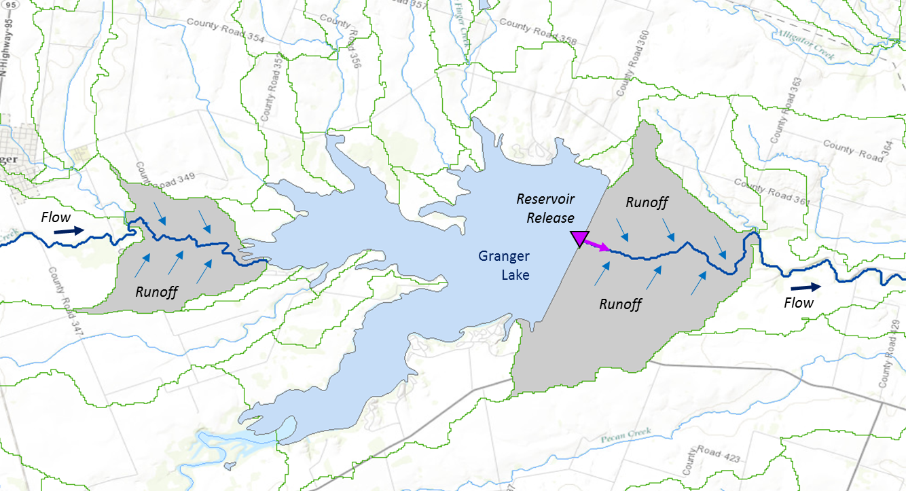
RAPID River Routing Model
River Application for Parallel ComputatIon of Discharge
Computational Unit for Rivers
Forcing: Runoff and reservoir releases
NHDPlus Catchment
Flow
Legend
Dam
Junction
Catchment
http://rapid-hub.org/

Slide 14
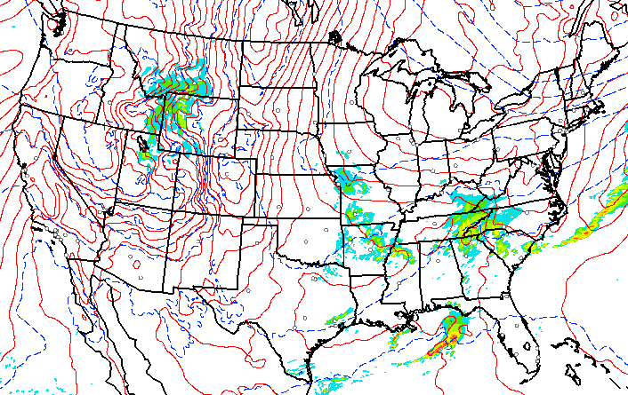
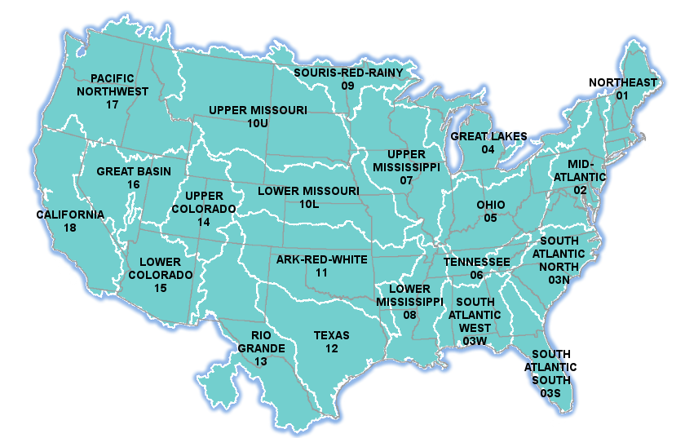

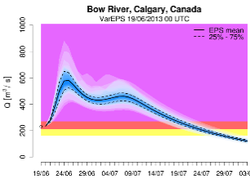
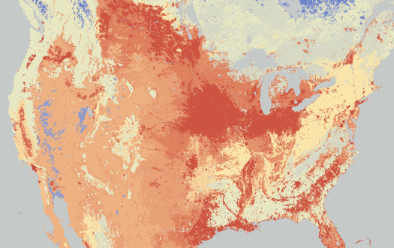
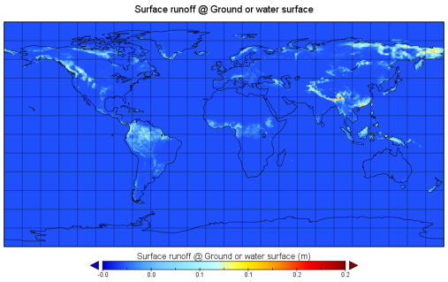

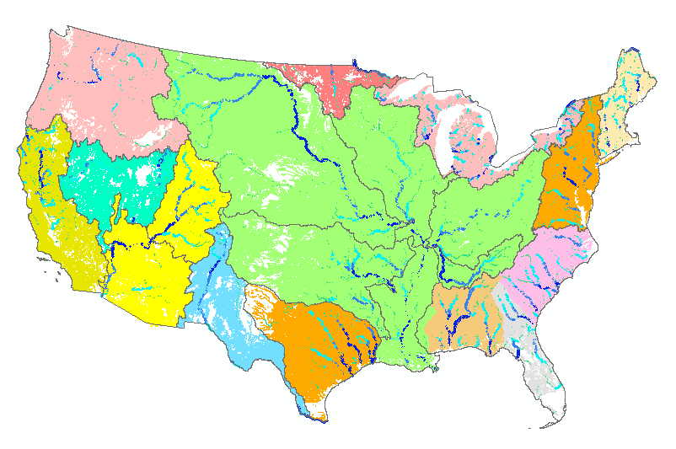

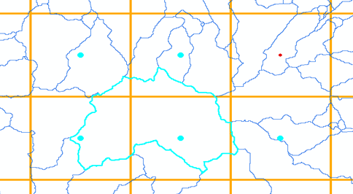

NFIE-Hydro – Flood Forecasting Models
HRRR
Forcing
NHDPlus
to RAPID
WRF-Hydro
ECMWF
TACC
Grid to
catchment

Slide 15
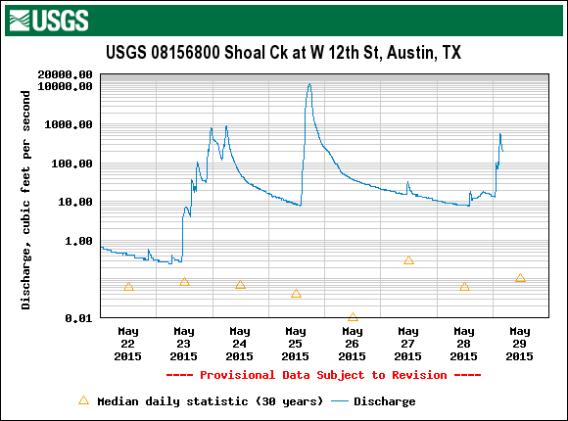
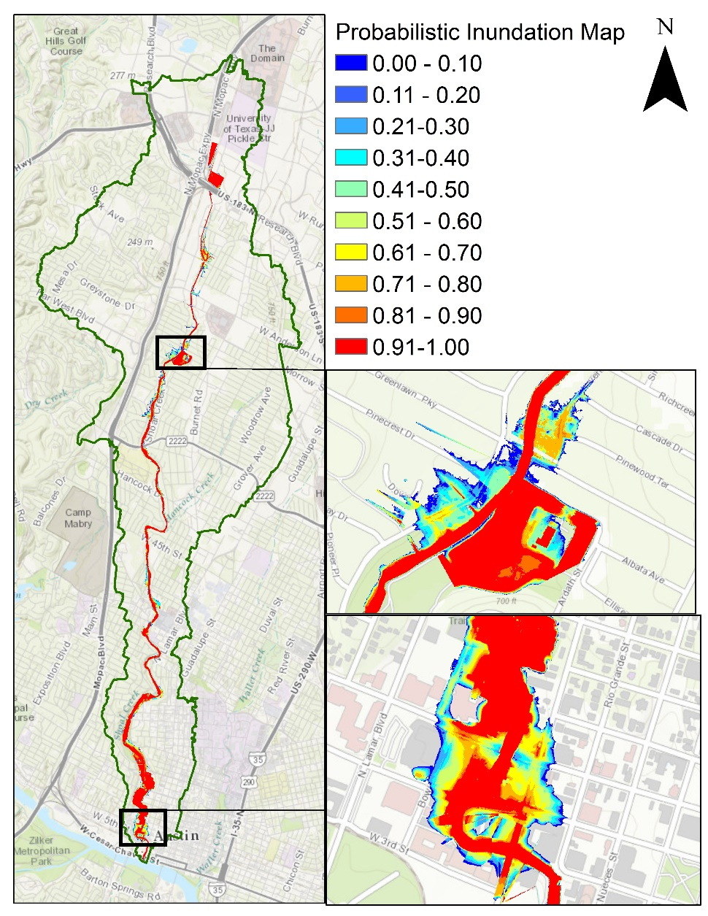
Probability of Flooding on Shoal Ck, Austin, Tx
HEC-RAS model
Rating curves library
ECMWF-RAPID flow forecasts
Deterministic flood maps
Probabilistic flood maps
Ensemble of 50 flood forecasts

Slide 16
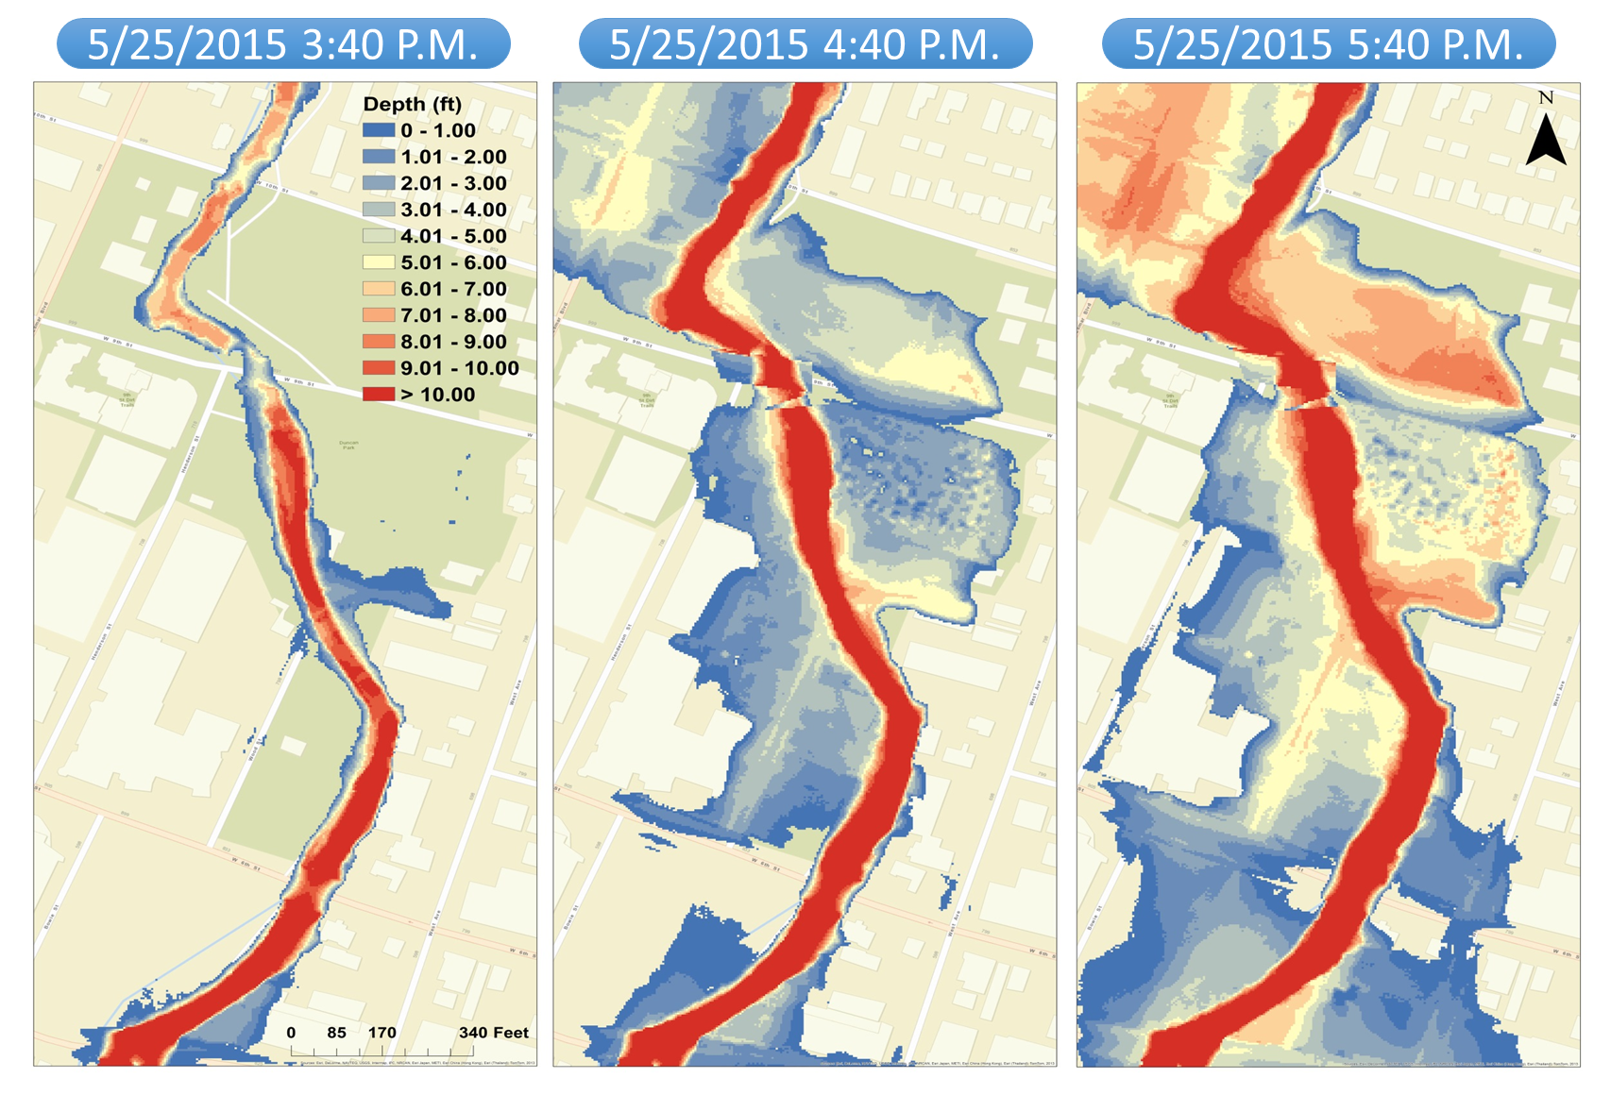
Progression of Memorial Day Flood on Shoal Creek

Slide 17
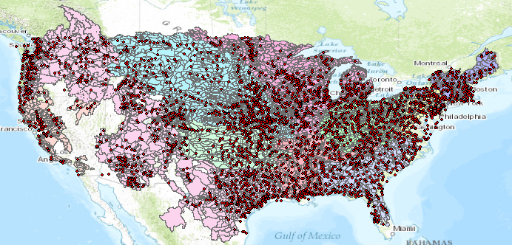
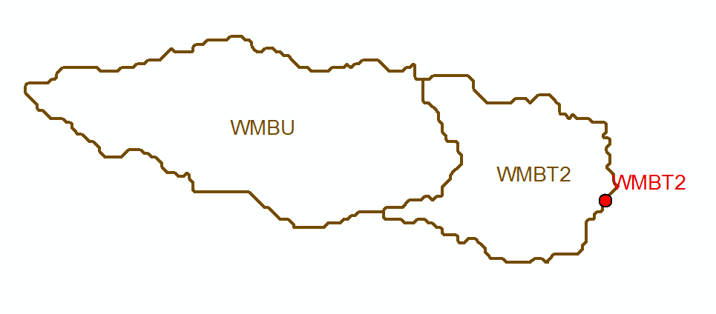
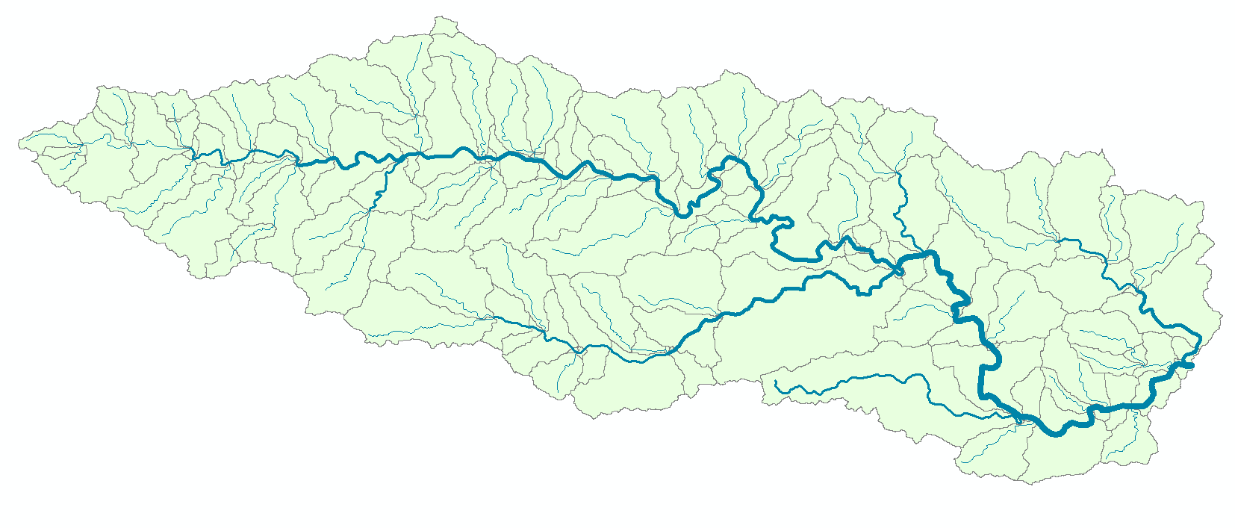
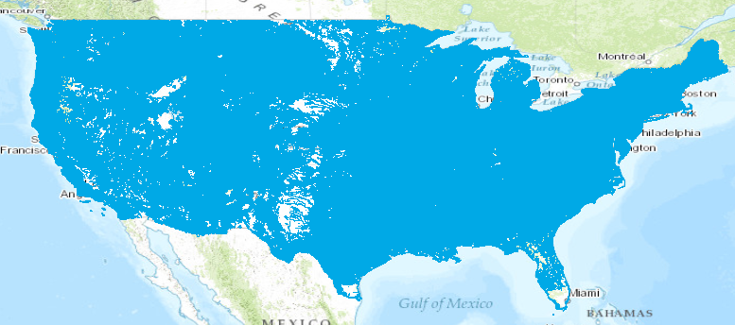
Flow Continuum Model – a national stream network, atmosphere to oceans, coast to coast
Blanco River at Wimberley
Current: 6600 basins and 3600 forecast points
Two basins and one forecast point
Watershed Hydrology – basins and outlet points
Basin ~ 400 Sq Mile
becomes
NFIE: 2.7 million stream reaches and catchments
Continental Hydrology – network flow continuum
Reach Catchment ~ 1 Sq Mile
130 Catchments and Flowlines
uniquely labelled
A national flow network

Slide 18
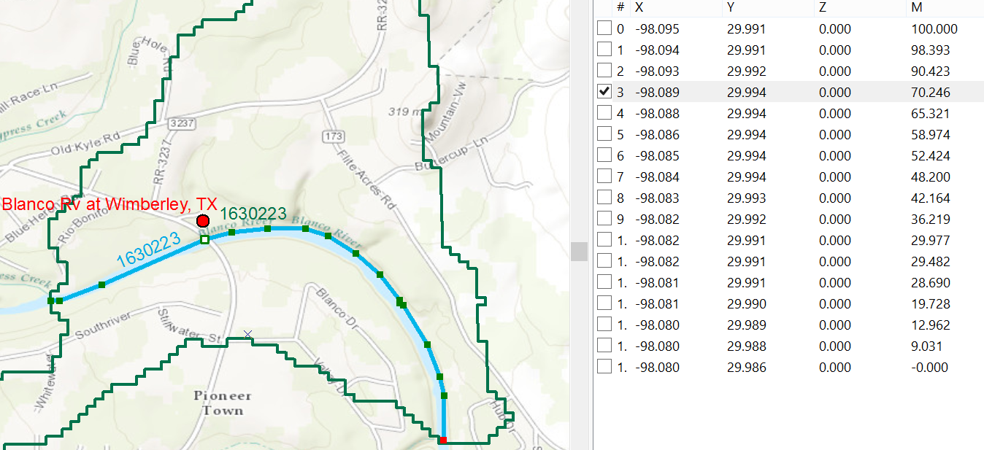
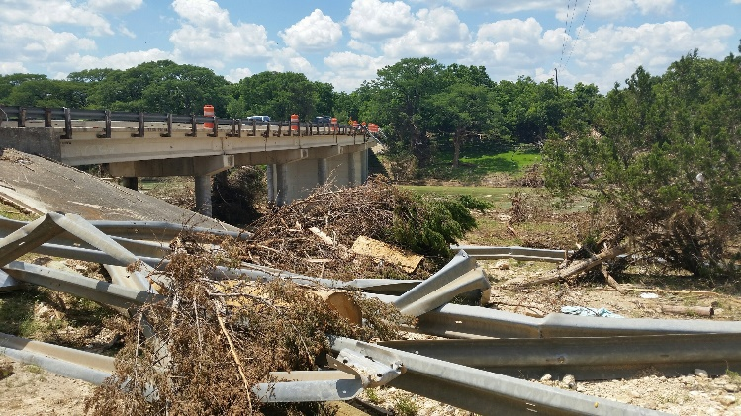
Linear Referencing on Flowlines
Using measures, the flow can be estimated at any point along the line
Bridge and Stream Gage at RR 12 is at Measure 70.246
on Flowline 1630223
Long.
Lat.
Measure
Measure is the % distance upstream from most downstream point on line

Slide 19
Next Step: National Water Model
WRF-Hydro Configurations – June 2016
Analysis & Assimilation
Short-Range
‘Flood Prediction’
Medium Range
‘Flow Prediction’
Long Range
‘Water Resources’
Cycling Frequency
Hourly
3-Hourly
Daily
~Daily (x16)
Forecast Duration
- 3 hrs
0-2 days
0-10 days
0-30 days
Spatial Discretization & Routing
1km/250m/NHDPlus Reach
1km/250m/NHDPlus Reach
1km/250m/NHDPlus Reach
1 km/catchment /NHDPlus Reach
Meteorological Forcing
MRMS blend/ HRRR-NAM bkgnd.
Downscaled HRRR /RAP/NAM blend
Short-range + Downscaled GFS
Downscaled & bias-corrected CFS

Slide 20
Multi-Year Strategic
Science and Services Plan
Total Water Prediction and National Water Center
FY 19-24
Major Integration
FY 18-23
Water Quality
Key Enhancement
FY 17-22
Dry Side: Drought and Post-Fire
Integrate enhanced NWM with key water quality data sets, models and tools to begin water quality prediction
  Incorporate water quality data from federal and State partners into NWM
  Link NWM output to NOAA ecological forecasting operations
  New decision support services for predicting water quality issues such as Harmful Algal Blooms
  New decision support services for emergencies such as chemical spills
  NWC operations center expands to include water quality decision support services
Major Integration
FY 16-21
Coastal Total Water Level
Key Enhancement
Couple NWM with groundwater and transport models to predict low flows, drought and fire impacts
  Add NWM processes that affect subsurface water movement and storage during dry conditions
  Add NWM ability to track constituents (e.g. sediment, contaminants, nutrients) through stream network
  New decision support services for water shortage situations and waterborne transport
  NWC operations center expands to include drought and post-fire decision support services
FY 15-20
Flash Flood and Urban Hydrology
Core Capability
Couple NWM with marine models to predict combined storm surge, tide, and riverine effects
  More complete picture of coastal storm impacts
  Water prediction information linked to geospatial risk and vulnerability
  New service delivery model implemented – increased stakeholder engagement and integrated information
  NWC operations center opens and provides national decision support services and situational awareness
Centralized Water Forecasting
Enhance NWM with nested hyper- resolution zoom capability and urban hydrologic processes
  Heightened focus on regions of interests (e.g. follow storms)
  Street level flood inundation forecasts for selected urban demonstration areas
  NWC increases guidance to NWS field offices to improve consistency and services for flash floods
National Water Model (NWM) operational May 2016
  Water forecasts for 2.7 million stream reaches in U.S.
  100 million people get a terrestrial water forecast for first time
  National Water Center (NWC) begins providing daily situational awareness and guidance to NWS field offices

Slide 21
Improvements in Flood Response Planning
Federal
GIS database and flood discharge forecasts
for 2.67 million stream reaches in
continental US from National Water Center
Conversion to water level forecasts and
inundation maps for 102,000 reaches in Texas
using 10m terrain data. Address points for flood
emergency response planning in each reach
State
Flood impact on transportation system
Flood response planning for stream reaches
and critical infrastructure. Inundation mapping
using LIDAR terrain data, if available.
Local
Flood response portal for citizens (ATXFlood)
Automated flood warnings from cell-phone
towers to phones in flood risk zones
Citizen

Slide 22
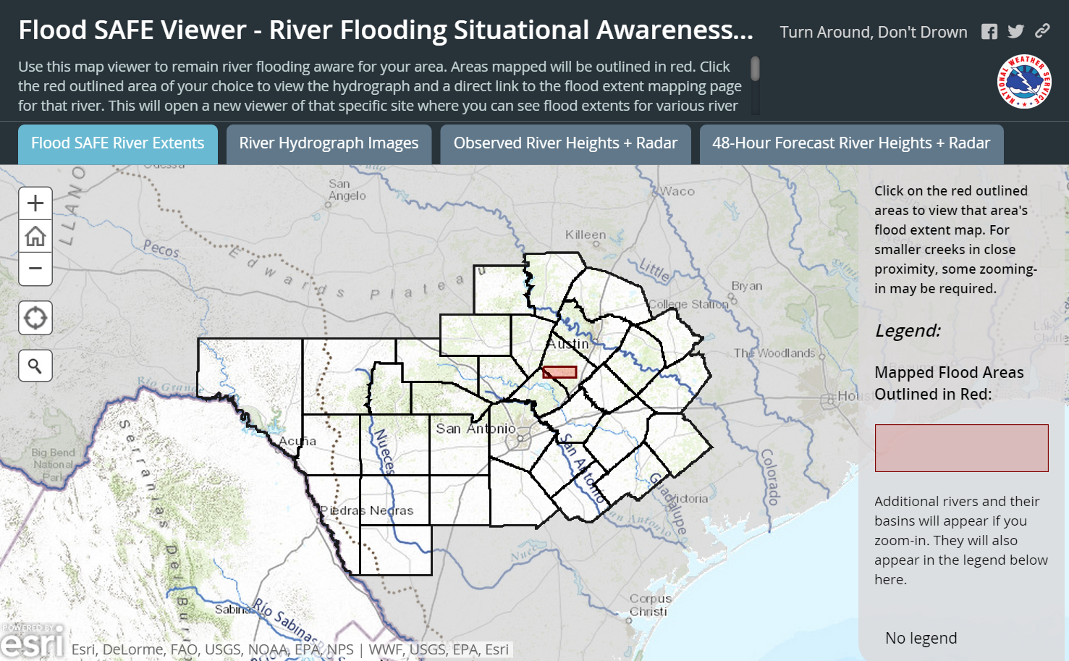
Situational Awareness For Everyone (SAFE)
Source: Jared Allen, NWS Austin-San Antonio Weather Forecast Office
Flood SAFE Viewer: http://arcg.is/1LPOHnE

Slide 23
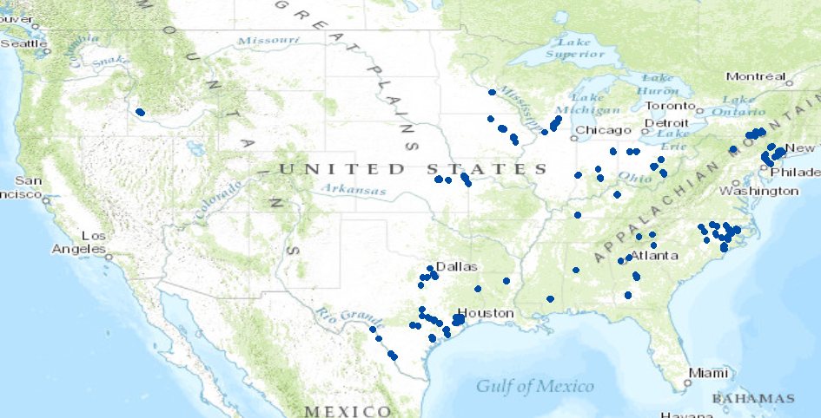
NWS Flood Inundation Maps for the US (130 in total)
33 maps in Texas (one quarter of total)

Slide 24
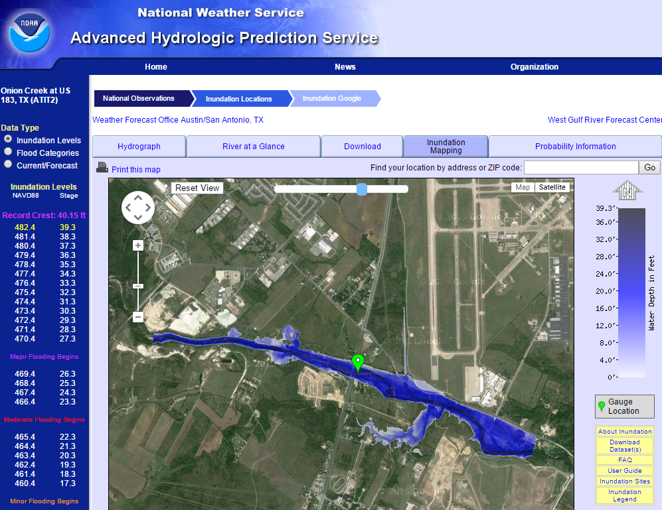
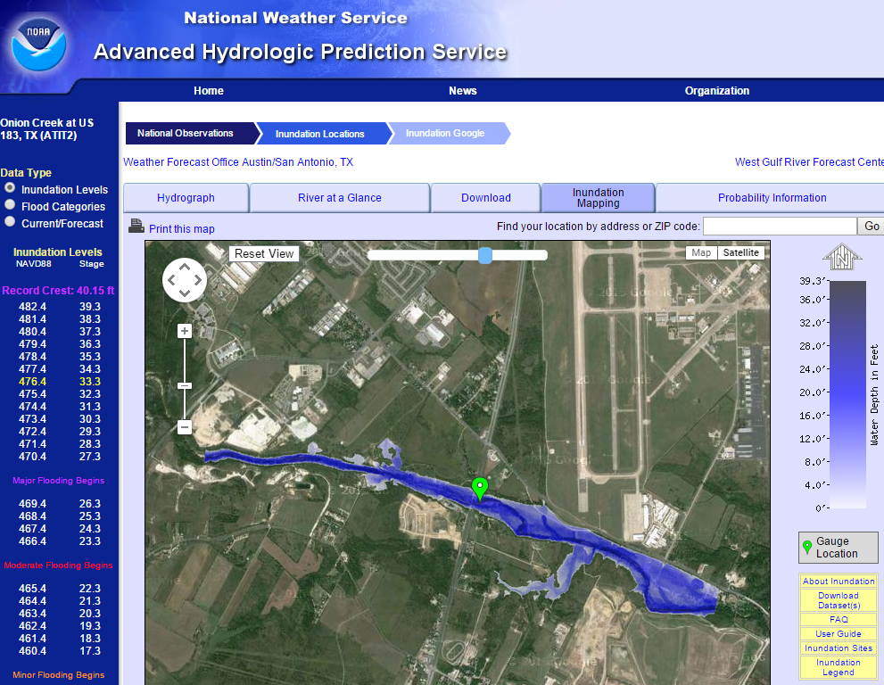
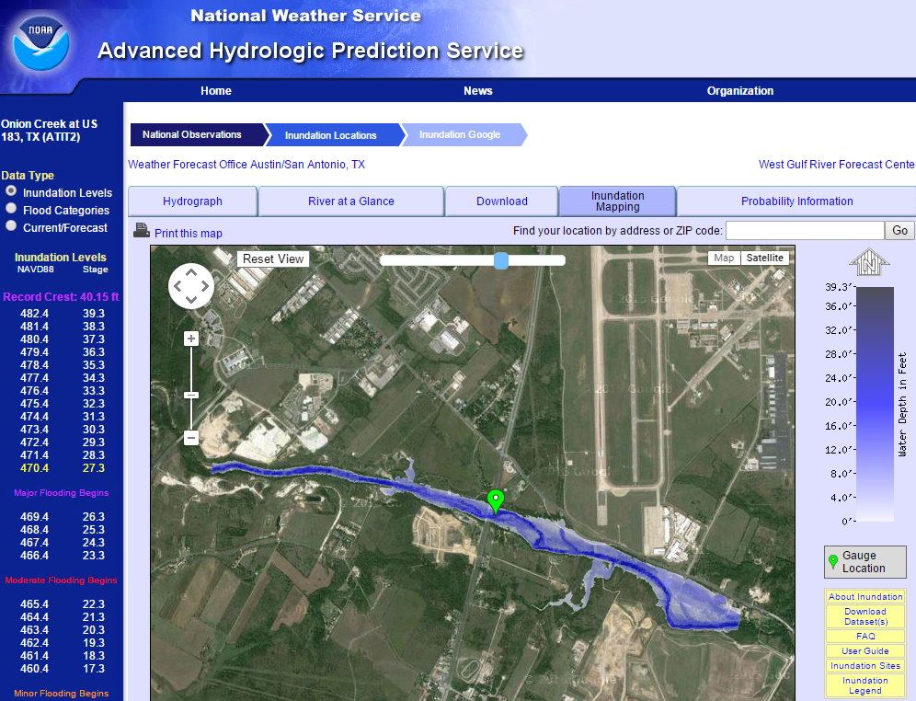

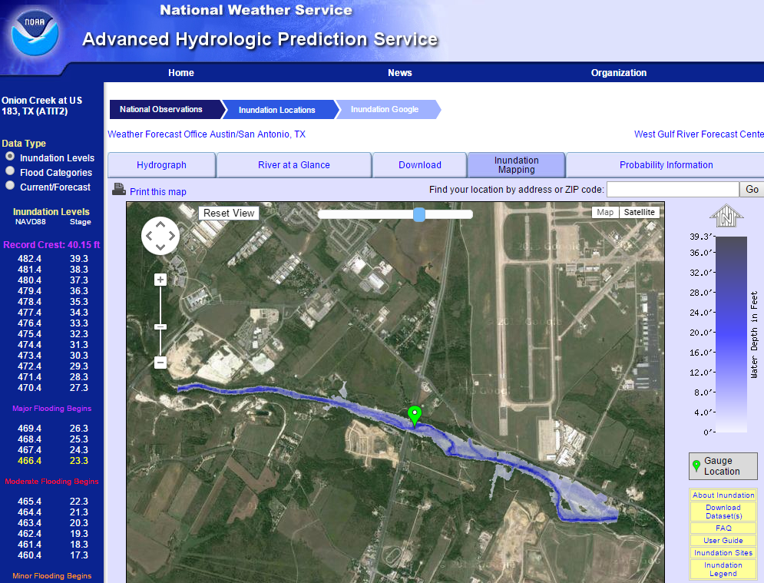
Real-Time Flood Inundation Mapping (USGS/NWS)
http://water.weather.gov/ahps2/inundation/inundation_google.php?gage=atit2

Slide 25




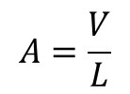
Reach Hydraulic Parameters
Comid | H | A | R | P | T | V | Ab | As
5781175 | 3
5781175 | 4
A_{s}
Surface Area
Wetted Bed Area
L
V
Volume
A_{b}
T
$$A=\frac{V}{L}$$
Cross Section Area
Depth
h
A
P
P$=\frac{Ab}{L}$
Wetted Perimeter
T$=\frac{As}{L}$
Top Width
R$=\frac{A}{P}$
Hydraulic Radius

Slide 26
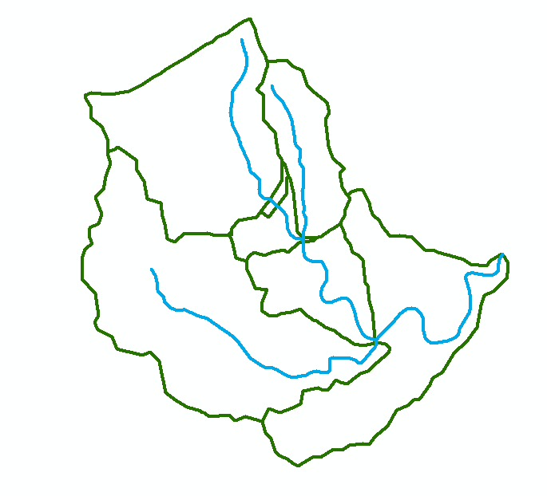
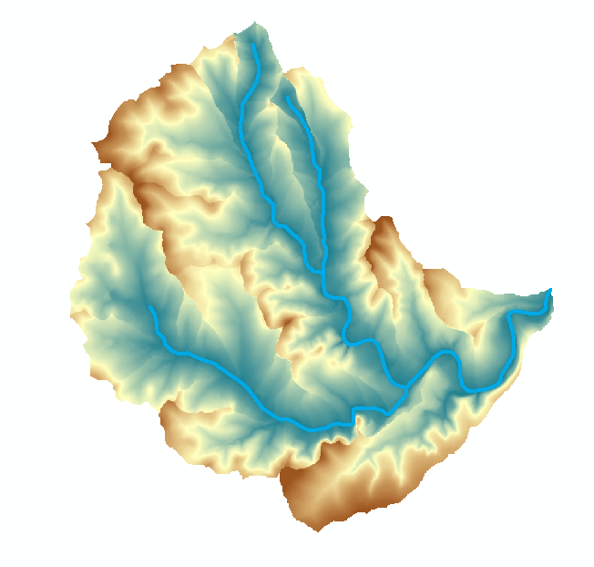
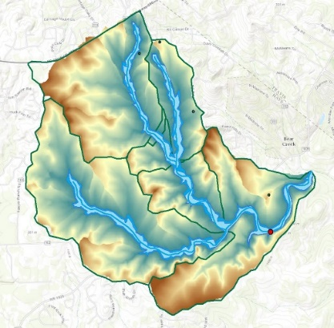

Flood Inundation Mapping
Catchments and Flowlines
Height Above Nearest
Drainage (HAND)
(relative elevation of land
surface cell above cell in
stream to which it flows)
Inundation map
(Depth to stream < 15 ft)
Digital Elevation Model

Slide 27
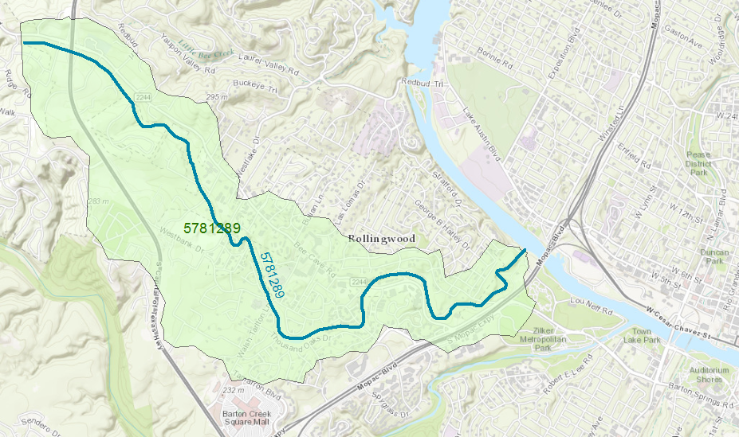
Reach Catchment 5781289
Eanes Creek, Rollingwood, Texas
Drainage area = 3.13 mi²
Reach Length = 4.3 miles

Slide 28
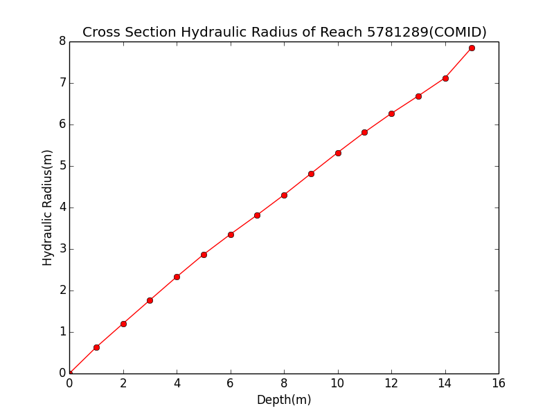
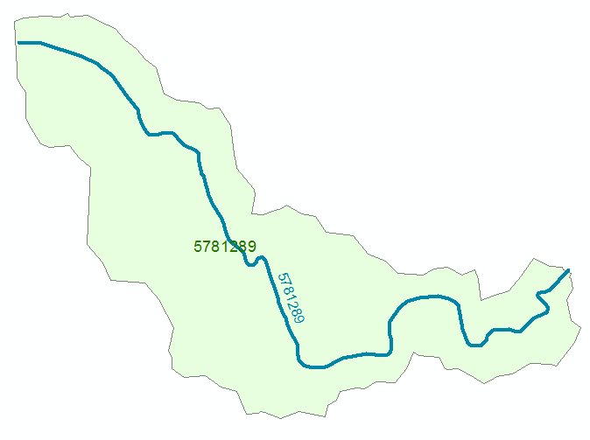
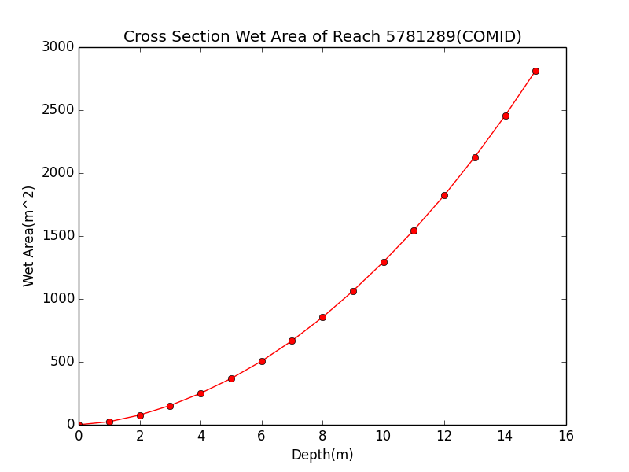

Discharge Computation
Hydraulic Radius, R
Flood Discharge, Q (cfs)
$$Q=\frac{1.49}{n}AR^{2/3}S_{o}^{1/2}$$
Flood Depth, h (ft)
Crossection Area, A
n = 0.035 Manning roughness of channel
S_{o} = 0.0163 Bed slope

Slide 29

Rating Curve for Eanes Creek
Flood Depth, h (ft)
$$Q=\frac{1.49}{n}AR^{2/3}S_{o}^{1/2}$$
Forecast Discharge, Q, from National Water Model

Slide 30

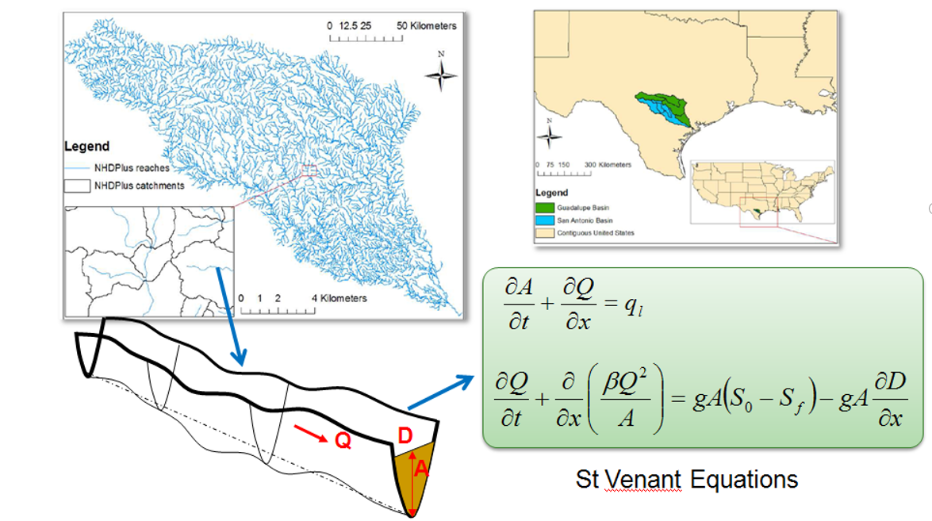


SPRNT Model – flow and water depth on large networks
Open source code in Github
Very Large Scale Integrated (VLSI) design of computer chips – solve 100 million equations each night to check on effects of design changes on electricity flow in chip
Dynamic wave routing
Compute water flow by analogy with electricity flow in chips

Slide 31
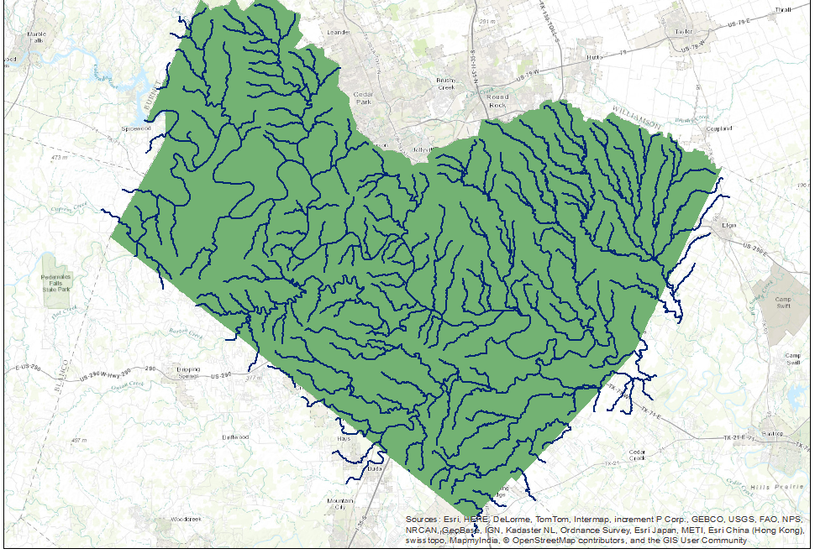
Rating the Landscape using SPRNT
Total 540 flowlines in Travis County.
Catchment Area: 2942.76 km²
Rainfall
Rainfall increased in uniform
increments of 1 mm/hr
Flow reaches equilibrium
in Travis County in 200 hours
Mannings “n” = 0.05
Time

Slide 32
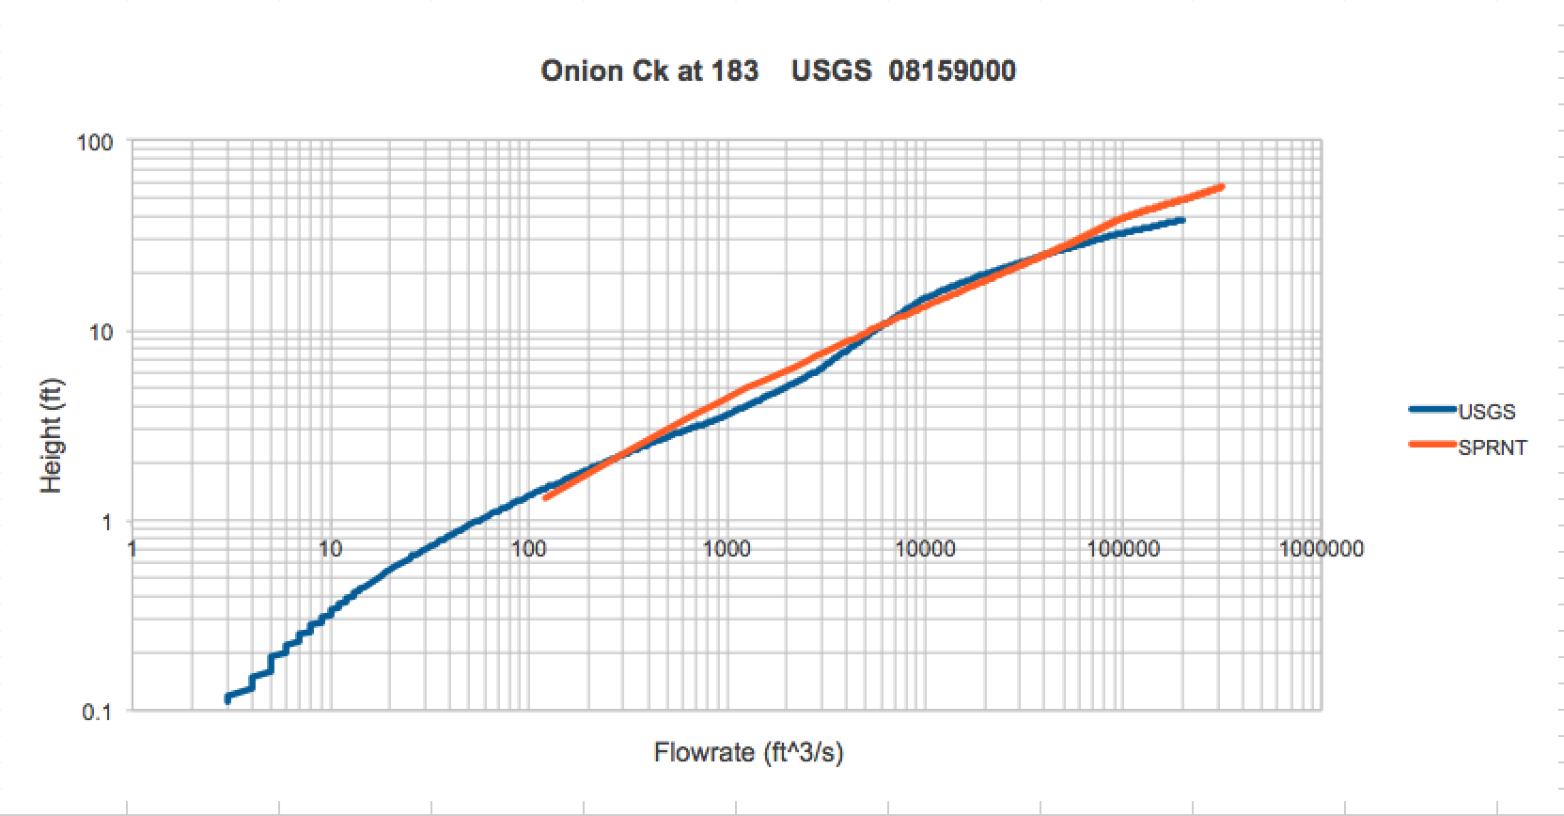
Rating Curves for Stream Gages in
Travis County
USGS Rating
SPRNT

Slide 33
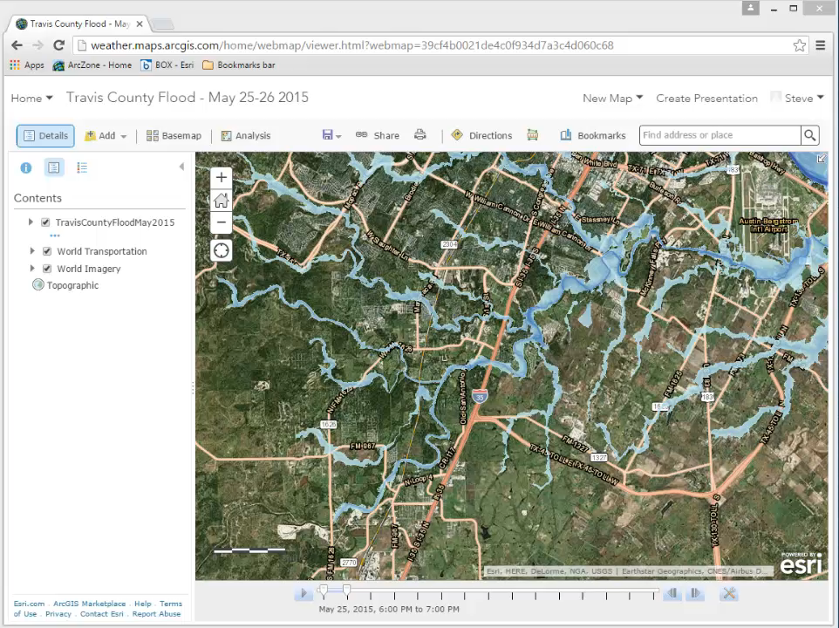

Slide 34


Community Flood Response Map Book
Source: Tomas Rodriguez, City of Austin

Slide 35

Flood Emergency Response Mapping
Table Top Exercise
Pre-planning Flood Maps
Detailed information about flood area
Used “on a blue sunny day”
Review what the flood could do
and how to respond
Operation Flood Map
Incident/Area Command
  Flood info at an area command level
  Laminated for recording situational awareness
  Able to log where units are assigned
Strategic
  Overview map of entire area
  Used at Emergency Operations Center
  Used to keep track of several area commands, groups of units
More information about this at Thursday Morning Flood Symposium

Slide 36


Strategic Overview Map
One area of risk

Slide 37

Incident/Area Command Map
Onion Creek at Pleasant Valley/William Cannon

Slide 38

Pre-Planning Flood Map
Actions, Indicators, Road Closures and Depth

Slide 39


Connecting with Local Decision Makers
Work with the first response community to define flood strategy for stream reaches
https://www.youtube.com/watch?v=ympaR6YUxiA&feature=youtube

Slide 40



