Slide 1
Critical Depth

Slide 2
Gradually Varied Flow Profile
Normal Depth

Slide 3
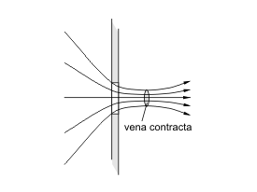

Vena Contracta
Contraction = $\frac{A_{2}}{A_{1}}$ ~ 0.64
A₁
A₂
http://en.wikipedia.org/wiki/Vena_contracta

Slide 4
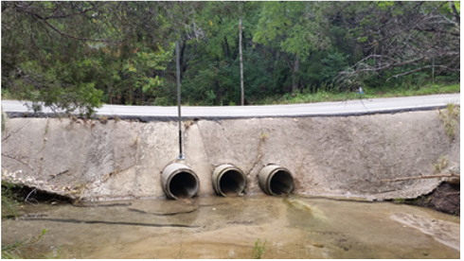
Road Culvert

Slide 5
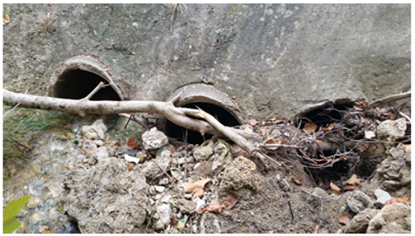
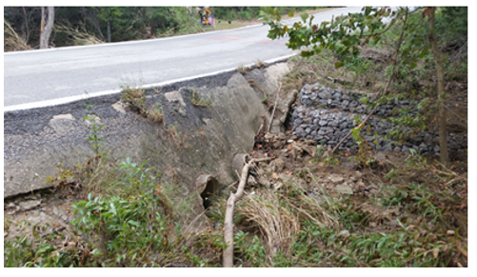
Road Culvert (upstream side!)
How do we deal with potential blockages in design?

Slide 6
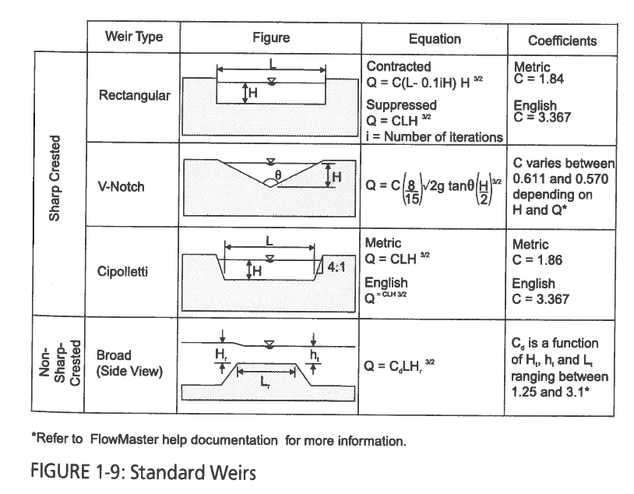
Weir Coefficients
Source: “Computer Applications in Hydraulic Engineering”, 8th Ed. Haested Methods, 2013

