Slide 1
Stormwater Best Management Practices
Michael Barrett, Ph.D., P.E.
University of Texas at Austin

Slide 2
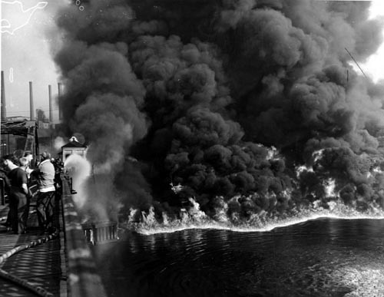
Cuyahoga River, Cleveland

Slide 3
Dates to Remember
1948 Federal Water Pollution Control Act passed by Congress
1972 Clean Water Act prohibits any discharge of pollutants without NPDES permit - (fishable and swimmable)
1987 Clean Water Act amended to require permits for stormwater discharges
2003 NPDES Phase II permits required

Slide 4
Clean Water Act
Requires NPDES permit for stormwater from cities, industry, construction sites
Requires assessment of beneficial uses and impairments of receiving waters
Impaired segments reported to EPA – 303(d) list.
Development of TMDL (total maximum daily load) for impaired segments

Slide 5
Common Impairments
Constituent/Parameter | Number of Water Bodies Impaired
Bacteria | 418
Low Dissolved Oxygen Concentration | 130
PCBs | 104
Salinity | 102
Dioxins | 90
Mercury | 75

Slide 7
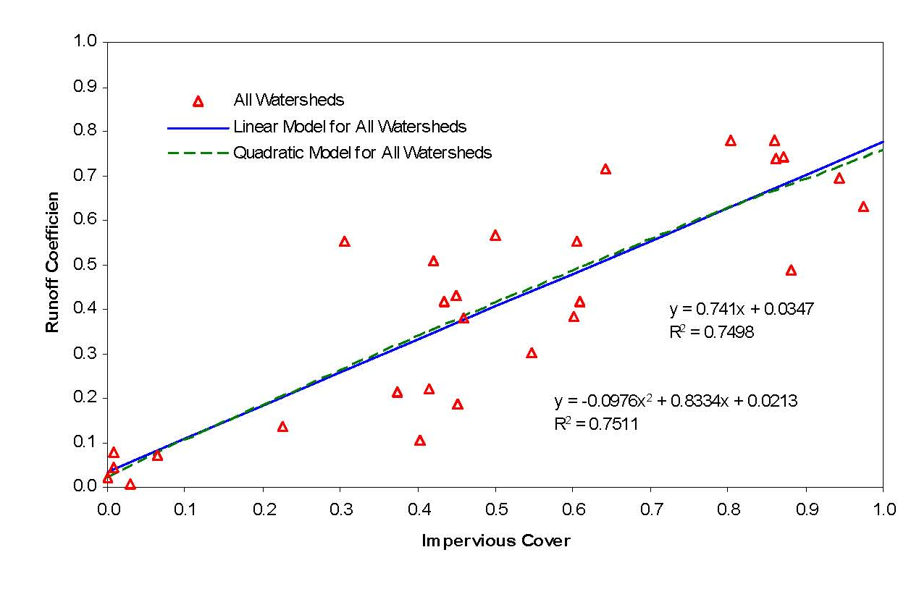
Impervious Cover and Runoff

Slide 8
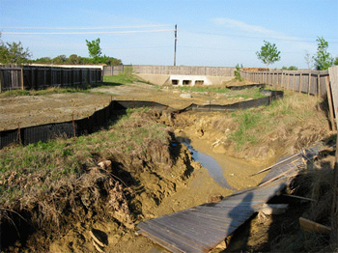
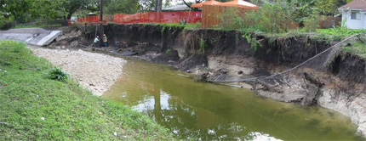
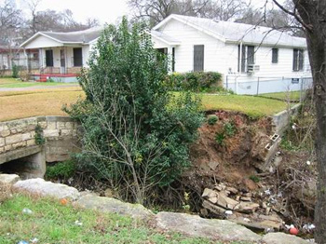
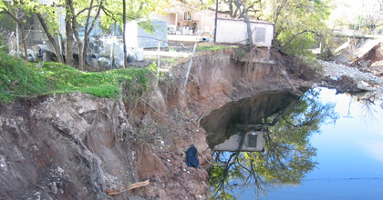
Channel Degradation
Bear Creek
Fort Branch
ShoalCreek
Boggy Creek

Slide 9
Constituents in Urban Runoff
Bacteria – fecal coliform, e coli.
Nutrients – nitrate/nitrite, TKN, total phosphorus
Insecticides
Herbicides
Metals – zinc, copper, lead
Hydrocarbons – PAHs
Sediment – Total suspended solids

Slide 10
Sources of Pollutants
Vehicles – Tires, Brake pads, Fluids, Tracking
Atmospheric Deposition
Fertilizers
Pesticides
Pets
Pavement abrasion
Channel Erosion

Slide 11
Water Quality Data
https://data.austintexas.gov/Environmental/Water-Quality-Sampling-Data/5tye-7ray
http://www.fws.gov/southwest/es/Documents/R2ES/LitCited/4TX_Sal/COA_2006_Stormwater_runoff_quality_and_quantity_in_Small_Austin_Watersheds.pdf
https://www.tceq.texas.gov/assets/public/waterquality/standards/tswqs_2014/TSWQ2014Rule.pdf

Slide 12
Requirements for Stormwater Treatment
City of Austin – Required since 1981, mainly sand filters
TCEQ – Requires removal of 80% of sediment in stormwater for Edwards Aquifer
LCRA – Requires 70-75% removal of sediment, phosphorus, and oil & grease for Highland Lakes

Slide 13
Treatment Difficulties
Runoff occurs on an irregular basis
Volume and rate of runoff from storms is highly variable
Quality of runoff varies from storm to storm
Concentrations of constituents of concern often very low

Slide 14
“First Flush” of Pollutants
Stenstrom & Kayhanian, 2005

Slide 15
Best Management Practice (BMP) Selection
End-of-pipe
  Fewer facilities to manage, inspect, and maintain
  Little volume control
  Little redundancy
Onsite
  Low Impact Development (LID) – “Green Infrastructure”
  Maintain pre-development hydrology
  Lower cost
  More facilities

Slide 16
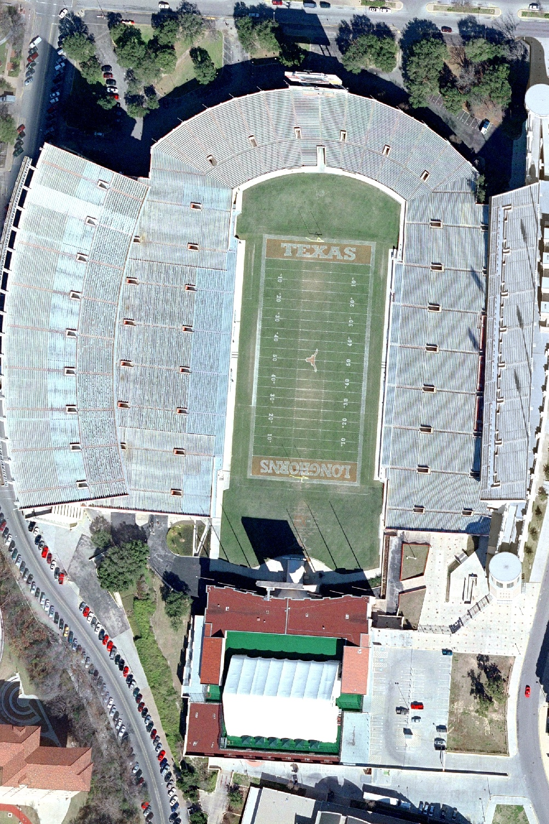
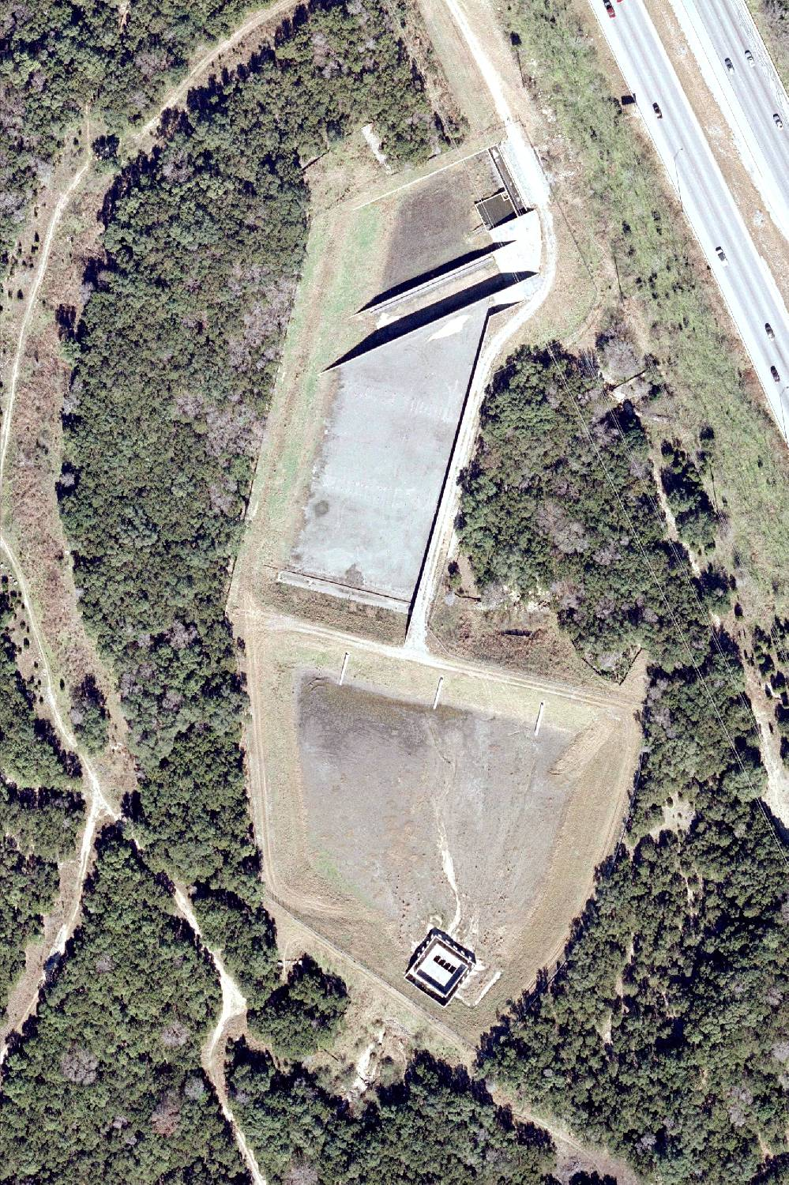
Courtesy Matt Hollon
1,000 ft
Loop 360
TxDOT Pond
Notes:
Extreme example of end of pipe.

Slide 17
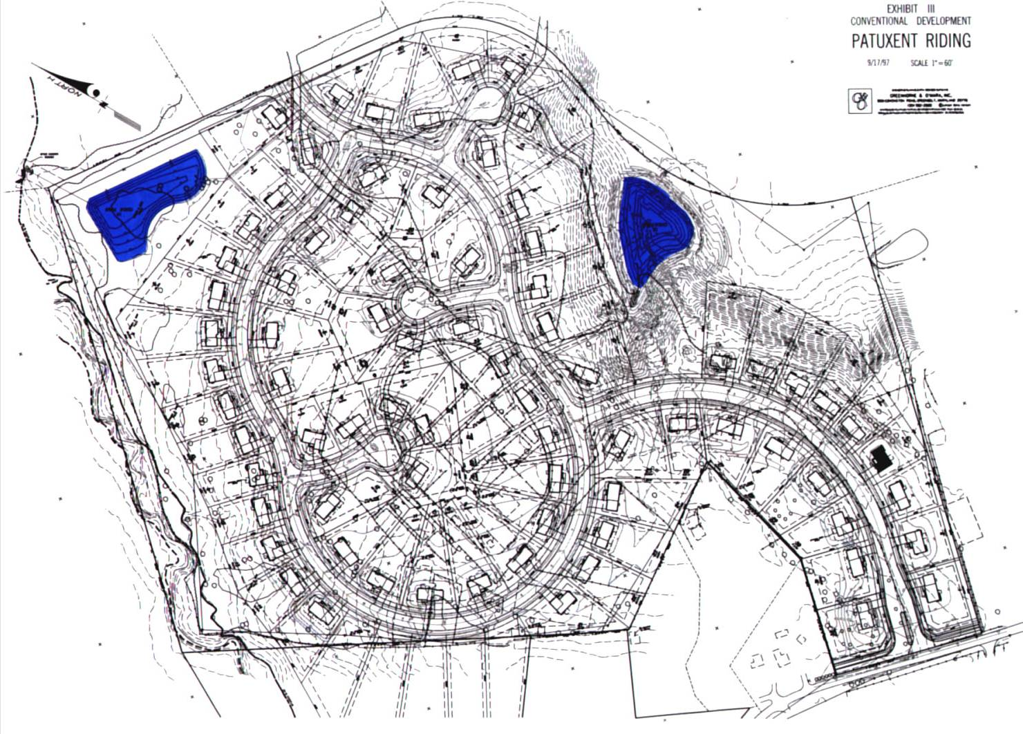
Conventional Development

Slide 18
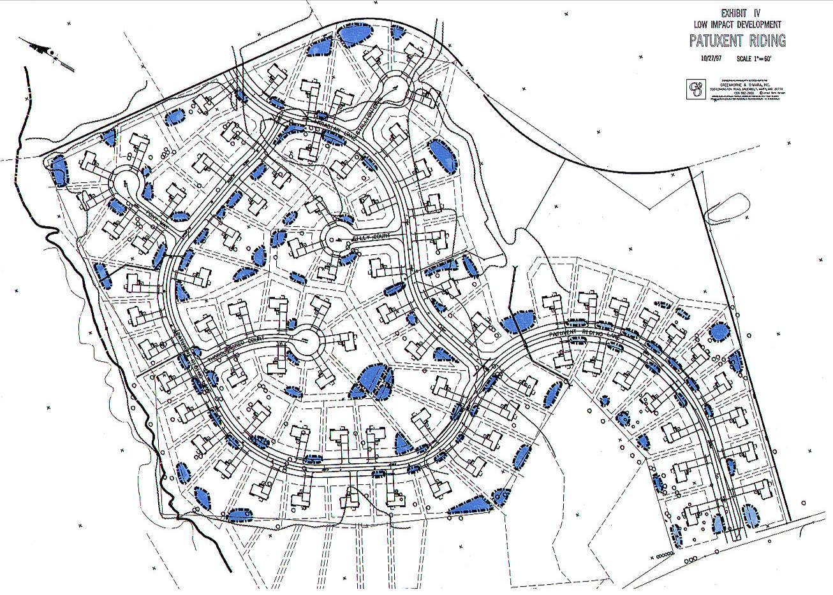
LID Development
Multiple Systems
Disconnected Decentralized Distributed Multi-functional

Slide 19
Pollutant Removal Mechanisms
Particle settling
Filtration
Biological uptake/degradation
Infiltration
Volatilization
Photodegradation
Oxidation

Slide 20
Typical LID Practices
Bioretention/rain gardens
Porous Pavement
Vegetated swales and buffer strips
Rainwater Harvesting
Green roofs

Slide 21
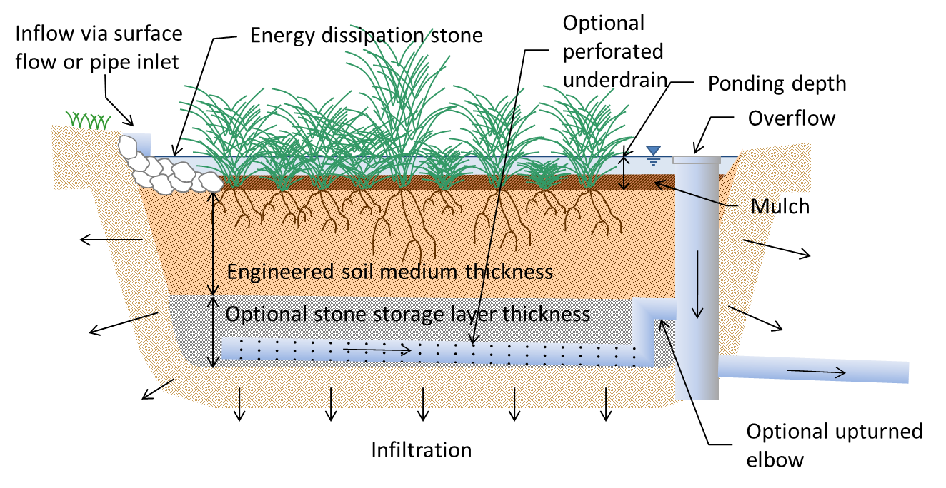
Bioretention

Slide 22
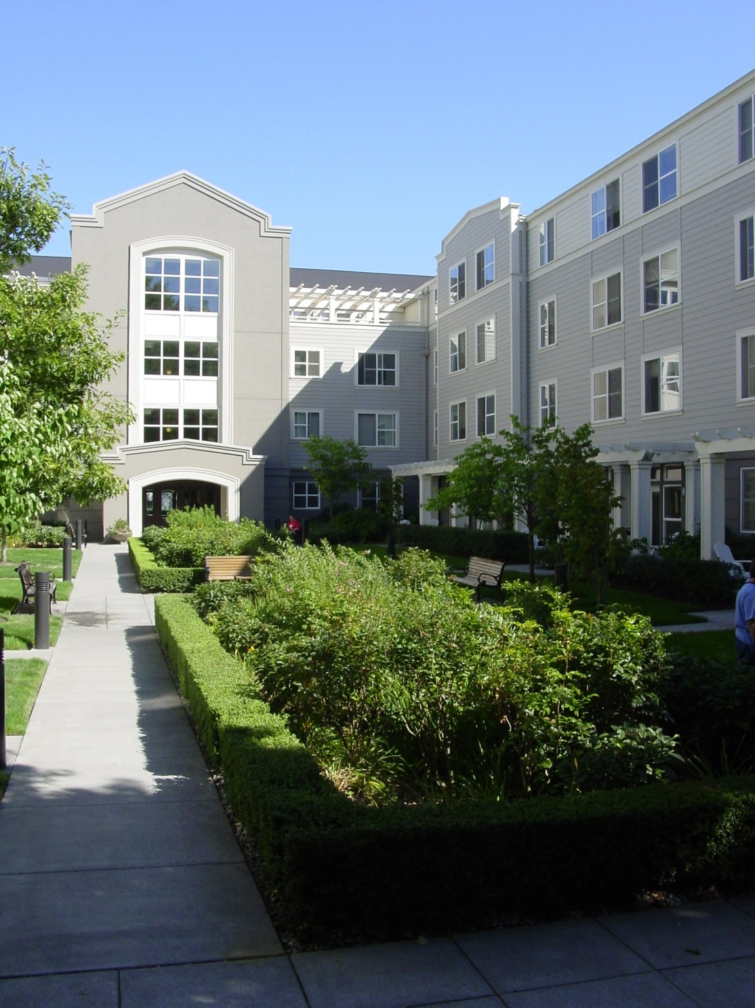
Bioretention

Slide 23
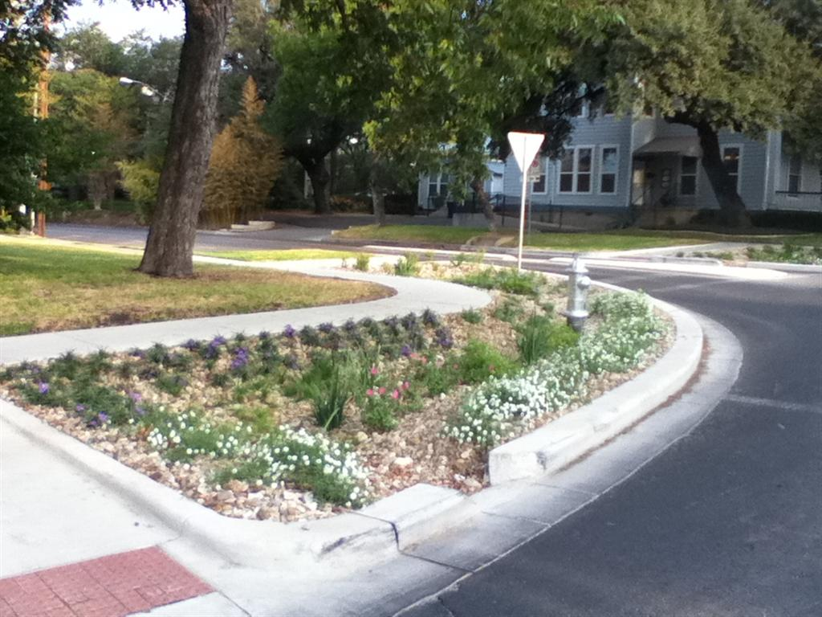
10th & Rio Grande
Image courtesy Tom Franke

Slide 24
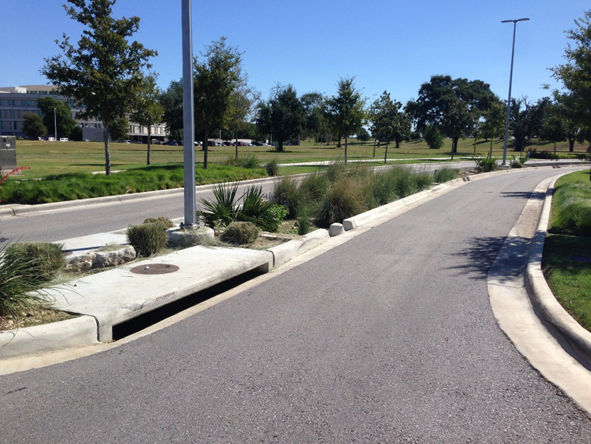
ABIA

Slide 25
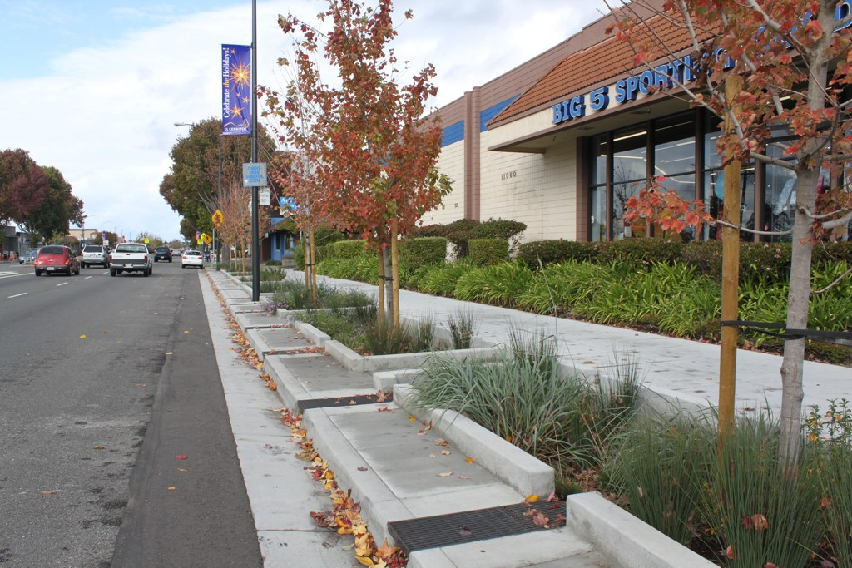
Setback Bioretention

Slide 26
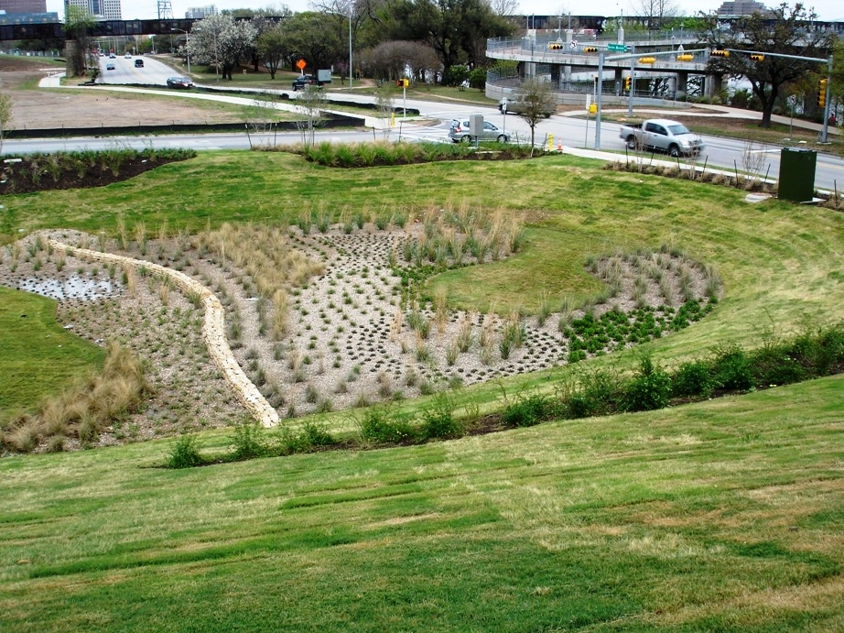
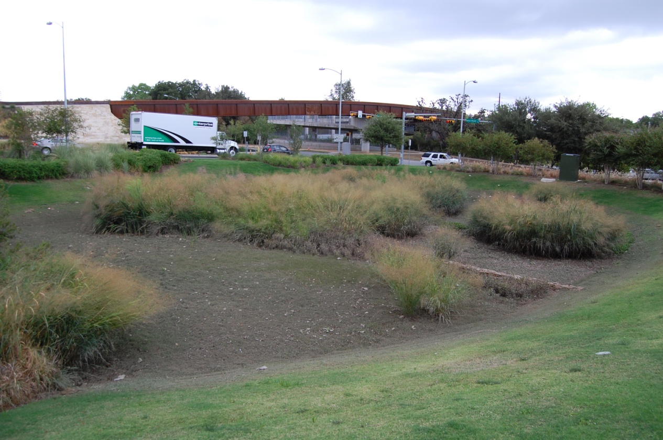
Sand Beach
Biofiltration Pond
March 2009
October 2011

Slide 27
Types of Porous Pavement
Pervious Concrete
Porous Asphalt
Pavers

Slide 28
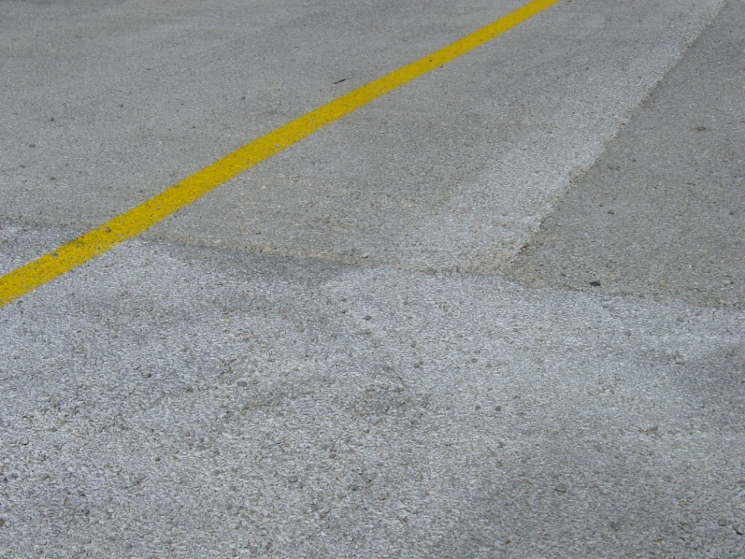
Pervious Concrete
Generally has a lower strength
Water content is critical for proper installation
Requires specialized crew for installation
Each batch tends to have a different color/texture
Tends to ravel in high traffic areas

Slide 29
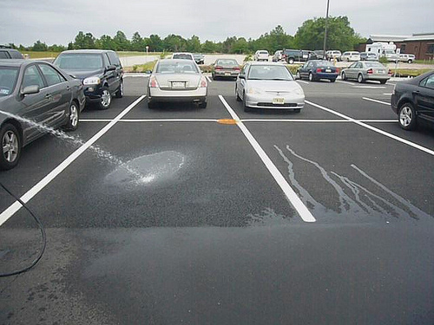
Porous Asphalt
Created by omitting fine material from asphalt
Asphalt is considered flexible pavement, so low strength is not as much an issue.
Less expensive than concrete
No specialized training needed for installation

Slide 30
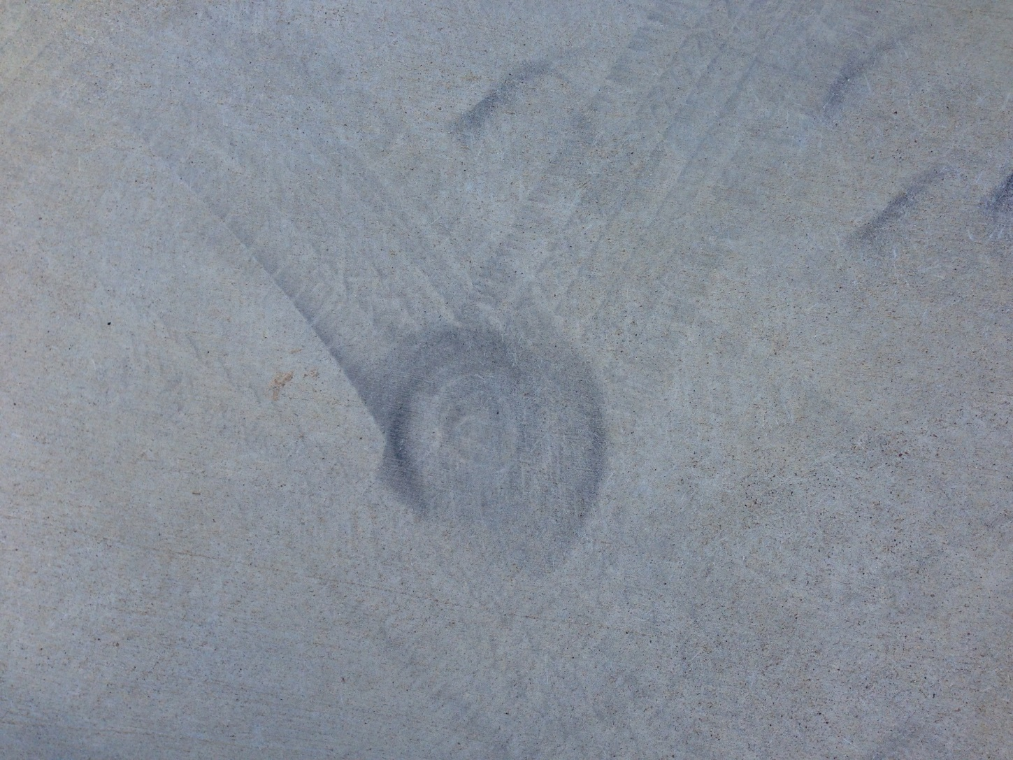
Source of Raveling

Slide 31
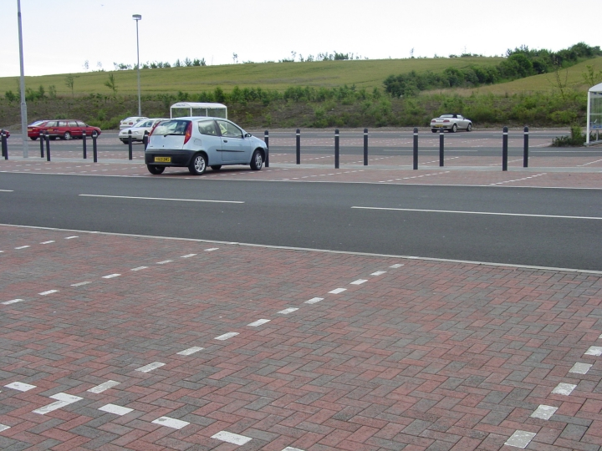
Porous Pavement only in Parking Stalls

Slide 32
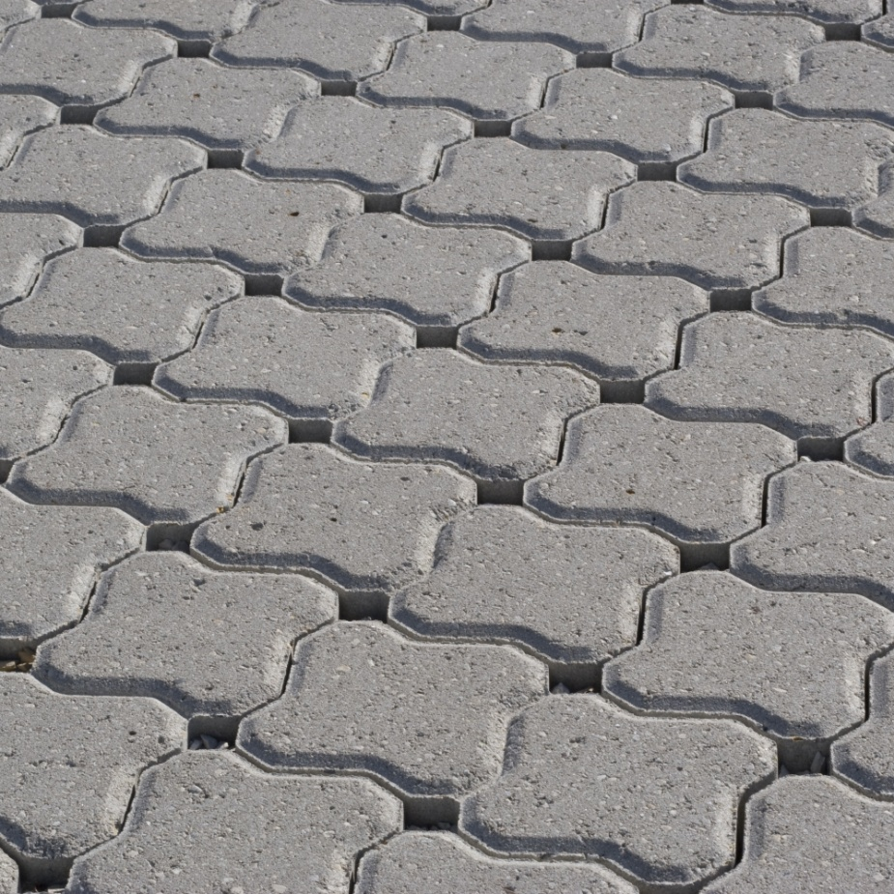
Pavers
Most expensive option
Decorative element
Easily removed and replaced if needed

Slide 33
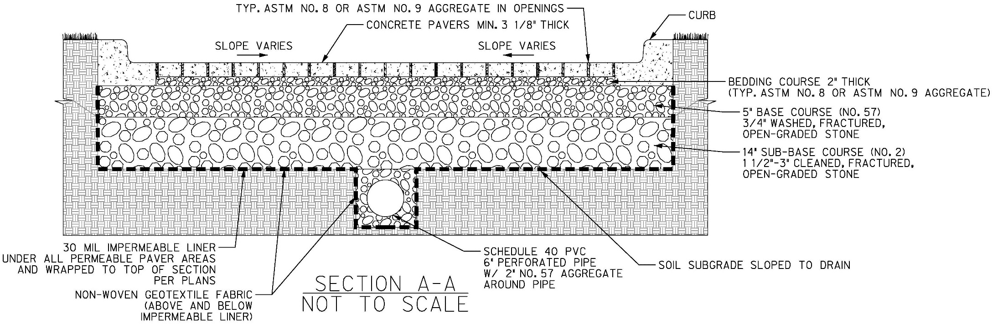
Pavement Section

Slide 34
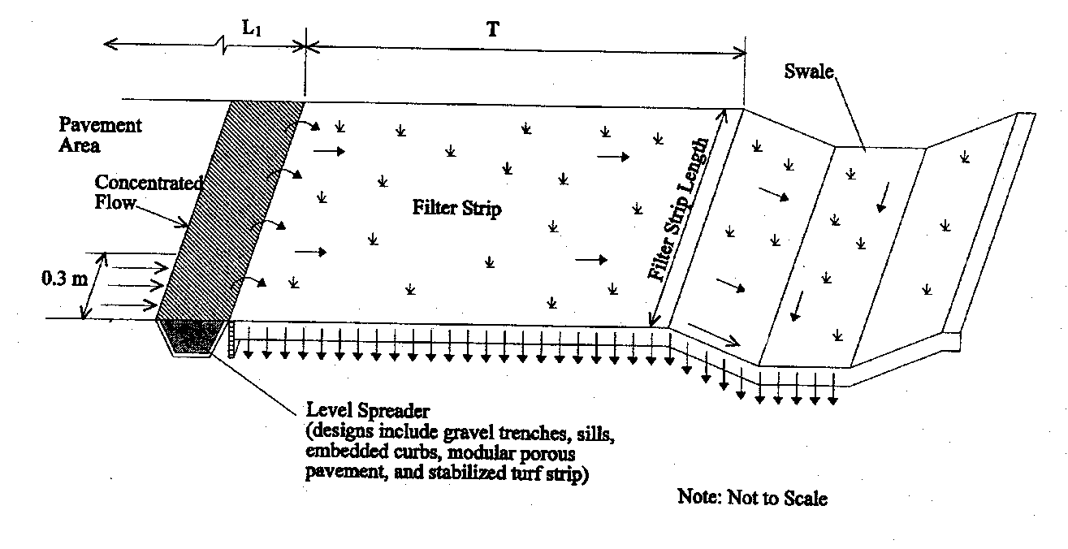
Schematic of Swale and Strip

Slide 35
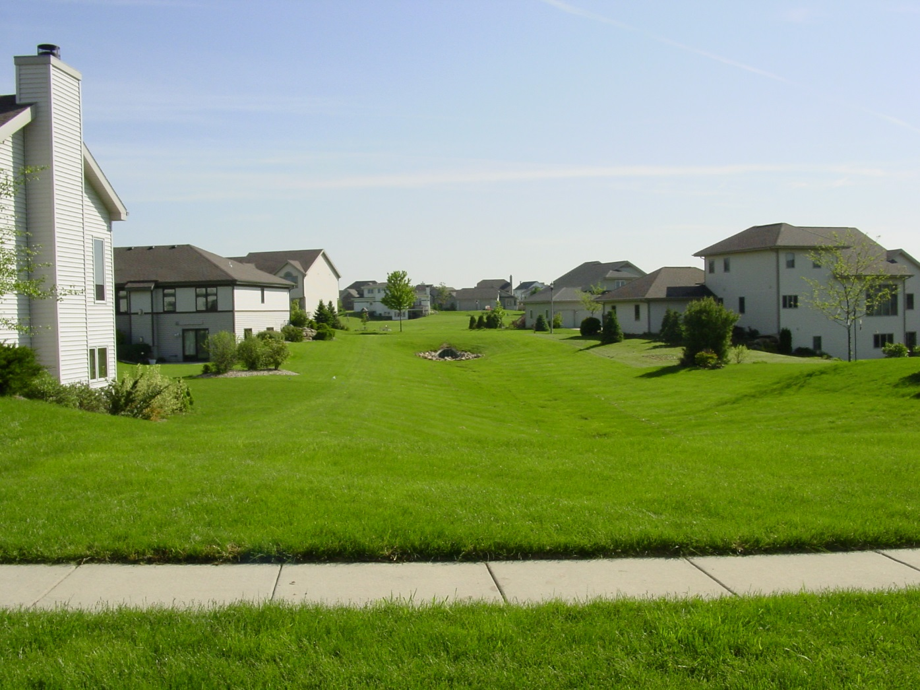

Slide 36
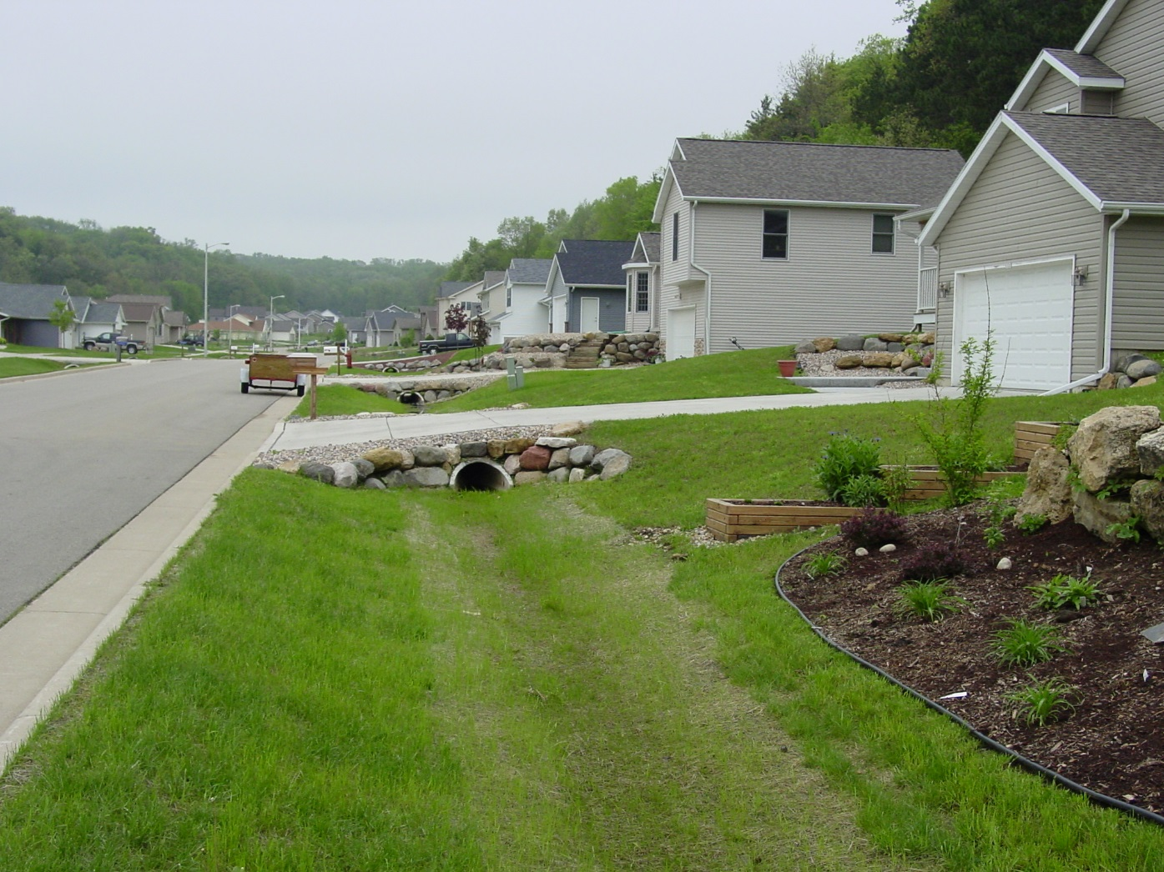

Slide 37
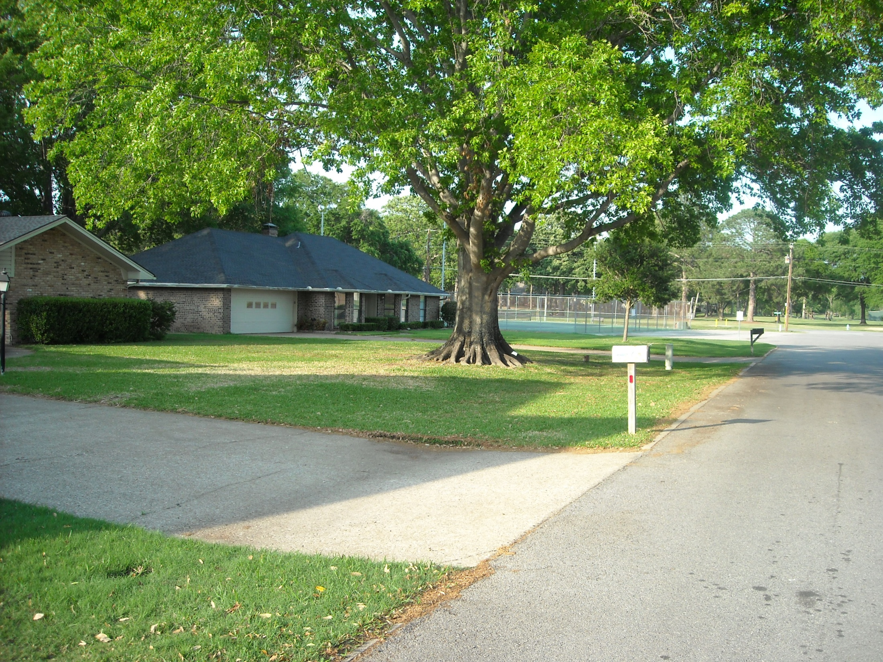

Slide 38
Vegetated Filter Strips

Slide 39
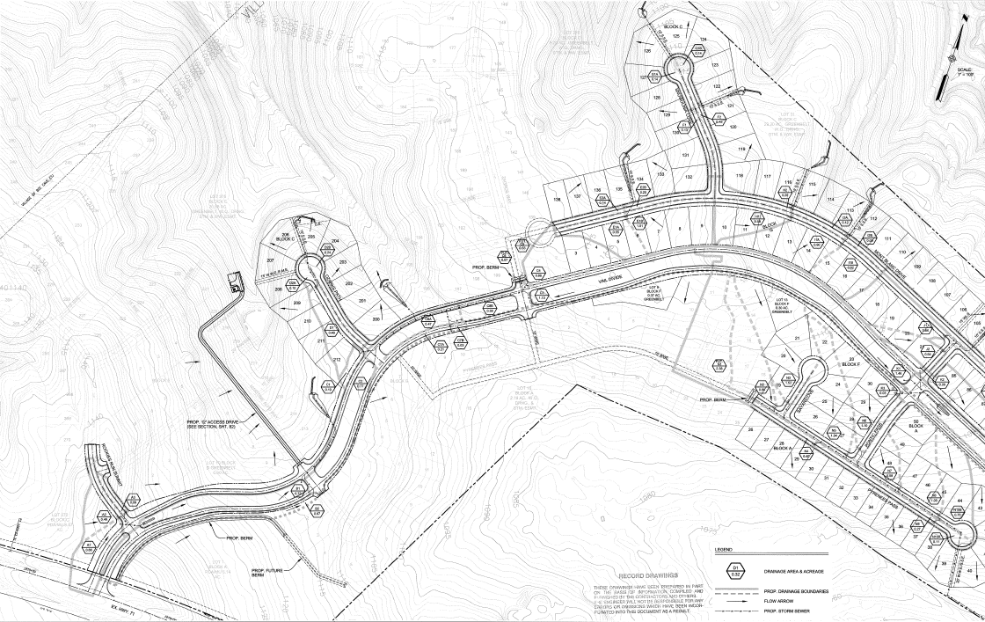
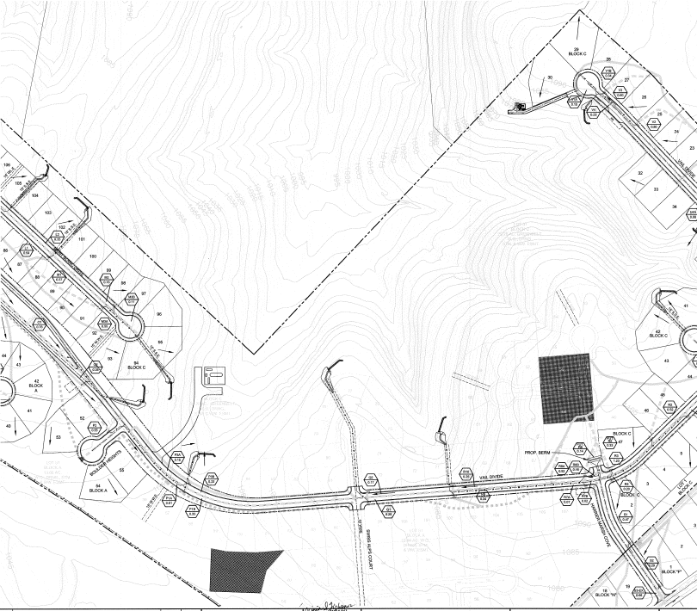
Falconhead West Development
Ozark Path Site
Swiss Alps Site
SH 71

Slide 40
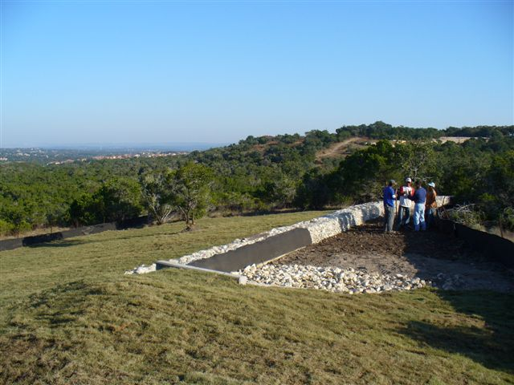

Slide 41
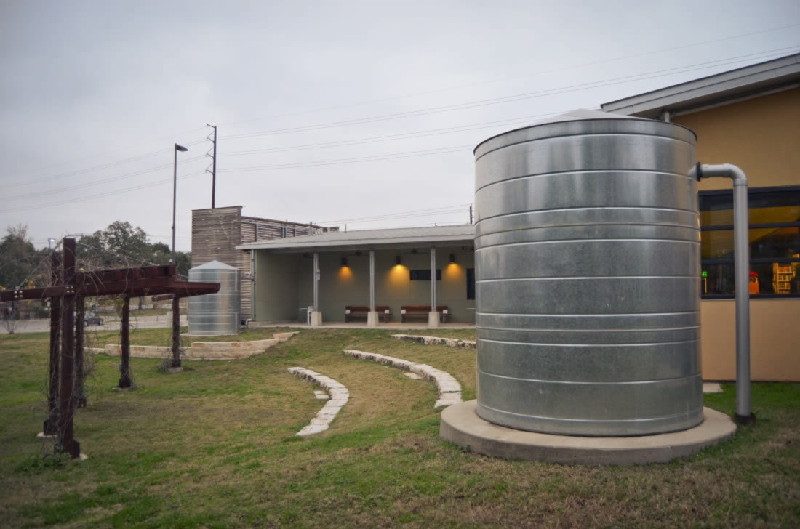
Rainwater Harvesting

Slide 42
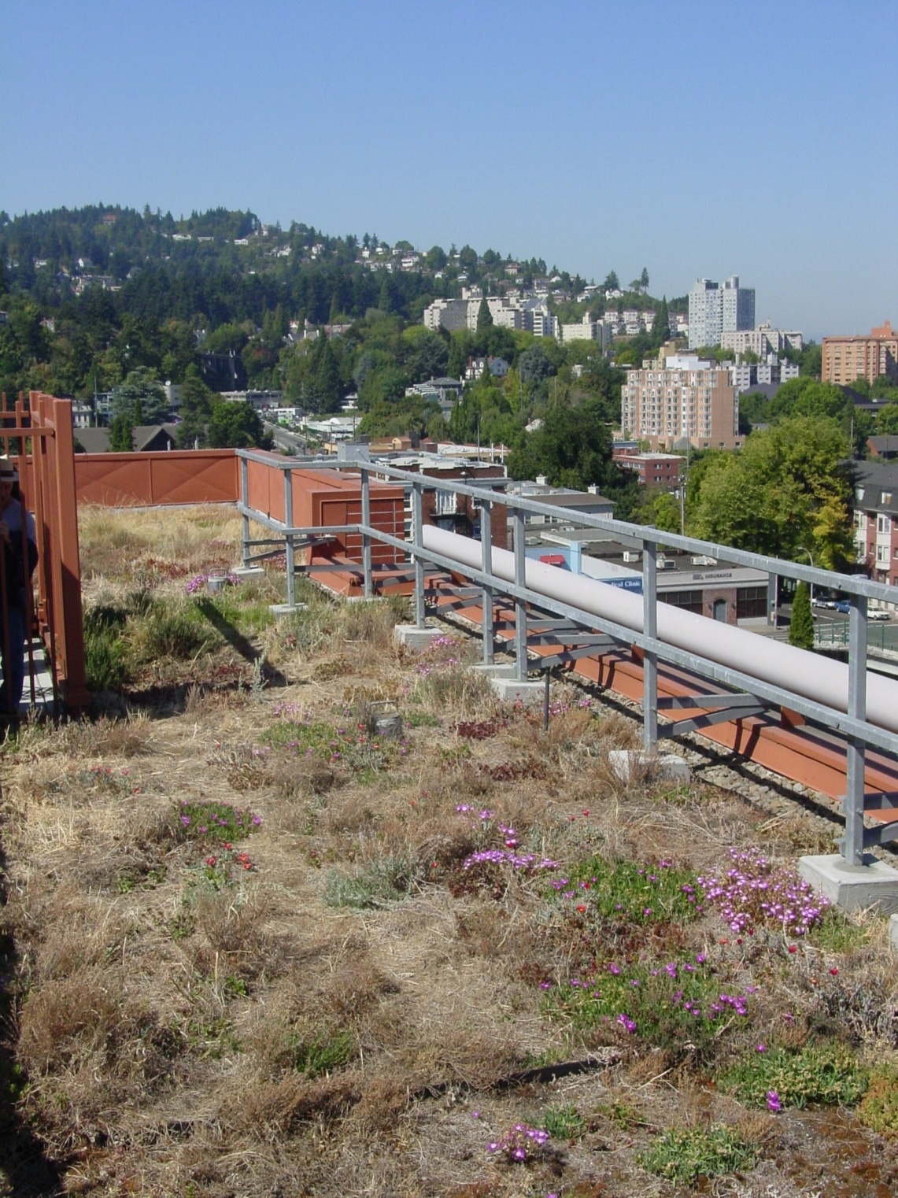
Green Roofs

Slide 43
End of Pipe Controls
Sand filters
Retention irrigation
Retention (wet) ponds
Extended detention
Infiltration basins and trenches
Proprietary devices

Slide 44
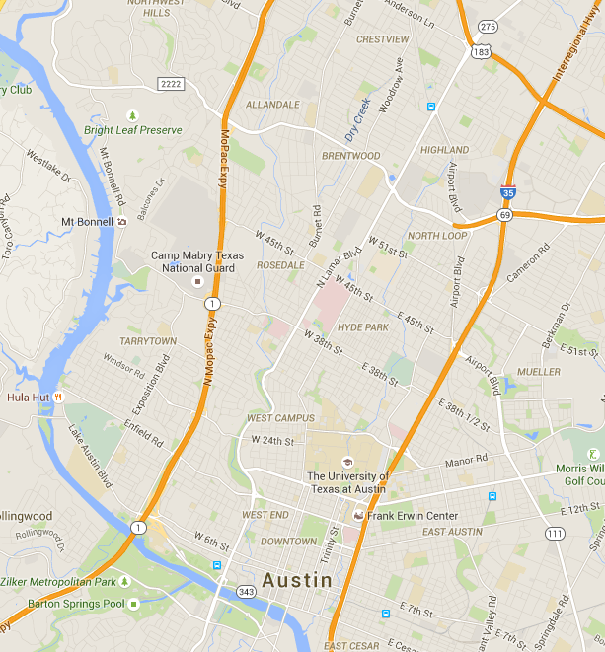
Brentwood Neighborhood

Slide 45
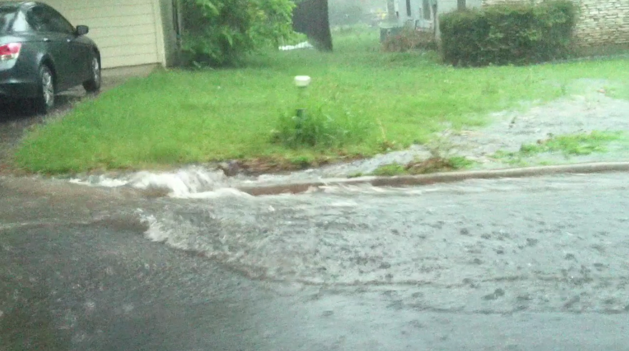
Payne Ave
(April 2, 2013)

Slide 46
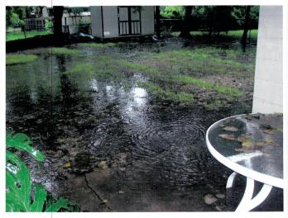
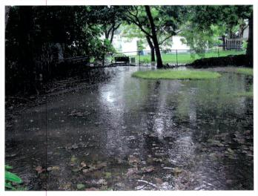
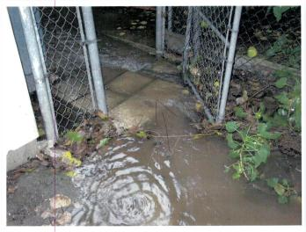
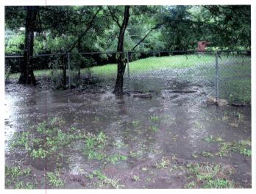
1006 Arcadia
(July 20, 2007)

Slide 47
Modeled “Max GI” Scenario
ROW Green Streets | 70,000 SF of new green streets addressing 111 acres (approx. 100 units)
Residential Cisterns | 93,000 CF of new "shared use" capacity addressing 13 acres of roofs (approx. 370 homes)
Residential Enhanced Disconnection | 10 acres of enhanced disconnects and soil amendments addressing 4.8 acres impervious area (approx. 120 lots)
Green Parking Lots (Non-Res Lots) | 20,000 SF of green parking lot features addressing 10 commercial/industrial lots
Non-Residential Cisterns and Blue Roof Program | 87,000 CF of new detention-only cistern storage addressing 16 commercial/industrial/MF lots
Permeable Friction Course | Overlay of 18 acres of street
Explicit Biofiltration with Connection to Storm Drain | 36 new units with a total footprint area of 54,000 SF addressing over 150 acres
Explicit Biodetention | 7 new units with a total footprint area of 5,000 SF in strategic locations
Lions Field Detention | 110,000 CF of multi-stage storage and flow control
Channel Widening | 8,500 SF of new off-channel floodplain
Overall: approx. 15 ac-ft of storage ≈ 0.48 watershed inches

Slide 48
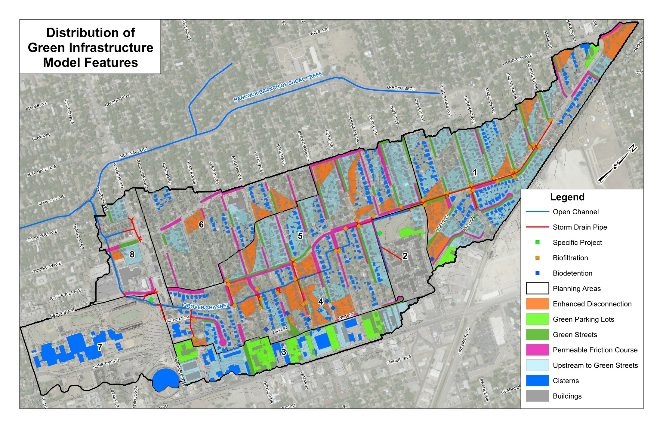
Grey Bypass Options
Bypass Analysis Point
Removal of GI
Grey Bypass Options
Grey Bypass Options

Slide 49
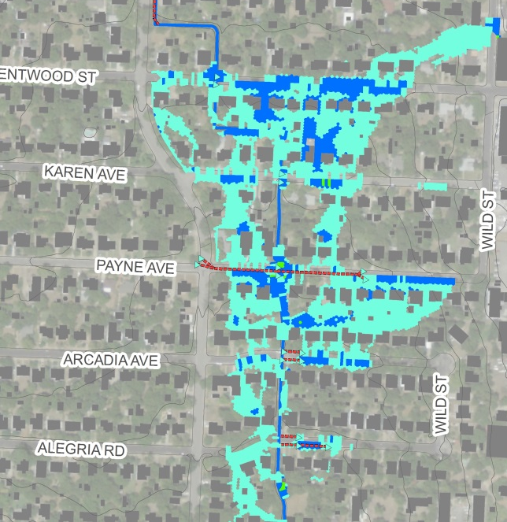
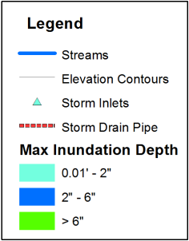
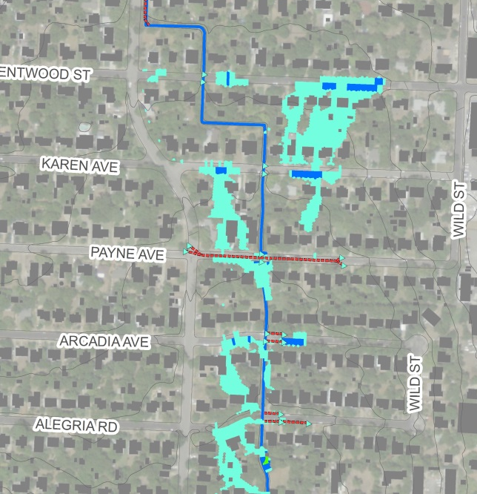
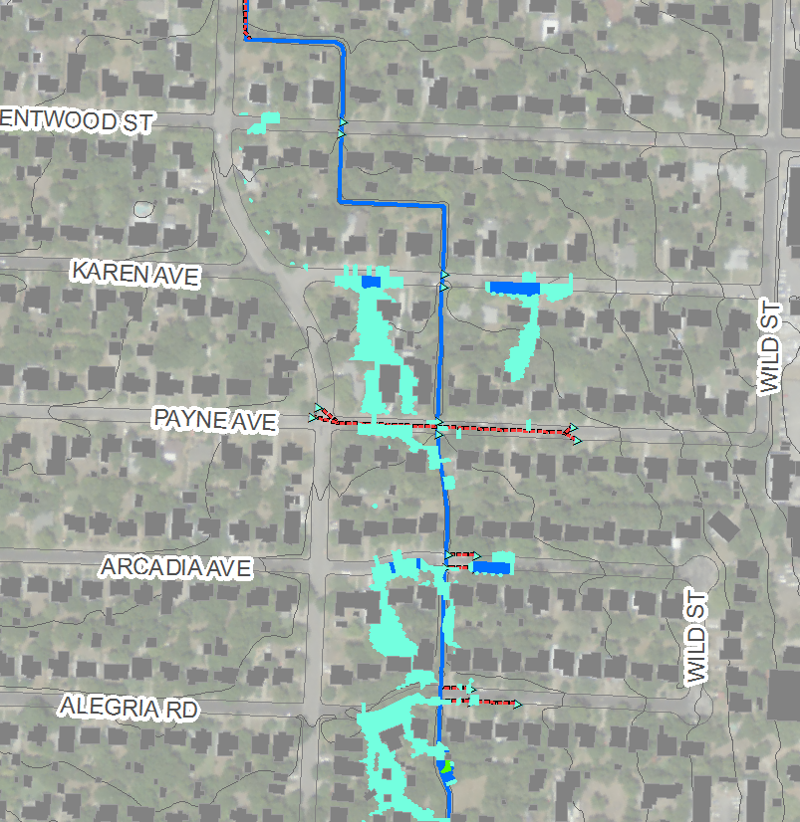

2D Design Storm Inundation
5-year Design Storm Event
Existing
Conditions
Max GI Scenario
Grey Bypass Options
Grey Bypass Options
Green/Grey Scenario

Slide 50
Summary
Substantial environmental impacts of urbanization
Objectives of BMPs are to reduce concentrations of pollutants and runoff volumes
Move towards LID practices from end-of-pipe
Stormwater treatment is an integral part of urban runoff management

