Slide 1




What is GIS
A geographic information system (GIS) is a system designed to capture, store, manipulate, analyze, manage, and present all types of geographical data. -- Wikipedia
data
computers
maps
tools

Slide 2
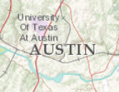
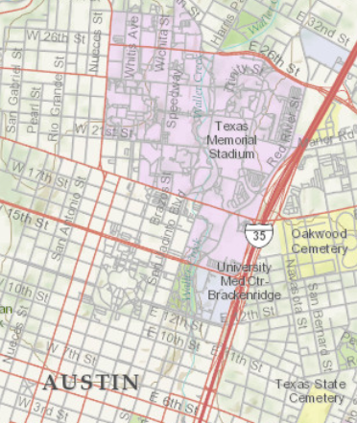
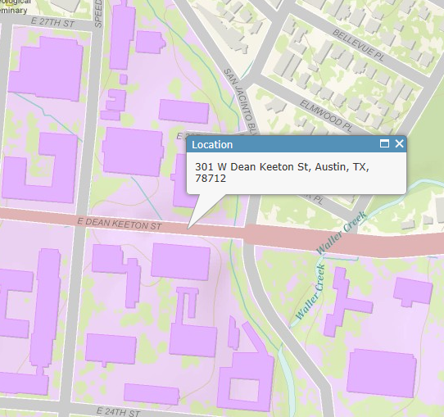
Geography is visualized in maps
map
www.arcgis.com

Slide 3
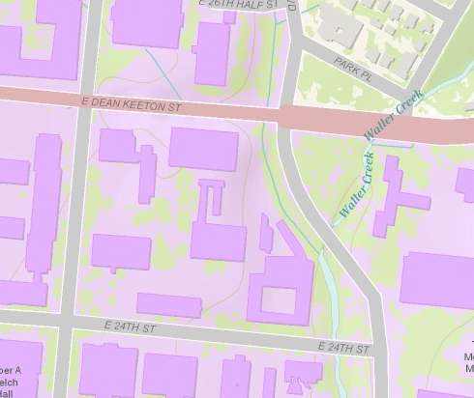
Maps are built from data
Road
Name: E. Dean Keeton St
Type: Div Highway
Speed: 35 mph
Shape: [Geometry]
Building
Name: Ernest Cockrell Jr Hall
Address: 301 E. Dean Keeton St
Shape: [Geometry]
data
Shape includes the geometry of the feature and where it is located on earth
map

Slide 4
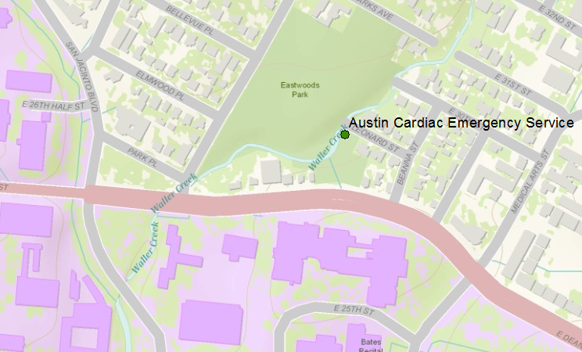
Vector data represent discrete features
points
lines
data
polygons
map

Slide 5
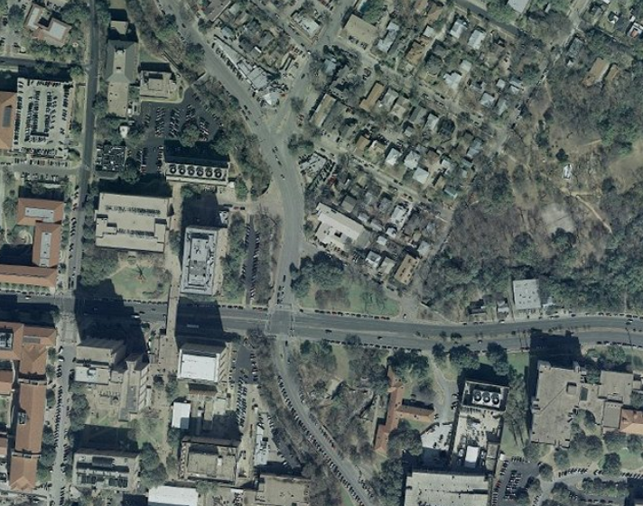
Raster data form a grid of cells or pixels
data
map

Slide 6
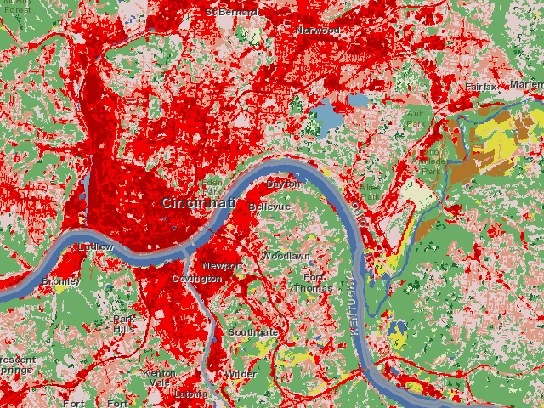
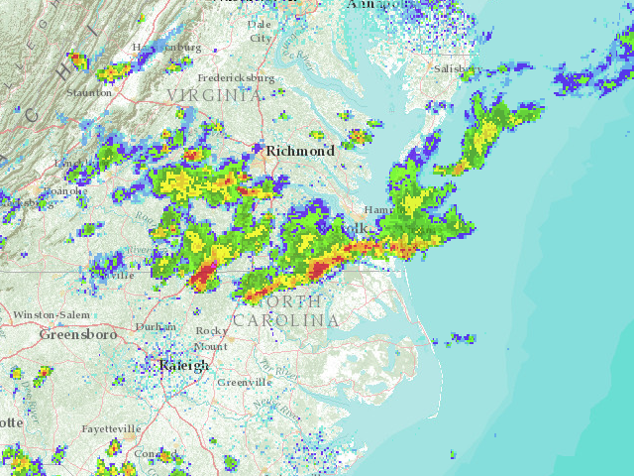
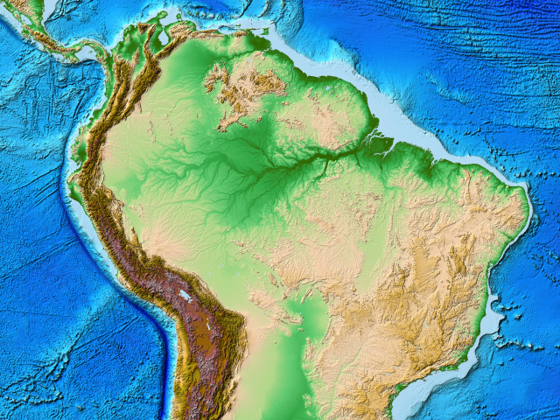
More Raster Examples
data
land use
rainfall
elevation
map

Slide 7
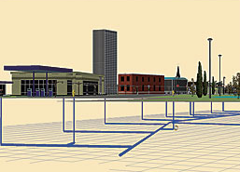
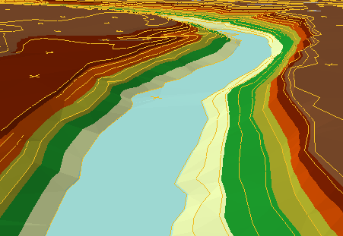
There are many more data types
multipatch
triangulated
irregular network
data
Martin Luther King Dr W
annotation
map

Slide 8
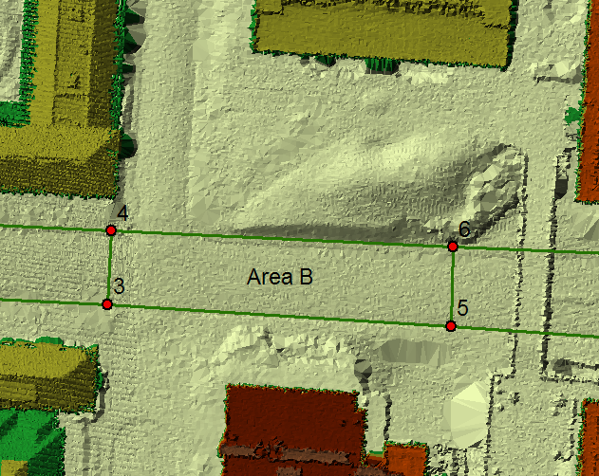
TIN on Dean Keaton St
CPE
RLM

Slide 9
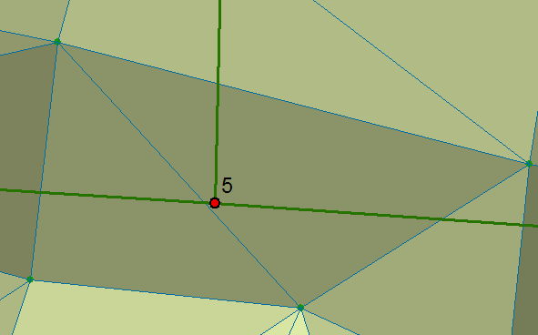
TIN Points on Dean Keaton
547.23
547.2
546.91
546.911

Slide 10
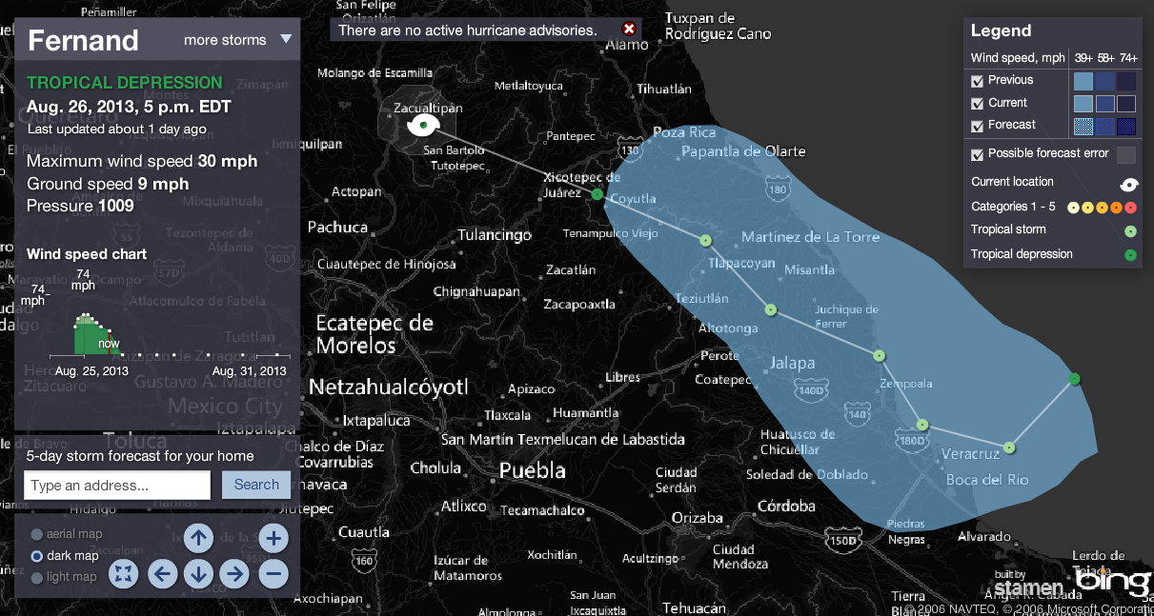
Connected Map, Chart and Animation
Tropical Storm Fernand
http://www.msnbc.msn.com/id/26295161/ns/weather/

Slide 11
Geographic Data Model
Conceptual Model – a set of concepts that describe a subject and allow reasoning about it
Mathematical Model – a conceptual model expressed in symbols and equations
Data Model – a conceptual model expressed in a data structure (e.g. ascii files, Excel tables, …..)
Geographic Data Model – a conceptual model for describing and reasoning about the world expressed in a GIS database

Slide 12
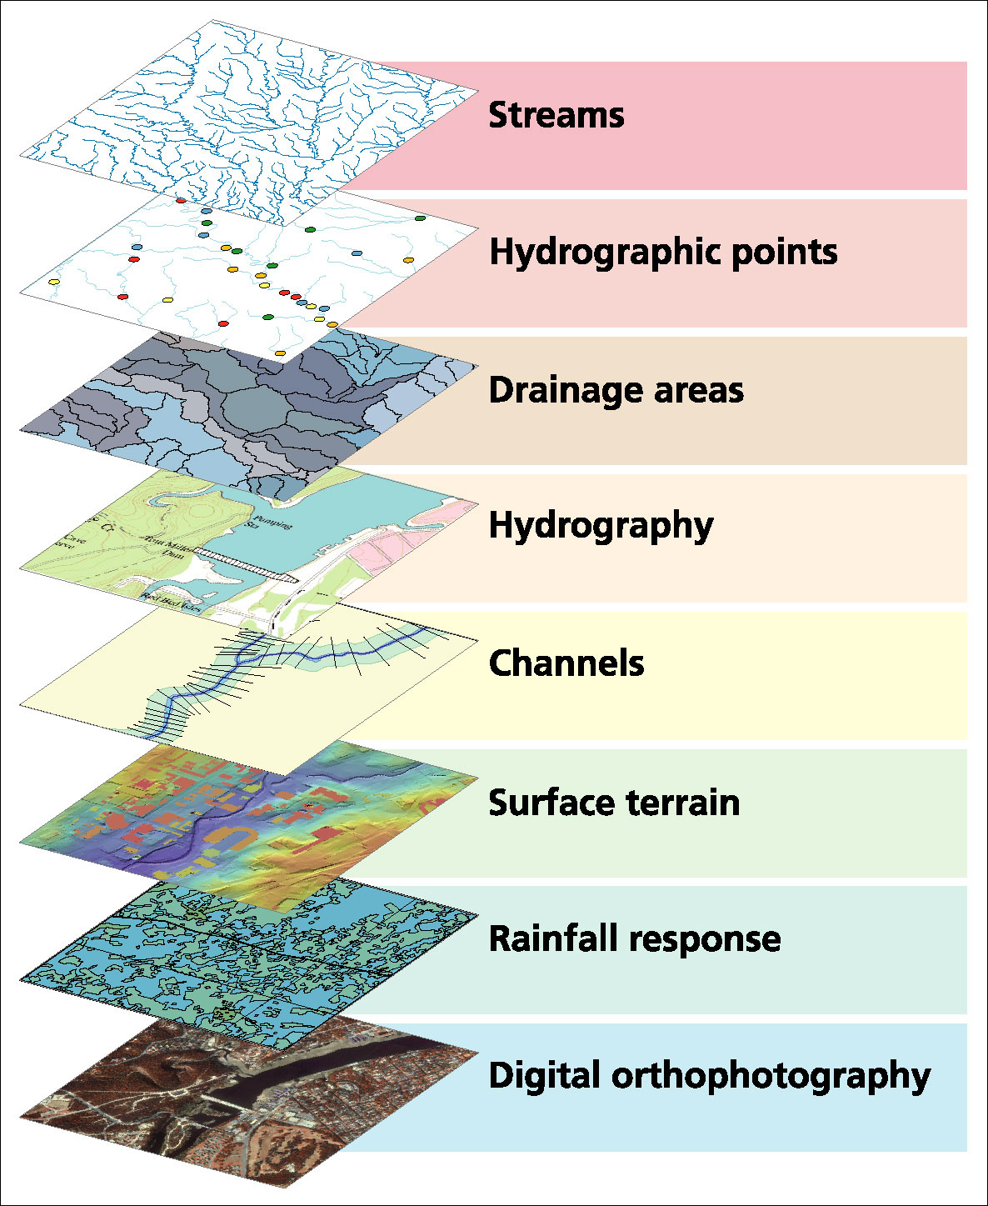
Data Model based on a collection of data themes

Slide 13
Spatial Data: Vector format
Vector data are defined spatially:
(x₁,y₁)
Point - a pair of x and y coordinates
vertex
Line - a sequence of points
Node
Polygon - a closed set of lines
Notes:
DRM

Slide 14
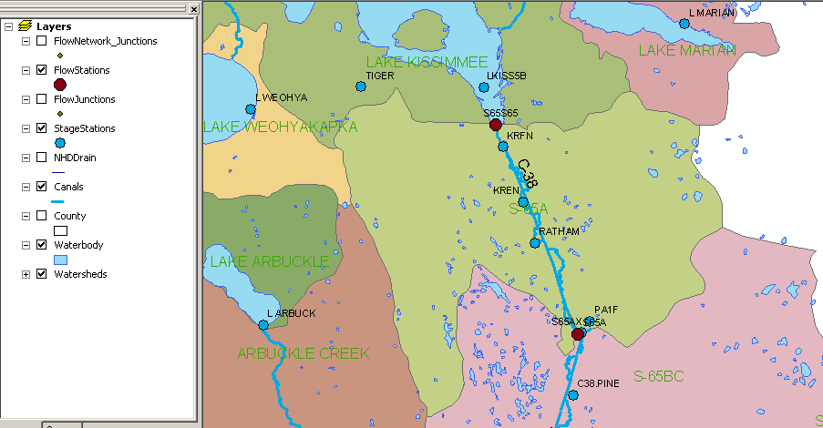
Kissimmee watershed, Florida
Themes

Slide 15
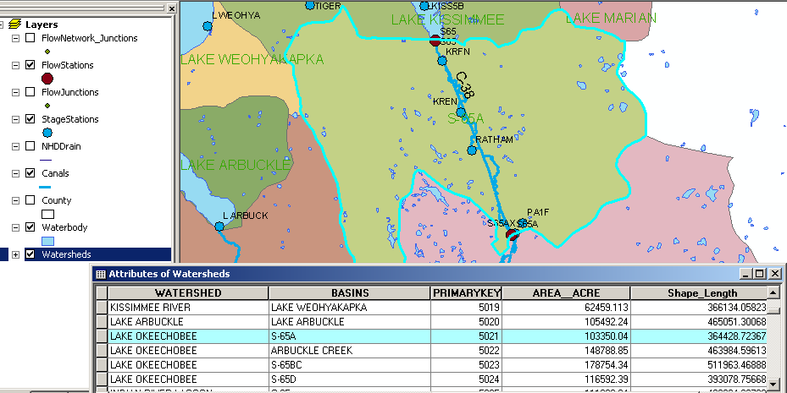
Attributes of a Selected Feature

Slide 16
Raster and Vector Data
Raster data are described by a cell grid, one value per cell
Vector
Raster
Point
Line
Zone of cells
Polygon
Notes:
DRM

Slide 17

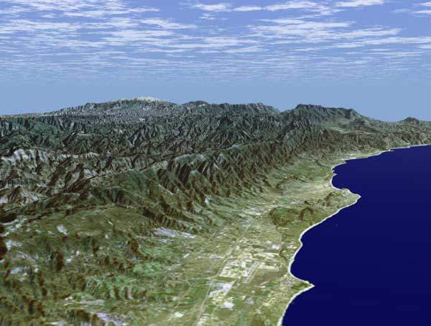
Santa Barbara, California
http://srtm.usgs.gov/srtmimagegallery/index.html

Slide 18
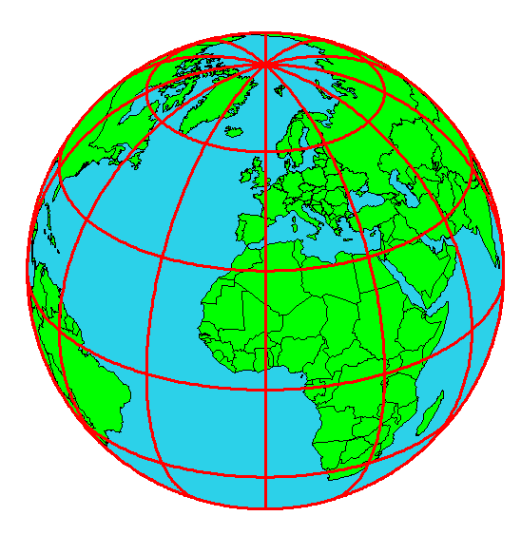
Origin of Geographic Coordinates
Equator
(0,0)
Prime Meridian

Slide 19
Latitude and Longitude
Longitude line (Meridian)
N
W
E
S
Range: 180ºW - 0º - 180ºE
Latitude line (Parallel)
N
W
E
S
(0ºN, 0ºE)
Equator, Prime Meridian
Range: 90ºS - 0º - 90ºN

Slide 20
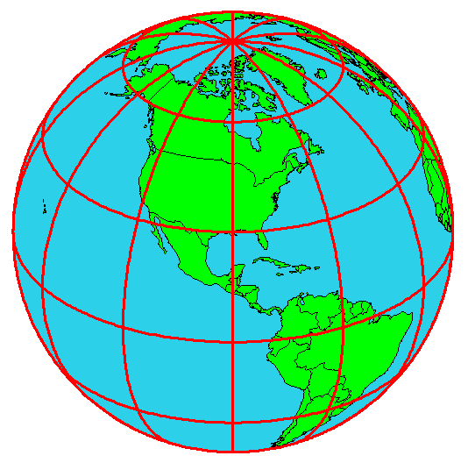
Latitude and Longitude in North America
Austin:
Logan:
(30°18' 22" N, 97°45' 3" W)
60 N
30 N
(41°44' 24" N, 111°50' 9" W)
120 W
60 W
90 W
0 N

Slide 21
Map Projection
Flat Map
Cartesian coordinates: x,y
(Easting & Northing)
Curved Earth
Geographic coordinates: φ, λ
(Latitude & Longitude)
Notes:
DRM

Slide 22
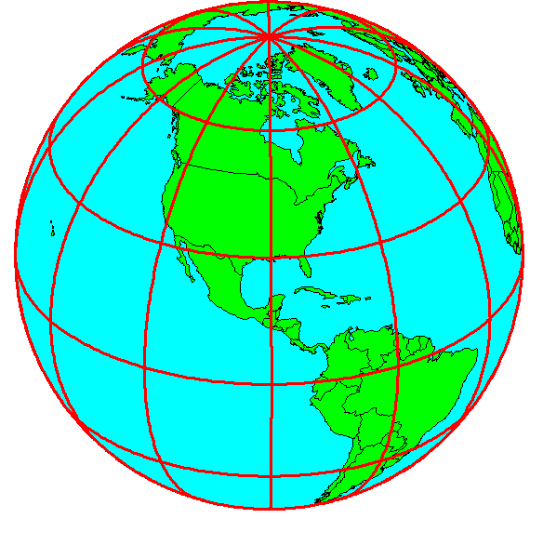
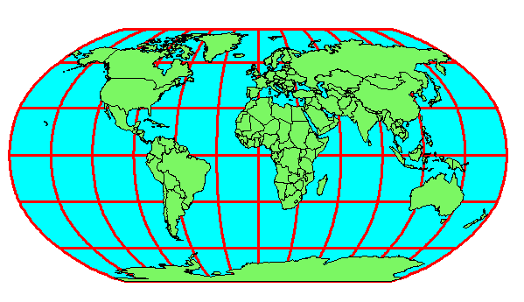
Earth to Globe to Map
Map Scale:
Map Projection:
Representative Fraction
Globe distance
Earth distance
Scale Factor
Map distance
Globe distance
=
=
(e.g. 1:24,000)
(e.g. 0.9996)

Slide 23
Coordinate Systems
A planar coordinate system is defined by a pair
of orthogonal (x,y) axes drawn through an origin
Y
Origin
X
(x_{o},y_{o})
(φ_{o},λ_{o})
Projected Coordinates
Geographic Coordinates

