Slide 1
Watershed and Stream Network Delineation using GIS
CE 365K Spring 2016
http://desktop.arcgis.com/en/arcmap/10.3/tools/spatial-analyst-toolbox/an-overview-of-the-hydrology-tools.htm

Slide 2
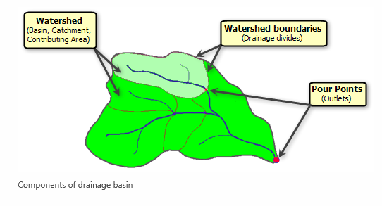
Components of a Drainage Basin

Slide 3
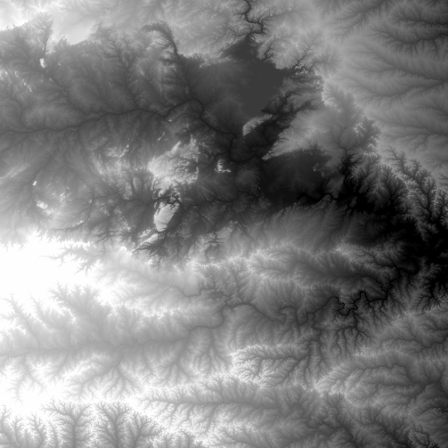
National Elevation Dataset
http://ned.usgs.gov/
Digital Elevation Model with 1 arc-second (30m), 1/3 arc-second (10m) and some 1/9 arc second (3m) cells
Distributed as part of the National Map
10 billion data
Derived from USGS 1:24,000 quadrangle sheets and at higher resolution from LIDAR
Get the data:
http://nationalmap.gov/viewer.html

Slide 4
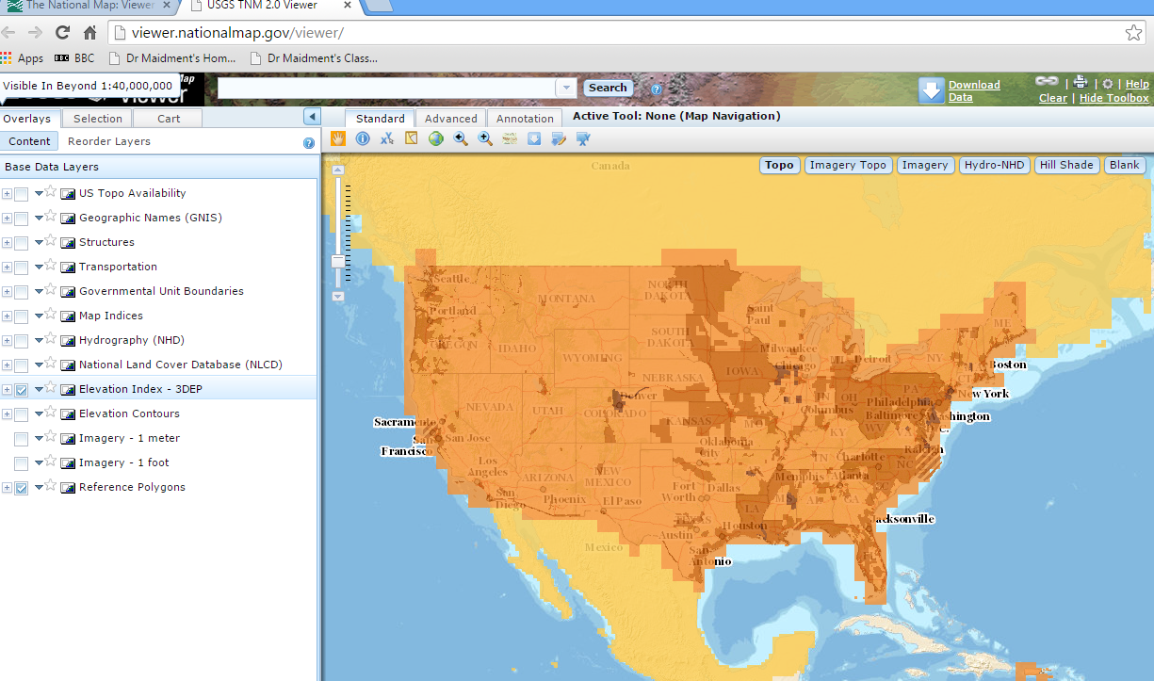
National Elevation Dataset Availability
From http://nationalmap.gov/viewer.html

Slide 5
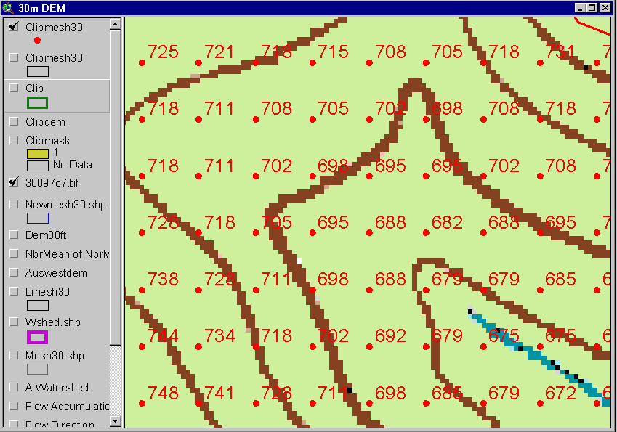
Digital Elevation Model (DEM)
720
720
Contours
740
720
700
680
740
720
700
680

Slide 6
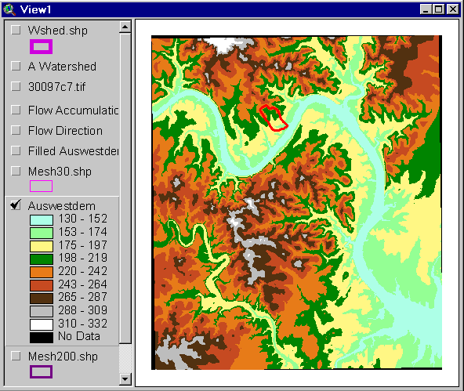
Austin West 30 Meter DEM

Slide 7
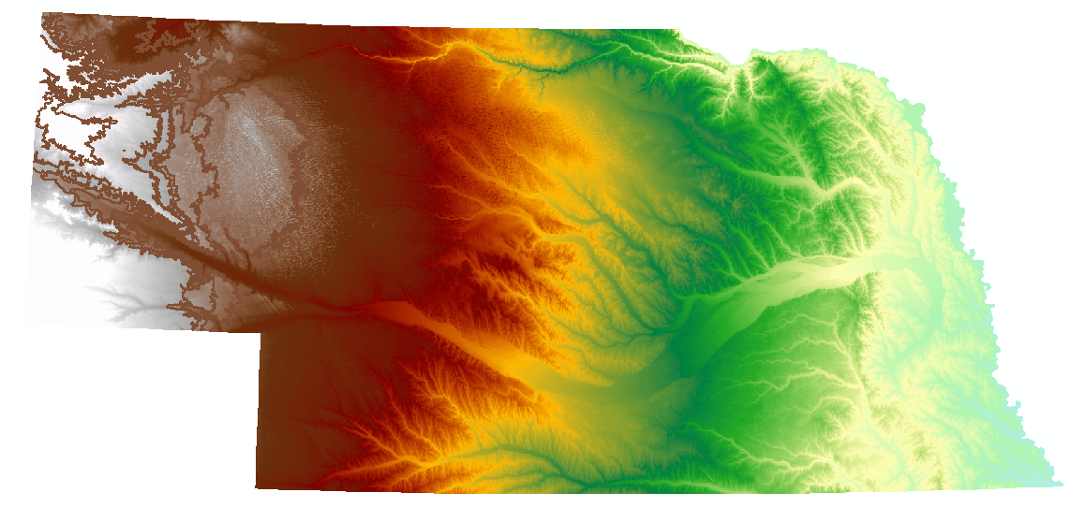
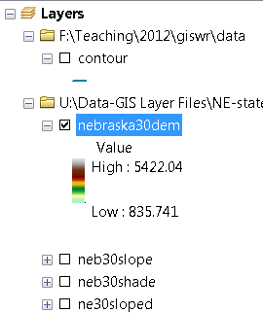
Digital Elevation Model (DEM)-30 meter

Slide 8
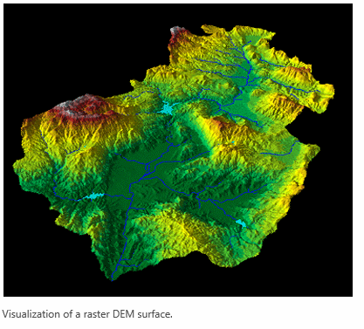
Raster Digital Elevation Model (DEM)

Slide 9
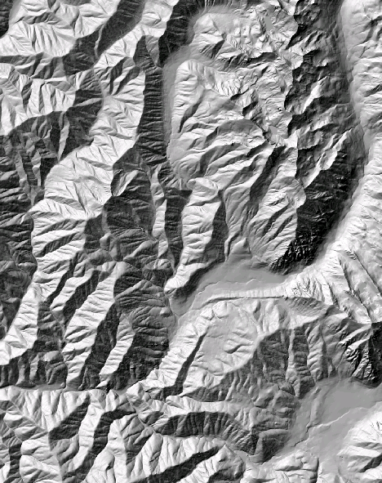
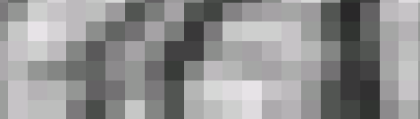
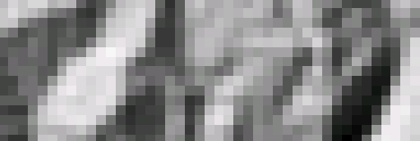
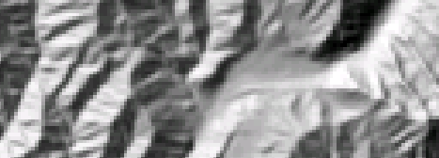
The challenge of increasing Digital Elevation Model (DEM) resolution
1980’s DMA 90 m
10² cells/km²
1990’s USGS DEM 30 m
10³ cells/km²
2000’s NED 10-30 m
10⁴ cells/km²
2010’s LIDAR ~1 m
10⁶ cells/km²

Slide 10
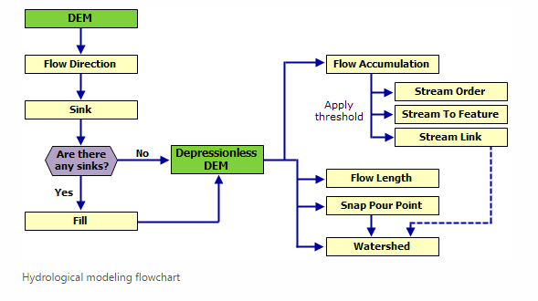
Hydrologic Modeling Flowchart

Slide 11
Eight Direction Pour Point Model
ArcGIS raster operations involved in watershed delineation are derived from the premise that “water flows downhill, in doing so, will follow the steepest descent
32
64
128
16
1
8
4
2
Water in a given cell flows one or more of eight adjacent cells in the direction of steepest descent (ArcGIS)

Slide 12
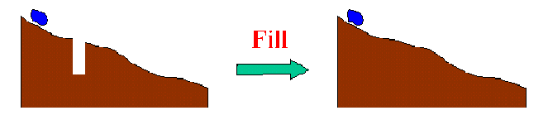
The Pit Removal Problem
DEM creation results in artificial pits in the landscape
A pit is a set of one or more cells which has no downstream cells around it
Unless these pits are removed they become sinks and isolate portions of the watershed
Pit removal is first thing done with a DEM

Slide 13


Pit Filling
Increase elevation to the pour point elevation until the pit drains to a neighbor

Slide 14
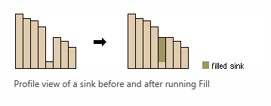
Fill function
http://desktop.arcgis.com/en/arcmap/10.3/tools/spatial-analyst-toolbox/how-fill-works.htm

Slide 15
Pit Filling
Original DEM
Pits Filled
Pits
Pour Points
Grid cells or zones completely surrounded by higher terrain
The lowest grid cell adjacent to a pit
Notes:
Elevations are filled to that of the pools pour point

Slide 16
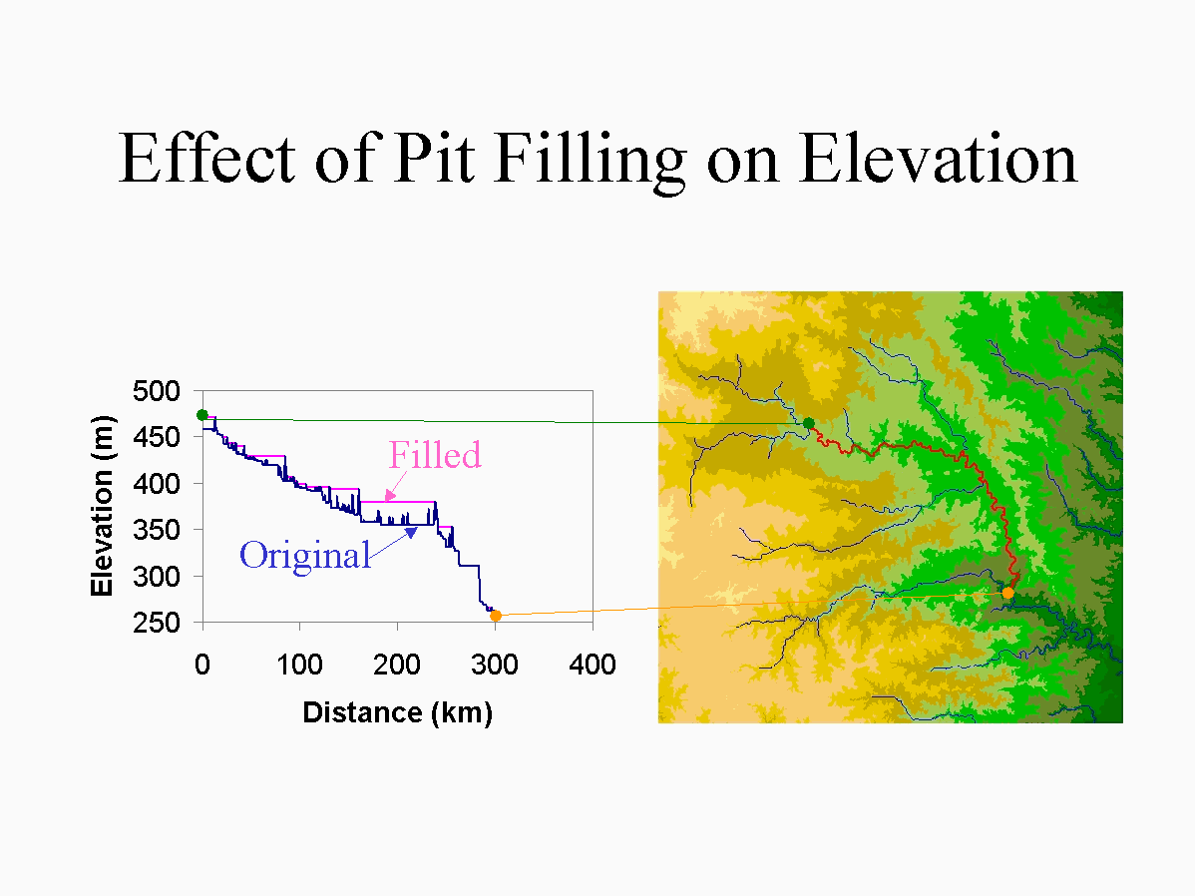

Slide 17
Eight Direction Pour Point Model
ArcGIS raster operations involved in watershed delineation are derived from the premise that “water flows downhill, in doing so, will follow the steepest descent
32
64
128
16
1
8
4
2
Water in a given cell flows one or more of eight adjacent cells in the direction of steepest descent (ArcGIS)

Slide 18
Hydrologic Slope
- Direction of Steepest Descent
30
30
80
74
63
80
74
63
69
67
56
69
67
56
60
52
48
60
52
48
Slope:

Slide 19
Eight Direction (D8) Flow Model
32
64
128
16
1
8
4
2
2
2
4
4
8
1
2
4
8
4
4
1
2
4
8
2
4
4
4
4
1
2
1
4
16

Slide 20
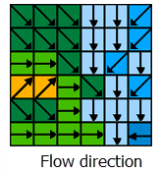

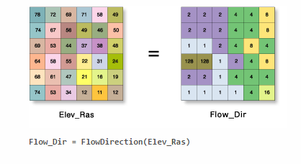
Flow Direction

Slide 21
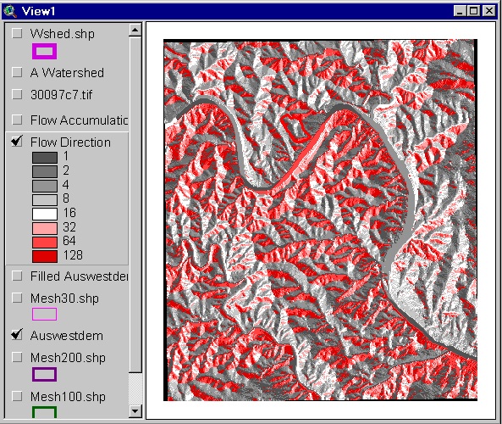
Flow Direction Grid
32
64
128
16
1
8
4
2

Slide 22
Grid Network

Slide 23
Flow Accumulation Grid.
Area draining in to a grid cell
0
0
0
0
0
0
0
0
0
0
0
2
2
2
0
0
2
2
2
0
0
0
10
0
1
0
0
1
0
10
1
0
0
14
0
1
0
0
0
14
0
4
1
19
1
0
4
1
1
19
Link to Grid calculator
ArcHydro Page 72

Slide 24
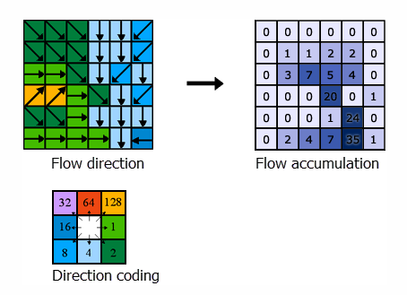
Flow Accumulation

Slide 25
Stream Network for 10 cell Threshold Drainage Area
Flow Accumulation
> 10 Cell Threshold
0
0
0
0
0
0
0
0
0
0
0
2
2
2
0
0
2
2
2
0
0
0
10
0
1
0
0
1
0
10
1
0
0
14
0
1
0
0
0
14
0
4
1
19
1
0
4
1
1
19

Slide 26
Watershed Draining to Outlet
Watershed mapped as all grid cells that drain to an outlet
Streams mapped as grid cells with flow accumulation greater than a threshold

Slide 27
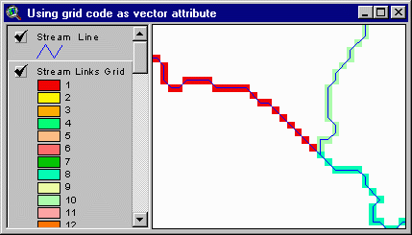
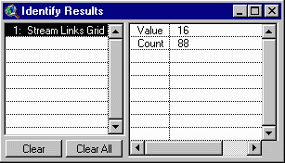
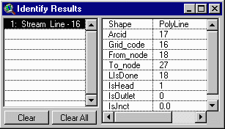
Vectorized Streams Linked Using Grid Code to Cell Equivalents
Vector
Streams
Grid
Streams
ArcHydro Page 75

Slide 28
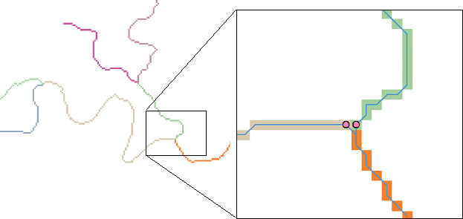
DrainageLines are drawn through the centers of cells on the stream links. DrainagePoints are located at the centers of the outlet cells of the catchments
ArcHydro Page 75

Slide 29
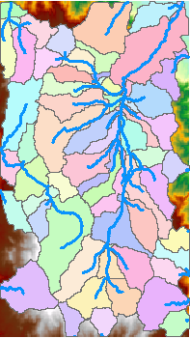
Catchments
For every stream segment, there is a corresponding catchment
Catchments are a tessellation of the landscape through a set of physical rules

Slide 30

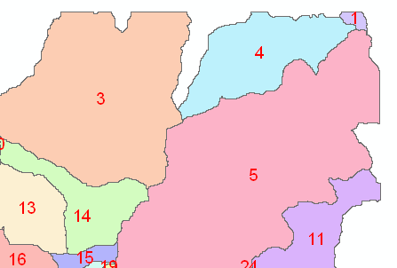
Raster Zones and Vector Polygons
One to one connection
DEM GridCode
Catchment GridID
4
3
5
Raster Zones
Vector Polygons

Slide 31
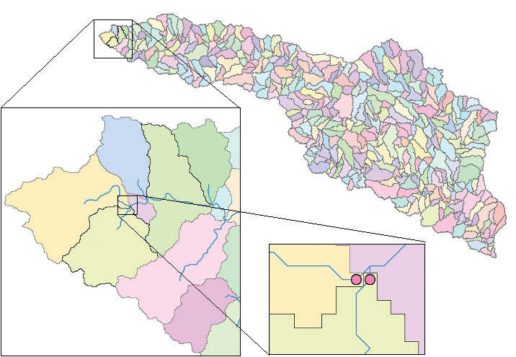
Catchments, DrainageLines and DrainagePoints of the San Marcos basin
ArcHydro Page 75

Slide 32
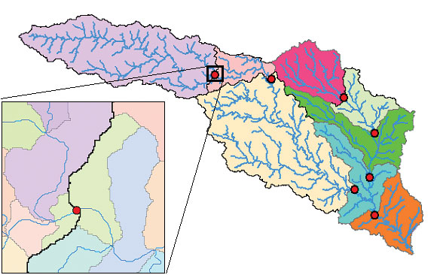
Catchment, Watershed, Subwatershed.
Subwatersheds
Catchments
Watershed
Watershed outlet points may lie within the interior of a catchment, e.g. at a USGS stream-gaging site.
ArcHydro Page 76

Slide 33
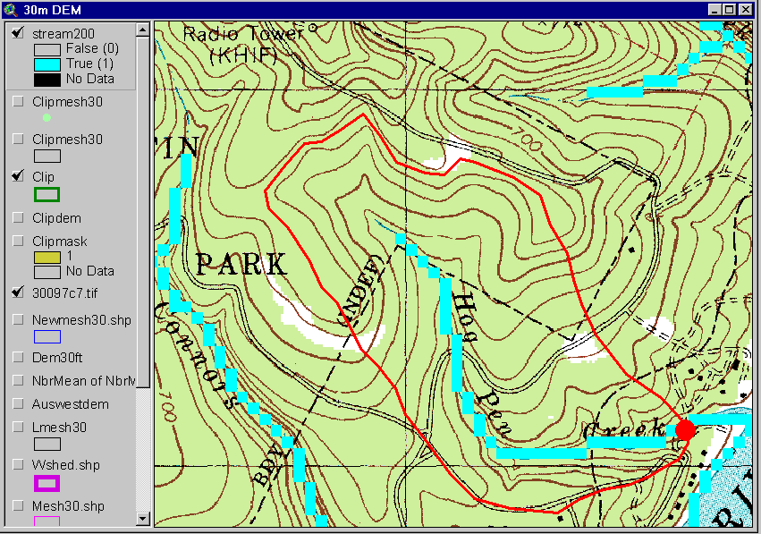
Delineation of Streams and Watersheds on a DEM

Slide 34
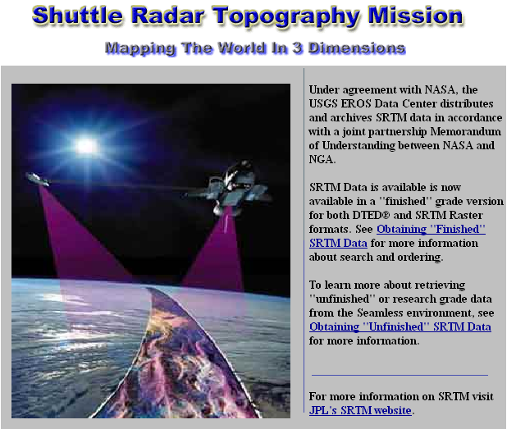
http://srtm.usgs.gov/

Slide 35
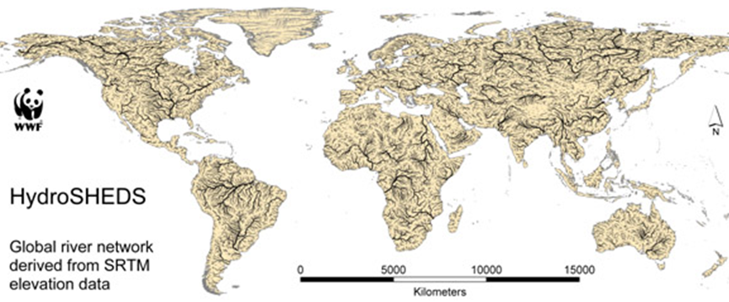
HydroSheds derived from SRTM
http://hydrosheds.cr.usgs.gov/

Slide 36
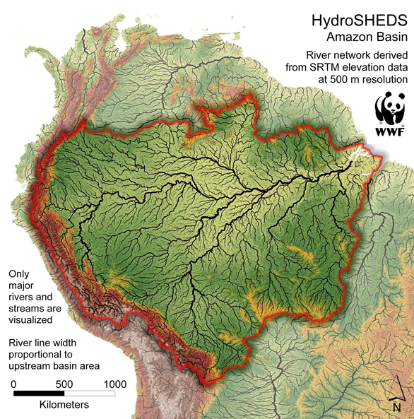

Slide 37
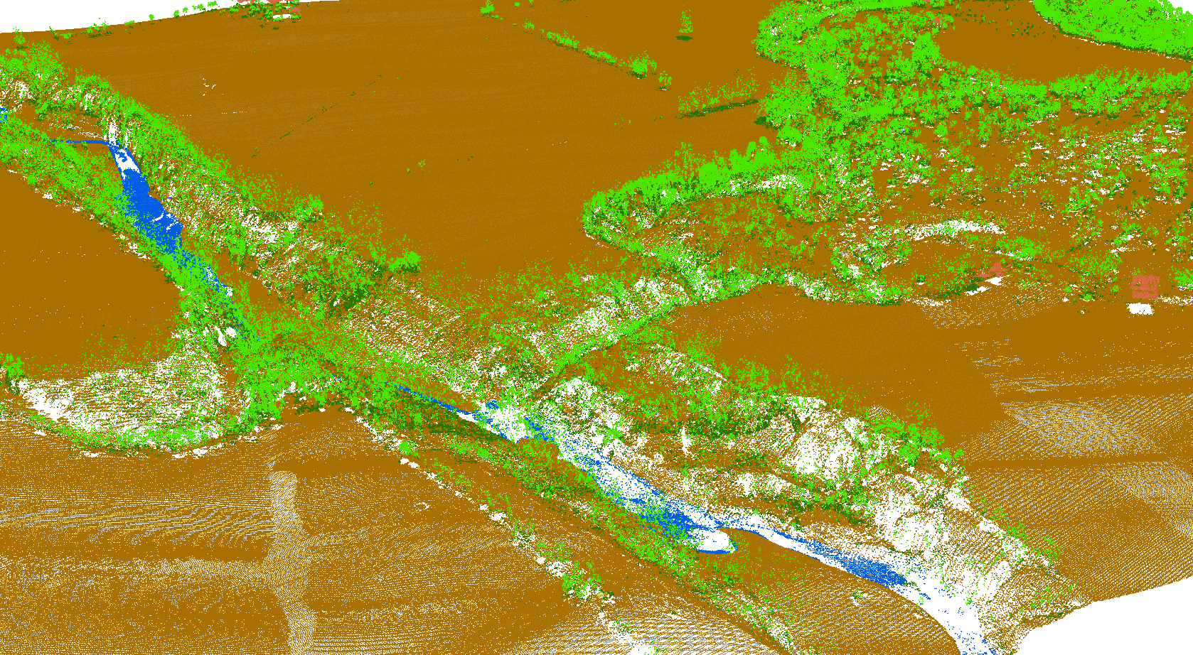
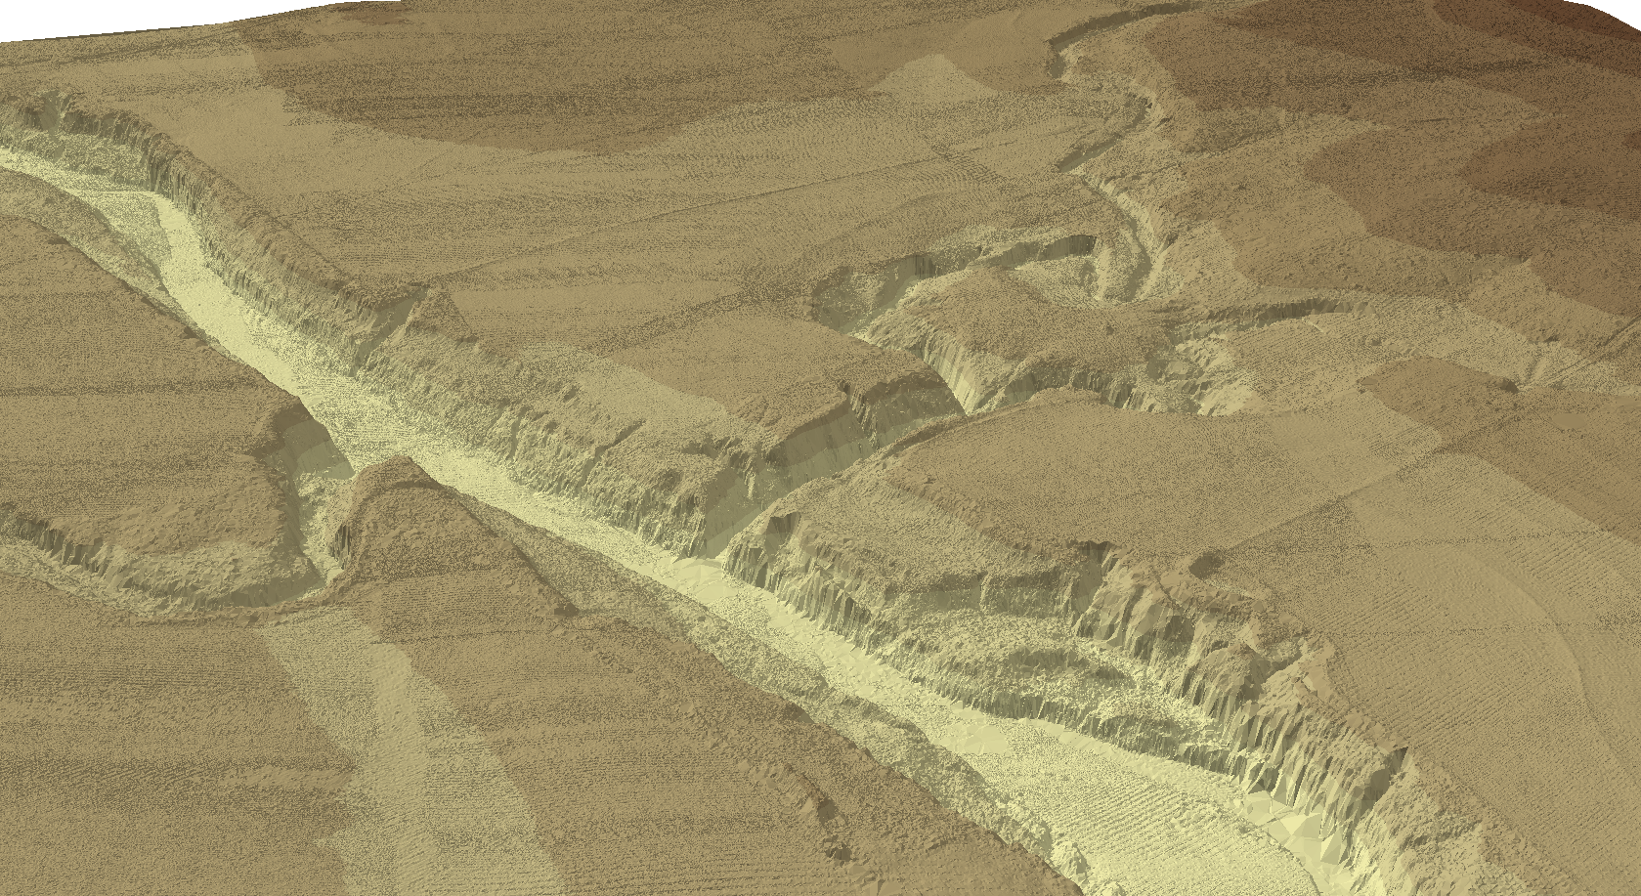
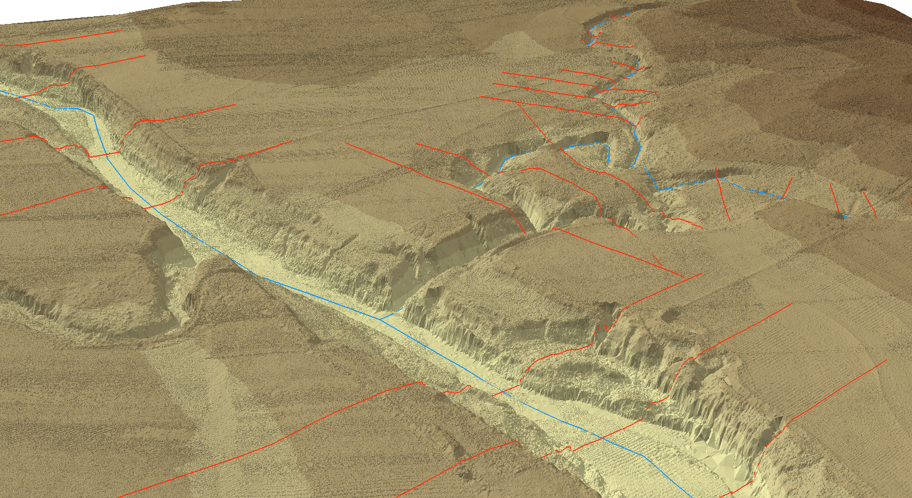
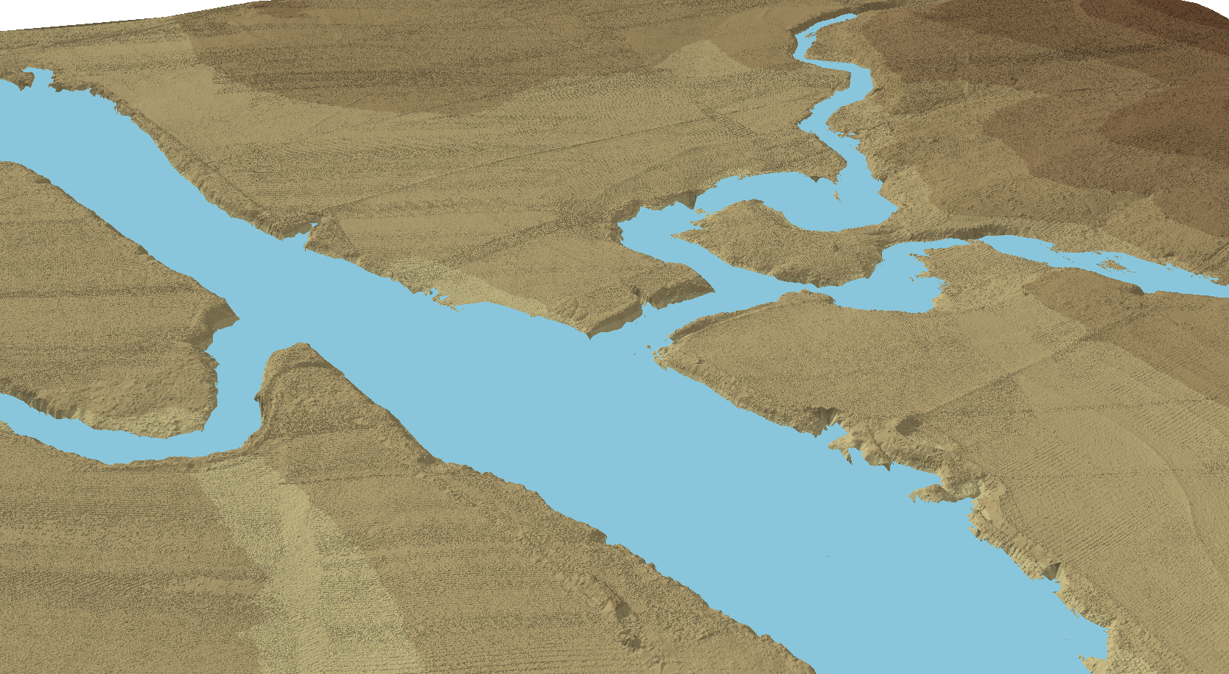
LIDAR-Based Inundation Mapping

Slide 38
USACE National Coastal Mapping Program
Jennifer M. Wozencraft, JALBTCX
Director, Joint Airborne Lidar Bathymetry Technical Center of Expertise
Program Manager, USACE National Coastal Mapping Program
15 October 2015
National Academies of Sciences, Engineering, and Medicine
Mapping Science Committee
Lidar workshop

Slide 39
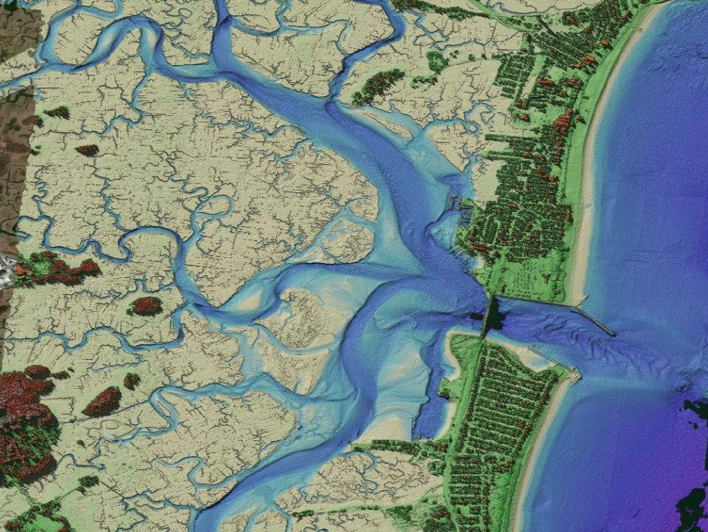
Seabrook, NH, federal navigation project and backbay marsh

Slide 40
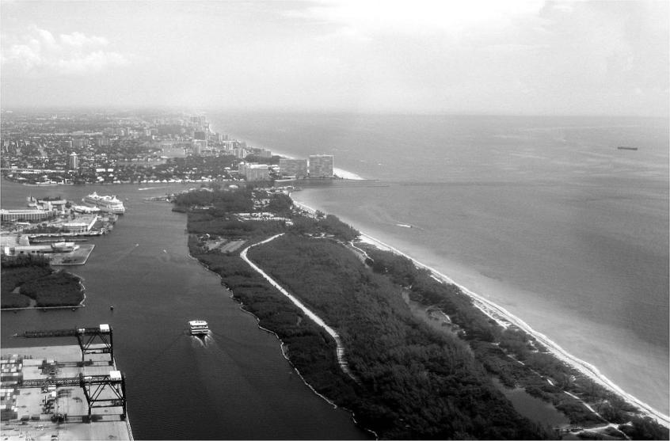


10,000 Hz Pulse Rate (hydro / topo)
0.4 Hz / 25 MP Digital camera (~20 cm pixel)
CASI-1500 Hyperspectral Imager
  1500 pixels
  380 – 1050 nm wavelength
  288 possible bands
15 cm RMSE bathymetry
7.5 cm RMSE topography
Shot spacing:
0.7 X 0.7 meter topo / shallow hydro
2.0 X 2.0 meter deep hydro
300 - 400 m op altitude (hydro)
300 - 1200 m op altitude (topo)
400 m
Dia: 290m
Shorter laser pulse length and receiver response for increased accuracy, especially in shallow (<2m) water
Large field-of-view afforded by prism, and more sensitive receivers, increase signal-to-noise ratio.
Improved depth detection in shallow turbid water
40

Slide 41

Bathymetric lidar principle
Surface
(Interface)
Return
INCIDENT LASER PULSE
RECEIVER FIELD OF VIEW
SPECULAR
INTERFACE
REFLECTION
Detection
Points
AMPLITUDE
Bottom
Return
ILLUMINATED
SURFACE
AREA
SEA SURFACE
Volume Backscatter
SCATTERING AND
ABSORPTION
SURFACE REGION
IN RECEIVER FOV
MEAN WATER
NADIR ANGLE
Δ_{t}
TIME
DIFFUSE
BOTTOM
REFLECTION
UNSCATTERED REF PATH
VOLUME BACKSCATTER
VERTICAL DEPTH
REFLECTED
BOTTOM
SIGNAL
ILLUMINATED BOTTOM REGION

Slide 42


FAQ’s
National Academies of Sciences of Sciences Engineering Medicine
Mapping Science Committee
LiDAR Workshop
Existing and future potential of high-accuracy LiDAR from high-altitude manned and unmanned platforms
Mark E. Romano
Sr. Product Manager
Space and Intelligence Systems

Slide 43
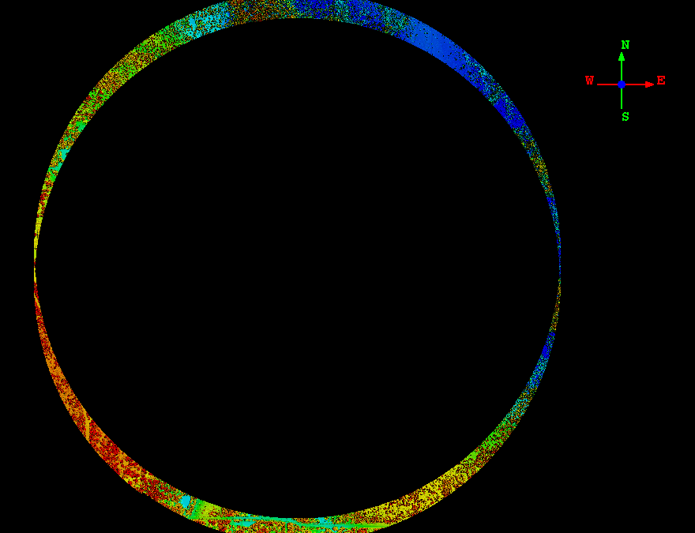
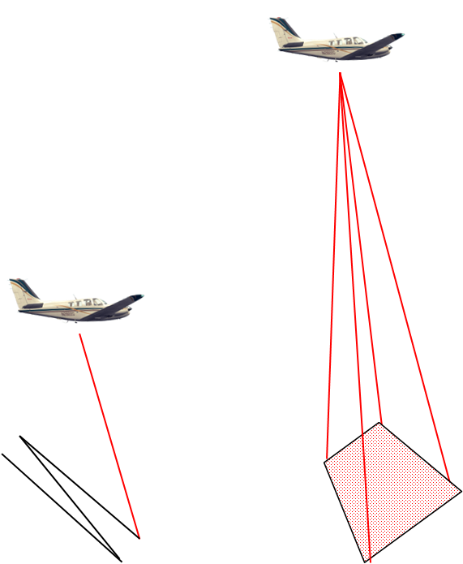
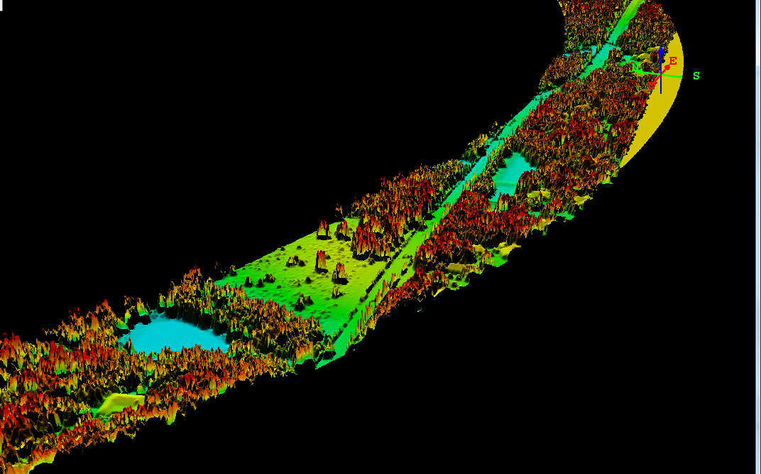
What makes Geiger Mode so Different?
Geiger Mode
Linear Mode
  Geiger-mode sensors sample the same spot on the ground thousands of times

Slide 44

Linear Mode LiDAR
High power, low sensitivity
Technology Comparison
Linear LiDAR
Single Pulse
Single measurement
Low sample rate
Approximately 500 KHz sample rate for single scanner designs

Slide 45

Geiger-mode LiDAR
Low Power, High Sensitivity (single photon)
Technology Comparison
Geiger LiDAR
Large array collection
Collection from multiple angles
High sample rate
(204 million samples per second)
200MHz vs. 500 KHz

Slide 46
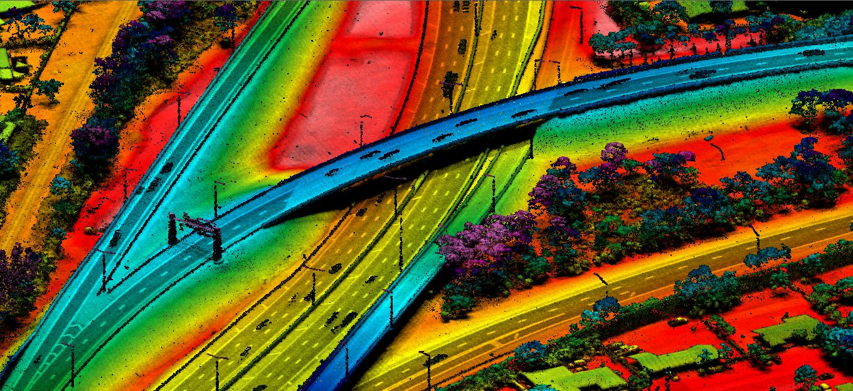
Benefits of Geiger-mode LiDAR
Transportation Example
The results include ability to see finest detail from the desktop

Slide 47
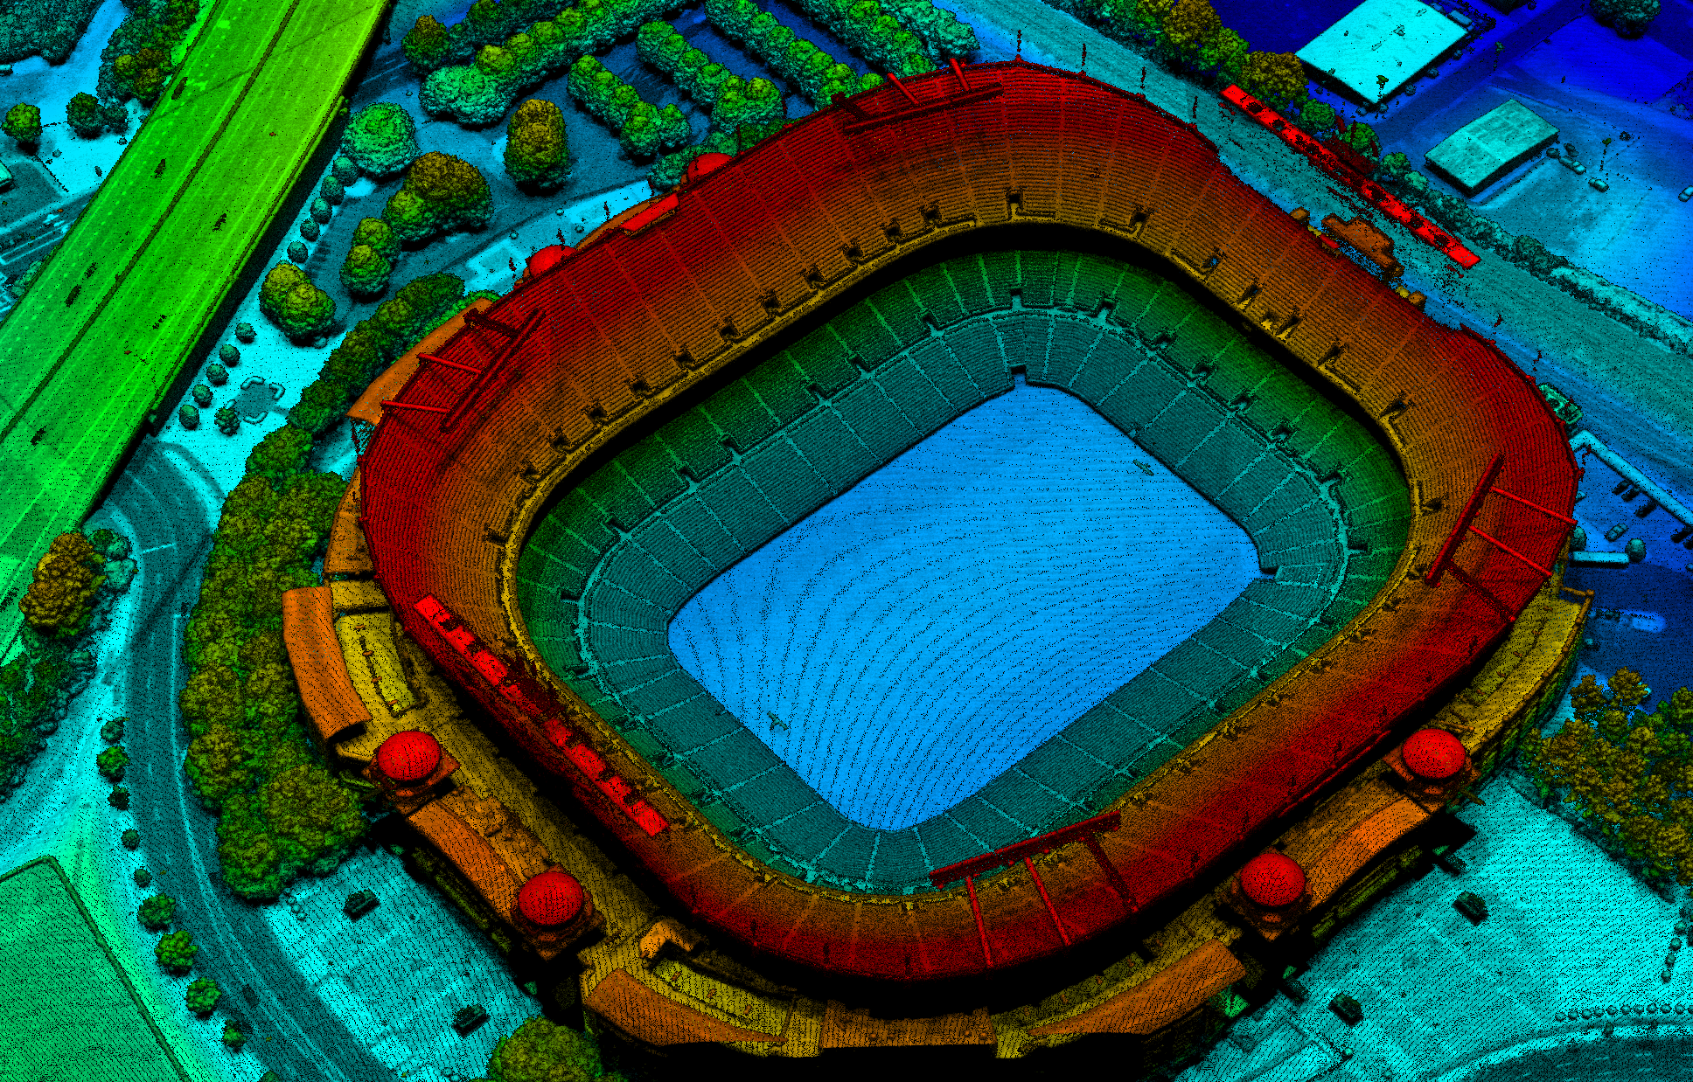
Questions?

