Slide 1

City of Austin Creek Flooding Hazard Mitigation
Flood Mitigation Projects for Roadway Crossings
Reem J. Zoun, PE, CFM
April 2016

Slide 2
Outline
Flooding
Roadways in Floodplain in COA
Flood Scores for Roadway Crossings
Feasibility Study
CIP Project Example

Slide 3
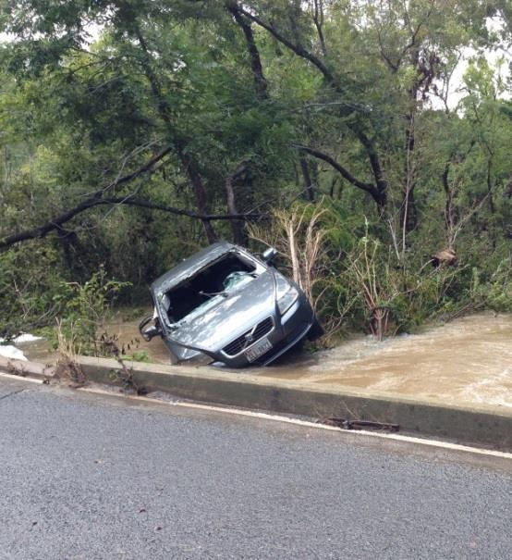
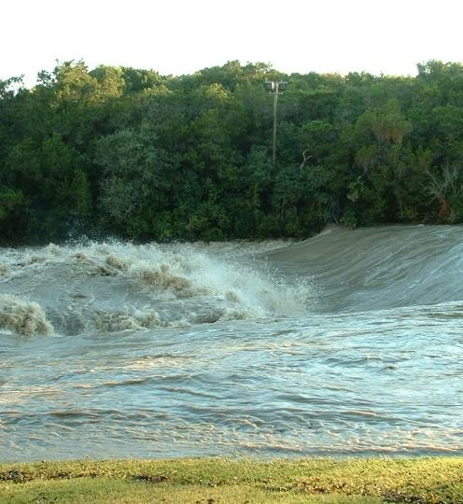
Creek Flood
Flooding
  Leading cause of weather-related deaths
  Texas is the state with the most flood/flash flood deaths
  ~ 75% of flood-related drownings are vehicle-related
Flooding occurs as a result of overloads of the primary drainage system, the creeks, “CREEK FLOODING” or the secondary drainage system, the storm drains, “LOCAL FLOODING”
Creek Flood Mission
  Protect lives and property by reducing the risk of flooding along creeks of Austin
Notes:
Creek flooding commonly poses the greatest threat to public safety.
http://floodsafety.com/national/life/statistics.htm
Flash flooding is the leading cause of weather-related deaths in the U.S.- approximately 200 deaths per year. Texas is the state with the most flood/flash flood deaths in the past 36 years. National Weather Service Fatality Data for South Central Texas indicates 203 flood/ flash flood fatalities from 1973 to 2000, 136 of which were vehicle related.
Flooding occurs as a result of overloads of the primary drainage system, the creeks, or the secondary drainage system, the storm drains.
Both Creek Flooding and Localized Flooding were identified in our WPD Master plan and both are important to protect lives and properties. The objective of the Creek Flood Hazard Mitigation Section is to reduce the depth and frequency of flooding for all structures and road in the 100 year floodplain. The objective of the Local Flood Hazard Mitigation Section is to reduce. the depth and frequency of localized flooding for buildings, yards, and streets. This table only indicates the residential buildings within the full purpose limits of the City of Austin that are at risk of creek flooding.
Over the last thirty years, an average of 94 deaths occur per year due to floods. Most of the fatalities are vehicle-related and occur during flash flood events. (click)
For this reason, an important activity of the Flooding mission is to issue early flood warnings during heavy storms. Flood insurance and floodplain information is also distributed on a routine basis to help mitigate property damage from floods and save lives.
Creek Flood components include:
Public warnings (public safety)
Closing of low water crossings
Floodplain information distribution
Property safety
Creek level monitoring
Weather monitoring
Flooding infrastructure

Slide 4
Flood Mitigation for Creek Crossings
Project Identification
  Masterplan and flood scoring
  Buildings and Creek Crossings
Feasibility studies
  Site visits
  Detailed evaluation of the elevation and expected inundation depths
  Evaluations of potential solutions (structural, buyout, elevation, etc.),
  Identification of project constraints
  Preliminary cost estimates
  Partnership/integration opportunities
  Funding plan/schedule
  Evaluate, design and construct Capital Improvement Projects
Notes:
Feasibility studies involve site visits, a more detailed evaluation of the elevation of structures, expected inundation depths based on frequency of storm events, evaluations of potential solutions (structural, buyout, elevation, etc.), identification of project constraints and partnership/integration opportunities, and preliminary cost estimates.
Projects that mitigate the risk of creek floods include culverts and low water crossing upgrades, floodwalls, buyouts, detention ponds, and channel modifications.

Slide 5
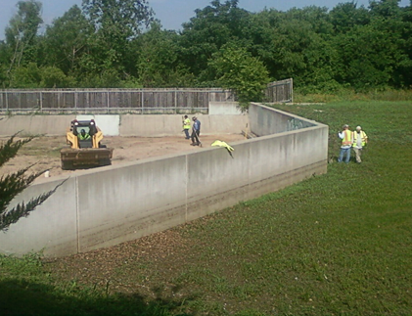
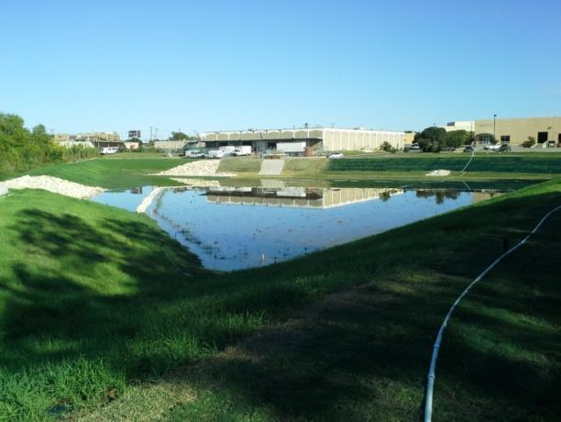
Capital Improvement Project Solutions
Roadway Improvements
Regional Ponds
Channel conveyance modifications
Channel diversions
Floodwalls/Levees
Structure Raising
Property Buyouts
Notes:
Feasibility studies involve site visits, a more detailed evaluation of the elevation of structures, expected inundation depths based on frequency of storm events, evaluations of potential solutions (structural, buyout, elevation, etc.), identification of project constraints and partnership/integration opportunities, and preliminary cost estimates.
Projects that mitigate the risk of creek floods include culverts and low water crossing upgrades, floodwalls, buyouts, detention ponds, and channel modifications.

Slide 6
Roadway improvements
Raise roadways
Improve stormwater conveyance under roadways with culverts or bridges
Reduce flood risks to drivers and pedestrians
Reduce road closures
Reduce maintenance needs after storm events
Allows FEWS to concentrate on other flood risks
Notes:
Creek flooding commonly poses the greatest threat to public safety.
http://floodsafety.com/national/life/statistics.htm
Flash flooding is the leading cause of weather-related deaths in the U.S.- approximately 200 deaths per year. Texas is the state with the most flood/flash flood deaths in the past 36 years. National Weather Service Fatality Data for South Central Texas indicates 203 flood/ flash flood fatalities from 1973 to 2000, 136 of which were vehicle related.
Flooding occurs as a result of overloads of the primary drainage system, the creeks, or the secondary drainage system, the storm drains.
Both Creek Flooding and Localized Flooding were identified in our WPD Master plan and both are important to protect lives and properties. The objective of the Creek Flood Hazard Mitigation Section is to reduce the depth and frequency of flooding for all structures and road in the 100 year floodplain. The objective of the Local Flood Hazard Mitigation Section is to reduce. the depth and frequency of localized flooding for buildings, yards, and streets. This table only indicates the residential buildings within the full purpose limits of the City of Austin that are at risk of creek flooding.
Over the last thirty years, an average of 94 deaths occur per year due to floods. Most of the fatalities are vehicle-related and occur during flash flood events. (click)
For this reason, an important activity of the Flooding mission is to issue early flood warnings during heavy storms. Flood insurance and floodplain information is also distributed on a routine basis to help mitigate property damage from floods and save lives.
Creek Flood components include:
Public warnings (public safety)
Closing of low water crossings
Floodplain information distribution
Property safety
Creek level monitoring
Weather monitoring
Flooding infrastructure

Slide 7
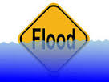
Roadways in Floodplain in COA

Slide 8
Total ~ 400 Roadways at risk in
COA Full Purpose
Notes:
Needs update

Slide 9
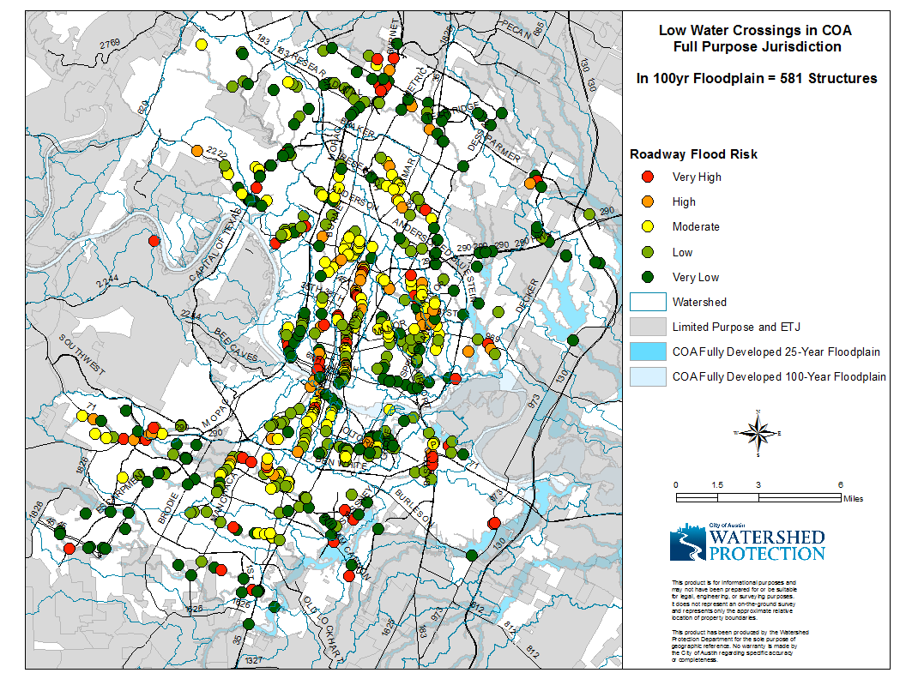
Notes:
Total scored 733 in 26 watersheds
In full purpose 581
At risk of flooding in 100yr in full purpose = 394
Top 20

Slide 10
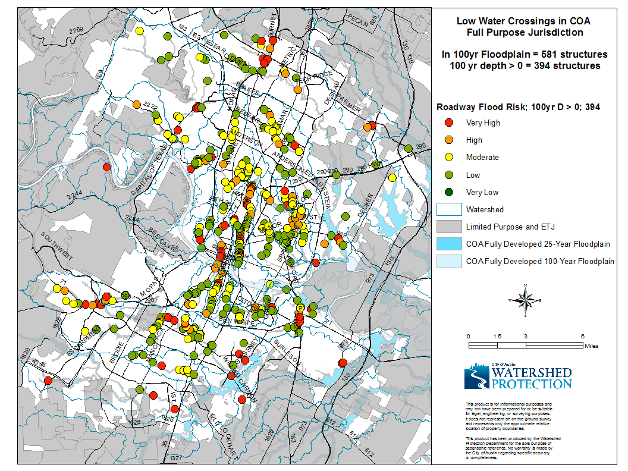
Notes:
Total scored 733 in 26 watersheds
In full purpose 581
At risk of flooding in 100yr in full purpose = 394
Top 20

Slide 11

Flood Scores for Roadway Crossings

Slide 12
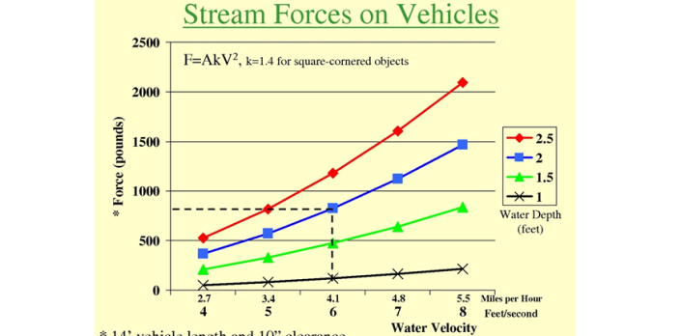
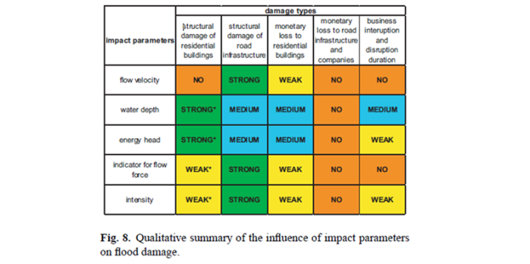
Roadway Crossing Scoring
Where:
RV = Resource Value*
D₂ = flood inundation depth for the COA fully developed 2 - year storm event
V₂ = channel velocity for the COA fully developed 2 – year storm event
*Resource Values:
  Differentiates between type and use of street crossings and structures
  Reflects potential structural damage and risk to public safety due to flooding
  Resource values based on “impact” value, not monetary damages
Notes:
Kreibich H. et al, “Is flow velocity a significant parameter of flood damage modelling?”,
Natural Hazards and Earth System Sciences, Vol.9, pg. 1679-1692, 2009.

Slide 13
Flood Control Resource Values
Flood Control Resource Values
Structures |  | Street Crossings
Public Care Facilities | 100 | Highway | 100
Residential: Multi-Family | 80 | Arterial Road | 95
Mixed Use | 80 | Single Access Road | 90
Residential: Single Family | 60 | Collector Road | 85
Non-Residential | 60 | Local Road | 80
Parking Garage | 40
Resource values for current scoring is based on 2006 land use data available in COA GIS DataMart

Slide 14
Calculating Flood Scores
Identify structures in the 100yr floodplain (point file)
Identify roadway class and assign resource value
Get minimum weir elevation from HEC-RAS
Get WSE and velocity information for 2, 10, 25 and 100yr storm evens
Calculate depth of flooding
Calculate score

Slide 15
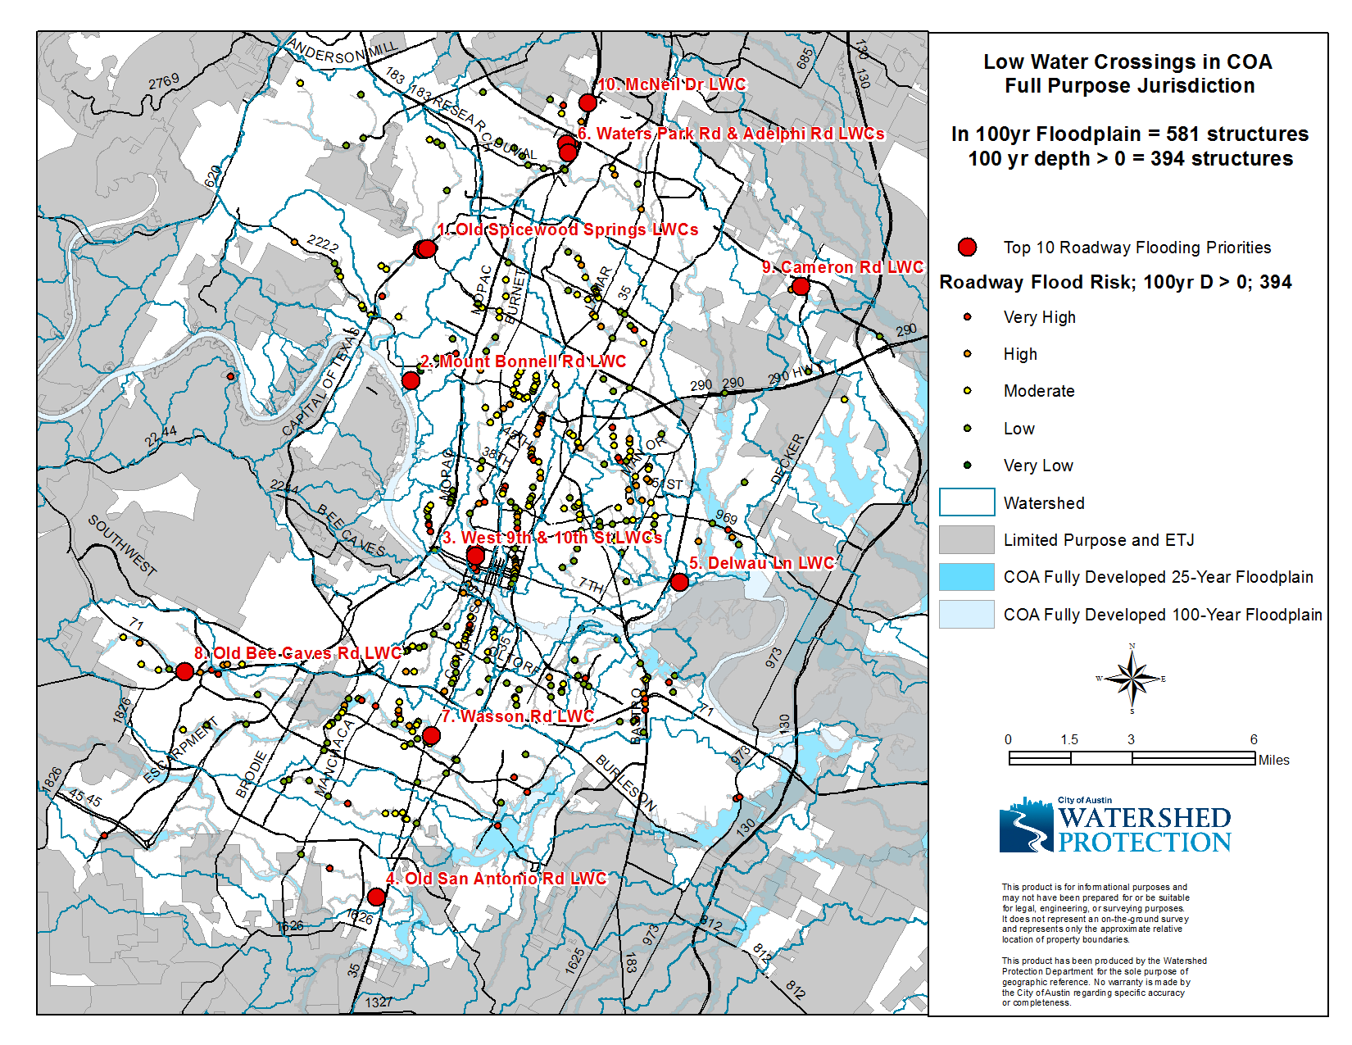

Slide 16
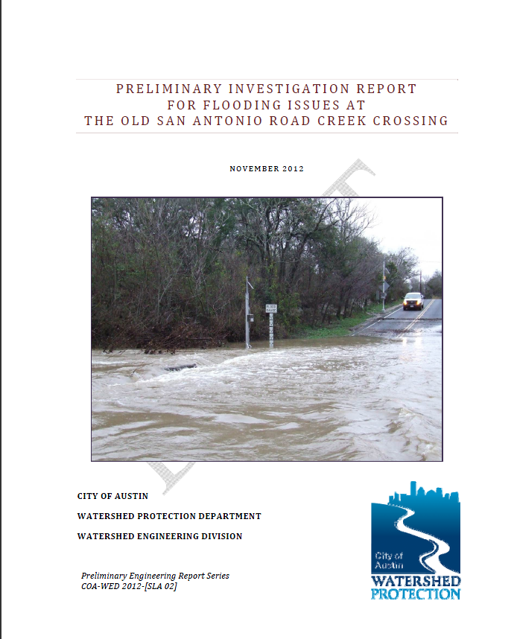
Preliminary Engineering Design

Slide 17
Preliminary Engineering Design
Components
  Site visits
  Access, traffic count
  Detailed evaluation of the elevation and expected inundation depths
  Assess current condition
  Evaluations of potential solutions (structural, buyout, elevation, etc.),
  Identification of project constraints
  Constructability
  Preliminary cost estimates
  Partnership/integration opportunities
  Multi-mission objectives
Notes:
Feasibility studies involve site visits, a more detailed evaluation of the elevation of structures, expected inundation depths based on frequency of storm events, evaluations of potential solutions (structural, buyout, elevation, etc.), identification of project constraints and partnership/integration opportunities, and preliminary cost estimates.
Projects that mitigate the risk of creek floods include culverts and low water crossing upgrades, floodwalls, buyouts, detention ponds, and channel modifications.

Slide 18
Design Goal
  COA DCM Requirement
    Pass a 100yr design flow with less that 6” of water on the roadway for all street other than local (DCM 1.2.4 D)
    Pass a 100yr design flow with less that 12” of water on the roadway for local street ((DCM 1.2.4 C)
    No adverse impact allowed (DCM 1.2.2 A)
    https://www.municode.com/library/tx/austin/codes/drainage_criteria_manual
  Alternative Evaluation
    Meet DCM
    Pass 100 year flow
    Pass 25y year flow
    Pass 10 year flow
  Cost Estimate
  Recommended solution

Slide 19
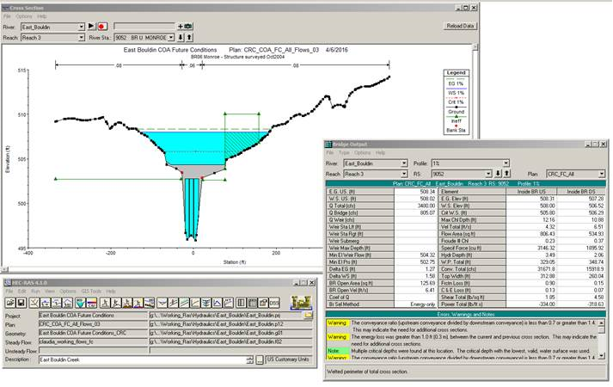
Current Capacity
  Bridge/ Culvert Capacity
  Run COA Effective Fully Developed Condition Model
  Cross Section Output

Slide 20
  No Adverse Impact
  Run proposed alternative
  RAS Profile Plot – no increase in downstream or upstream WSE

Slide 21
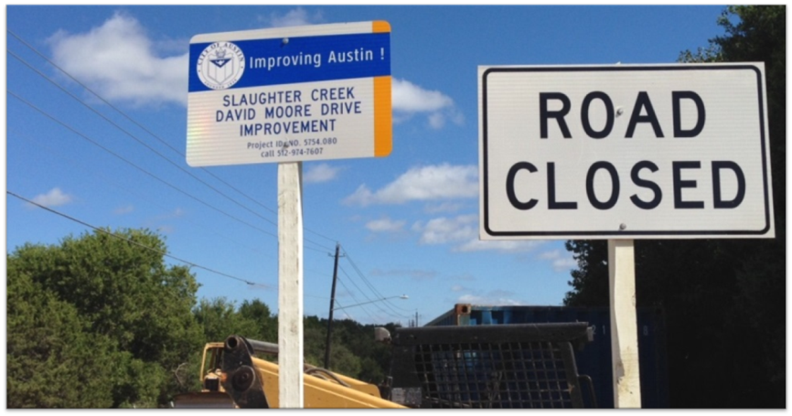
Capital Improvement Project Example

Slide 22
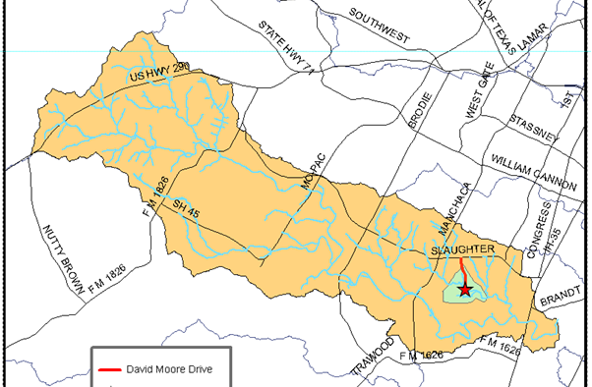
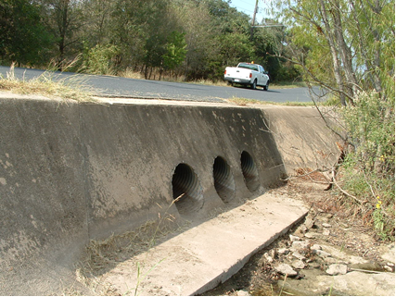
Preliminary Engineering Report
Low water crossing
Lower part of Slaughter Creek
Current Conditions
  3- 24” CMP
  24’ Asphalt roadway
  Overtops during 2-yr storm
  4.5’ depth during 100-yr storm
  5,080 cfs during 100-yr storm
  On routine emergency closure list
Drainage Criteria
  < 6” overtopping allowed during 100-yr storm
  Fully convey 25-yr
  No adverse impact allowed
Mission Integration Prioritization (MIP)
  Flood
  Erosion
  Water Quality

Slide 23
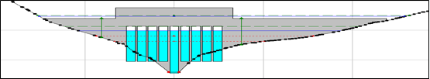

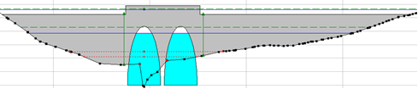
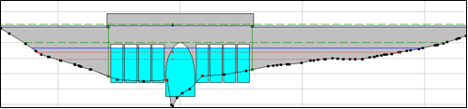
Preliminary Engineering Report
Modeling and Mapping
  HEC-RAS
  GIS – ESRI
Alternatives (cost)
  1 - Box Culverts ($1M)
  2 - Clear-Span Bridge ($2M)
  3 – Two CONSPAN ($1.5M)
  4 - CONSPAN and Box Culverts (($1.2M)

Slide 24
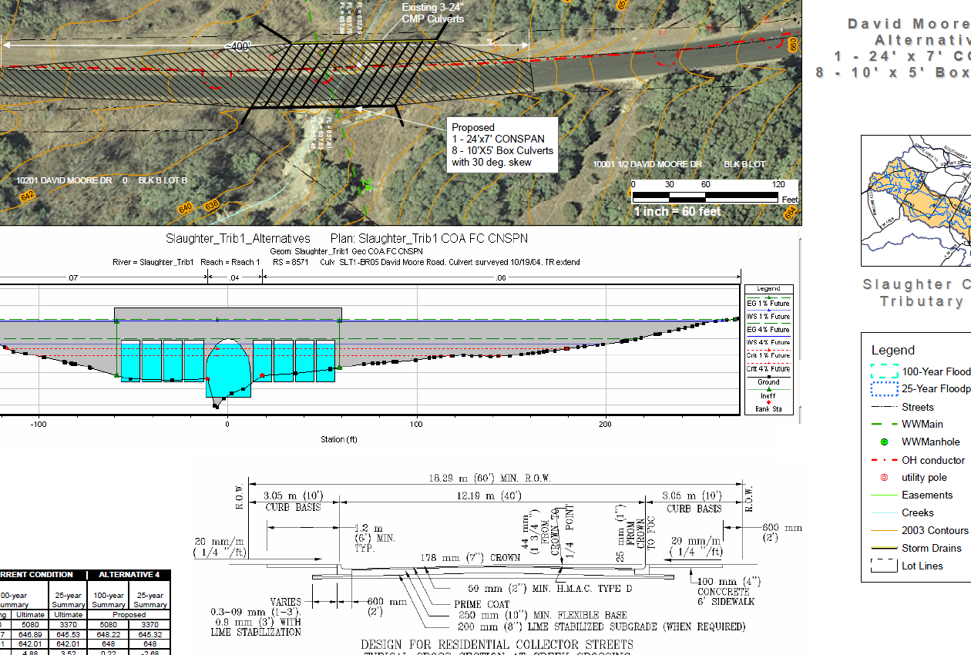
PER Recommendation

Slide 25
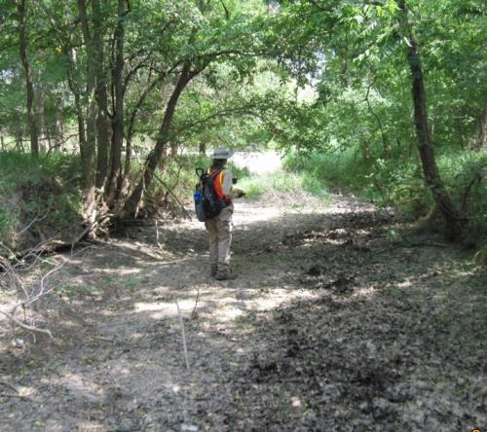
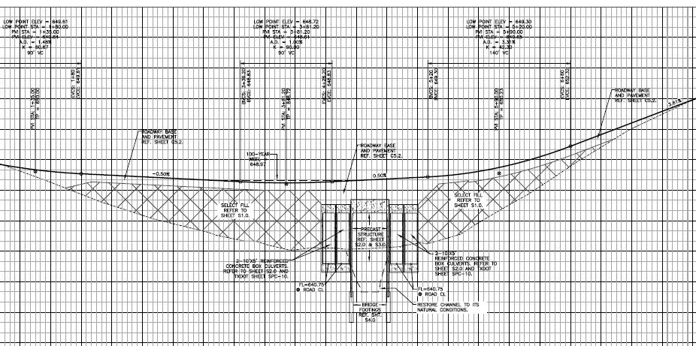
David Moore Drive Low Water Crossing Replacement
Design
Precast Bridge Unit (31° Skew) and 4-10’x5’ Box Culverts
City of Austin Hydraulic Criteria: Pass 25-year Storm; no more than 6” overtopping during the 100-year Storm
Geomorphologic Considerations: Urban vs. Rural Crossings Significant Development Dynamic Streams
Drainage Easement Acquisition
Design Included 150 LF of Storm Sewer
Notes:
9’ of embankment

Slide 26
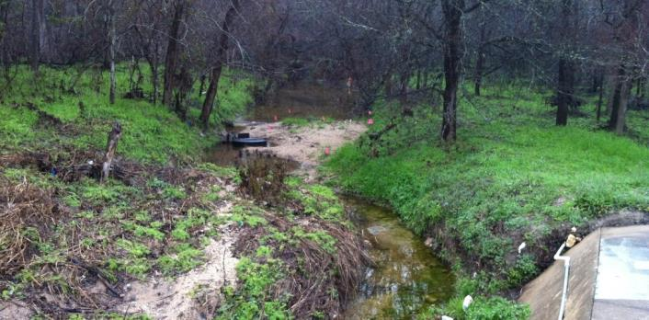
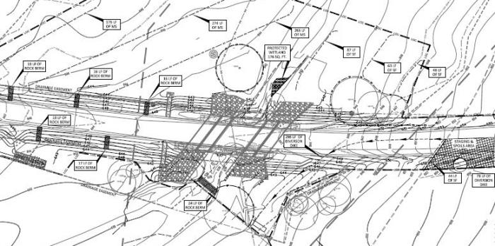
David Moore Drive
Low Water Crossing Replacement
Engineer’s Estimate - $900K
4 Bids Received within 3% of Engineer’s Estimate
Project Awarded to –
Smith Contracting Company
Bid $850K
Construction Challenges
David Moore Drive Road Closure limited to the AISD summer break; 79 days between June 6, 2014 and August 24, 2014; excluding weekends and public holidays this is 54 days
Limited lay down area adjacent to floodplain
Slaughter Creek tributary classified as Waters of the U.S., as defined by Section 404 of the Clean Water Act. Construction of the proposed project is required to follow the terms and conditions outlined in the USACE Nationwide Permit 13 for Bank Stabilization
Special attention to keep all activity inside the limits of construction to avoid impacts to adjacent wetland

Slide 27
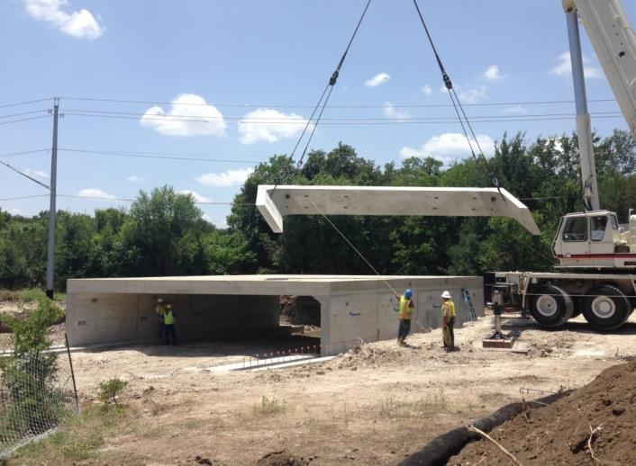
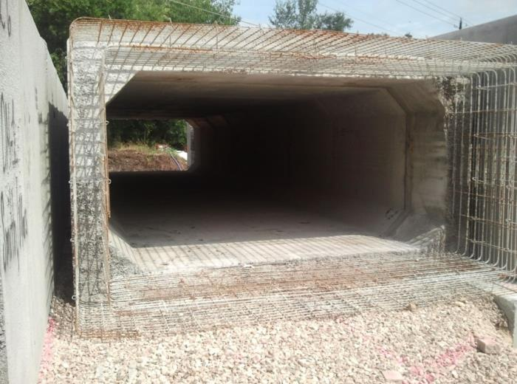
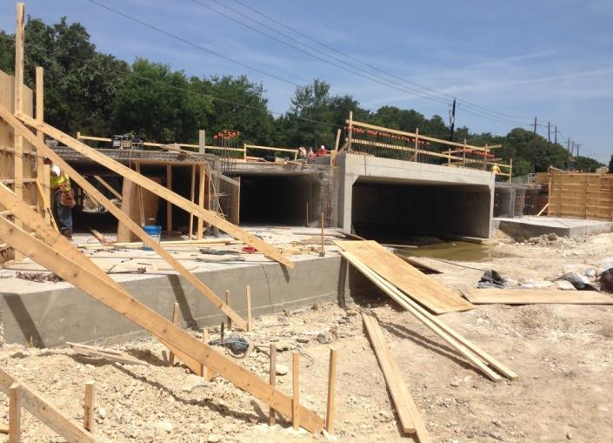
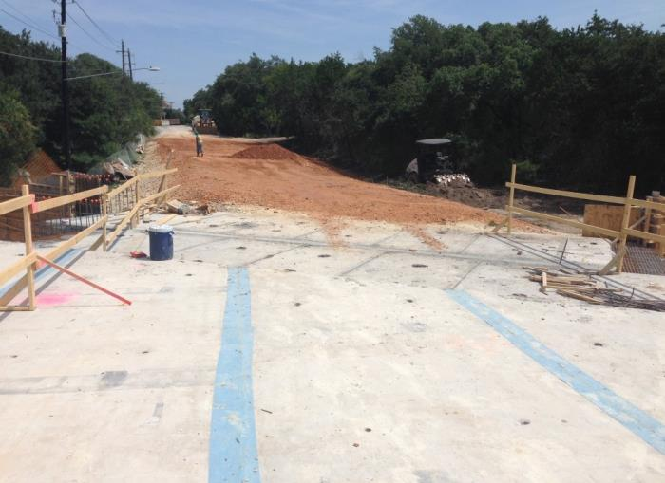
WEEK 11 – 7/2/2014
WEEK 13 – 7/17/2014
WEEK 15 – 7/30/2014
WEEK 15 - 7/30/2014
David Moore Drive Construction Overview Precon Held 4/15/2014 Road Closure 6/6/2014 to 8/24/2014

Slide 28






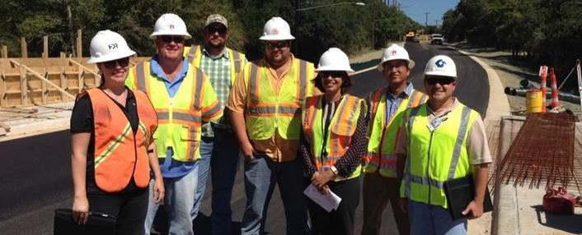
Project Team
David Moore Drive - Low Water Crossing Replacement Project
Notes:
City of Austin - Jorge Morales, PE, CFM: Watershed Development Project Sponsor during project development
City of Austin - Reem Zoun, PE, CFM: Watershed Development Project Sponsor during project execution and construction
HDR Engineering, Inc. - Laura McKay Casset, PE, CFM, CPESC: Project Manager aiding the City with project development, execution, and construction

Slide 29
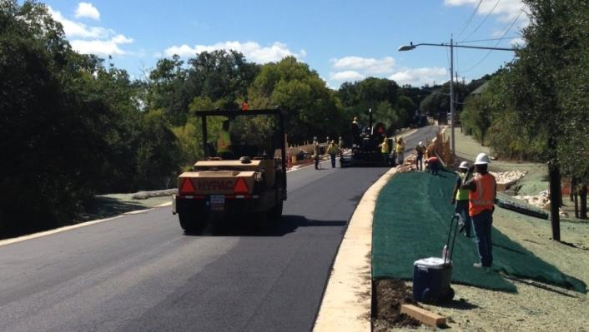
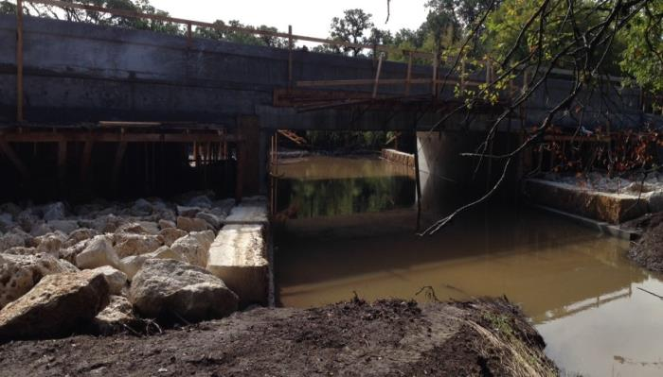
David Moore Drive Low Water Crossing Replacement
Project Successes
  The David Moore Drive Roadway Crossing currently meets COA DCM
  Improved public safety and reduced roadway closure
  Cost savings in the form of saved staff time for roadway closure and emergency response
  Project completed within contracted time and on budget
  Flood gauge salvaged and utilized at another LWC
  Design expects to restore natural creek condition
Notes:
Construction 06/07 to 09/14/2014
Road reopen on 09/16/2014
Substantial completion on 09/24/2014
Total construction cost ~ 890K

Slide 30
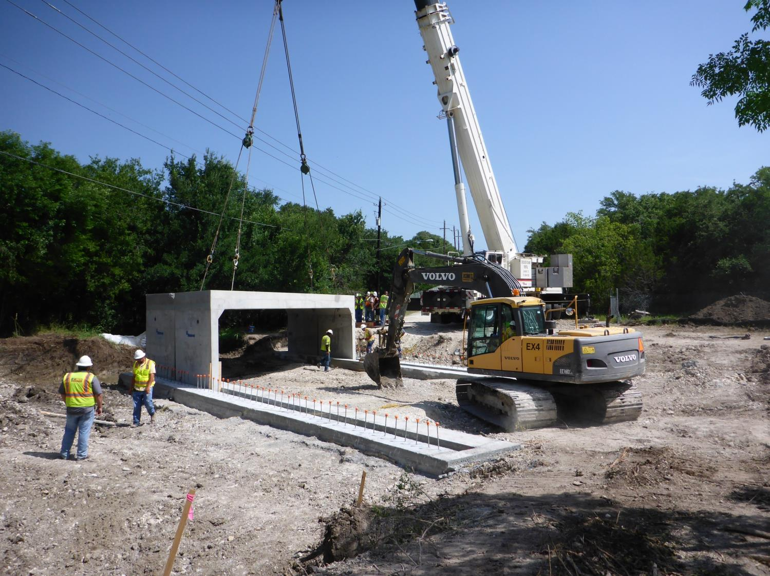

Slide 31
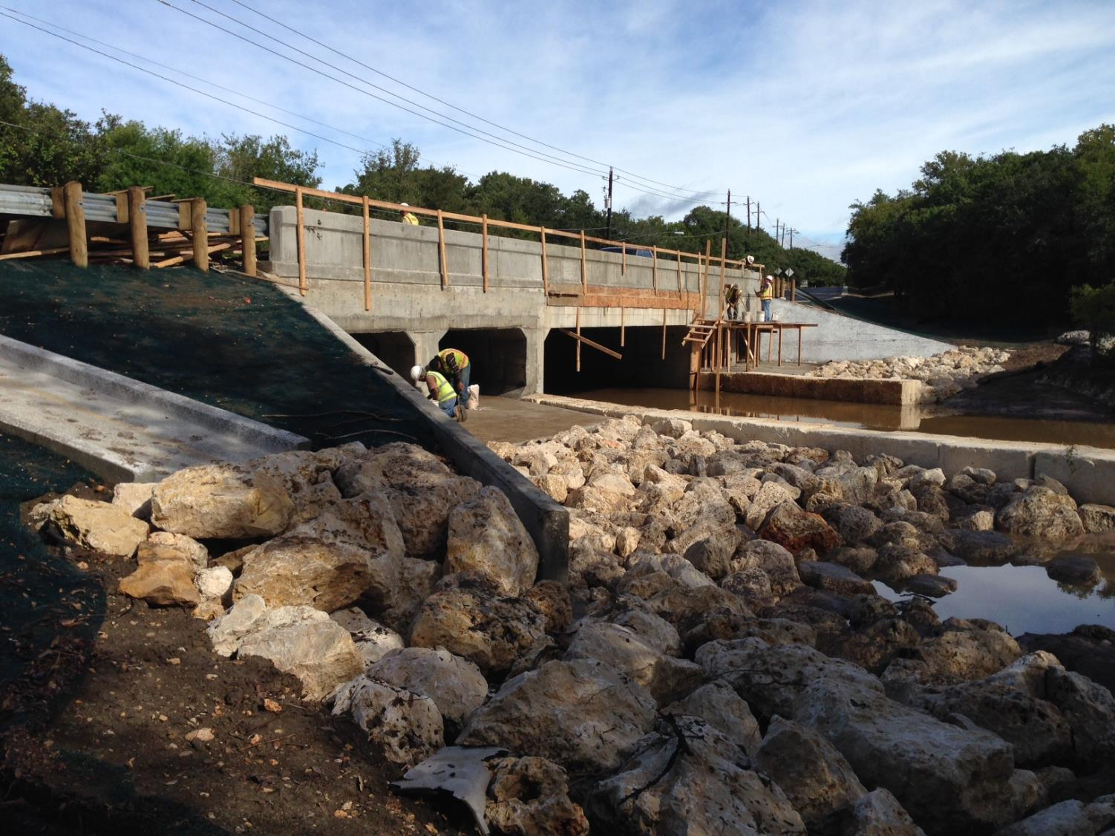

Slide 32
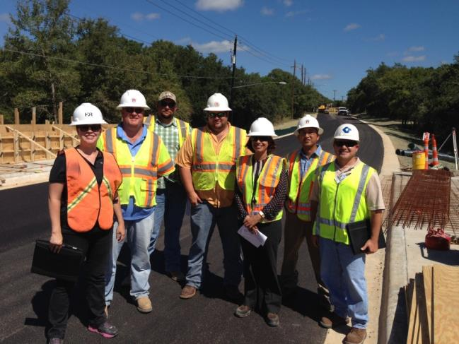
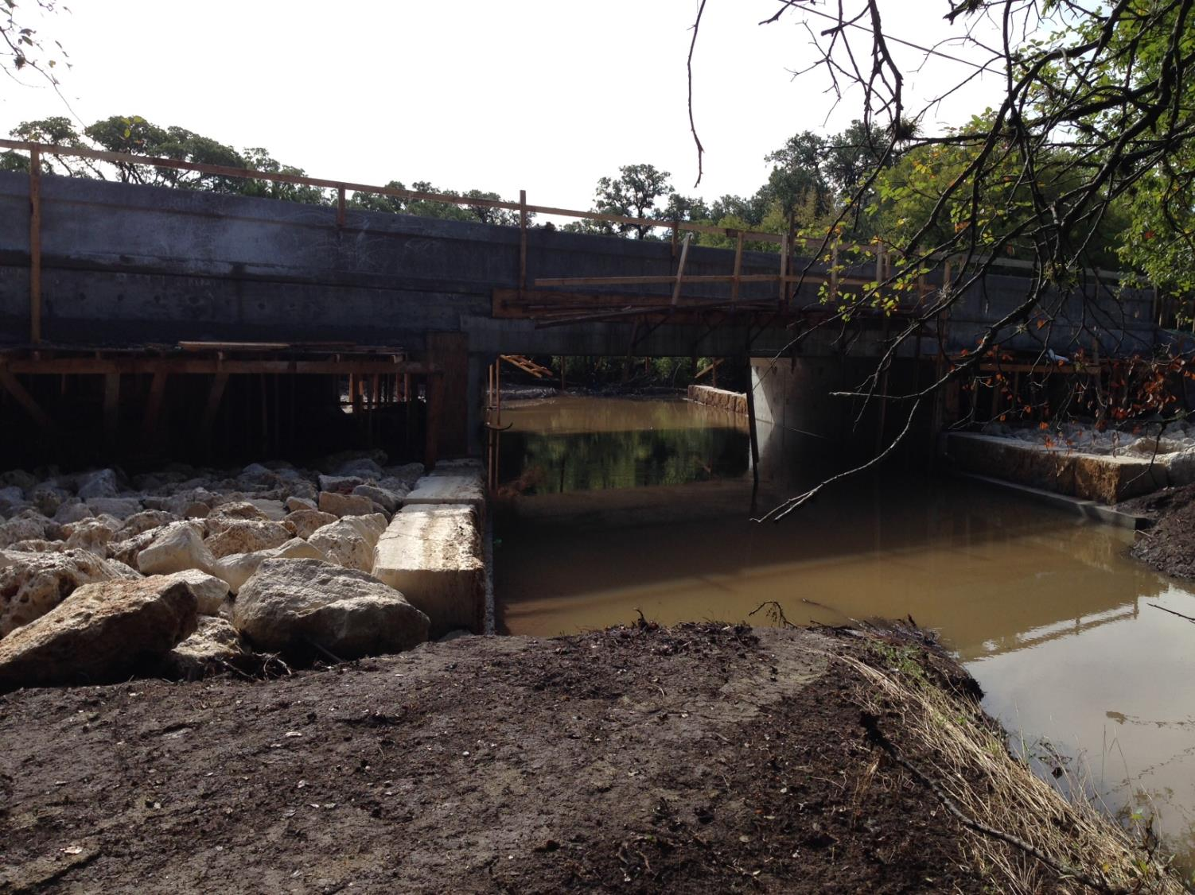

Slide 33
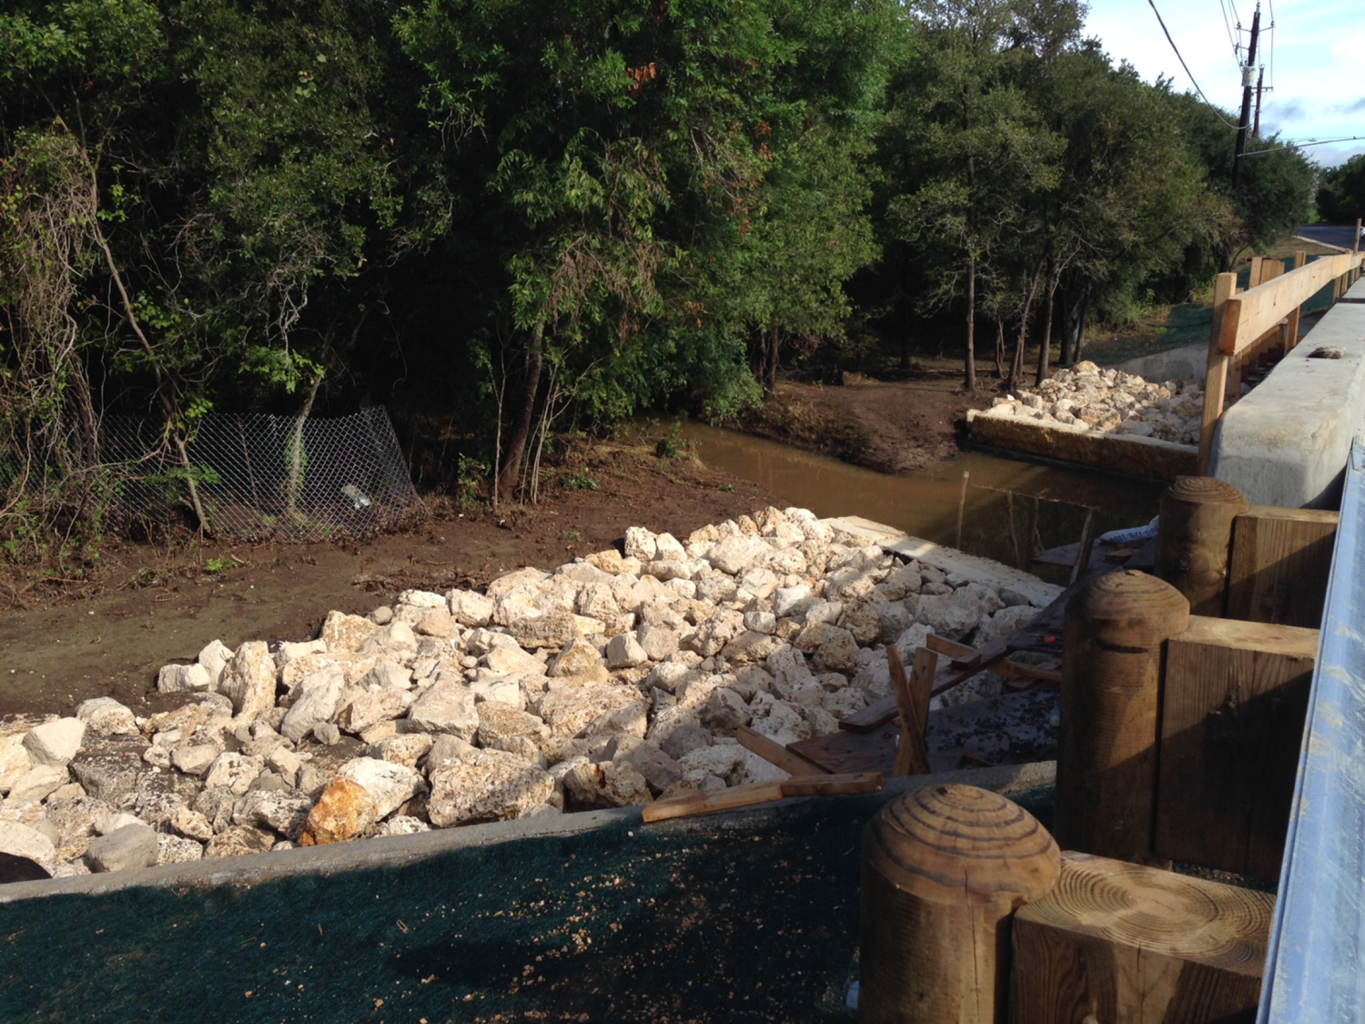

Slide 34
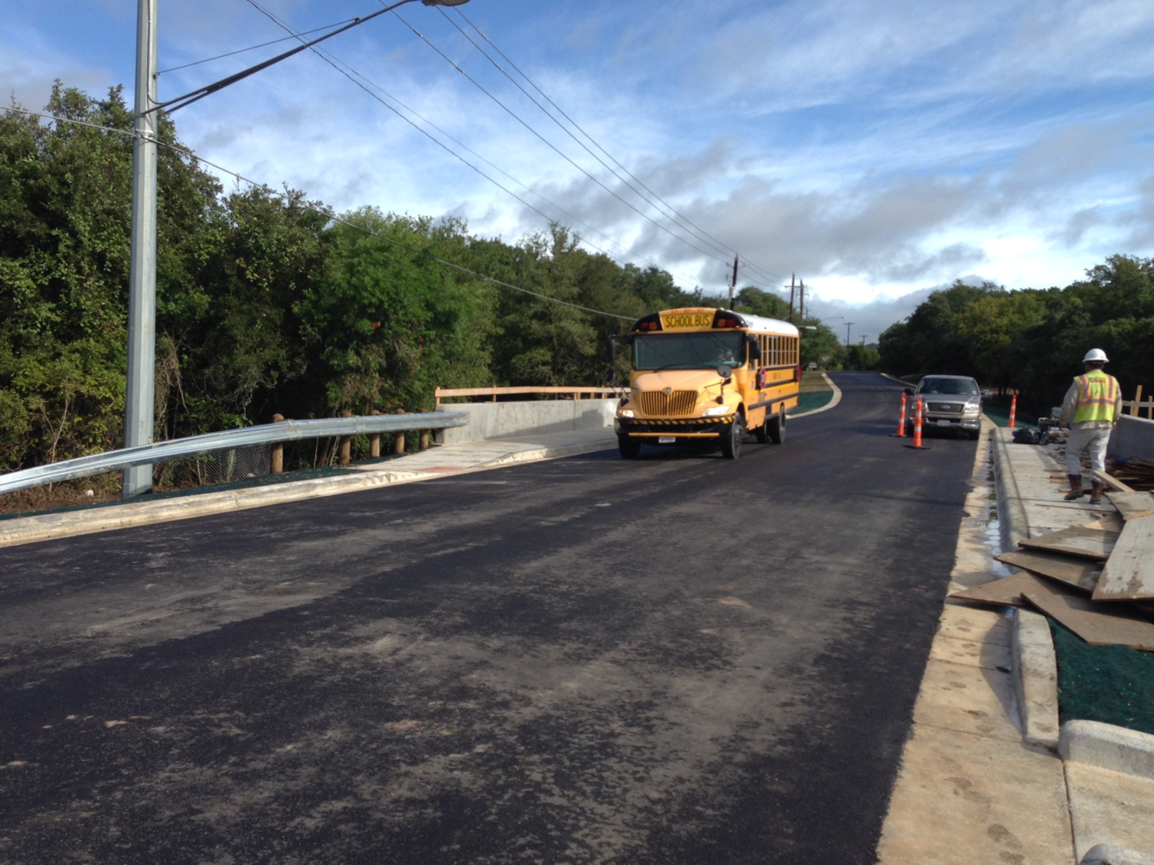
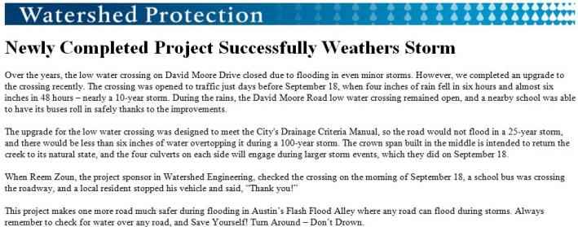
Notes:
School bus on bridge after September 19th storm

Slide 35
City of Austin - Land Development Code (LDC)
25-8-211 - WATER QUALITY CONTROL REQUIREMENT
(A) In the Barton Springs Zone, water quality controls are required for all development.
(B) In a watershed other than a Barton Springs Zone watershed, water quality controls are required for development:
  (1) located in the water quality transition zone;
  (2) of a golf course, play field, or similar recreational use, if fertilizer, herbicide, or pesticide is applied; or
  (3) if the total of new and redeveloped impervious cover exceeds 8,000 square feet.
(C) All new development must provide for removal of floating debris from stormwater runoff.
(D) The water quality control requirements in this division do not require water quality controls on a single-family or duplex lot but apply to the residential subdivision as a whole.
(E)The water quality control requirements in this division do not require water quality controls for a roadway project with less than 8,000 square feet of new impervious cover. For the purposes of this Section, roadway improvements are limited to intersection upgrades, low-water crossing upgrades, additions for bicycle lanes, and additions for mass transit stops.

Slide 36
LDC 25-8-213
Water Quality Control Standards
(A) A water quality control must be designed in accordance with the Environmental Criteria Manual.
  (1) The control must provide at least the treatment level of a sedimentation/filtration system under the Environmental Criteria Manual.
  (2) An impervious liner is required in an area where there is surface runoff to groundwater conductivity. If a liner is required and controls are located in series, liners are not required for the second or later in the series following sedimentation, extended detention, or sedimentation/filtration.
  (3) The control must be accessible for maintenance and inspection as prescribed in the Environmental Criteria Manual.
(B) A water quality control must capture and treat the water draining to the control from the contributing area. The required capture volume is:
  (1) the first one-half inch of runoff; and
  (2) for each 10 percent increase in impervious cover over 20 percent of gross site area, an additional one-tenth of an inch of runoff.

Slide 37
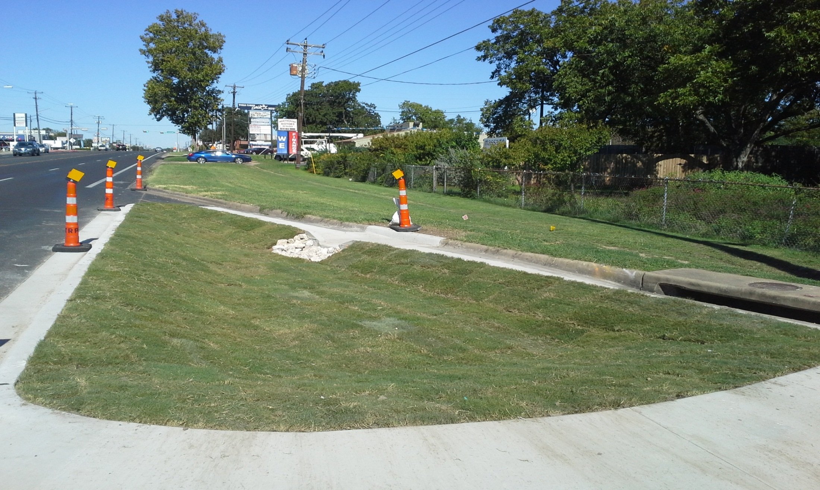
Burnet & Cullen

Slide 38
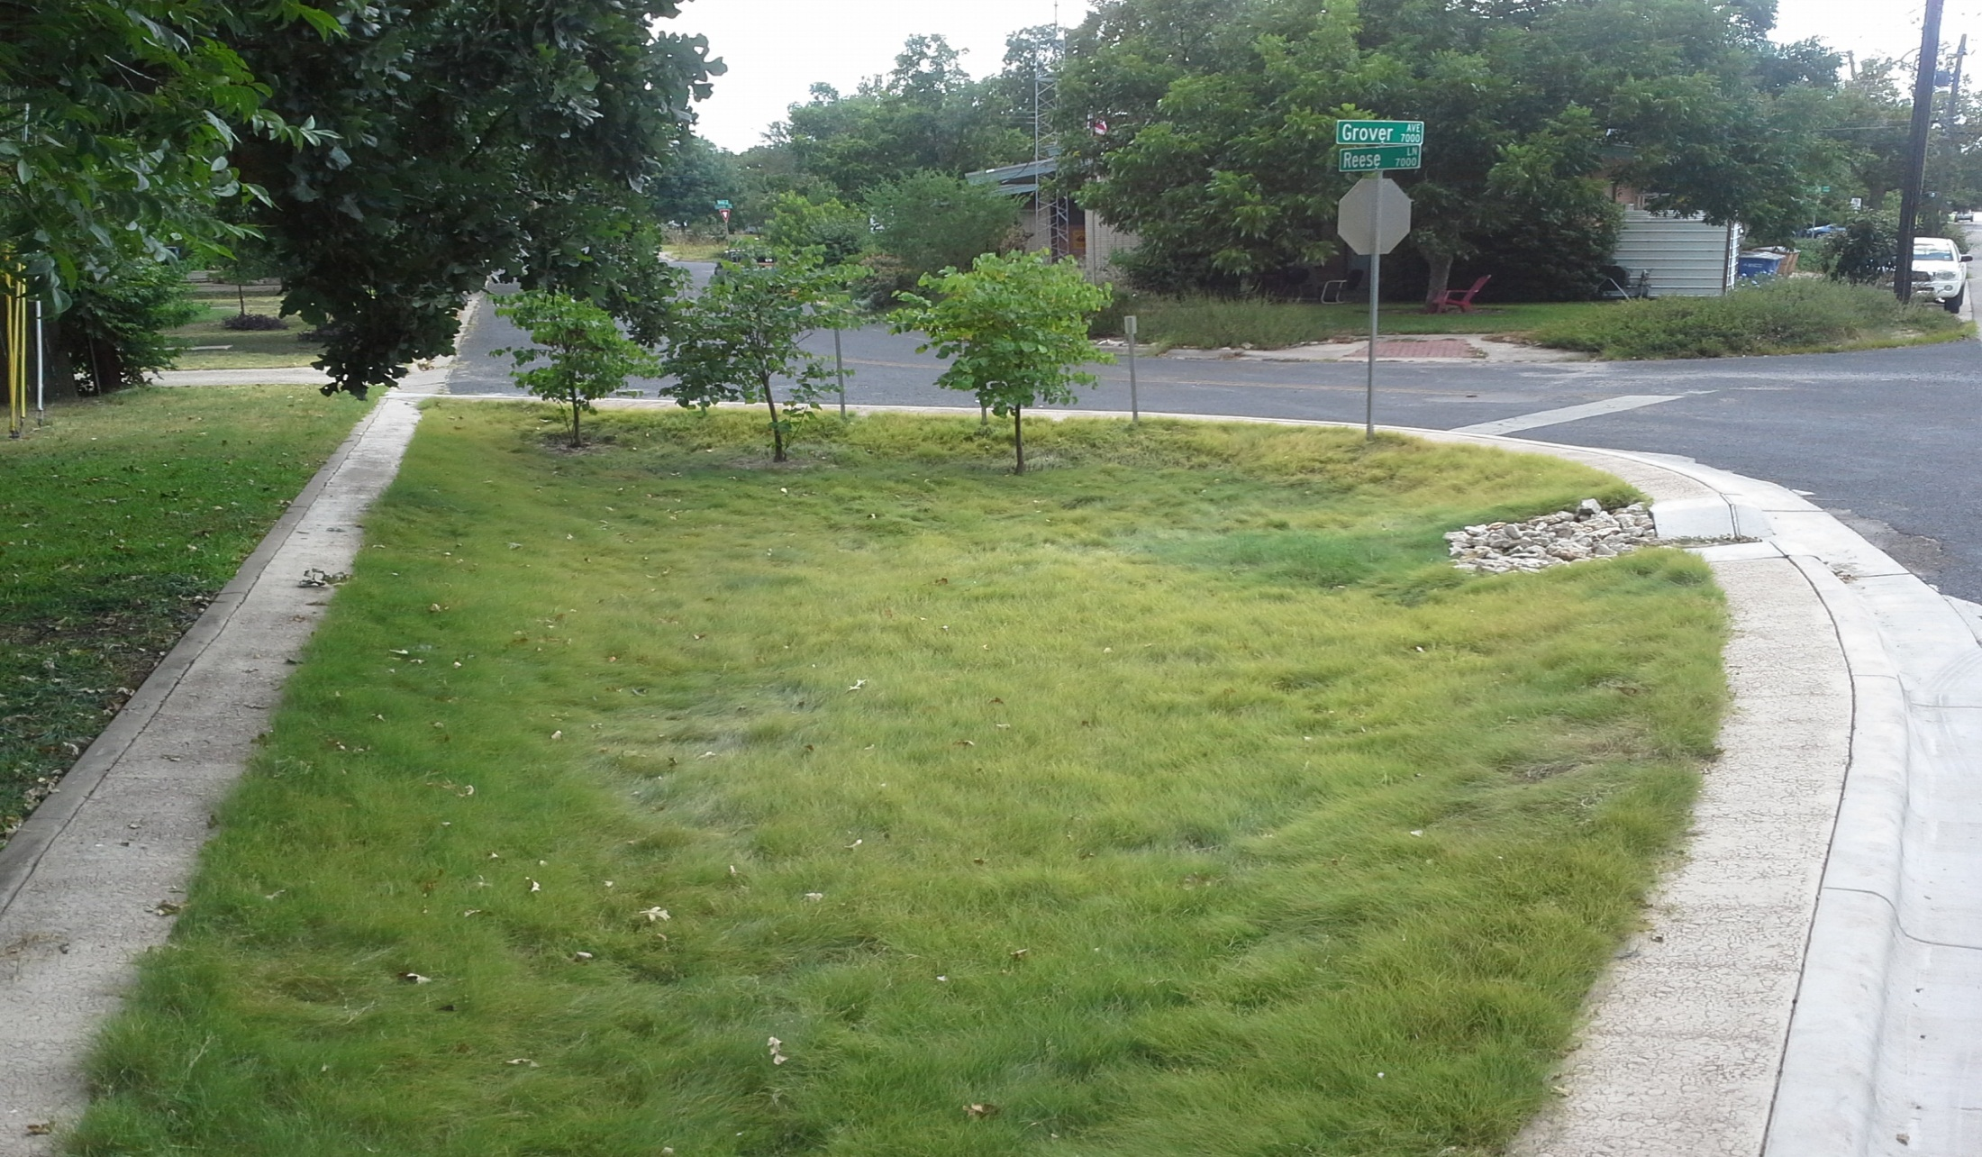
Grover & Reese

Slide 39
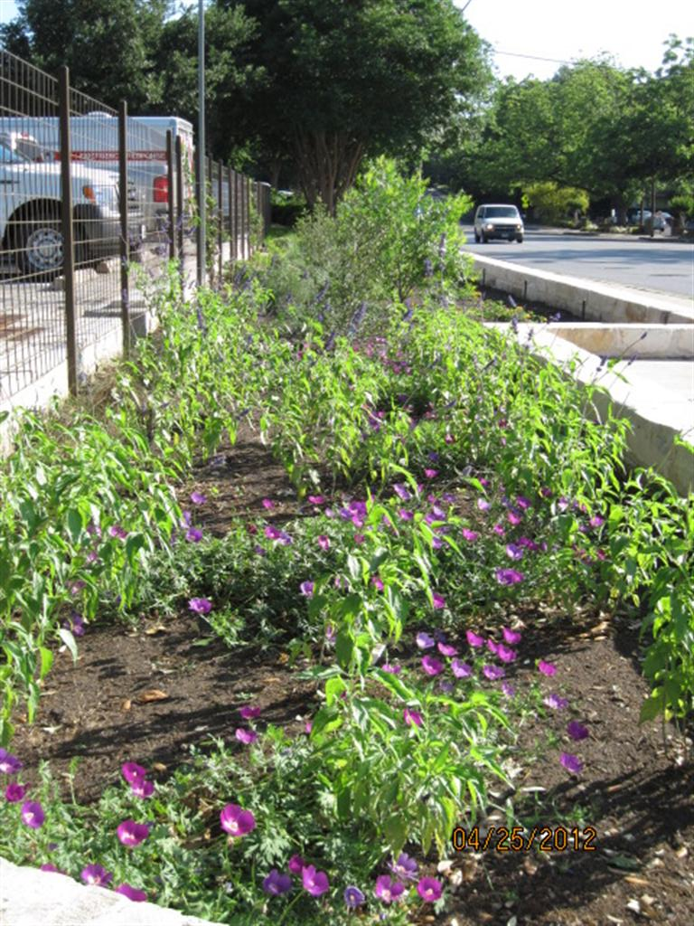
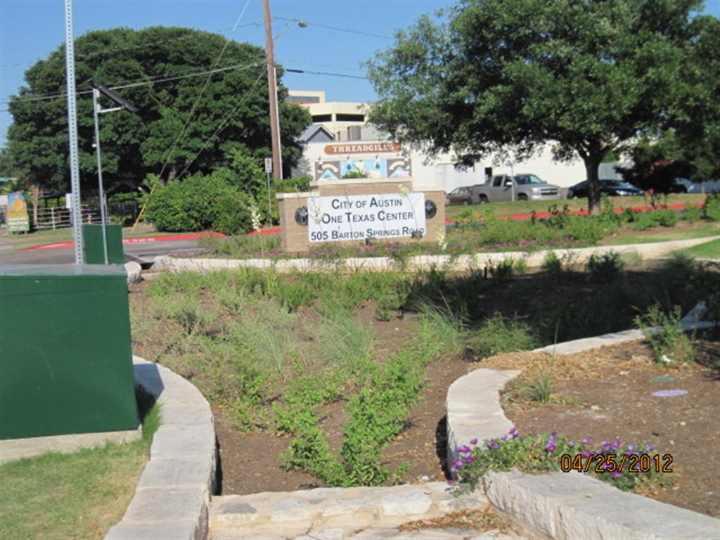
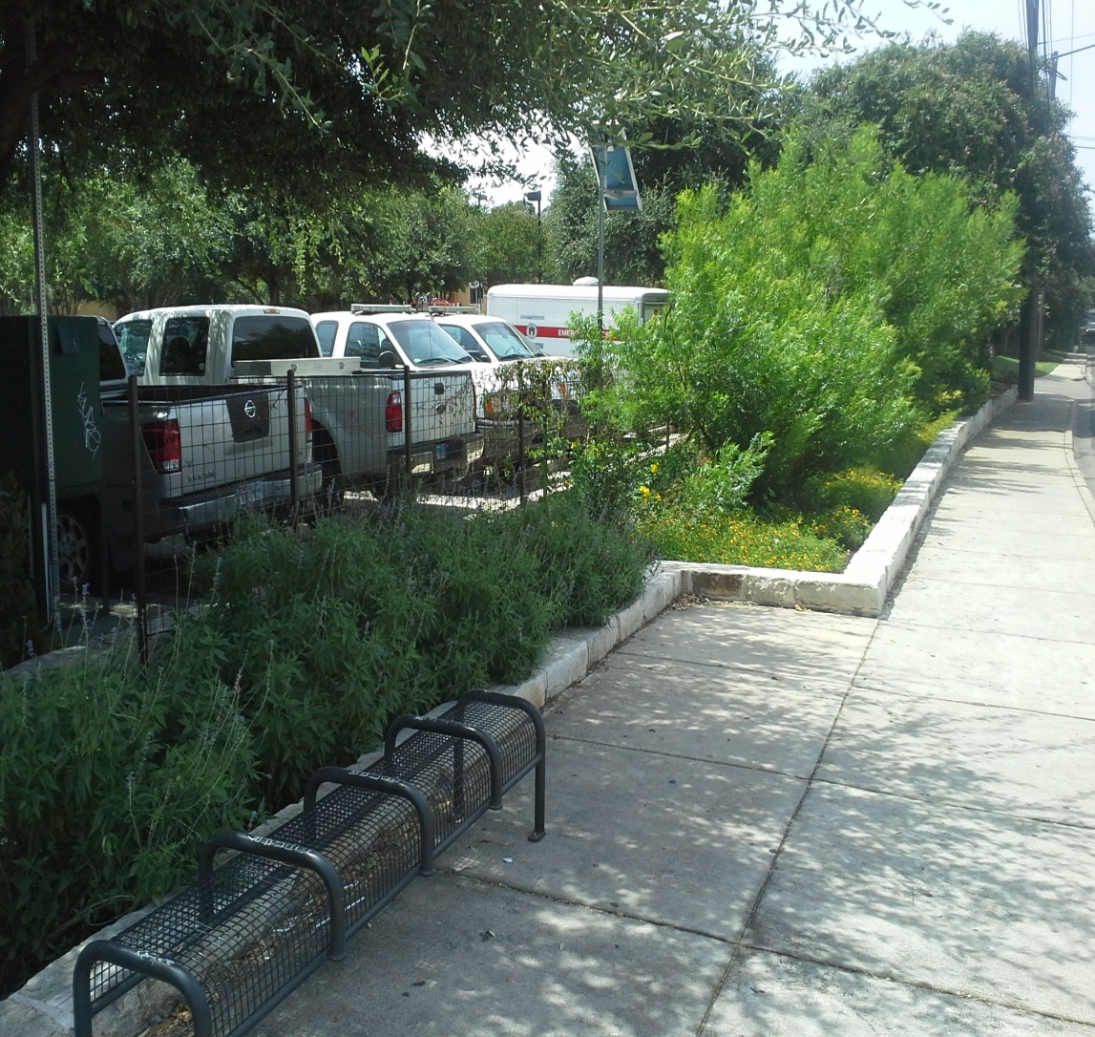
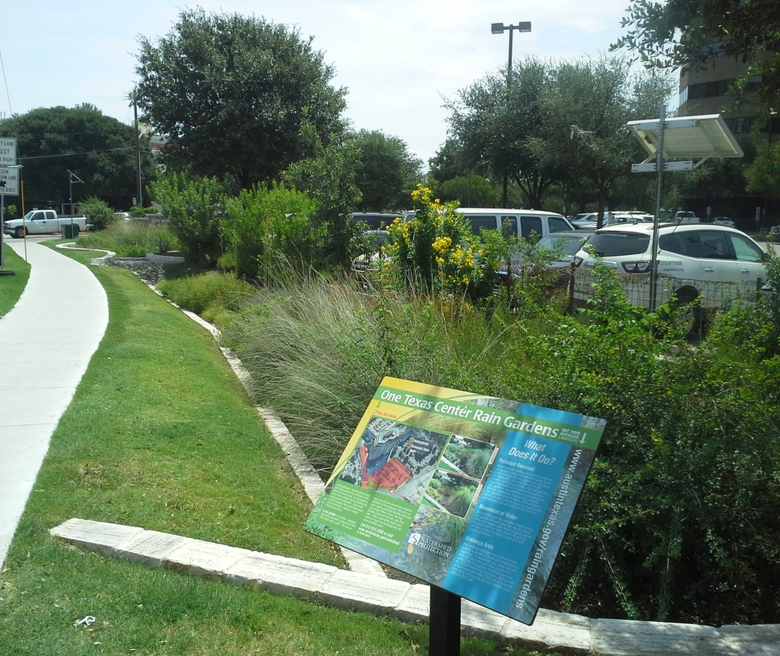
One Texas Center

Slide 40
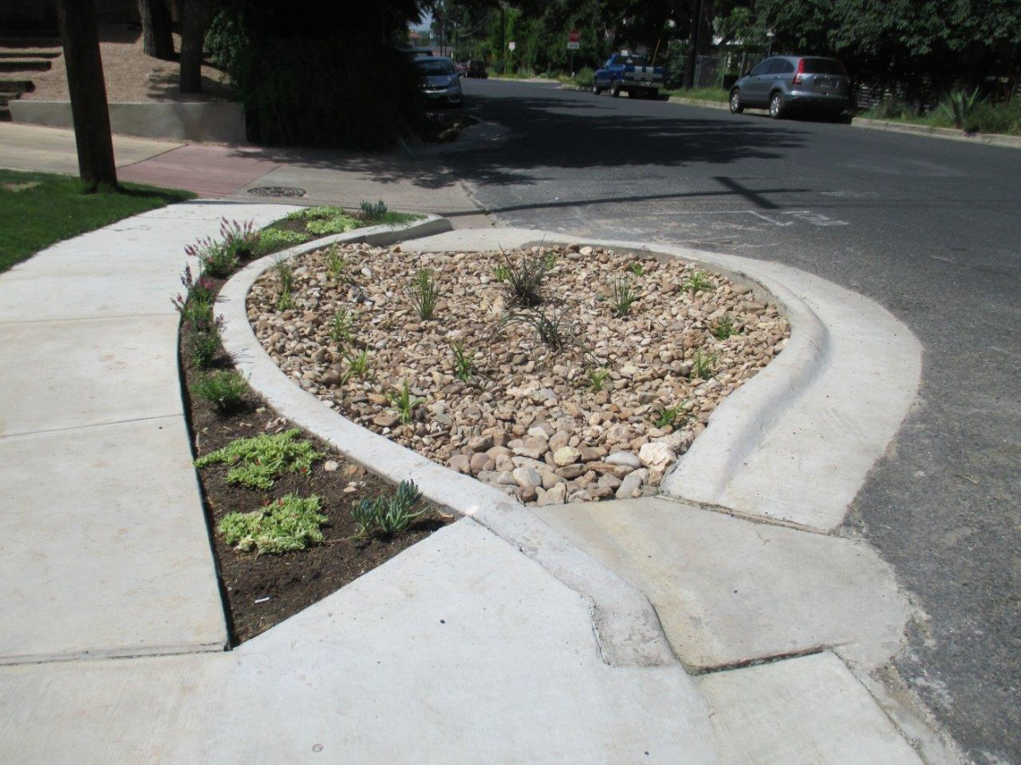
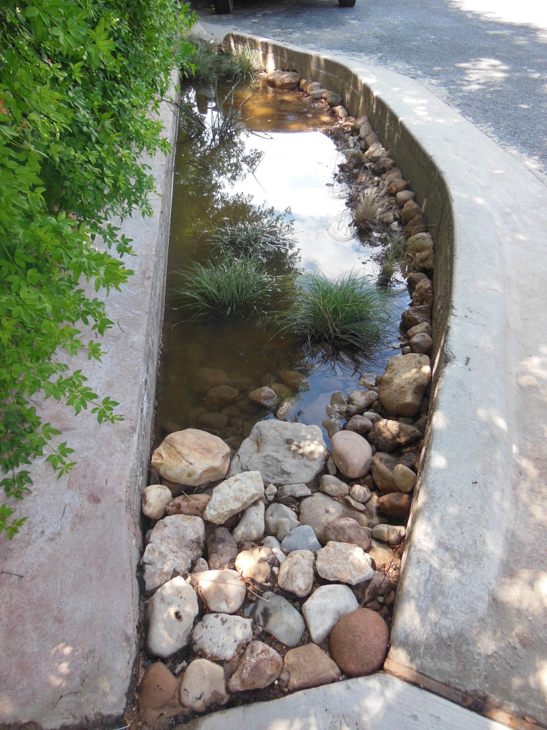
Green Alley at 8th & Waller
Tom Franke
512-974-1882
Tom.franke@austintexas.gov

Slide 41
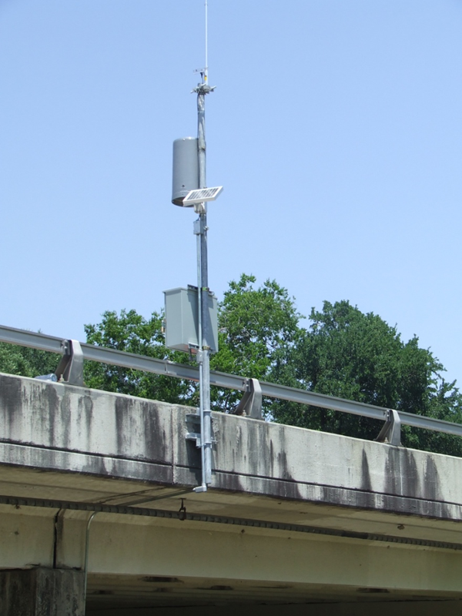
Public Safety Programs
FEWS
  Gages
  Flashing lights
  Gates
  Signs
Field Operations
  Road closures
  Debris removal
Public Information
  Turn around, don’t drown
Photo: Emerald Forest Drive Gage (WMS)
Notes:
Creek flooding commonly poses the greatest threat to public safety.
http://floodsafety.com/national/life/statistics.htm
Flash flooding is the leading cause of weather-related deaths in the U.S.- approximately 200 deaths per year. Texas is the state with the most flood/flash flood deaths in the past 36 years. National Weather Service Fatality Data for South Central Texas indicates 203 flood/ flash flood fatalities from 1973 to 2000, 136 of which were vehicle related.
Flooding occurs as a result of overloads of the primary drainage system, the creeks, or the secondary drainage system, the storm drains.
Both Creek Flooding and Localized Flooding were identified in our WPD Master plan and both are important to protect lives and properties. The objective of the Creek Flood Hazard Mitigation Section is to reduce the depth and frequency of flooding for all structures and road in the 100 year floodplain. The objective of the Local Flood Hazard Mitigation Section is to reduce. the depth and frequency of localized flooding for buildings, yards, and streets. This table only indicates the residential buildings within the full purpose limits of the City of Austin that are at risk of creek flooding.
Over the last thirty years, an average of 94 deaths occur per year due to floods. Most of the fatalities are vehicle-related and occur during flash flood events. (click)
For this reason, an important activity of the Flooding mission is to issue early flood warnings during heavy storms. Flood insurance and floodplain information is also distributed on a routine basis to help mitigate property damage from floods and save lives.
Creek Flood components include:
Public warnings (public safety)
Closing of low water crossings
Floodplain information distribution
Property safety
Creek level monitoring
Weather monitoring
Flooding infrastructure

Slide 42
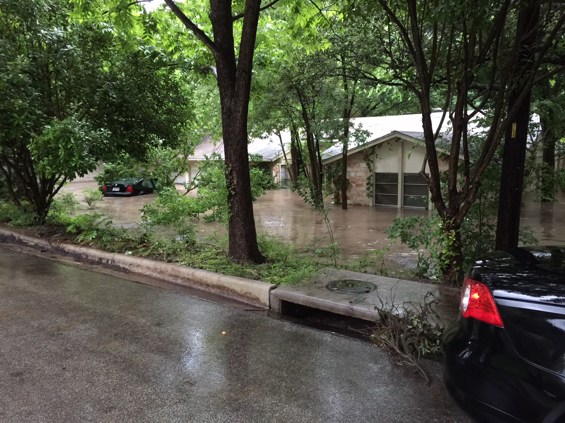
Questions?
Reem Zoun, PE, CFM
City of Austin
Watershed Protection Department
Reem.Zoun@austintexas.gov
512 -947-000

