Slide 1
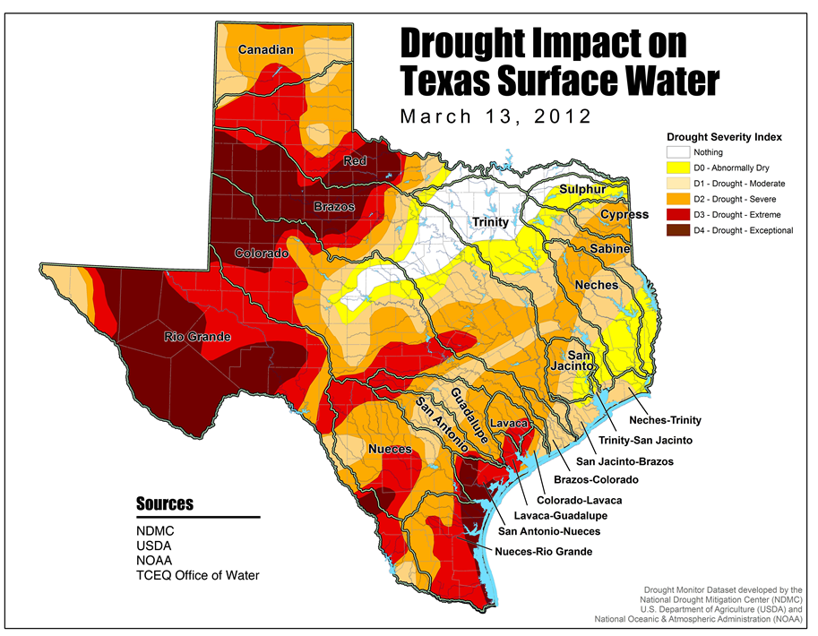
http://www.tceq.texas.gov/assets/public/response/drought/DM-120313.jpg
http://www.tceq.texas.gov/assets/public/response/drought/DM-120313.jpg

Slide 2
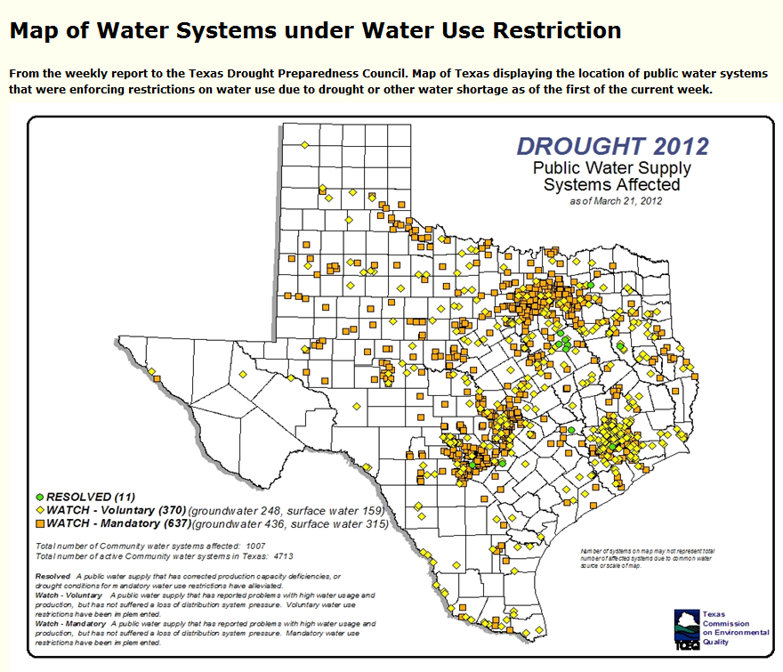
1007 public water supplies have problems
http://www.tceq.texas.gov/drinkingwater/trot/location.html

Slide 3
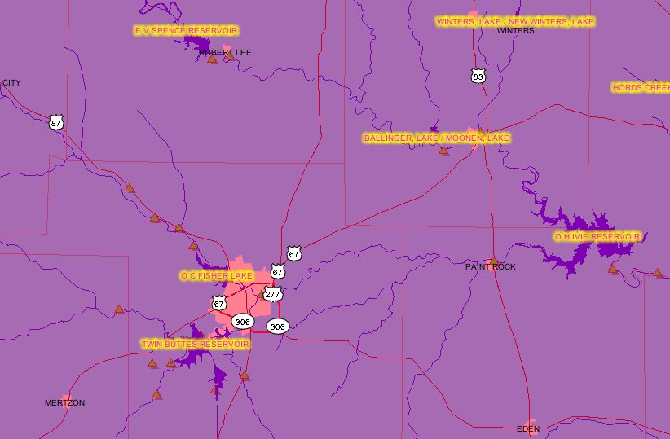
San Angelo, Texas
Metropolitan area population = 111,000
Winters Lake
EV Spence, 0.5%
Ballinger Lake
O.C. Fisher, 0%
O.H. Ivie, 18%
Twin Buttes, 0%
% full as of 22 March 2012

Slide 4
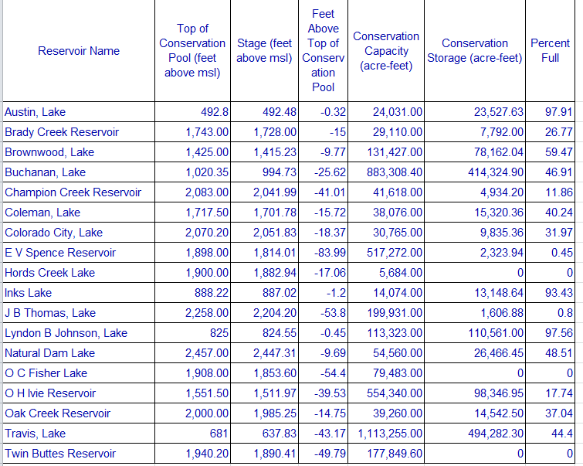
Lakes in Colorado Basin, 22 March 2012
http://wiid.twdb.state.tx.us/

