Slide 1
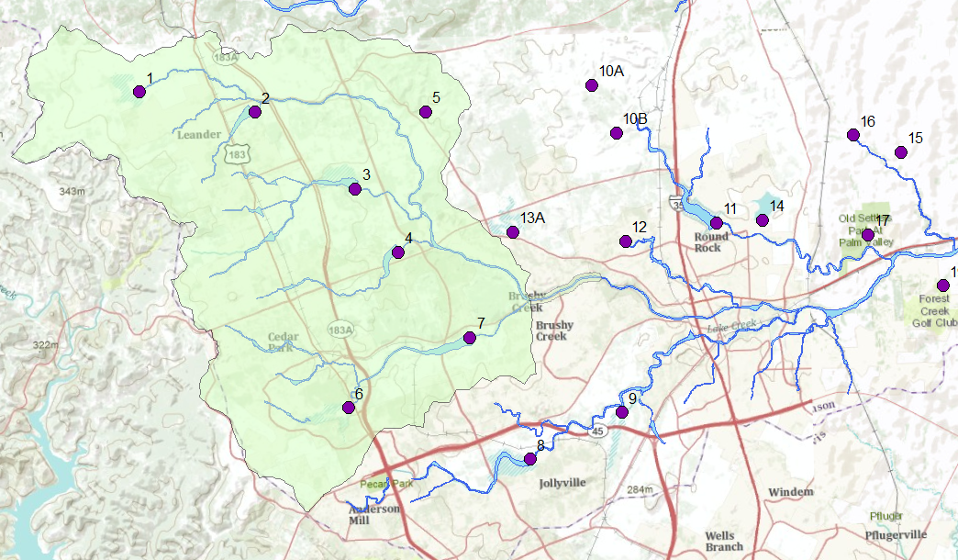
Upper Brushy Creek Watershed
3
2
1
45 Toll Rd
183
Mopac
IH-35

Slide 2
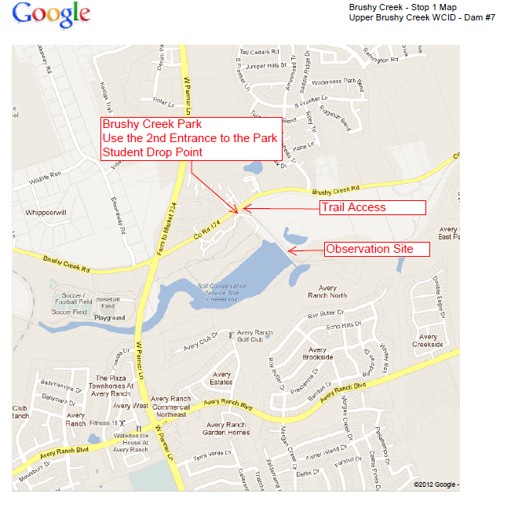

Slide 3
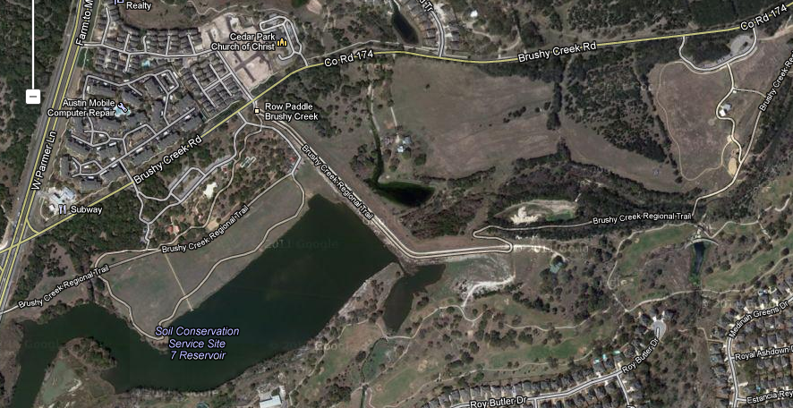
1. Brushy Creek Rd, Dam 7 Brushy Creek Rd and West Parmer Ln

Slide 4
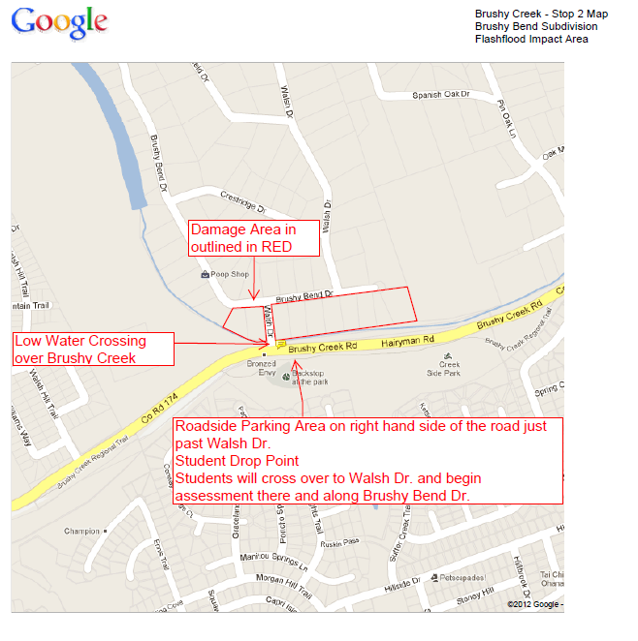

Slide 5
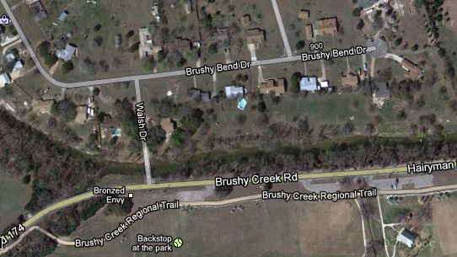
2. Brushy Bend Dr Flooded homes, low water crossing

Slide 6
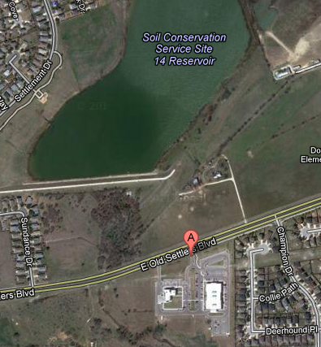
3. Williamson County Offices 1801 E. Old Settlers Blvd, Round Rock

