Slide 1
Hydraulic Routing in Rivers
Reading: Applied Hydrology Sections 9.1, 9.2, 9.3, 9.7, 10.1, 10.2
Reference: HEC-RAS Hydraulic Reference Manual, Version 4.1, Chapters 1 and 2
Reading: HEC-RAS Manual pp. 2-1 to 2-12
http://www.hec.usace.army.mil/software/hec-ras/documents/HEC-RAS_4.1_Reference_Manual.pdf

Slide 2
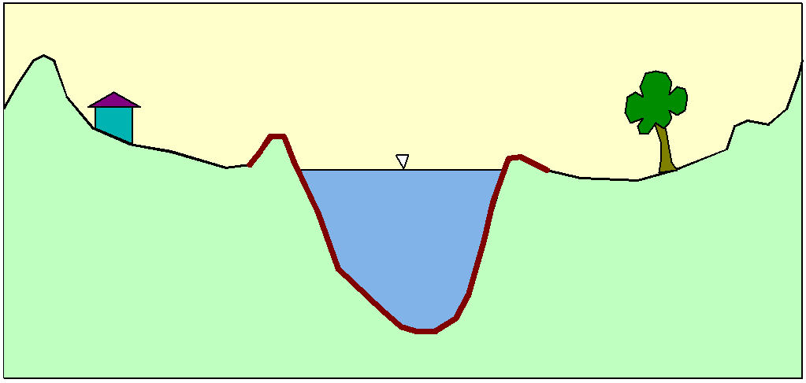
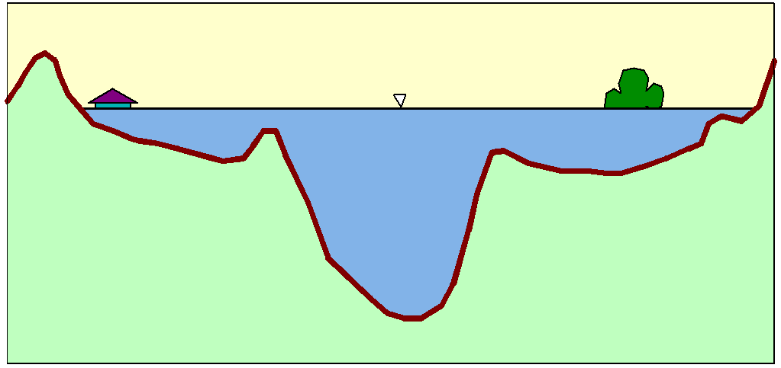
Flood Inundation

Slide 3
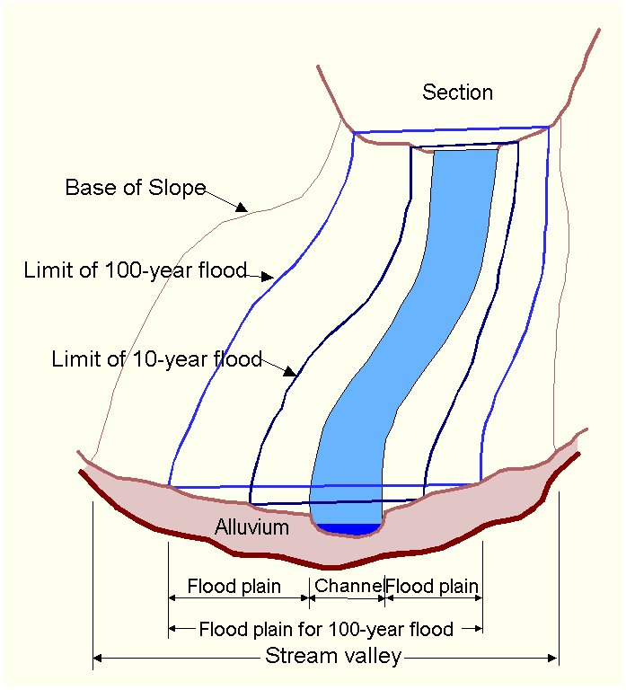
Floodplain Delineation
Notes:
The channel and floodplain are both integral parts of the natural conveyance of a stream. The floodplain carries flow in excess of the channel capacity. The greater the discharge, the greater the extent of inundation. …. Because of its devastating nature, flooding poses serious hazards to human populations in many parts of the world. “The Flood Disaster Protection Act of 1973” required the identification of all floodplain areas in the United States and the establishments of flood-risk zones within those areas.

Slide 4
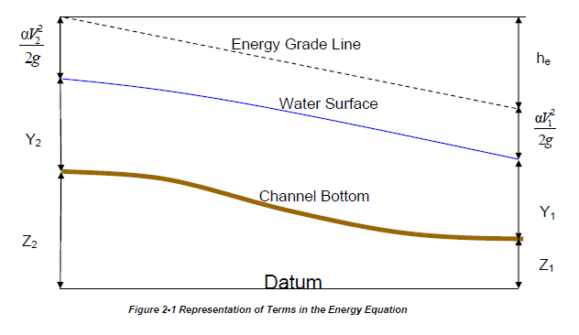
Steady Flow Solution

Slide 5
One-Dimensional Flow Computations
Cross-section
Channel centerline
and banklines
Right Overbank
Left Overbank

Slide 6
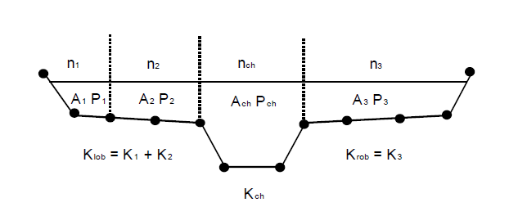
Flow Conveyance, K
Left Overbank
Channel
Right Overbank
$$Q=\frac{1.49}{n}AR^{2/3}S_{f}^{1/2}$$
$$or Q=KS_{f}^{1/2}$$
$$K=\frac{1.49}{n}AR^{2/3}$$
$$or K=\frac{1.49}{n}{\frac{A^{5/3}}{P^{2/3}} }^{}$$

Slide 7
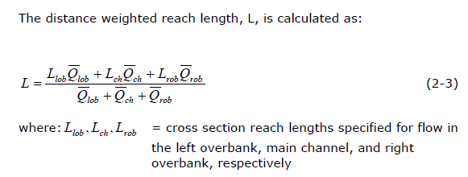
Reach Lengths
(1)
Floodplain
L_{ch}
R_{ob}
L_{ob}
Floodplain
(2)
Left to Right looking downstream

Slide 8
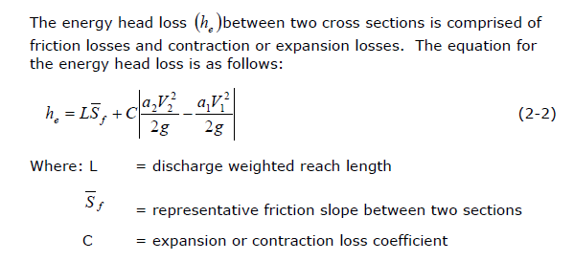
Energy Head Loss

Slide 9
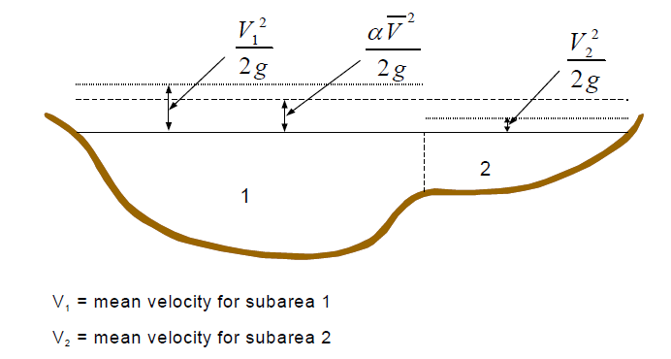
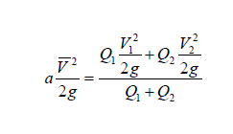
Velocity Coefficient, α

Slide 10
Solving Steady Flow Equations
Q is known throughout reach
All conditions at (1) are known, Q is known
Select h₂
compute Y₂, V₂, K₂, S_{f}, h_{e}
Using energy equation (A), compute h₂
Compare new h₂ with the value assumed in Step 2, and repeat until convergence occurs
(A)
h₂
h₁
(2)
(1)
$$S_{f}={\left(\frac{Q}{K}\right)}^{2}$$

Slide 11
Flow Computations
Reach 3
Reach 2
Start at the downstream end (for subcritical flow)
Treat each reach separately
Compute h upstream, one cross-section at a time
Use computed h values to delineate the floodplain
Reach 1

Slide 12
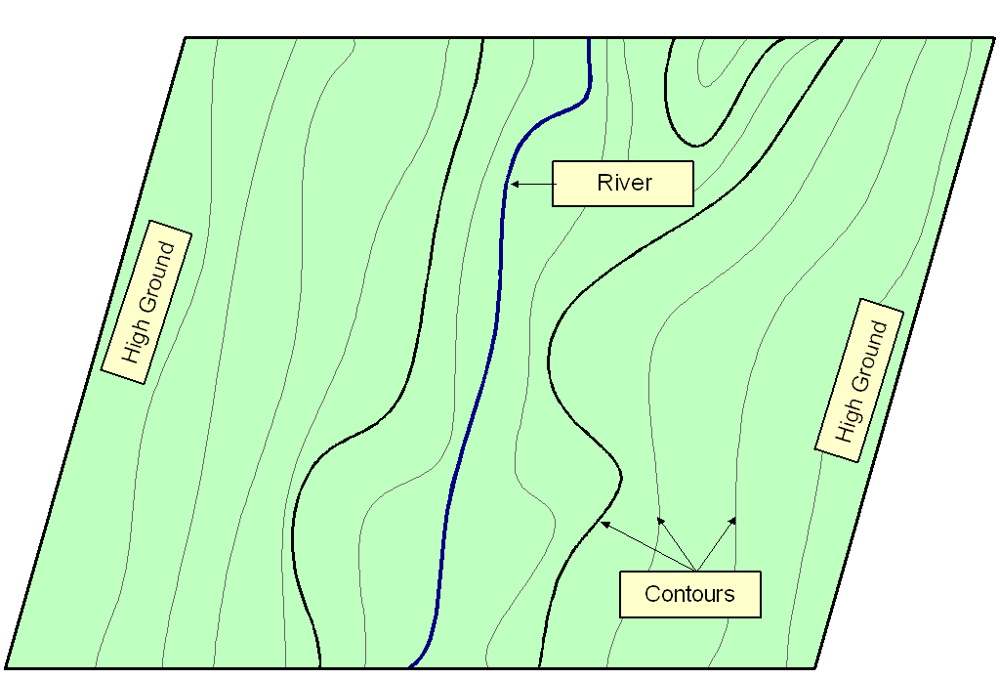
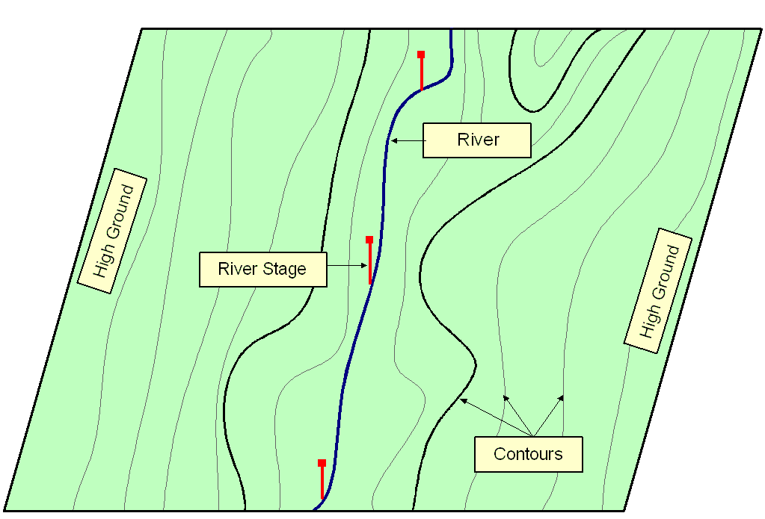
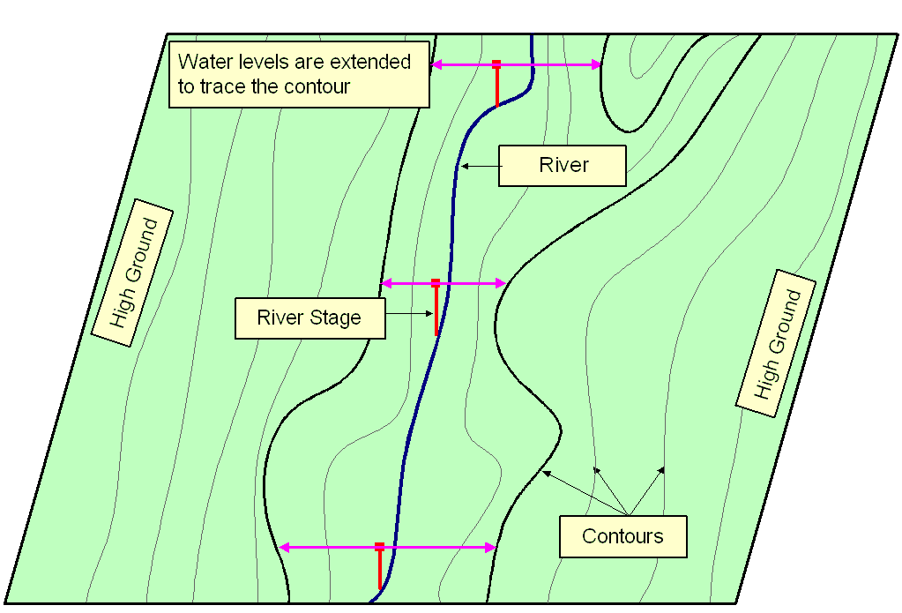
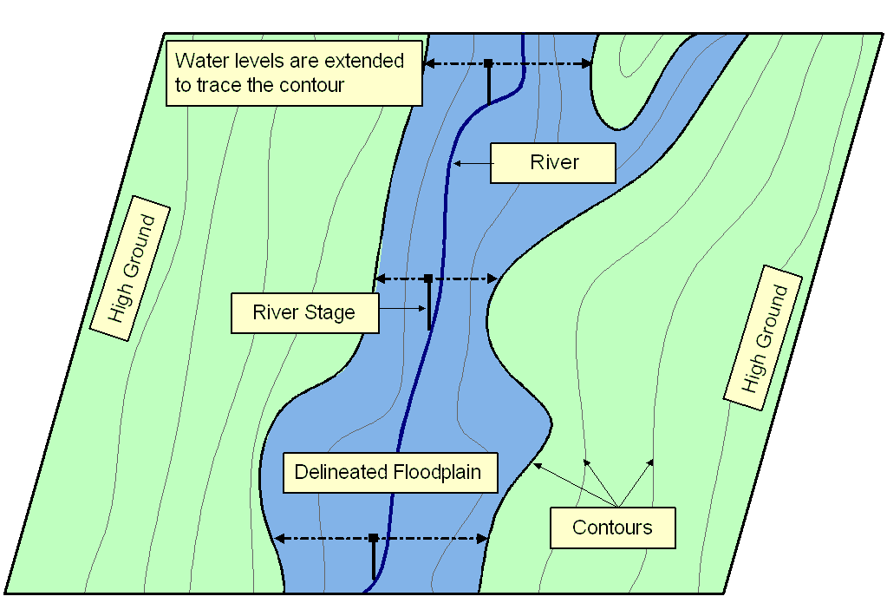
Floodplain Delineation
Notes:
Ideally should have Two D Models…... A floodplain delineation process determines inundation extent by comparing water levels with ground surface elevations. We start with a DTM or topomap. > Water levels are computed based on cross-sections. During normal condition, flow remains within the main channel, but > during flood, water spill over the bank. In these cases it’s important to extent cross-section over the floodplain. > We then bring back water levels on the topomap. > Extent water levels until hit contour of higher elevations. > Finally delineate floodplain following the contours. The accuracy largely depends on water levels and in turns on the cross-section used for computation.

Slide 13
Unsteady Flow Routing in Open Channels
Flow is one-dimensional
Hydrostatic pressure prevails and vertical accelerations are negligible
Streamline curvature is small.
Bottom slope of the channel is small.
Manning’s equation is used to describe resistance effects
The fluid is incompressible

Slide 14
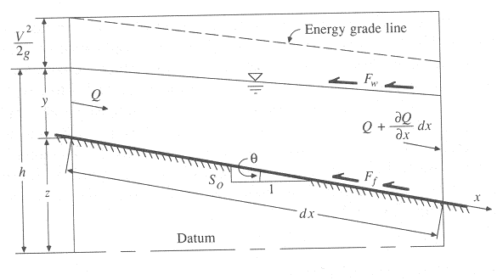
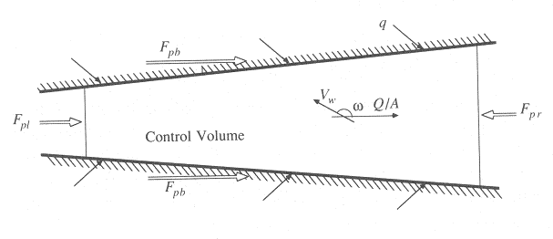
Continuity Equation
Q = inflow to the control volume
q = lateral inflow
Rate of change of flow with distance
Outflow from the C.V.
Change in mass
Elevation View
Reynolds transport theorem
Plan View

Slide 15
Momentum Equation
From Newton’s 2nd Law:
Net force = time rate of change of momentum
Sum of forces on the C.V.
Momentum stored within the C.V
Momentum flow across the C. S.

Slide 16
Forces acting on the C.V.
F_{g} = Gravity force due to weight of water in the C.V.
F_{f} = friction force due to shear stress along the bottom and sides of the C.V.
F_{e} = contraction/expansion force due to abrupt changes in the channel cross-section
F_{w} = wind shear force due to frictional resistance of wind at the water surface
F_{p} = unbalanced pressure forces due to hydrostatic forces on the left and right hand side of the C.V. and pressure force exerted by banks
Elevation View
Plan View

Slide 17
Momentum Equation
Sum of forces on the C.V.
Momentum stored within the C.V
Momentum flow across the C. S.

Slide 18
Momentum Equation(2)
Local acceleration term
Convective acceleration term
Pressure force term
Gravity force term
Friction force term
Kinematic Wave
Diffusion Wave
Dynamic Wave

Slide 19
Momentum Equation (3)
Steady, uniform flow
Steady, non-uniform flow
Unsteady, non-uniform flow

Slide 20
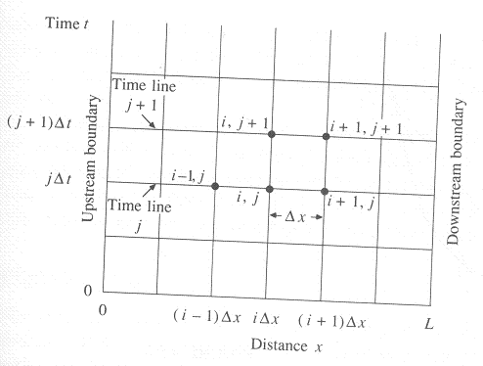
Solving St. Venant equations
Analytical
Solved by integrating partial differential equations
Applicable to only a few special simple cases of kinematic waves
Numerical
Finite difference approximation
Calculations are performed on a grid placed over the (x,t) plane
Flow and water surface elevation are obtained for incremental time and distances along the channel
x-t plane for finite differences calculations

Slide 21
Applications of different forms of momentum equation
Kinematic wave: when gravity forces and friction forces balance each other (steep slope channels with no back water effects)
Diffusion wave: when pressure forces are important in addition to gravity and frictional forces
Dynamic wave: when both inertial and pressure forces are important and backwater effects are not negligible (mild slope channels with downstream control, backwater effects)

Slide 22
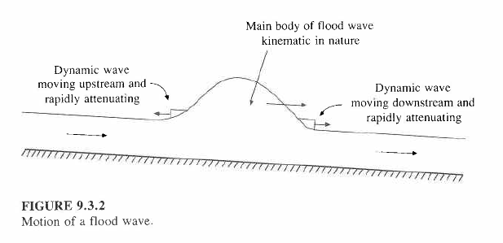
Kinematic Wave
Kinematic wave celerity, c_{k} is the speed of movement of the mass of a flood wave downstream
Approximately, c_{k} = 5v/3 where v = water velocity

Slide 23
Muskingum-Cunge Method
A variant of the Muskingum method that has a more physical hydraulic basis
This is what Dean Djokic has used in the Brushy Creek HEC-HMS models
$K=\frac{Δx}{c_{k}}$, where Δx = reach length or an increment of this length
$X=\frac{1}{2}\left(1−\frac{Q}{Bc_{k}S_{0}Δx}\right)$, where B = surface width, S₀ is the bed slope

Slide 24
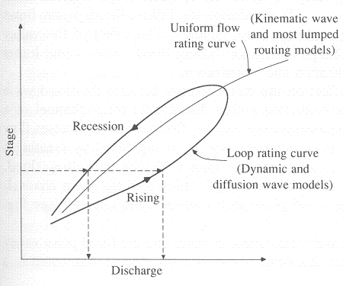
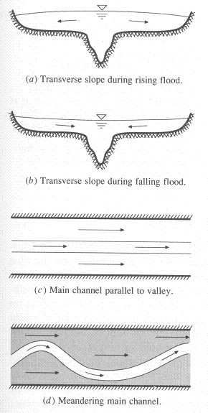
Dynamic Wave Routing
Flow in natural channels is unsteady, non-uniform with junctions, tributaries, variable cross-sections, variable resistances, variable depths, etc etc.

Slide 25
i-1, j+1
i-1, j+1
i+1, j+1
∆t
i-1, j
i, j
i+1, j
∆x
∆x
Cross-sectional view in x-t plane
x-t plane
h₀, Q₀, t₁
h₁, Q₁, t₁
h₂, Q₂, t₂
∆t
h₀, Q₀, t₀
h₁, Q₁, t₀
h₂, Q₂, t₀
∆x
∆x

