Slide 1
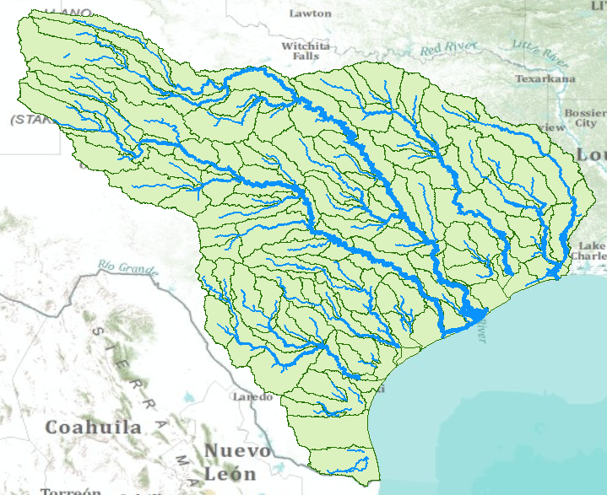
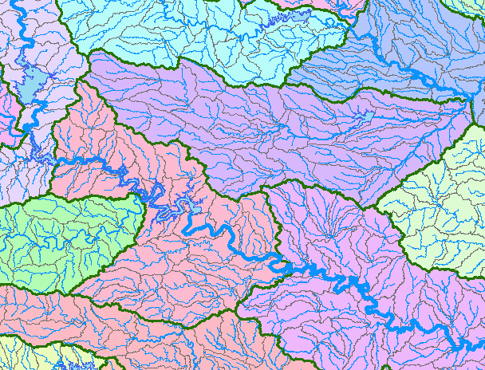
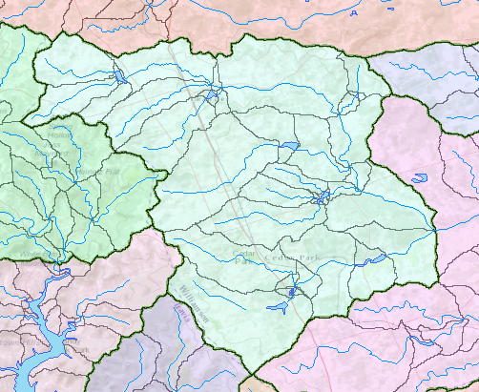
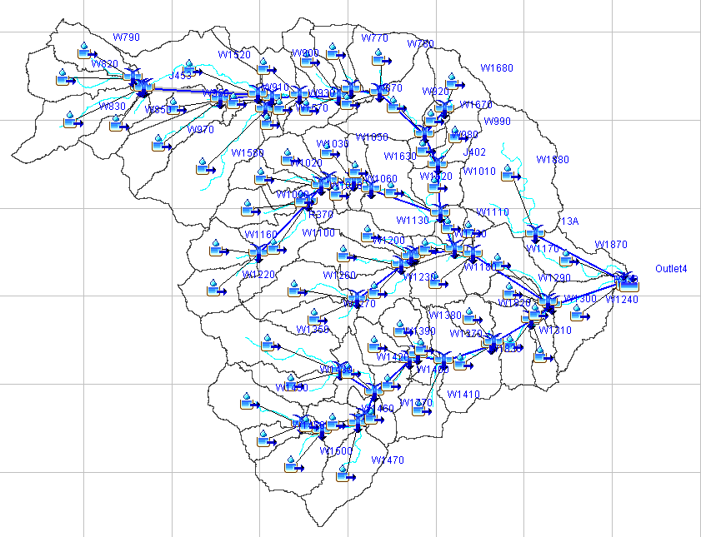
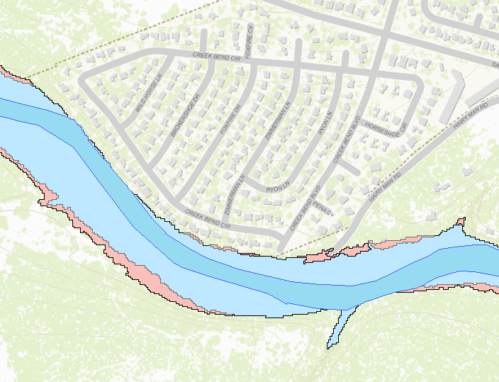
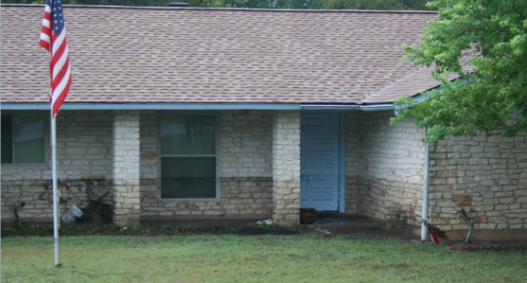
Regional to Engineering Scale
HUC8
HUC12
Catchment
Personal – a flooded home
Engineering Hydrology
Engineering Hydraulics

Slide 2
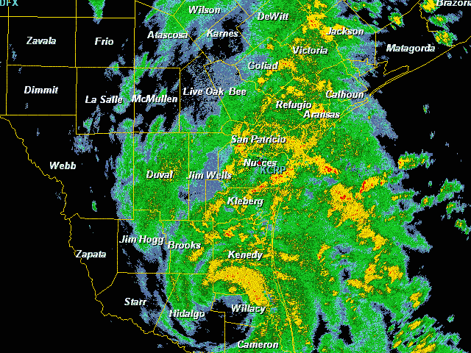
Tropical Storm Hermine in Texas
Sept 7-8, 2010

Slide 3
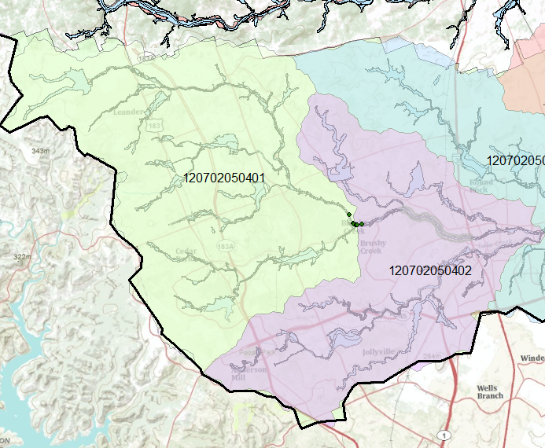
HUC-12 Subwatershed 120702050401
Upper Brushy Creek
Hermine Flooding
Flood Control Dams

Slide 4
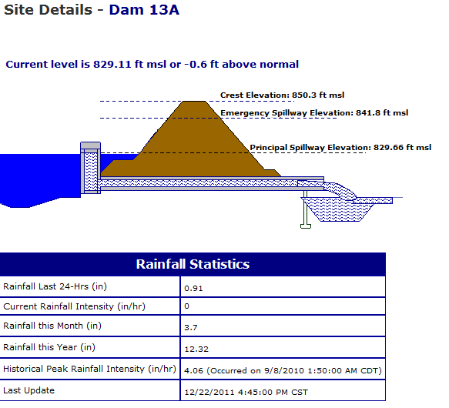
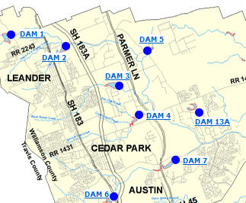
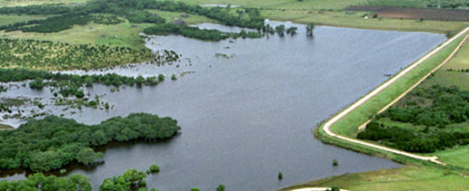
Flood Control Dam

Slide 5
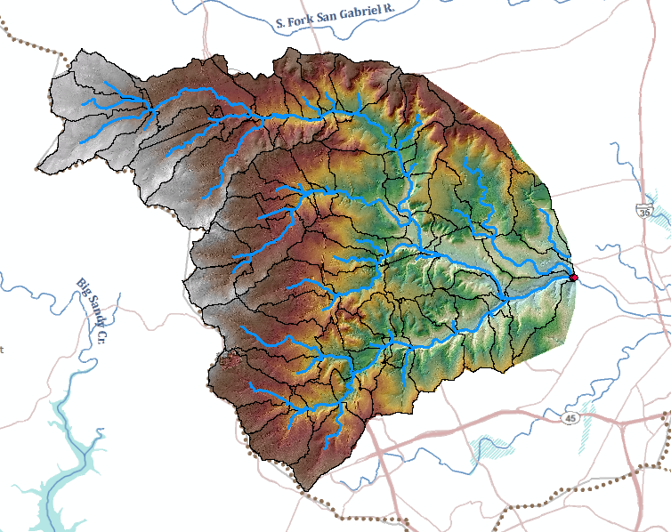
GIS Hydrology Analysis (HEC-GeoHMS) using 10ft DEM derived from LIDAR

Slide 6
Engineering Hydraulics
Personal – a flooded home

Slide 7
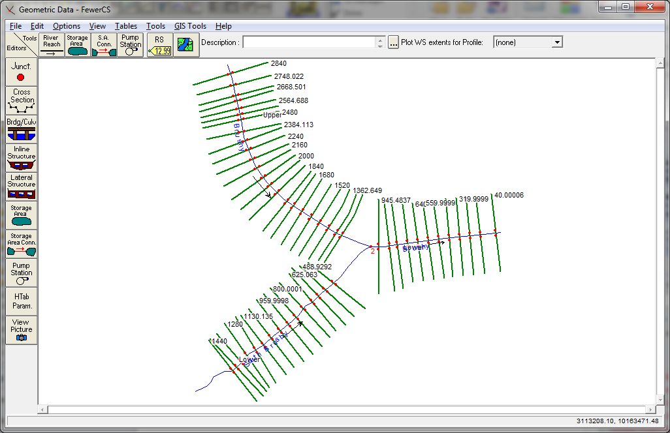
Reaches and Rivers in Brushy Creek
Upper Brushy
Lower Brushy
South Brushy

Slide 8
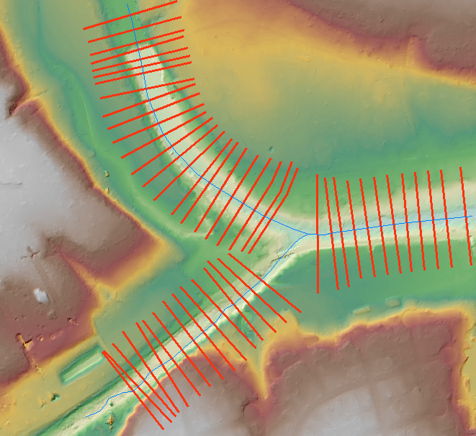
HEC-RAS Flood Elevation Model
using 1 ft DEM derived from LIDAR
Cross-Sections for HEC-RAS model

Slide 9
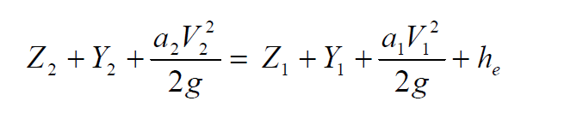
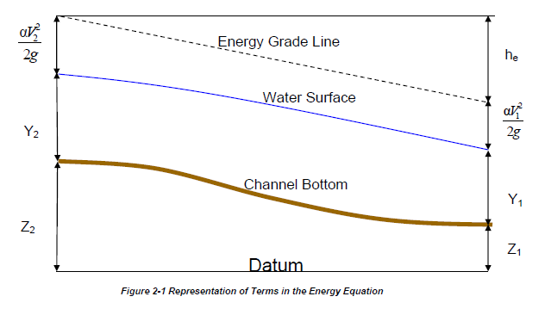
Steady Flow Solution

Slide 10
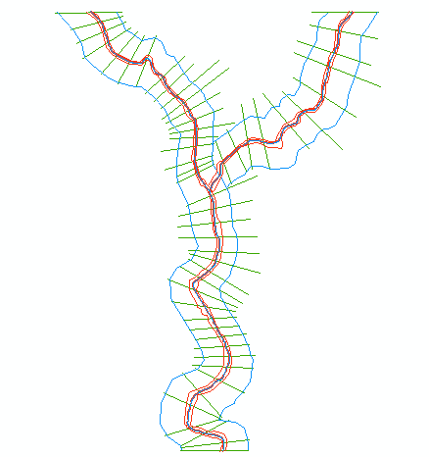
One-Dimensional Flow Computations
Cross-section
Channel centerline
and banklines
Right Overbank
Left Overbank

Slide 11
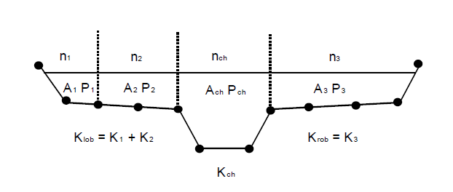


Flow Conveyance, K
Left Overbank
Channel
Right Overbank
$$Q=\frac{1.49}{n}AR^{2/3}S_{f}^{1/2}$$
$$or Q=KS_{f}^{1/2}$$
$$K=\frac{1.49}{n}AR^{2/3}$$
$$or K=\frac{1.49}{n}{\frac{A^{5/3}}{P^{2/3}} }^{}$$

Slide 12
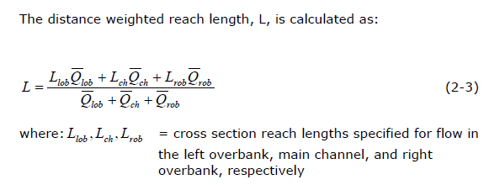
Reach Lengths
(1)
Floodplain
L_{ch}
R_{ob}
L_{ob}
Floodplain
(2)
Left to Right looking downstream

Slide 13
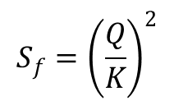
Solving Steady Flow Equations
Q is known throughout reach
All conditions at (1) are known, Q is known
Select h₂
compute Y₂, V₂, K₂, S_{f}, h_{e}
Using energy equation (A), compute h₂
Compare new h₂ with the value assumed in Step 2, and repeat until convergence occurs
(A)
h₂
h₁
(2)
(1)
$$S_{f}={\left(\frac{Q}{K}\right)}^{2}$$

Slide 14
Flow Computations
Reach 3
Reach 2
Start at the downstream end (for subcritical flow)
Treat each reach separately
Compute h upstream, one cross-section at a time
Use computed h values to delineate the floodplain
Reach 1

Slide 15
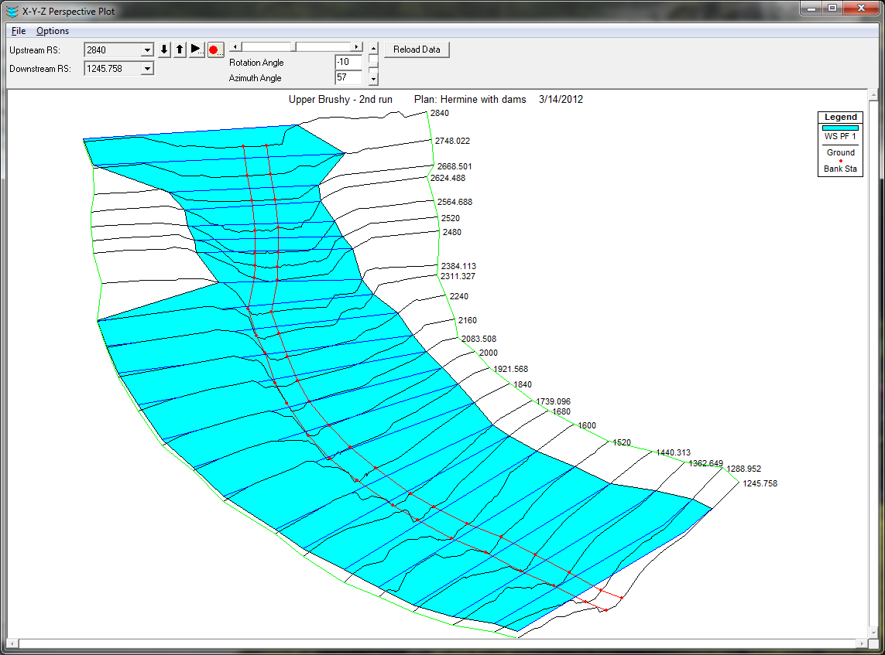
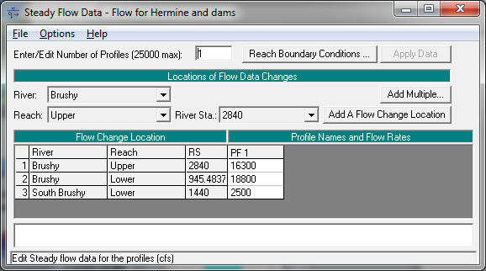
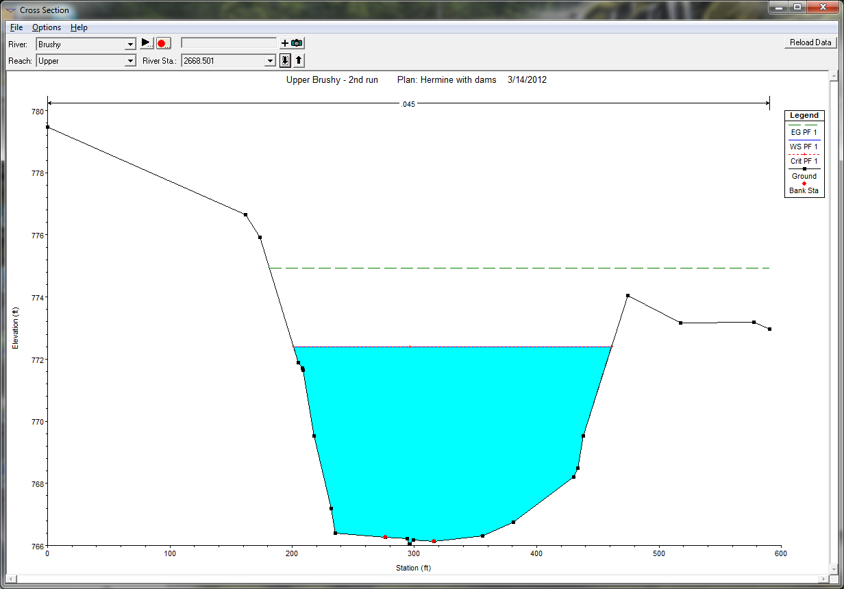
HEC-RAS Flood Water Surface Elevation Model

Slide 16
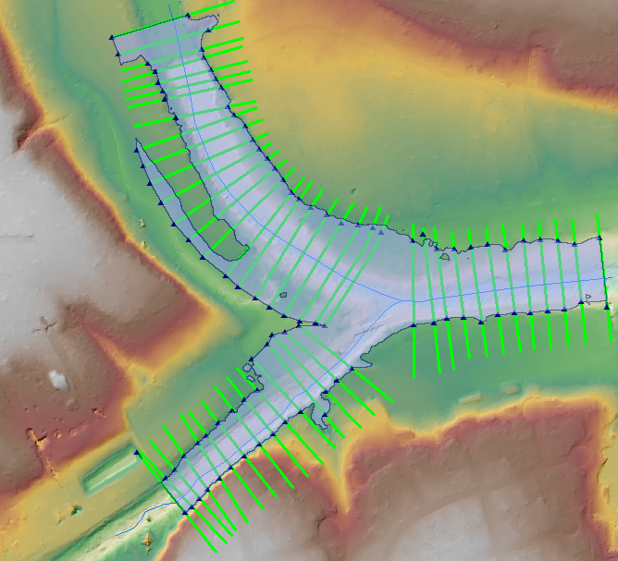
Flood Inundation Map

Slide 17
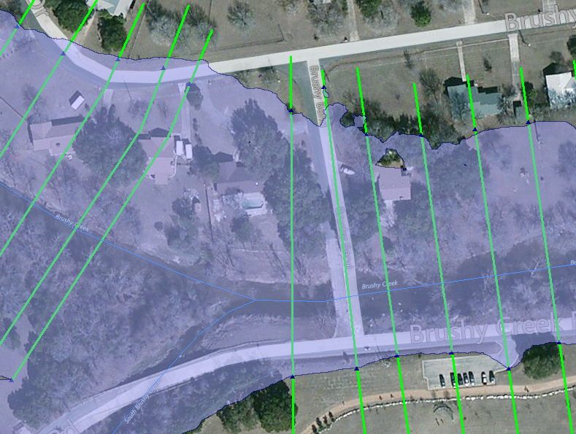
Flood Impact on Houses

Slide 18
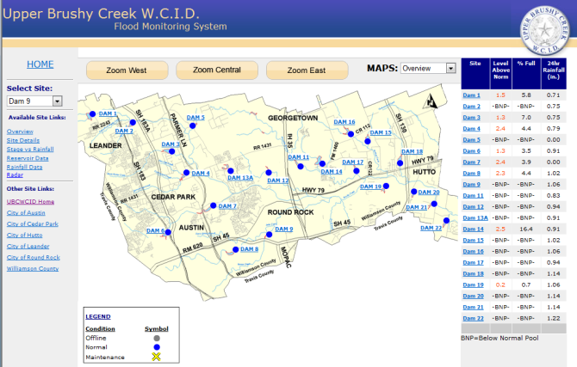
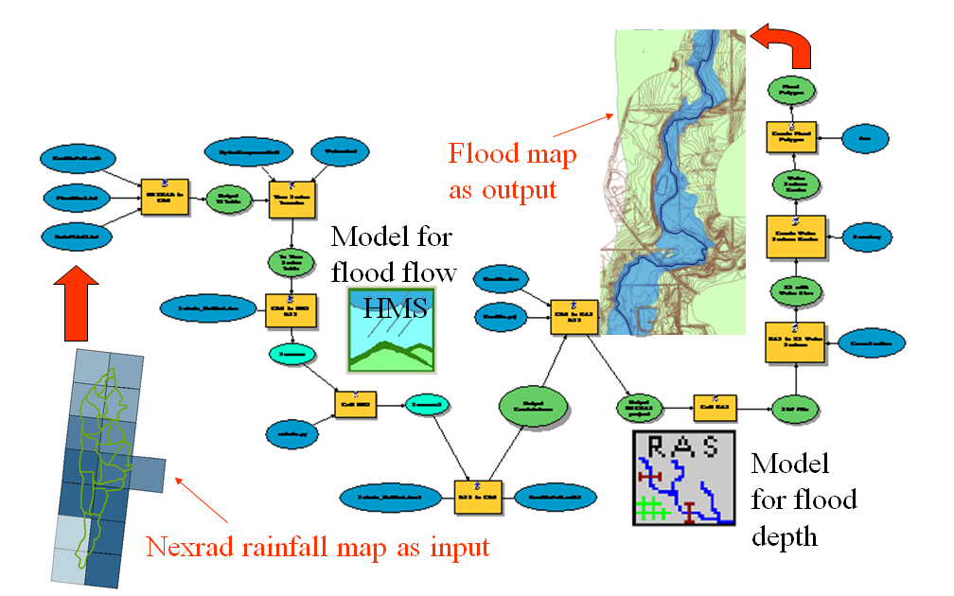
Rain Map to Flood Map
Connect the Models to Real-Time Observations in Brushy Creek

Slide 19
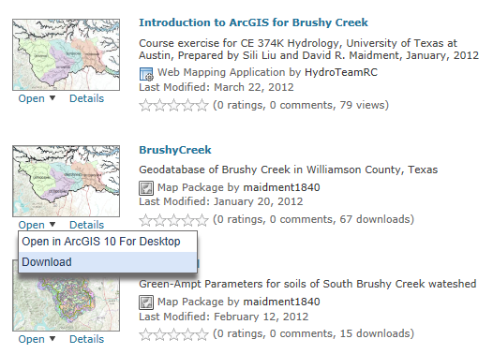
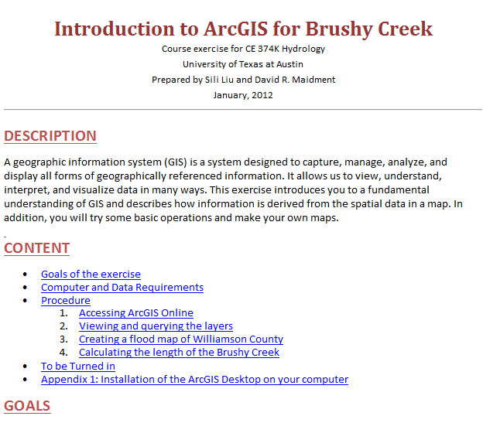
Brushy Creek in ArcGIS Online
http://www.arcgis.com/home/search.html?q=brushy&t=content

