Slide 1
Hydrologic Measurement
Precipitation
Evaporation
Streamflow
Channel Properties
Topography
GIS datasets
Reading: Applied Hydrology Chapter 6

Slide 2
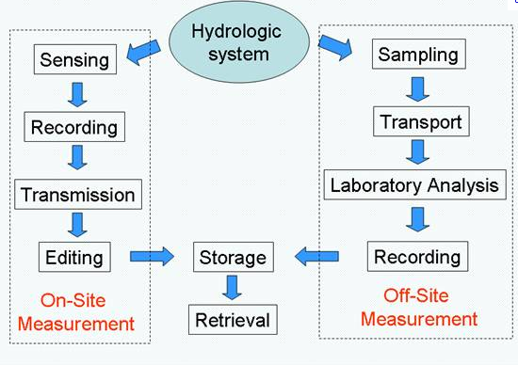
Hydrologic Measurement
Precipitation, Climate, Stream Gaging
Water Quality Sampling

Slide 3
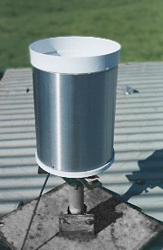
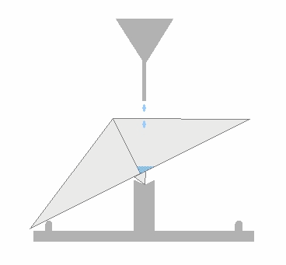
Precipitation Station
Tipping Bucket Raingage
  The gauge registers precipitation (rainfall) by counting small increments of rain collected.
  When rain falls into the funnel it runs into a container divided into two equal compartments by a partition
  When a specified amount of rain has drained from the funnel the bucket tilts the opposite way.
  The number and rate of bucket movements are counted and logged electronically.

Slide 4
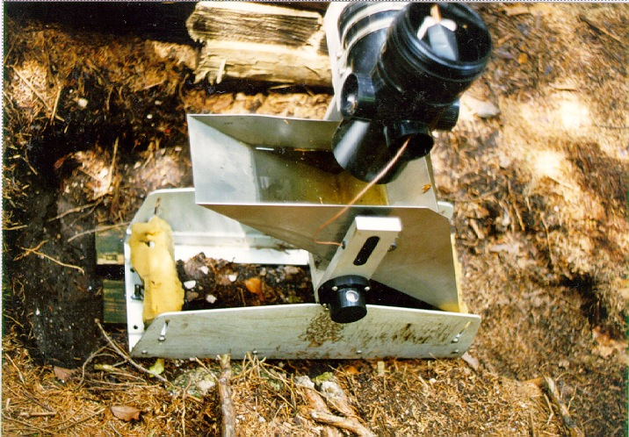
Tipping bucket rain gage

Slide 5
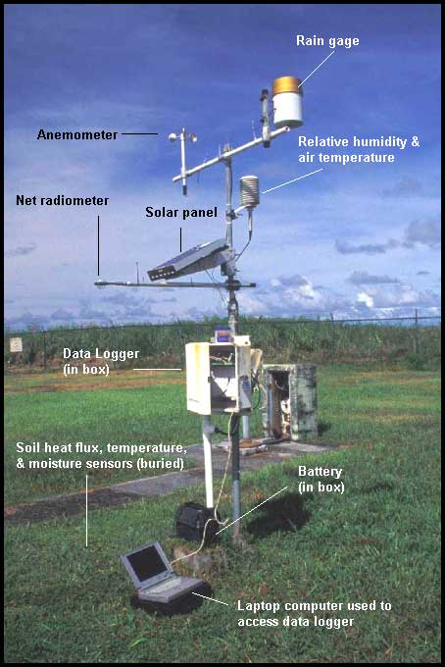
Weather/climate station
Following variables are recorded
  Wind velocity/direction
  Rainfall
  Relative humidity and temperature
  Radiation

Slide 6
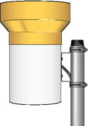
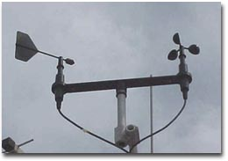
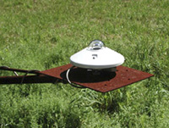
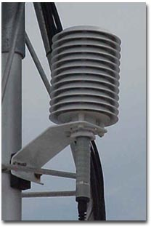
Components of a weather station
Anemometer
Tipping bucket raingage
Radiometer
Relative humidity and temperature

Slide 7
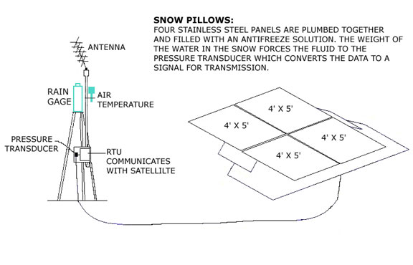
Precipitation (continued)
Snow Pillows
http://wsoweb.ladwp.com/Aqueduct/snow/pillow.htm

Slide 8
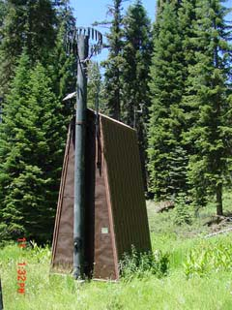
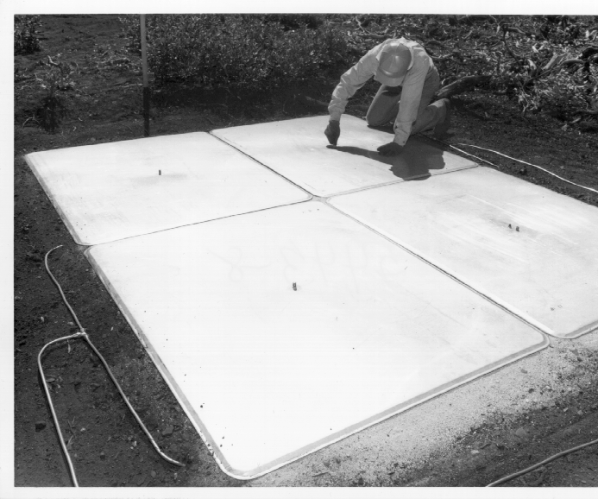
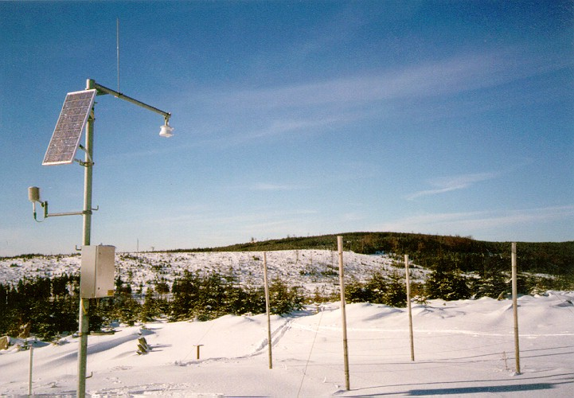
Snow Pillows

Slide 9
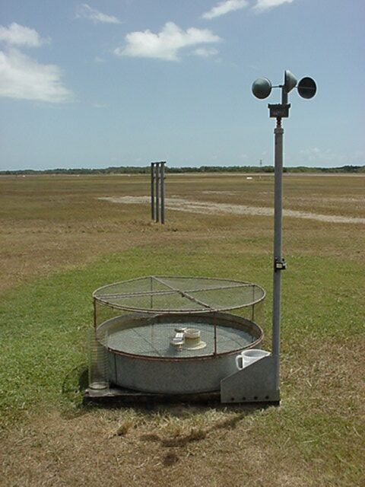
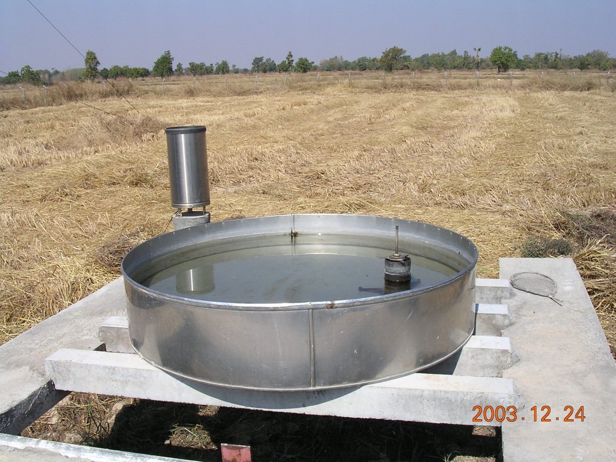
Evaporation pan

Slide 10
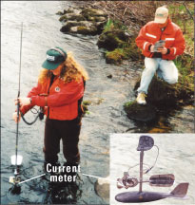
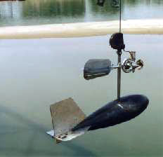
Measuring streamflow

Slide 11
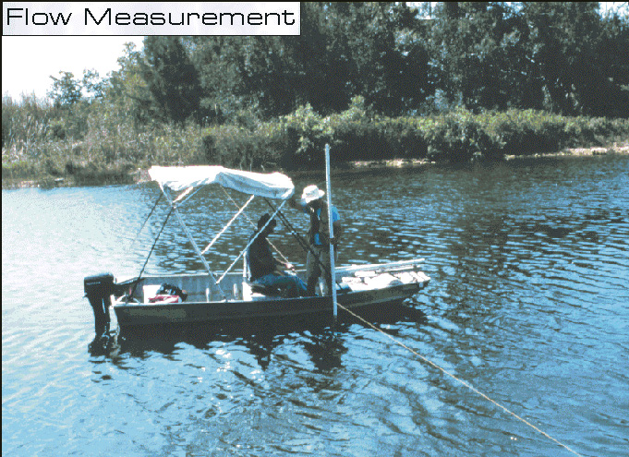
Streamflow using a boat
Tag line

Slide 12
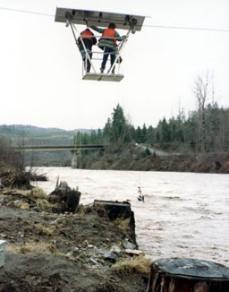
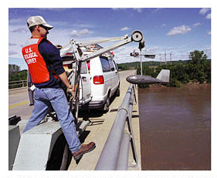
Measurement at high flows
Using stream gaging cable car
From bridge

Slide 13
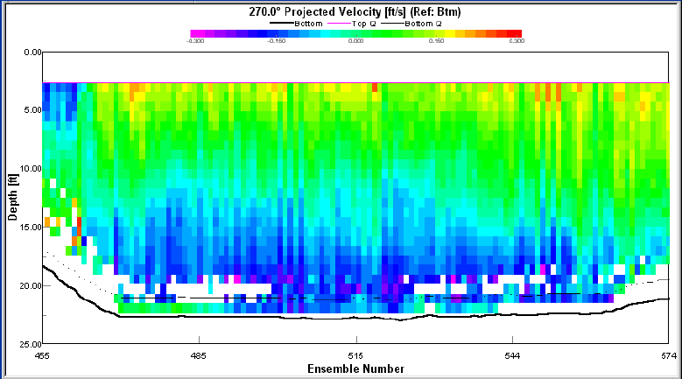

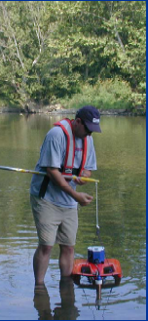
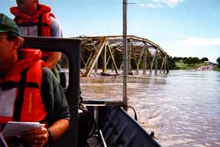
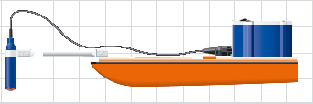
Acoustic Doppler Current Profiler

Slide 14
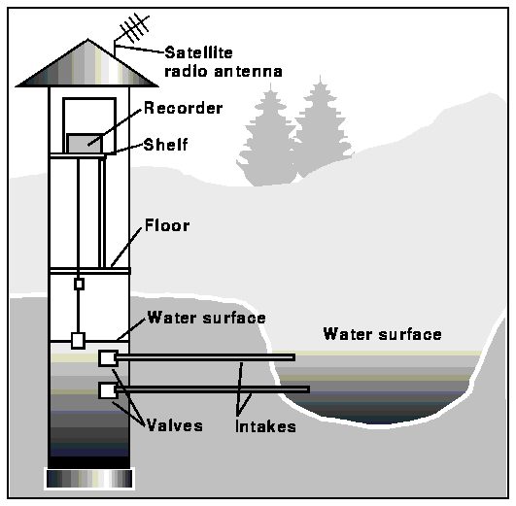
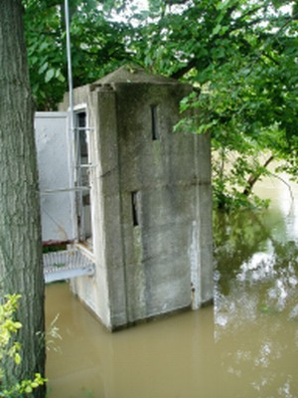
Schematic of a stilling well gaging station

Slide 15
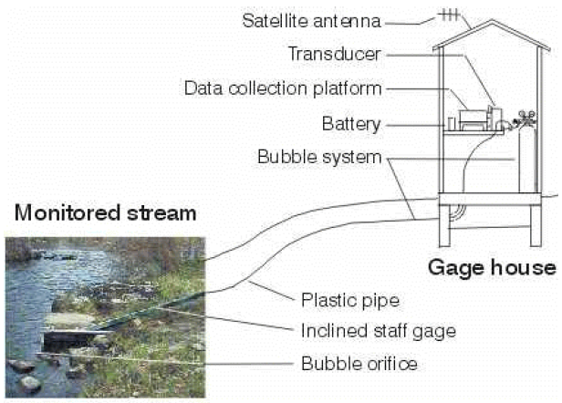
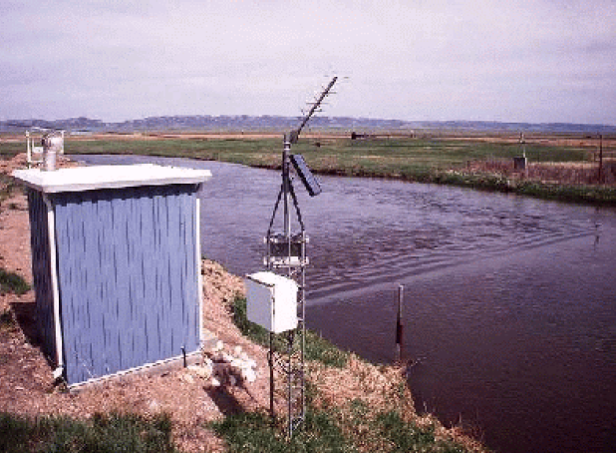
Pressure transducer gaging station

Slide 16
Stream Flow Rate
Water Surface
Height
above
bed
Depth
Averaged
Velocity
Velocity
Velocity profile in stream
Discharge at a cross-section

Slide 17
Example
Colorado River at Austin

Slide 18
Example (Cont.)
Q = 3061 ft3/s
V = Q/A = 1.81 ft/s

Slide 19
Rating Curve
It is not feasible to measure flow daily.
Rating curves are used to estimate flow from stage data
Rating curve defines stage/streamflow relationship
http://nwis.waterdata.usgs.gov/nwis/measurements/?site_no=08158000

Slide 20
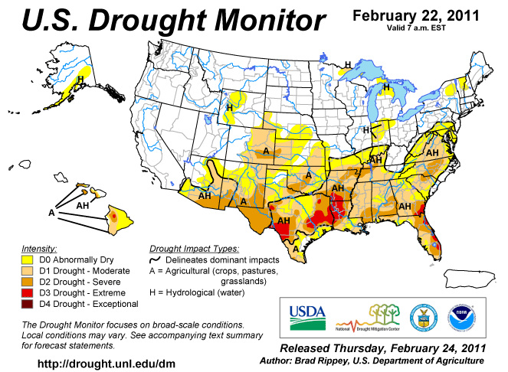
http://www.drought.unl.edu/dm/archive.html

Slide 21
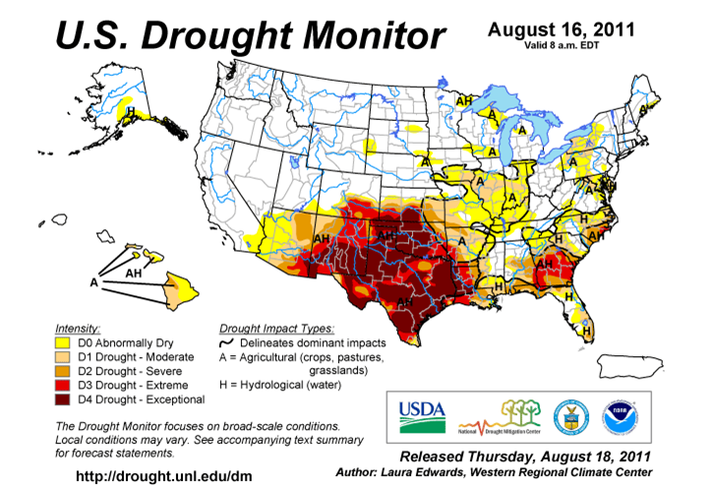

Slide 22
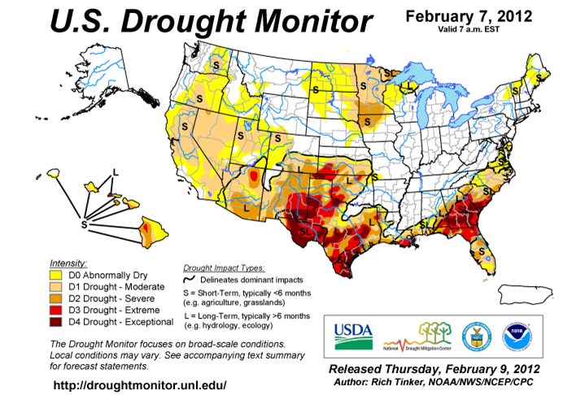

Slide 23
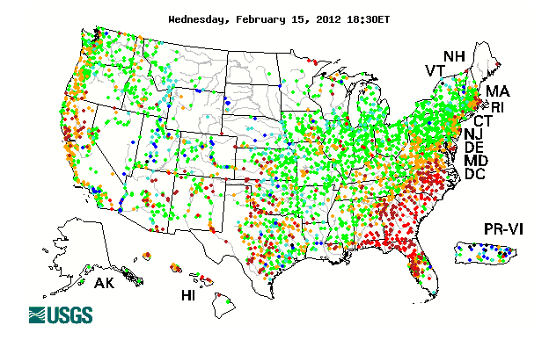
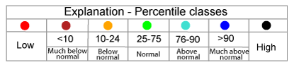
Water Watch
http://waterwatch.usgs.gov/new/

Slide 24
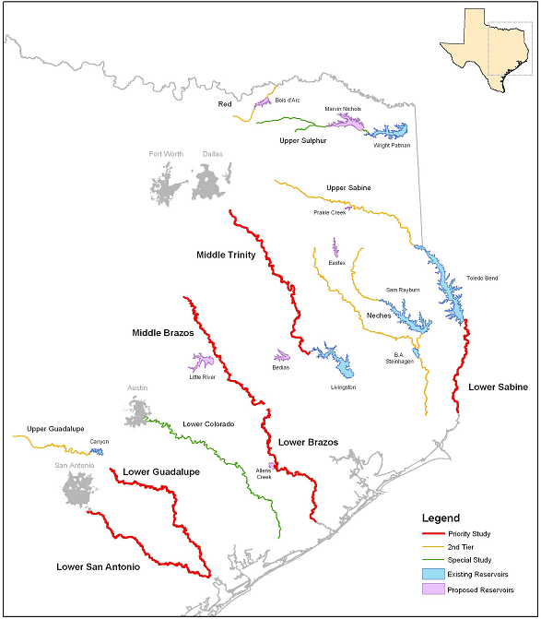
Improvements from Senate Bill 2:
Instream Flow requirements
Requires TPWD, TWDB, TCEQ to develop procedures for defining instream flow requirements
Implemented on priority study regions by 2010
Based on fish habitat analysis
Trinity
Brazos
Sabine
Guadalupe
San Antonio
Priority Study Regions

Slide 25
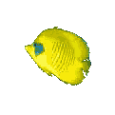
Process Flowchart
Criterion
Depth & velocity
Species groups
Hydrodynamic
Habitat
Habitat
Model
Model
Descriptions
SMS/RMA2
Data Collection and some statistics
ArcGIS
Instream
Flow
Decision Making
Notes:
This is just a flow chart of the process that I spoke in the last slide. We used SMS (Surface water modeling system) with RMA2 module for hydrodynamic modeling. From hydrodynamic modeling studies we get water depth and velocity for different flow-rates. For habitat descriptions, we collect data for different kind of fish species and since we cannot capture all the fishes that are available we used some confidence intervals. Once we have the hydraulic and biological data different criteria are developed. For example Fish of a particular type is found within a particular velocity and depth range. In ArcGIS you go through all the data and if you find a location that satisfy a particular criteria you assign some value to that location which will correspond to a particular fish type.

Slide 26
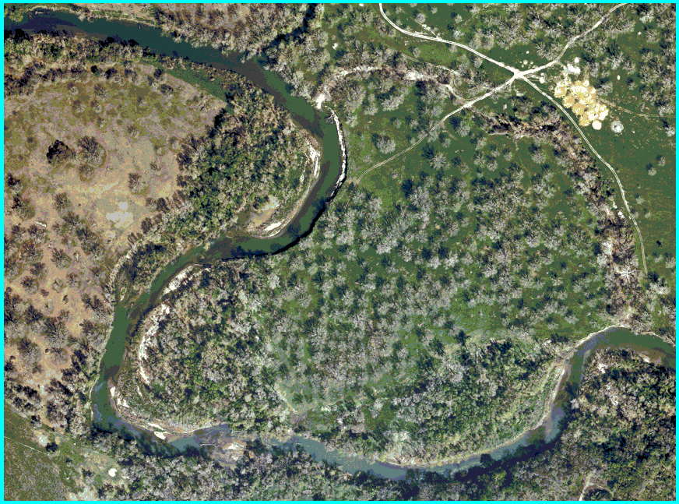
Study Area (Guadalupe river near Seguin, TX)
1/2 meter Digital Ortho Photography
Notes:
This is a DOQ of the study area which is near Seguin in Texas.

Slide 27
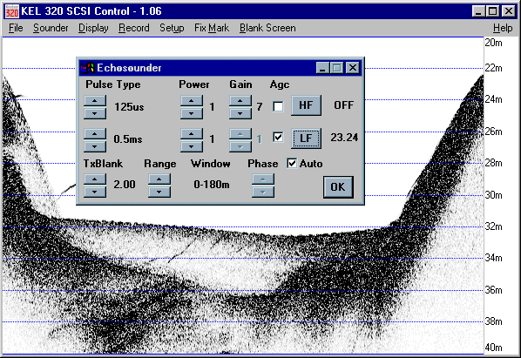
Depth Sounder (Echo Sounder)
The electronic depth sounder operates in a similar way to radar It sends out an electronic pulse which echoes back from the bed. The echo is timed electronically and transposed into a reading of the depth of water.
Notes:
The most important dataset for hydrodynamic modeling is the bathymetry data to define the channel bed. Depth sounder is used to find the water depth in the river channel. It shoots an electronic pulse into the water and depending on how much time it takes for the pulse to come back, it finds the water depth.

Slide 28
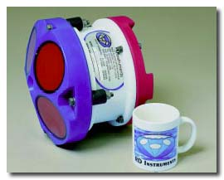
Acoustic Doppler Current Profiler
Provides full profiles of water current speed and direction in the ocean, rivers, and lakes. Also used for discharge, scour and river bed topography.
Notes:
Acoustic Doppler is used to find out the velocity. It uses the Doppler effect to measure current velocity by transmitting a short pulse of sound, listening to its echo and measuring the change in pitch or frequency of the echo.
Doppler Effect
You hear the Doppler effect whenever a train passes by - the change in pitch you hear tells you how fast the train is moving. The Aquadopp uses the Doppler effect to measure current velocity by transmitting a short pulse of sound, listening to its echo and measuring the change in pitch or frequency of the echo.

Slide 29
Measurement System
GPS Antenna
Computer and power setup
Depth Sounder
Notes:
This the final set-up. You can see that the depth sounder is attached to the GPS. So when the depth sounder shoots a pulse we get z for that point and the GPS gives the (x,y) location and so we get (x,y,z) for all the data points. The next slide that I’m going to show is prepared in ArcScene. You can see how we can produce some really cool stuff in ArcScene.

Slide 30
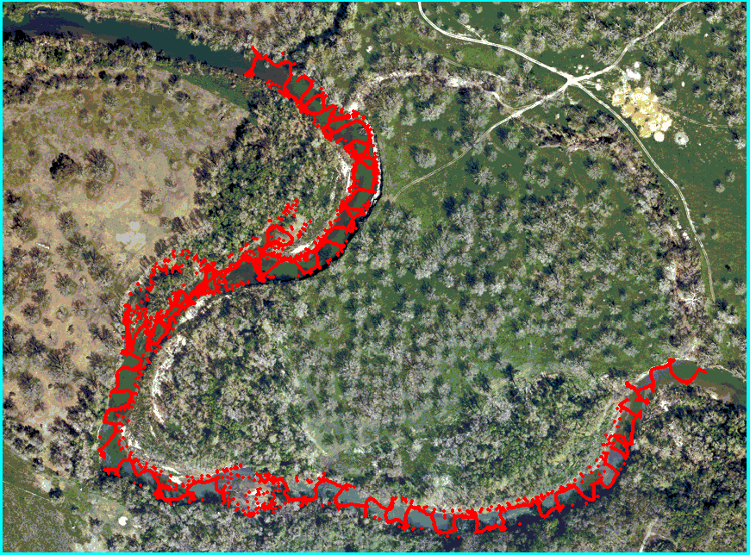
Channel Bed Soundings
Notes:
This slide shows the DOQ with the bathymetry data overlapped on top of it. The red dots are the bathymetry points.

Slide 31
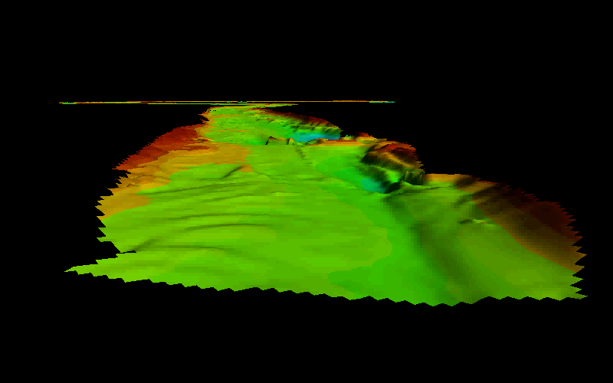
Bathymetry from Side-Scanning Sonar
Channel demo

Slide 32
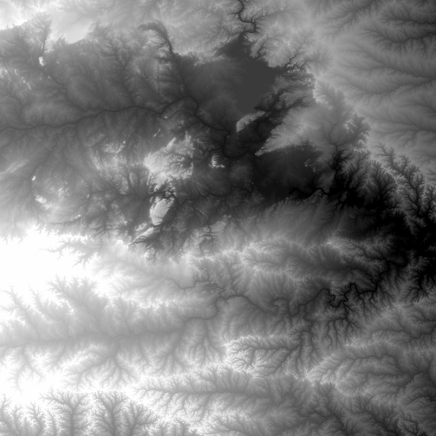
National Elevation Dataset
http://ned.usgs.gov/
Digital Elevation Model with 1 arc-second (30m) cells
Seamless in 1° blocks for the United States
10 billion data
Derived from USGS 1:24,000 quadrangle sheets
Get the data:
http://seamless.usgs.gov/

Slide 33
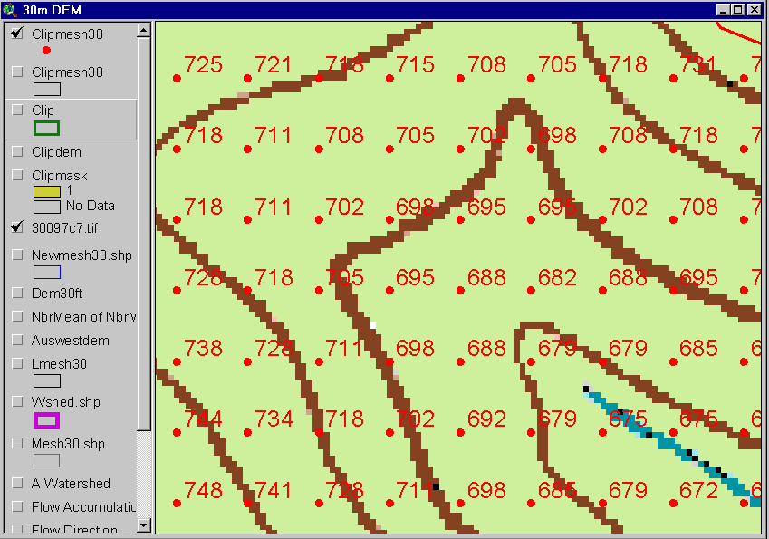
Digital Elevation Model (DEM)
720
720
Contours
740
720
700
680
740
720
700
680

Slide 34
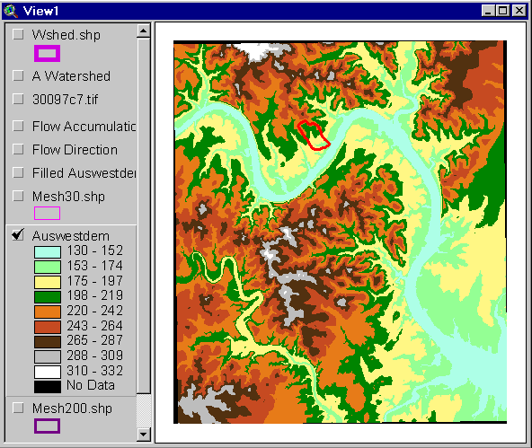
Austin West 30 Meter DEM

Slide 35
Eight Direction Pour Point Model
32
64
128
16
1
8
4
2
Water flows in the direction of steepest descent

Slide 36
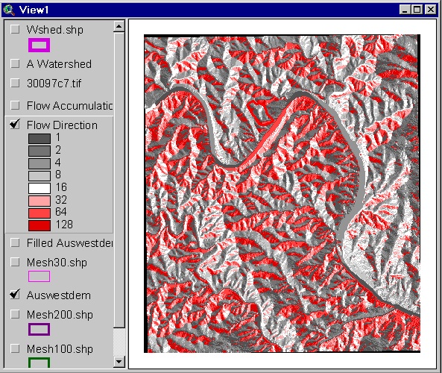
Flow Direction Grid
32
64
128
16
1
8
4
2

Slide 37
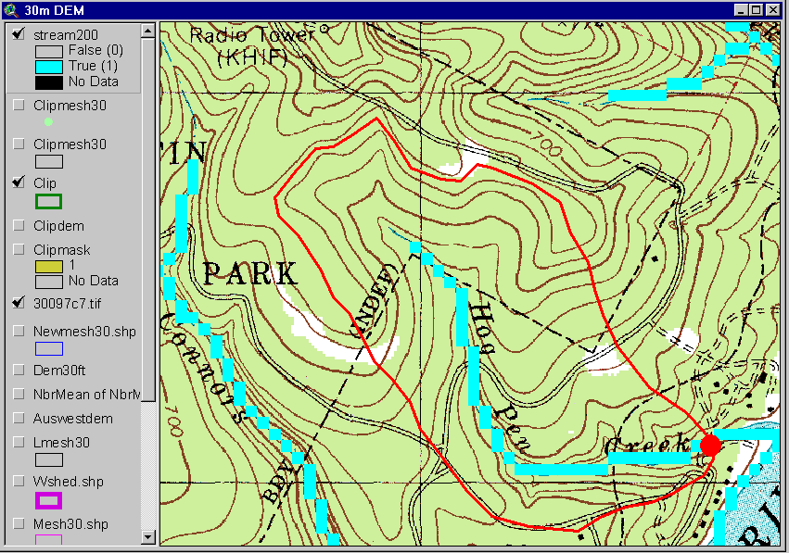
Delineation of Streams and Watersheds on a DEM

Slide 38
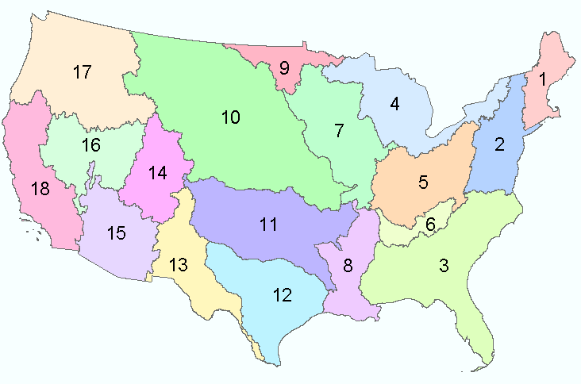
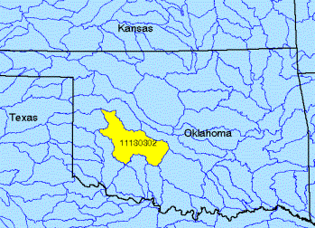
Watersheds of the US
2-digit water resource regions
8-digit HUC watersheds

Slide 39
Watershed Hierarchy
Digit #
2
4
6
8 HUC
10
12
NHDPlus
Available
In Progress

Slide 40
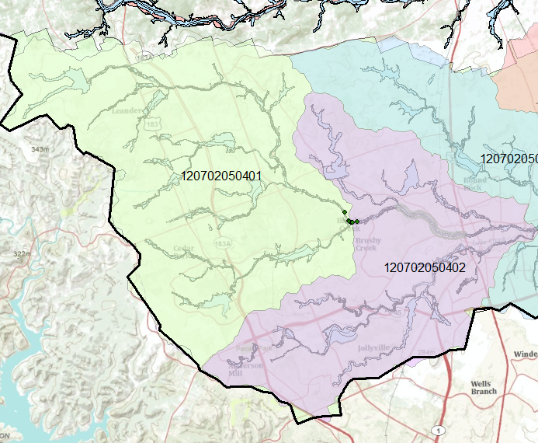
Watershed of Brushy Bend
HUC12 number

Slide 41
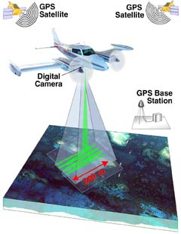
LIDAR surveying
LIDAR (Light Detection and Ranging; or Laser Imaging Detection and Ranging) is a technology that determines distance to an object or surface using laser pulses. Like the similar radar technology, which uses radio waves instead of light, the range to an object is determined by measuring the time delay between transmission of a pulse and detection of the reflected signal.

Slide 42
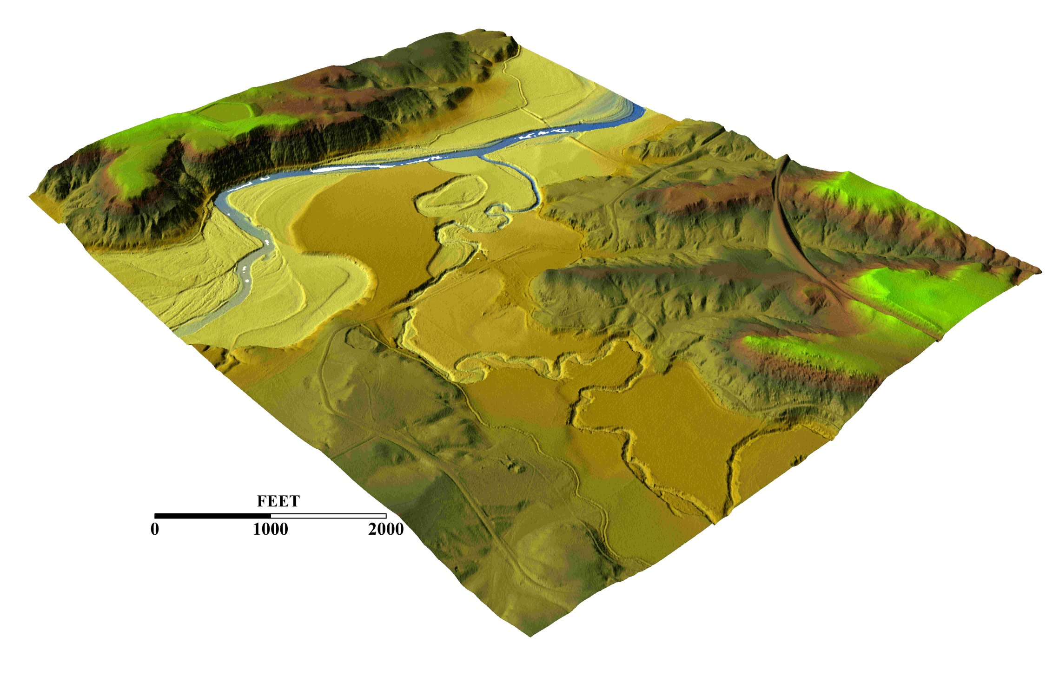
3-D detail of the Tongue river at the WY/Mont border from LIDAR.
Roberto Gutierrez
University of Texas at Austin

Slide 43

http://srtm.usgs.gov/

Slide 44

HydroSheds derived from SRTM
http://hydrosheds.cr.usgs.gov/

Slide 45


Slide 46


River networks
for 8-digit HUC
watersheds
http://nhd.usgs.gov/

Slide 47


Slide 48

Lower West Fork, Trinity River Basin
HUC = 12030102

Slide 49



1:250,000 Scale Soil Information
http://www.ncgc.nrcs.usda.gov/products/datasets/statsgo/

Slide 50


Ssurgo for Travis County
103 soil map units described by 7530 polygons of average area 35.37 ha (87 acres)

Slide 51


National Land Cover Dataset
Get the data:
http://seamless.usgs.gov/

Slide 52


