Slide 1
Wave Celerity and Flow Routing
Reading: Applied Hydrology Sections 9.3-9.7

Slide 2
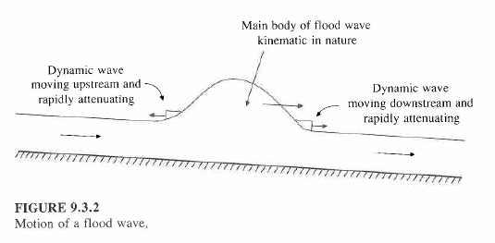
Kinematic and Dynamic Waves

Slide 3
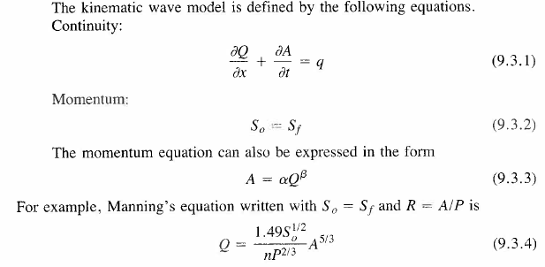

Kinematic Wave Equations
Combine (9.3.1) and (9.3.4) and after some working you get:

Slide 4

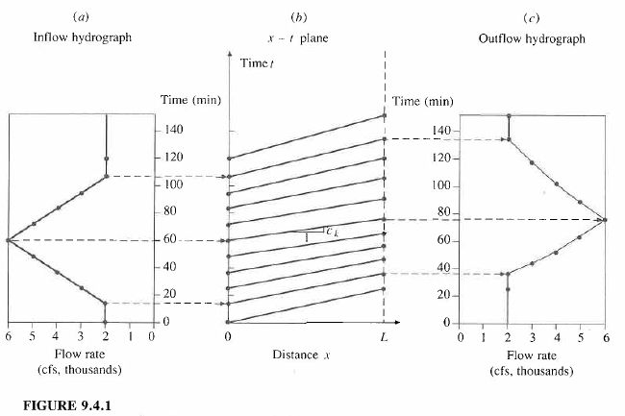
Analytical Solution of the Kinematic Wave

Slide 5

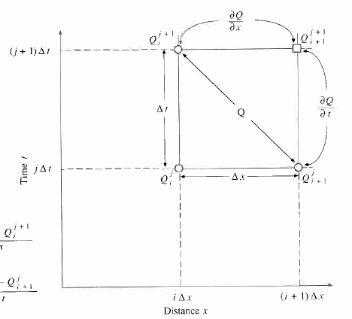
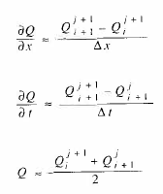

Numerical Solution of the Kinematic Wave

Slide 6
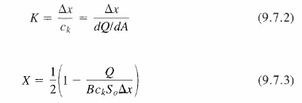
Muskingum-Cunge Method

Slide 7
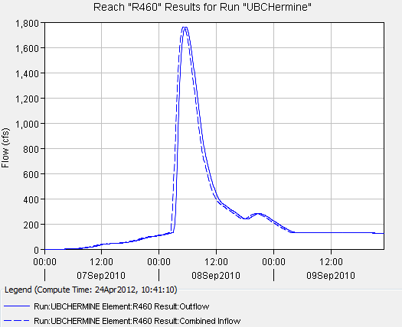
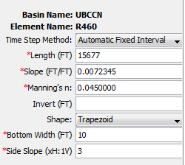
Muskingum-Cunge Method for Reach 460

