Slide 1
CE 374K Hydrology – Lecture 1
Syllabus, sequence of topics
Case study of Brushy Creek watershed
Hydrology as a science and as a profession
Hydrologic cycle and world water balance
Water as a physical substance
Readings:
For today – Applied Hydrology and Chapter 1
For Thursday, Applied Hydrology, Sections 2.1 and 2.2

Slide 2

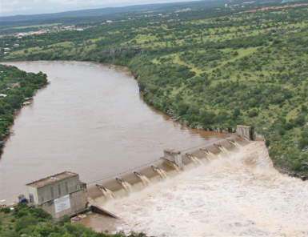
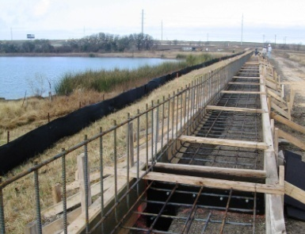
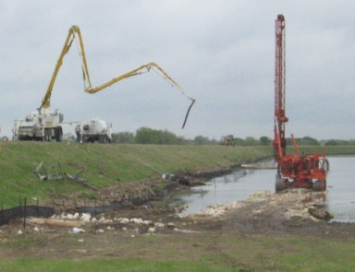
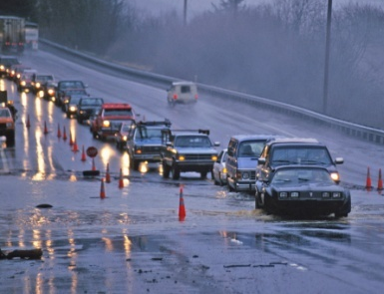
Upper Brushy Creek Water Control & Improvement District
Ruth Haberman, General Manager

Slide 3
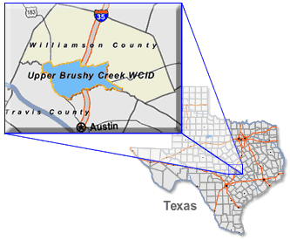
DISTRICT OVERVIEW
Original District was formed by the Texas Legislature in 1956 for flood and erosion control within the Brushy Creek watershed
Primary focus has been operation and maintenance of 23 dams constructed by the SCS (now NRCS) in the 1950s and 1960s

Slide 4
MISSION STATEMENT
The mission of the Upper Brushy Creek Water Control and Improvement District is to maintain and improve flood control structures and take appropriate measures to protect public safety as well as economic infrastructure of the District, in consultation and cooperation with other governmental entities. The District will actively foster a regional perspective and will encourage cooperation among governmental entities. We will accomplish these tasks utilizing cost-effective methods, minimizing the impact to the environment, considering the community values of our stakeholders, and conducting our business with openness, honesty and integrity.

Slide 5
JURISDICTIONAL BOUNDARIES

Slide 6
DRAINAGE AREAS

Slide 7
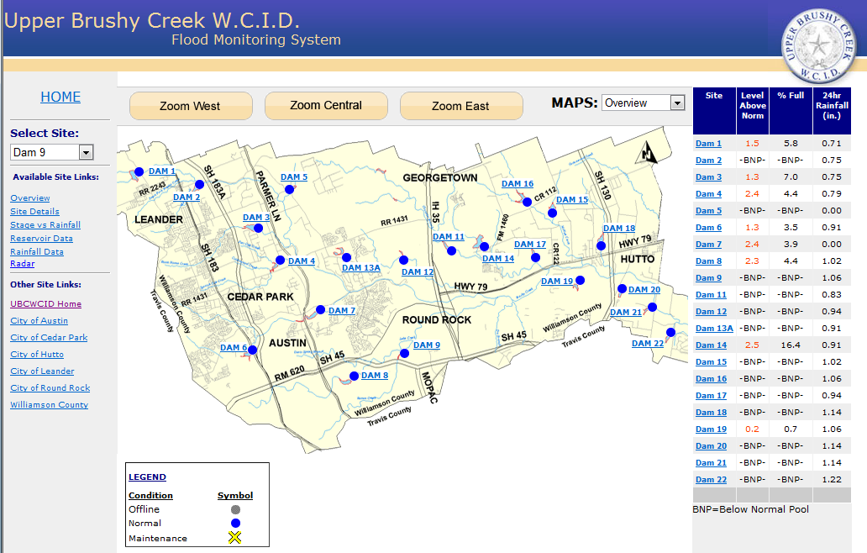
Flood Monitoring System
http://www.ubcwcid.org/Overview/Overview.aspx?id=1

Slide 8
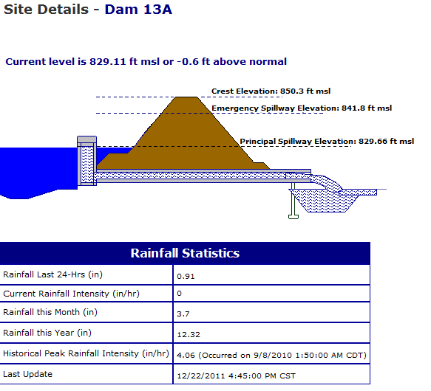
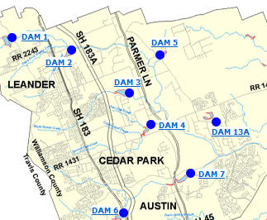
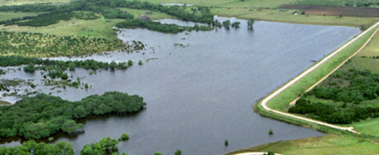
Flood Control Dam

Slide 9
FLOODING ISSUES IN THE DISTRICT
Tropical Storm Hermine
Even with the dams operating as expected, there were still threats to public safety and risk of property damage.
District Infrastructure:
The dams functioned as designed, constructed and maintained.
The dams experienced only minor damage from the flooding.
The web-based data displays allowed District engineers, elected officials, and both City and County emergency managers to monitor the rainfall in the area.

Slide 10
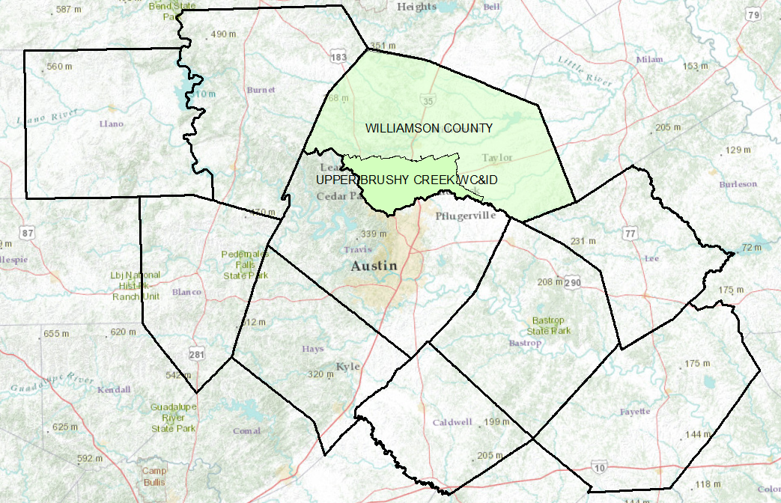
Flood Emergency Response for Williamson County

Slide 11
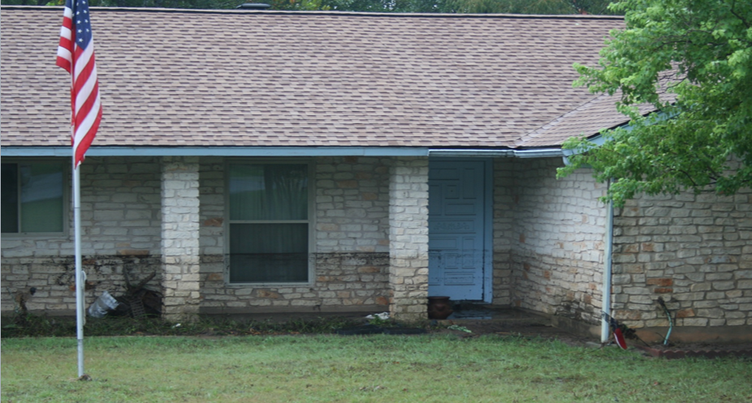
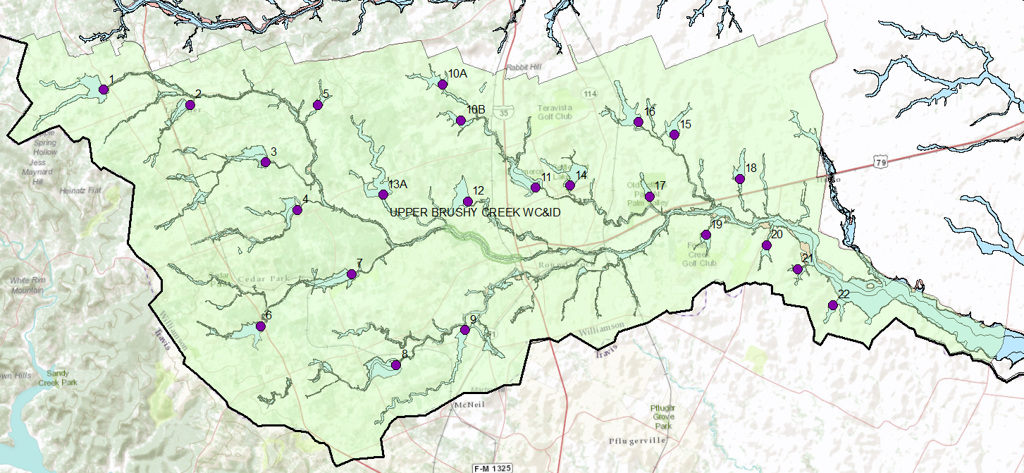
Upper Brushy Creek Watershed

Slide 12
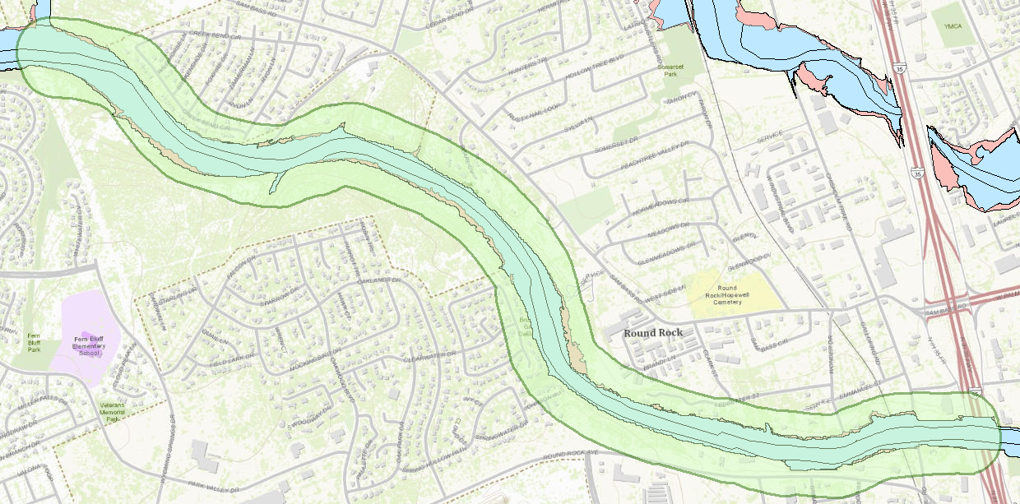
Flood Response Polygon
Color this Green, Yellow, Orange, Red according to flood risk

Slide 13

Hydrology as a Science
“Hydrology is the science that treats the waters of the earth, their occurrence, circulation and distribution, their chemical and physical properties, and their reaction with their environment, including their relation to living things. The domain of hydrology embraces the full life history of water on the earth”
The “Blue Book”
From “Opportunities in Hydrologic Science”, National Academies Press, 1992
http://www.nap.edu/catalog.php?record_id=1543
Has this definition evolved in recent years? Are new issues important?

Slide 14
Hydrology as a Profession
A profession is a “calling requiring specialized knowledge, which has as its prime purpose the rendering of a public service”
What hydrologists do:
  Water use – water withdrawal and instream uses
  Water Control – flood and drought mitigation
  Pollution Control – point and nonpoint sources
Have these functions changed in recent years? Are priorities different now?

Slide 15
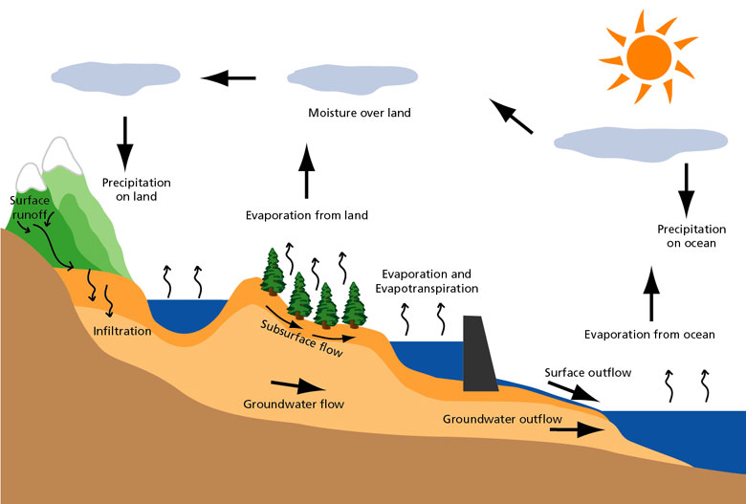
Hydrologic Cycle

Slide 16
Global water balance (volumetric)
Units are in volume per year relative to precipitation on land (119,000 km³/yr) which is 100 units
Precipitation
100
Atmospheric moisture flow 39
Precipitation
385
Evaporation
424
Evaporation
61
Surface Outflow
38
Land (148.7 km²)
(29% of earth area)
Ocean (361.3 km²)
(71% of earth area)
Subsurface Outflow
1
What conclusions can we draw from these data?

Slide 17
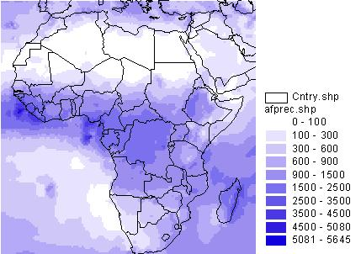
Digital Atlas of the World Water Balance
(Precipitation)
http://www.crwr.utexas.edu/gis/gishyd98/atlas/world.htm#animations

Slide 18
Global water balance
Precipitation
800 mm (31 in)
Atmospheric moisture flow 316 mm (12 in)
Precipitation
1270 mm (50 in)
Evaporation
1400 mm (55 in)
Evaporation
480 mm (19 in)
Outflow
320 mm (12 in)
Land (148.7 km²)
(29% of earth area)
(Values relative to land area)
Ocean (361.3 km²)
(71% of earth area)
What conclusions can we draw from these data?
Applied Hydrology, Table 1.1.2, p.5

Slide 19
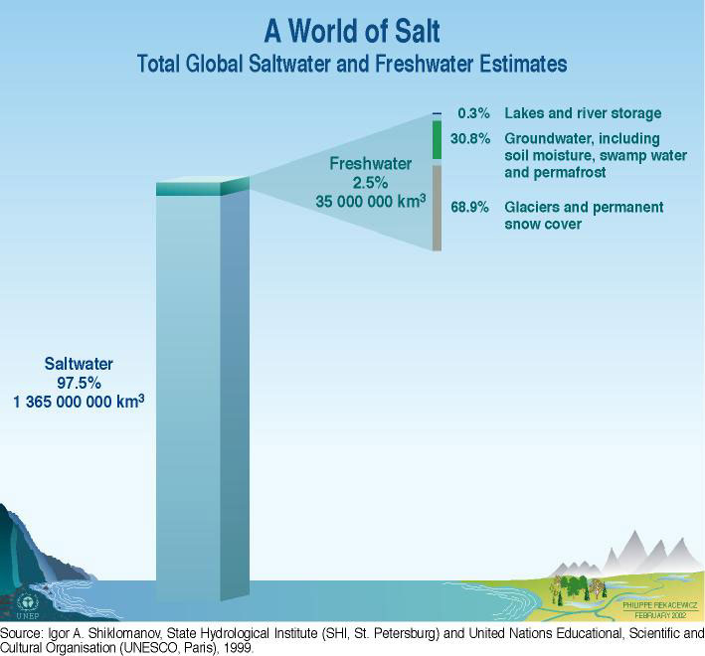
Global Water Resources
105,000 km³ or 0.0076% of total water

Slide 20
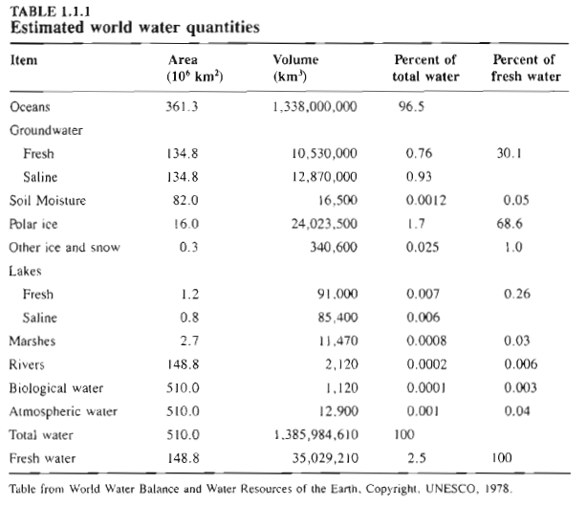

Slide 21
Residence Time
Residence time:
Average travel time for water to pass through a subsystem of the hydrologic cycle
T_{r} = S/Q
Storage/flow rate
Residence time of global atmospheric moisture (Ex. 1.1.1)
Volume (storage) of atmospheric water: 12,900 km3
Flow rate of moisture from the atmosphere as precipitation = 577,000 km³/yr
T_{r} = 12,900/577,000 = 0.022 yr = 8.2 days
One reason why weather cannot be forecast accurately more than a few days ahead!

Slide 22
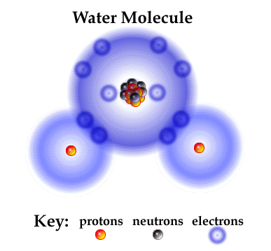
Water Molecule
Electrons desired
  “s” shell – 2
  “p” shell – 8
  Total – 10
Electrons available:
  Hydrogen H¹ – 1
  Oxygen O¹⁶ – 8
  For H₂O – 10
http://www.brooklyn.cuny.edu/bc/ahp/SDgraphics/PSgraphics/SD.PS.LG.Water.html

Slide 23
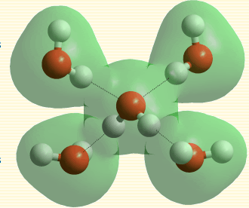
Polar Bonding
10 – 50 times weaker than covalent bonds between atoms in a molecule
Water as a solvent --more substances dissolve in greater quantities in water than in any other liquid
http://www1.lsbu.ac.uk/water/hbond.html

Slide 24
Water Molecule
Electrons desired
  “s” shell – 2
  “p” shell – 8
  Total – 10
Electrons available:
  Hydrogen H¹ – 1
  Oxygen O¹⁶ – 8
  For H₂O – 10
http://www.brooklyn.cuny.edu/bc/ahp/SDgraphics/PSgraphics/SD.PS.LG.Water.html

Slide 25
Polar Bonding
10 – 50 times weaker than covalent bonds between atoms in a molecule
Water as a solvent --more substances dissolve in greater quantities in water than in any other liquid
http://www1.lsbu.ac.uk/water/hbond.html

Slide 26
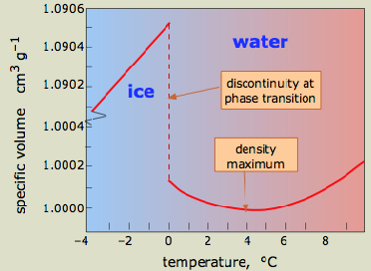
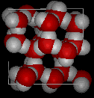
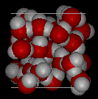
Water Density
Water as a solid (ice) is less dense than as a liquid
Maximum density is at 4°C
Ice
Water
http://www.chem1.com/acad/sci/aboutwater.html

