Slide 1
CE 394K.2
Mass, Momentum, Energy
Begin with the Reynolds Transport Theorem
Momentum – Manning and Darcy eqns
Energy – conduction, convection, radiation
Energy Balance of the Earth
Atmospheric water
Reading: Applied Hydrology Sections 3.1 to 3.4 on Atmospheric Water and Precipitation

Slide 2
Reynolds Transport Theorem
Total rate of change of B in the fluid system
Rate of change of B stored in the control volume
Net outflow of B across the control surface

Slide 3
Continuity Equation
B = m; β = dB/dm = dm/dm = 1; dB/dt = 0 (conservation of mass)
ρ = constant for water
hence
or

Slide 4
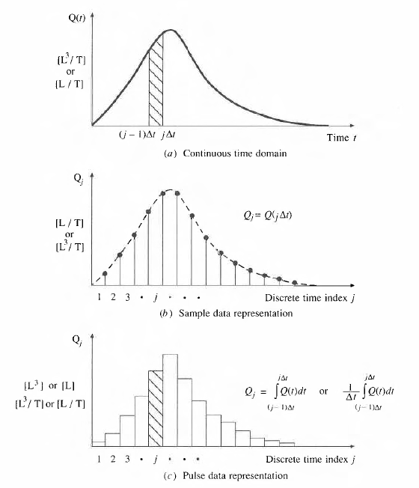
Continuous and Discrete time data
Figure 2.3.1, p. 28 Applied Hydrology
Continuous time representation
Δt
j-1
j
Sampled or Instantaneous data
(streamflow)
truthful for rate, volume is interpolated
Can we close a discrete-time water balance?
Pulse or Interval data
(precipitation)
truthful for depth, rate is interpolated

Slide 5
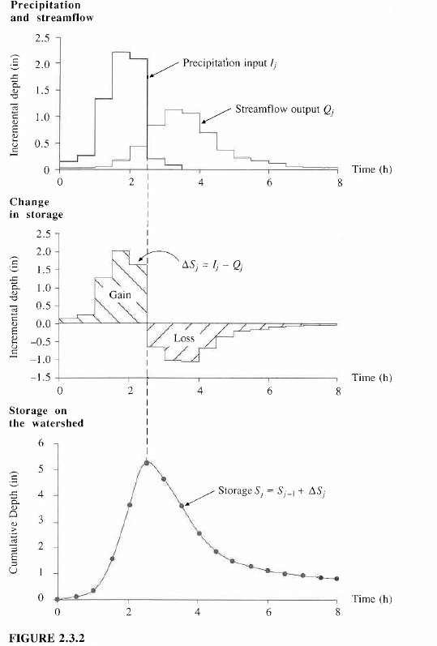
I_{j}
Q_{j}
Continuity Equation, dS/dt = I – Q
applied in a discrete time interval [(j-1)Δt, jΔt]
ΔS_{j} = I_{j} - Q_{j}
Δt
j-1
j
S_{j} = S_{j-1} + ΔS_{j}

Slide 6
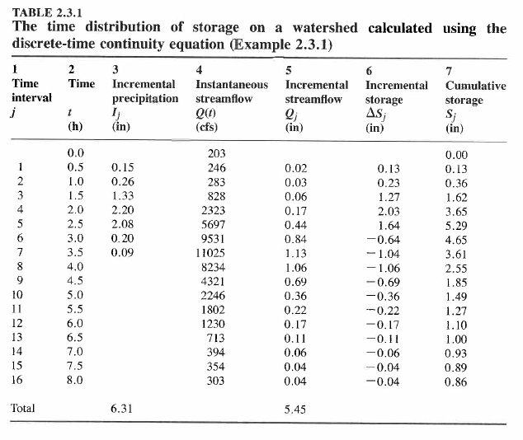

Slide 7
Momentum
B = mv; b = dB/dm = dmv/dm = v; dB/dt = d(mv)/dt = ΣF (Newtons 2nd Law)
For steady flow
For uniform flow
so
In a steady, uniform flow

Slide 8
Surface and Groundwater Flow Levels are related to Mean Sea Level
Mean Sea Level is a surface of constant
gravitational potential called the Geoid
Sea surface
Ellipsoid
Earth surface
Geoid

Slide 9
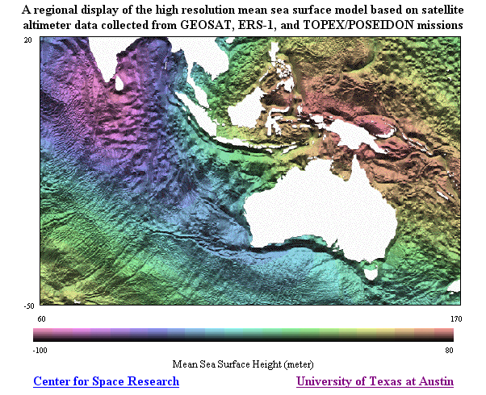
http://www.csr.utexas.edu/ocean/mss.html

Slide 10
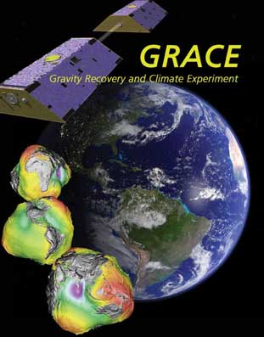
GRACE Mission
Gravity Recovery And Climate Experiment
http://www.csr.utexas.edu/grace/
Creating a new map of the earth’s gravity field every 30 days
Water Mass of Earth
http://www.csr.utexas.edu/grace/gallery/animations/measurement/measurement_qt.html

Slide 11
Vertical Earth Datums
A vertical datum defines elevation, z
NGVD29 (National Geodetic Vertical Datum of 1929)
NAVD88 (North American Vertical Datum of 1988)
takes into account a map of gravity anomalies between the ellipsoid and the geoid

Slide 12
Energy equation of fluid mechanics
h_{f}
energy
grade line
y₁
water
surface
y₂
bed
z₁
L
z₂
Datum
How do we relate friction slope,
to the velocity of flow?

Slide 13
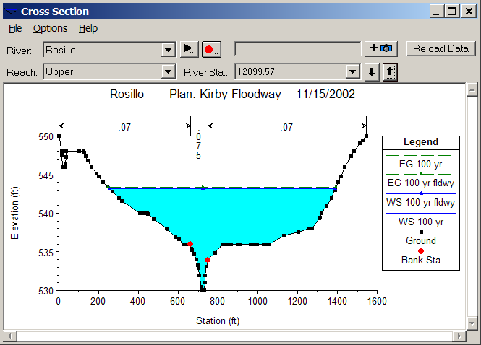
Open channel flow
Manning’s equation
Channel Roughness
Channel Geometry
Hydrologic Processes
(Open channel flow)
Hydrologic conditions
(V, S_{f})
Physical environment
(Channel n, R)

Slide 14
Subsurface flow
Darcy’s equation
q
A
q
Hydraulic conductivity
Hydrologic Processes
(Porous medium flow)
Hydrologic conditions
(q, S_{f})
Physical environment
(Medium K)

Slide 15
Comparison of flow equations
Open Channel Flow
Porous medium flow
Why is there a different power of S_{f}?

Slide 16
Energy
B = E = mv²/2 + mgz + E_{u}; β = dB/dm = v₂/2 + gz + e_{u};
dE/dt = dH/dt – dW/dt (heat input – work output) First Law of Thermodynamics
Generally in hydrology, the heat or internal energy component
(E_{u}, dominates the mechanical energy components (mv²/2 + mgz)

Slide 17
Heat energy
Energy
  Potential, Kinetic, Internal (E_{u})
Internal energy
  Sensible heat – heat content that can be measured and is proportional to temperature
  Latent heat – “hidden” heat content that is related to phase changes

Slide 18
Energy Units
In SI units, the basic unit of energy is Joule (J), where 1 J = 1 kg x 1 m/s²
Energy can also be measured in calories where 1 calorie = heat required to raise 1 gm of water by 1°C and 1 kilocalorie (C) = 1000 calories (1 calorie = 4.19 Joules)
We will use the SI system of units

Slide 19
Energy fluxes and flows
Water Volume [L³] (acre-ft, m³)
Water flow [L³/T] (cfs or m³/s)
Water flux [L/T] (in/day, mm/day)
Energy amount [E] (Joules)
Energy “flow” in Watts [E/T] (1W = 1 J/s)
Energy flux [E/L²T] in Watts/m²
Energy flow of
1 Joule/sec
Area = 1 m²

Slide 20
MegaJoules
When working with evaporation, its more convenient to use MegaJoules, MJ (J x 10⁶)
So units are
  Energy amount (MJ)
  Energy flow (MJ/day, MJ/month)
  Energy flux (MJ/m²-day, MJ/m²-month)

Slide 21
Internal Energy of Water
Water vapor
Water
Ice
Heat Capacity (J/kg-K) Latent Heat (MJ/kg)
Ice 2220 0.33
Water 4190 2.5
2.5/0.33 = 7.6
Water may evaporate at any temperature in range 0 – 100°C
Latent heat of vaporization consumes 7.6 times the latent heat of fusion (melting)

Slide 22
Water Mass Fluxes and Flows
Water Volume, V [L³] (acre-ft, m³)
Water flow, Q [L³/T] (cfs or m³/s)
Water flux, q [L/T] (in/day, mm/day)
Water mass [m = ρV] (Kg)
Water mass flow rate [m/T = ρQ] (kg/s or kg/day)
Water mass flux [M/L²T = ρq] in kg/m²-day
Water flux
Area = 1 m²

Slide 23
Latent heat flux
Water flux
  Evaporation rate, E (mm/day)
Energy flux
  Latent heat flux (W/m²), H_{l}
ρ = 1000 kg/m³
l_{v} = 2.5 MJ/kg
28.94 W/m² = 1 mm/day
Temp | Lv | Density | Conversion
0 | 2501000 | 999.9 | 28.94
10 | 2477300 | 999.7 | 28.66
20 | 2453600 | 998.2 | 28.35
30 | 2429900 | 995.7 | 28.00
40 | 2406200 | 992.2 | 27.63
Area = 1 m²

Slide 24
Radiation
Two basic laws
  Stefan-Boltzman Law
    R = emitted radiation (W/m2)
    ε = emissivity (0-1)
    σ = 5.67x10⁻⁸W/m2-K⁴
    T = absolute temperature (K)
  Wiens Law
    λ = wavelength of emitted radiation (m)
All bodies emit radiation
Hot bodies (sun) emit short wave radiation
Cool bodies (earth) emit long wave radiation

Slide 25
Net Radiation, R_{n}
R_{i} Incoming Radiation
R_{o} =αR_{i} Reflected radiation
= albedo (0 – 1)
R_{e}
R_{n} Net Radiation
Average value of R_{n} over the earth and
over the year is 105 W/m²

Slide 26
Net Radiation, R_{n}
H – Sensible Heat
LE – Evaporation
G – Ground Heat Flux
R_{n} Net Radiation
Average value of R_{n} over the earth and
over the year is 105 W/m²

Slide 27
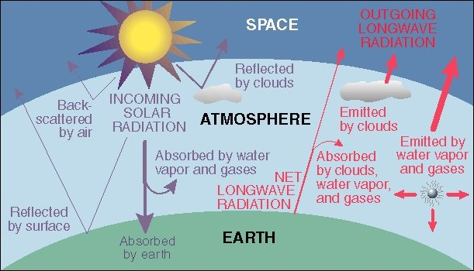
Energy Balance of Earth
20
70
100
6
6
26
4
38
15
19
21
Sensible heat flux 7
Latent heat flux 23
51
http://www.uwsp.edu/geo/faculty/ritter/geog101/textbook/energy/radiation_balance.html

Slide 28
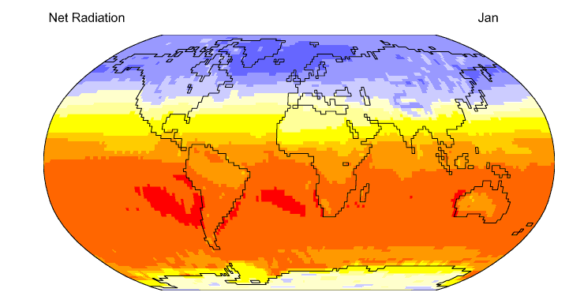

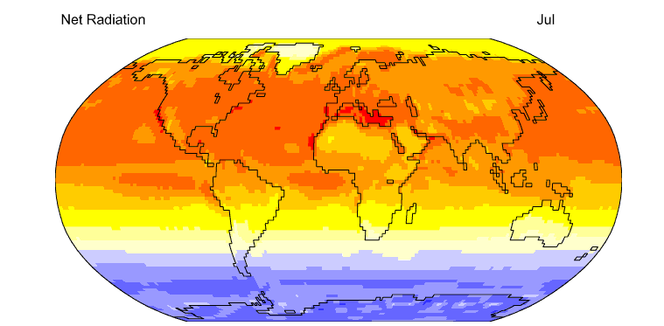
Net Radiation
http://geography.uoregon.edu/envchange/clim_animations/flash/netrad.html
Mean annual net radiation over the earth and over the year is 105 W/m²

Slide 29
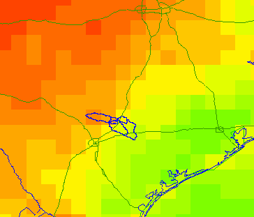
Energy Balance in the San Marcos Basin from the NARR (July 2003)
Note the very large amount of longwave radiation exchanged between land and atmosphere
Average fluxes over the day
495
61
72
112
3
310
415
Net Shortwave = 310 – 72 = 238; Net Longwave = 415 – 495 = - 80

Slide 30
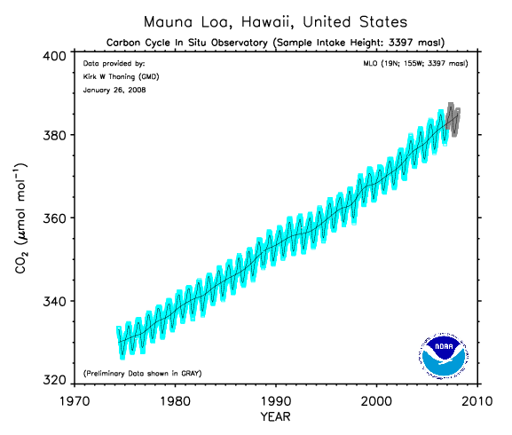
Increasing carbon dioxide in the atmosphere (from about 300 ppm in preindustrial times)
We are burning fossil carbon (oil, coal) at 100,000 times the rate it
was laid down in geologic time

Slide 31
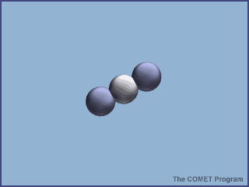
Absorption of energy by CO₂

Slide 32
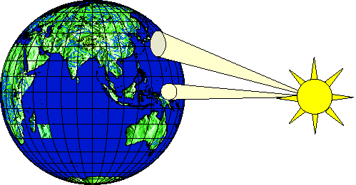
Heating of earth surface
Heating of earth surface is uneven
  Solar radiation strikes perpendicularly near the equator (270 W/m²)
  Solar radiation strikes at an oblique angle near the poles (90 W/m²)
Emitted radiation is more uniform than incoming radiation
Amount of energy transferred from equator to the poles is approximately 4 x 10⁹ MW

Slide 33
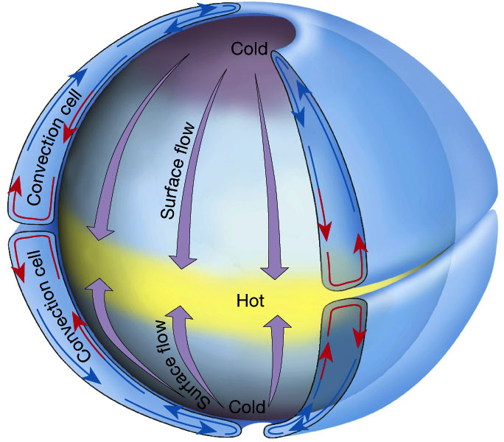
Hadley circulation
Atmosphere (and oceans) serve to transmit heat energy from the equator to the poles
Warm air rises, cool air descends creating two huge convective cells.

Slide 34
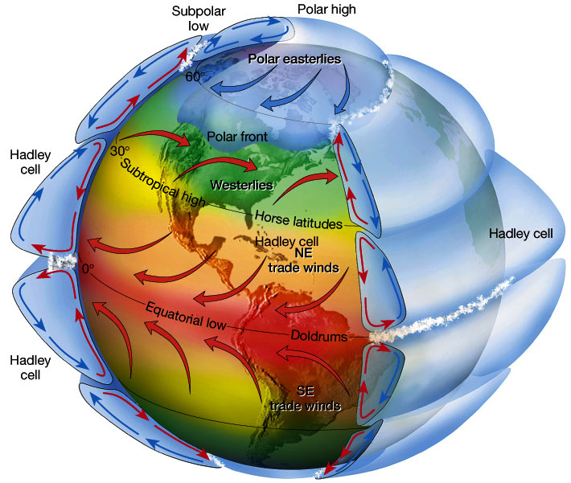
Atmospheric circulation
Circulation cells
Polar Cell
Hadley cell
Ferrel Cell
Polar cell
Ferrel Cell
Winds
Tropical Easterlies/Trades
Westerlies
Polar easterlies
Latitudes
Intertropical convergence zone (ITCZ)/Doldrums
Horse latitudes
Subpolar low
Polar high

Slide 35
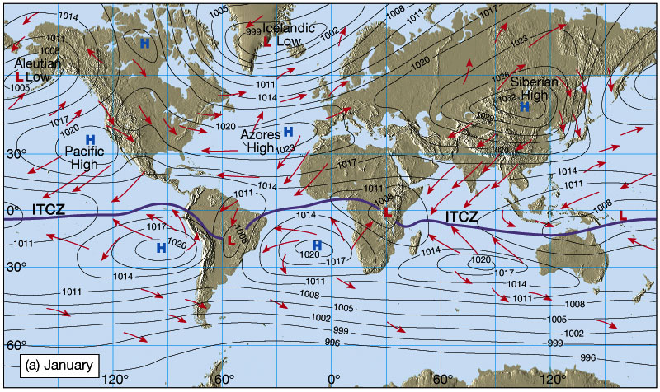
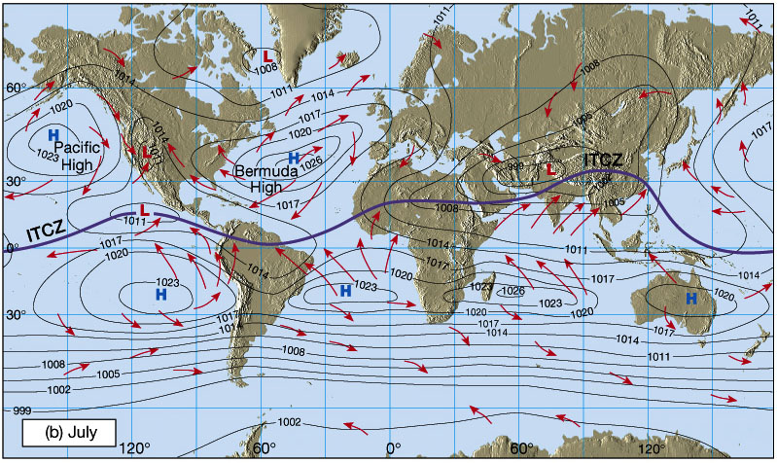
Shifting in Intertropical Convergence Zone (ITCZ)
Owing to the tilt of the Earth's axis in orbit, the ITCZ shifts north and south.
Southward shift in January
Creates wet Summers (Monsoons) and dry winters, especially in India and SE Asia
Northward shift in July

Slide 36
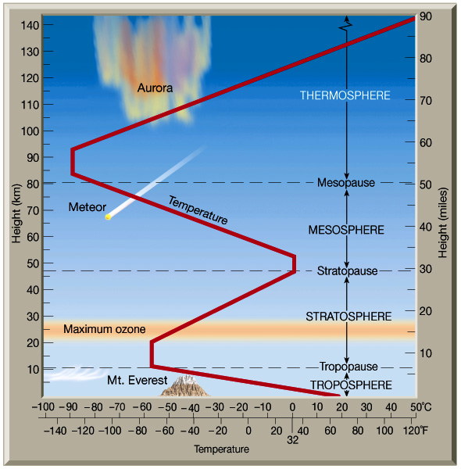
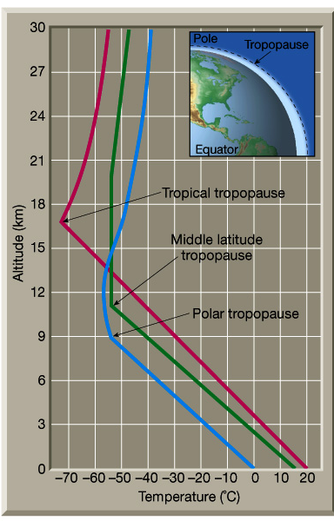
Structure of atmosphere

Slide 37
Atmospheric water
Atmospheric water exists
  Mostly as gas or water vapor
  Liquid in rainfall and water droplets in clouds
  Solid in snowfall and in hail storms
Accounts for less than 1/100,000 part of total water, but plays a major role in the hydrologic cycle

Slide 38
Water vapor
Suppose we have an elementary volume of atmosphere dV and
we want quantify how much water vapor it contains
Water vapor density
dV
m_{a} = mass of moist air
m_{v} = mass of water vapor
Air density
Atmospheric gases:
Nitrogen – 78.1%
Oxygen – 20.9%
Other gases ~ 1%
http://www.bambooweb.com/articles/e/a/Earth's_atmosphere.html

Slide 39
Specific Humidity, q_{v}
Specific humidity measures the mass of water vapor per unit mass of moist air
It is dimensionless

Slide 40
Vapor pressure, e
Vapor pressure, e, is the pressure that water vapor exerts on a surface
Air pressure, p, is the total pressure that air makes on a surface
Ideal gas law relates pressure to absolute temperature T, R_{v} is the gas constant for water vapor
0.622 is ratio of mol. wt. of water vapor to avg mol. wt. of dry air (=18/28.9)

Slide 41
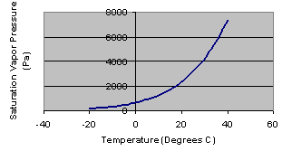
Saturation vapor pressure, e_{s}
Saturation vapor pressure occurs when air is holding all the water vapor
that it can at a given air temperature
Vapor pressure is measured in Pascals (Pa), where 1 Pa = 1 N/m²
1 kPa = 1000 Pa

Slide 42
Relative humidity, R_{h}
e_{s}
e
Relative humidity measures the percent
of the saturation water content of the air
that it currently holds (0 – 100%)

Slide 43
Dewpoint Temperature, T_{d}
e
T_{d}
T
Dewpoint temperature is the air temperature
at which the air would be saturated with its current
vapor content

Slide 44
Water vapor in an air column
We have three equations describing column:
  Hydrostatic air pressure, dp/dz = -ρ_{a}g
  Lapse rate of temperature, dT/dz = - α
  Ideal gas law, p = ρ_{a}R_{a}T
Combine them and integrate over column to get pressure variation elevation
2
Column
Element, dz
1

Slide 45
Precipitable Water
In an element dz, the mass of water vapor is dm_{p}
Integrate over the whole atmospheric column to get precipitable water,m_{p}
m_{p}/A gives precipitable water per unit area in kg/m²
2
Column
Element, dz
1
Area = A

Slide 46
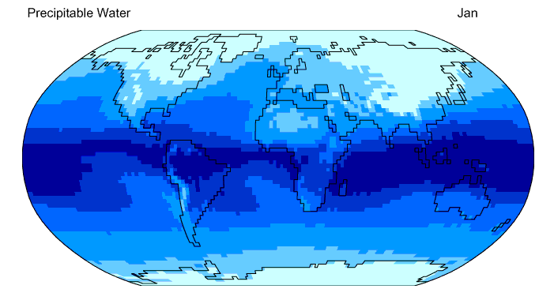
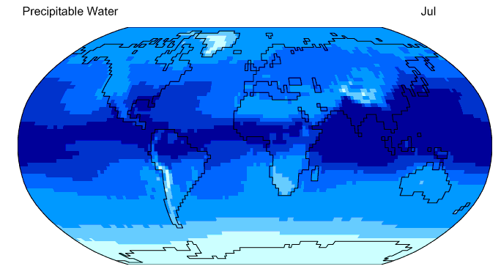

Precipitable Water
http://geography.uoregon.edu/envchange/clim_animations/flash/pwat.html
Frontal rainfall in the winter
Thunderstorm rainfall in the summer
25 mm precipitable water divides frontal from thunderstorm rainfall

