Slide 1
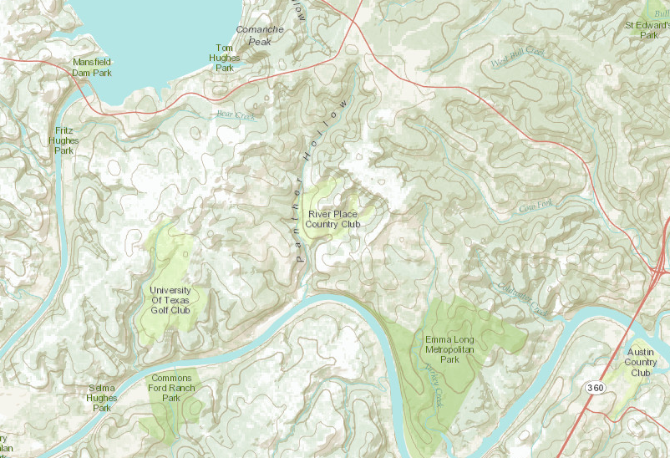
Streamflow in Panther Hollow
RR 620
RR 2222
Observation Site

Slide 2
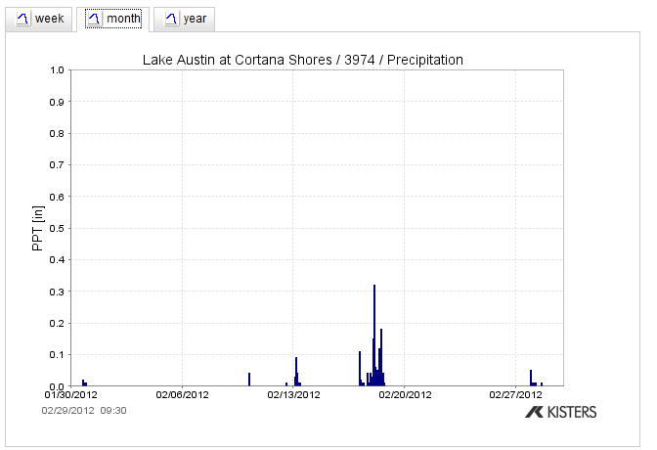
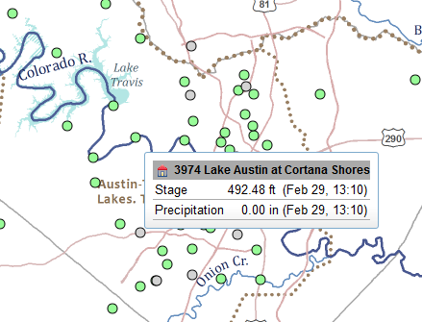
Precipitation in February 2012
Photos taken after rain on Feb 19

Slide 3
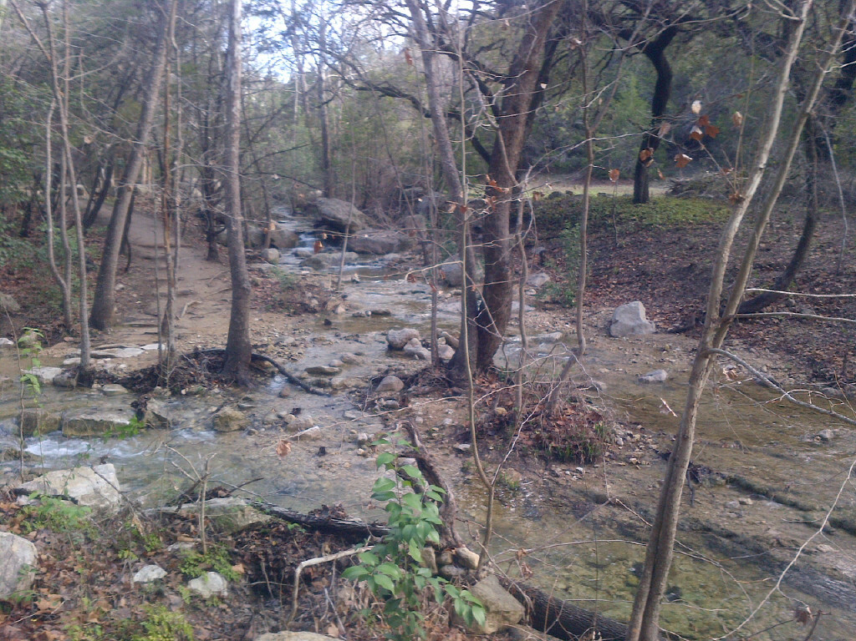
Panther Hollow

Slide 4
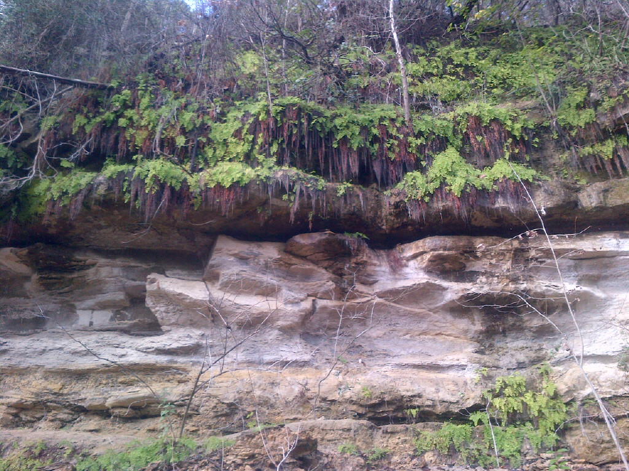
Groundwater Strata

Slide 5
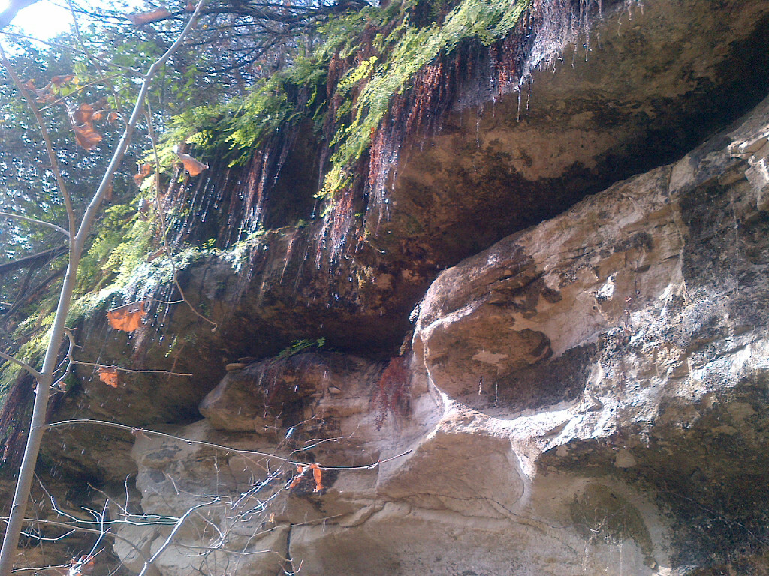
Groundwater Seepage

