Slide 1
CE 374K Hydrology
Review for Second Exam
April 17, 2012

Slide 2
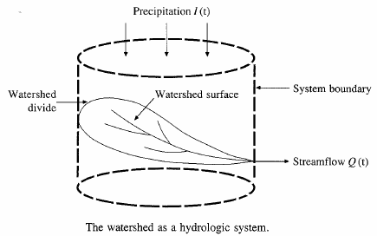






Hydrologic Analysis
Change in storage w.r.t. time = inflow - outflow
In the case of a linear reservoir, S = kQ
Transfer function for a linear system (S = kQ).

Slide 3
Proportionality and superposition
Linear system (k is constant in S = kQ)
  Proportionality
    If I₁ → Q₁ then C*I₂ → C*Q₂
  Superposition
    If I₁ → Q₁ and I₂ → Q₂, then I₁ +I₂→ Q₁ + Q₂

Slide 4
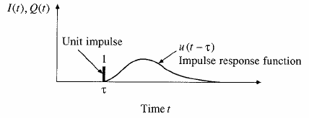
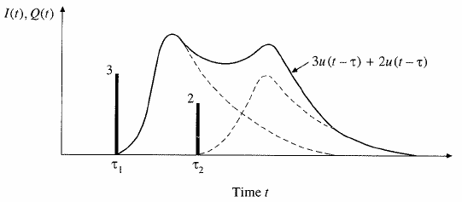
Impulse response function
Impulse input: an input applied instantaneously (spike) at time τ and zero everywhere else
An unit impulse at τ produces as unit impulse response function u(t-τ)
Principle of proportionality and superposition

Slide 5
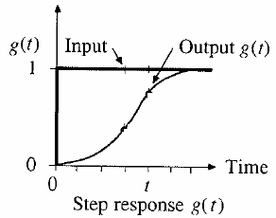
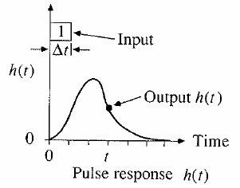
Step and pulse inputs
A unit step input is an input that goes from 0 to 1 at time 0 and continues indefinitely thereafter
A unit pulse is an input of unit amount occurring in duration Δt and 0 elsewhere.
Precipitation is a series of pulse inputs!

Slide 6
Unit Hydrograph Theory
Direct runoff hydrograph resulting from a unit depth of excess rainfall occurring uniformly on a watershed at a constant rate for a specified duration.
Unit pulse response function of a linear hydrologic system
Can be used to derive runoff from any excess rainfall on the watershed.

Slide 7
Discrete Convolution
Continuous
Discrete
Q is flow, P is precipitation and U is unit hydrograph
M is the number of precipitation pulses, n is the number of flow rate intervals
The unit hydrograph has N-M+1 pulses

Slide 8
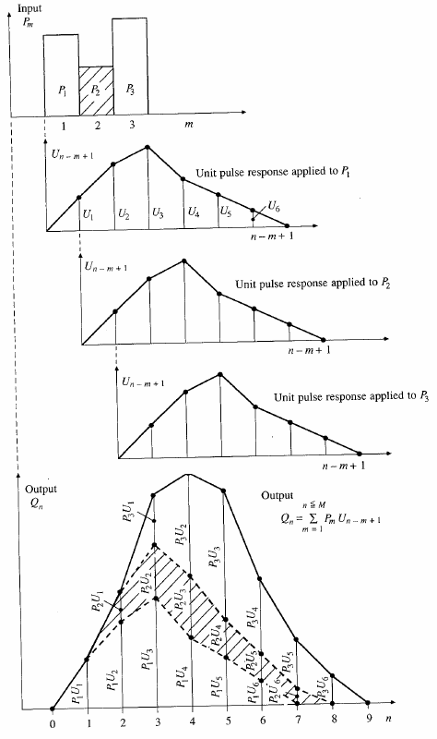
Application of convolution to the output from a linear system

Slide 9
SCS dimensionless hydrograph
Synthetic UH in which the discharge is expressed by the ratio of q to q_{p} and time by the ratio of t to T_{p}
If peak discharge and lag time are known, UH can be estimated.
T_{c}: time of concentration
C = 2.08 (483.4 in English system)
A: drainage area in km² (mi²)

Slide 10
Flow Routing
Q
Procedure to determine the flow hydrograph at a point on a watershed from a known hydrograph upstream
As the hydrograph travels, it
  attenuates
  gets delayed
t
Q
t
Q
t
Q
t

Slide 11
Hydrologic Routing
Discharge
Discharge
Inflow
Transfer
Function
Outflow
Upstream hydrograph
Downstream hydrograph
Input, output, and storage are related by continuity equation:
Q and S are unknown
Storage can be expressed as a function of I(t) or Q(t) or both
For a linear reservoir, S=kQ

Slide 12
Level pool methodology
Discharge
Inflow
Outflow
Time
Storage
Unknown
Known
Need a function relating
Time
Storage-outflow function

Slide 13
Level pool methodology
Given
  Inflow hydrograph
  Q and H relationship
Steps
  Develop Q versus Q+ 2S/Δt relationship using Q/H relationship
  Compute Q+ 2S/Δt using
  Use the relationship developed in step 1 to get Q

Slide 14
Hydrologic river routing (Muskingum Method)
Wedge storage in reach
Advancing
Flood
Wave
I > Q
K = travel time of peak through the reach
X = weight on inflow versus outflow (0 ≤ X ≤ 0.5)
X = 0 ➔ Reservoir, storage depends on outflow, no wedge
X = 0.0 - 0.3 ➔ Natural stream
Receding
Flood
Wave
Q > I

Slide 15
Muskingum Method (Cont.)
Recall:
Combine:
If I(t), K and X are known, Q(t) can be calculated using above equations

Slide 16
Types of flow routing
Lumped/hydrologic
  Flow is calculated as a function of time alone at a particular location
  Governed by continuity equation and flow/storage relationship
Distributed/hydraulic
  Flow is calculated as a function of space and time throughout the system
  Governed by continuity and momentum equations

Slide 17
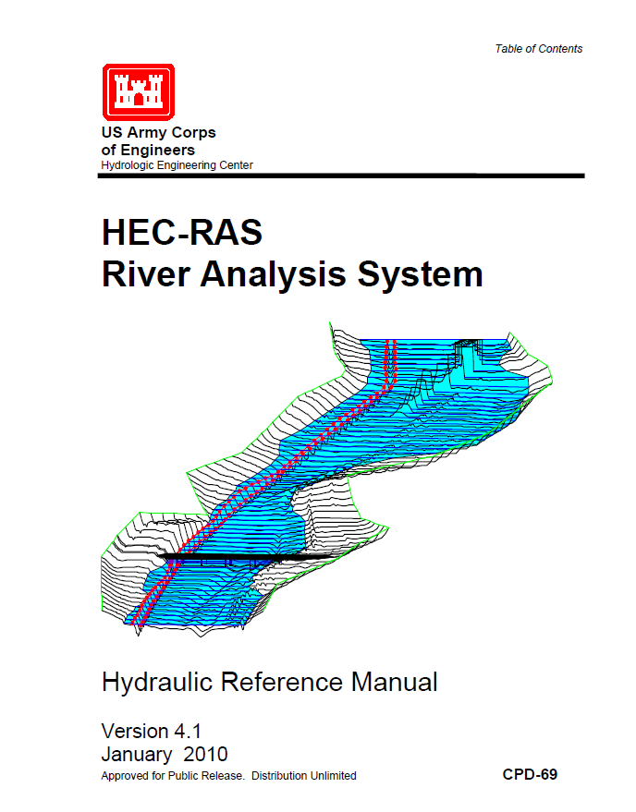
Hydraulic Routing in Rivers
Reference: HEC-RAS Hydraulic Reference Manual, Version 4.1, Chapters 1 and 2
Reading: HEC-RAS Manual pp. 2-1 to 2-12
Applied Hydrology, Sections 10-1 and 10-2
http://www.hec.usace.army.mil/software/hec-ras/documents/HEC-RAS_4.1_Reference_Manual.pdf

Slide 18
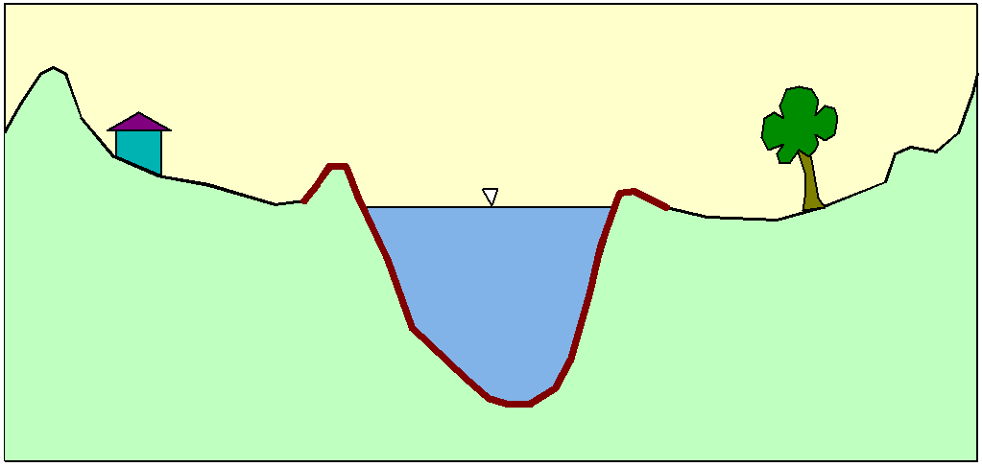
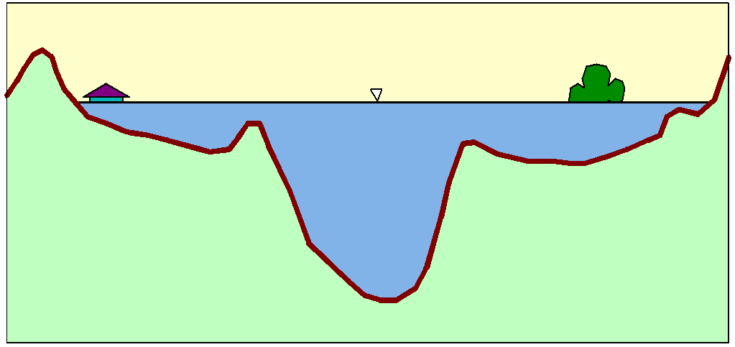
Flood Inundation

Slide 19
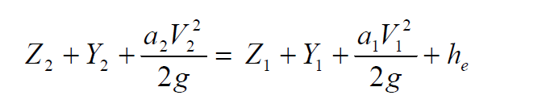
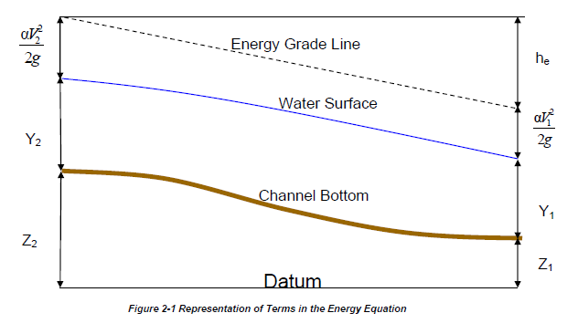
Steady Flow Solution

Slide 20
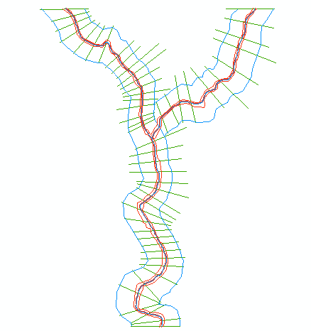
One-Dimensional Flow Computations
Cross-section
Channel centerline
and banklines
Right Overbank
Left Overbank

Slide 21
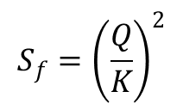
Solving Steady Flow Equations
Q is known throughout reach
All conditions at (1) are known, Q is known
Select h₂
compute Y₂, V₂, K₂, S_{f}, h_{e}
Using energy equation (A), compute h₂
Compare new h₂ with the value assumed in Step 2, and repeat until convergence occurs
(A)
h₂
h₁
(2)
(1)
$$S_{f}={\left(\frac{Q}{K}\right)}^{2}$$

Slide 22
Unsteady Flow Routing in Open Channels
Flow is one-dimensional
Hydrostatic pressure prevails and vertical accelerations are negligible
Streamline curvature is small.
Bottom slope of the channel is small.
Manning’s equation is used to describe resistance effects
The fluid is incompressible

Slide 23
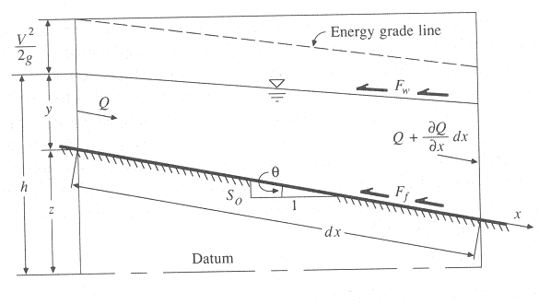
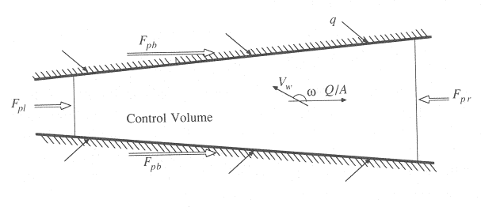
Continuity Equation
Q = inflow to the control volume
q = lateral inflow
Rate of change of flow with distance
Outflow from the C.V.
Change in mass
Elevation View
Reynolds transport theorem
Plan View

Slide 24
Momentum Equation (3)
Steady, uniform flow
Steady, non-uniform flow
Unsteady, non-uniform flow

Slide 25
Random Variable
Random variable: a quantity used to represent probabilistic uncertainty
  Incremental precipitation
  Instantaneous streamflow
  Wind velocity
Random variable (X) is described by a probability distribution
Probability distribution is a set of probabilities associated with the values in a random variable’s sample space

Slide 26
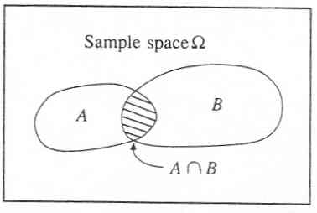

Slide 27
Summary statistics
Also called descriptive statistics
  If x₁, x₂, …x_{n} is a sample then
Mean,
μ for continuous data
Variance,
σ² for continuous data
Standard deviation,
σ for continuous data
Coeff. of variation,
Also included in summary statistics are median, skewness, correlation coefficient,

Slide 28
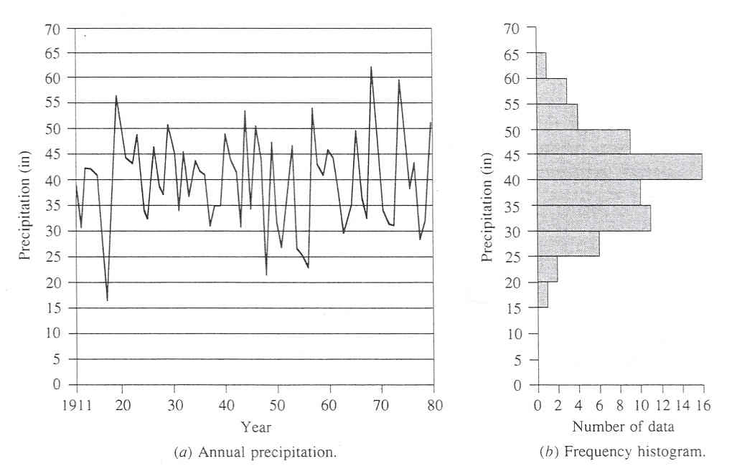

Slide 29
Return Period
Random variable:
Threshold level:
Extreme event occurs if:
Recurrence interval:
Return Period:
  Average recurrence interval between events equalling or exceeding a threshold
If p is the probability of occurrence of an extreme event, then
or

Slide 30
Probability distributions
Normal family
  Normal, lognormal, lognormal-III
Generalized extreme value family
  EV1 (Gumbel), GEV, and EVIII (Weibull)
Exponential/Pearson type family
  Exponential, Pearson type III, Log-Pearson type III

Slide 31
Frequency Factors
Once a distribution has been selected and its parameters estimated, then how do we use it?
Chow proposed using:
where
f_{X}(x)
x

Slide 32
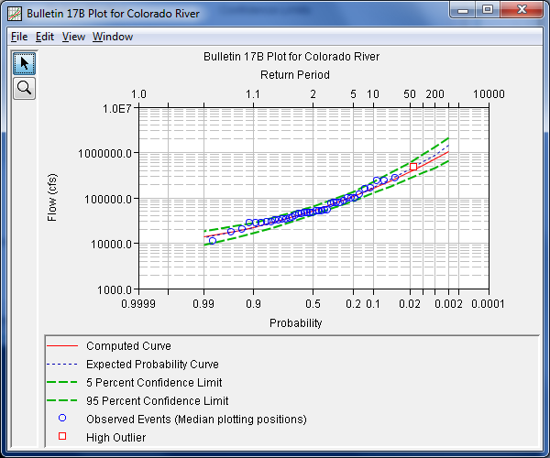
Flood Frequency Analysis

Slide 33
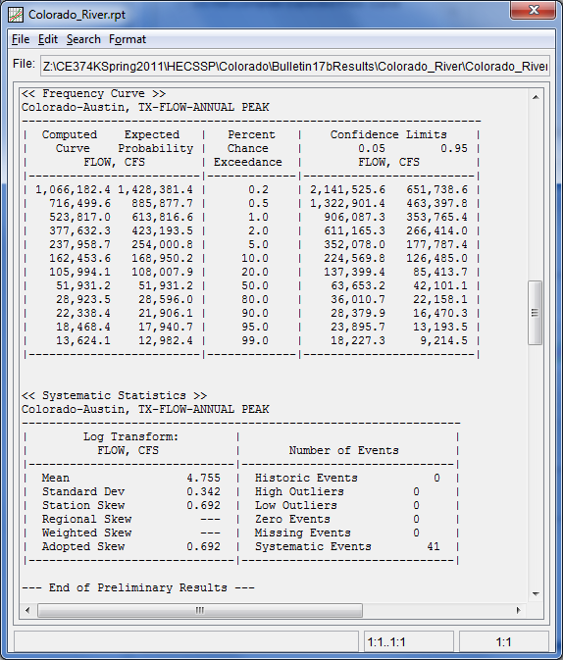
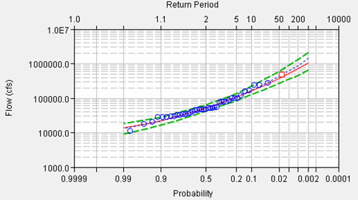
HEC-SSP

Slide 34
Hydrologic design level
Hydrologic design level – magnitude of the hydrologic event to be considered for the design or a structure or project.
Three approaches for determining design level
  Empirical/probabilistic
  Risk analysis
  Hydroeconomic analysis

Slide 35
Estimated Limiting Value (ELV)
Lower limit on design value – 0
Upper limit on design value – ELV
ELV – largest magnitude possible for a hydrologic event at a given location, based on the best available hydrologic information.
  Length of record
  Reliability of information
  Accuracy of analysis
Probable Maximum Precipitation (PMP) / Probable Maximum Flood (PMF)

Slide 36
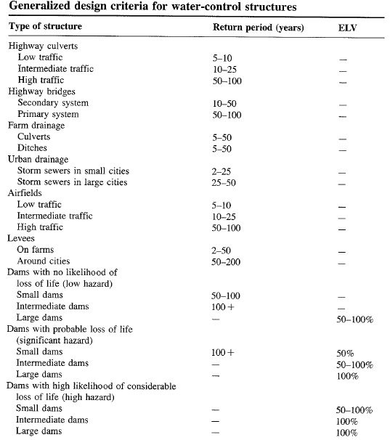

Slide 37
Design Storms
Get Depth, Duration, Frequency Data for the required location
Select a return period
Convert Depth-Duration data to a design hyetograph.

Slide 38
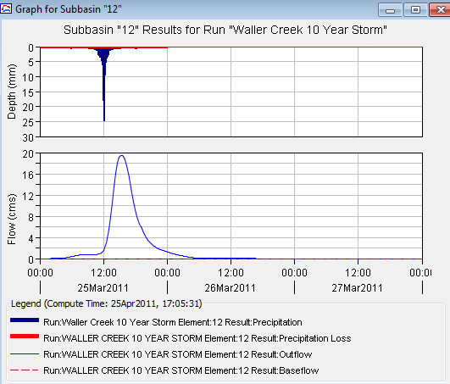
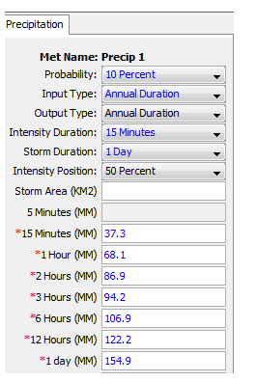
Depth Duration Data to Rainfall Hyetograph

Slide 39
Example 14.2.1
Determine i and P for a 20-min duration storm with 5-yr return period in Chicago
From the IDF curve for Chicago,
i = 3.5 in/hr for T_{d} = 20 min and T = 5yr
P = i x T_{d} = 3.5 x 20/60 = 1.17 in

Slide 40
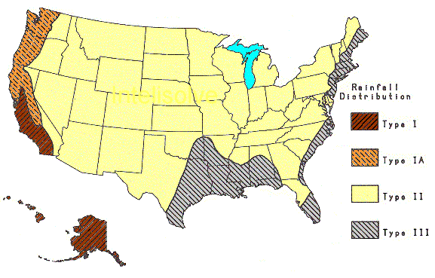
SCS Method
SCS (1973) adopted method similar to DDF to develop dimensionless rainfall temporal patterns called type curves for four different regions in the US.
SCS type curves are in the form of percentage mass (cumulative) curves based on 24-hr rainfall of the desired frequency.
If a single precipitation depth of desired frequency is known, the SCS type curve is rescaled (multiplied by the known number) to get the time distribution.
For durations less than 24 hr, the steepest part of the type curve for required duraction is used

Slide 41
Example: Alternating Block Method
Find: Design precipitation hyetograph for a 2-hour storm (in 10 minute increments) in Denver with a 10-year return period 10-minute

Slide 42
Responding to drought (and megadrought!) in Texas
Robert E. Mace, Ph.D., P.G.
Texas Water Development Board
March 27, 2012

Slide 43
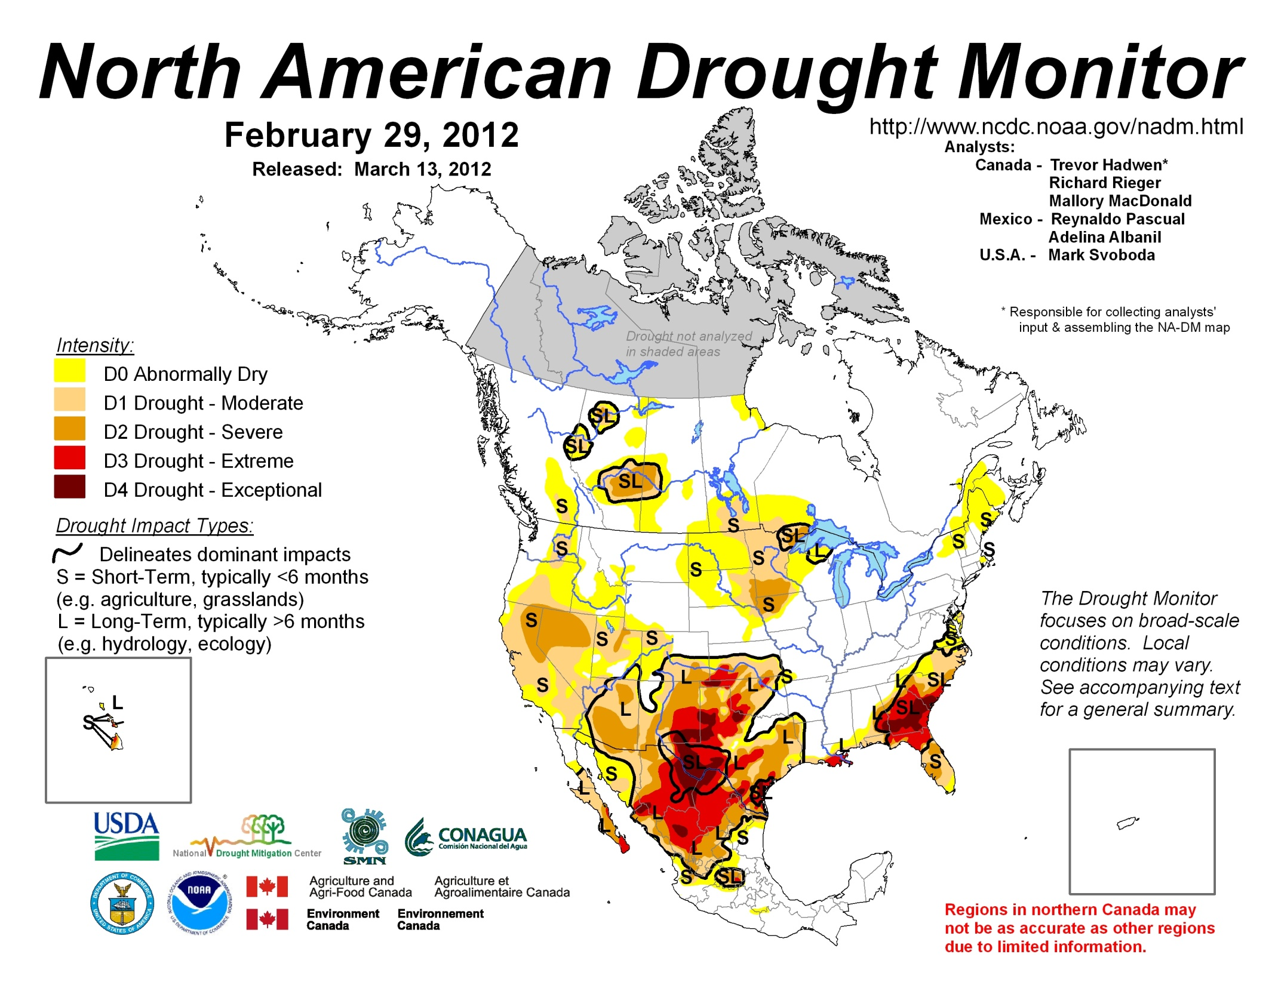

Slide 44
How drought impacts water
Less rainfall
  Less runoff
    Less flow in rivers
      Less water in reservoirs
  Less recharge
    Less water in aquifers
      Less flow in rivers
        Less water in reservoirs

Slide 45
How drought impacts water
Less rainfall
  More water use
    Less water in rivers
      Less water in reservoirs
    Less water in reservoirs
    Less water in aquifer
      Less flow in rivers
        Less water in reservoirs

Slide 46
How drought impacts water
More evaporation
  Less runoff
    Less flow in rivers
      Less water in reservoirs
  Less recharge
    Less water in aquifers
      Less flow in rivers
        Less water in reservoirs
Bottom line: reservoirs get hit hard…

Slide 47
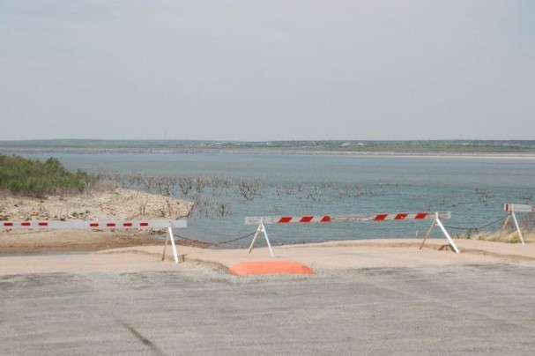
O.H. Ivie Reservoir
  Owned and operated by the Colorado River Municipal Water District
  Purpose: Water Supply
  Supplies: Odessa, Big Spring, Snyder, Midland, Abilene, San Angelo, Ballinger and Millersview-Doole
  Storage Capacity: 554,339 acre-feet
  Current Storage: 98,400 acre-feet
  2011 Change in Storage: -81,820 acre-feet
M. Bewley

Slide 48
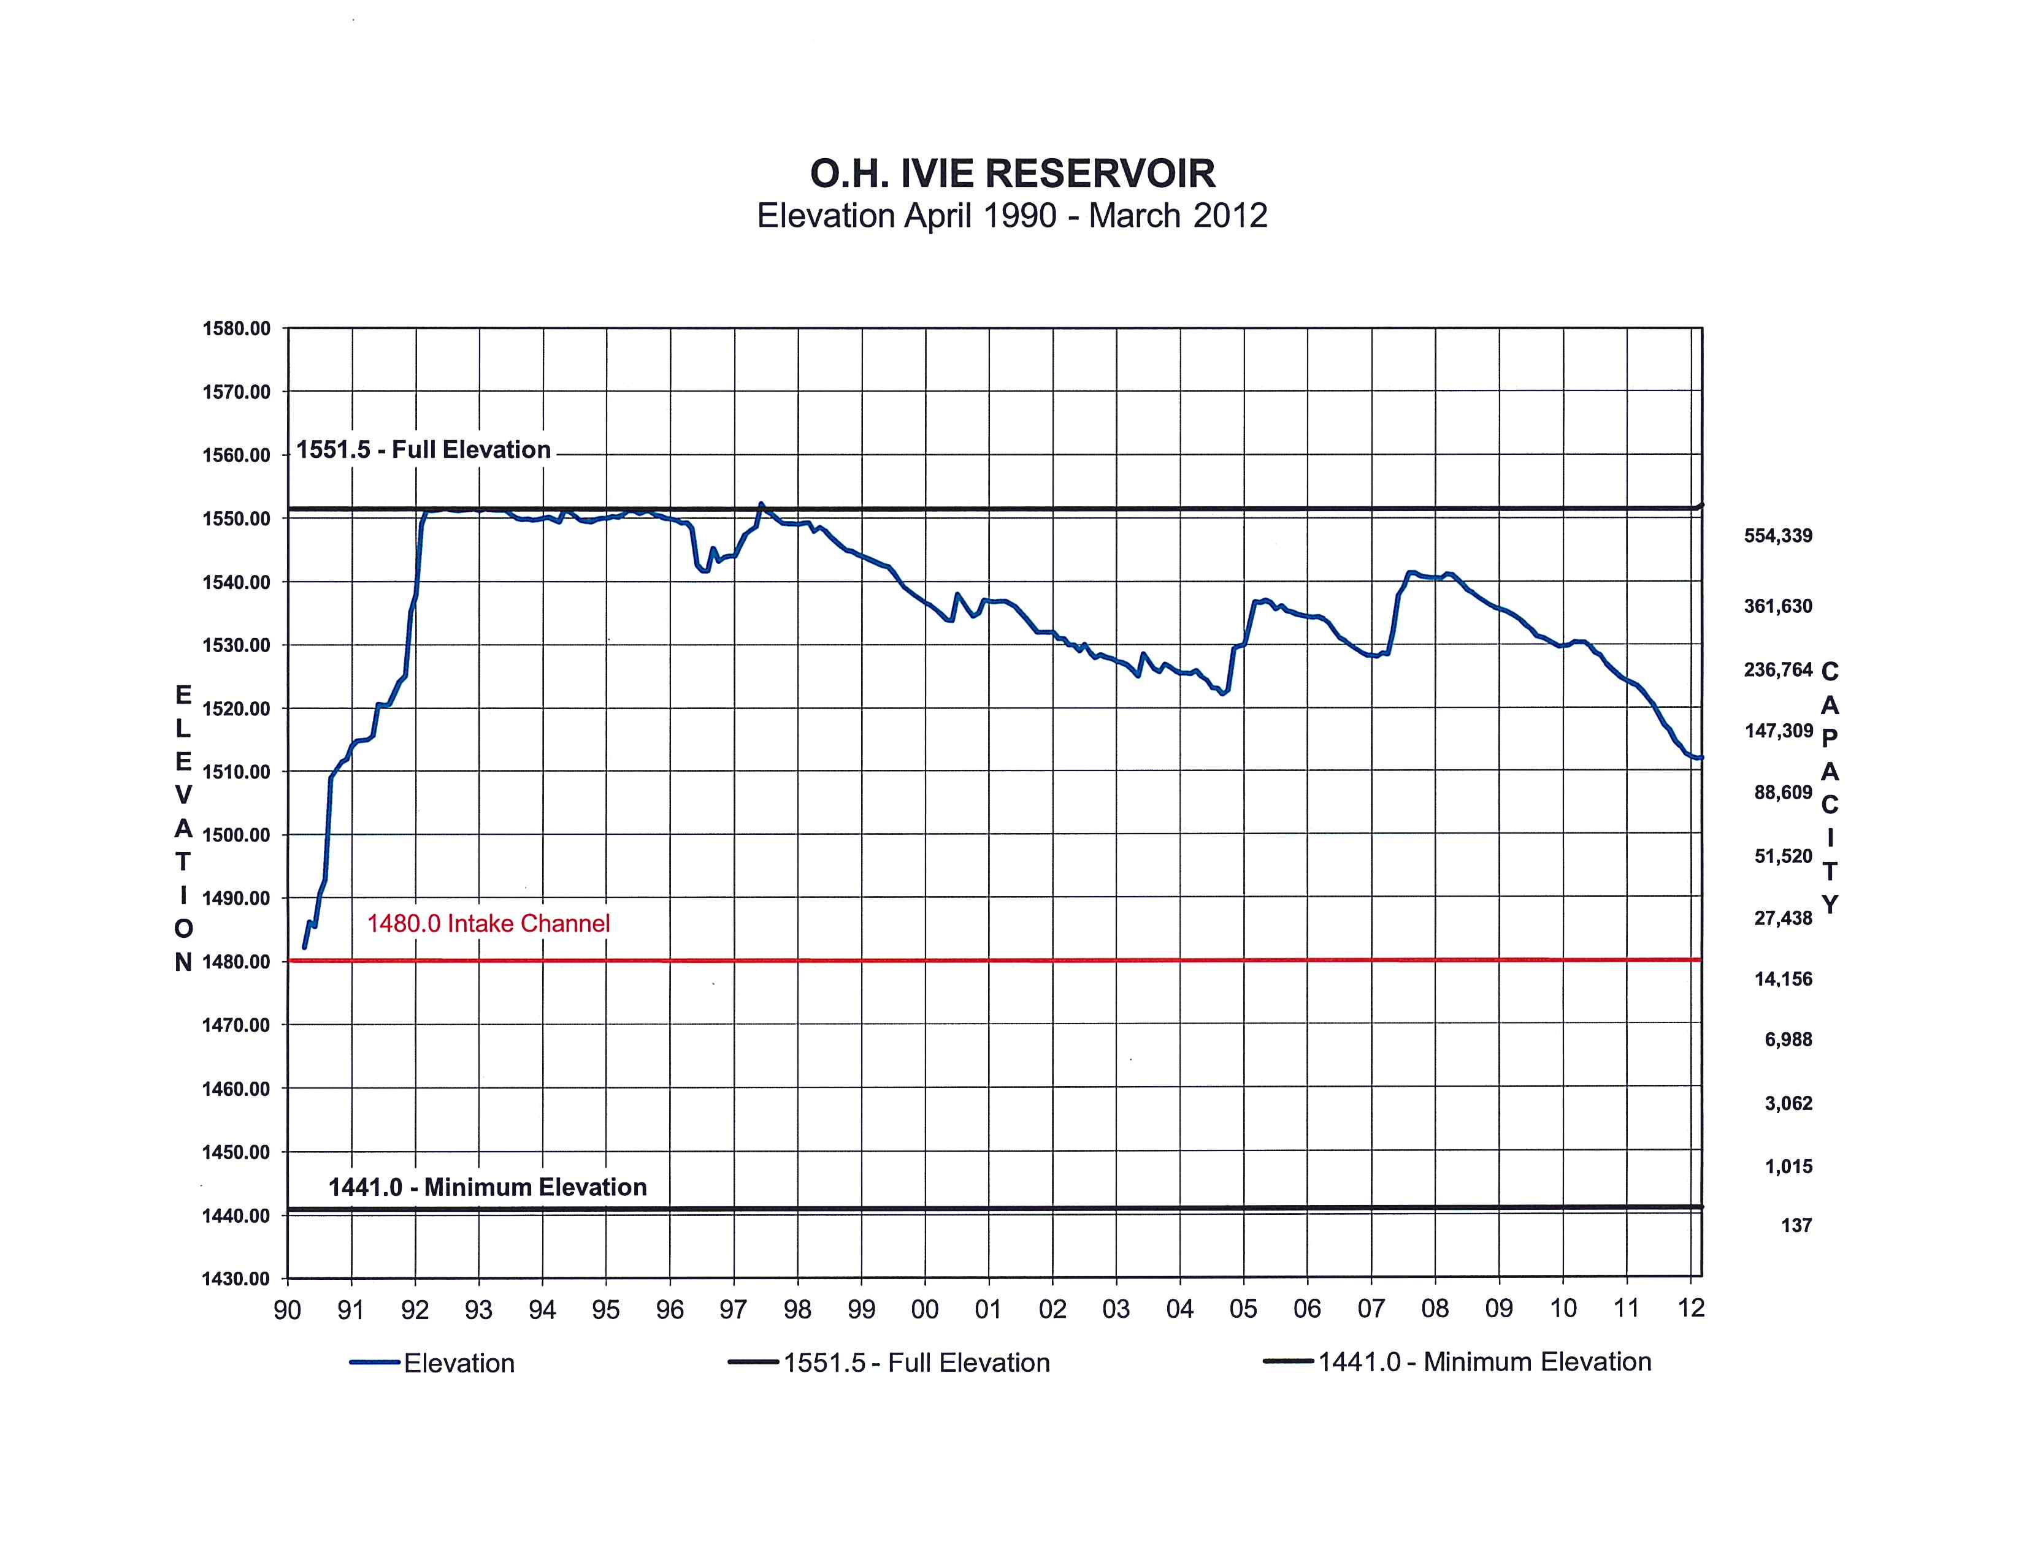

Slide 49
HEC-HMS and HEC-RAS Modeling at the City of Austin
Karl McArthur, PE, CFM
City of Austin
Watershed Protection Department
www.austintexas.gov/department/watershed-protection

Slide 50
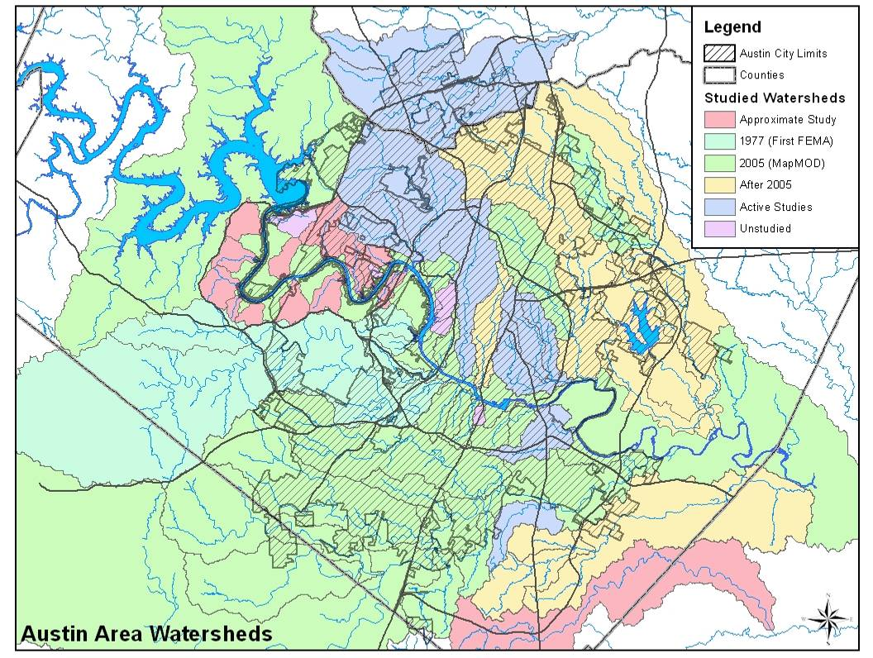
Notes:
Varying Complexity of Watershed Modeling
Simple (relatively) – Dry Creek East
Complex – Carson Creek
Unsteady – Colorado River
Two-Dimensional – Shoal Creek
Beyond HEC-RAS
Waller Creek Tunnel
2D – XPSWMM and InforWorks RS
SWAT
Complication of Model Versions
HEC-RAS 2.2 through 4.1
HEC-HMS 2.1.2 through 3.5

Slide 51
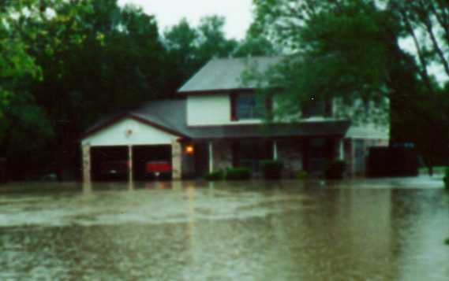
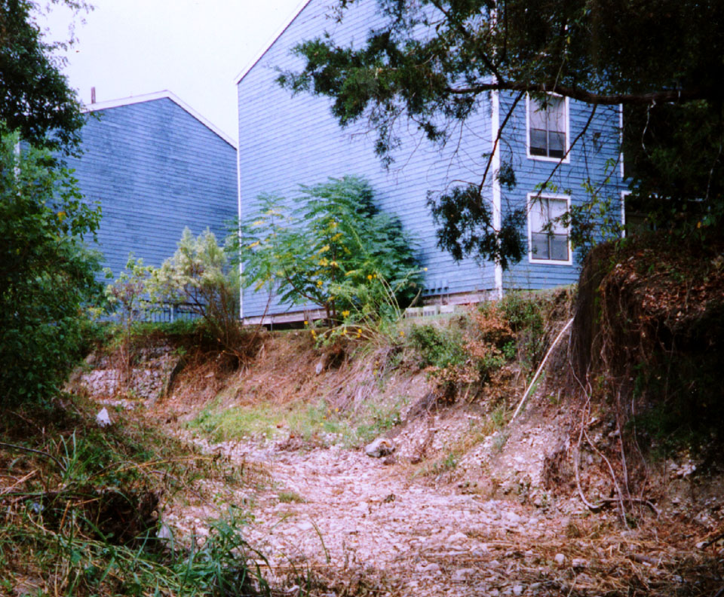
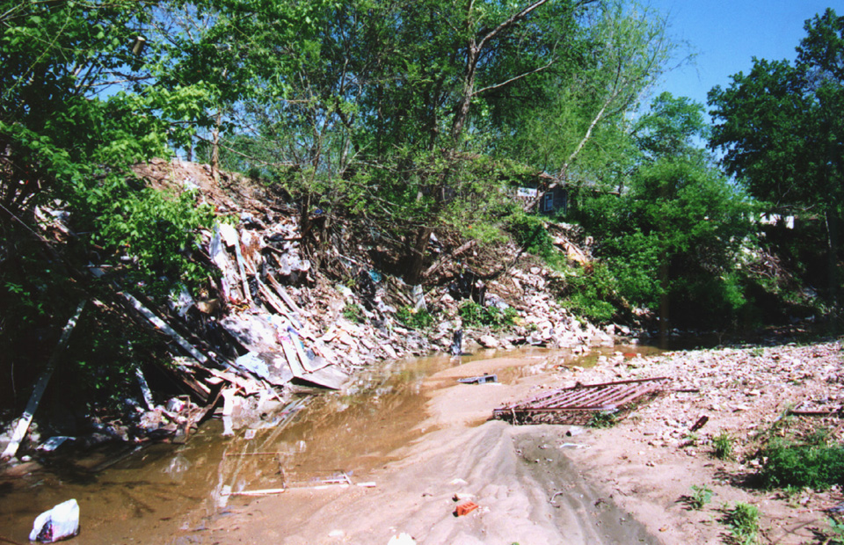
Lives, Property and the Environment
Flooding
Erosion
WQ Degradation
Public
Safety
Property
Protection
Environmental
Protection
Master Plan Process
P u b l i c I n v o l v e m e n t
Assessment
Solution
Development
Implementation

Slide 52










Flood Risk Products and Datasets
Three Flood Risk Products
  Flood Risk Database
  Flood Risk Report
  Flood Risk Map
Four Flood Risk Datasets
  Flood Depth & Analysis Grids
  Flood Risk Assessments
  Changes Since Last FIRM
  Areas of Mitigation Interest
Flood Risk
Database
Flood Risk Report
Flood Risk Map
Flood Risk Datasets
Notes:
The 3 Flood Risk Products are 3 different ways to deliver the 4 Flood Risk Datasets. All the datasets are present in the database and elements of the datasets are shown on the map and described in the report.
52

Slide 53
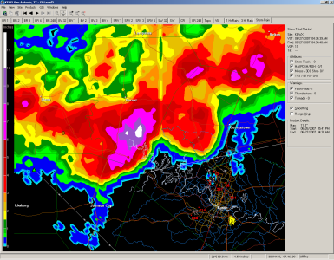
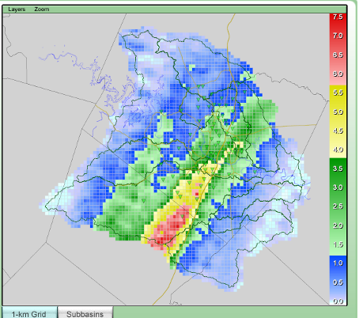
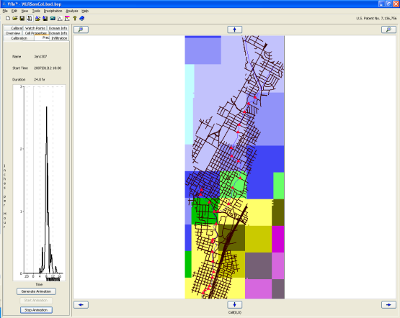
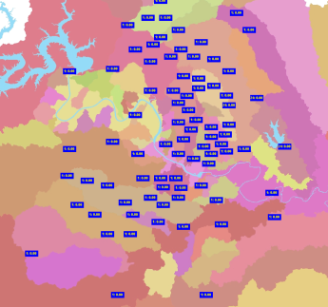

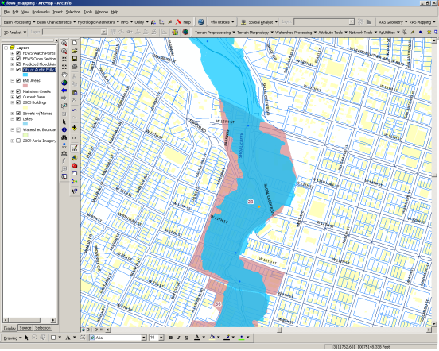
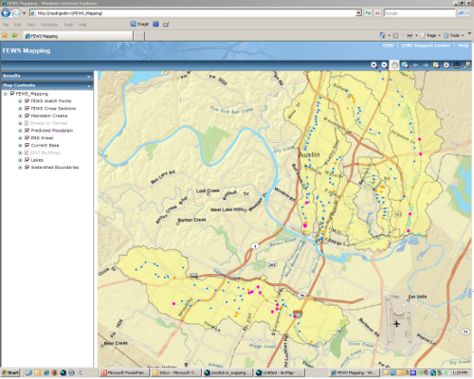
FEWS Automated Mapping Process
NEXRAD Radar
And Gauge Data
Ground-Truthed
Distributed Rainfall
Predictive H&H Model
Model Output
XML
GIS Processing
Internal Website
Notes:
53

Slide 54
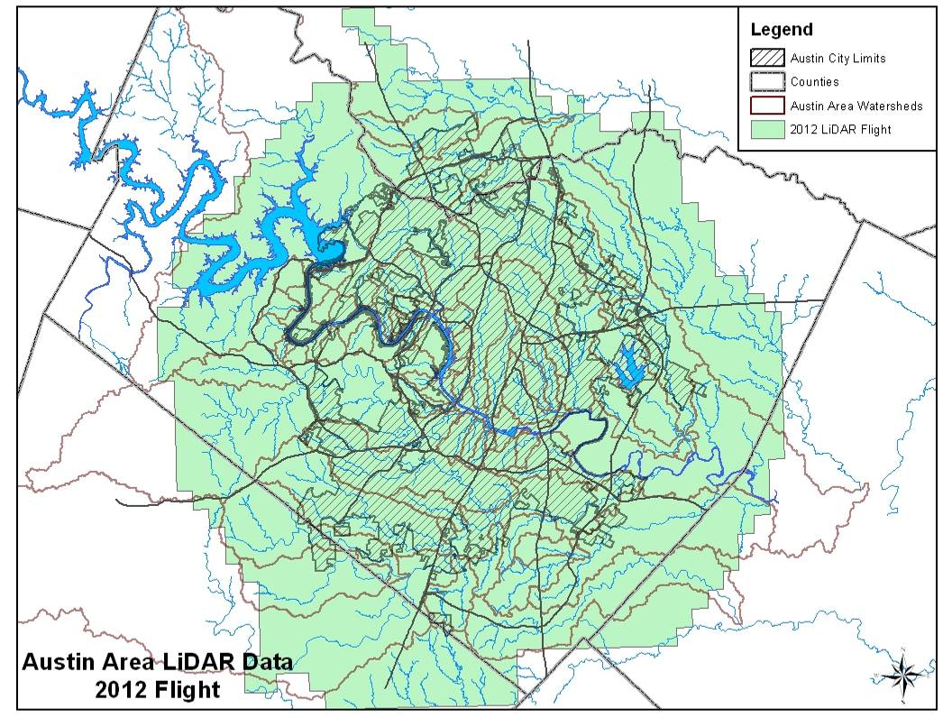
Notes:
New LiDAR should be available in September, 2012.

Slide 55
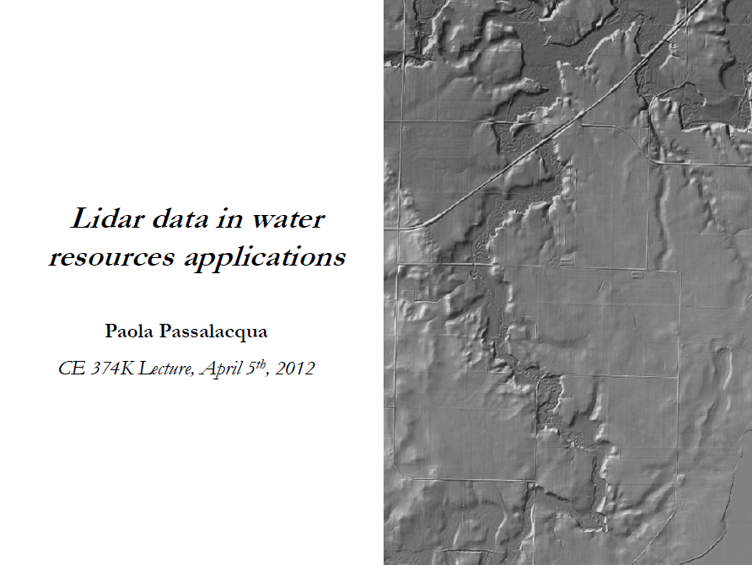

Slide 56
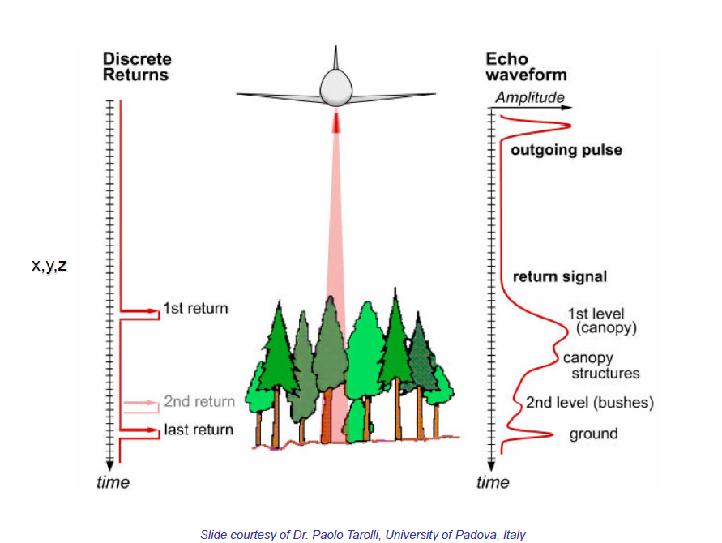
Lidar Terrain Measurement

Slide 57
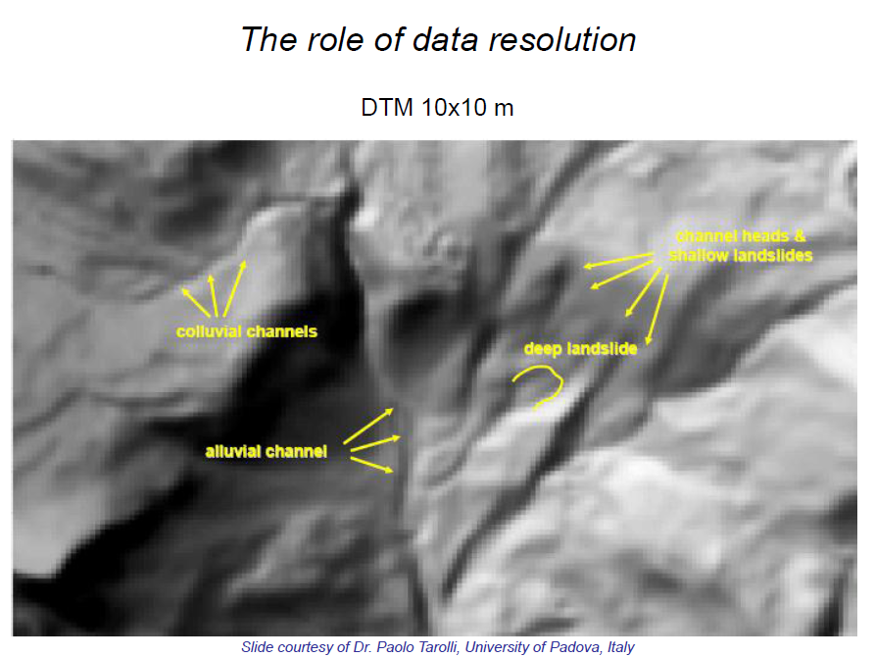

Slide 58
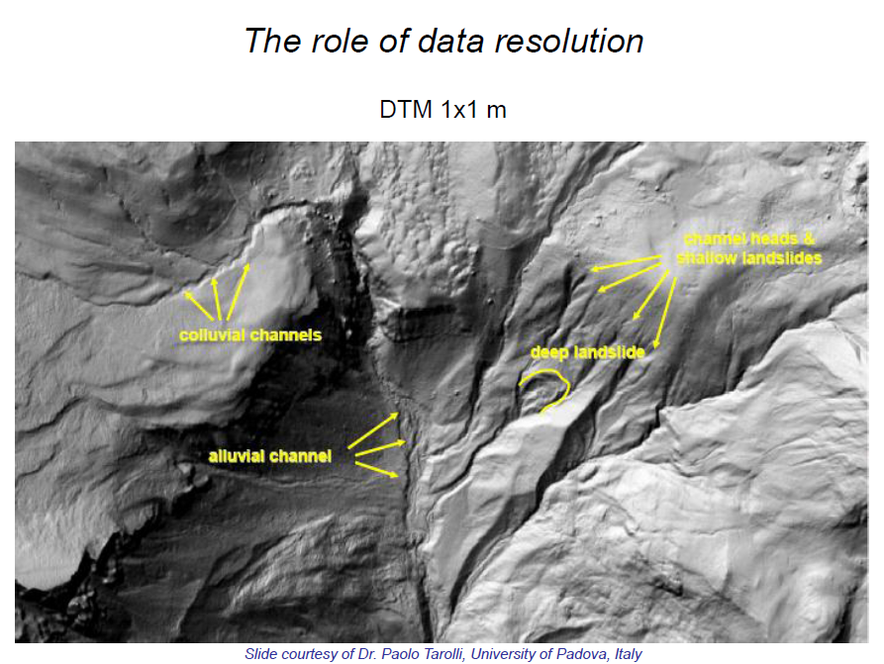

Slide 59
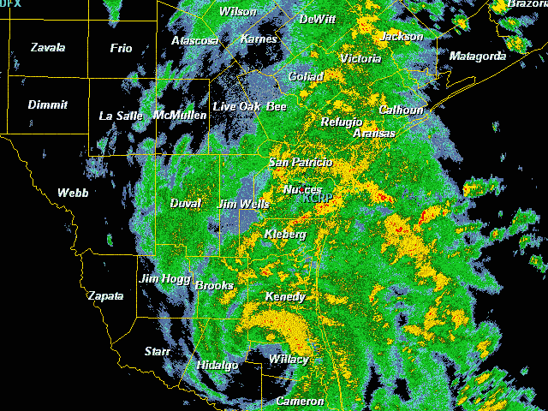
Tropical Storm Hermine in Texas
Sept 7-8, 2010

Slide 60
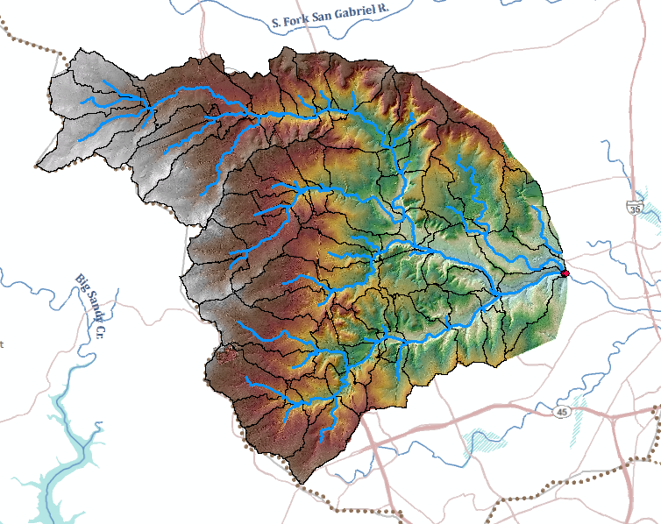
GIS Hydrology Analysis (HEC-GeoHMS) using 10ft cells derived from LIDAR

Slide 61
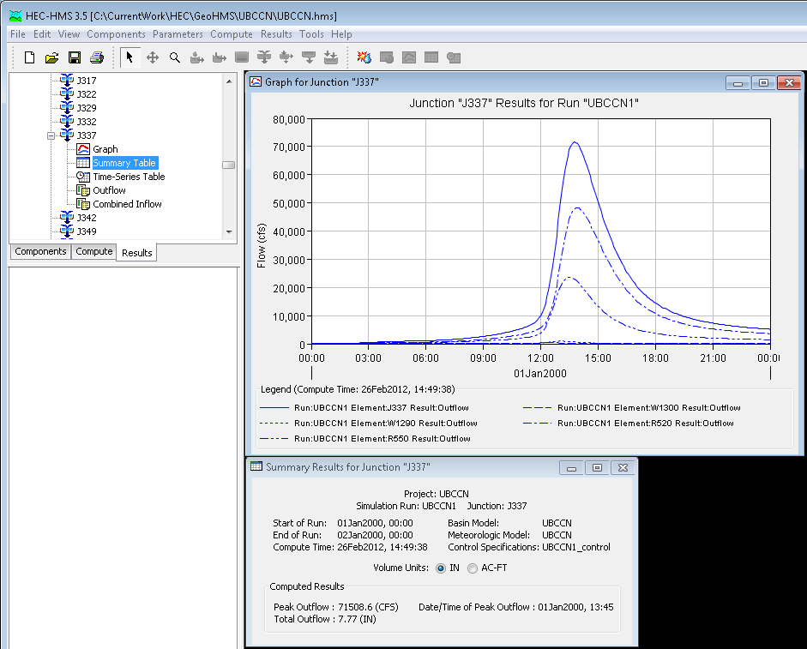
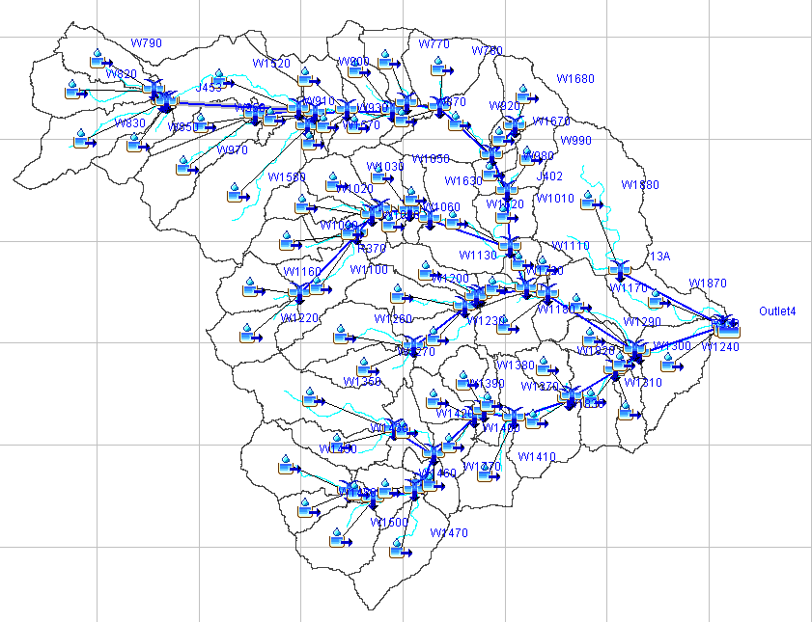
HEC-HMS Flood Discharge Model

Slide 62
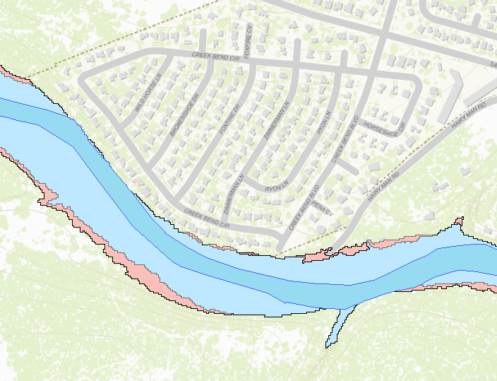
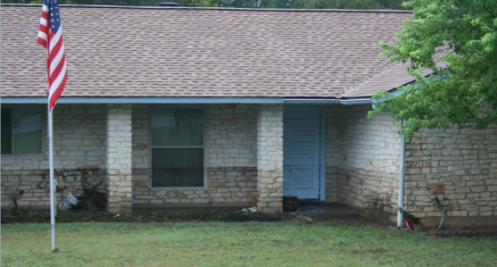
Engineering Hydraulics
Personal – a flooded home

Slide 63
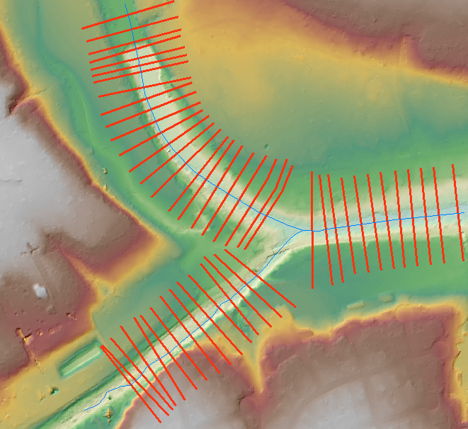
Flood Elevation Model (HEC-GeoRAS)
using 1ft cells derived from LIDAR
Cross-Sections for HEC-RAS model

Slide 64
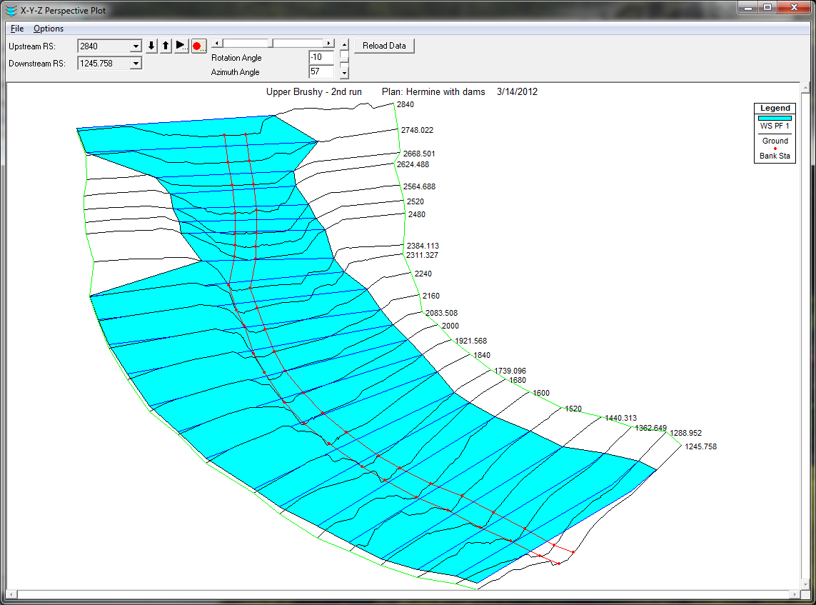


HEC-RAS Flood Water Surface Elevation Model

Slide 65

Flood Inundation Map

Slide 66

Flood Impact on Houses

Slide 67
National Flood Insurance Program
Started in 1968 and administered by FEMA
Based on agreement between federal and local government
Federal government provides flood insurance
Local government regulates land use to minimize flood risk
Federal Government
(Flood insurance, flood mapping)
Local Government (Cities, Counties)
Floodplain regulation

Slide 68

Flood Insurance Rate Map (FIRM)
Flood Hazard Zone
≥ 1% chance of flooding in any year

Slide 69

Digital Flood Insurance Rate Map (DFIRM)
Old, paper FIRM
New, digital (D)FIRM
The ideal DFIRM: more accurate than paper FIRM, more flexible to use and update, more versatile for community use

Slide 70

(x,y)
(z)

Slide 71

Conclusions from 2007 Study
Basemap imagery is fine for floodplain mapping
Existing elevation data have about 1/10 accuracy needed for floodplain mapping and are too old
A new elevation coverage of the nation is needed
Most likely technology to produce this is Lidar
Cost for national coverage ~ $500-600 million
We need “Elevation for the Nation”

