Slide 1
Review for Final Exam
Reading: Applied Hydrology Sections 9.3-9.7, 15.3, 15.6

Slide 2
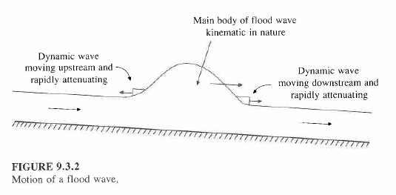
Kinematic and Dynamic Waves

Slide 3
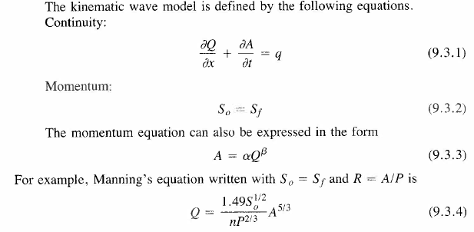

Kinematic Wave Equations
Combine (9.3.1) and (9.3.4) and after some working you get:

Slide 4

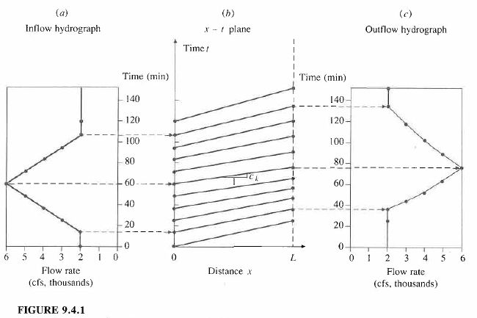
Analytical Solution of the Kinematic Wave

Slide 5
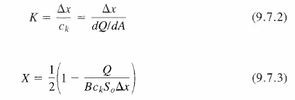
Muskingum-Cunge Method
http://www.whycos.org/cms/

Slide 6
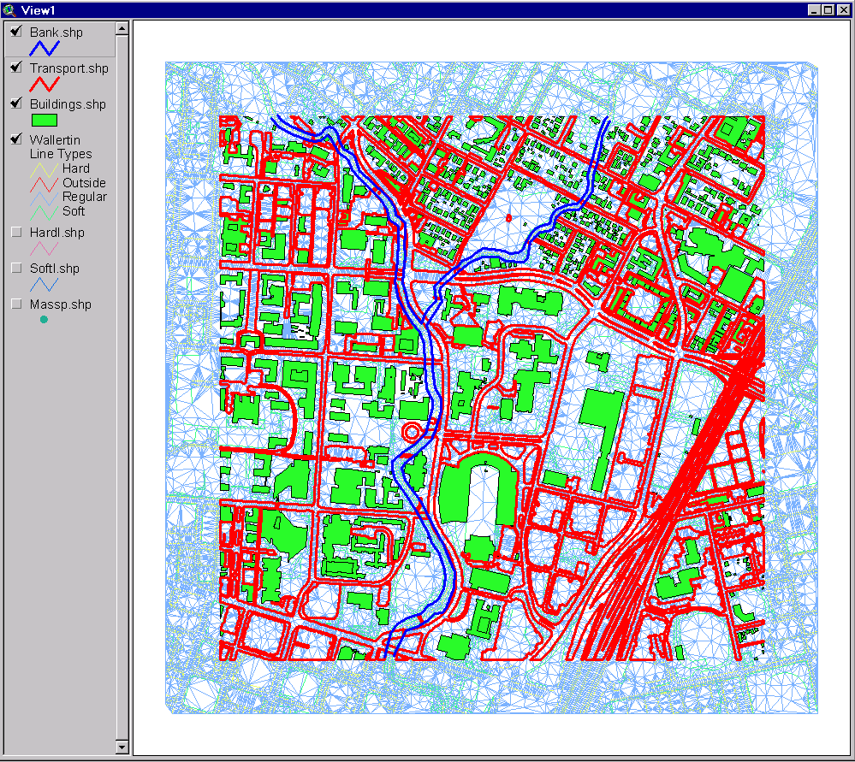
TIN with Surface Features
Classroom
UT Football
Stadium
Waller Creek

Slide 7
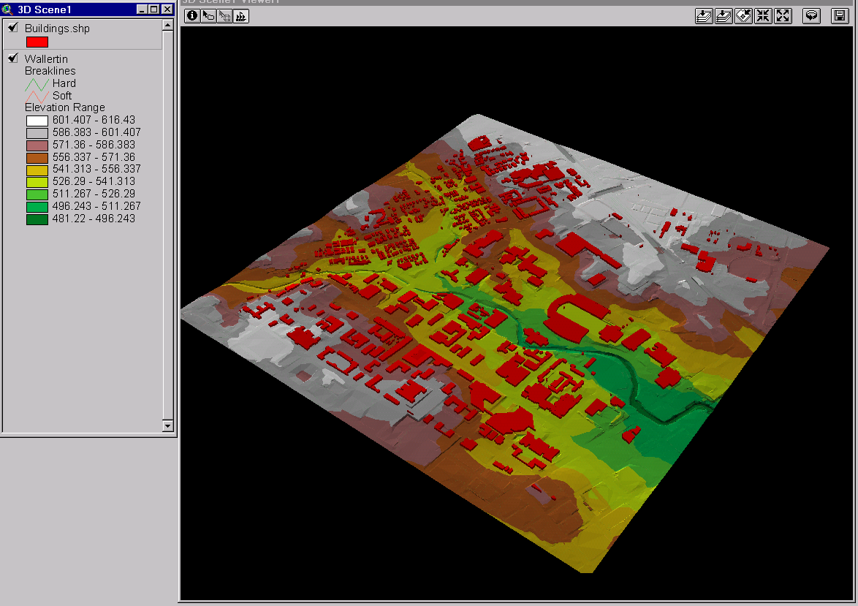
3-D Scene with Buildings

Slide 8
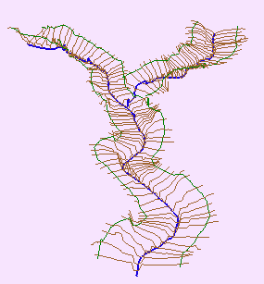
Channel and Cross-Section
Direction of Flow
Channel
Cross-Section

Slide 9
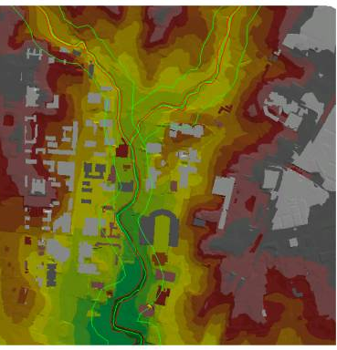
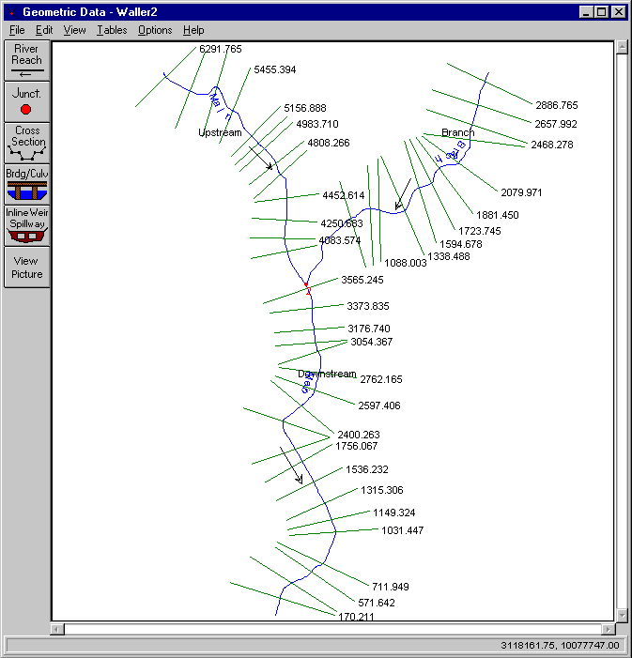
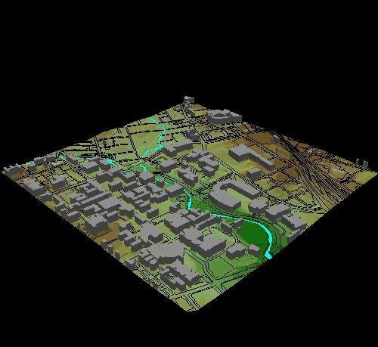
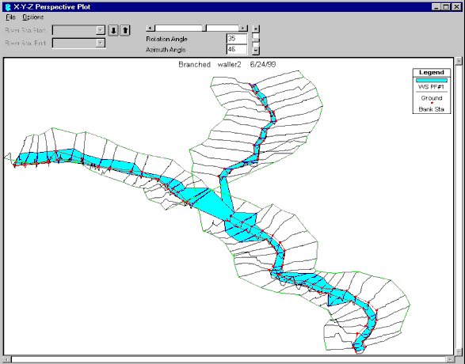
Hydraulic Modeling with HecGeo-RAS
GIS data
HEC-RAS Geometry
HEC-RAS Flood Profiles
Flood display in GIS

Slide 10
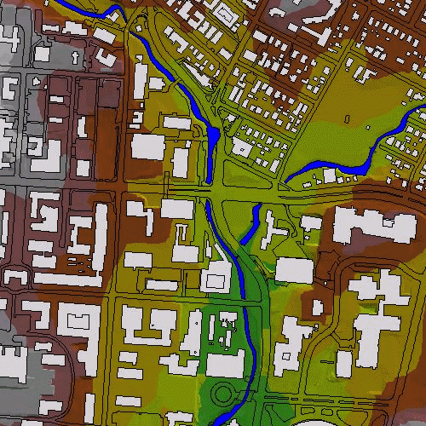
Floodplain Mapping
2-D floodplain
animation
(500 – 5,000 cfs).
Notes:
Or you can make animated gifs like this one showing the effect when the flow varies from 500-5000 cfs.

Slide 11
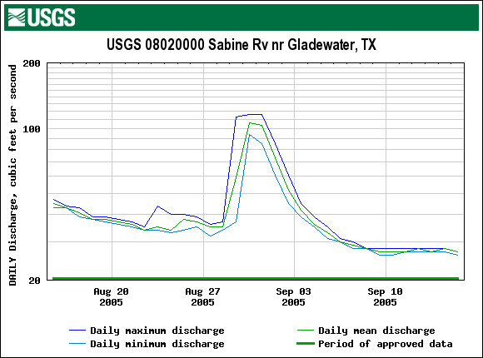
the natural flow regime
Rate of Change
Magnitude
Duration
Timing
Not depicted: frequency

Slide 12

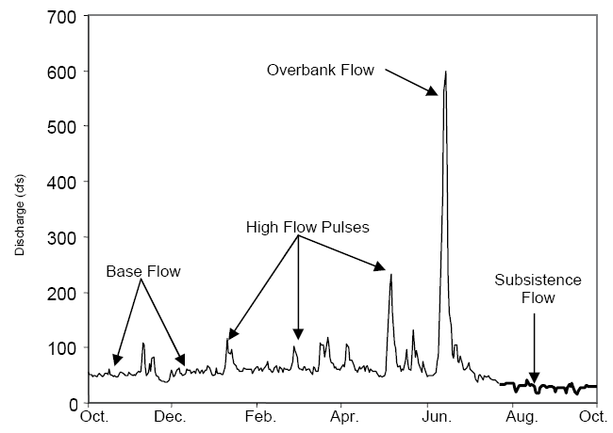
flow components
(NRC 2005)

Slide 13
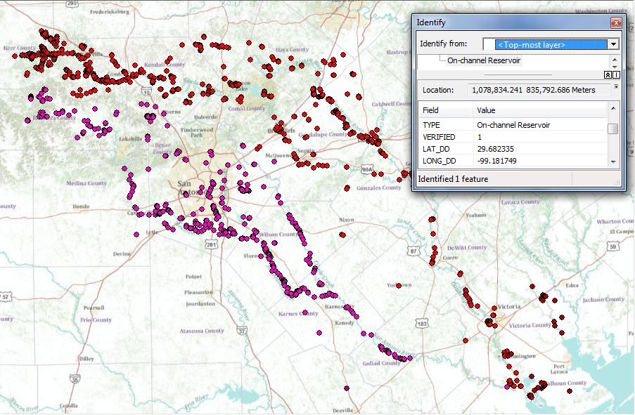
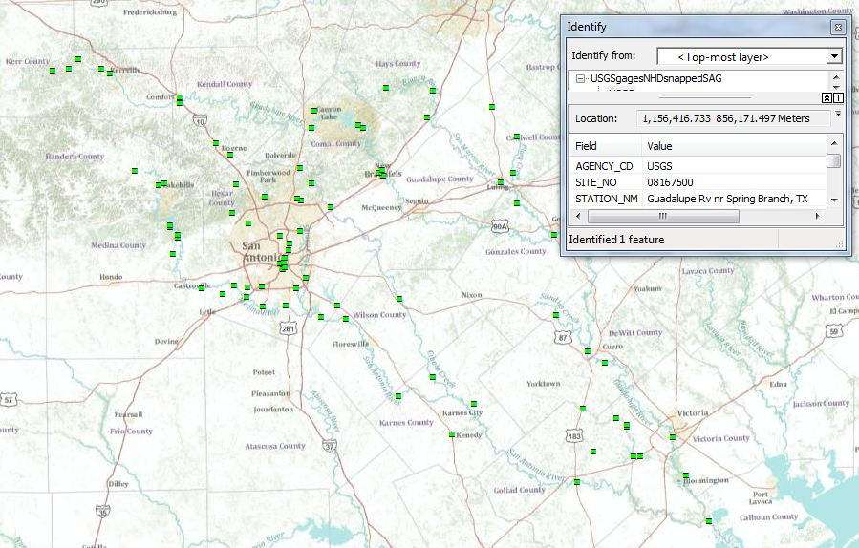
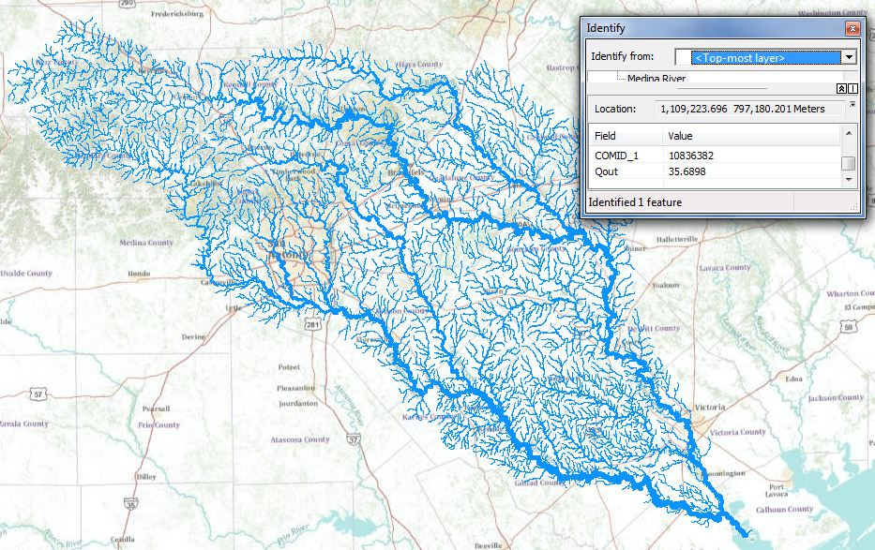
Data Sources
TCEQ Water Rights Points
USGS Gages
NHDPlus

Slide 14
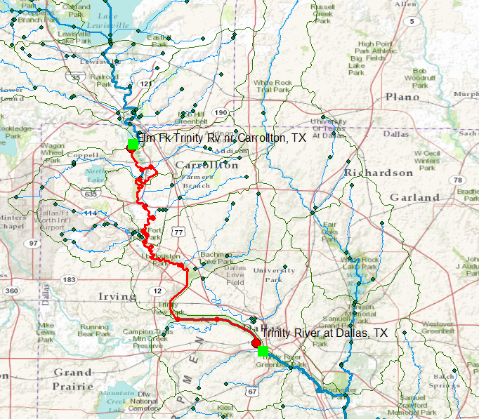
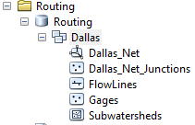
River Reach between Gages

Slide 15
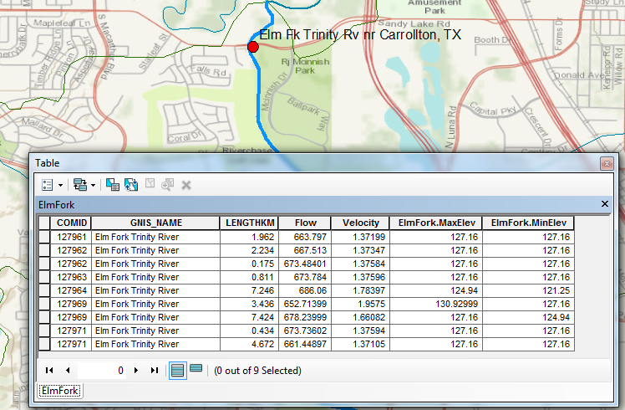
Elm Fork Attributes
Length = 28.39 km Mean Flow = 670 cfs Mean Velocity = 1.52 ft/sec
Max Elev = 130.93 m Min Elev = 121.25m Slope = 0.34m/km or 0.034%

Slide 16
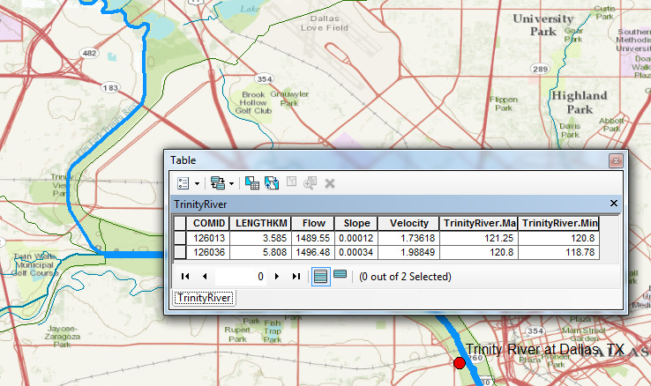
Trinity River Attributes
Length = 9.39 km Mean Flow = 1493 cfs Mean Velocity = 1.86 ft/sec
Max Elev = 121.25 m Min Elev = 118.78m Slope = 0.26m/km or 0.026%

Slide 17
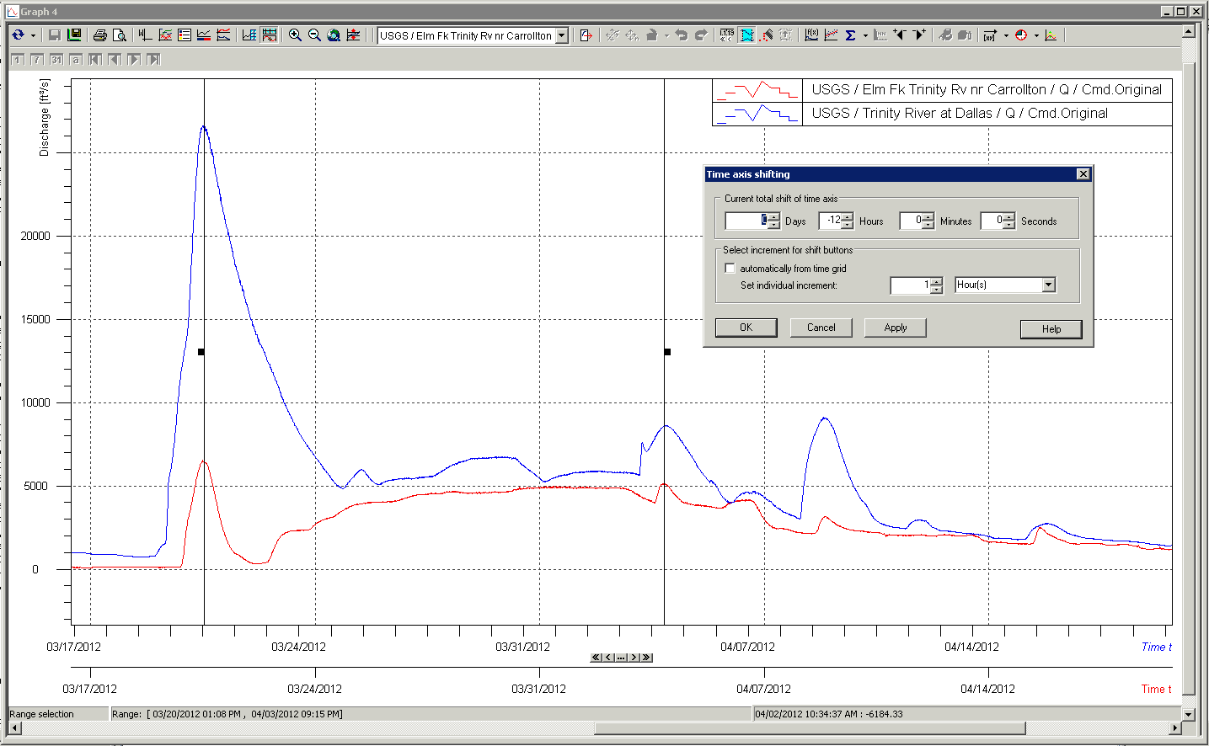
Finding Pulse Lag Times in WiSKI
12 Hours
Image courtesy of Matt Ables, Kisters

Slide 18
Wave Celerity vs. Flow Velocity
Wave celerity = 5/3 * flow velocity
 | Length (km) | Flow Velocity (ft/s) | Wave Celerity (ft/s) | Travel Time (hours)
Elm Fork | 28.39 | 1.52 | 2.53 | 10.23
Trinity | 9.39 | 1.86 | 3.10 | 2.76
 |  |  | TOTAL | 12.99

Slide 19
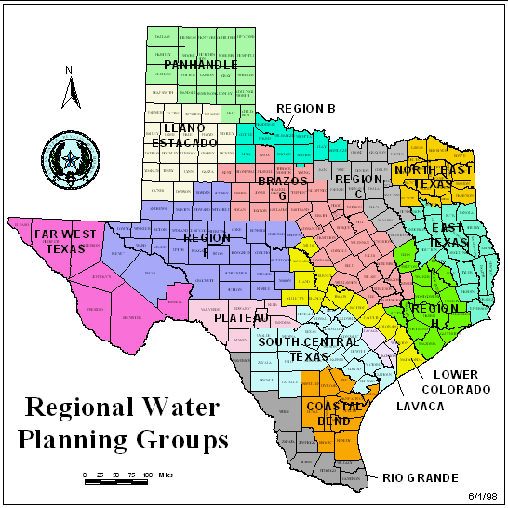
Senate Bill 1 (1997)
Water Modeling and Planning
Before Senate Bill 1, water planning was done state-wide by TWDB
SB1 established 14 water planning regional groups, who are now responsible for planning water supply in their area
Water Availability Modeling
(TNRCC)

Slide 21
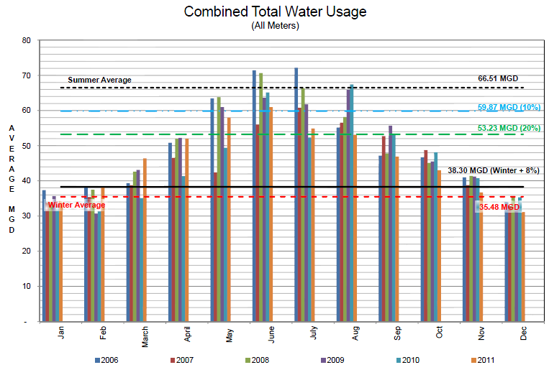

Slide 22
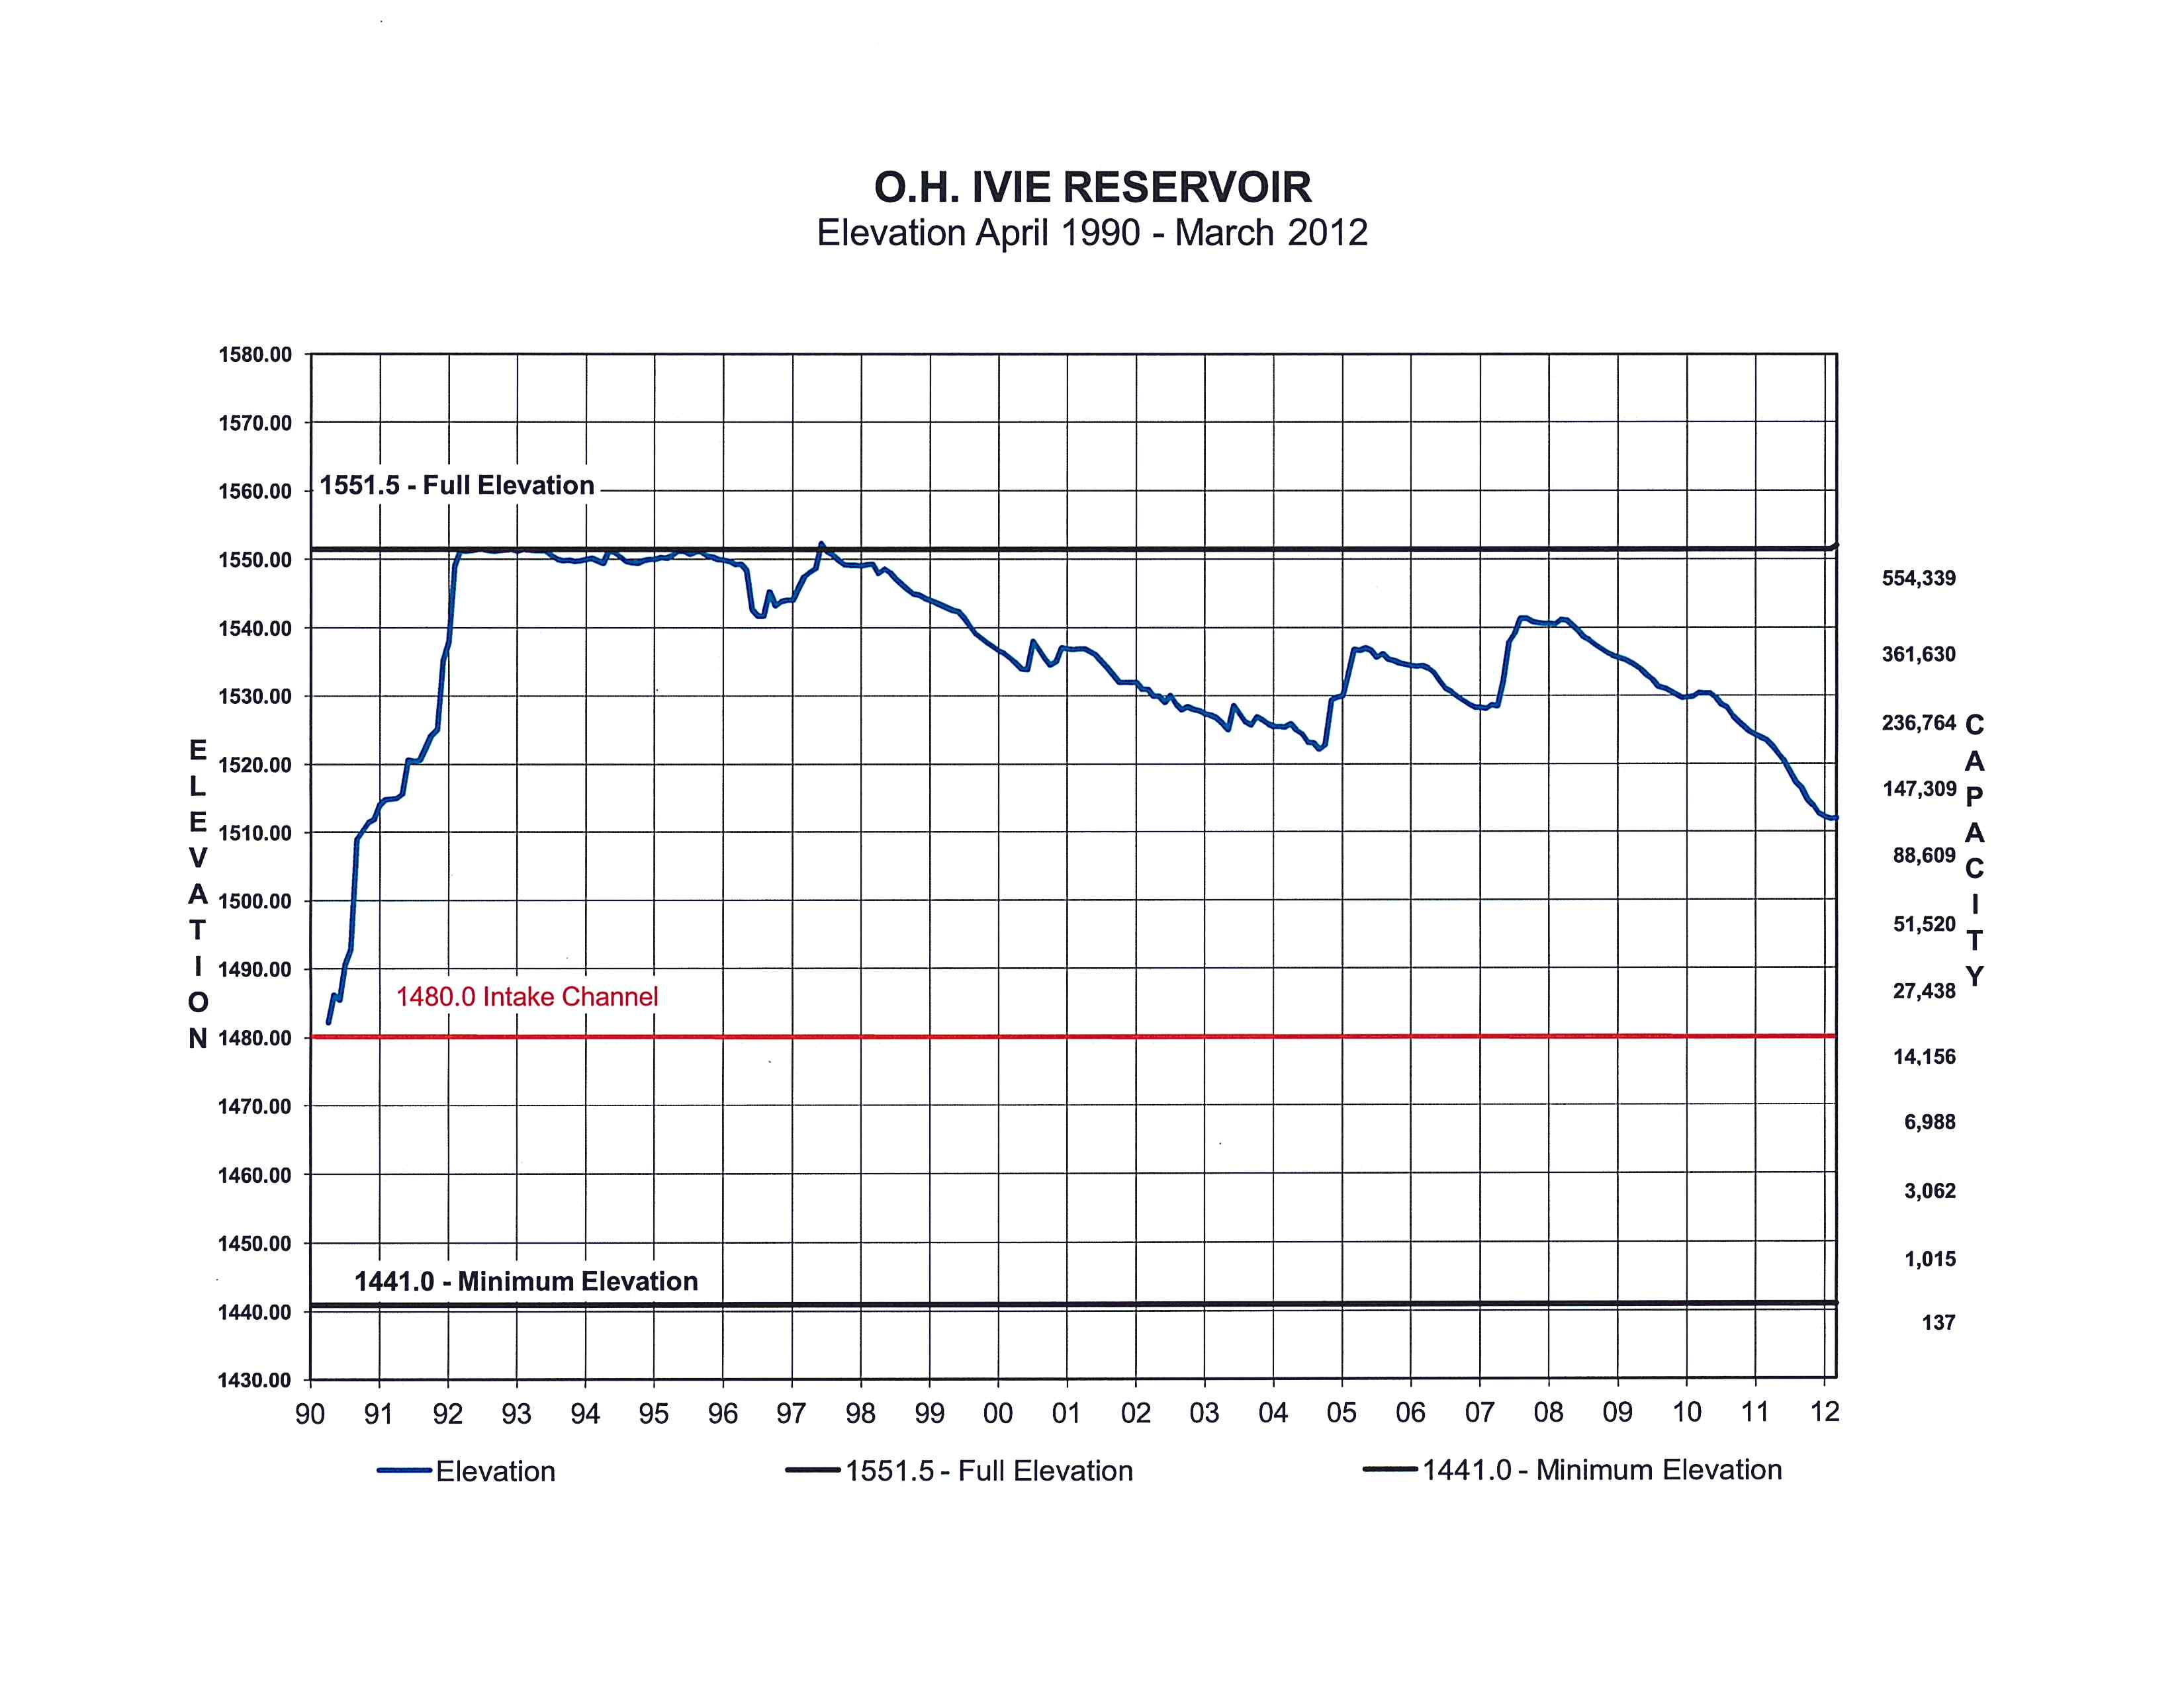

Slide 23
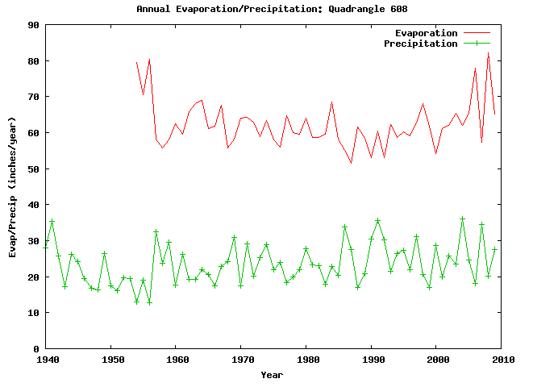
Mean = 64.4 inches = 5.36 ft
Lake surface area at 1 May 2012 ~ 3400 acres,
so evap loss = 3400 * 5.36 = 18,200 acre-ft/year = 25 cfs = 16 MGD
This is equal to the winter water demand of Odessa, Texas, pop. 270,000

Slide 24
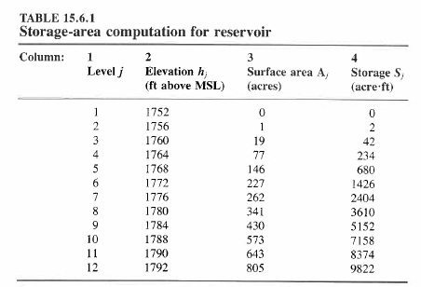

Slide 25
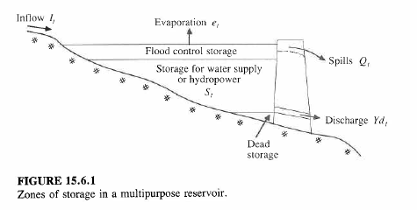
Reservoir Storage Analysis

Slide 26
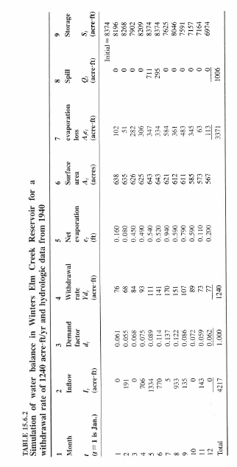
Reservoir Water Balance for Winters Elm Creek, Texas

