Slide 1
Runoff Processes
Reading: Applied Hydrology Sections 5.6 to 5.8 and Chapter 6 for Thursday

Slide 2
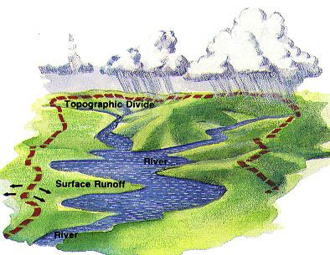
Surface water
Watershed – area of land draining into a stream at a given location
Streamflow – gravity movement of water in channels
  Surface and subsurface flow
  Affected by climate, land cover, soil type, etc.

Slide 3
Streamflow generation
Streamflow is generated by three mechanisms
  Hortonian overland flow
  Subsurface flow
  Saturation overland flow

Slide 4
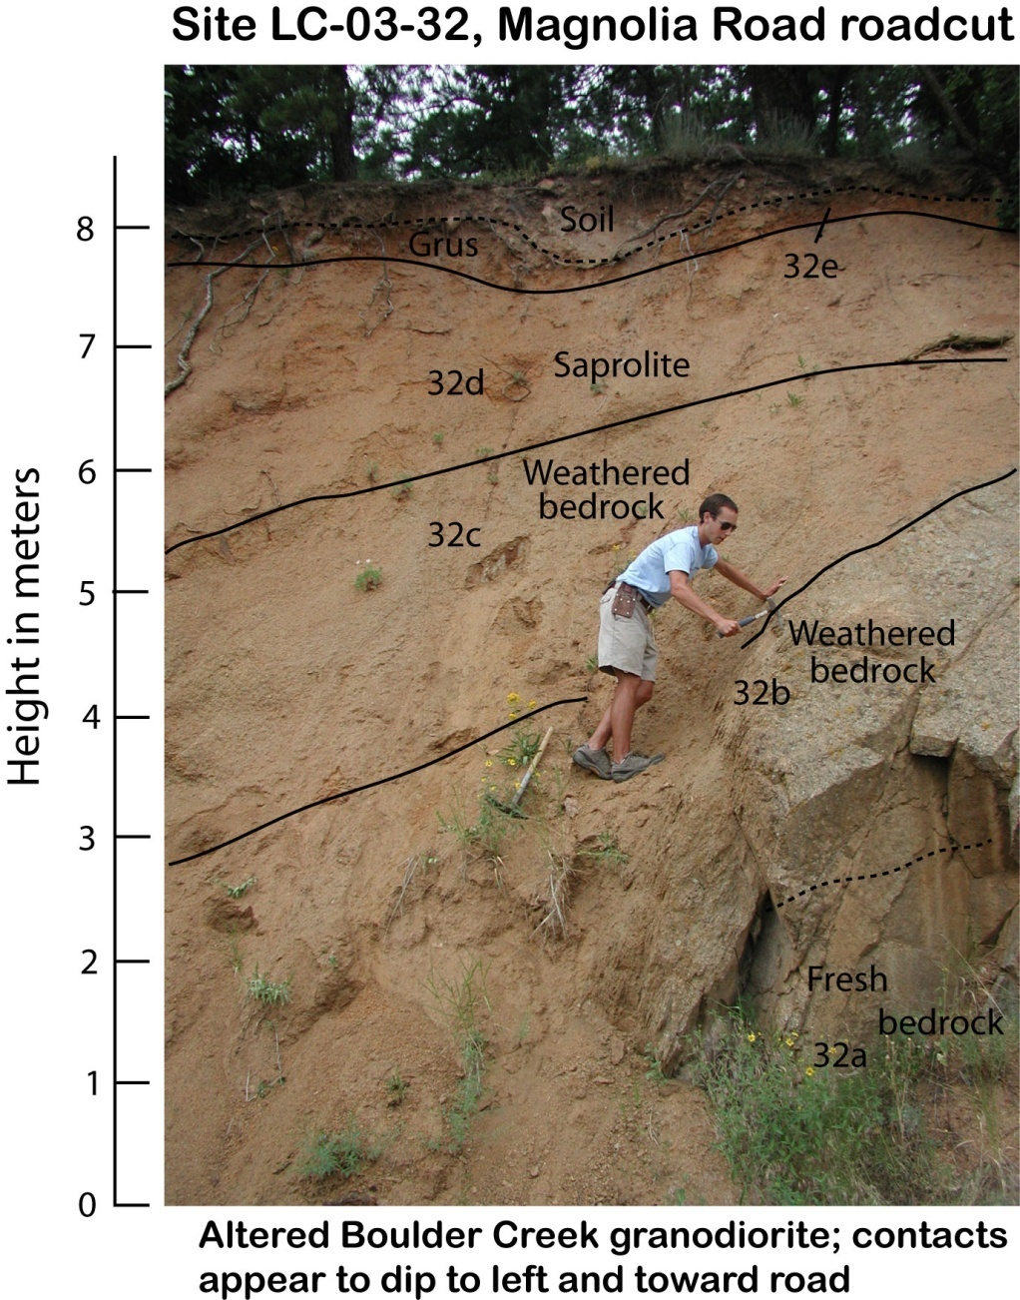
Welcome to the Critical Zone

Slide 5
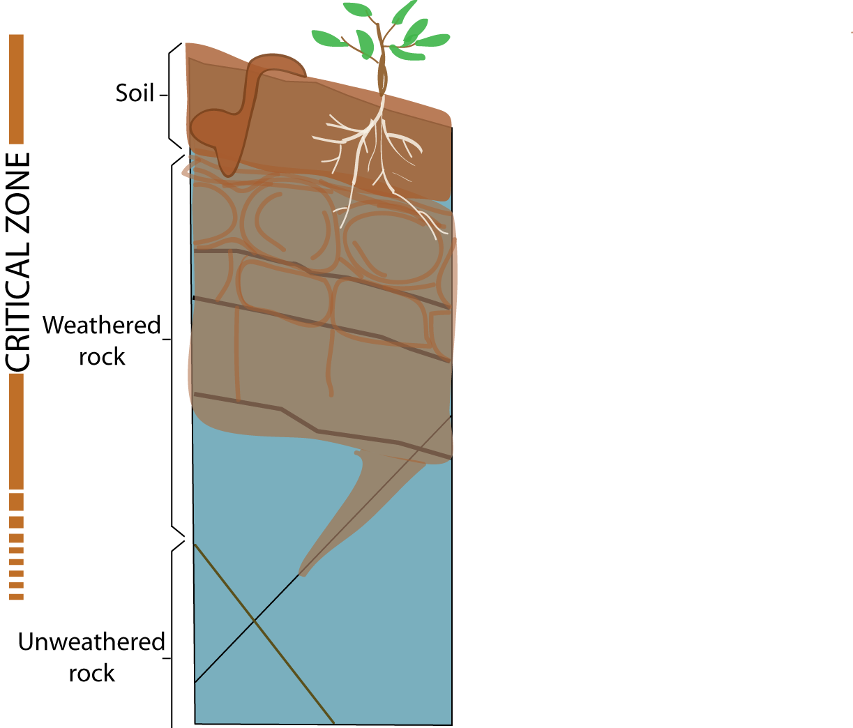
Denudation
Erosion and weathering control the extent of critical zone development
Weathering front advance

Slide 6
Critical zone architecture influences sediment sources, hydrology, water chemistry and ecology
Sediment
Water, solutes and nutrients

Slide 7
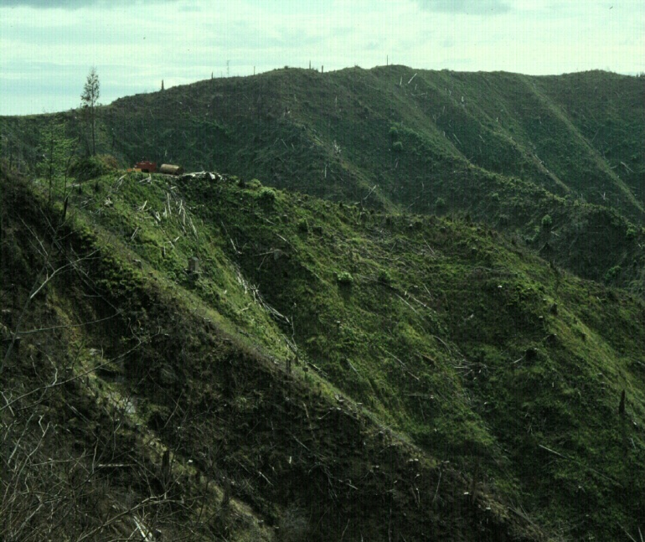
Oregon Coast Range- Coos Bay
Channel head
Anderson et al., 1997, WRR.
Montgomery et al., 1997, WRR
Torres et al., 1998, WRR

Slide 8
Hortonian Flow
Sheet flow described by Horton in 1930s
When i<f, all i is absorbed
When i > f, (i-f) results in rainfall excess
Applicable in
  impervious surfaces (urban areas)
  Steep slopes with thin soil
  hydrophobic or compacted soil with low infiltration
Rainfall, i
i > q
Infiltration, f
Later studies showed that Hortonian flow rarely occurs on vegetated surfaces in humid regions.

Slide 9
Subsurface flow
Lateral movement of water occurring through the soil above the water table
primary mechanism for stream flow generation when f>i
  Matrix/translatory flow
    Lateral flow of old water displaced by precipitation inputs
    Near surface lateral conductivity is greater than overall vertical conductivity
    Porosity and permeability higher near the ground
  Macropore flow
    Movement of water through large conduits in the soil

Slide 10
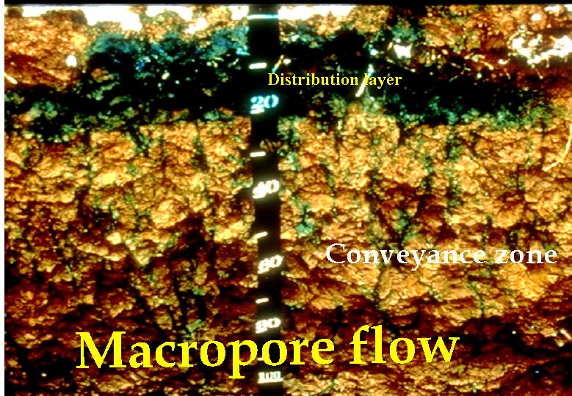
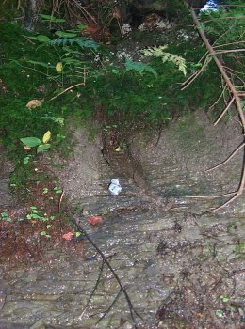
Soil macropores

Slide 11
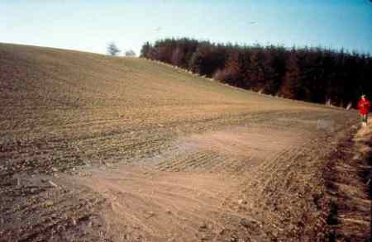
Saturation overland flow
Soil is saturated from below by subsurface flow
Any precipitation occurring over a saturated surface becomes overland flow
Occurs mainly at the bottom of hill slopes and near stream banks

Slide 12
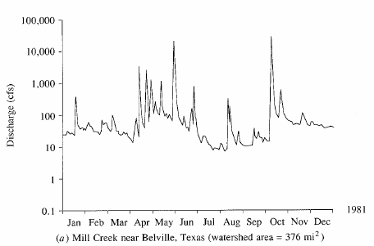
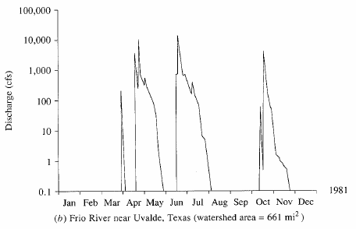
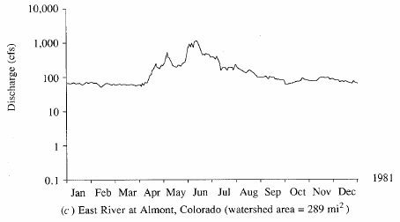
Streamflow hydrograph
Direct runoff
Graph of stream discharge as a function of time at a given location on the stream
Baseflow
Perennial river
Ephemeral river
Snow-fed River

Slide 13
Excess rainfall
Rainfall that is neither retained on the land surface nor infiltrated into the soil
Graph of excess rainfall versus time is called excess rainfall hyetograph
Direct runoff = observed streamflow - baseflow
Excess rainfall = observed rainfall - abstractions
Abstractions/losses – difference between total rainfall hyetograph and excess rainfall hyetograph

Slide 14
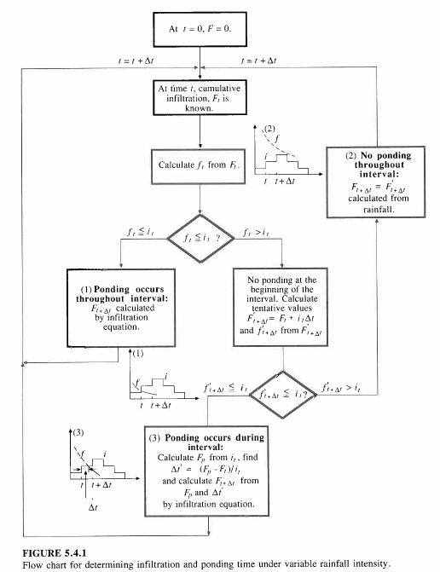


Green-Ampt Method
Apply the Green-Ampt method to rainfall in intervals of time: t, t + Δt, t + 2Δt, …

Slide 15
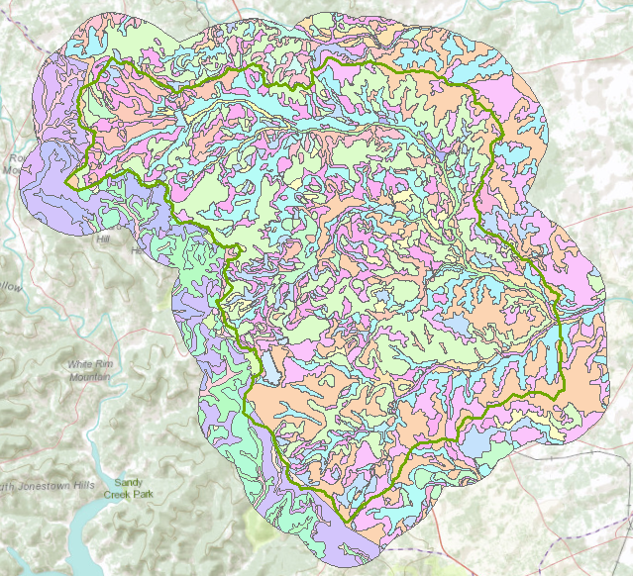
Soils in Brushy Creek Watershed

Slide 16
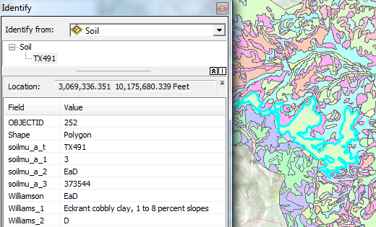
Soil Map Unit
Soil Class
Hydrologic Soil Group

Slide 17
Green-Ampt Parameters for Soil Map Units
GreenAmpt | Texture | ThetaE | Porosity | Suction | Conductivity
1 | Sand | 0.417 | 0.437 | 49.5 | 117.8
2 | Loamy Sand | 0.401 | 0.437 | 61.3 | 29.9
3 | Sandy Loam | 0.412 | 0.453 | 110.1 | 10.9
4 | Loam | 0.434 | 0.463 | 88.9 | 3.4
5 | Silt Loam | 0.486 | 0.501 | 166.8 | 6.5
6 | Sandy Clay Loam | 0.330 | 0.398 | 218.5 | 1.5
7 | Clay Loam | 0.309 | 0.464 | 208.8 | 1.0
8 | Silty Clay Loam | 0.432 | 0.471 | 273.0 | 1.0
9 | Sandy Clay | 0.321 | 0.430 | 239.0 | 0.6
10 | Silty Clay | 0.423 | 0.470 | 292.2 | 0.5
11 | Clay | 0.385 | 0.475 | 316.3 | 0.3
GreenAmpt | Williamson
7 | BkC
7 | BkE
11 | BkG
11 | CfA
11 | CfB
11 | DAM
10 | DnA
10 | DnB
10 | DnC
10 | DoC
11 | EaD
11 | EeB
11 | ErE
11 | ErG
11 | FaA
Lookup Table
mm
mm/hr

Slide 18
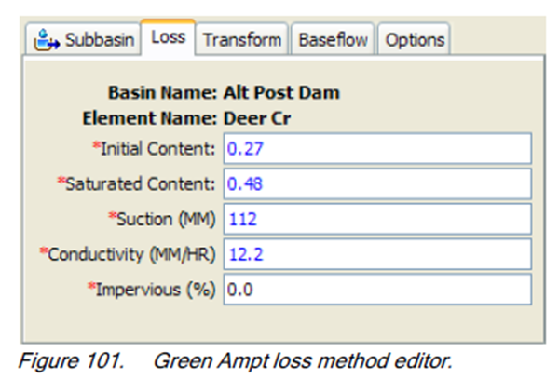
Green-Ampt in HEC-HMS
initial saturation as a volume ratio – θ_{i}
total porosity as a volume ratio – n
wetting front soil suction head – ψ
hydraulic conductivity – K
percent of basin with impervious cover

Slide 19
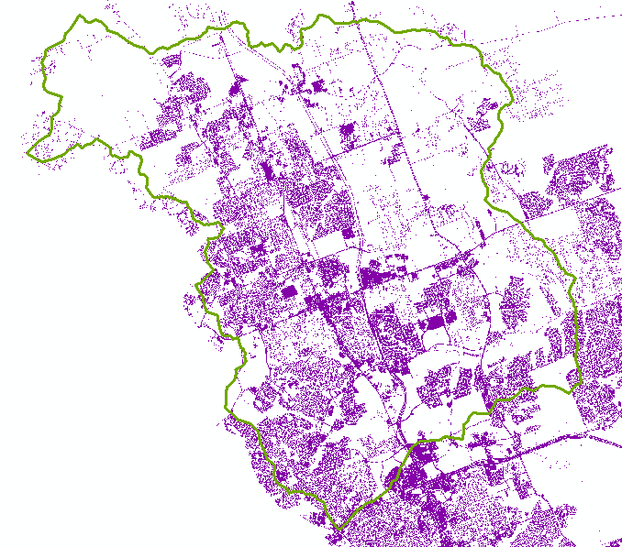
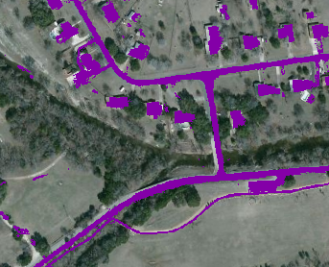
Impervious Cover
1104 Brushy Bend Dr
Walsh Dr
Interpreted from remote sensing

Slide 20
SCS method
Soil conservation service (SCS) method is an experimentally derived method to determine rainfall excess using information about soils, vegetative cover, hydrologic condition and antecedent moisture conditions
The method is based on the simple relationship that P_{e} = P - F_{a} – I_{a}
P_{e} is runoff depth, P is precipitation depth, F_{a} is continuing abstraction, and I_{a} is the sum of initial losses (depression storage, interception, ET)
Precipitation
Time

Slide 21
Abstractions – SCS Method
In general
After runoff begins
Potential runoff
SCS Assumption
Combining SCS assumption with P=P_{e}+I_{a}+F_{a}
Precipitation
Time

Slide 22
SCS Method (Cont.)
Experiments showed
So
Surface
  Impervious: CN = 100
  Natural: CN < 100

Slide 23
SCS Method (Cont.)
S and CN depend on antecedent rainfall conditions
Normal conditions, AMC(II)
Dry conditions, AMC(I)
Wet conditions, AMC(III)

Slide 24
SCS Method (Cont.)
SCS Curve Numbers depend on soil conditions
Group | Minimum Infiltration Rate (in/hr) | Hydrologic Soil Group
A | 0.3 – 0.45 | High infiltration rates. Deep, well drained sands and gravels
B | 0.15 – 0.30 | Moderate infiltration rates. Moderately deep, moderately well drained soils with moderately coarse textures (silt, silt loam)
C | 0.05 – 0.15 | Slow infiltration rates. Soils with layers, or soils with moderately fine textures (clay loams)
D | 0.00 – 0.05 | Very slow infiltration rates. Clayey soils, high water table, or shallow impervious layer

Slide 25
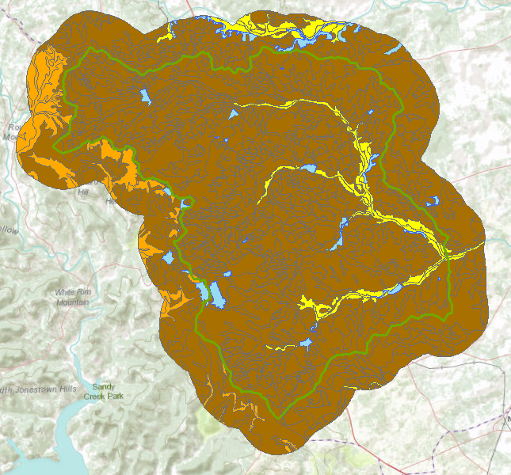

Hydrologic Soil Group in Brushy Creek
Water

Slide 26
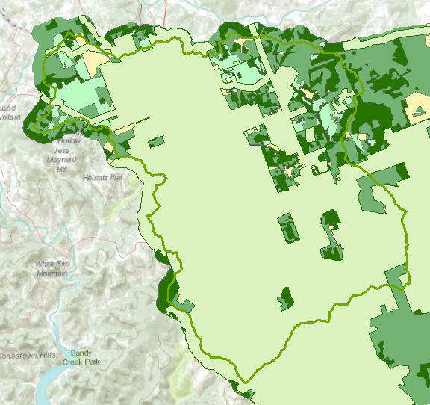

Land Cover
Interpreted from remote sensing

Slide 27
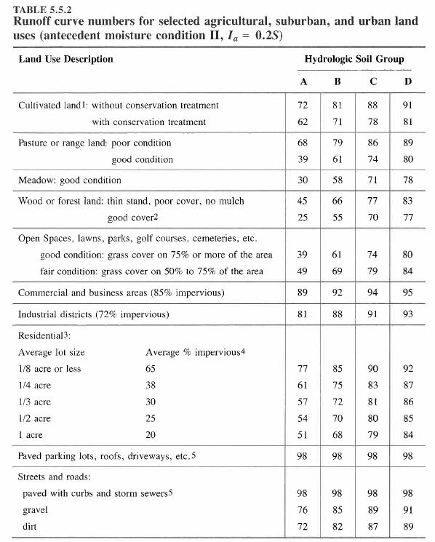
CN Table

Slide 28
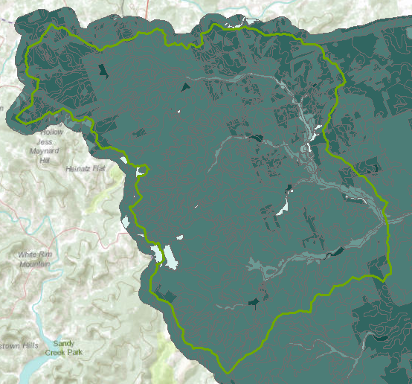

SCS Curve Number

Slide 29
Example - SCS Method
Rainfall: 5 in.
Area: 1000-ac
Soils:
  Class B: 50%
  Class C: 50%
Antecedent moisture: AMC(II)
Land use
  Residential
    40% with 30% impervious cover
    12% with 65% impervious cover
  Paved roads: 18% with curbs and storm sewers
  Open land: 16%
    50% fair grass cover
    50% good grass cover
  Parking lots, etc.: 14%

Slide 30
Example (SCS Method – 1, Cont.)
 | Hydrologic Soil Group
 | B |  |  | C
Land use | % | CN | Product | % | CN | Product
Residential (30% imp cover) | 20 | 72 | 14.40 | 20 | 81 | 16.20
Residential (65% imp cover) | 6 | 85 | 5.10 | 6 | 90 | 5.40
Roads | 9 | 98 | 8.82 | 9 | 98 | 8.82
Open land: good cover | 4 | 61 | 2.44 | 4 | 74 | 2.96
Open land: Fair cover | 4 | 69 | 2.76 | 4 | 79 | 3.16
Parking lots, etc | 7 | 98 | 6.86 | 7 | 98 | 6.86
Total | 50 |  | 40.38 | 50 |  | 43.40
CN values come from Table 5.5.2

Slide 31
Example (SCS Method – 1 Cont.)
Average AMC
Wet AMC

