Slide 1
Soil Water
Topics
  Soils
  Soil water properties
  Soil water balance
Reading: Applied Hydrology Sections 4.3 and 4.4 (Green-Ampt method)

Slide 2
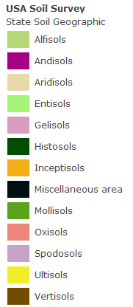
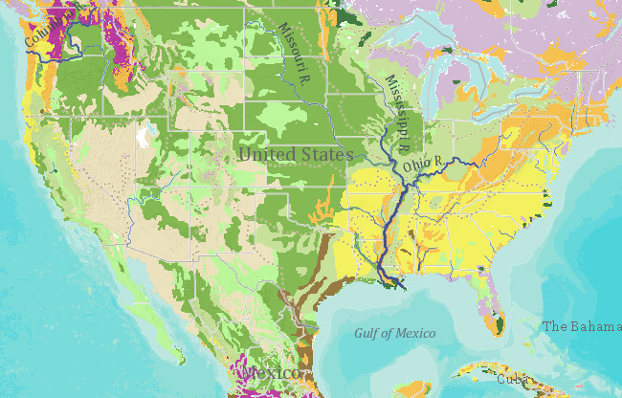
Soil Map of the United States
USDA Soil Classes
Developed from SSURGO – Soil Survey Geographic Database
http://www.arcgis.com/home/webmap/viewer.html?webmap=0edea1c7bbb84ba5842d20483af11679

Slide 3
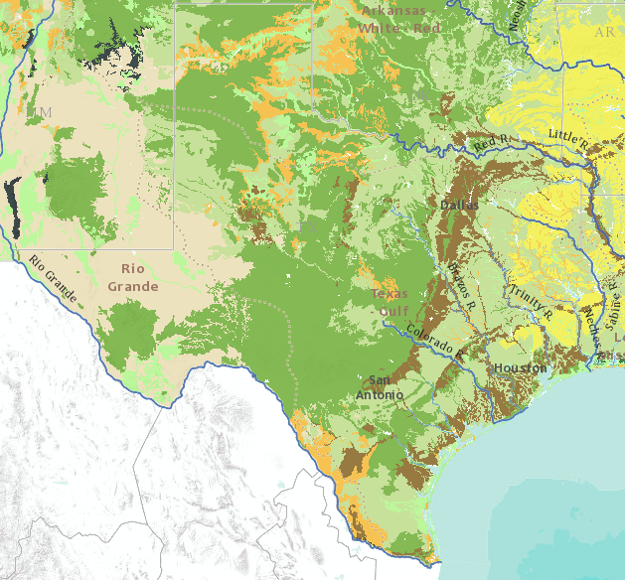
Soil Map of Texas
Developed from SSURGO – Soil Survey Geographic Database

Slide 4
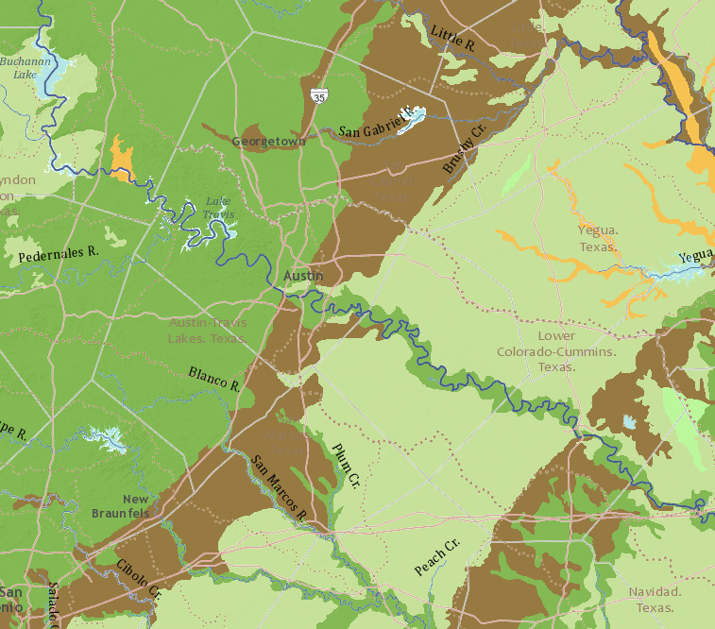
Soil Map of Central Texas

Slide 5
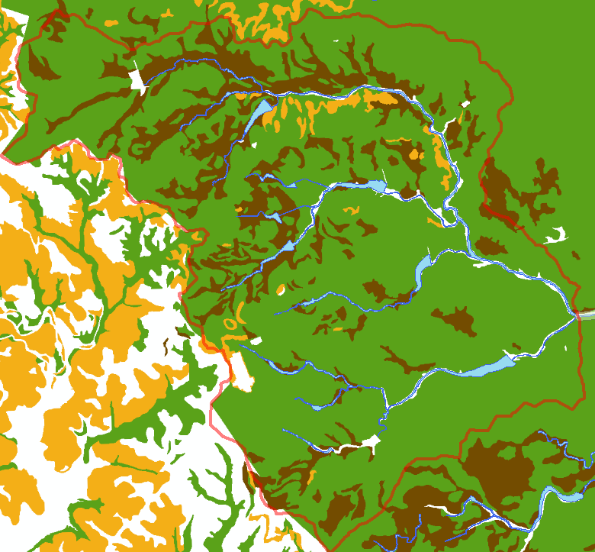
Soils in the Brushy Creek Watershed
Brushy Bend Dr
Dam 7

Slide 6
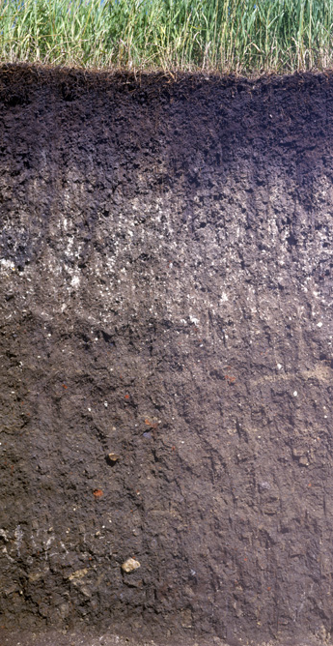
Mollisols
Mollisols have deep, high organic matter, nutrient-enriched surface soil (A horizon), typically between 60–80 cm in depth
Formed under grasslands (the liveoak savannah that originally covered much of south and central Texas)

Slide 7
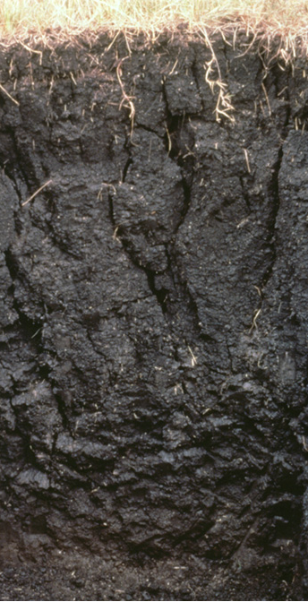
Vertisols
Soils that have a high content of expanding clay and that have at some time of the year deep wide cracks. They shrink when drying and swell when they become wetter

Slide 8
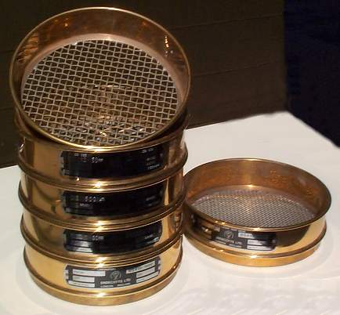
Soil Sieves
http://www.rtg.wa.edu.au/loanpool/belmont/sieves.jpg

Slide 9
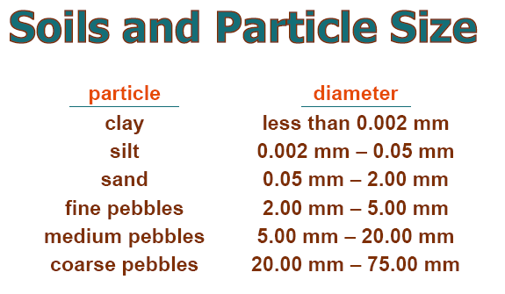
http://www.uga.edu/srel/kidsdoscience/soils-planets/soil-particle-size.pdf

Slide 10
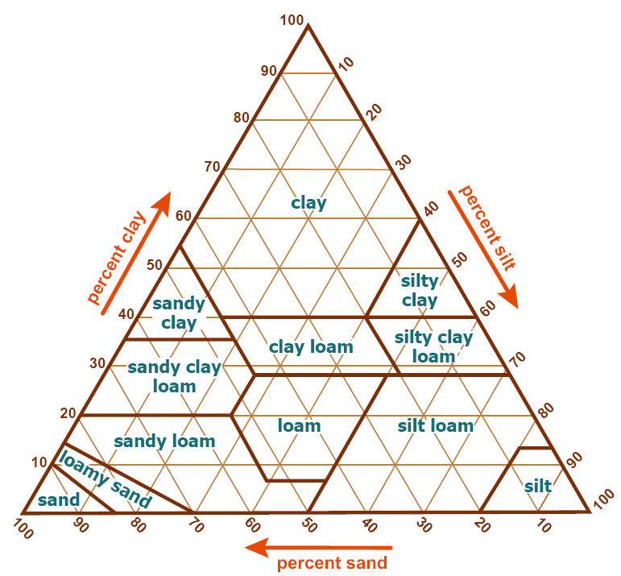
Soil Texture
Triangle
Source: USDA Soil
Survey Manual Chapter 3

Slide 11
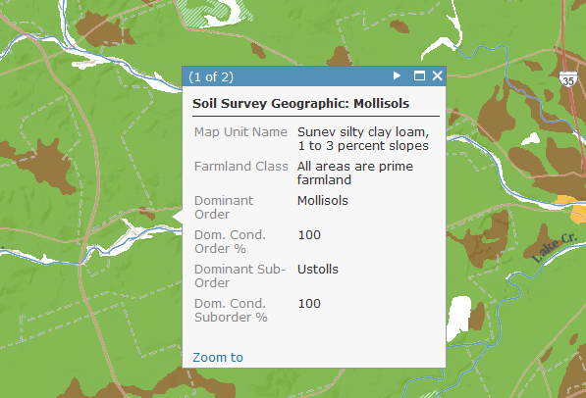
Soil Texture is defined by % of silt, sand, clay
Silty Clay Loam
~ 55% silt, 10% sand, 35% clay

Slide 12
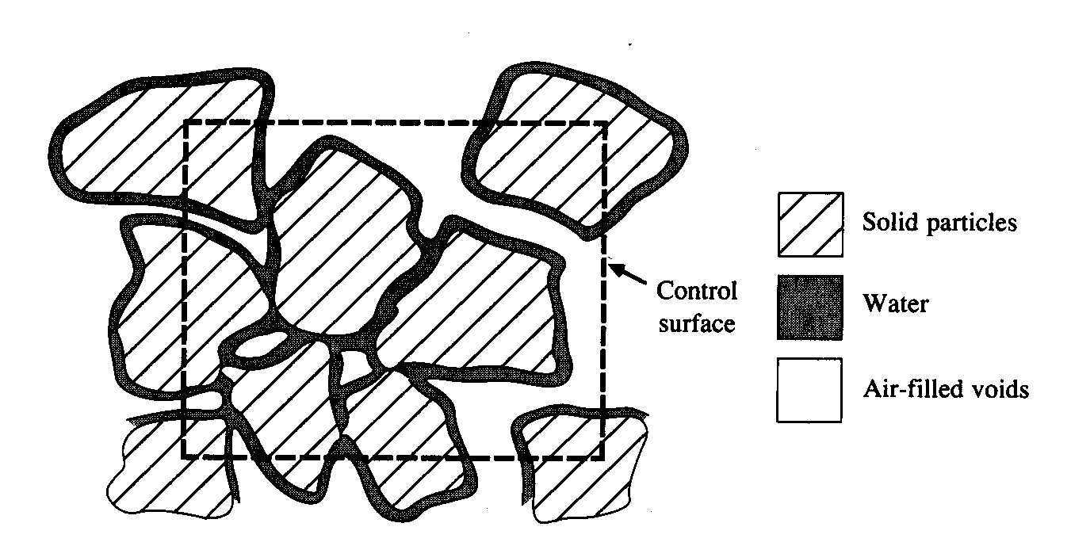
Soil Water Content
Soil Water Content

Slide 13
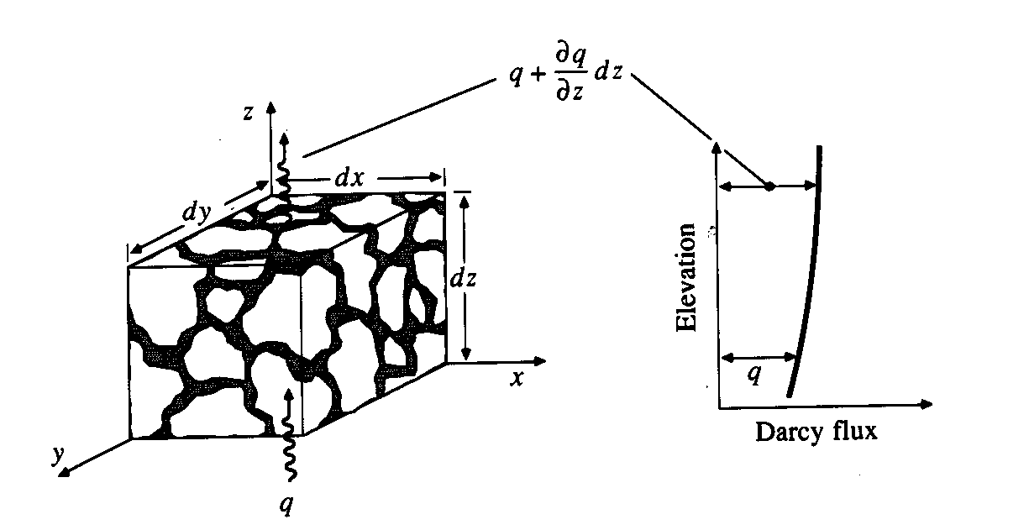
Soil Water Flux, q
q = Q/A

Slide 14
Soil Water Tension, ψ
Measures the suction head of the soil water
Like p/γ in fluid mechanics but its always a suction (negative head)
Three key variables in soil water movement
  Flux, q
  Water content, θ
  Tension, ψ
Total energy head = h
z=0
z₁
q₁₂
z₂

Slide 15
Soil Water Measurement
Tensiometers
  Measure soil water potential (tension)
  Practical operating range is about 0 to 0.75 bar of tension (this can be a limitation on medium- and fine-textured soils)
Electrical resistance blocks
  Measure soil water potential (tension)
  Tend to work better at higher tensions (lower water contents)
Thermal dissipation blocks
  Measure soil water potential (tension)
  Require individual calibration

Slide 16
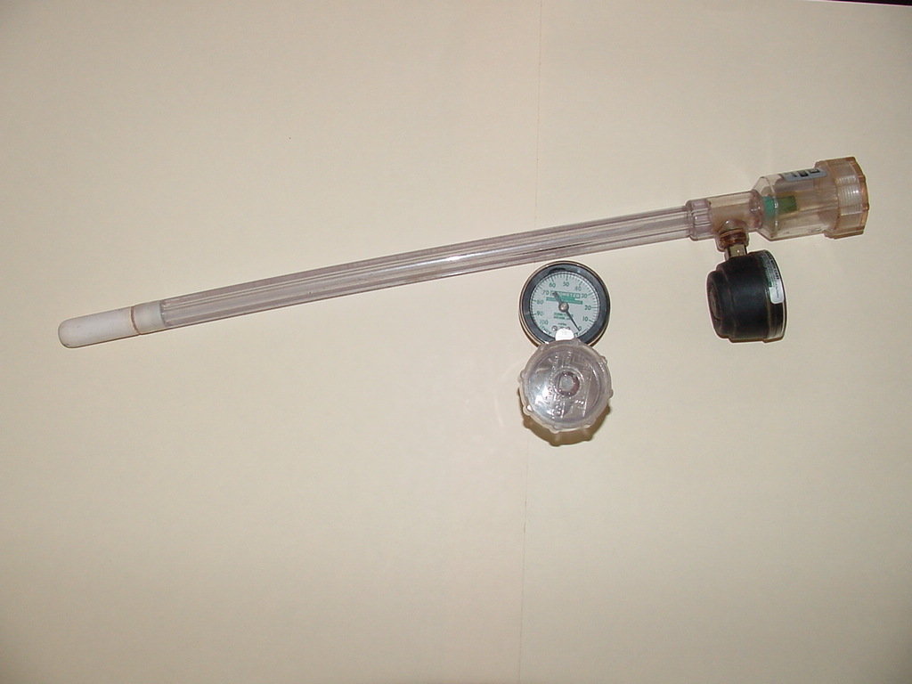
Tensiometer for Measuring Soil Water Potential, ψ
Water Reservoir
Variable Tube Length (12 in- 48 in) Based on Root Zone Depth
Porous Ceramic Tip
Vacuum Gauge (0-100 centibar)

Slide 17
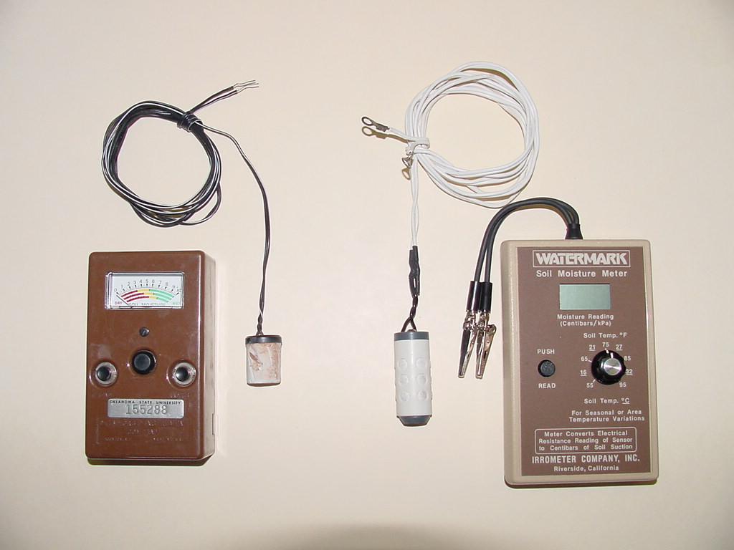
Electrical Resistance Blocks & Meters

Slide 18
Soil Water Tension, ψ
Measures the suction head of the soil water
Like p/γ in fluid mechanics but its always a suction (negative head)
Three key variables in soil water movement
  Flux, q
  Water content, θ
  Tension, ψ
Total energy head = h
z=0
z₁
q₁₂
z₂

Slide 19
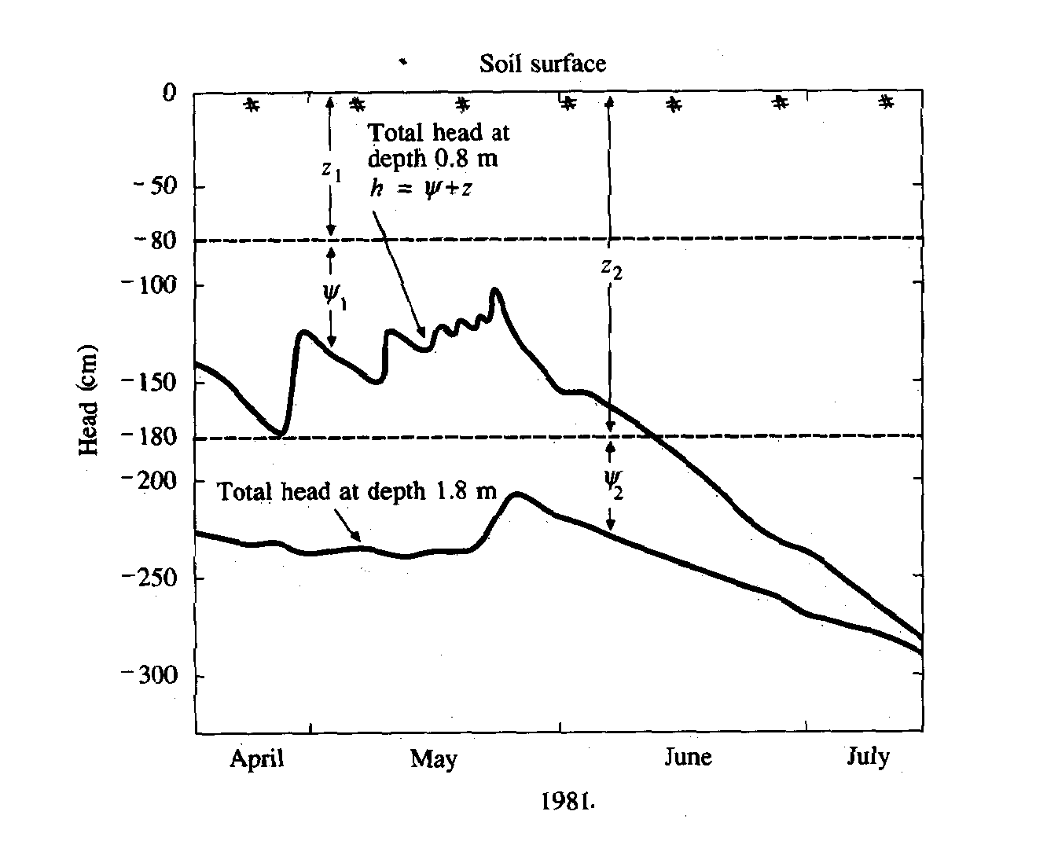

Slide 20
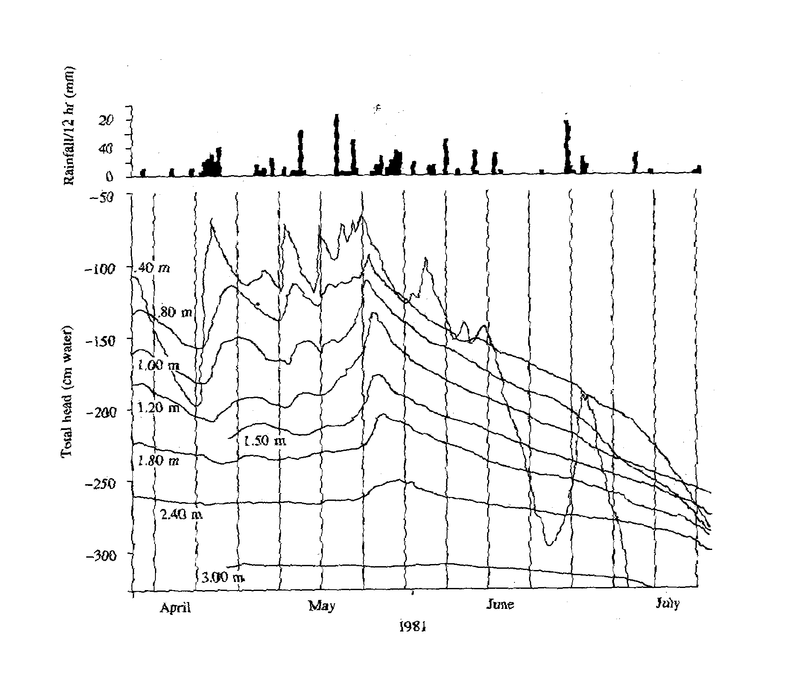

Slide 21
40 cm
80 cm

Slide 22
Darcy’s Law
K = hydraulic conductivity
q = specific discharge
V = q/n = average velocity through the area

Slide 23
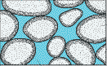
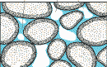
Definitions
Element of soil, V
(Saturated)
Pore with
water
solid
Pore with
air
Element of soil, V
(Unsaturated)

Slide 24
Continuity Equation
z
dx
dy
dz
y
x

Slide 25
Continuity (Cont.)
Continuity
Equation

Slide 26
Richard’s Equation
Recall
  Darcy’s Law
  Total head
So Darcy becomes
Richard’s eqn is:
Soil water diffusivity

