Slide 1
Triangulated Irregular Network
Edge
Node
Face

Slide 2
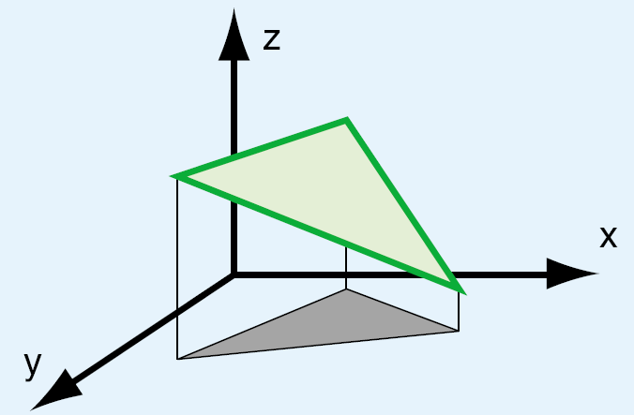
3D Structure of a TIN

Slide 3
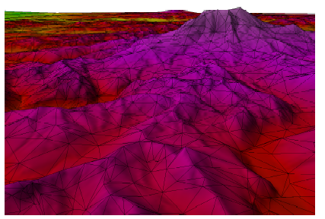
Real TIN in 3D!

Slide 4
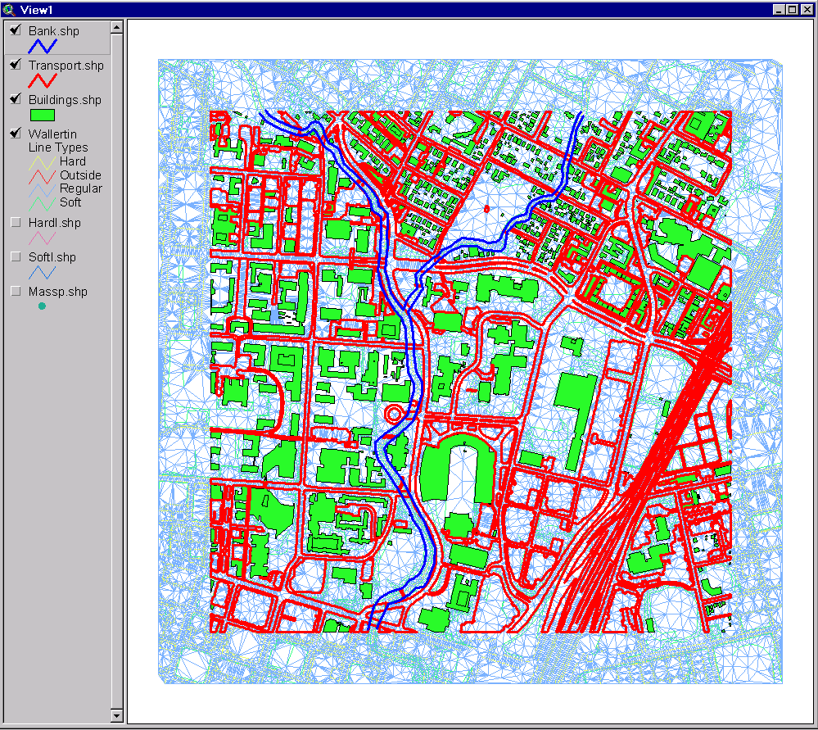
TIN with Surface Features
Classroom
UT Football
Stadium
Waller Creek

Slide 5
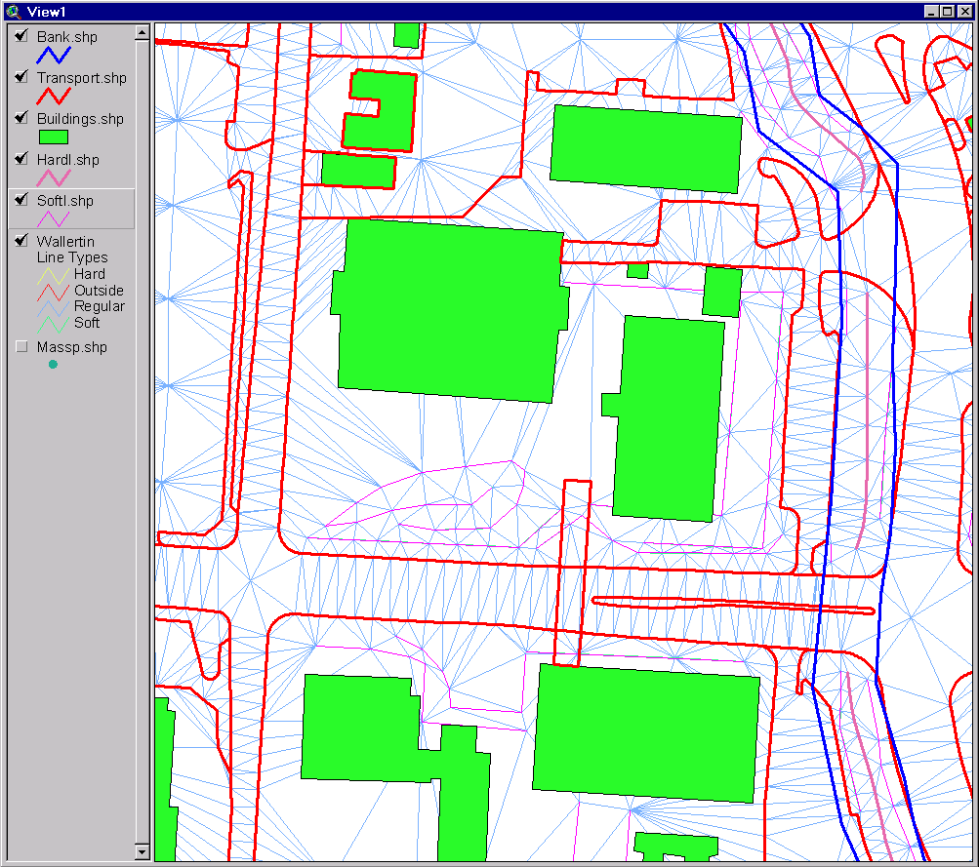
A Portion of the TIN

Slide 6
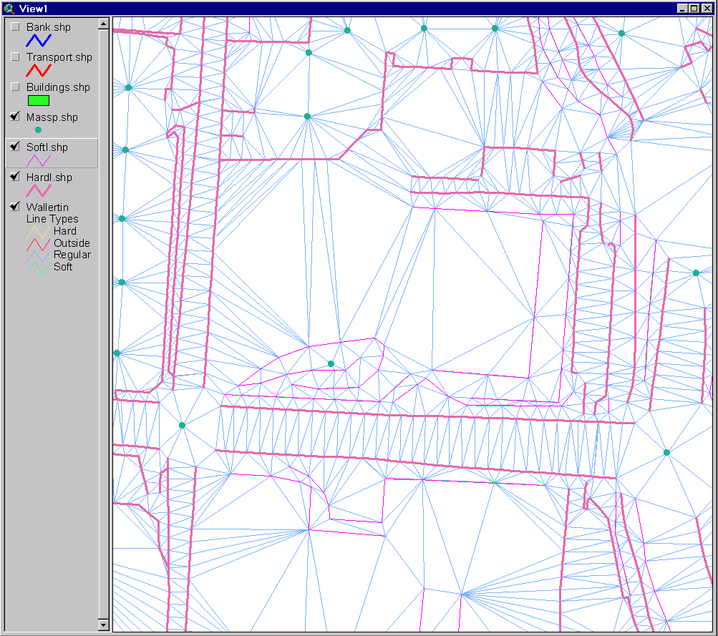
Input Data for this Portion
Mass Points
Soft Breaklines
Hard Breaklines

Slide 7
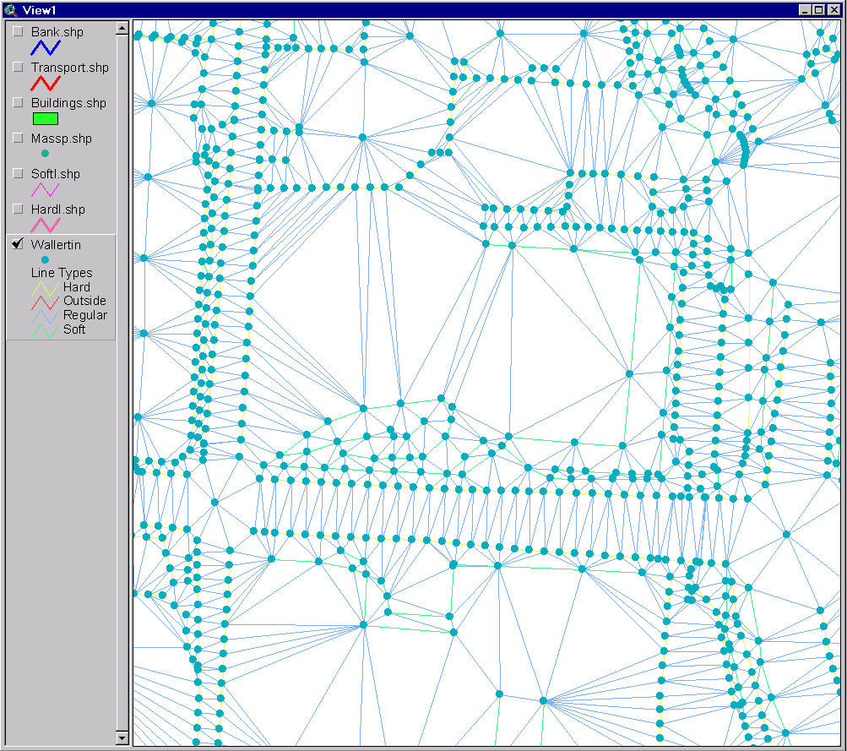
TIN Vertices and Triangles

Slide 8
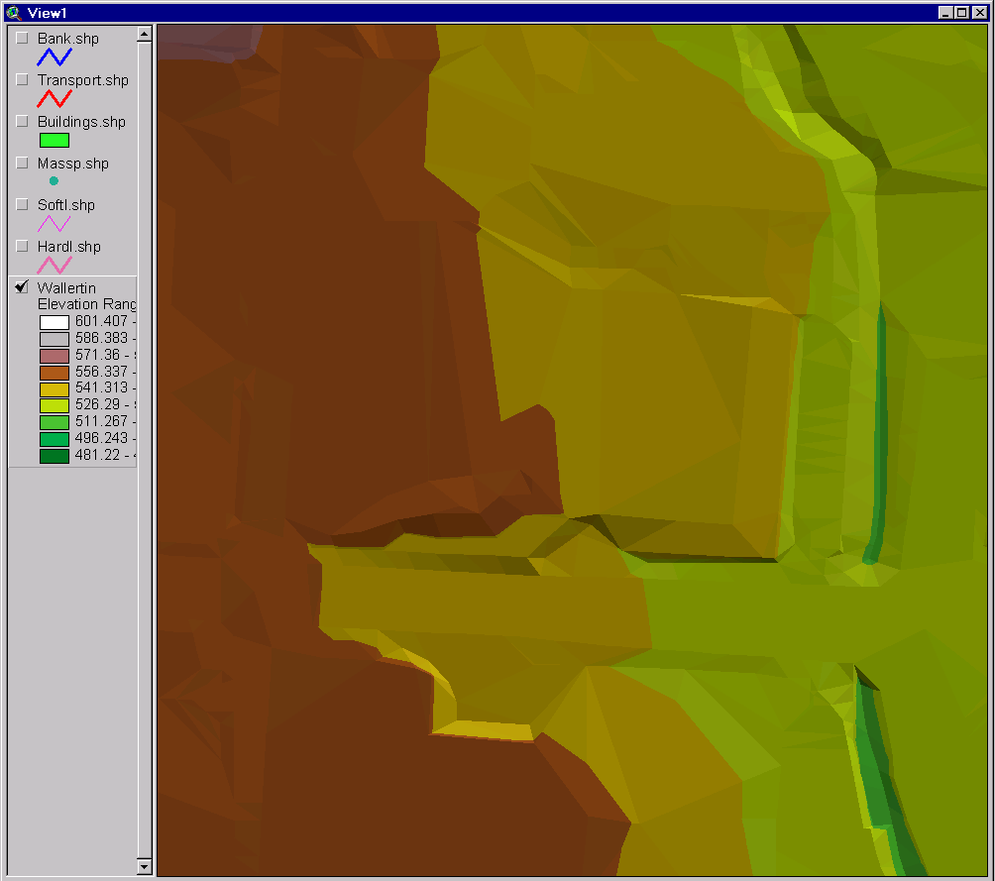
TIN Surface Model
Waller
Creek
Street and
Bridge

Slide 9
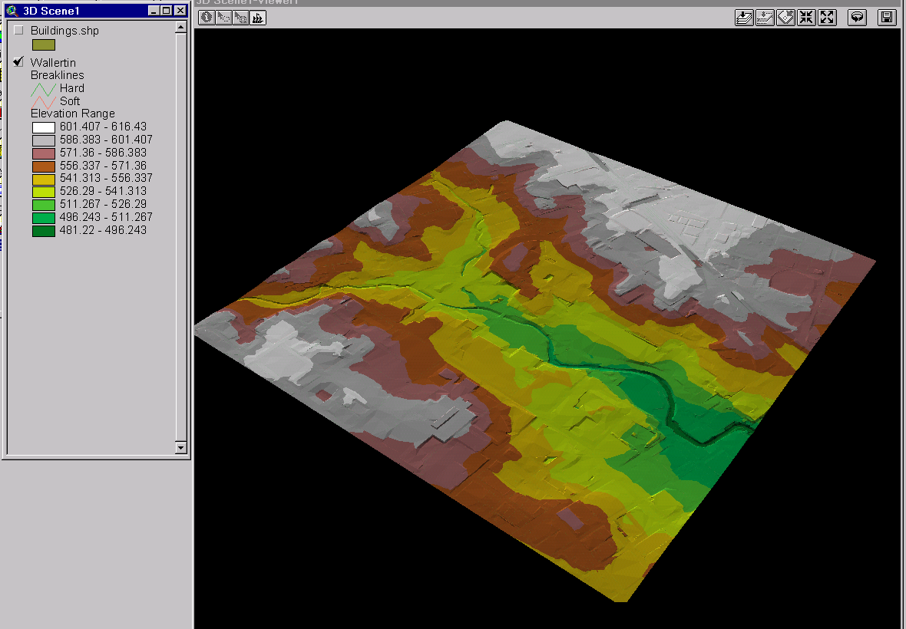
3-D Scene

Slide 10
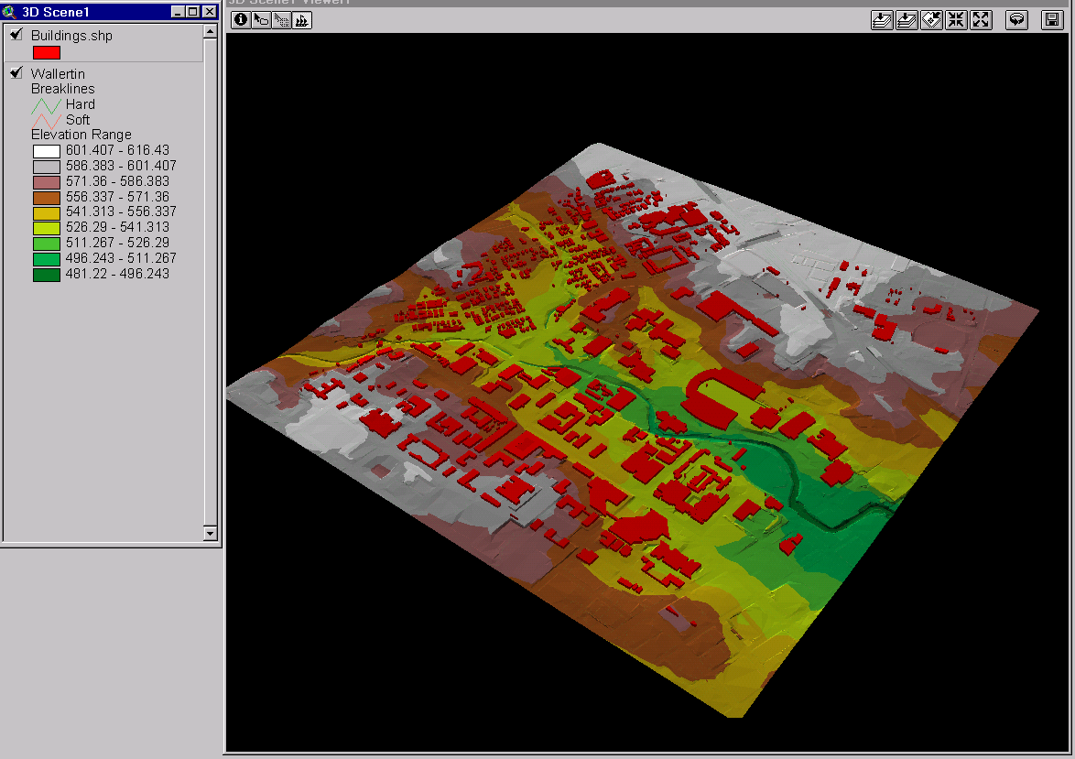
3-D Scene with Buildings

Slide 11
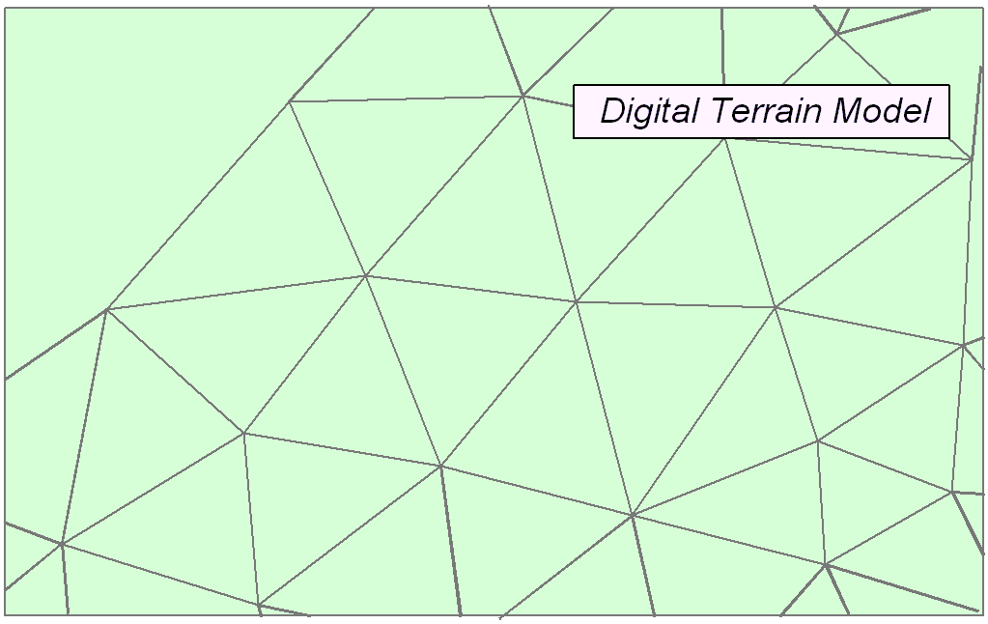
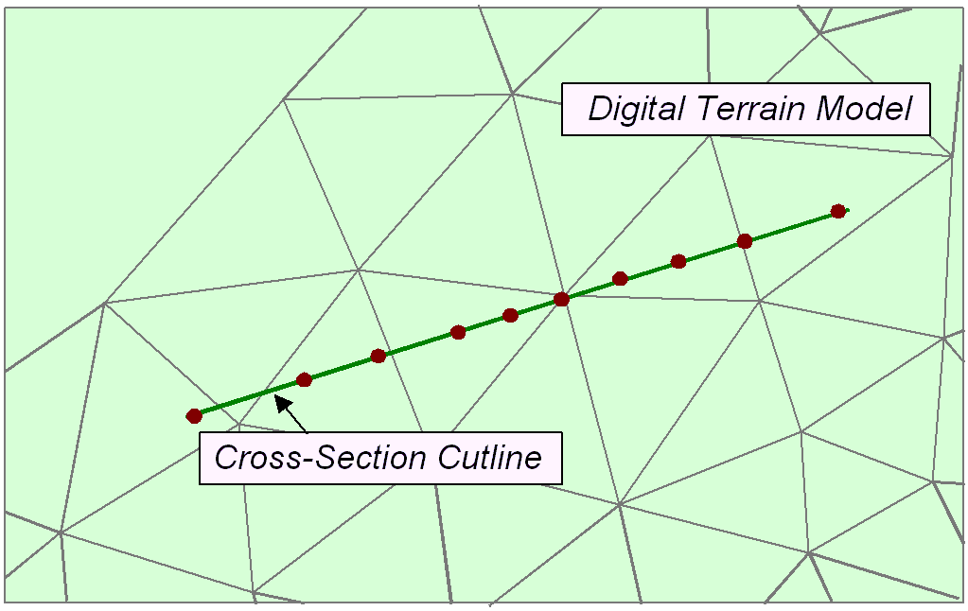
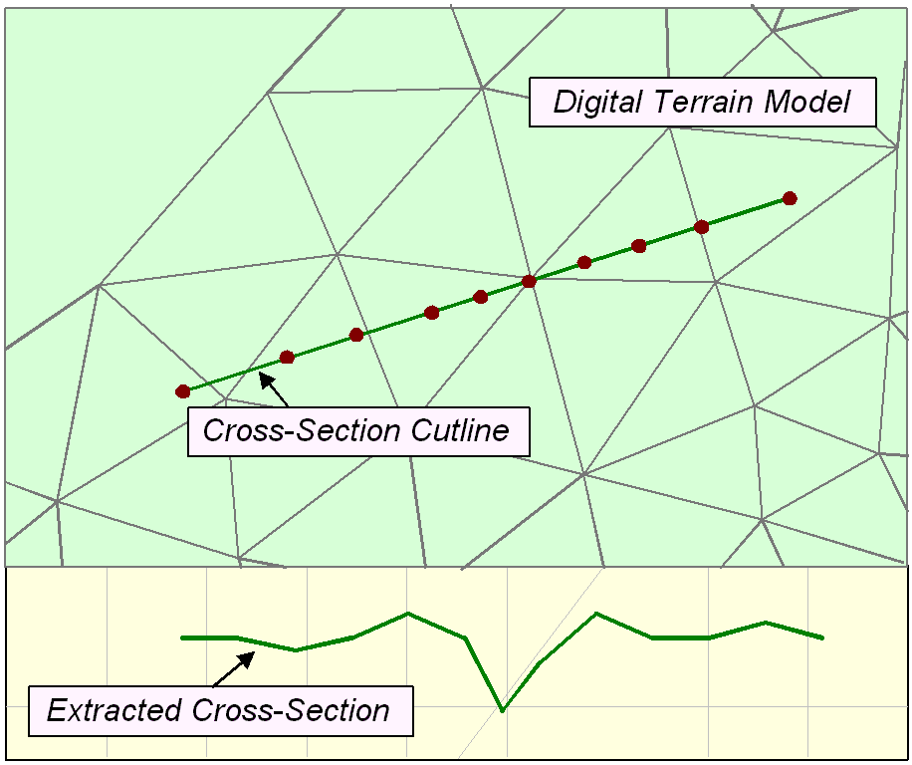
TIN as a source of cross-sections

Slide 12
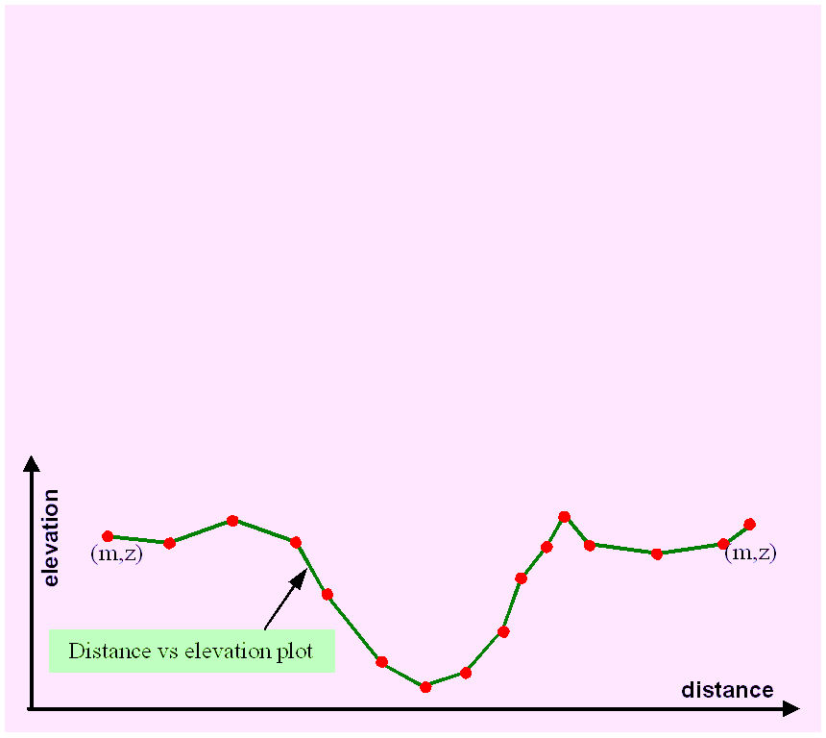
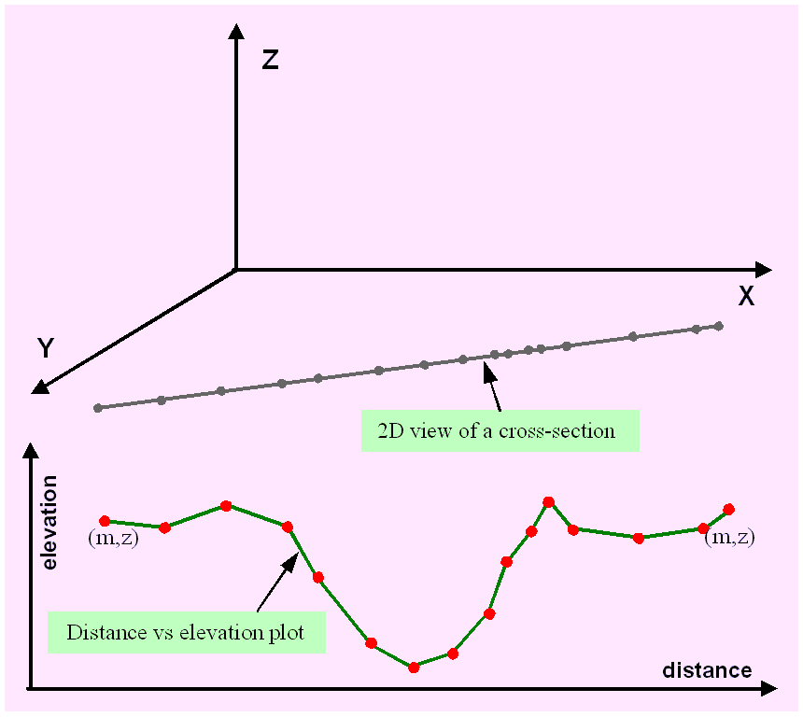
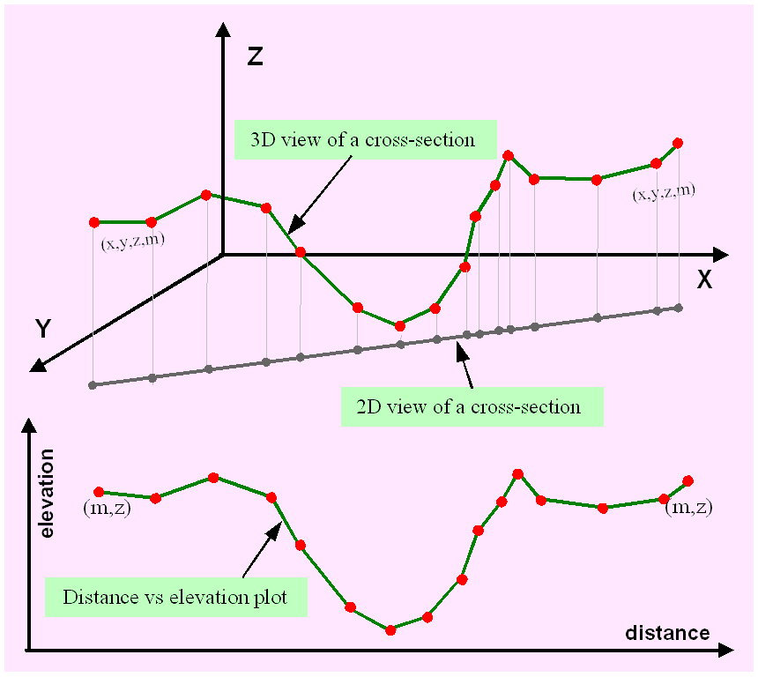
CrossSections

Slide 13
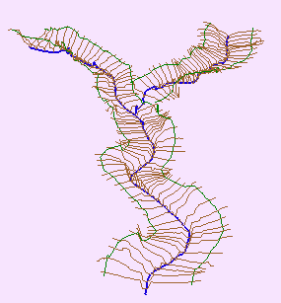
Channel and Cross-Section
Direction of Flow
Channel
Cross-Section

Slide 14
HEC GeoRAS
A set of ArcGIS tools for processing of geospatial data for
  Export of geometry HEC-RAS
  Import of HEC-RAS output for display in GIS
Available from HEC at http://www.hec.usace.army.mil/software/hec-ras/hec-georas.html
An old tutorial on using GeoRAS for Waller Creek with ArcView 3.x is available at: http://www.crwr.utexas.edu/gis/gishydro01/Class/exercises/georas.html

Slide 15
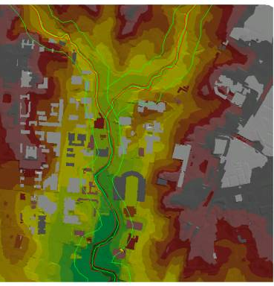
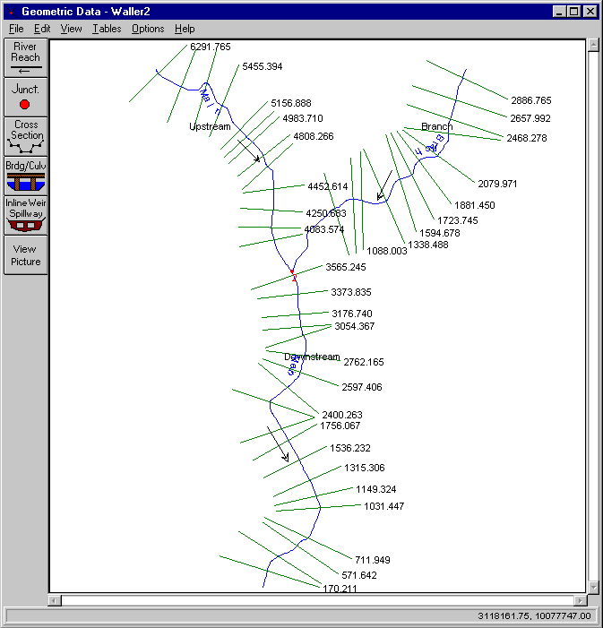
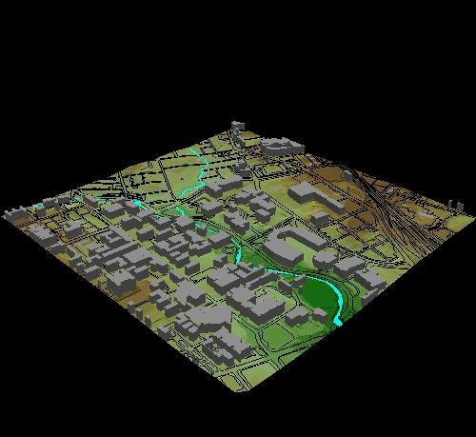
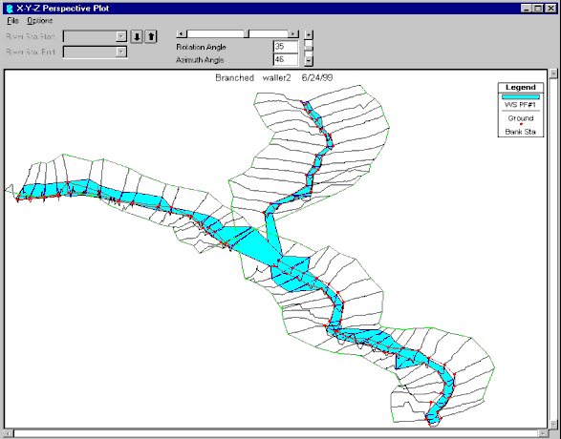
Hydraulic Modeling with Geo-RAS
GIS data
HEC-RAS Geometry
HEC-RAS Flood Profiles
Flood display in GIS

Slide 16
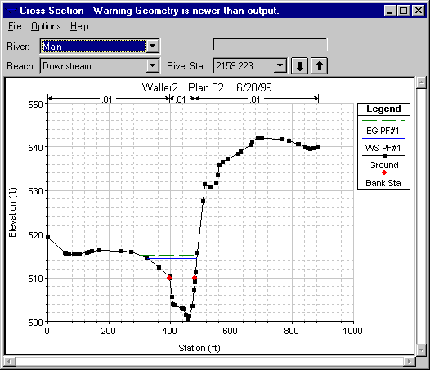
Hydraulic Modeling with HEC-RAS
Cross-section extracted
from the TIN.
RAS stream geometry.
Notes:
HEC-RAS schematic with the stream centerline and the cross-sections we defined in GIS. We can appreciate in each cross-section the banks and water elevation (once calculated).
The primary procedure for computing water surface profiles between cross-sections used for steady gradually varied flow is the standard step method (based on iterative solution of the energy equation from downstream -water elevation- to upstream).

Slide 17

Hydraulic Modeling with HEC-RAS
Resulting water
elevations.
Notes:
The output of the model comes in two primary forms: a graphical xyz perspective plot, and in ASCII text format.
At this point, the hydraulic engineer would typically return to the original contour maps showing the cross-sections, and plot the water elevations. In this manner, the floodplain extent is determined. This could quickly become tedious if the goal is to evaluate different flow scenarios. However, we can use AVRas and export the water elevations into GIS and accomplish the floodplain delineation automatically.

Slide 18
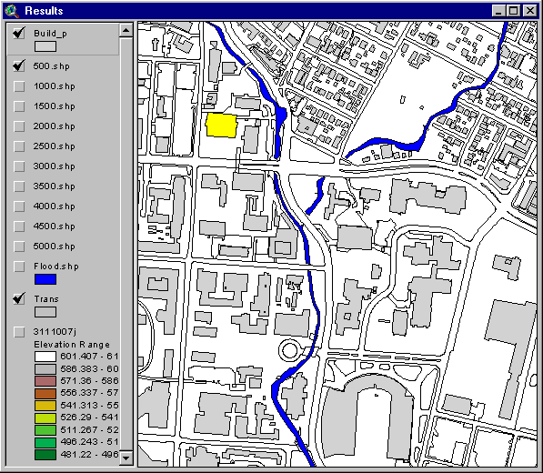
Floodplain Mapping
Floodplain for
500 cfs.
Notes:
Overlapping Buildings and Transportation layers helps identify affected areas.
The user can click anywhere on the inundated area and determine water depth.

Slide 19
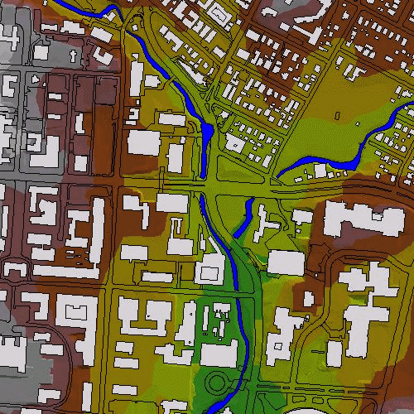
Floodplain Mapping
2-D floodplain
animation
(500 – 5,000 cfs).
Notes:
Or you can make animated gifs like this one showing the effect when the flow varies from 500-5000 cfs.

Slide 20

Floodplain Mapping
3-D floodplain
animation.
Notes:
Finally, you can also create 3D animations that give you a more realistic vision of the study area.

