Slide 1
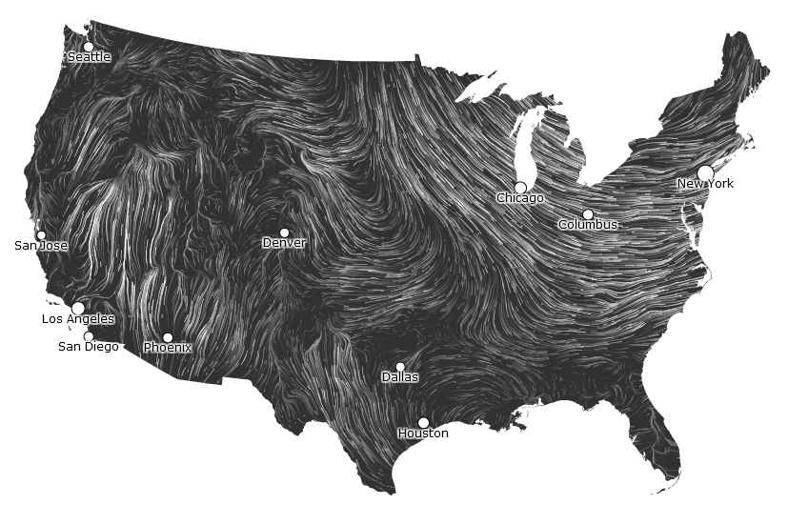
Wind Map
http://hint.fm/wind/

Slide 2
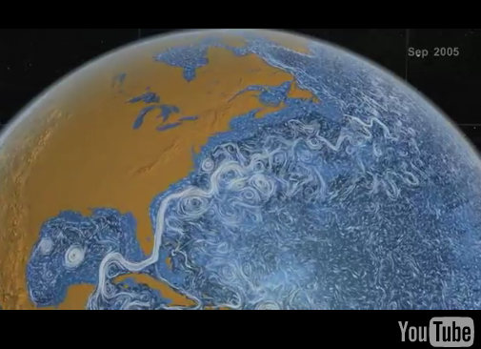
Ocean Currents
http://www.youtube.com/watch?v=oNppEPKt52E

