Slide 1
Problem 3 on Homework 2
Four rain gages are located within a rectangular area whose four corners are A (0,0), B (0,13), C (14,13), and D (14,0). These rain gages have the following locations and rainfalls as shown in the following table. Determine the average rainfall inside the rectangle ABCD.
Gage | Coordinates (miles) | Rainfall (inches)
1 | 2,9 | 0.59
2 | 7,11 | 0.79
3 | 12,10 | 0.94
4 | 6,2 | 1.69

Slide 2
12
10
8
6
4
2
0
0
2
4
6
8
10
12
14
12

Slide 3
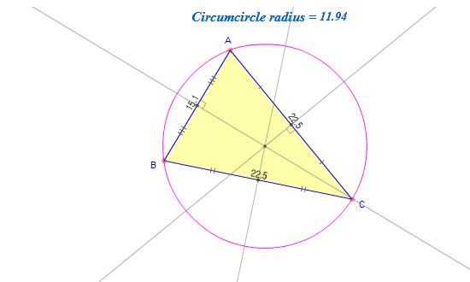
Circumcenter and Circumcircle
http://www.mathopenref.com/trianglecircumcircle.html

Slide 4
12
2
10
3
1
8
Delauney Triangulation
6
4
2
4
0
0
2
4
6
8
10
12
14
12

Slide 5
12
2
10
3
1
8
Perpendicular Bisectors
Midpoints on triangle edges
Slopes of triangle edges
Inverse slopes of perpendicular bisectors
Equations for perp. bisectors
Points on domain borders
Draw perp. bisectors
6
4
2
4
0
0
2
4
6
8
10
12
14
12

Slide 6
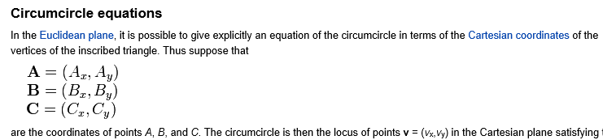
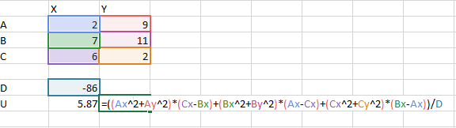
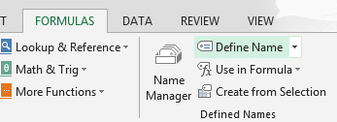
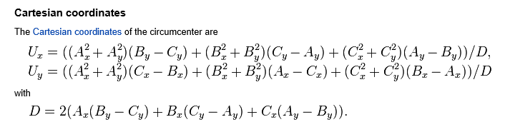
http://en.wikipedia.org/wiki/Circumcenter

Slide 7
12
2
10
3
1
Find Circumcenters
U₁ = (5.87, 6.57)
8
U₂ = (8.65, 6.26)
U₁
U₂
6
These vertex locations can also be obtained by solving for x, y between the equations describing any pair of the perpendicular bisectors that intersect there.
4
2
4
0
0
2
4
6
8
10
12
14
12

Slide 8
12
2
10
3
1
8
U₁
U₂
6
Find Area for Each Gage
Area for Gage 3
4
Find Average precipitation over domain
2
4
0
0
2
4
6
8
10
12
14
12

Slide 9
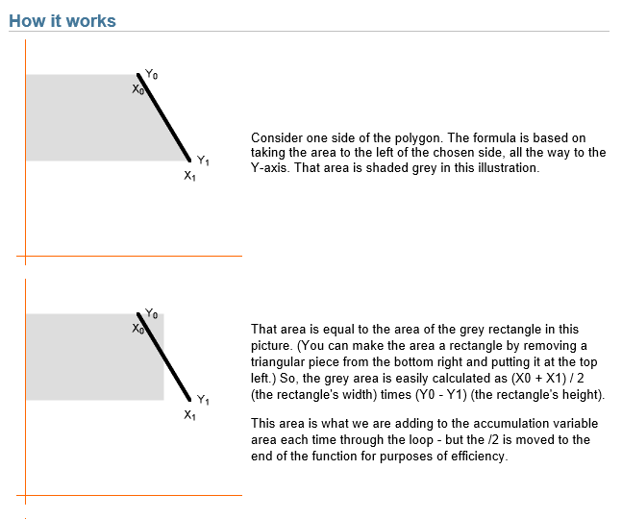
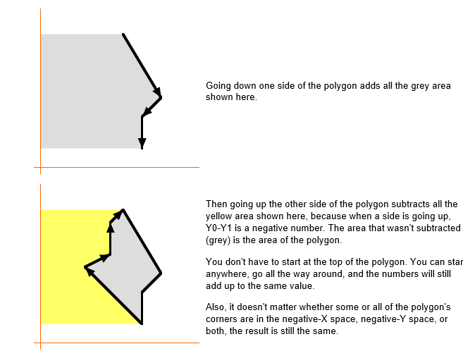
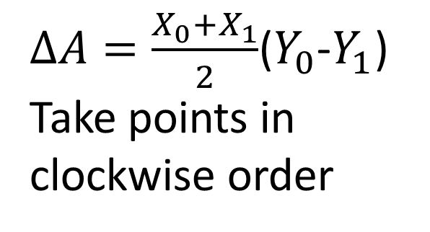
Computing Polygon Areas
$∆A=\frac{X_{0}+X_{1}}{2}$($Y_{0}$-$Y_{1}$)
Take points in clockwise order
http://www.mathopenref.com/coordpolygonarea2.html

Slide 10
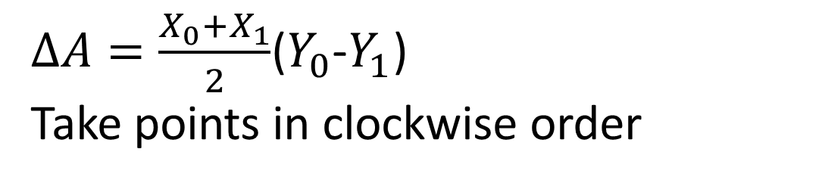
Example for Area associated with Gage 3
$∆A=\frac{X_{0}+X_{1}}{2}$($Y_{0}$-$Y_{1}$)
Take points in clockwise order
(10,13)
(14,13)
XCOORD | YCOORD | AREA
10 | 13
14 | 13 | 0.00
14 | 2.25 | 150.50
8.65 | 6.26 | -45.41
10 | 13 | -62.85
 | TOTAL | 42.24
(8.65,6.26)
(14,2.25)

