Slide 1
CE 374K Hydrology, Lecture 4
Atmosphere and Atmospheric water
Energy balance of the earth
Drought in Texas
Atmospheric circulation
Atmospheric water
Reading for next Tuesday – Applied Hydrology, Sections 3.4 to 3.4 Precipitation

Slide 2
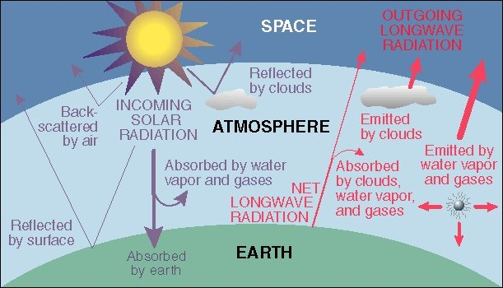
Energy Balance of Earth
20
70
100
6
6
26
4
38
15
19
21
Sensible heat flux 7
Latent heat flux 23
51
http://www.uwsp.edu/geo/faculty/ritter/geog101/textbook/energy/radiation_balance.html

Slide 3
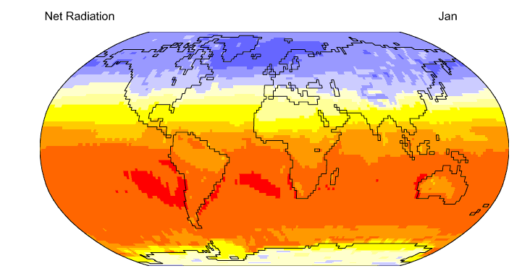

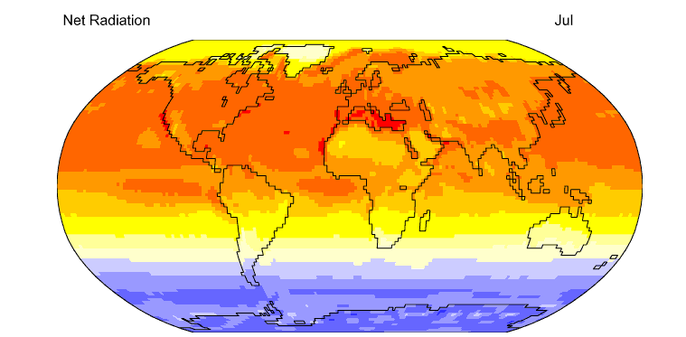
Net Radiation
http://geography.uoregon.edu/envchange/clim_animations/flash/netrad.html
Mean annual net radiation over the earth and over the year is 105 W/m²

Slide 4
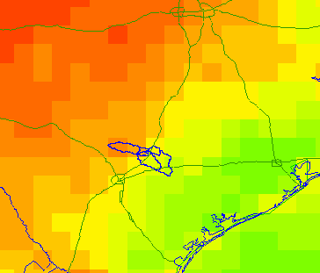
Energy Balance in the San Marcos Basin from the NARR (July 2003)
Note the very large amount of longwave radiation exchanged between land and atmosphere
Average fluxes over the day
495
61
72
112
3
310
415
Net Shortwave = 310 – 72 = 238; Net Longwave = 415 – 495 = - 80

Slide 5
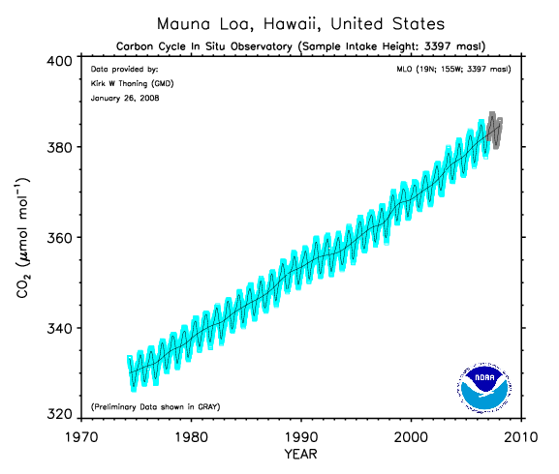
Increasing carbon dioxide in the atmosphere (from about 300 ppm in preindustrial times)
We are burning fossil carbon (oil, coal) at 100,000 times the rate it
was laid down in geologic time

Slide 6
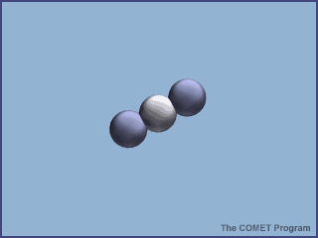
Absorption of energy by CO₂

Slide 7
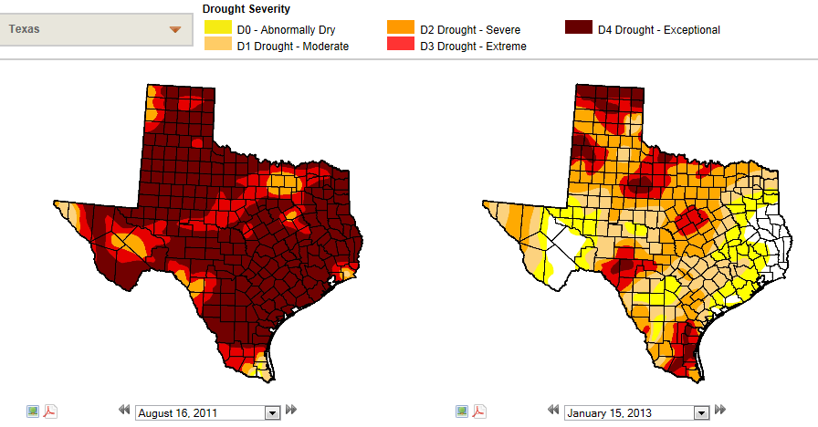
Drought Monitor for Texas
http://droughtmonitor.unl.edu/archive.html

Slide 8
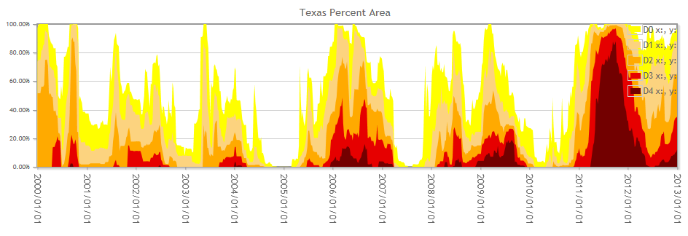
Trends in Drought in Texas
Currently, 91% of Texas is in some form of drought

Slide 9
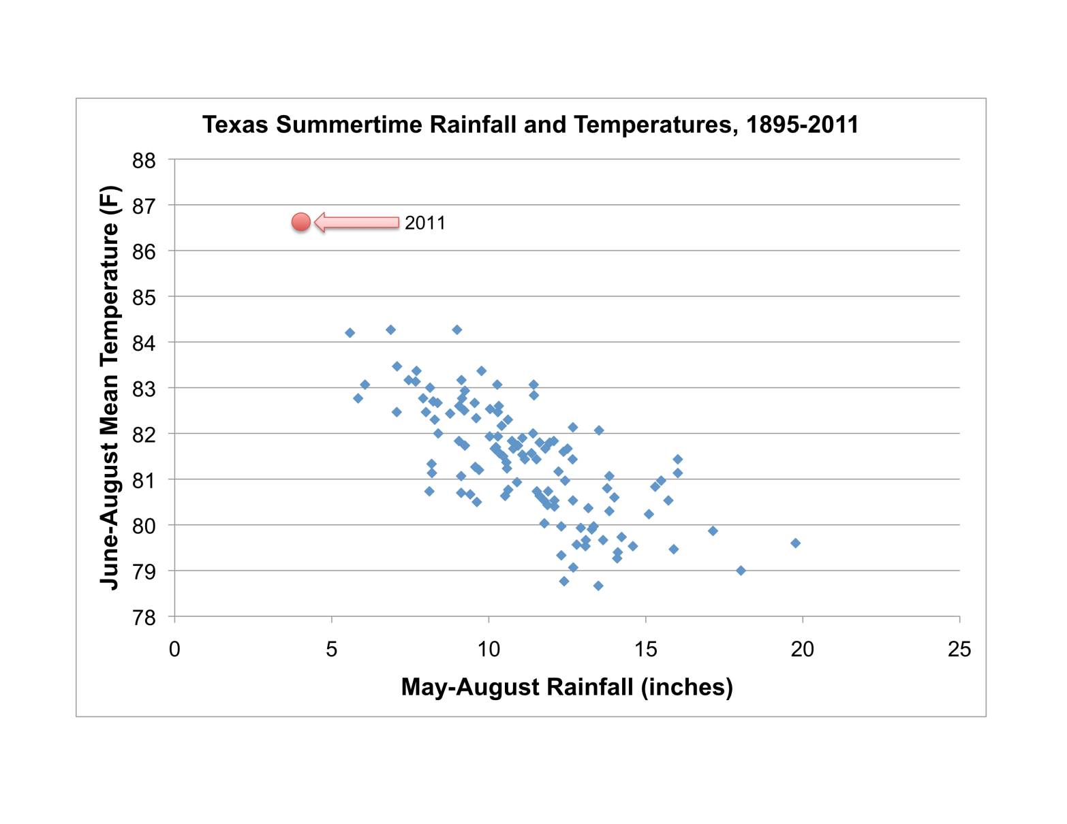
In the summer of 2011, Texas and Oklahoma experienced the hottest summer ever recorded in the history of the United States
Source: John Nielson-Gammon

Slide 10

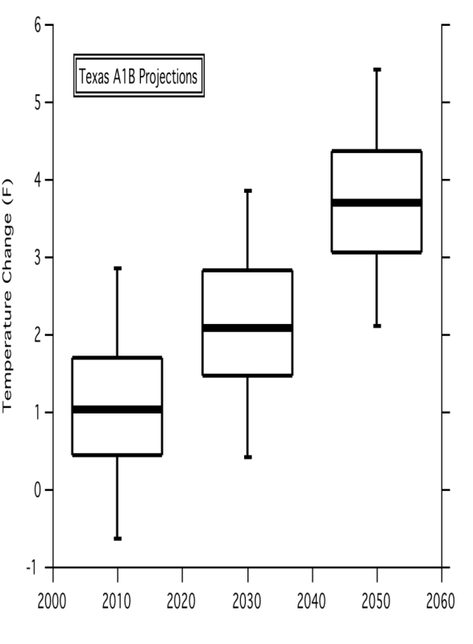
What does the future hold?
As temperatures rise, rain decreases….
Temperature is expected to rise…
whether due to natural variations or anthropogenic causes
Sources: Danny Reible, John Nielson-Gammon

Slide 11
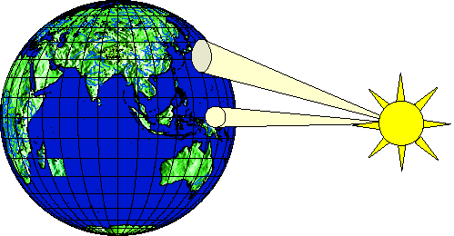
Heating of earth surface
Heating of earth surface is uneven
  Solar radiation strikes perpendicularly near the equator (270 W/m²)
  Solar radiation strikes at an oblique angle near the poles (90 W/m²)
Emitted radiation is more uniform than incoming radiation
Amount of energy transferred from equator to the poles is approximately 4 x 10⁹ MW

Slide 12
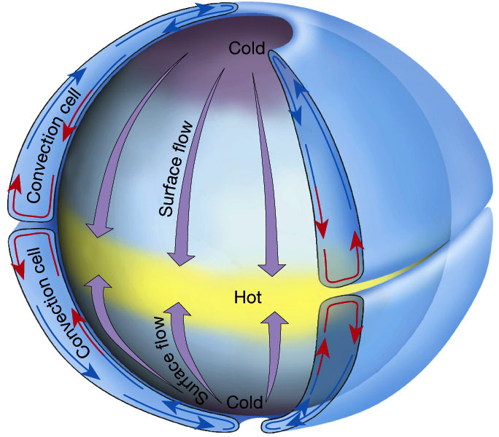
Hadley circulation
Atmosphere (and oceans) serve to transmit heat energy from the equator to the poles
Warm air rises, cool air descends creating two huge convective cells.

Slide 13
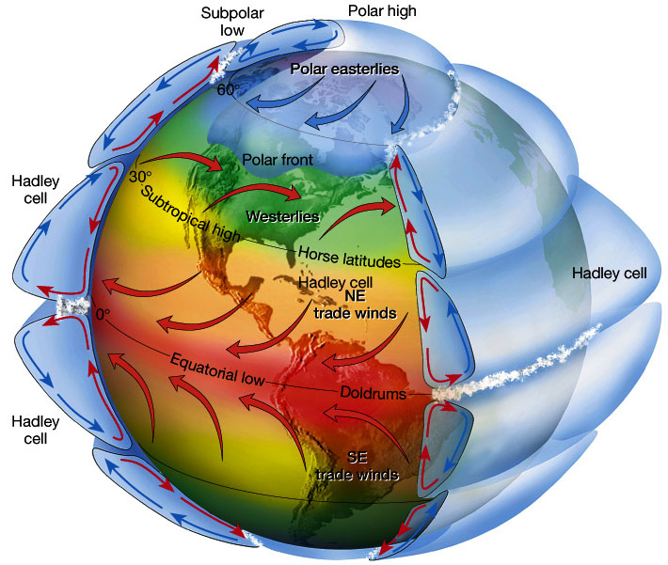
Atmospheric circulation
Circulation cells
Polar Cell
Hadley cell
Ferrel Cell
Polar cell
Ferrel Cell
Winds
Tropical Easterlies/Trades
Westerlies
Polar easterlies
Latitudes
Intertropical convergence zone (ITCZ)/Doldrums
Horse latitudes
Subpolar low
Polar high

Slide 14
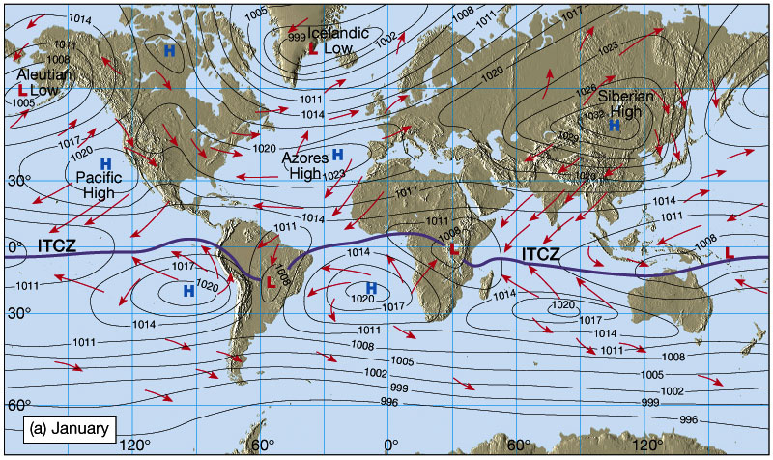
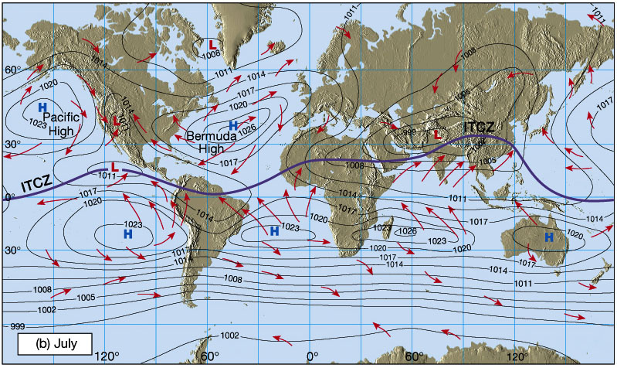
Shifting in Intertropical Convergence Zone (ITCZ)
Owing to the tilt of the Earth's axis in orbit, the ITCZ shifts north and south.
Southward shift in January
Creates wet Summers (Monsoons) and dry winters, especially in India and SE Asia
Northward shift in July

Slide 15
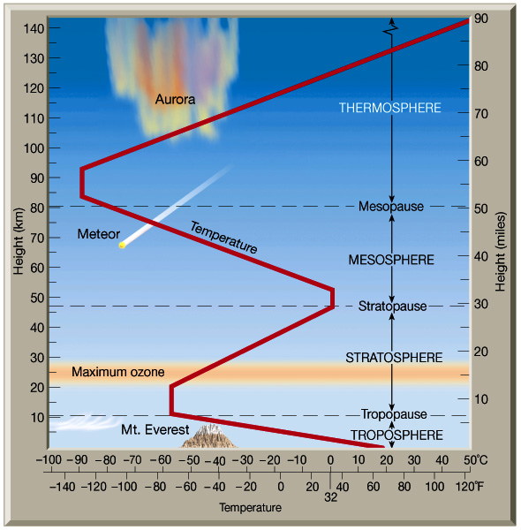
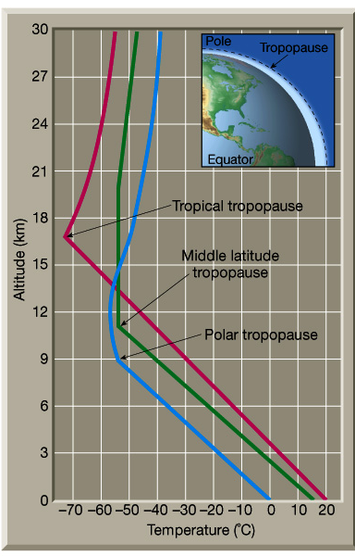
Structure of atmosphere

Slide 16
Atmospheric water
Atmospheric water exists
  Mostly as gas or water vapor
  Liquid in rainfall and water droplets in clouds
  Solid in snowfall and in hail storms
Accounts for less than 1/100,000 part of total water, but plays a major role in the hydrologic cycle

Slide 17
Water vapor
Suppose we have an elementary volume of atmosphere dV and
we want quantify how much water vapor it contains
Water vapor density
dV
m_{a} = mass of moist air
m_{v} = mass of water vapor
Air density
Atmospheric gases:
Nitrogen – 78.1%
Oxygen – 20.9%
Other gases ~ 1%
http://www.bambooweb.com/articles/e/a/Earth's_atmosphere.html

Slide 18
Specific Humidity, q_{v}
Specific humidity measures the mass of water vapor per unit mass of moist air
It is dimensionless

Slide 19
Vapor pressure, e
Vapor pressure, e, is the pressure that water vapor exerts on a surface
Air pressure, p, is the total pressure that air makes on a surface
Ideal gas law relates pressure to absolute temperature T, R_{v} is the gas constant for water vapor
0.622 is ratio of mol. wt. of water vapor to avg mol. wt. of dry air (=18/28.9)

Slide 20
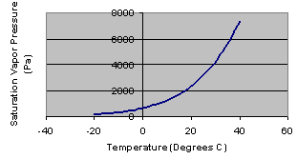
Saturation vapor pressure, e_{s}
Saturation vapor pressure occurs when air is holding all the water vapor
that it can at a given air temperature
Vapor pressure is measured in Pascals (Pa), where 1 Pa = 1 N/m²
1 kPa = 1000 Pa

Slide 21
Relative humidity, R_{h}
e_{s}
e
Relative humidity measures the percent
of the saturation water content of the air
that it currently holds (0 – 100%)

Slide 22
Dewpoint Temperature, T_{d}
e
T_{d}
T
Dewpoint temperature is the air temperature
at which the air would be saturated with its current
vapor content

Slide 23
Water vapor in an air column
We have three equations describing column:
  Hydrostatic air pressure, dp/dz = -ρ_{a}g
  Lapse rate of temperature, dT/dz = - α
  Ideal gas law, p = ρ_{a}R_{a}T
Combine them and integrate over column to get pressure variation elevation
2
Column
Element, dz
1

Slide 24
Precipitable Water
In an element dz, the mass of water vapor is dm_{p}
Integrate over the whole atmospheric column to get precipitable water,m_{p}
m_{p}/A gives precipitable water per unit area in kg/m²
2
Column
Element, dz
1
Area = A

Slide 25
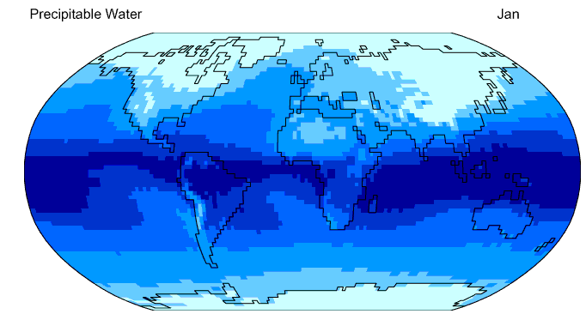
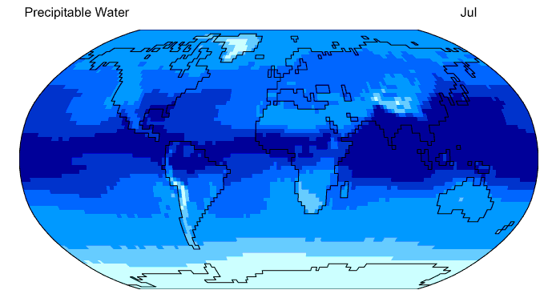

Precipitable Water
http://geography.uoregon.edu/envchange/clim_animations/flash/pwat.html
Frontal rainfall in the winter
Thunderstorm rainfall in the summer
25 mm precipitable water divides frontal from thunderstorm rainfall

