Slide 1
Channel Flow Routing
Reading:
Applied Hydrology Sections 8.4, 9.1-9.4, 9.7

Slide 2
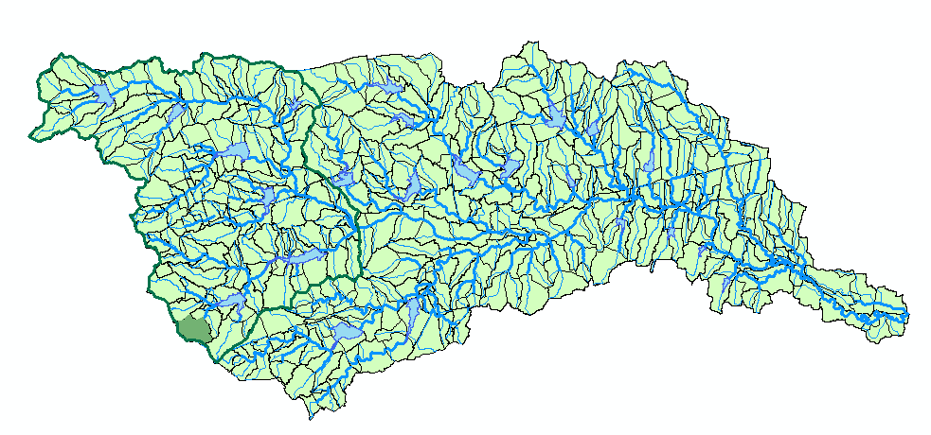
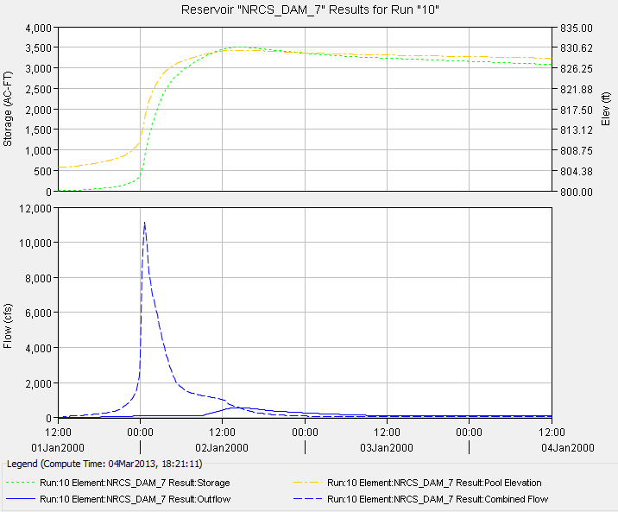
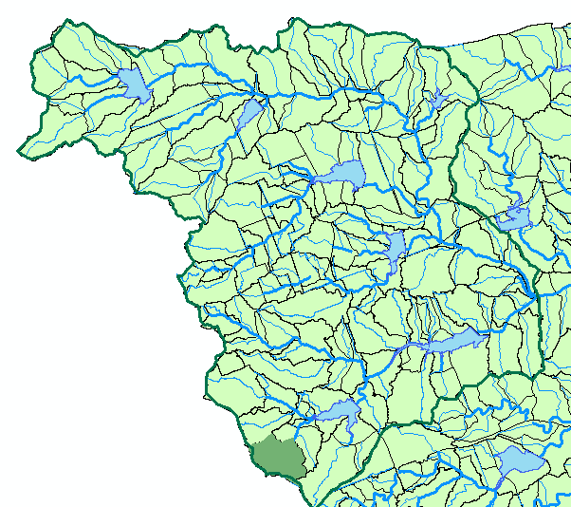
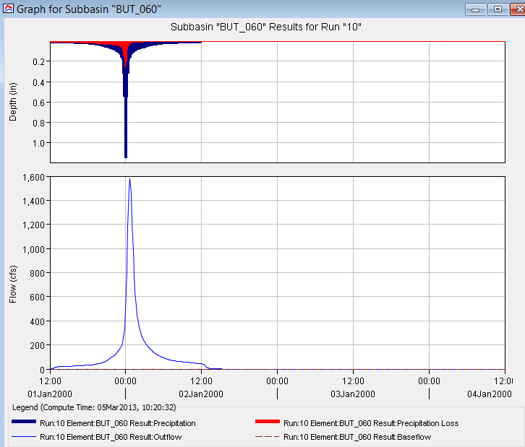
Brushy Creek Watershed
Reservoir
Routing
Subasin Rainfall
-Runoff
Dam 7
Subbasin BUT_060

Slide 3
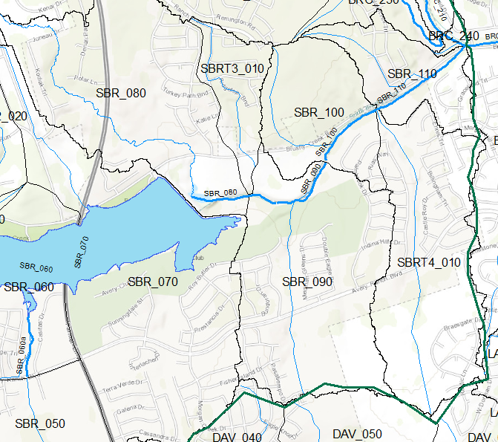
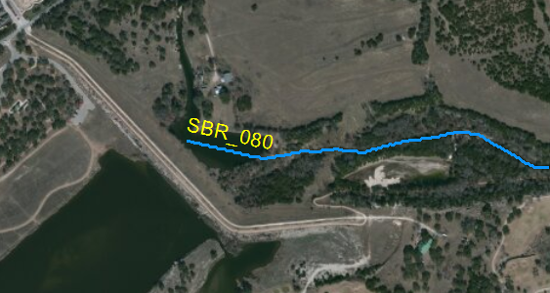
Reach SBR_080 Downstream of Dam 7
How do we route the flow through Reach SBR_080?

Slide 4
Hydrologic river routing (Muskingum Method)
Wedge storage in reach
Advancing
Flood
Wave
I > Q
K = travel time of peak through the reach
X = weight on inflow versus outflow (0 ≤ X ≤ 0.5)
X = 0 ➔ Reservoir, storage depends on outflow, no wedge
X = 0.0 - 0.3 ➔ Natural stream
Receding
Flood
Wave
Q > I

Slide 5
Muskingum Method (Cont.)
Recall:
Combine:
If I(t), K and X are known, Q(t) can be calculated using above equations

Slide 6
Muskingum - Example
Given:
  Inflow hydrograph
  K = 2.3 hr, X = 0.15, Δt = 1 hour, Initial Q = 85 cfs
Find:
  Outflow hydrograph using Muskingum routing method

Slide 7
Muskingum – Example (Cont.)
C₁ = 0.0631, C₂ = 0.3442, C₃ = 0.5927

Slide 8
Unsteady Flow Routing in Open Channels
Flow is one-dimensional
Hydrostatic pressure prevails and vertical accelerations are negligible
Streamline curvature is small.
Bottom slope of the channel is small.
Manning’s equation is used to describe resistance effects
The fluid is incompressible

Slide 9
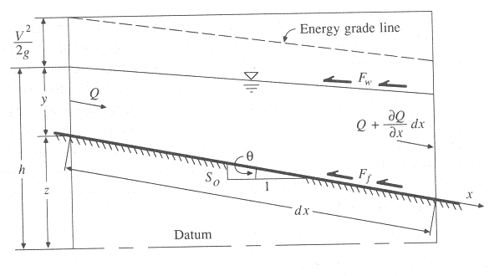
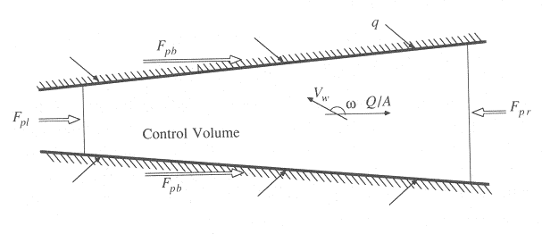
Continuity Equation
Q = inflow to the control volume
q = lateral inflow
Rate of change of flow with distance
Outflow from the C.V.
Change in mass
Elevation View
Reynolds transport theorem
Plan View

Slide 10
Momentum Equation
From Newton’s 2nd Law:
Net force = time rate of change of momentum
Sum of forces on the C.V.
Momentum stored within the C.V
Momentum flow across the C. S.

Slide 11
Forces acting on the C.V.
F_{g} = Gravity force due to weight of water in the C.V.
F_{f} = friction force due to shear stress along the bottom and sides of the C.V.
F_{e} = contraction/expansion force due to abrupt changes in the channel cross-section
F_{w} = wind shear force due to frictional resistance of wind at the water surface
F_{p} = unbalanced pressure forces due to hydrostatic forces on the left and right hand side of the C.V. and pressure force exerted by banks
Elevation View
Plan View

Slide 12

Momentum Equation
Sum of forces on the C.V.
Momentum stored within the C.V
Momentum flow across the C. S.

Slide 13
Momentum Equation(2)
Local acceleration term
Convective acceleration term
Pressure force term
Gravity force term
Friction force term
Kinematic Wave
Diffusion Wave
Dynamic Wave

Slide 14
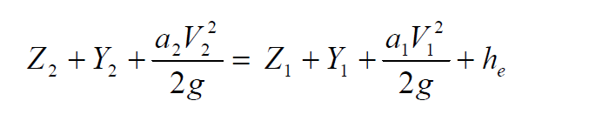
Momentum Equation (3)
Steady, uniform flow
Steady, non-uniform flow
Unsteady, non-uniform flow

Slide 15
Applications of different forms of momentum equation
Kinematic wave: when gravity forces and friction forces balance each other (steep slope channels with no back water effects)
Diffusion wave: when pressure forces are important in addition to gravity and frictional forces
Dynamic wave: when both inertial and pressure forces are important and backwater effects are not negligible (mild slope channels with downstream control, backwater effects)

Slide 16
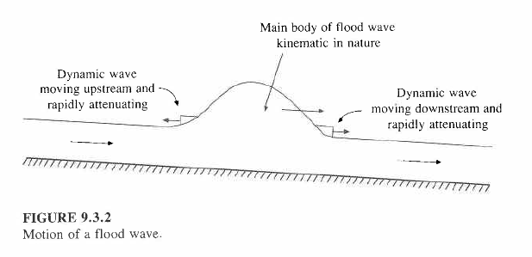
Kinematic Wave
Kinematic wave celerity, c_{k} is the speed of movement of the mass of a flood wave downstream
  Approximately, c_{k} = 5v/3 where v = water velocity

Slide 17
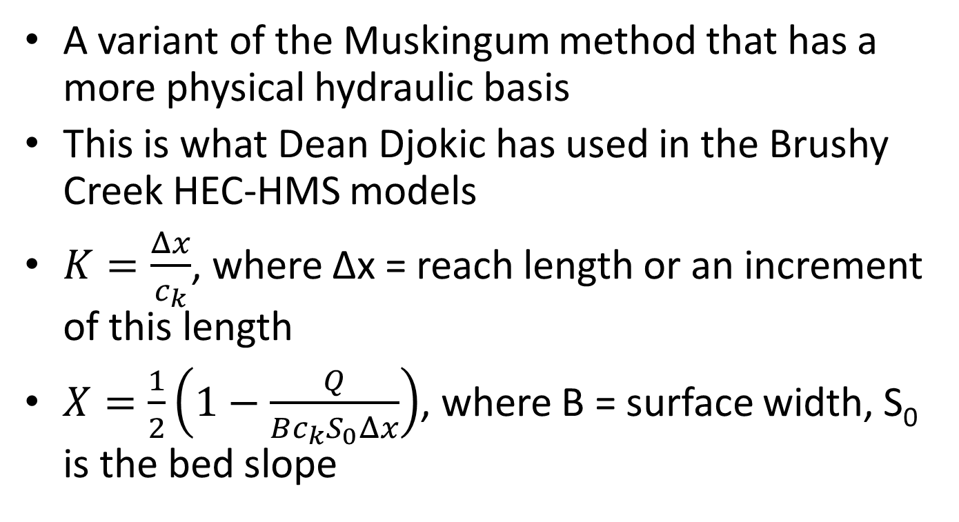
Muskingum-Cunge Method
A variant of the Muskingum method that has a more physical hydraulic basis
This is what Dean Djokic has used in the Brushy Creek HEC-HMS models
$K=\frac{Δx}{c_{k}}$, where Δx = reach length or an increment of this length
$X=\frac{1}{2}\left(1−\frac{Q}{Bc_{k}S_{0}Δx}\right)$, where B = surface width, S₀ is the bed slope

Slide 18
Reach SBR_080 Downstream of Dam 7
How do we route the flow through Reach SBR_080?

Slide 19
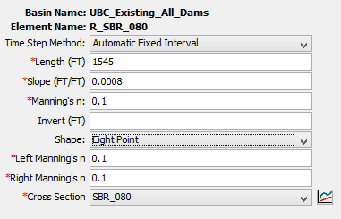
Longitudinal profile for reach SBR_080
1545 ft
0.0008
1

Slide 20
Cross-Section for SBR_080
Station | Elevation
0 | 797.6057
118.1 | 790.0711
236.2 | 781.6702
284 | 777.0652
304 | 777.0652
323.42 | 783.5712
344.26 | 789.859
365.1 | 795.4788

Slide 21
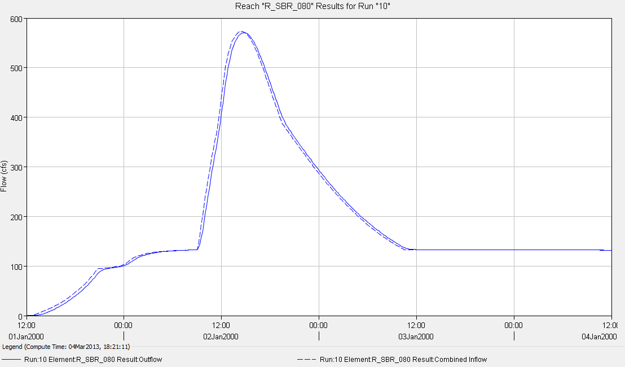
Routing in stream reach downstream of Dam 7

