Slide 1
Darcy’s Law for Flow through Porous Medium, first published in 1856
“Note D is on water filtration. It includes a description of a new device that seems to simply and economically resolve the problem of filtering water to supply a large city. To obtain this result, I take into consideration the law of water flow through sand, a law that I have demonstrated experimentally….. I have not seen the documents that are included in Note D collected in any special book. In particular, to my knowledge at least, no one has experimentally determined the laws of water flow through sand.”
Bobeck translation, p. xxv
Published in Paris by Victor Dalmont, Publisher for Imperial Corps of Bridges, Roads and Mines
Quai des Augustins, 49 1856
Translation, Patrica Bobeck, 2004

Slide 2
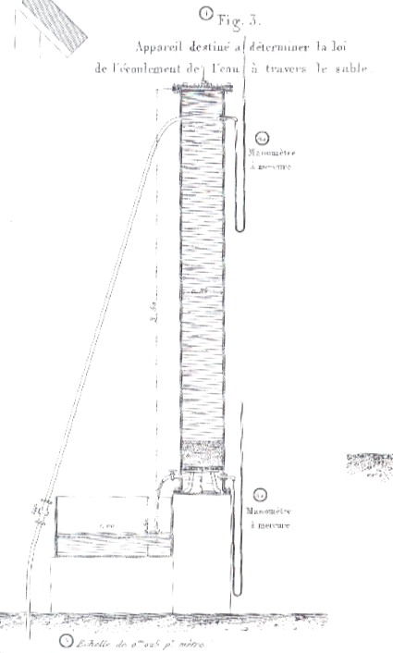
Darcy’s Law
“Thus, if we denote the thickness of the sand
layer by e, its surface area by s, atmospheric pressure by P, and the height of the water on the sand layer by h, we will have P+h for the pressure to which the upper end will be subjected. In addition, if P ± h₀ is the pressure to which the lower surface is subjected, k is a coefficient that depends on the permeability of the layer and q is the volume discharge, we have
$$q=k\frac{s}{e}\left[h+e±h_{0}\right]$$
which reduces to
$q=k\frac{s}{e}\left[h+e\right]$
when h₀ = 0 or pressure under the filter is equal to atmospheric pressure.”
P+h
Pressurized water supply in a hospital
s
e
k
Sand column is 2.3 m high
0.35m diameter
P ± h₀
q
Diagram from Plate 24
Description of experiments and equation, p. 455-459,
as part of Appendix D in the book of 506 pages.

Slide 3
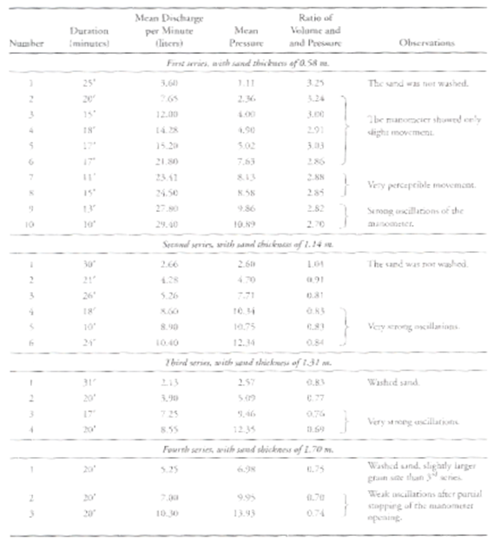
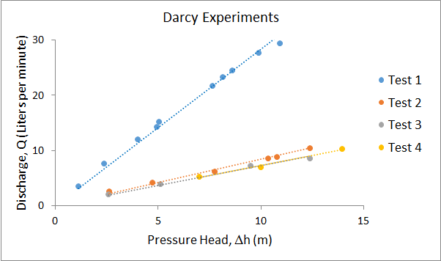
Tests conducted on 29-30 October, and 6 November, 1855
“Thus, it appears that for an identical sand, it can be assumed that the volume discharged is proportional to the head and inversely proportional to the thickness of the sand layer that the water passes through.”
Test 1 – sand was not washed
Test 2 – sand was not washed
Test 3 – sand was washed
Test 4 – washed sand with a slightly larger grain size
Ratio of discharge/pressure head ~ constant for each test

Slide 4
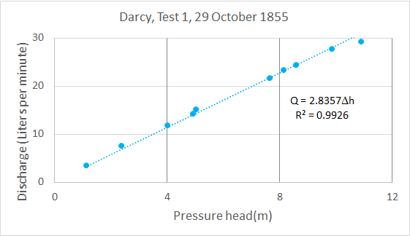
Hydraulic Conductivity in Test 1, 29 Oct 1855
Darcy’s Law:
$$Q=KA\frac{Δh}{L}$$
$A=\frac{π}{4}D^{2}$= $\frac{π}{4}{(0.35)}^{2}$ = 0.09621m²
$$K=\frac{1}{A}\frac{Q}{Δh}L=\frac{1}{0.09621}\frac{Q}{Δh}L=10.394\frac{Q}{Δh}L$$
For Test 1, Q/Δh = 2.8357, L$=0.58m$
$$K= 10.394∗2.8357 ∗0.58$$
$$=17.09\frac{L}{min−m2 }$$
$$=\underline{1.03m/hr }$$
These are reasonable numbers for “slow sand” filters
Modern “rapid sand” filters have conductivities of 5-12 m/hr
The Green-Ampt conductivity for sand is 12 cm/hr

