Slide 1
Hydrologic Design Storms
Reading: Applied Hydrology Sections 14-1 to 14-4

Slide 2
Hydrologic design
Water control
  Peak flows, erosion, pollution, etc.
Water management
  Domestic and industrial use, irrigation, instream flows, etc
Tasks
  Determine design inflow
  Route the design inflow
  Find the output
    check if it is sufficient to meet the demands (for management)
    Check if the outflow is at safe level (for control)

Slide 3
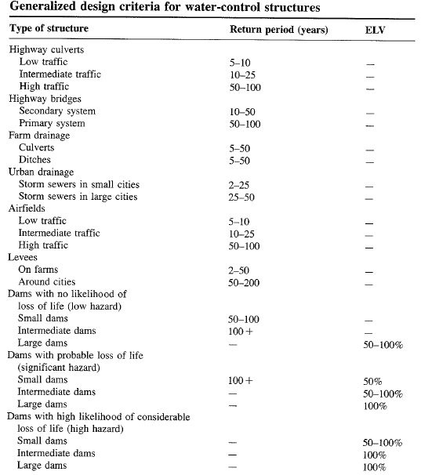

Slide 4
Return Period
Random variable:
Threshold level:
Extreme event occurs if:
Recurrence interval:
Return Period:
  Average recurrence interval between events equalling or exceeding a threshold
If p is the probability of occurrence of an extreme event, then
or

Slide 5
More on return period
If p is probability of success, then (1-p) is the probability of failure
Find probability that (X ≥ x_{T}) at least once in N years.

Slide 6
Risk Analysis
Uncertainty in hydrology
  Inherent - stochastic nature of hydrologic phenomena
  Model – approximations in equations
  Parameter – estimation of coefficients in equations
Consideration of Risk
  Structure may fail if event exceeds T–year design magnitude
  R = P(event occurs at least once in n years)
    Natural inherent risk of failure

Slide 7
Example 13.2.2
Expected life of culvert = 10 yrs
Acceptable risk of 10 % for the culvert capacity
Find the design return period
What is the chance that the culvert designed for an event of 95 yr return period will have its capacity exceeded at least once in 50 yrs?
The chance that the capacity will not be exceeded during the next 50 yrs is 1-0.41 = 0.59

Slide 8
Hydroeconomic Analysis
Probability distribution of hydrologic event and damage associated with its occurrence are known
As the design period increases, capital cost increases, but the cost associated with expected damages decreases.
In hydroeconomic analysis, find return period that has minimum total (capital + damage) cost.

Slide 9
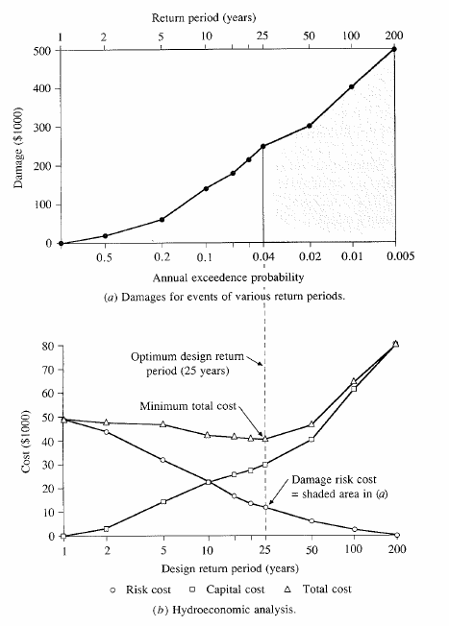

Slide 10
Design Storms
Get Depth, Duration, Frequency Data for the required location
Select a return period
Convert Depth-Duration data to a design hyetograph.

Slide 11
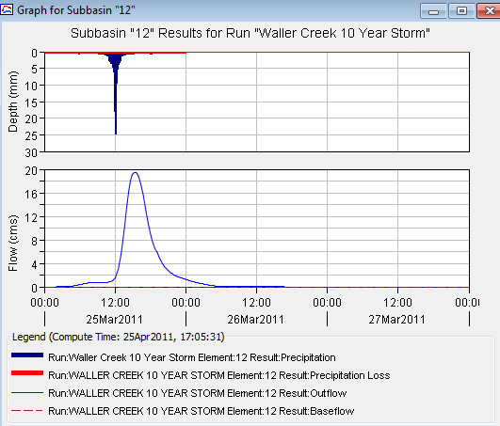
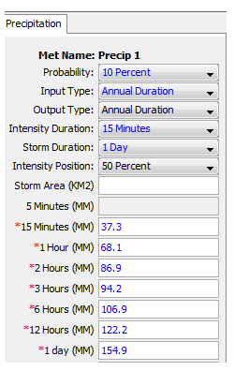
Depth Duration Data to Rainfall Hyetograph

Slide 12
TP 40
Hershfield (1961) developed isohyetal maps of design rainfall and published in TP 40.
TP 40 – U. S. Weather Bureau technical paper no. 40. Also called precipitation frequency atlas maps or precipitation atlas of the United States.
  30mins to 24hr maps for T = 1 to 100
Web resources for TP 40 and rainfall frequency maps
  http://www.tucson.ars.ag.gov/agwa/rainfall_frequency.html
  http://www.erh.noaa.gov/er/hq/Tp40s.htm
  http://hdsc.nws.noaa.gov/hdsc/pfds/

Slide 13
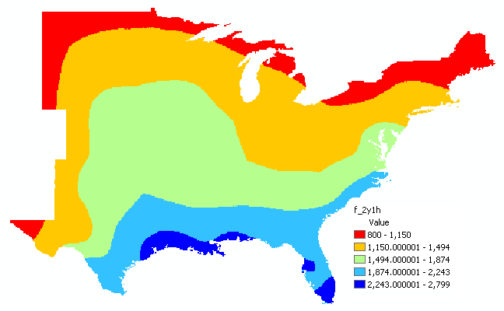
2yr-60min precipitation GIS map

Slide 14
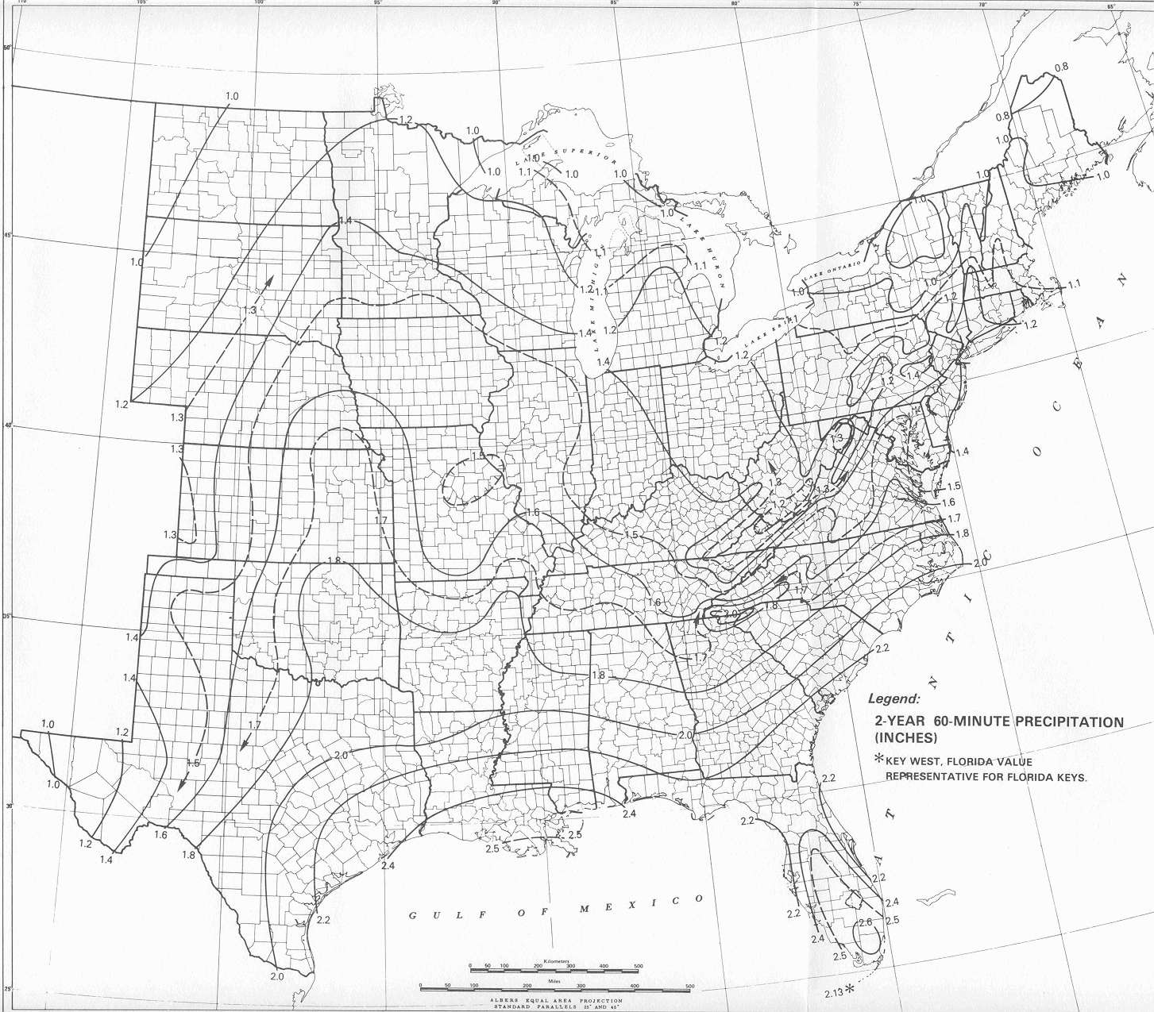
2yr-60min precipitation map
This map is from HYDRO 35 (another publication from NWS) which supersedes TP 40

Slide 15

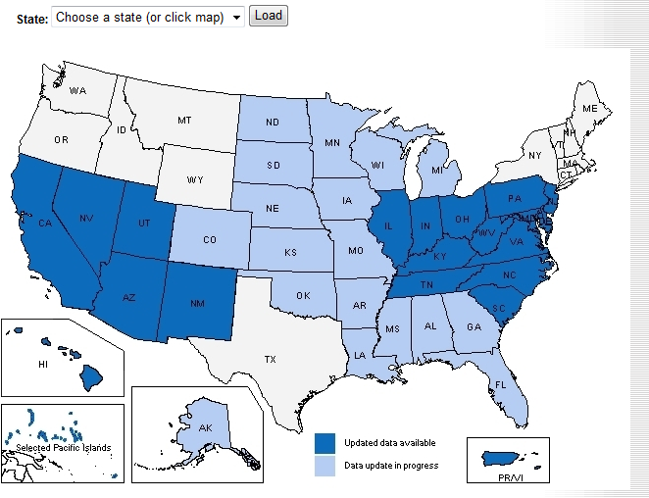
http://hdsc.nws.noaa.gov/hdsc/pfds/index.html

Slide 16
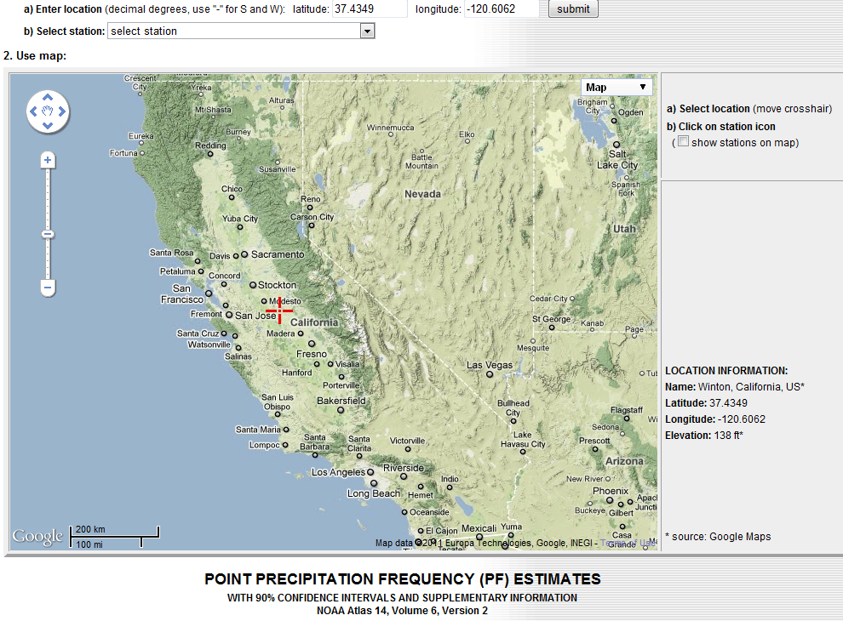
An example of precipitation frequency estimates for a location in California
37.4349 N
120.6062 W

Slide 17
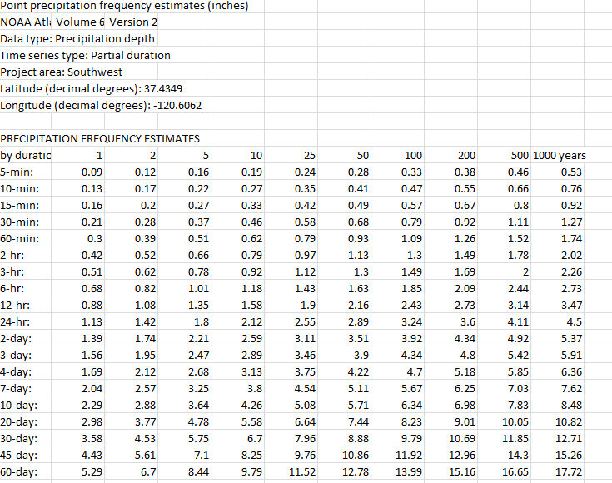
Results of Precip Frequency Query

Slide 18
Design areal precipitation
Point precipitation estimates are extended to develop an average precipitation depth over an area
Depth-area-duration analysis
  Prepare isohyetal maps from point precipitation for different durations
  Determine area contained within each isohyet
  Plot average precipitation depth vs. area for each duration

Slide 19
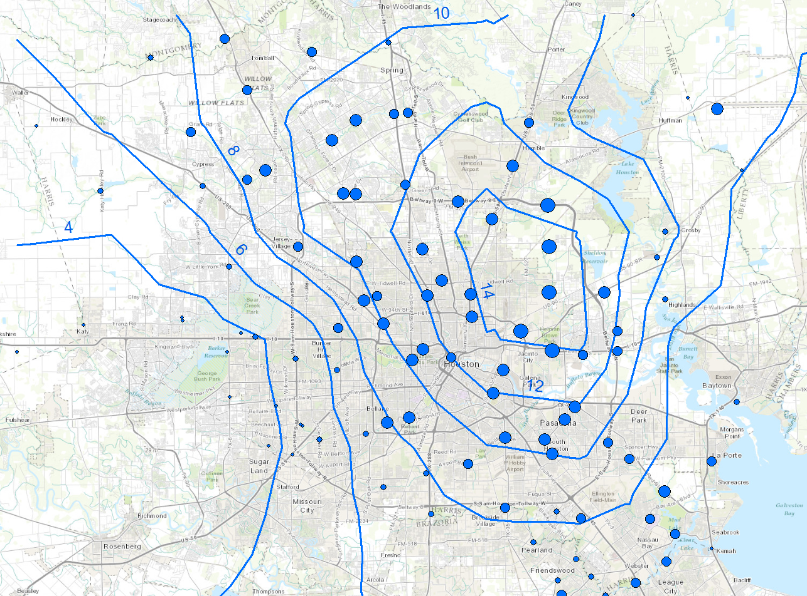
Tropical Storm Allison

Slide 20
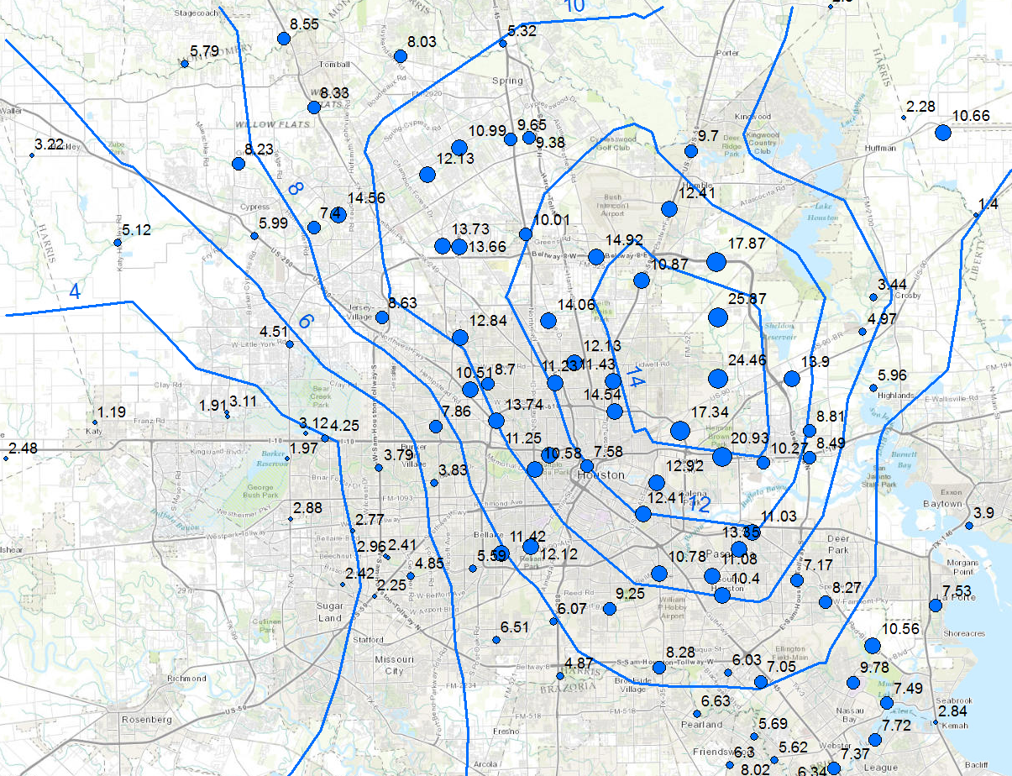
TS Allison

Slide 21
Depth-area curve
(World Meteorological Organization, 1983)

Slide 22
TS Allison

Slide 23
Extreme Rainfalls, Station 1600
Time | Rainfall | 2-Hour | 3-Hour | 4-hour
1.00 | 0.00
2.00 | 0.04 | 0.04
3.00 | 1.18 | 1.22 | 1.22
4.00 | 0.98 | 2.16 | 2.20 | 2.20
5.00 | 2.48 | 3.46 | 4.64 | 4.68
6.00 | 2.40 | 4.88 | 5.86 | 7.04
7.00 | 1.46 | 3.86 | 6.34 | 7.32
8.00 | 1.69 | 3.15 | 5.55 | 8.03
9.00 | 4.88 | 6.57 | 8.03 | 10.43
10.00 | 3.39 | 8.27 | 9.96 | 11.42
11.00 | 3.86 | 7.25 | 12.13 | 13.82
12.00 | 3.19 | 7.05 | 10.44 | 15.32
13.00 | 0.00 | 3.19 | 7.05 | 10.44
14.00 | 0.20 | 0.20 | 3.39 | 7.25
15.00 | 0.08 | 0.28 | 0.28 | 3.47
16.00 | 0.04 | 0.12 | 0.32 | 0.32
17.00 | 0.00 | 0.04 | 0.12 | 0.32
Depth | 4.88 | 8.27 | 12.13 | 15.32
Intensity | 4.88 | 4.13 | 4.03 | 3.83
Values in inches for depth
and inches per hour for intensity

Slide 24
Depth (intensity)-duration-frequency
DDF/IDF – graph of depth (intensity) versus duration for different frequencies
  TP 40 or HYDRO 35 gives spatial distribution of rainfall depths for a given duration and frequency
  DDF/IDF curve gives depths for different durations and frequencies at a particular location
  TP 40 or HYDRO 35 can be used to develop DDF/IDF curves
Depth (P) = intensity (i) x duration (T_{d})

Slide 25
IDF curve

Slide 26
Example 14.2.1
Determine i and P for a 20-min duration storm with 5-yr return period in Chicago
From the IDF curve for Chicago,
i = 3.5 in/hr for T_{d} = 20 min and T = 5yr
P = i x T_{d} = 3.5 x 20/60 = 1.17 in

Slide 27
Equations for IDF curves
IDF curves can also be expressed as equations to avoid reading from graphs
i is precipitation intensity, T_{d} is the duration, and c, e, f are coefficients that vary for locations and different return periods
This equation includes return period (T) and has an extra coefficient (m)

Slide 28
Example 14.2.4
Using IDF curve equation, determine 10-yr 20-min design rainfall intensities for Denver
From Table 14.2.3 in the text, c = 96.6, e = 0.97, and f = 13.9
Similarly, i = 4.158 and 2.357 in/hr for T_{d} = 10 and 30 min, respectively

Slide 29
IDF curves for Austin
Source: City of Austin, Watershed Management Division

Slide 30
Design Precipitation Hyetographs
Most often hydrologists are interested in precipitation hyetographs and not just the peak estimates.
Techniques for developing design precipitation hyetographs
  SCS method
  Triangular hyetograph method
  Using IDF relationships (Alternating block method)

Slide 31
TS Allison

Slide 32
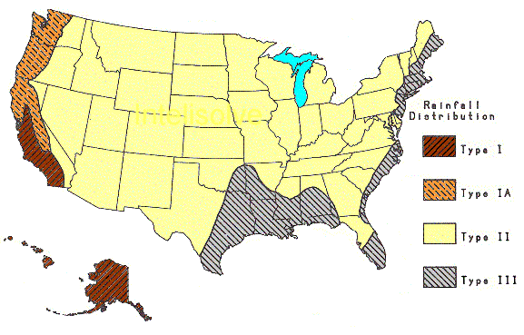
SCS Method
SCS (1973) adopted method similar to DDF to develop dimensionless rainfall temporal patterns called type curves for four different regions in the US.
SCS type curves are in the form of percentage mass (cumulative) curves based on 24-hr rainfall of the desired frequency.
If a single precipitation depth of desired frequency is known, the SCS type curve is rescaled (multiplied by the known number) to get the time distribution.
For durations less than 24 hr, the steepest part of the type curve for required duraction is used

Slide 33
SCS type curves for Texas (II&III)
SCS 24-Hour Rainfall Distributions |  |  |  | SCS 24-Hour Rainfall Distributions
T (hrs) | Fraction of 24-hr rainfall |  |  | T (hrs) | Fraction of 24-hr rainfall
 | Type II | Type III |  |  | Type II | Type III
0.0 | 0.000 | 0.000 |  | 11.5 | 0.283 | 0.298
1.0 | 0.011 | 0.010 |  | 11.8 | 0.357 | 0.339
2.0 | 0.022 | 0.020 |  | 12.0 | 0.663 | 0.500
3.0 | 0.034 | 0.031 |  | 12.5 | 0.735 | 0.702
4.0 | 0.048 | 0.043 |  | 13.0 | 0.772 | 0.751
5.0 | 0.063 | 0.057 |  | 13.5 | 0.799 | 0.785
6.0 | 0.080 | 0.072 |  | 14.0 | 0.820 | 0.811
7.0 | 0.098 | 0.089 |  | 15.0 | 0.854 | 0.854
8.0 | 0.120 | 0.115 |  | 16.0 | 0.880 | 0.886
8.5 | 0.133 | 0.130 |  | 17.0 | 0.903 | 0.910
9.0 | 0.147 | 0.148 |  | 18.0 | 0.922 | 0.928
9.5 | 0.163 | 0.167 |  | 19.0 | 0.938 | 0.943
9.8 | 0.172 | 0.178 |  | 20.0 | 0.952 | 0.957
10.0 | 0.181 | 0.189 |  | 21.0 | 0.964 | 0.969
10.5 | 0.204 | 0.216 |  | 22.0 | 0.976 | 0.981
11.0 | 0.235 | 0.250 |  | 23.0 | 0.988 | 0.991
 |  |  |  | 24.0 | 1.000 | 1.000

Slide 34
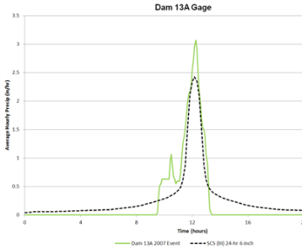
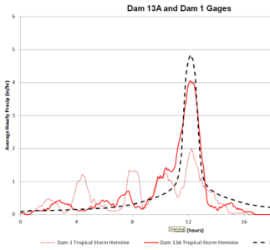
Choice of Calibration Storms
    Representative?
      In temporal shape
2007 Storm
2010 Hermine Storm

Slide 35
SCS Method Steps
Given T_{d} and frequency/T, find the design hyetograph
  Compute P/i (from DDF/IDF curves or equations)
  Pick a SCS type curve based on the location
  If T_{d} = 24 hour, multiply (rescale) the type curve with P to get the design mass curve
    If T_{d} is less than 24 hr, pick the steepest part of the type curve for rescaling
  Get the incremental precipitation from the rescaled mass curve to develop the design hyetograph

Slide 36
Example – SCS Method
Find - rainfall hyetograph for a 25-year, 24-hour duration SCS Type-III storm in Harris County using a one-hour time increment
a = 81, b = 7.7, c = 0.724 (from Tx-DOT hydraulic manual)
Find
  Cumulative fraction - interpolate SCS table
  Cumulative rainfall = product of cumulative fraction * total 24-hour rainfall (10.01 in)
  Incremental rainfall = difference between current and preceding cumulative rainfall
TxDOT hydraulic manual is available at:
http://manuals.dot.state.tx.us/docs/colbridg/forms/hyd.pdf

Slide 37
SCS – Example (Cont.)
If a hyetograph for less than 24 needs to be prepared, pick time intervals that include the steepest part of the type curve (to capture peak rainfall). For 3-hr pick 11 to 13, 6-hr pick 9 to 14 and so on.

Slide 38
Triangular Hyetograph Method
T_{d}: hyetograph base length = precipitation duration
t_{a}: time before the peak
r: storm advancement coefficient = t_{a}/T_{d}
t_{b}: recession time = T_{d} – t_{a} = (1-r)T_{d}
t_{a}
t_{b}
Rainfall intensity, i
h
T_{d}
Time
Given T_{d} and frequency/T, find the design hyetograph
  Compute P/i (from DDF/IDF curves or equations)
  Use above equations to get t_{a}, t_{b}, T_{d} and h (r is available for various locations)

Slide 39
Triangular hyetograph - example
Find - rainfall hyetograph for a 25-year, 6-hour duration in Harris County. Use storm advancement coefficient of 0.5.
a = 81, b = 7.7, c = 0.724 (from Tx-DOT hydraulic manual)
3 hr
3 hr
Rainfall intensity, in/hr
2.24
6 hr
Time

Slide 40
Alternating block method
Given T_{d} and T/frequency, develop a hyetograph in Δt increments
  Using T, find i for Δt, 2Δt, 3Δt,…nΔt using the IDF curve for the specified location
  Using i compute P for Δt, 2Δt, 3Δt,…nΔt. This gives cumulative P.
  Compute incremental precipitation from cumulative P.
  Pick the highest incremental precipitation (maximum block) and place it in the middle of the hyetograph. Pick the second highest block and place it to the right of the maximum block, pick the third highest block and place it to the left of the maximum block, pick the fourth highest block and place it to the right of the maximum block (after second block), and so on until the last block.

Slide 41
Example: Alternating Block Method
Find: Design precipitation hyetograph for a 2-hour storm (in 10 minute increments) in Denver with a 10-year return period 10-minute

