Slide 1
Evaporation
What is evaporation?
How is evaporation measured?
How is evaporation estimated?
Reading for today: Applied Hydrology Sections 3.5 and 3.6
Reading for Tuesday: Applied Hydrology Sections 4.1 and 4.2 on Infiltration and soil water movement

Slide 2
Evaporation
  Evaporation – process by which liquid water becomes water vapor
  Transpiration – process by which liquid water passes from liquid to vapor through plant metabolism
  Evapotranspiration – evaporation through plants and trees, and directly from the soil and land surface
  Potential Evaporation – evaporation from an open water surface or from a well-watered grass surface

Slide 3
Factors Influencing Evaporation
Energy supply for vaporization (latent heat)
  Solar radiation
Transport of vapor away from evaporative surface
  Wind velocity over surface
  Specific humidity gradient above surface
Vegetated surfaces
  Supply of moisture to the surface
  Evapotranspiration (ET)
    Potential Evapotranspiration (PET) – moisture supply is not limited
Net radiation
u
Air Flow
Evaporation

Slide 4
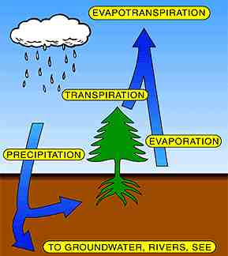
Evapotranspiration (ET)
Over land surfaces, we cannot distinguish between water vapor that evaporated from the soil and water vapor that was transpired through plants

Slide 5
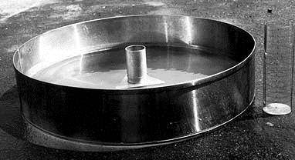
Evaporation from an Open Water Surface
Simplest form of evapotranspiration
  This is the amount of water lost from lakes and reservoirs
  Often estimating by measuring the loss from a National Weather Service Class A pan
This is referred to as Potential Evapotranspiration (ET_{p}) because it is the maximum potential rate of ET under the given meteorological conditions

Slide 6
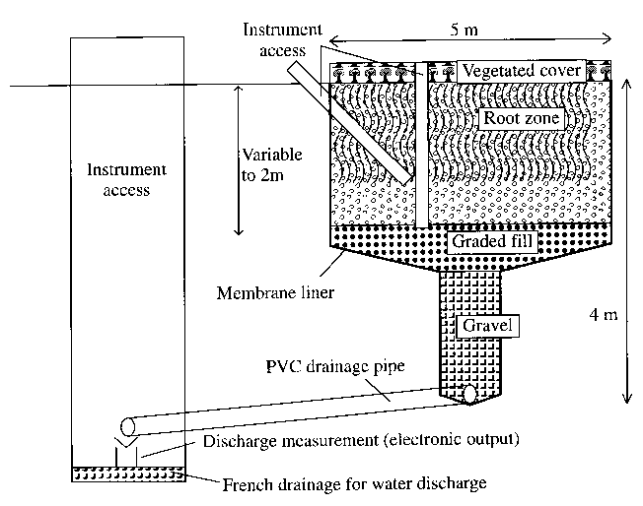
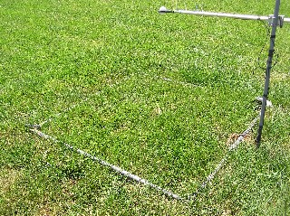
Lysimeters
Measurement of evapotranspiration

Slide 7
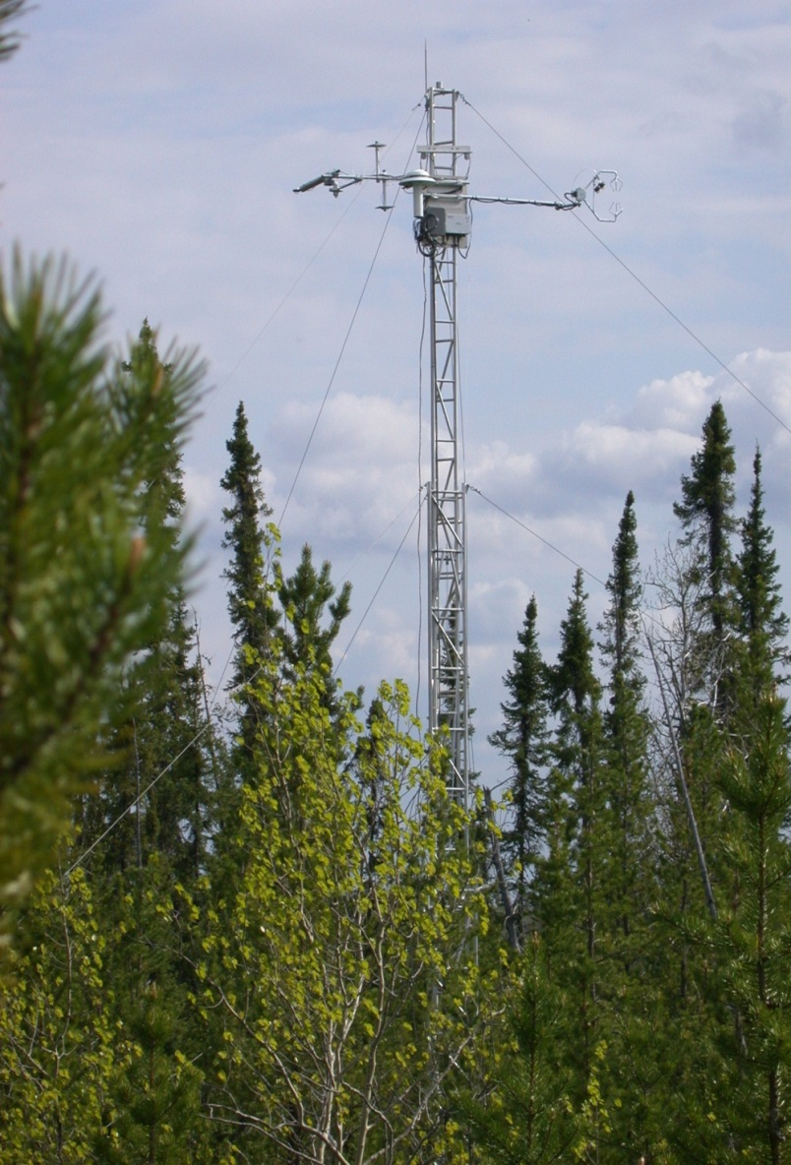
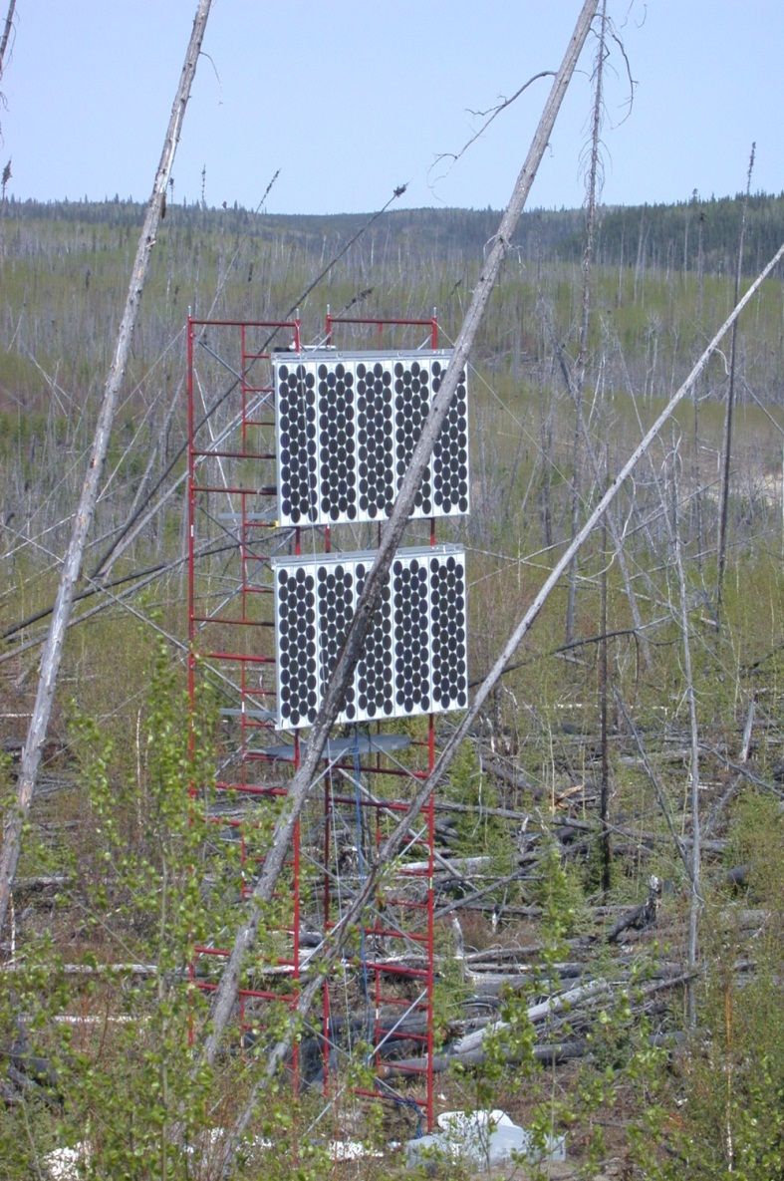
Flux Towers (Marcy Litvak)

Slide 8
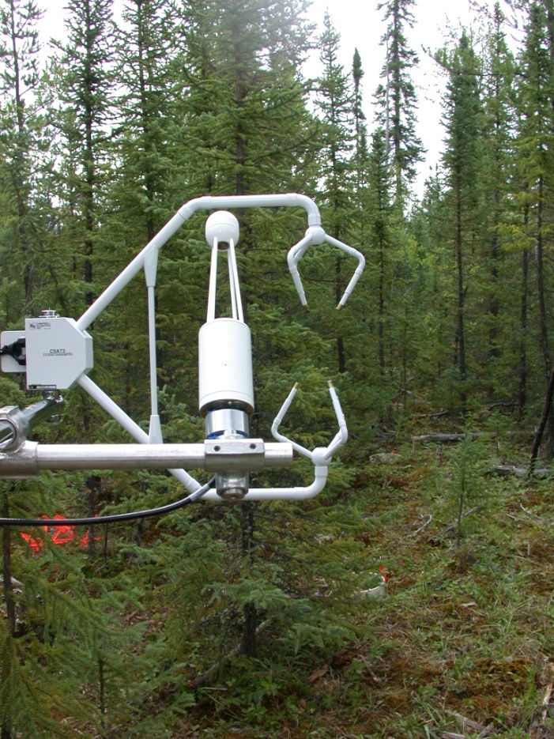
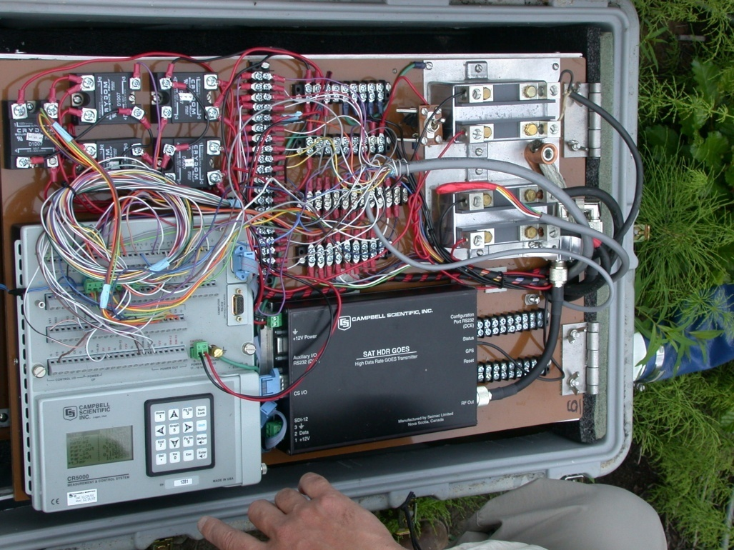
Flux tower instruments
Notes:
The eddy correlation technique is very simple in theory, but quite difficult to put into practice. A major problem has been availability of sufficiently fast instruments to measure the fluctuating signals. Unless an instrument has a sufficiently fast response and logging time to resolve the fastest eddies contributing to the turbulent flux, this portion of the flux will not be recorded. Another effect of slow logging is that the faster eddies may fold around the
Ultrasonic Doppler anemometers are normally used to measure the three components of wind. These instruments are easily fast enough to resolve turbulence under most practical conditions, - they have maximum response and reporting frequencies up to around 100 Hz. The problem with such anemometers tends to be designing logging systems fast enough to log the data.
The potential difficulty in designing working Eddy Covariance systems is often in finding the right instrument to detect the variable of interest to be correlated with the vertical wind fluctuations (the scalar variable). Some instruments simply are not fast enough, for example the DMPS (see section 7), and many chemiluminescent analysers. Also, measuring certain gases is fundamentally problematic, as some ("sticky") gases can adhere to the inside of inlet lines before reaching the analyser. This damps the signal, giving the same problem as a poor frequency response instrument (although without the frequency folding).
The final factor affecting response time of eddy covariance systems is the size of the sensor. Eddies smaller than the size of the transducer array of the anemometer cannot be detected effectively. This places an upper frequency limit on response according to Taylor’s hypothesis (see section 4.1). The effect of this limit has not been observed in measurements referred this work.
The frequency required for the Eddy Covariance method depends upon the mean eddy size at the sensors. This is a function of surface roughness length z0 (see section 4.2.4) and measurement height z. Specifically, larger values of z0 give larger mean eddy sizes and ease the frequency requirements for the system. Equally, larger values of z (larger measurement heights) give larger mean eddy sizes, having the same effect.

Slide 9
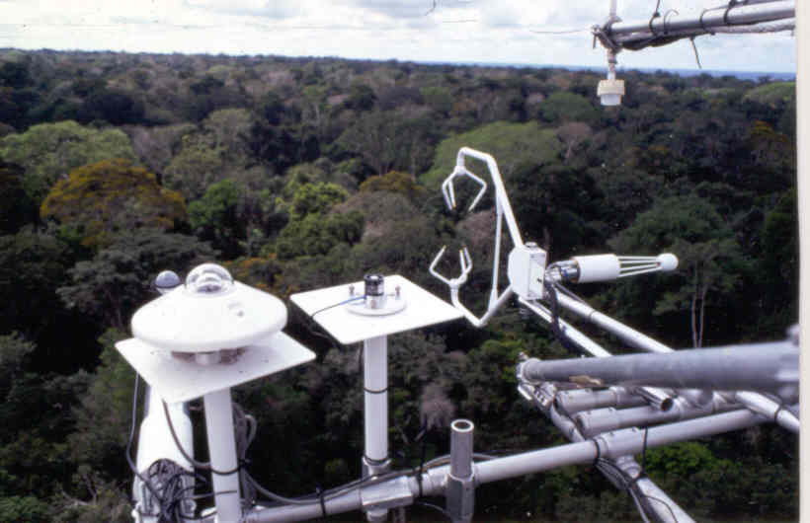
Flux tower instruments
3-D Sonic anemometer
Quantum
sensor
Pyrronometer
IRGA
Net radiometer

Slide 10
Air Temperature at 1m and 10m
Freeman Ranc Flux Tower (Marcy Litvak)

Slide 11
Vapor Pressure and Saturated Vapor Pressure (kPa)

Slide 12
Relative Humidity at 1m and 10m
Average = 0.71
Average = 0.61

Slide 13
Wind Speed (m/s)

Slide 14
Net Radiation (W/m²)

Slide 15
ET -Eddy covariance method
Measurement of vertical transfer of water vapor driven by convective motion
Directly measure flux by sensing properties of eddies as they pass through a measurement level on an instantaneous basis
Statistical tool

Slide 16
Basic Theory
Instantaneous
Perturbation from
The mean
Instantaneous
signal
Time averaged property
All atmospheric entities show short-period fluctuations about their long term mean value
Notes:
All atmospheric entities show short-period fluctuations about their longer term mean value
Overbar indicates time-averaged property
Prime signifies instantaneous deviation from the mean, positive indicates above the mean

Slide 17
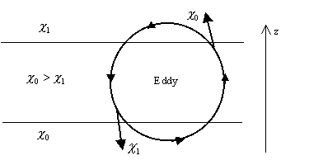
Turbulent mixing
Propterties carried by eddies:
Mass, density ρ
Vertical velocity w
Volumetric content q_{v}
Temperature T
Notes:
Eddy mixes air from above downwards, and from below upwards
Concentration of entity is greater below, as it is mixed upwards causes a positive perturbation

Slide 18
Sensible Heat Flux (W/m²)

Slide 19
Latent Heat Flux (W/m²)

Slide 20
Evaporation (mm/day)
Average = 3.15 mm/day

Slide 21
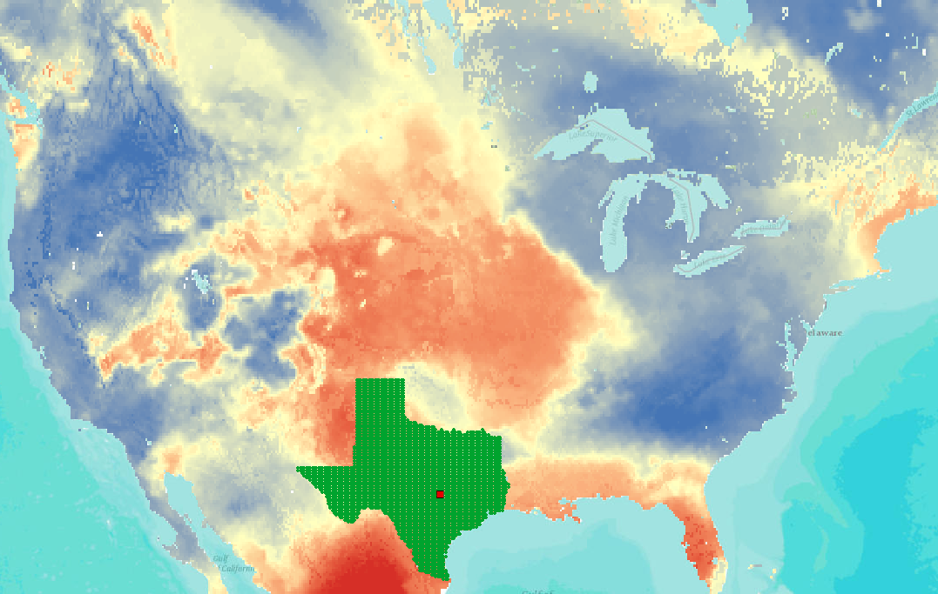

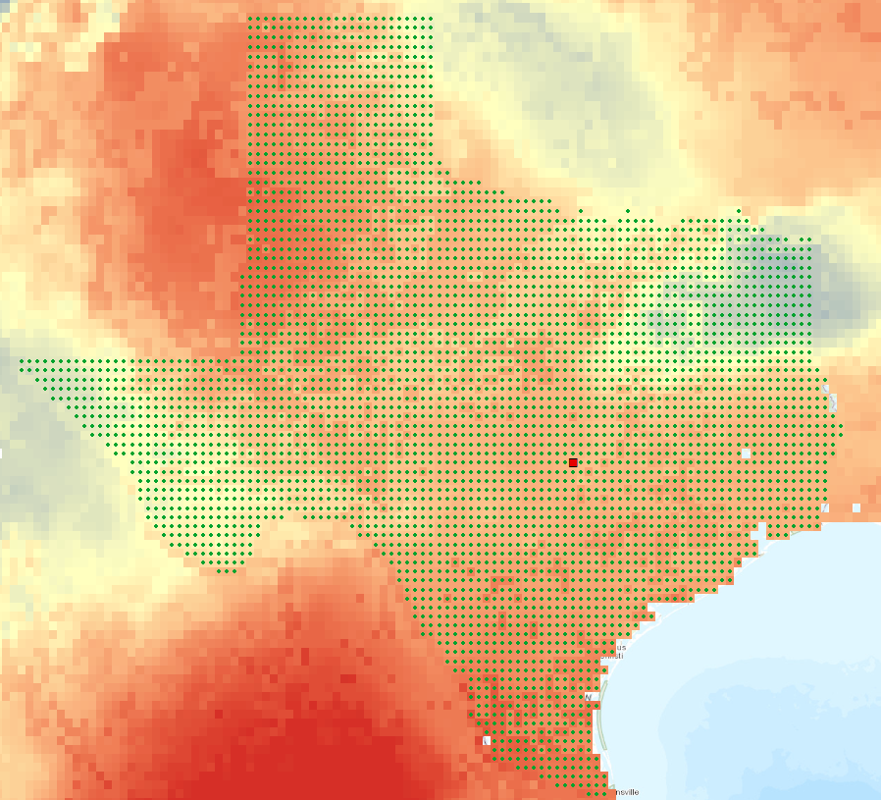
National Land Data Assimilation System (NLDAS)
464 x 224 = 103,936 cells
(67°W, 53°N)
1/8°
1/8°
(125°W, 25°N)
One cell is selected for download of time series data

Slide 22
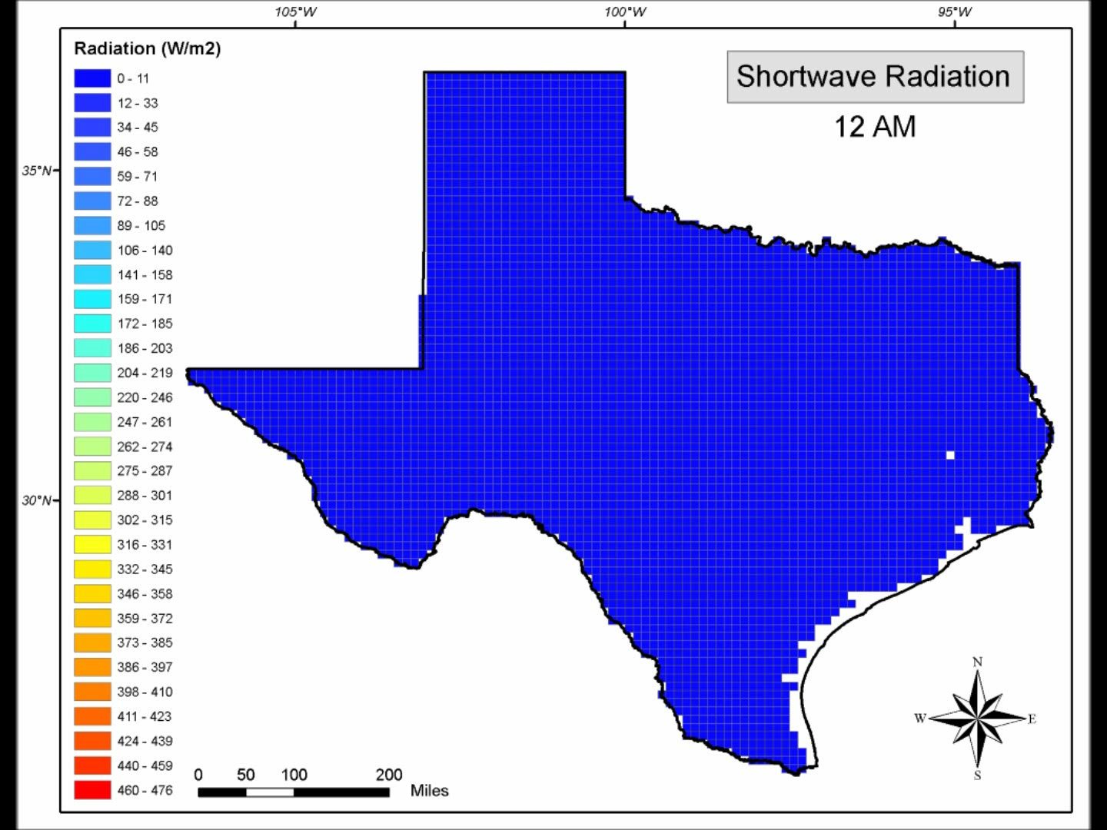
Net Short Wave Radiation (NLDAS)

Slide 23
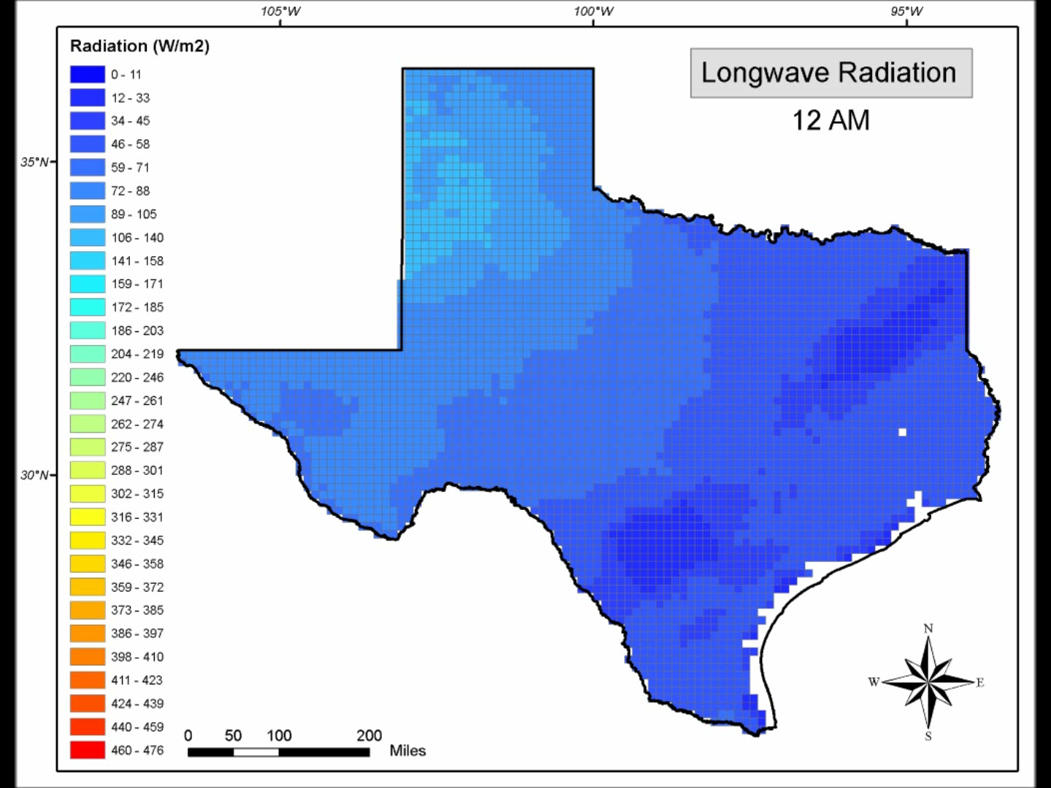
Net Longwave Radiation (NLDAS)

Slide 24
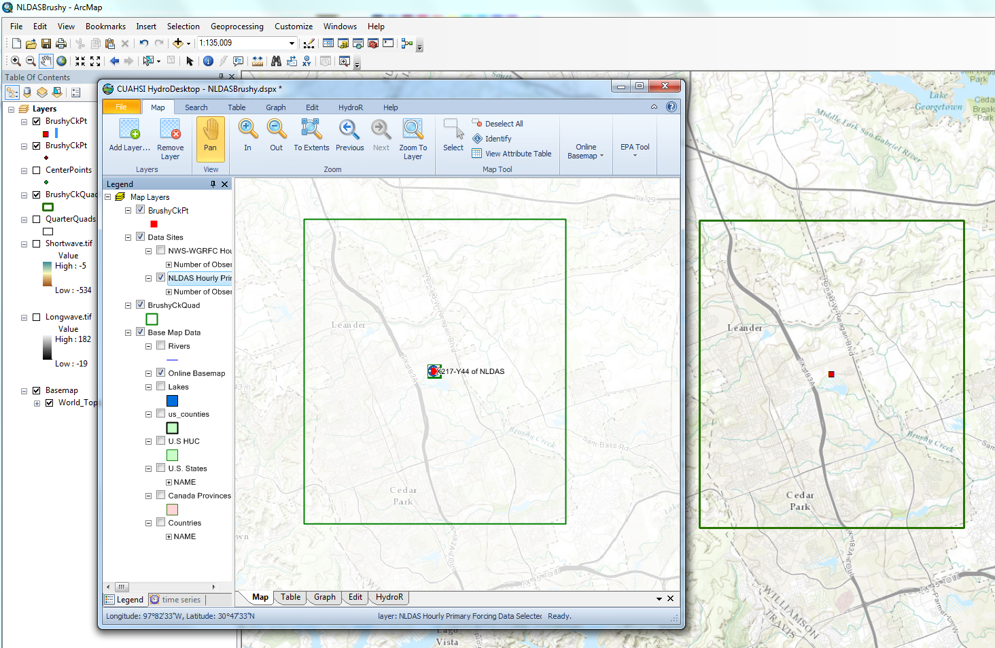
NLDAS in ArcMap and HydroDesktop
One cell is selected in ArcMap for download of time series data in HydroDesktop
HydroDesktop
ArcMap
An NLDAS point and surrounding area (USGS 7.5’ quad map area) on ESRI topographic base map

Slide 25
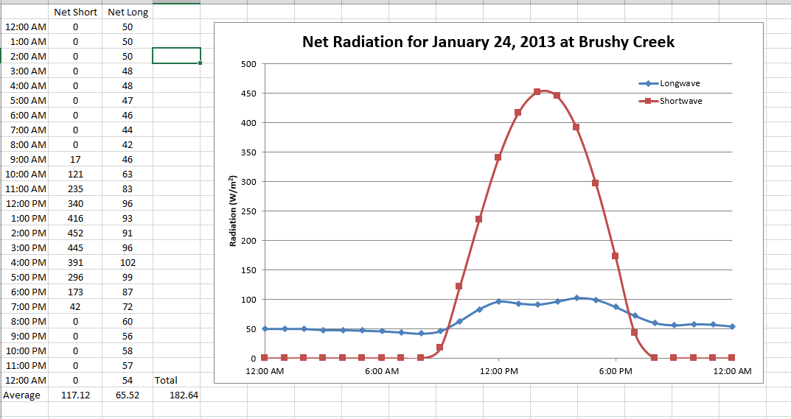
Net Radiation at Brushy Creek

Slide 26
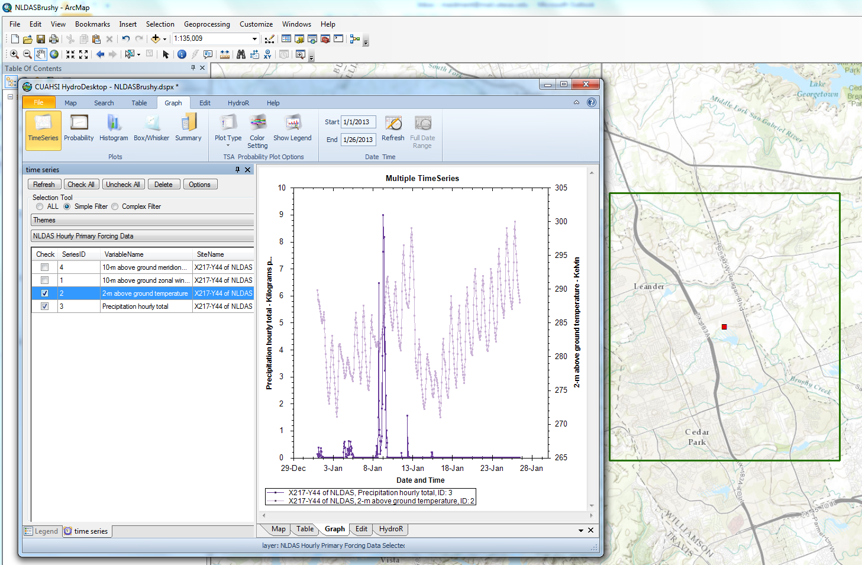
Hourly NLDAS data for 2013
Data up to Jan 26 are accessible on Jan 30
Air Temperature
Precipitation

Slide 27
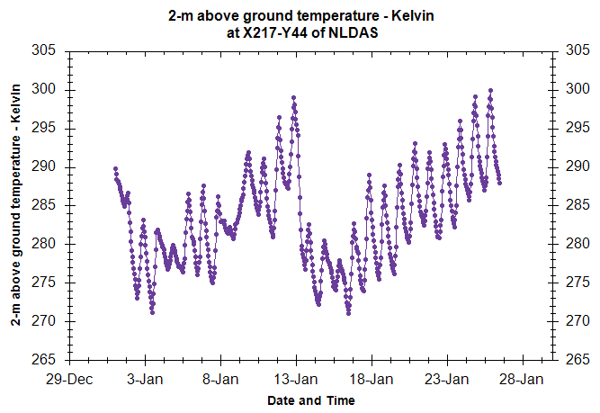
Air Temperature (NLDAS)

Slide 28
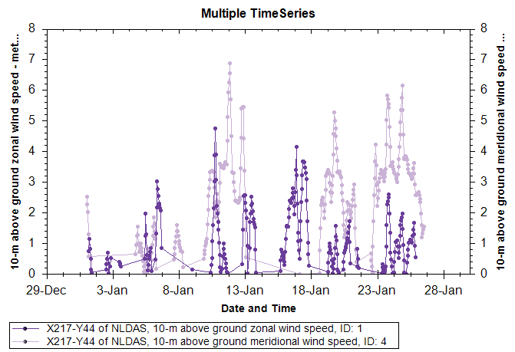
Wind Speed (m/s) (NLDAS)

Slide 29
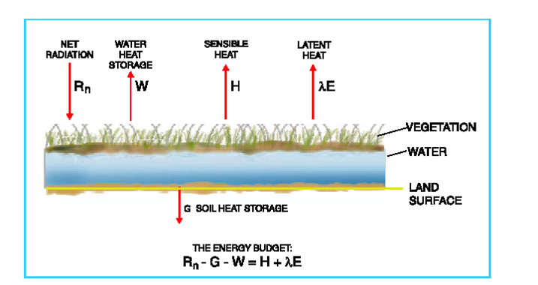
Energy Balance Method
Can directly measure these variables
How do you partition
H and λE??

Slide 30
Energy Method
CV contains liquid and vapor phase water
Continuity - Liquid phase
No flow of liquid
water through CS
h

Slide 31
Energy Method
Continuity - Vapor phase
Steady flow of air
over water
h

Slide 32
Energy Method
Energy Eq.
h

Slide 33
Energy Method
Energy Eq. for Water in CV
h
Assume:
1. Constant temp of water in CV
2. Change of heat is change in internal energy of water evaporated
Recall:
Neglecting sensible and ground heat fluxes

Slide 34
Wind as a Factor in Evaporation
Wind has a major effect on evaporation, E
  Wind removes vapor-laden air by convection
  This Keeps boundary layer thin
  Maintains a high rate of water transfer from liquid to vapor phase
  Wind is also turbulent
    Convective diffusion is several orders of magnitude larger than molecular diffusion

Slide 35
Aerodynamic Method
Include transport of vapor away from water surface as function of:
  Humidity gradient above surface
  Wind speed across surface
Upward vapor flux
Upward momentum flux
Net radiation
Air Flow
Evaporation

Slide 36
Aerodynamic Method
Log-velocity profile
Momentum flux
Net radiation
Air Flow
Z
Evaporation
u
Thornthwaite-Holzman Equation

Slide 37
Aerodynamic Method
Often only available at 1 elevation
Simplifying
Net radiation
Air Flow
Evaporation

Slide 38
Combined Method
Evaporation is calculated by
  Aerodynamic method
    Energy supply is not limiting
  Energy method
    Vapor transport is not limiting
Normally, both are limiting, so use a combination method
Priestly & Taylor

