Slide 1
Extreme Storms
Reading: Applied Hydrology Sections 14-5, 14-6

Slide 2
http://www.tsarp.com/
Most costly urban flood disaster in the history of the United States

Slide 3
Major Highways during Tropical Storm Allison
I-10 West
I-45 South
http://www.chron.com/content/chronicle/special/01/flood/

Slide 4
Kayaking on US 59, Houston (Tropical Storm Allison)
http://www.chron.com/content/chronicle/special/01/flood/

Slide 5
Residential Flooding in Tropical Storm Allison
http://www.chron.com/content/chronicle/special/01/flood/

Slide 6
The Human Cost
Saving the wedding photos
Cleaning out the car
http://www.chron.com/content/chronicle/special/01/flood/

Slide 7
5-day rain total (Tropical Storm Allison)
City of Houston
Harris County

Slide 8
12-hour rain total (Tropical Storm Allison)

Slide 9
Extreme Rainfall Statistics (Tropical Storm Allison)

Slide 10
73,000 houses and apartment buildings flooded

Slide 11
Watersheds
Stream gaging
station
Watershed = area that drains to
a particular river or stream network

Slide 12
Tropical Storm Allison
http://www.hcfcd.org/downloads/reports/TS-Allison_PubReportENGLISH.pdf

Slide 13
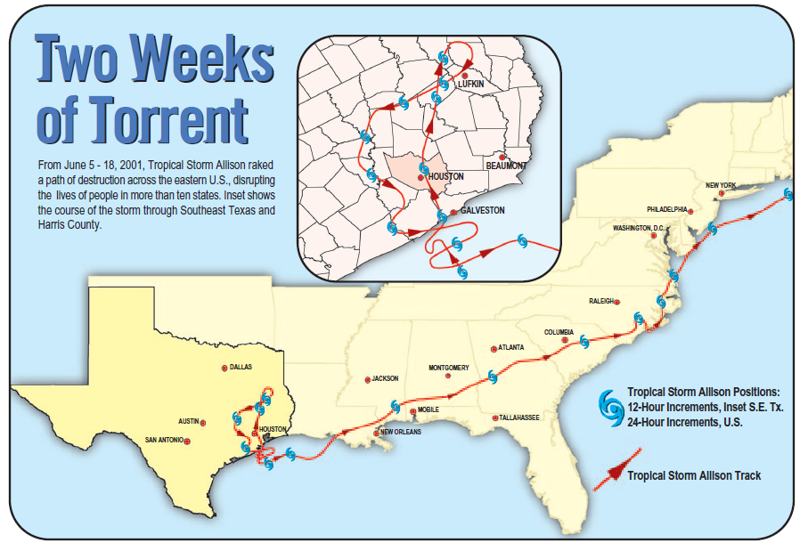

Slide 14
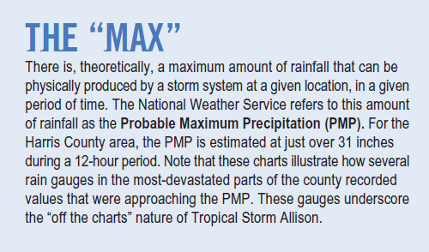
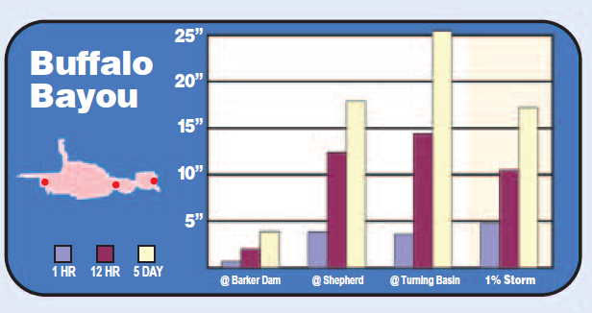
PMP is ~31” in 12 hours
100 year storm
Rain Gage Locations

Slide 15
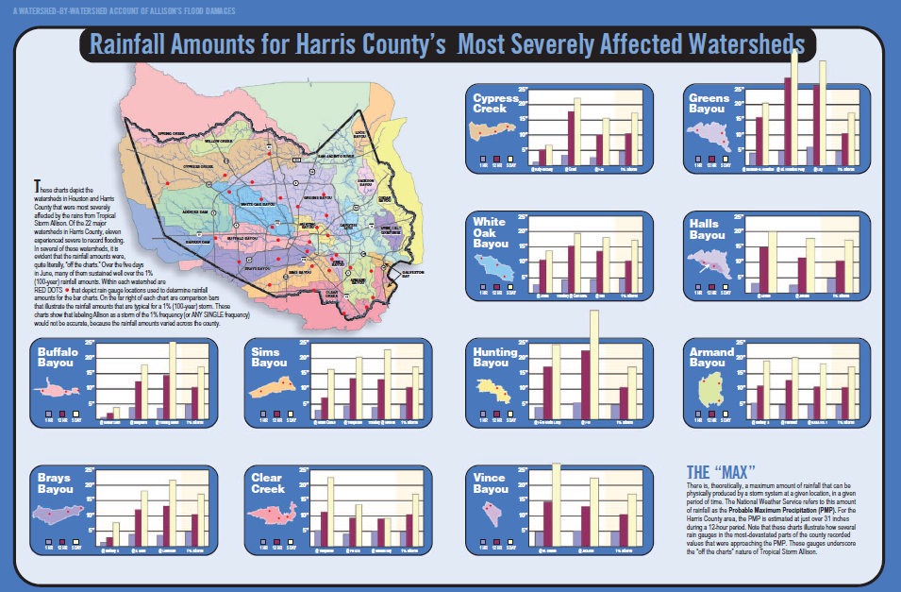

Slide 16
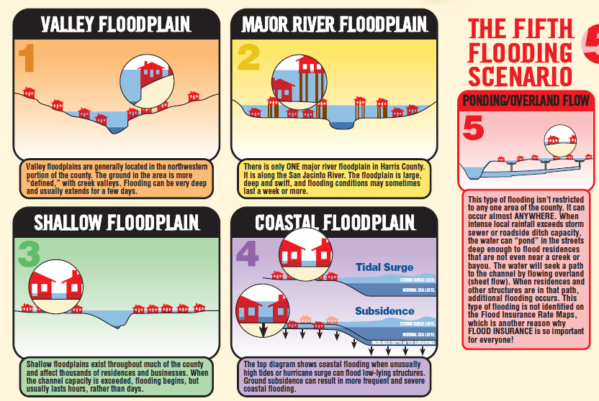
Flooding Scenarios in Houston

Slide 17
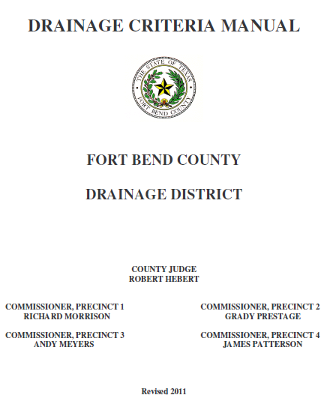
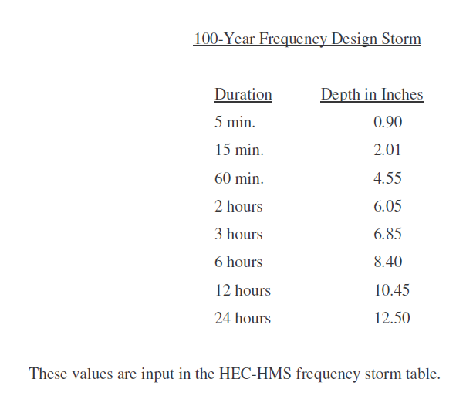
100 year storm depths
http://fbcmap.co.fort-bend.tx.us/floodplainmap/Drainage%20Criteria%20Manual%202011/Entire%20Document%201.pdf

Slide 18
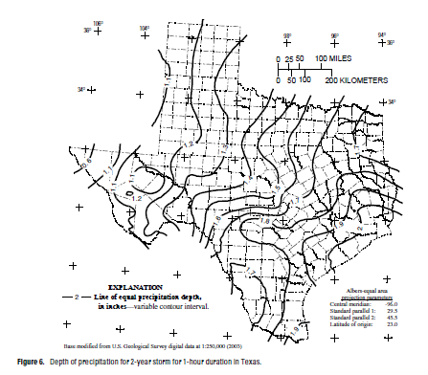
Atlas of Depth-Duration-Frequency for Texas
Return period = 2, 5, 10, 25, 50 100, 250, 500 years
Duration = 15, 30 min, 1,2,3,6, 12 hr, 1,2,3,5,7 days
8 return periods x 12 durations = 96 maps
http://pubs.usgs.gov/sir/2004/5041/pdf/sir2004-5041.pdf

Slide 19
Rainfall Frequency Analysis in Texas
In 1998, William Asquith at the USGS Texas Office analyzed virtually all rainfall data available in the State of Texas using L-moment methodology and published the results in a USGS Water Resources Investigations Report (WRIR 98-4044). In November 2001, Dr. Asquith summarized his rainfall study of 1998 and generated the IDF and the DDF (depth-duration-frequency) values that are suitable for use in the City of Austin and Travis County.

Slide 20
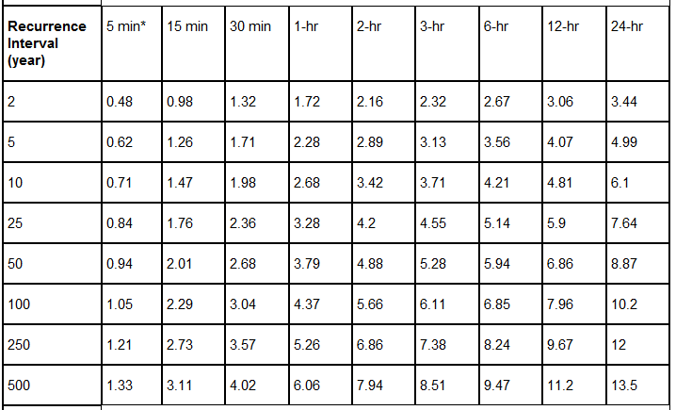
City of Austin Depth-Duration-Frequency (inches)
http://austintech.amlegal.com/nxt/gateway.dll/Texas/drainage/cityofaustintexasdrainagecriteriamanual?f=templates$fn=default.htm$3.0$vid=amlegal:austin_drainage$anc=

Slide 21
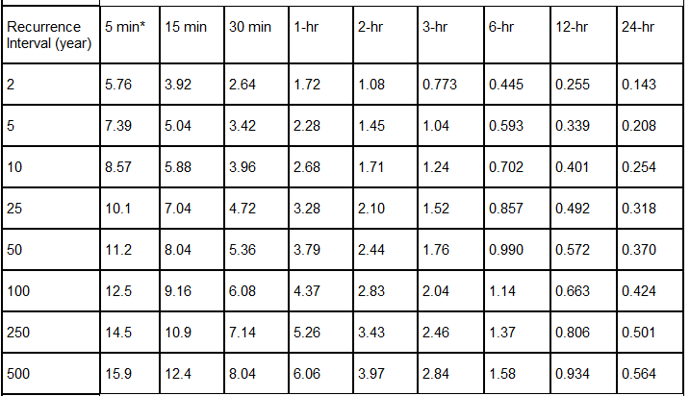
City of Austin Intensity-Duration-Frequency (In/hr)
http://austintech.amlegal.com/nxt/gateway.dll/Texas/drainage/cityofaustintexasdrainagecriteriamanual?f=templates$fn=default.htm$3.0$vid=amlegal:austin_drainage$anc=

Slide 22
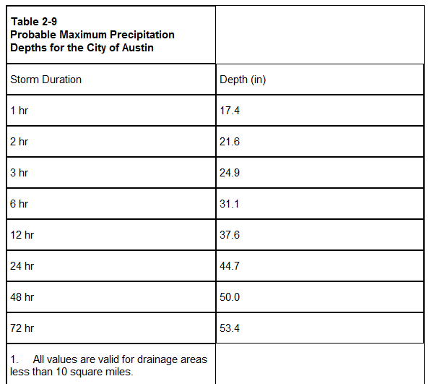
City of Austin Probable Maximum Precipitation
The PMP values were derived using Hydrometeorological Report No. 52 (HMR-52) and Hydrometeorological Report No. 51 (HMR-51) per the guidance provided in the Hydrologic and Hydraulic Guidelines for Dams in Texas (January 2007) available from the Dam Safety Program at the Texas Commission on Environmental Quality (TCEQ).

Slide 23
Design Storm Depths in Travis and Harris Counties

Slide 24
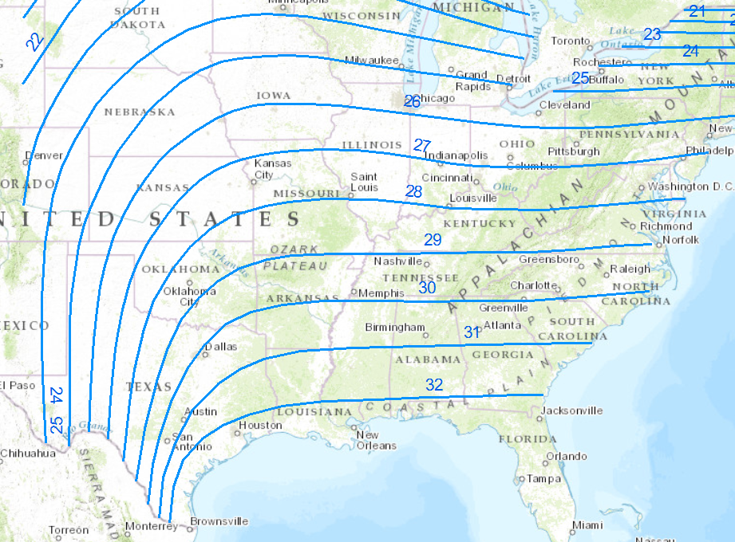
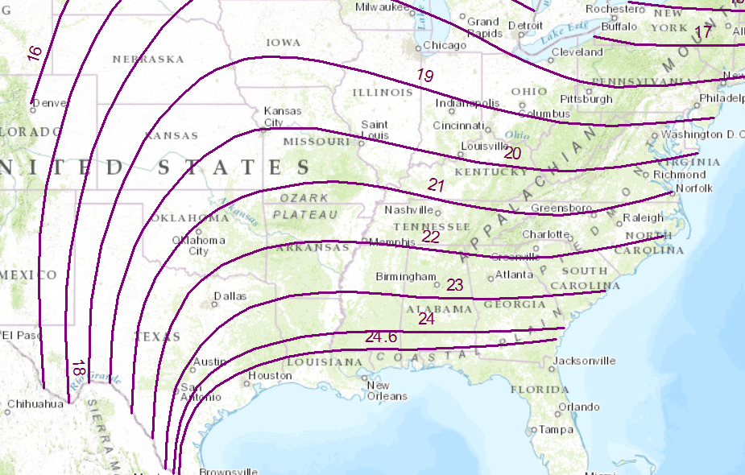
Probable Maximum Precipitation Depths
6-hour, 10 mile²
6-hour, 200 mile²

Slide 25
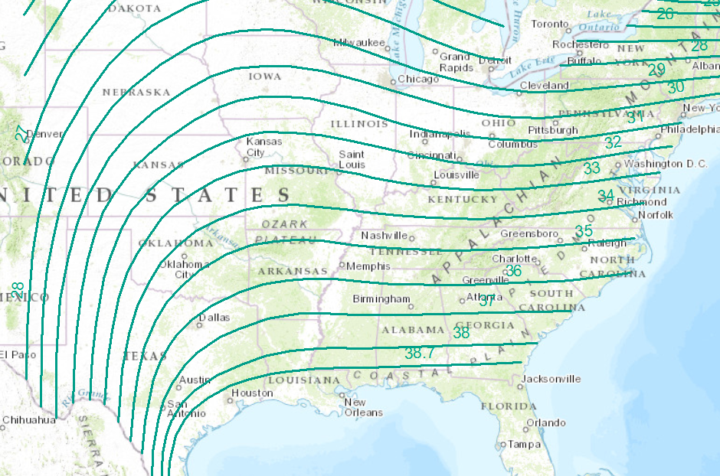
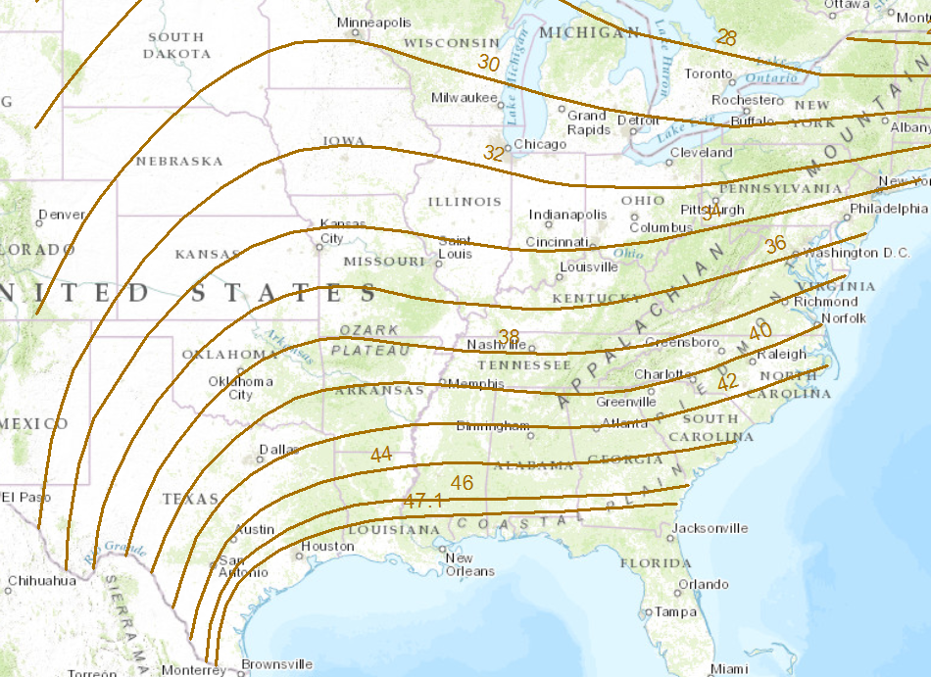
Probable Maximum Precipitation Depths
12-hour, 10 mile²
24-hour, 10 mile²

Slide 26
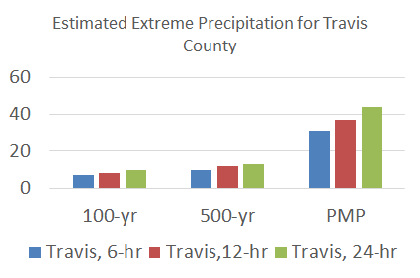
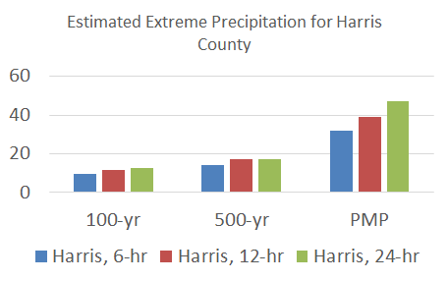
Extreme Precipitation Estimates in Travis and Harris Counties
Probable Maximum Precipitation (PMP) is for a 10 Km² storm area

Slide 27
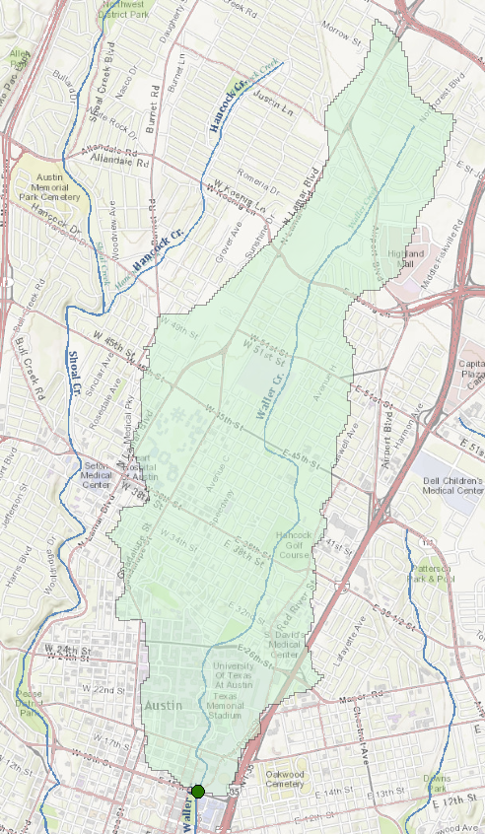
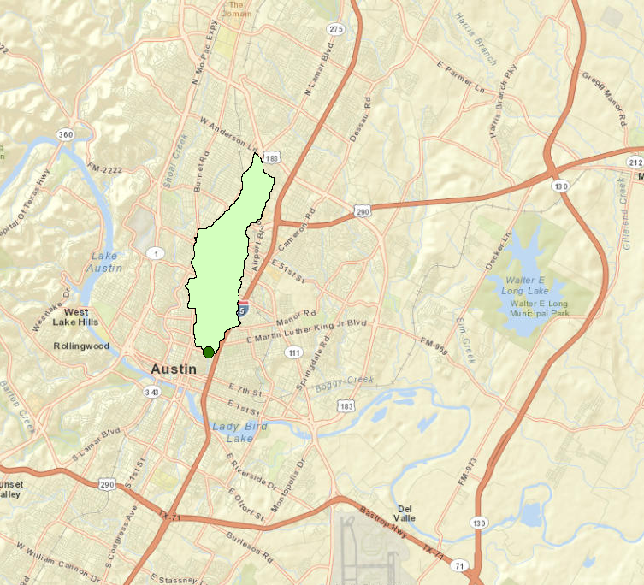
Drainage Area of Waller Creek at 15th St (12.2 km²)

Slide 28
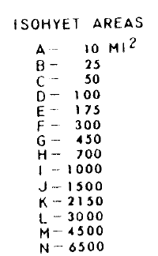
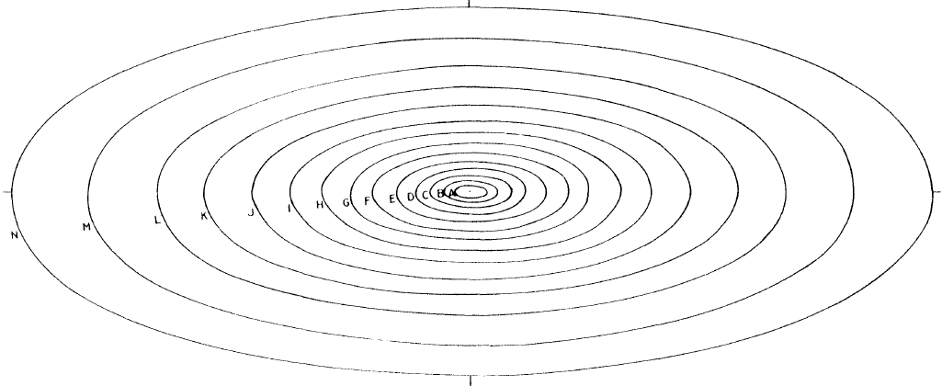
PMP Standard Storm Shape – Ellipse with axes 2.5:1
2.5
1.0
Smallest area = 10 mi²
Imagine this like a layer cake with most rain in A, less in B, less in C, and so on …..

Slide 29
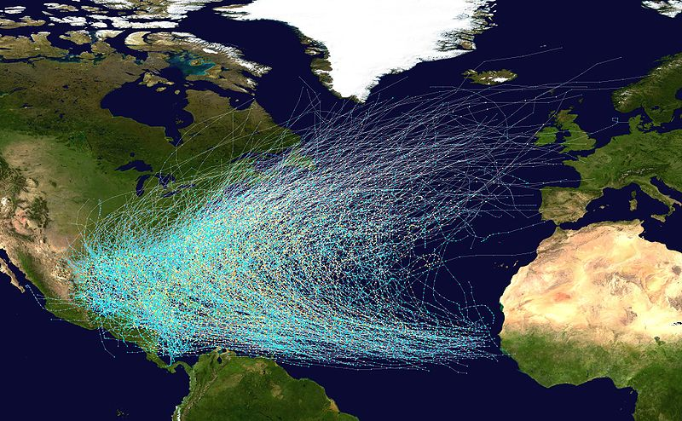
Hurricane Storm Tracks

Slide 30
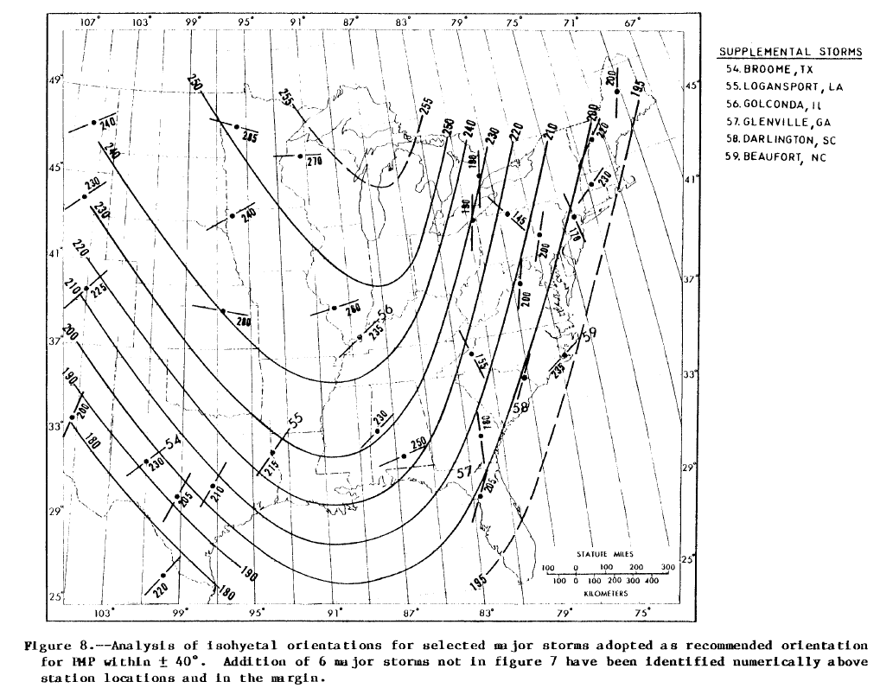
Recommended Storm Orientation for Austin is an azimuth of 200°

Slide 31
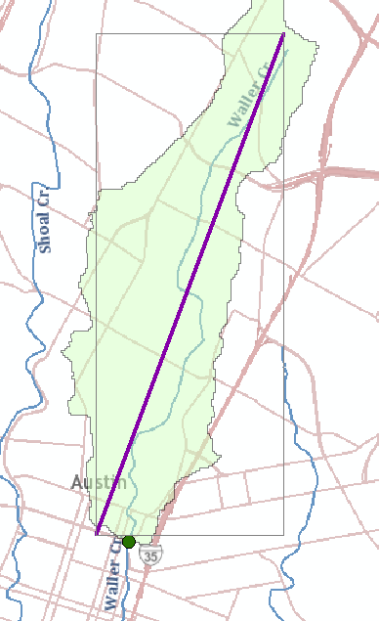
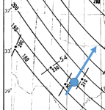
Waller Creek Watershed Orientation
$\tan{θ= \frac{8.2}{3.0}}$= 2.73
Θ = 70°
90 - Θ = 20°
Azimuth = 180° + 20° = 200°
8.2 km
200°
θ
Azimuth from North of the watershed is ~ 200°
3.0 km
Waller Creek falls right along the path of recommended storm orientation!

Slide 32
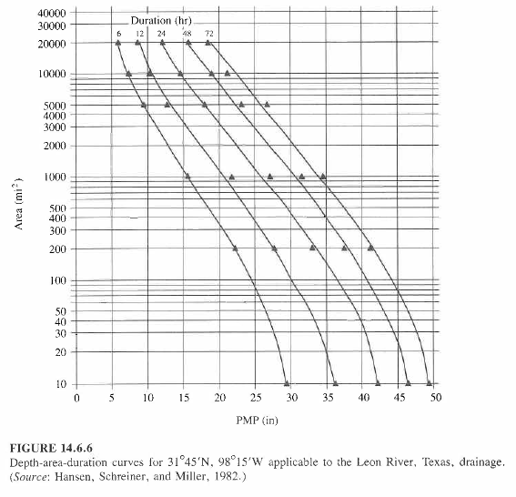
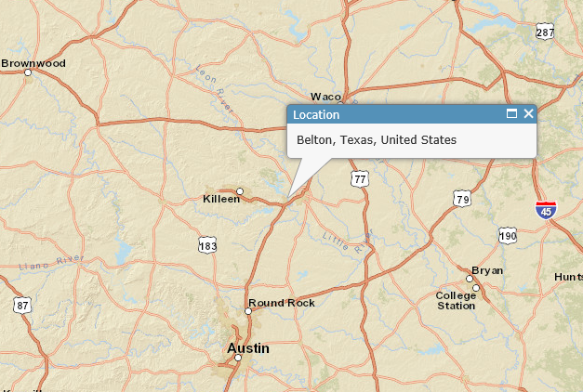
Depth-Area-Duration Curves for Leon Creek
Leon Creek
Area (mi²)
For 10 square miles in Austin, the PMP depths are
1-hr 17.4”, 2-hr 21.6”, 3-hr 24.9”, 6-hr 31.1”
12-hr 37.6”, 24-hr 44.7”, 48-hr 50.0”, 72-hr 53.4”
Slightly larger than for Leon Creek in Belton, Texas
6 12 24 48 72 Duration (hrs)
PMP Depth (Inches)
Mean annual precipitation in Austin is 34.2”

Slide 33
City of Austin Probable Maximum Flood
To determine the PMF, each of the possible storm durations (1, 2, 3, 6, 12, 24, 48, and 72 hour storms) needs to be analyzed in order to determine the critical duration. The critical duration is the storm duration that produces the highest water surface elevation behind the dam. The PMF for each storm duration is derived using the PMP depths from Table 2-9 and using a rainfall-runoff model (HEC-1, HEC-HMS, TR-20).
The runoff parameters used in the PMF model are the same as those used for runoff analyses of the more frequent storm events, with the exception of curve numbers and temporal distribution of rainfall.
The rainfall-runoff model should use the temporal distribution as provided in the Hydrologic and Hydraulic Guidelines for Dams in Texas. The temporal distribution for each storm duration has been reproduced in Figure 2-4, Appendix E.
Runoff curve numbers for the PMF need to reflect the assumption that the soils will be saturated. Therefore the runoff curve number should be based on Antecedent Moisture Condition III (AMC).

