Slide 1
CE 374K Hydrology Field Trip
University of Texas at Austin
Thursday 21 March 2013
Maps prepared by David R. Maidment

Slide 2
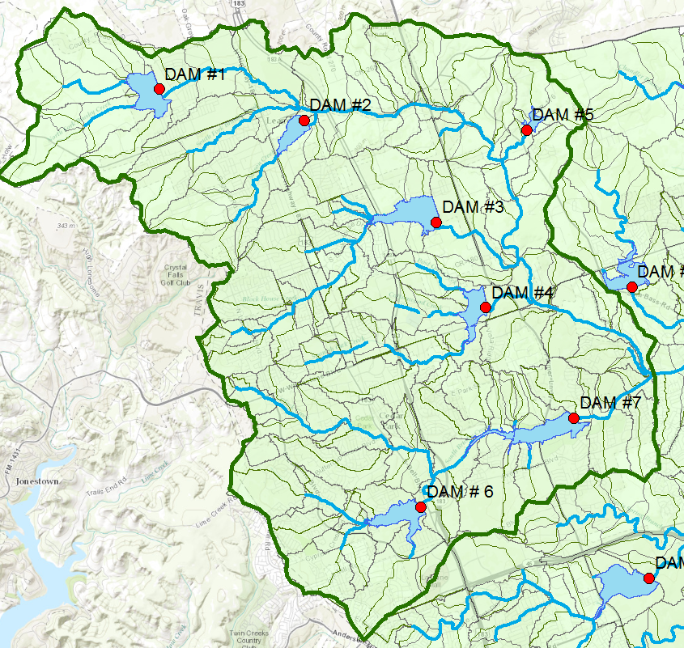
Upper Brushy Creek Watershed
Stop #3
Stop #2
Stop #1

Slide 3
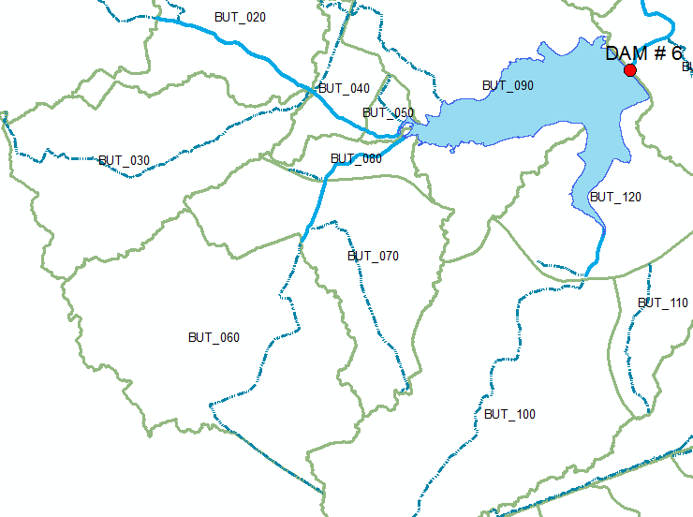
Watersheds upstream of Dam 6

Slide 4
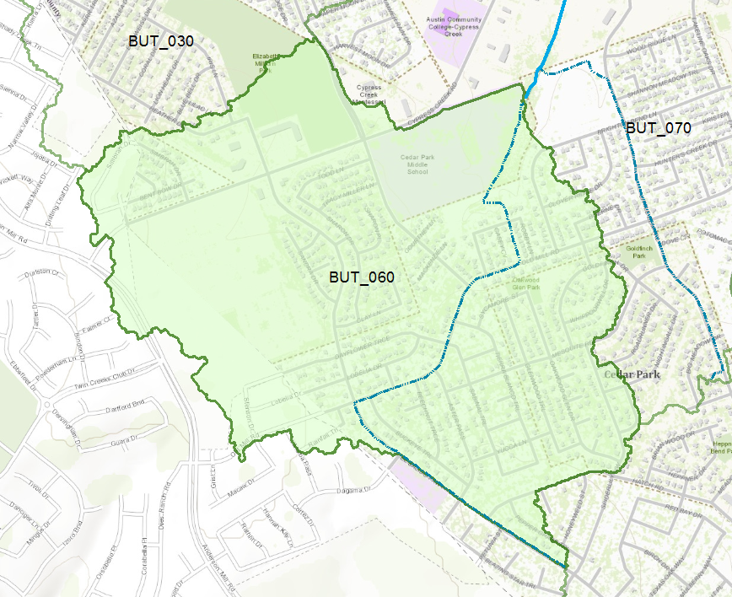
Subbasin BUT_060 – Stop #1

Slide 5
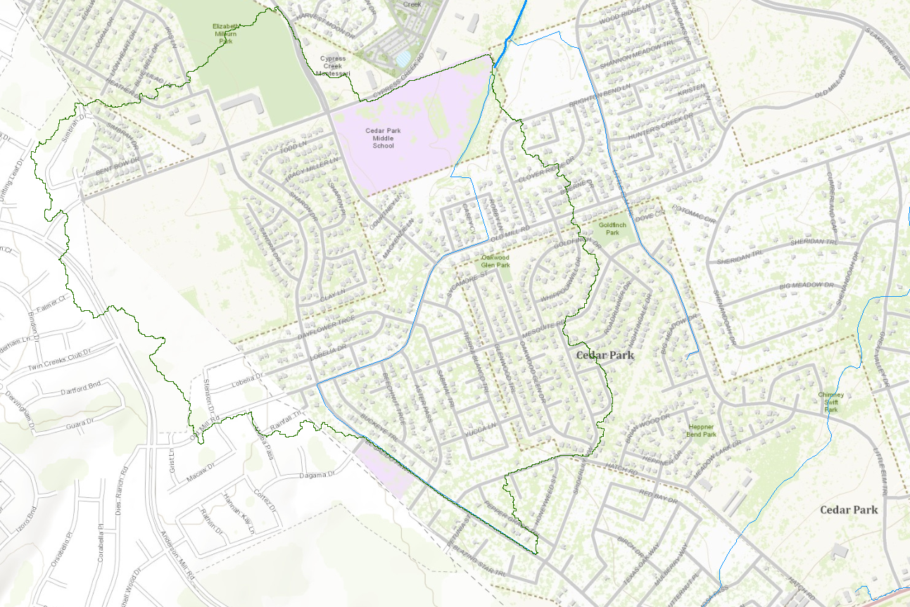
Little Elm Trail
Longest Flow Paths
Old Mill Rd
El Salido Parkway

Slide 6
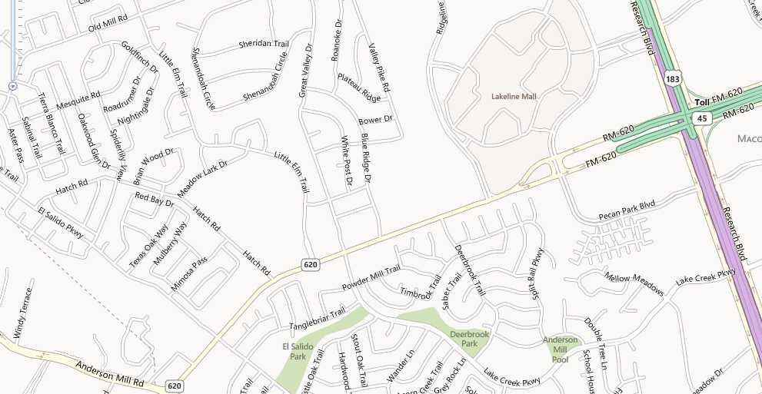
Getting to the Field Trip from Highway 183
Left on FM-620
Enter on 183 North
Right on El Salido Parkway

Slide 7
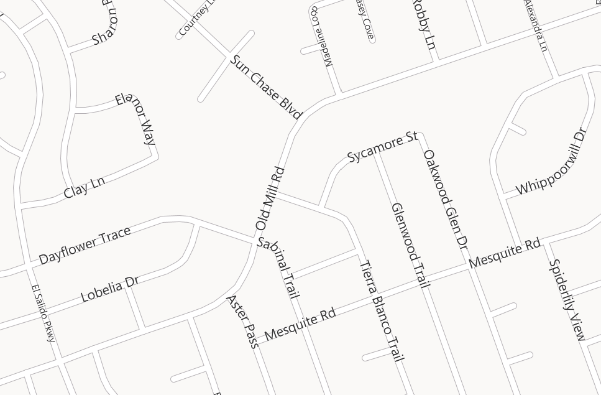
Pause
Stop #1 Sycamore St
Stop
Enter on El Salido Parkway

Slide 8
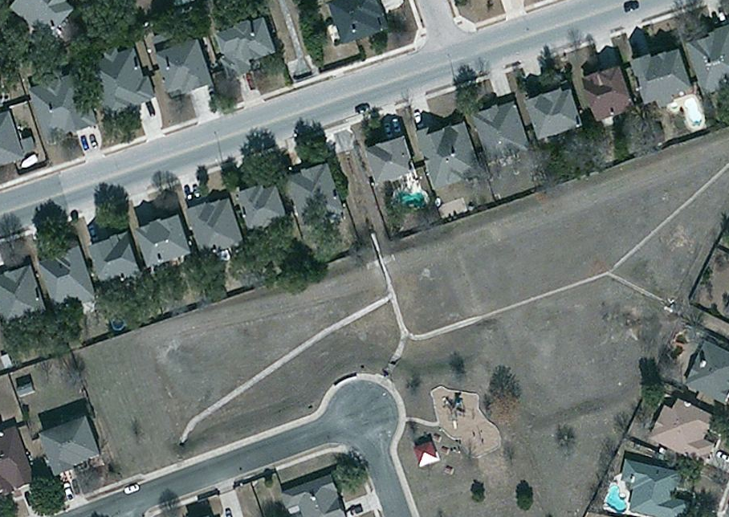
Pause: Old Mill Rd at creek crossing
Stop #1 Sycamore St

Slide 9
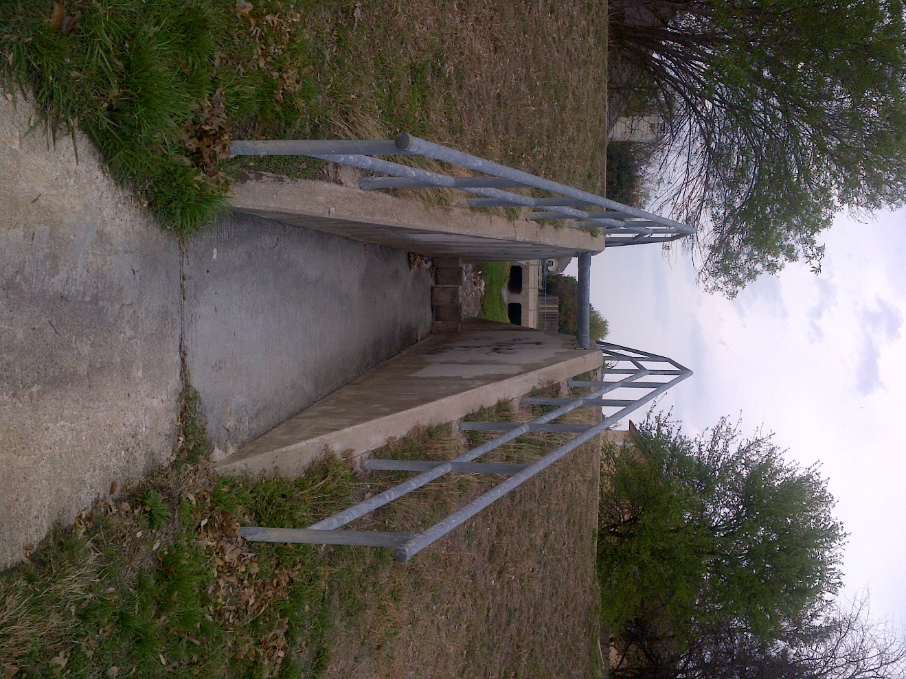
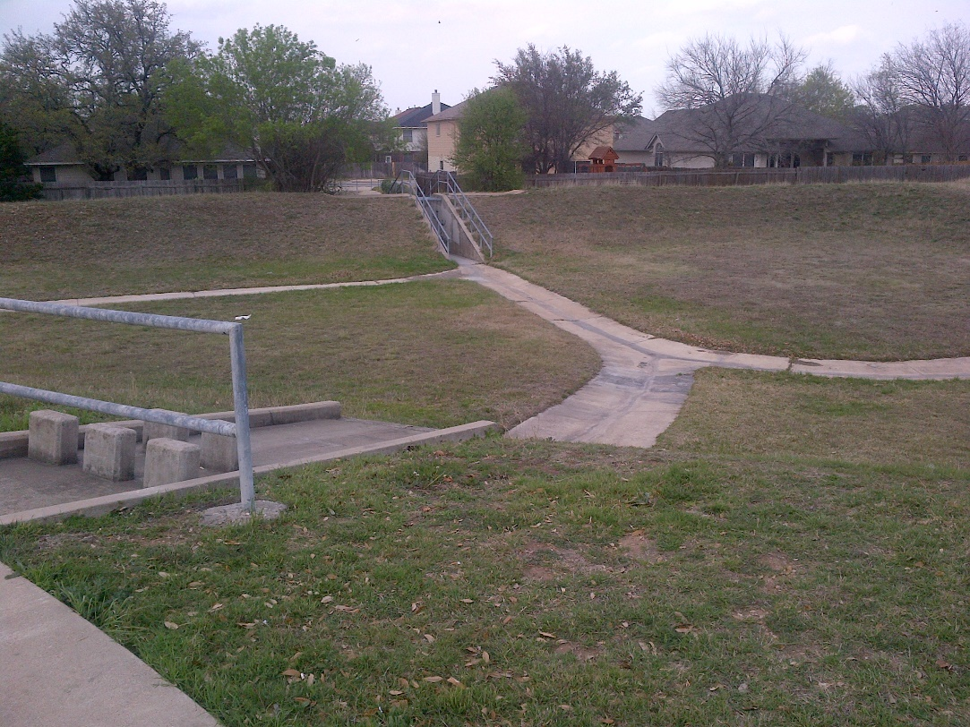
Detention Basin at Sycamore St

Slide 10
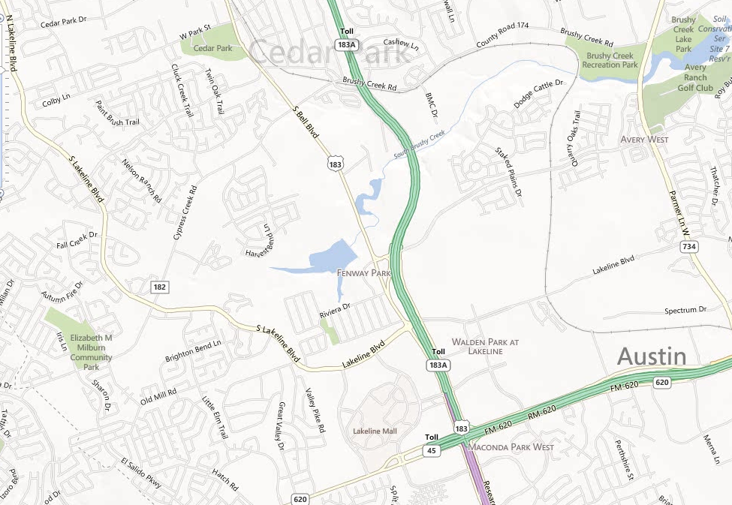
From Stop #1 to Stop #2
Continue Brushy Creek Rd
from Cypress Creek Rd
Right on
Cypress Creek Rd
Enter on Sun Chase Blvd

Slide 11
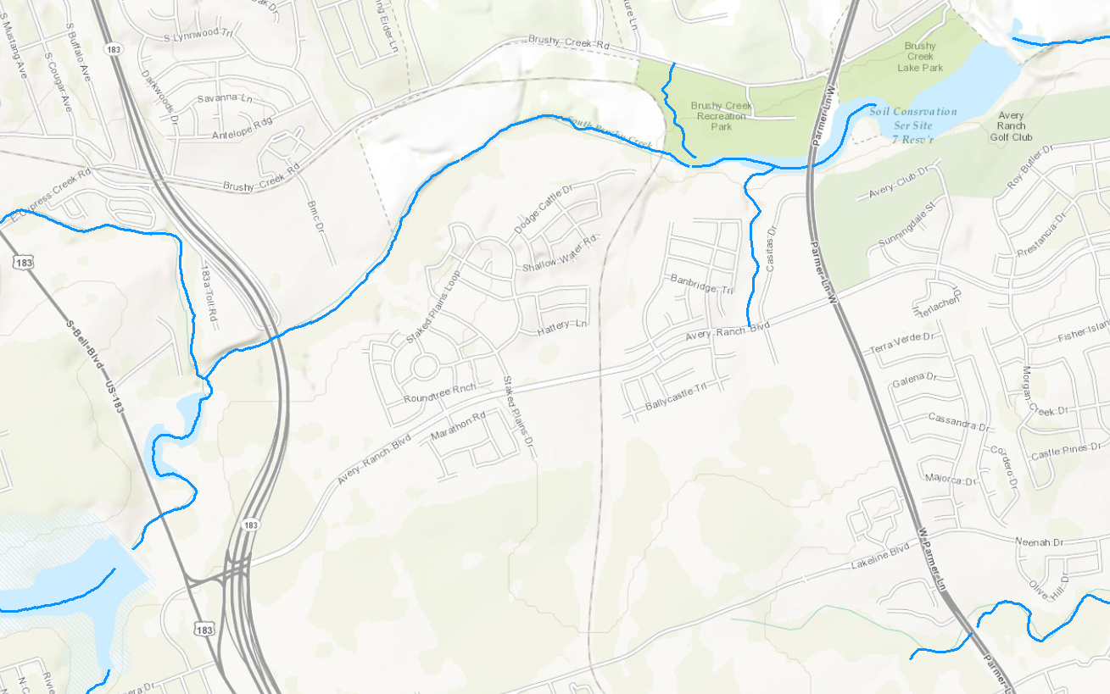
Dam 7
Dam 6

Slide 12
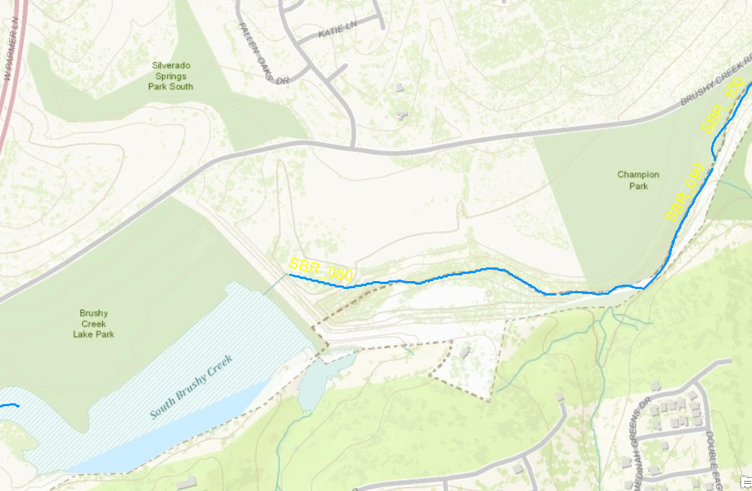
Dam 7 – Stop #2

Slide 13
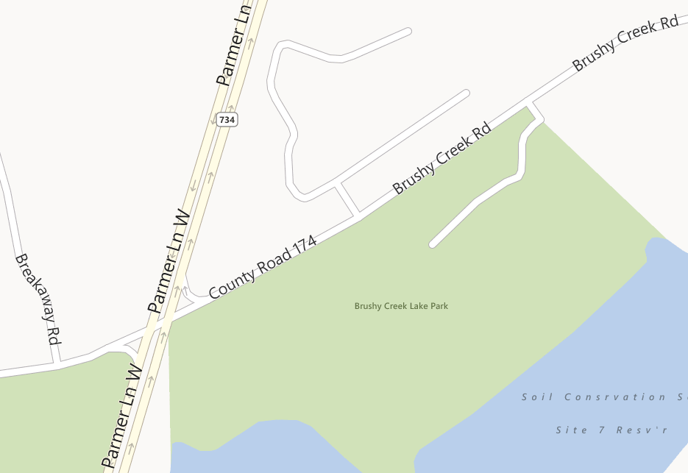
Stop #2 Brushy Creek Lake Park
Exit on Parmer Lane
Stop
Enter on
Brushy Creek Rd

Slide 14
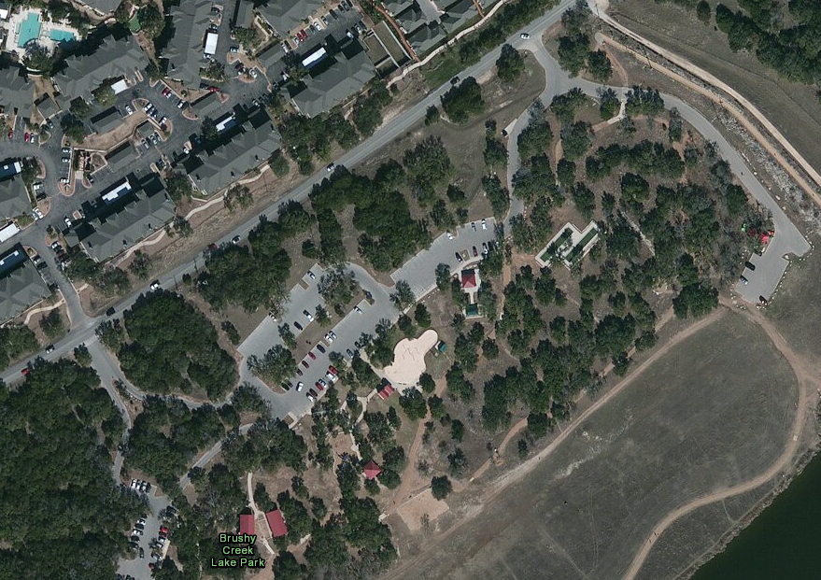
Stop #2 Brushy Creek Lake Park

Slide 15
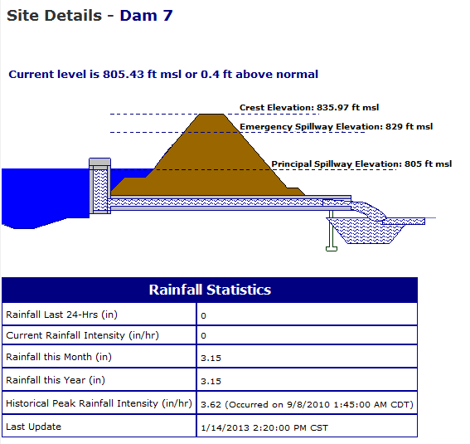
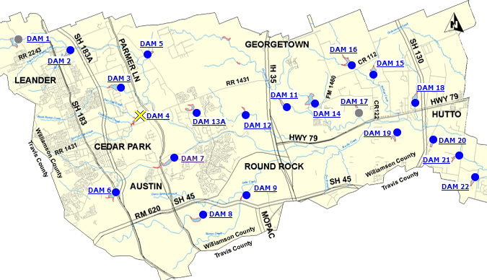
Flood Control Reservoir: Dam 7

Slide 16
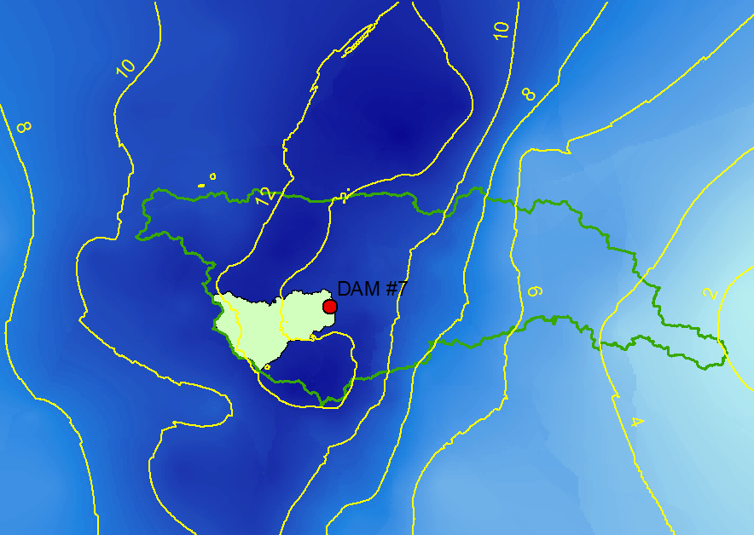

Precipitation in Tropical Storm Hermine (in)

Slide 17
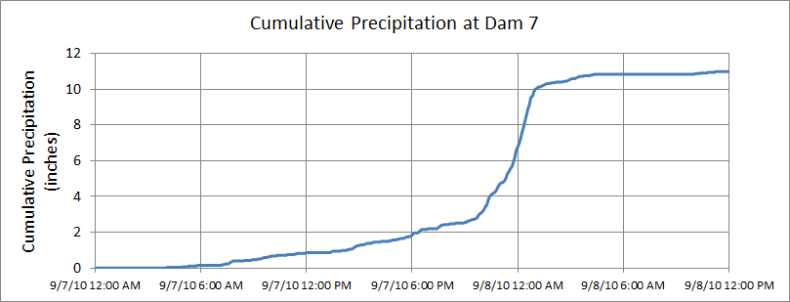
Precipitation Time Series at Dam 7
Total Precipitation = 10.98 inches

Slide 18
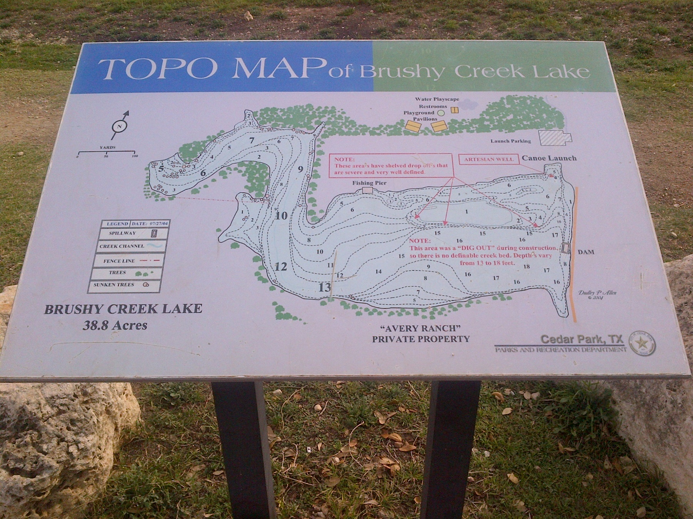
Brushy Creek Lake

Slide 19
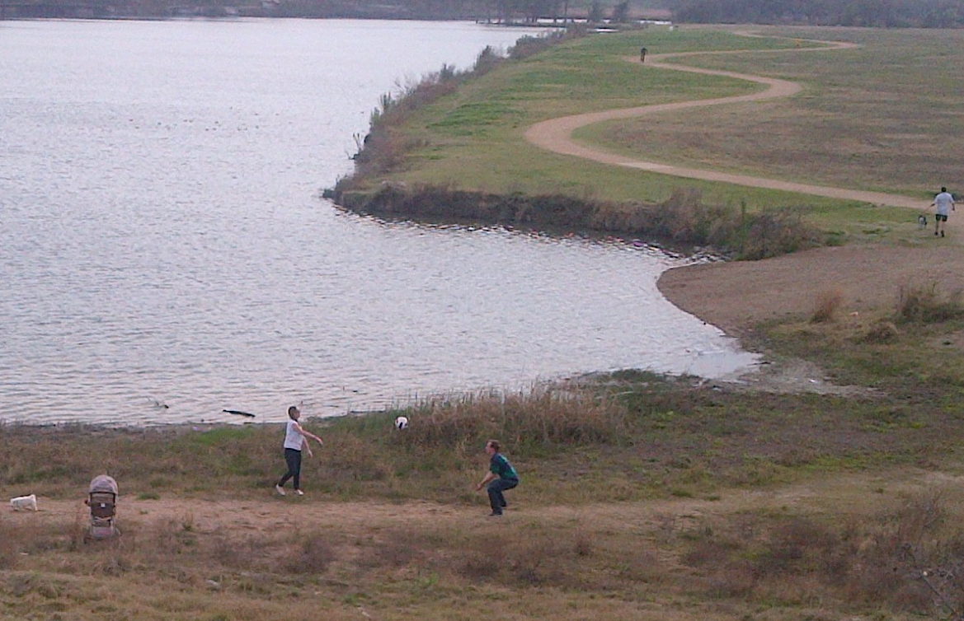
The Lake as a Recreational Facility

Slide 20
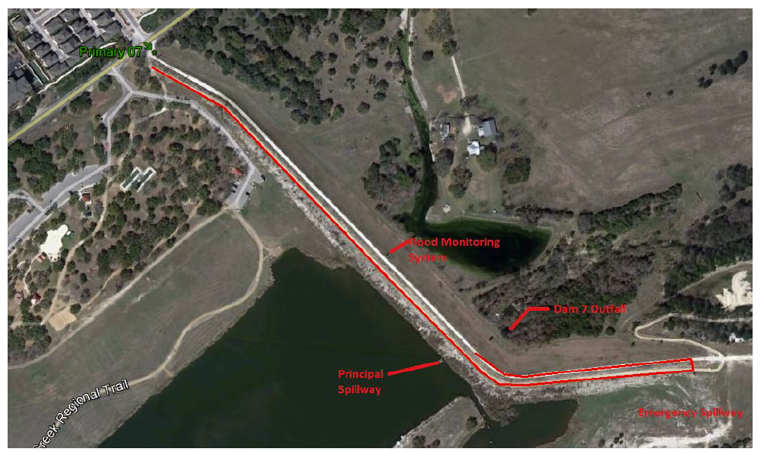
Dam 7, Upper Brushy Creek

Slide 21
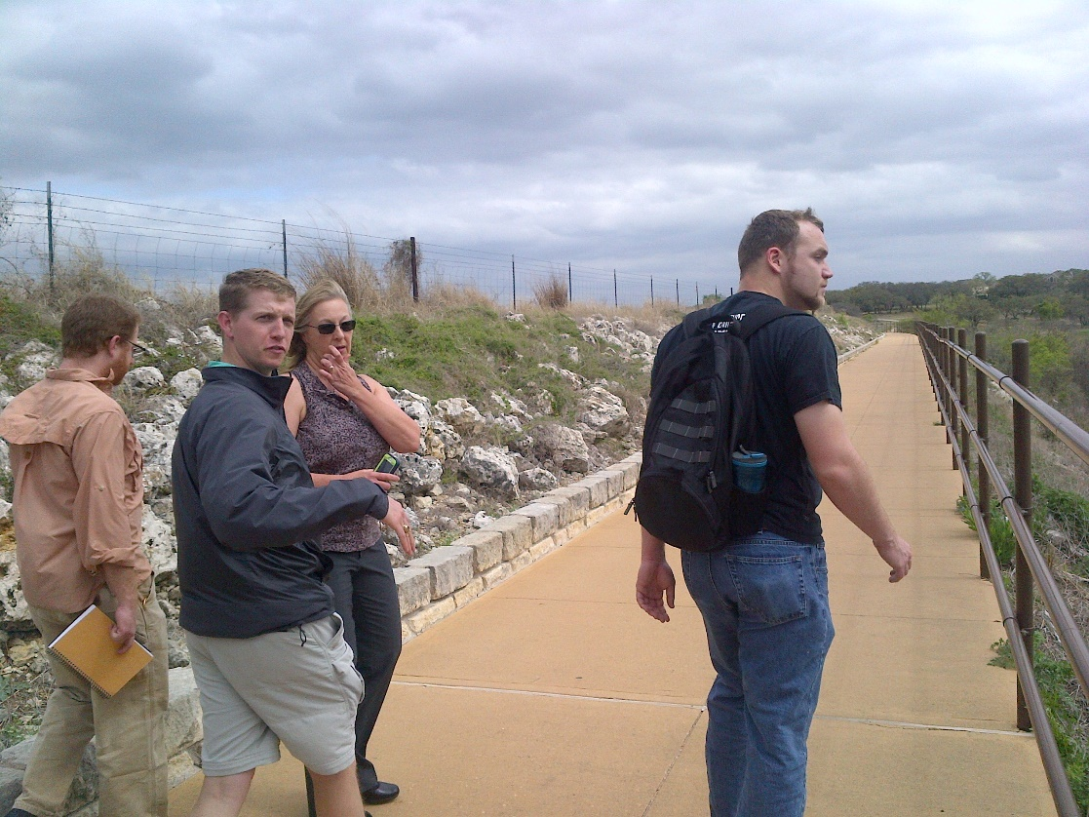
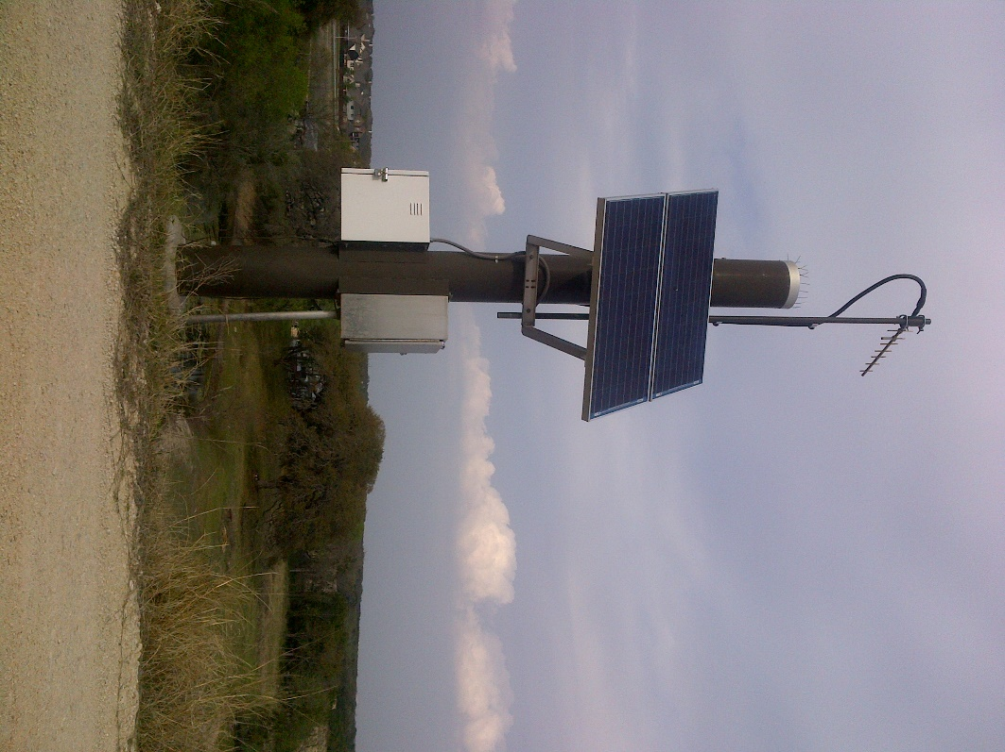
Observing Site on the Dam

Slide 22
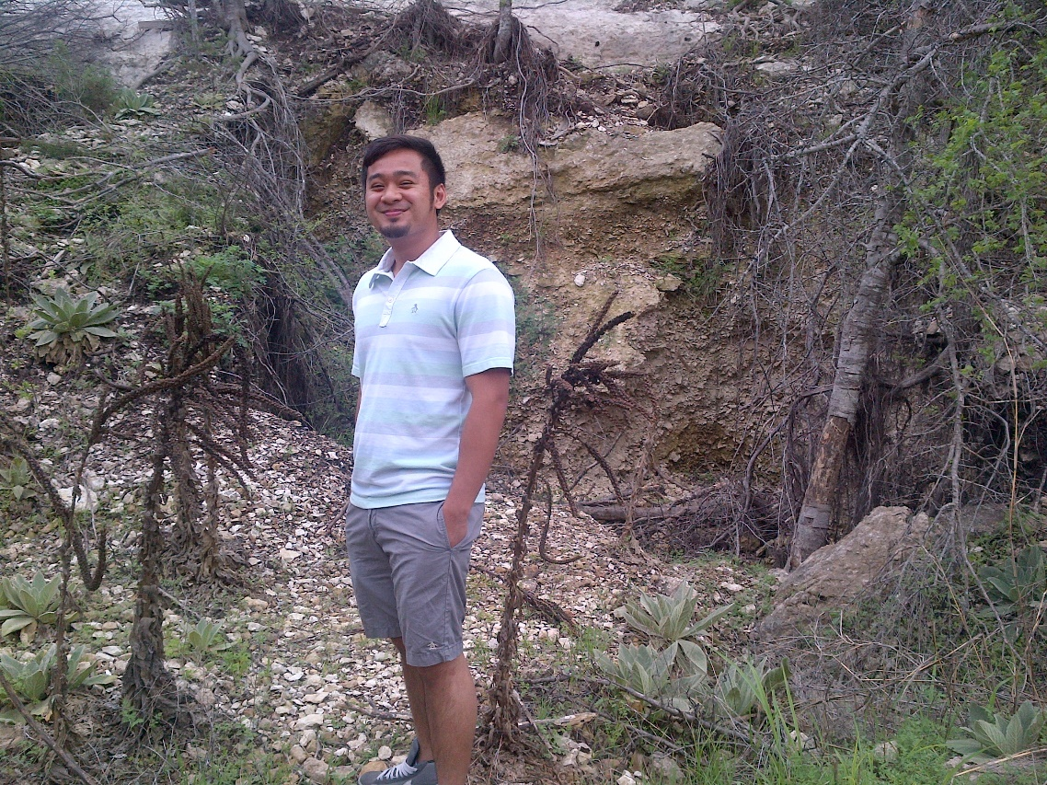
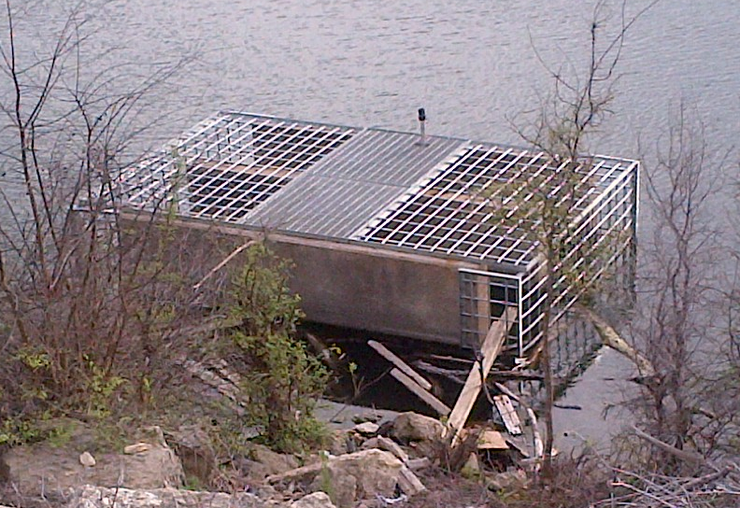
Features of Dam 7
Inlet Structure on Dam 7
Erosion downstream of the emergency spillway

Slide 23
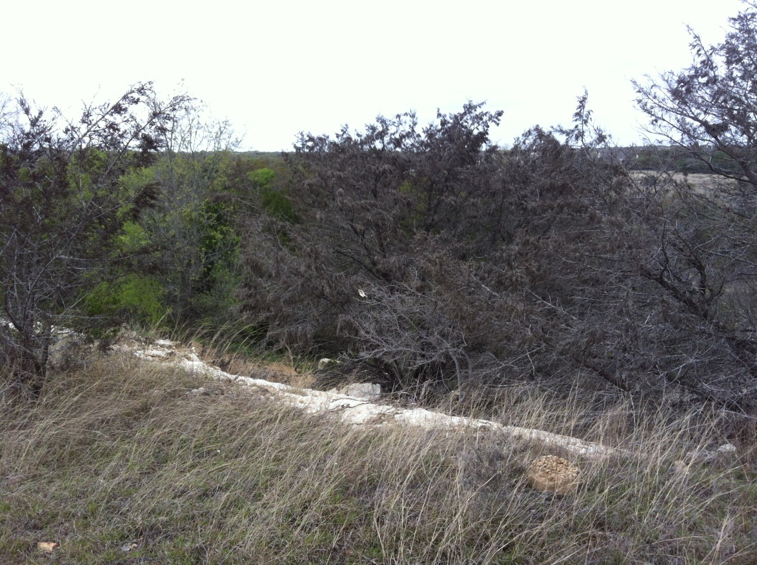
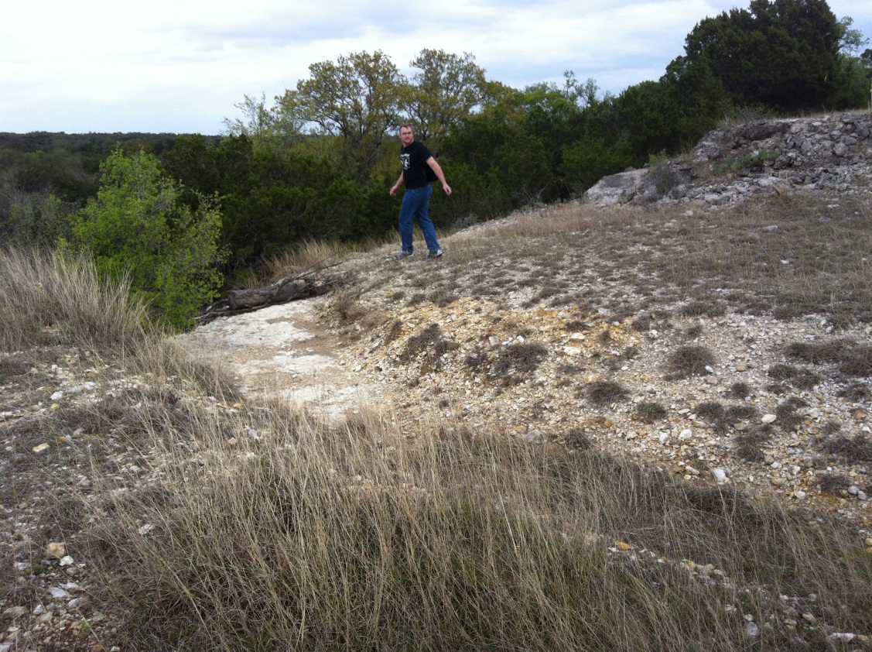
Erosion at Top of Spillway
Photos: Andrew Goodman

Slide 24
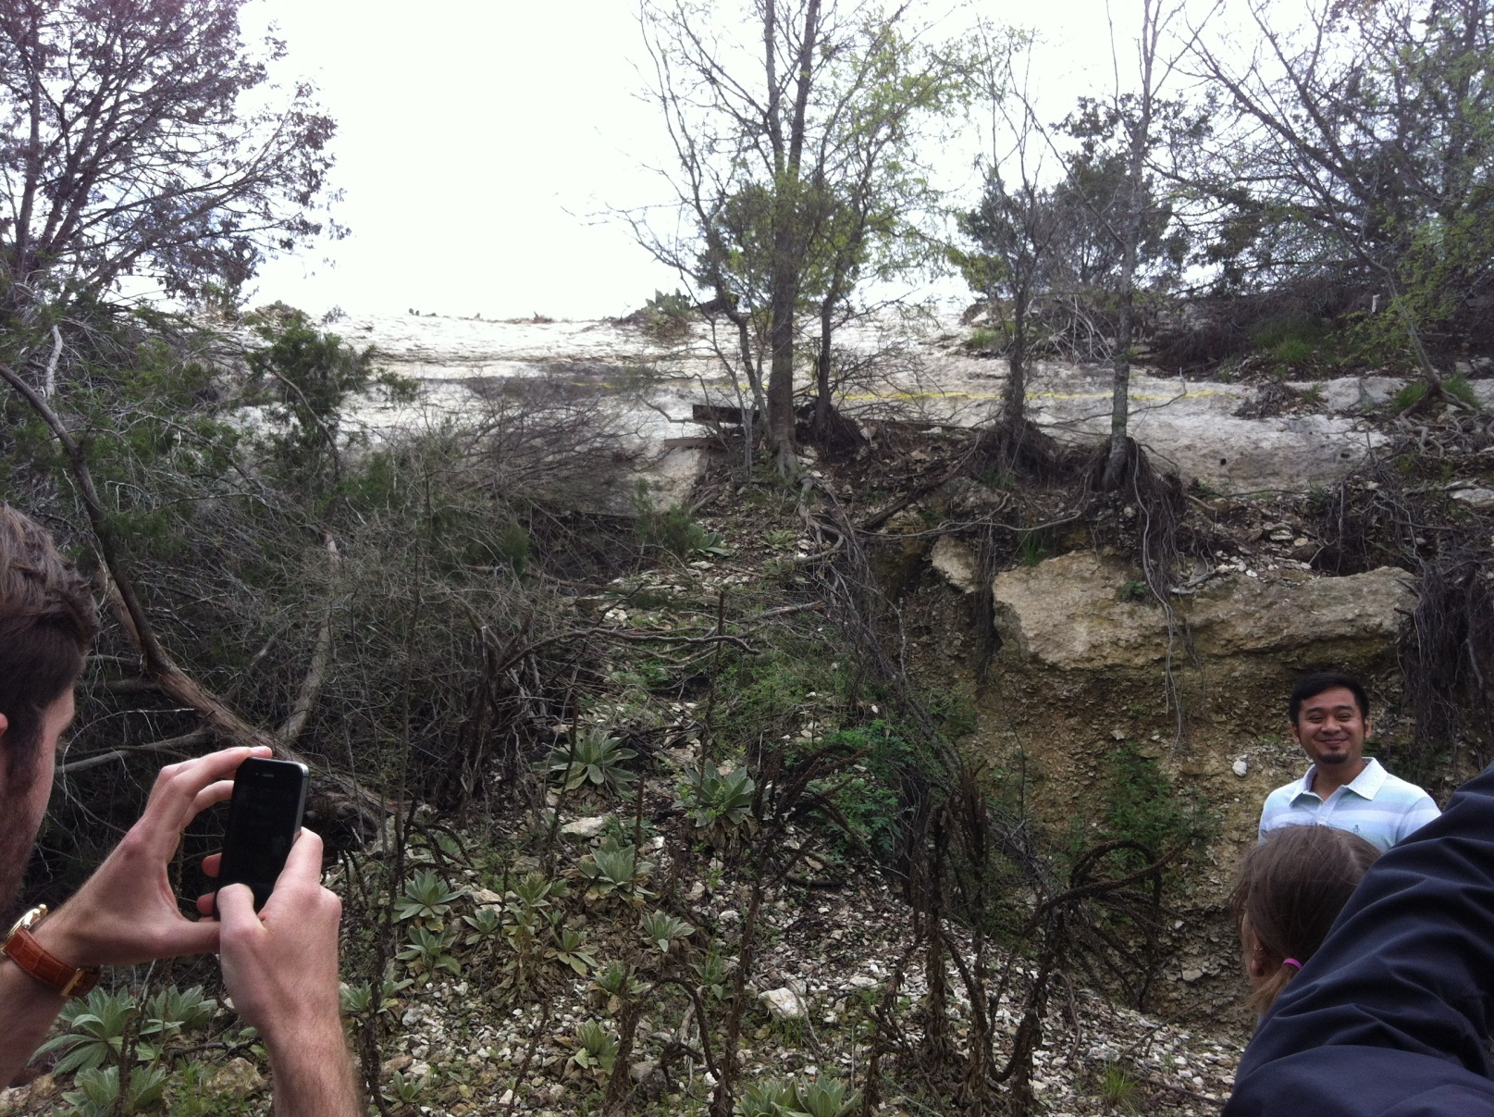
Erosion Downstream of Spillway
Photo: Andrew Goodman

Slide 25
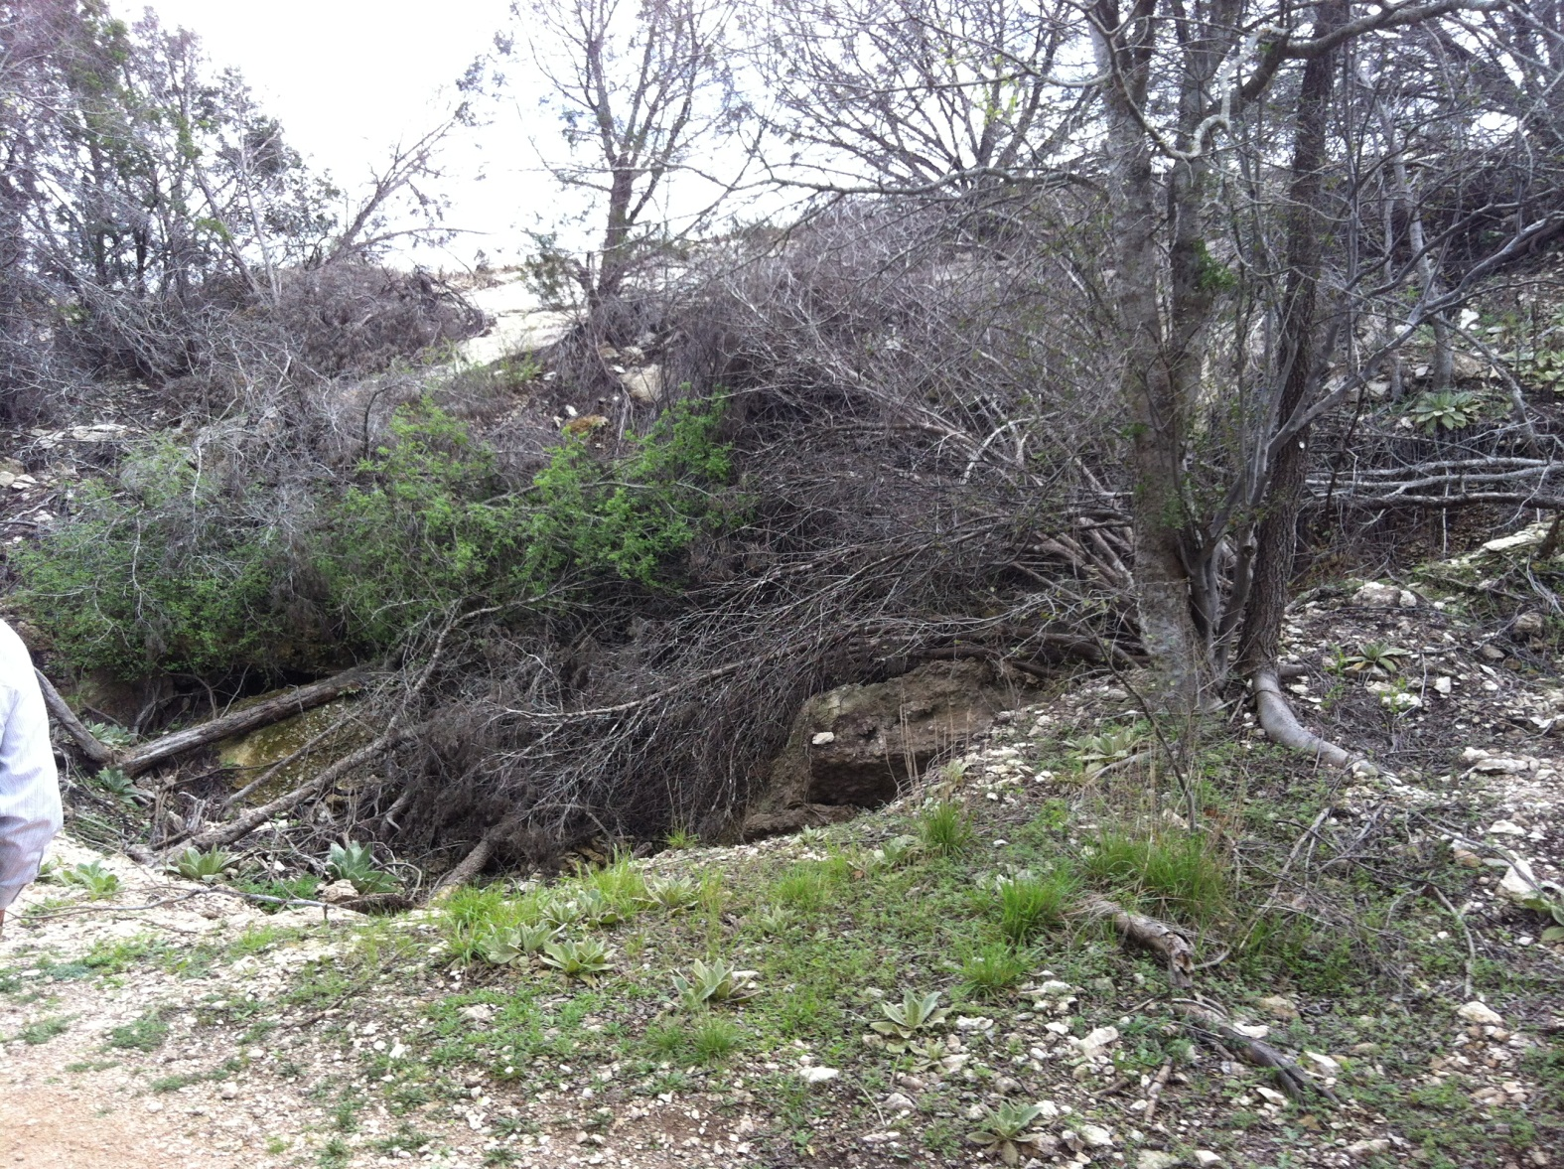
Erosion Downstream of the Spillway
Photo: Andrew Goodman

Slide 26
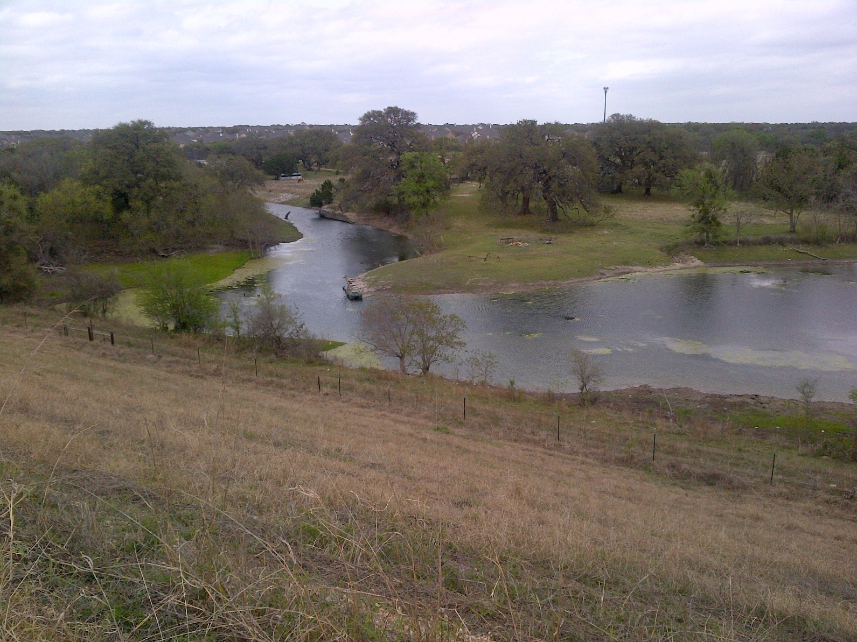
South Brushy Creek downstream of Dam 7

Slide 27
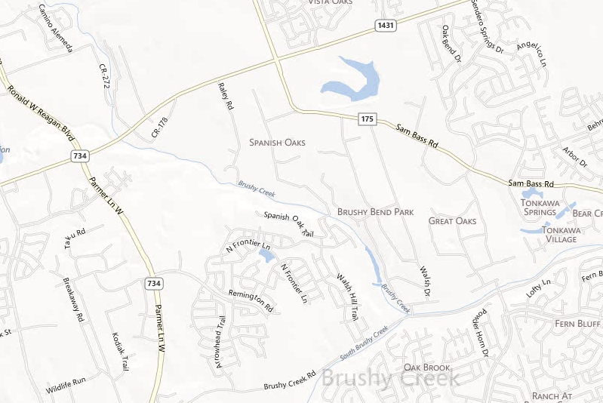
From Stop #2 to Stop #3
Right on Sam Bass Rd
Right on 1431
Right on Walsh Dr
Enter on Parmer Ln North

Slide 28
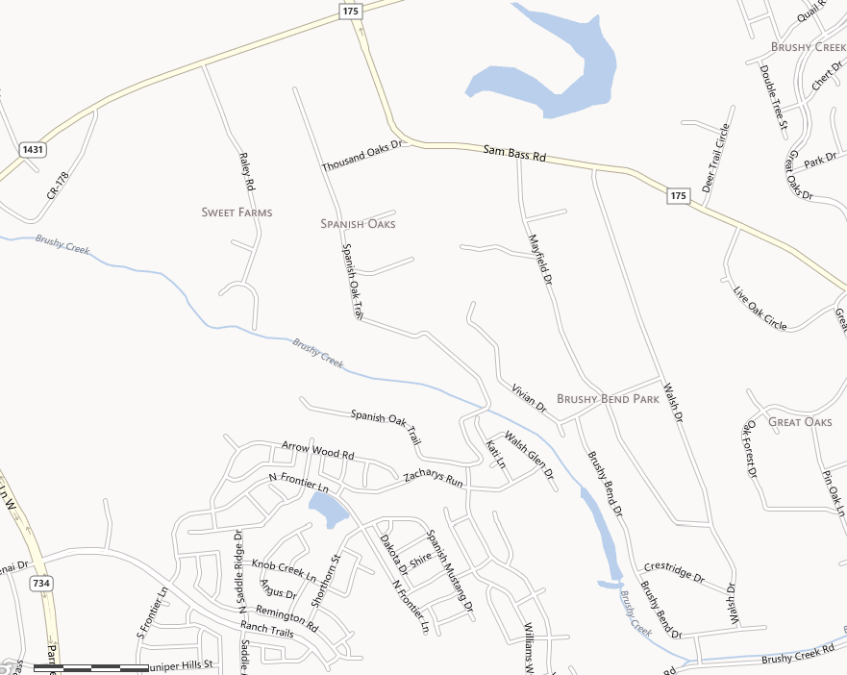
Enter on FM-1431
(Whitestone Blvd)
Exit on FM-1431
Stop #3 Brushy Bend Dr
Stop

Slide 29
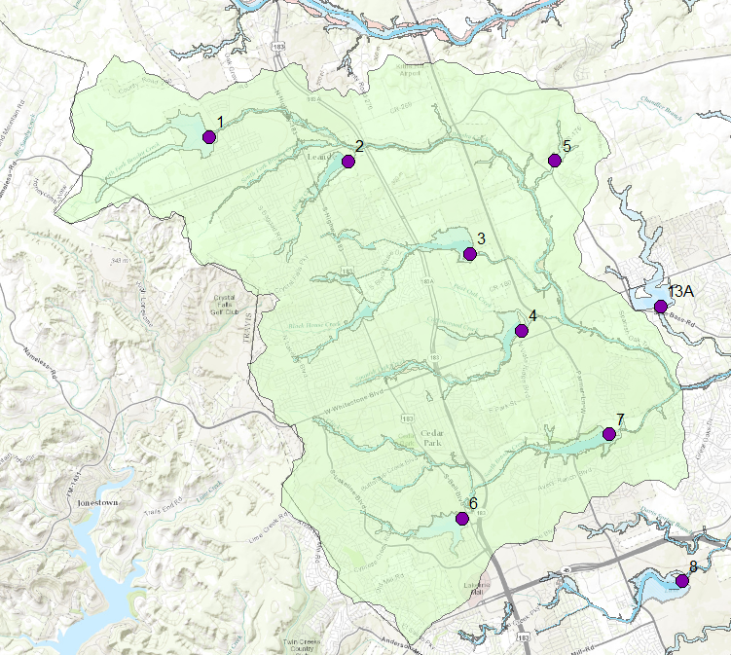
Upper Brushy Creek Dams and Floodplains
Flood Control Dam
Brushy Creek
Focus area
Dam 7

Slide 30
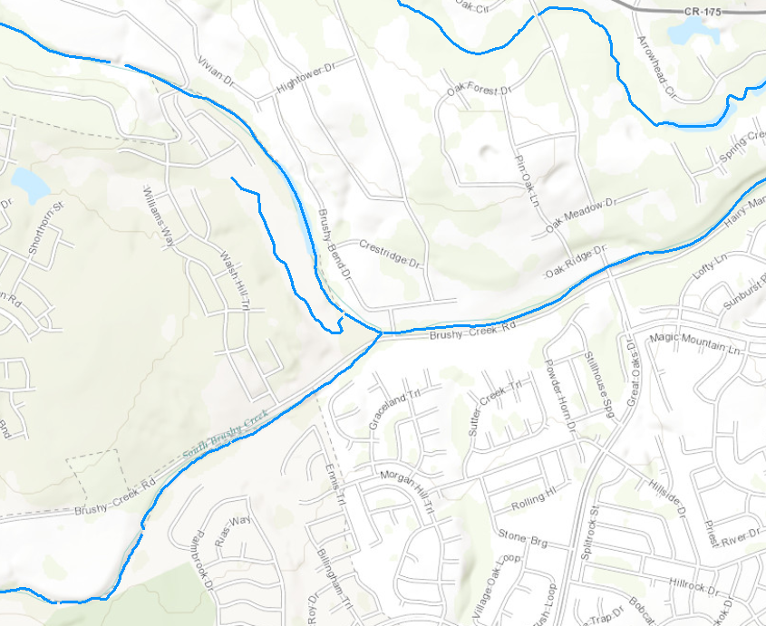
Brushy Bend Dr – Stop #3

Slide 31
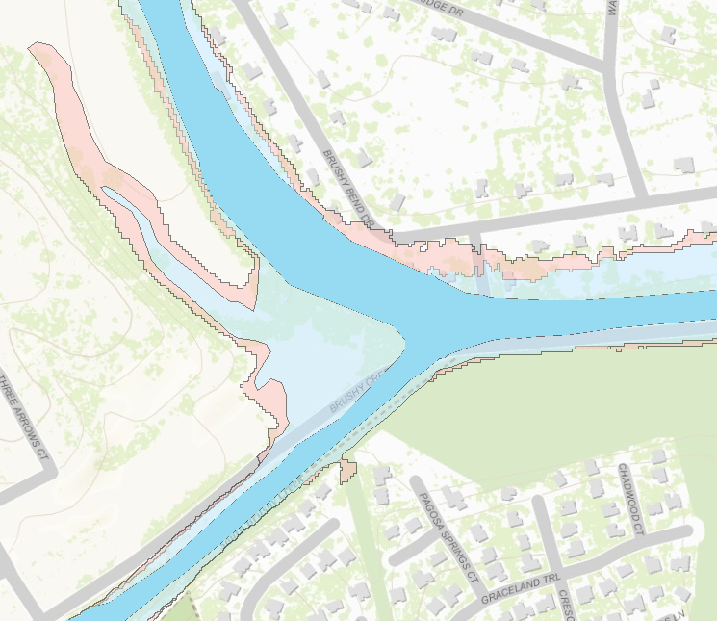
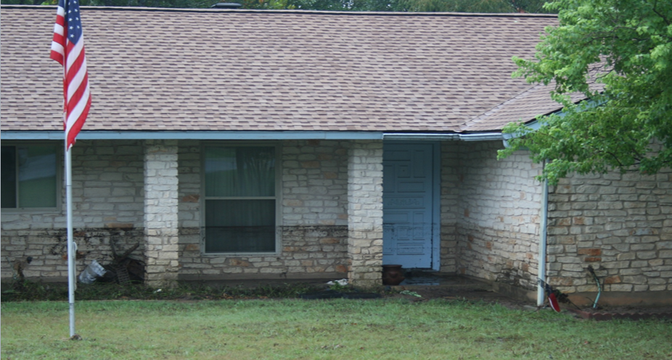


Floodplain Map
1% chance

Slide 32
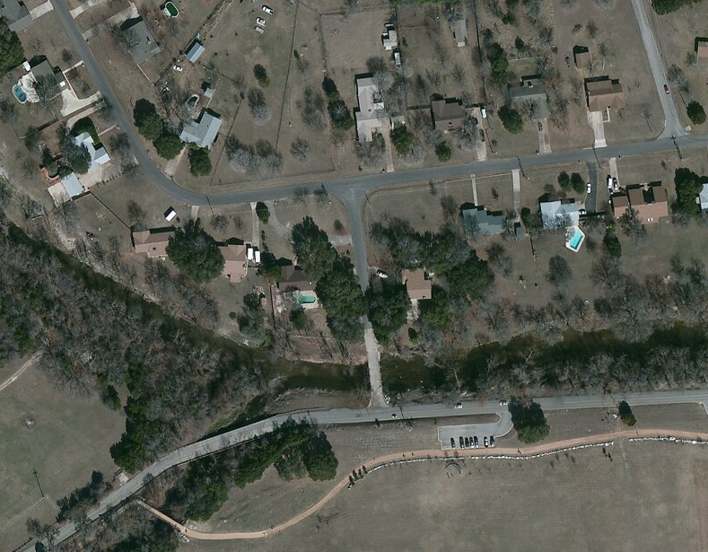
Stop #3 Brushy Bend Dr
Confluence of Brushy Creek and South Brushy Creek

Slide 33
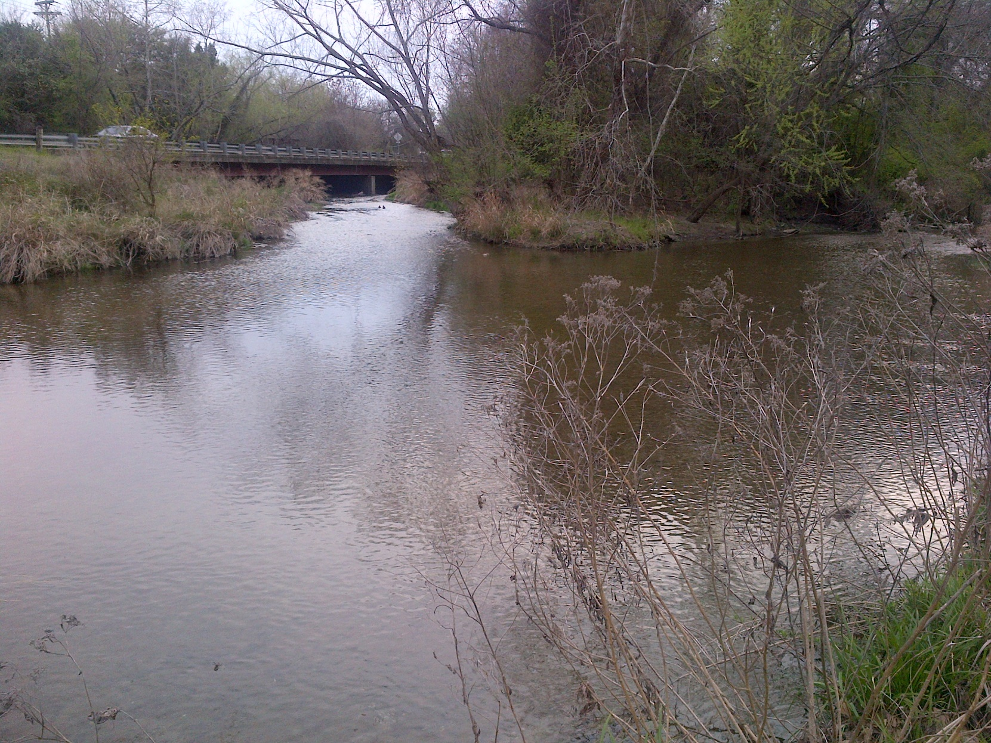
Confluence of Brushy Creek and South Brushy Creek

Slide 34
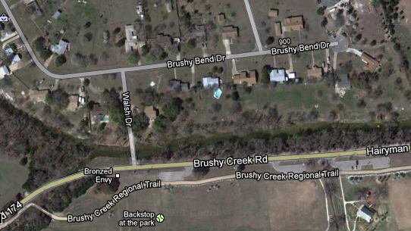
Brushy Bend Dr
Flooded homes, low water crossing

Slide 35
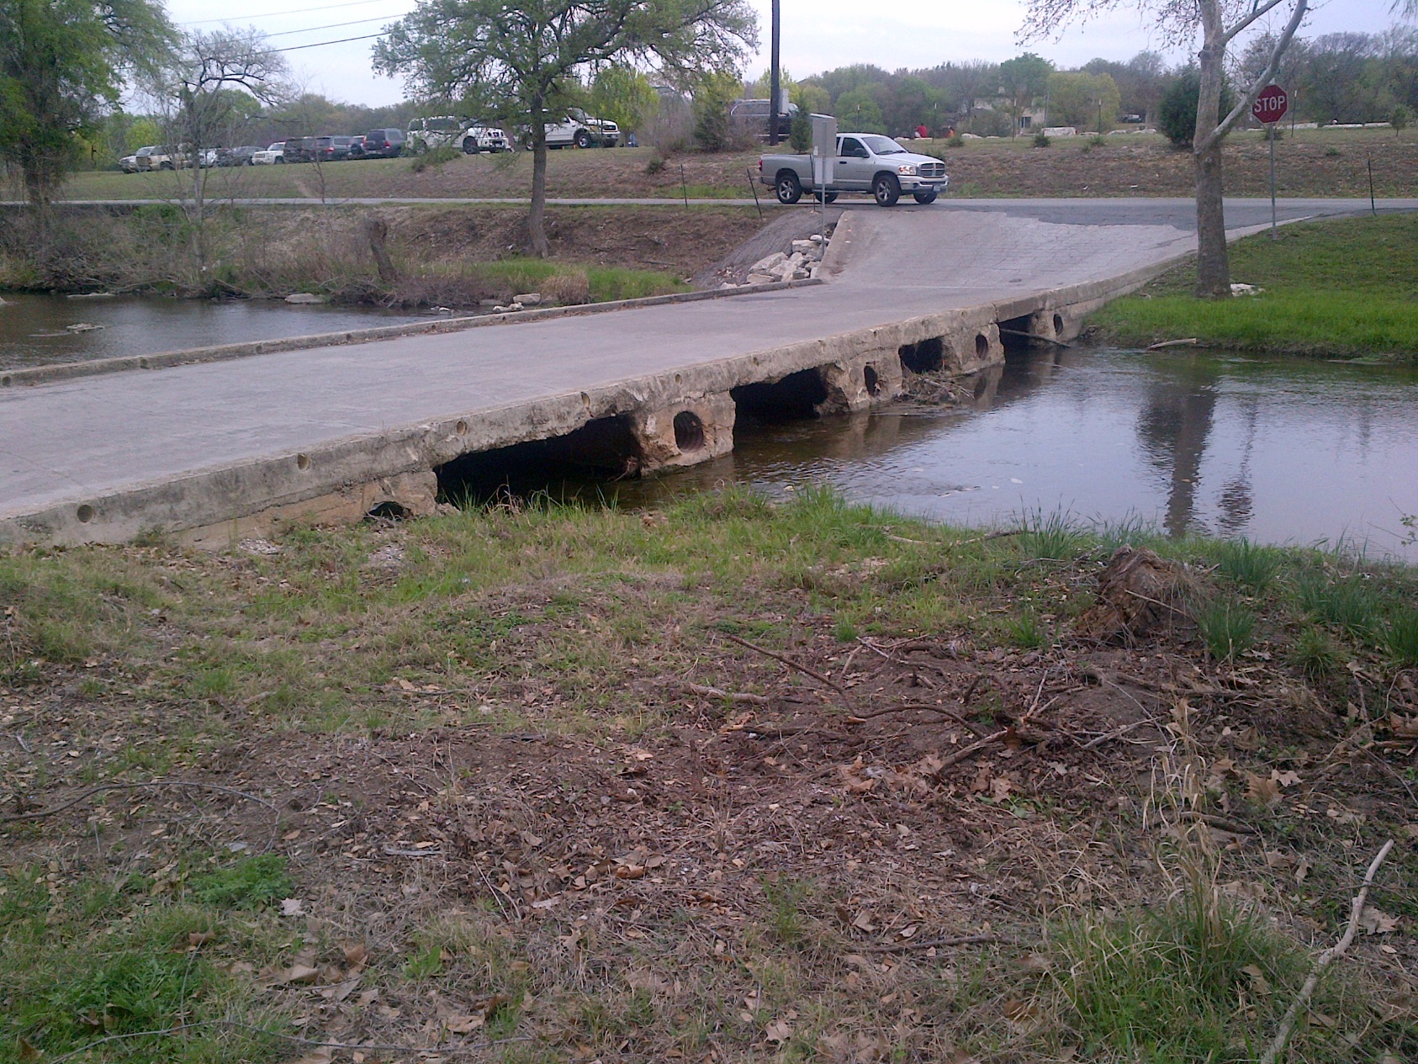
Low Water Crossing on Walsh Dr to Brushy Creek Rd

Slide 36
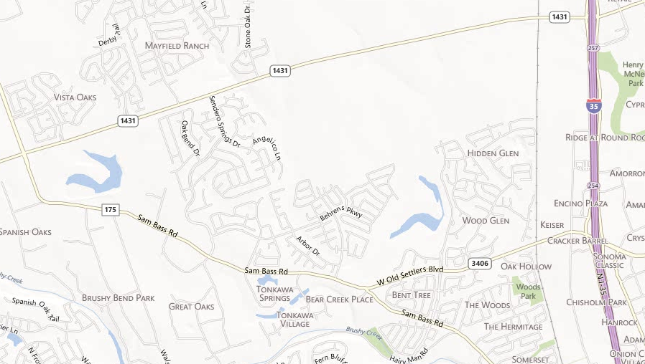
Returning to Campus via IH-35
Right on IH-35 S
Right on 1431 (Whitestone Blvd)
Enter on Sam Bass Rd

